Slide 1
Where Are the Other Nine?
Notes:
There is a story in the Gospel of Luke about 10 Lepers that Jesus miraculously healed. Here we see an artists rendition of that story. These nine lepers are jubilant, filled with joy because of the healing they received from Jesus, free from the awful disease that had plagued them: for perhaps many years and on their way to a new life,
But one of them is doing something different. What is he doing? He is worshipping at the feet of the man who healed him. We are going to learn about the nine and about the one, and hopefully we will also see ourselves somewhere in this story.

Slide 2
Note: After you download the slideshow, you may also need to download some videos from YouTube & add them into this PowerPoint. This tool can help you: Free YouTube Download
We present these messages in outdoor venues using the SonShineTent. Watch the video of our service that goes with this message, click here: http://campaignkerusso.org/?p=11472
We would love to know more about the people who download our lessons & sermons. We invite you to email us & let us know where & how you use them.
info@campaignkerusso.org

Slide 3
Welcome All

Slide 4
Let’s Begin with Prayer

Slide 5
Next Slide – Song Title: Give Thanks Download Here:
https://youtu.be/KMTmZKotTYw

Slide 6
Where Are the Other Nine?
Notes:
There is a story in the Gospel of Luke about 10 Lepers that Jesus miraculously healed. Here we see an artists rendition of that story. These nine lepers are jubilant, filled with joy because of the healing they received from Jesus, free from the awful disease that had plagued them: for perhaps many years and on their way to a new life,
But one of them is doing something different. What is he doing? He is worshipping at the feet of the man who healed him. We are going to learn about the nine and about the one, and hopefully we will also see ourselves somewhere in this story.

Slide 7
Next Slide – Video Title: The Cleansing of the Lepers Download Here:
https://youtu.be/UmrWWSzscus

Slide 8
“It happened that as he made his way toward Jerusalem, he crossed over the border between Samaria and Galilee. As he entered a village, ten men, all lepers, met him. They kept their distance but raised their voices, calling out, “Jesus, Master, have mercy on us!” Taking a good look at them, he said, “Go, show yourselves to the priests.” Lk. 11-16

Slide 9
“They went, and while still on their way, became clean. One of them, when he realized that he was healed, turned around and came back, shouting his gratitude, glorifying God. He kneeled at Jesus’ feet, so grateful. He couldn’t thank him enough—and he was a Samaritan.
Jesus said, “Were not ten healed? Where are the nine? Can none be found to come back and give glory to God except this outsider?” Then he said to him, “Get up. On your way. Your faith has healed and saved you.” Lk. 17:16-19
Notes:
This final question that Jesus asks of those around him reveals several things about the lepers…and about each one of us. What does it mean to be one of the nine. What does it mean to be the tenth man? Why does he return to Jesus? How does that make him different from the other nine?
But before we answer these questions, let’s look at a dramatization of the this story.

Slide 10
Next Slide – Song Title: Where Are The Other Nine Download Here:
https://youtu.be/fVHbeqpTUuc

Slide 11
1
8
9
2
3
4
5
6
7
Where are
the other
Nine?
10
Notes:
Here is Jesus and the tenth man standing before Him..and over there, are the other nine.

Slide 12
Ten Healed
One Showed Gratitude
Nine went away together
One, alone, sought after Jesus
Nine went on with their lives
One returned to worship Jesus
Nine got a blessing by the Jewish priest
One was blessed by our great High Priest
The Qualities of Gratitude
Notes:
Here is a spiritual flow chart of the story we’re studying. Let’s follow it to see where it leads. Starting in the upper left hand corner.
There is a song I’d like to play to help us on our way, perhaps to be more like the tenth man, who worshipped Christ.

Slide 13
The Qualities of Gratitude
His gratitude was rare.
His gratitude separated him from the others.
His gratitude was intense.
His gratitude was non-critical.
His gratitude received the special blessing of Jesus.
Notes:
Gratitude is Rare: This is sad but true. In this story it is revealed by a one-in-ten ratio.
Gratitude Seperates: The nine went on their, while the tenth pursued after Jesus.
Gratitude is Intense: This guy didn’t “phone it in.” He fell at the feet of Jesus and worshipped Him!
Gratitude is Non-Critical: The two cannot co-exist. There is no room for criticalness in a grateful heart.
Gratitude Can Open Salvation’s Door: Gratitude opened the door to a living relationship with Jesus.
The scripture says healed and SAVED.

Slide 14
Next Slide – Video Title: I AM the One Download Here:
https://youtu.be/c5gWqOuu5AI

Slide 15
Is Jesus
Speaking to You?
“They said to each other, ‘Did not our hearts burn within us while he talked to us on the road, while he opened to us the Scriptures?’”
John Wesley Said:
“…the preacher was describing the change which God works in the heart through faith in Christ and I felt my heart strangely warmed.”
Jesus makes His presence Known by a small voice!

Slide 17
What is the Sinner‘s Prayer?
This is a prayer we can pray when we are ready to admit we are sinners and need Christ’s forgiveness.
It must be prayed with faith in our hearts and a readiness to have a life-changing encounter with Jesus Christ.

Slide 18
A prayer of faith → Pray this prayer if :
If you never have before
You have in the past, but you think it would mean more today
You have been walking afar off and you want to come back
You want to set an example & show others how it is done
You just like to give your heart to Jesus again & again
Faith

Slide 19
We Declare Our Faith Publicly Because Jesus Declared His LOVE Publicly
“If you stand before others and are willing to say you believe in me, then I will tell my Father in heaven that you belong to me.” Mat 10:32

Slide 20
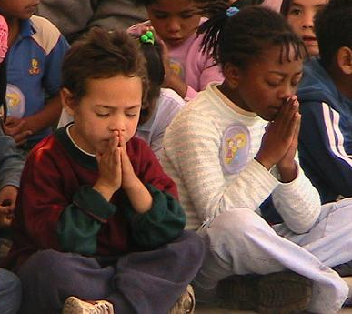
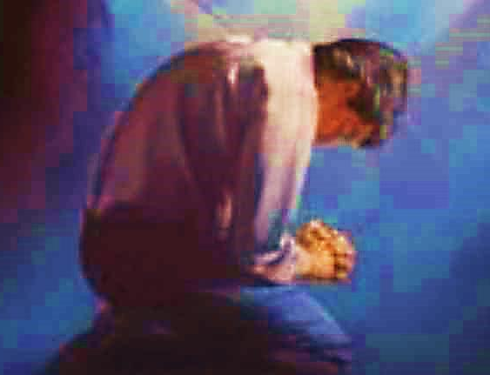
Three Important Questions
Do you want to know Jesus as your Savior right now?
Do you believe He died to save you from your sins & that He rose from the dead?
Do you believe that He is here, waiting to save you right now?

Slide 21
The Prayer of a Sinner Turning to Jesus
Dear Jesus, I know that I have sinned against You and that my sins separate me from You.
I am truly sorry.
Right now, I turn away from my sinful past .
Please forgive me, and help me to keep from sin.
I believe You died for my sins.
I Believe You rose from the dead, you are alive, and you hear this prayer from my heart.
I invite You Jesus to be both my Savior and the Lord of my life.
I want You to rule my life from now on.

Slide 22
“But some people did accept him. They believed in him, and he gave them the right to become children of God.”
John 1:12

Slide 24
“If you openly say, ‘Jesus is Lord’ and believe in your heart that God raised him from death, you will be saved.”
Rom. 10:9
What did you learn today?
What are you thankful for?
What have you been thinking about God lately?
What do you want to tell others about Jesus?

Slide 25
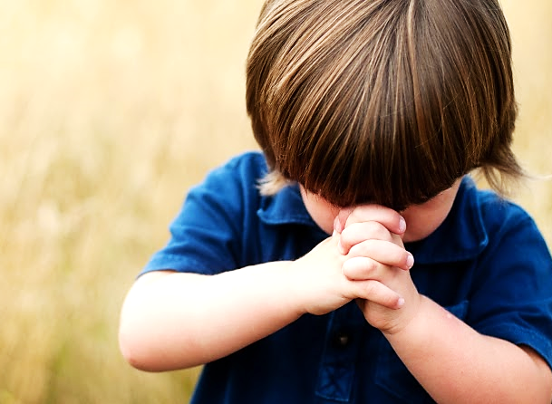
Let’s Close in Prayer

