Slide 1
Cover
Gratitude
is the
Key
Notes:
The key to what?
First: Gratitude is the Key to relationship with God

Slide 2
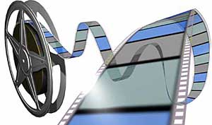
Note: After you download the slideshow, you may also need to download some videos from YouTube & add them into this PowerPoint. This tool can help you: Free YouTube Download
We present these messages in outdoor venues using the SonShineTent. Watch the video of our service that goes with this message, click here: http://campaignkerusso.org/?p=12791
We would love to know more about the people who download our lessons & sermons. We invite you to email us & let us know where & how you use them.
info@campaignkerusso.org

Slide 3
Welcome All

Slide 4
Let’s Begin with Prayer

Slide 5
Cover
Gratitude
is the
Key
Notes:
The key to what?
First: Gratitude is the Key to relationship with God

Slide 6
Gratitude is the Key to Relationship with God
Notes:
Story of woman with many sins who came to Jesus for to show her great gratitude to he Savior (in a way which was customary within that part of the world.)

Slide 7
This Slide - Video: A Grateful Woman Download Here: https://youtu.be/JxswSd5FmE4

Slide 8
This Slide - Song: Alabaster Box Download Here: https://youtu.be/hjGC_pI0Ed4

Slide 9
Cover
“Her many sins have been forgiven. She has shown that she understands this by her great acts of love. But whoever has been forgiven only a little, loves only a little.” Luke 7:47 ( NIRV)
Notes:
When I wrong someone - and I know it - and confess it, and that person forgives me, I’m grateful:
from the smallest incident, (like bumping into someone) to the worst possible offense, like betrayal and unfaithfulness.
To forgive me, that person had to give up part of themselves– the part that holds a grudge, the part that hurts, the part that is offended, the part that might hate me. And my response to their sacrifice, (because it is a sacrifice) :
is gratefuleness – and the greater my offense, the greater my gratitude.
There is a sacrifice that was made 2000 years ago for me and you that is beyond our ability to comprehend, but for the little I do know about the Cross of Jesus Christ, I AM GRATEFUL!
Andre Crouch wrote these words to the song, “My Tribute”:
How can I say thanks for all the things You have done for me? Things so undeserved, yet You gave to prove Your love for me. The voices of a million angels could not express my gratitude. All that I am and ever hope to be, I owe it all to Thee.

Slide 10
Gratitude is the
Key to
Christian Service

Slide 11
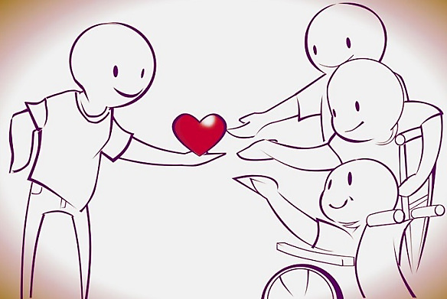
Grateful Christians
“Pay it Forward” in Jesus’ name.
Notes:
Back in 2000, a movie came out called “Pay it Forward.” This movie was, on a human level, quite inspirational. The principle of “Don’t pay it back, pay it forward” inspired each person to find three people and do something for them that they couldn’t do for themselves.
In the kingdom of God, Jesus did for all of us what we could not do for ourselves. He paid for all our sins with His sacrifice on the Cross. We cannot pay it back. Christian service is how we pay it forward. Telling others about what Jesus did for us, explaining to them the way of salvation - and helping them grow as Christians: is the way we can “Pay it Forward” for Jesus.

Slide 12
Cover
“Everything you say and everything you do, should be done for Jesus your Lord. And.. in all you do, give thanks to God the Father, through Jesus.”
Col. 3:17 (ERV)

Slide 13
Notes:
Finally : Gratitude is the Key to Happiness

Slide 14
“Whatever happens, keep thanking God because of Jesus Christ. This is what God wants you to do
I Thess. 5:18

Slide 15
Studies show that gratitude actually helps fend off depression,
stress and anxiety.
186 patients with some
heart damage filled out
The following
gratitude
Survey:
Notes:
Let’s ask ourselves the same questions that were on this survey:

Slide 16
Agree or Disagree
1. I have so much in life to be thankful for.
2. If I had to list everything that I felt grateful for, it would be a very long list.
3. When I look at the world, I don’t see much to be grateful for.
4. I am grateful to a wide variety of people.
5. As I get older I find myself more able to appreciate the people, events, and situations that have been part of my life history.
6. Long amounts of time can go by before I feel grateful to something or someone.

Slide 17
Those who scored highest, suffered less depression, and had
more energy. Also,
their blood tests
showed less inflammation
and
plaque.

Slide 18
Afterwards, 40 of the patients went on to keep a “Gratitude Journal”
listing 3 things for which they
were grateful, every day.
After only two months,
each of their “health”
indicators
showed a
definite improvement.
Notes:
The Bible says:
“And let the peace that comes from Christ rule in your hearts. For as members of one body you are called to live in peace. And always be thankful.” Col 3:15

Slide 19
Cover
Gratitude is the Key to:
Genuine Relationship with Our Wonderful Savior
Meaningful Christian Service
Health & Happiness:
(A Peaceful Heart)

Slide 20
This Slide - Song: Grateful Download Here: https://youtu.be/3jkreWYXlH8

Slide 21
Is Jesus
Speaking to You?
“They said to each other, ‘Did not our hearts burn within us while he talked to us on the road, while he opened to us the Scriptures?’”
John Wesley Said:
“…the preacher was describing the change which God works in the heart through faith in Christ and I felt my heart strangely warmed.”
Jesus makes His presence Known by a small voice!

Slide 23
What is the Sinner‘s Prayer?
This is a prayer we can pray when we are ready to admit we are sinners and need Christ’s forgiveness.
It must be prayed with faith in our hearts and a readiness to have a life-changing encounter with Jesus Christ.

Slide 24
A prayer of faith → Pray this prayer if :
If you never have before
You have in the past, but you think it would mean more today
You have been walking afar off and you want to come back
You want to set an example & show others how it is done
You just like to give your heart to Jesus again & again
Faith

Slide 25
We Declare Our Faith Publicly Because Jesus Declared His LOVE Publicly
“If you stand before others and are willing to say you believe in me, then I will tell my Father in heaven that you belong to me.” Mat 10:32

Slide 26
Three Important Questions
Do you want to know Jesus as your Savior right now?
Do you believe He died to save you from your sins & that He rose from the dead?
Do you believe that He is here, waiting to save you right now?

Slide 27
The Prayer of a Sinner Turning to Jesus
Dear Jesus, I know that I have sinned against You and that my sins separate me from You.
I am truly sorry.
Right now, I turn away from my sinful past .
Please forgive me, and help me to keep from sin.
I believe You died for my sins.
I Believe You rose from the dead, you are alive, and you hear this prayer from my heart.
I invite You Jesus to be both my Savior and the Lord of my life.
I want You to rule my life from now on.

Slide 28
“But some people did accept him. They believed in him, and he gave them the right to become children of God.”
John 1:12

Slide 30
“If you openly say, ‘Jesus is Lord’ and believe in your heart that God raised him from death, you will be saved.”
Rom. 10:9
What did you learn today?
For what do you feel grateful?
For what have you been thinking about God lately?
What do you want to tell others about Jesus?

Slide 31
Let’s Close in Prayer

Slide 32
Note: After you download the slideshow, you may also need to download some videos from YouTube & add them into this PowerPoint. This tool can help you: Free YouTube Download
We present these messages in outdoor venues using the SonShineTent. Watch the video of our service that goes with this message, click here: http://campaignkerusso.org/?p=12791
We would love to know more about the people who download our lessons & sermons. We invite you to email us & let us know where & how you use them.
info@campaignkerusso.org

