Slide 1
Christian Believers are like Tomatoes

Slide 2
Note: After you download the slideshow, you may also need to download some videos from YouTube & add them into this PowerPoint. This tool can help you: Free YouTube Download
We present these messages in outdoor venues using the SonShineTent. Watch the video of our service that goes with this message, click here: http://campaignkerusso.org/?p=14208
We would love to know more about the people who download our lessons & sermons. We invite you to email us & let us know where & how you use them.
info@campaignkerusso.org

Slide 3
Welcome All

Slide 4
Let’s Begin with Prayer

Slide 5
Christian Believers are like Tomatoes

Slide 6
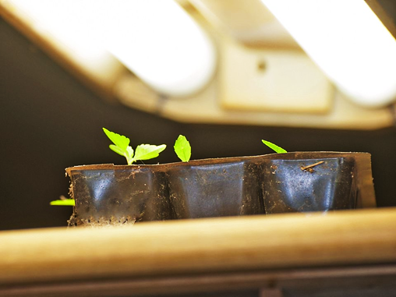
Abundant Light
“To ensure the plants grow stocky, not spindly, keep the young plants only a couple of inches from fluorescent grow lights.“
“Then Jesus spoke out again, ‘I am the light of the world. The one who follows me will never walk in darkness, but will have the light of life.’ Jn. 8:12

Slide 7
Abundant Water
“ “Water well, about 2 inches per week.
Feel the soil; if the top inch is dry, it’s time to water.”
“But no one who
drinks the water I give will ever be thirsty again. The water I give is like a flowing fountain that gives eternal life.” John 4:13

Slide 8
Use a Rock for Drought Times
“To help tomatoes
through a drought, place flat rocks next to plant. The rocks pull water up from under the ground and keep it from evaporating ...”
“They all drank the same spiritual water. They drank from the spiritual rock that went with them. That rock was Christ.” I Cor. 10:14

Slide 9
Keep the Water Fresh & Clean
“Soil Type: ‘Loamy’ (sandy, draining) well-drained soil.”
“A good person who gives in to evil is like a muddy spring or a dirty well.”
Prov. 25:26

Slide 10
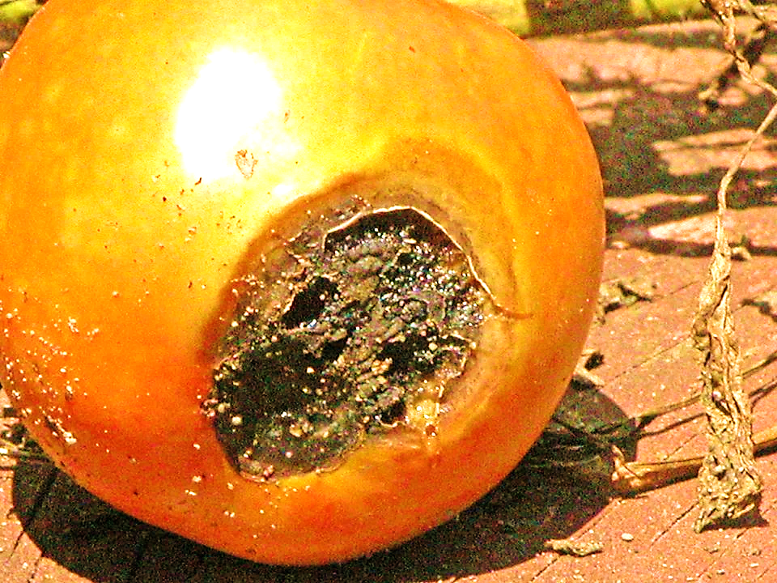
Water Consistently Don’t Skip Days
“Irregular watering - missing a week and trying to make up for it leads to ‘blossom end rot’ and ‘cracking.’”
“O God, you are my God, and I long for you. My whole being desires you; like a dry, worn-out, and waterless land, my soul is thirsty for you. Ps. 63:1

Slide 11
Wind & Movement
“If growing them indoors, provide a breeze for your tomatoes. ”
“The wind blows where it pleases, and you hear its sound, but you don’t know where it comes from or where it is going. So it is with everyone born of the Spirit.” John 3:8

Slide 12
Cover with Mulch
“Cover the ground with 2 to 4 inches of mulch to minimize weeds and help keep the soil evenly moist”
“When you pray, go into a room alone and close the door. Pray to your Father in private. He knows what is done in private, and he will reward you.” Mat. 6:5

Slide 13
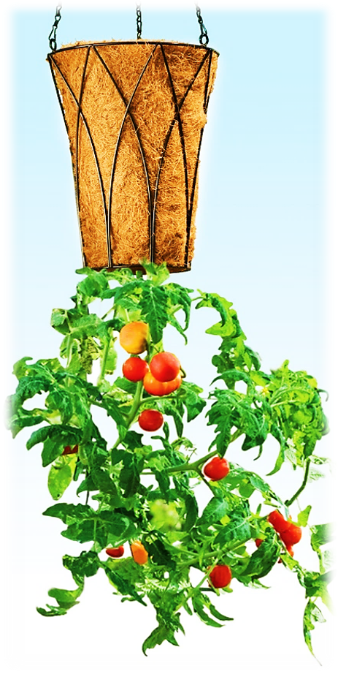
Beware of a Hard Frost
“When the first hard frost threatens, pull the plant and hang it upside down in the basement.”
“If my own people will humbly pray and turn back to me and stop sinning, then I will answer them from heaven. I will forgive them…”
Mat. 6:5

Slide 14
Young Ones Need Support

Slide 15
“Staking keeps developing tomato fruit off the ground, while caging lets the plant hold itself upright.”
“So encourage each other and help each other grow stronger in faith, just as you are already doing.”
1 Thess. 5:11

Slide 16
Go Deeper

Slide 17
“Plant your tomato plants deeper than they come in the pot, all the way up to the top few leaves.”
“So flee youthful desires and PURSUE righteousness, faith, love, and peace, with those who call on the Lord out of a pure heart.”
1 Tim. 2:22

Slide 18
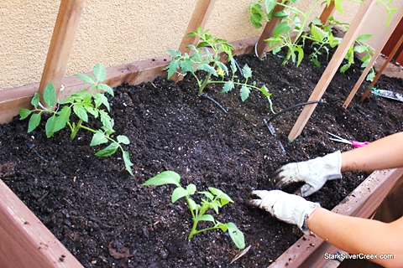
Give Them Room to Grow
v

Slide 19
“Give each plant enough room to grow. Crowded conditions inhibit their growth and lead to disease.”
“…equipping the saints for the work of ministry, to build up the body of Christ, until we all reach unity in the faith and in the knowledge of God’s Son, growing into maturity…” Eph. 4:23, 13

Slide 20
They are Not All the Same
“Tomatoes grow in all sizes, from tiny “currant” to “cherry” to large “beefsteak.”
“A body is made up of many parts, and each of them has its own use.” Rom. 12:4

Slide 21
Preparing the Ground

Slide 22
“Till soil to about 1 foot and mix in fertilizer.”
“Plow up the hard ground of your hearts, for now is the time to seek the Lord, that he may come and shower righteousness upon you.” Hos. 10:12

Slide 23
They Have Challenges to Overcome
“Soil pH: Acidic (Not alkaline)”
“For You, God, tested us; You refined us as silver is refined.” Ps. 66:10

Slide 24
Fruitful
“With proper care, this vining plant will produce a bumper crop.”
“You didn’t choose me, but I chose you. I have appointed you to go, to produce fruit …”
Jn. 15:16

Slide 25
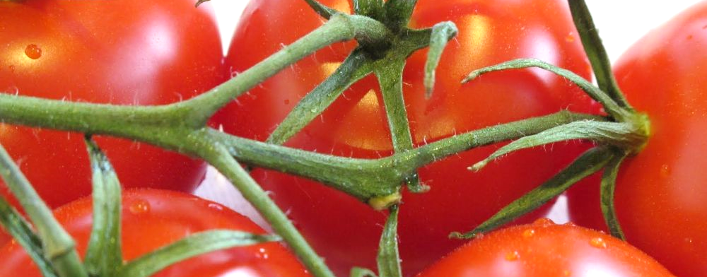
The Branches Need the Vine
“Leave your tomatoes on the vine as long as possible.”
“I am the vine, and you are the branches. Those who remain in me, and I in them, will bear much fruit; for you can do nothing without me.” Jn. 15:5

Slide 26
Feeds the Hungry

Slide 27
“Spanish explorers returned home from the New World with tomatoes. Wealthy people believed that the fruits were poisonous. Only the peasants were brave (and HUNGRY) enough to eat them.”
“Brothers, consider your calling: Not many are wise from a human perspective, not many powerful, not many of noble birth.”
1 Cor. 1:26

Slide 28
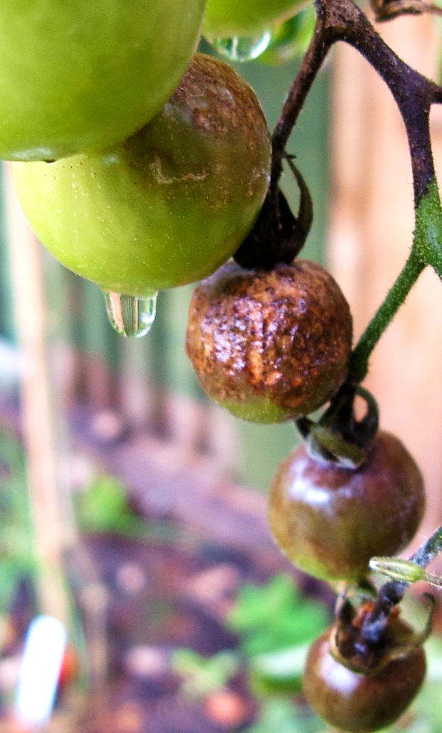
Bottom Hangers
“Blight is a fungal disease. Remove the leaves from the bottom. Being close to the ground, soil pathogens splash onto them. ”
“Don’t love the world or anything that belongs to the world. If you love the world, you cannot love the Father.” 1 Jn. 2:15

Slide 29
Getting a Fresh Start
“Practice crop rotation from year to year to prevent diseases that may have overwintered.”
“Change your hearts and lives! Turn back to God so that your sins may be wiped away.” Acts. 3:19

Slide 30
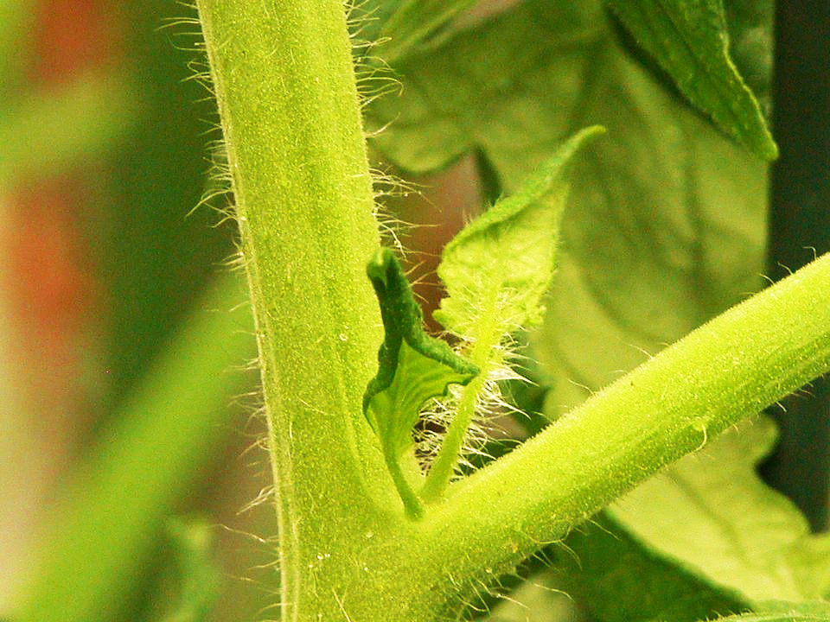
Suckers
“Pinch and remove suckers that develop in the joint. They won’t bear fruit and will take energy away from the rest of the plant.”
“For we hear that there are some among you who are idle. They are not busy but busybodies.” 1 Thess. 3:11

Slide 31
“Never refrigerate tomatoes, because temperatures below 55° cause the precious flavor compounds to break down.”
“Because disobedience will expand, the love of many will grow cold.” Mat. 24:12

Slide 32
Is Jesus
Speaking to You?
“They said to each other, ‘Did not our hearts burn within us while he talked to us on the road, while he opened to us the Scriptures?’”
John Wesley Said:
“…the preacher was describing the change which God works in the heart through faith in Christ and I felt my heart strangely warmed.”
Jesus makes His presence Known by a small voice!

Slide 34
What is the Sinner‘s Prayer?
This is a prayer we can pray when we are ready to admit we are sinners and need Christ’s forgiveness.
It must be prayed with faith in our hearts and a readiness to have a life-changing encounter with Jesus Christ.

Slide 35
A prayer of faith → Pray this prayer if :
If you never have before
You have in the past, but you think it would mean more today
You have been walking afar off and you want to come back
You want to set an example & show others how it is done
You just like to give your heart to Jesus again & again
Faith

Slide 36
We Declare Our Faith Publicly Because Jesus Declared His LOVE Publicly
“If you stand before others and are willing to say you believe in me, then I will tell my Father in heaven that you belong to me.” Mat 10:32

Slide 37
Three Important Questions
Do you want to know Jesus as your Savior right now?
Do you believe He died to save you from your sins & that He rose from the dead?
Do you believe that He is here, waiting to save you right now?

Slide 38
The Prayer of a Sinner Turning to Jesus
Dear Jesus, I know that I have sinned against You and that my sins separate me from You.
I am truly sorry.
Right now, I turn away from my sinful past .
Please forgive me, and help me to keep from sin.
I believe You died for my sins.
I Believe You rose from the dead, you are alive, and you hear this prayer from my heart.
I invite You Jesus to be both my Savior and the Lord of my life.
I want You to rule my life from now on.

Slide 39
“But some people did accept him. They believed in him, and he gave them the right to become children of God.”
John 1:12

Slide 41
“If you openly say, ‘Jesus is Lord’ and believe in your heart that God raised him from death, you will be saved.”
Rom. 10:9
What did you learn today?
What about Believers & Tomatoes?
What have you been thinking about God lately?
What do you want to tell others about Jesus?

Slide 42
Let’s Close in Prayer

Slide 43
Note: After you download the slideshow, you may also need to download some videos from YouTube & add them into this PowerPoint. This tool can help you: Free YouTube Download
We present these messages in outdoor venues using the SonShineTent. Watch the video of our service that goes with this message, click here: http://campaignkerusso.org/?p=14208
We would love to know more about the people who download our lessons & sermons. We invite you to email us & let us know where & how you use them.
info@campaignkerusso.org

