Slide 1
If Jesus Were Here Right Now
Notes:
There is no part of our existance that God is not concerned with. He wants to and is able to be there of every moment of day

Slide 2
Note: After you download the slideshow, you may also need to download some videos from YouTube & add them into this PowerPoint. This tool can help you: Free YouTube Download
We present these messages in outdoor venues using the SonShineTent. Watch the video of our service that goes with this message, click here: http://campaignkerusso.org/?p=14035
We would love to know more about the people who download our lessons & sermons. We invite you to email us & let us know where & how you use them.
info@campaignkerusso.org

Slide 3
Welcome All

Slide 4
Let’s Begin with Prayer

Slide 5
If Jesus Were Here Right Now
Notes:
There is no part of our existance that God is not concerned with. He wants to and is able to be there of every moment of day

Slide 6
If your father were here now…
Notes:
Scary for a kid to hear that!
This girl looks guilty and afraid but if she has a good father, he will help her and not hurt her.
We have a heavenly father who is always with us, It’s called “Omnipresence”
If her father were there, her behavior might have been different.
We can’t see Him, but the God of all creation is here all the time.
Here’s a song to help us remember that God is omnipresent

Slide 7
This Slide:
Song - If the Savior Stood Beside Me Download Here:
https://youtu.be/VEFbTgadnCU

Slide 8
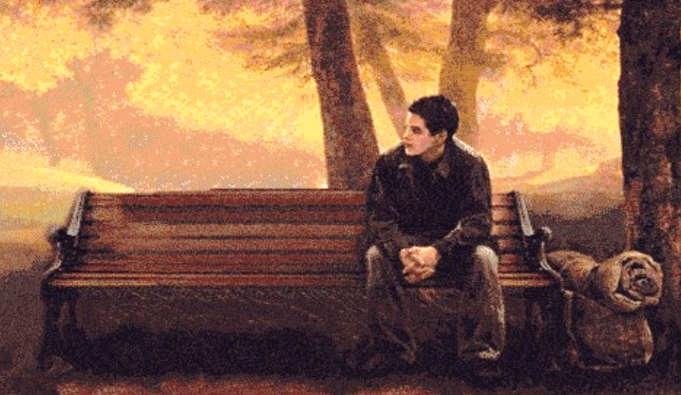
We are Not alone..
Notes:
“Lord, you have seen what is in my heart. You know all about me. ² You know when I sit down and when I get up. You know what I’m thinking even though you are far away. ³ You know when I go out to work and when I come back home. You know exactly how I live. ⁴ Lord, even before I speak a word, you know all about it.
⁵ You are all around me, behind me and in front of me. You hold me safe in your hand. ⁶ I’m amazed at how well you know me. It’s more than I can understand.
⁷ How can I get away from your Spirit? Where can I go to escape from you? ⁸ If I go up to the heavens, you are there. If I lie down in the deepest parts of the earth, you are also there. ⁹ Suppose I were to rise with the sun in the east. Suppose I travel to the west where it sinks into the ocean. ¹⁰ Your hand would always be there to guide me. Your right hand would still be holding me close.
¹¹ Suppose I were to say, “I’m sure the darkness will hide me. The light around me will become as dark as night.” ¹² Even that darkness would not be dark to you. The night would shine like the day, because darkness is like light to you.
¹³ You created the deepest parts of my being. You put me together inside my mother’s body. ¹⁴ How you made me is amazing and wonderful. I praise you for that. What you have done is wonderful. I know that very well. ¹⁵ None of my bones was hidden from you when you made me inside my mother’s body. That place was as dark as the deepest parts of the earth. When you were putting me together there, ¹⁶ your eyes saw my body even before it was formed. You planned how many days I would live. You wrote down the number of them in your book before I had lived through even one of them.
¹⁷ God, your thoughts about me are priceless. No one can possibly add them all up. ¹⁸ If I could count them, they would be more than the grains of sand. If I were to fall asleep counting and then wake up, you would still be there with me.
¹⁹ God, I wish you would kill the people who are evil! I wish those murderers would get away from me! ²⁰ They are your enemies. They misuse your name. They misuse it for their own evil purposes. ²¹ Lord, I really hate those who hate you! I really hate those who rise up against you! ²² I have nothing but hatred for them. I consider them to be my enemies.
²³ God, see what is in my heart. Know what is there. Test me. Know what I’m thinking. ²⁴ See if there’s anything in my life you don’t like. Help me live in the way that is always right.

Slide 9
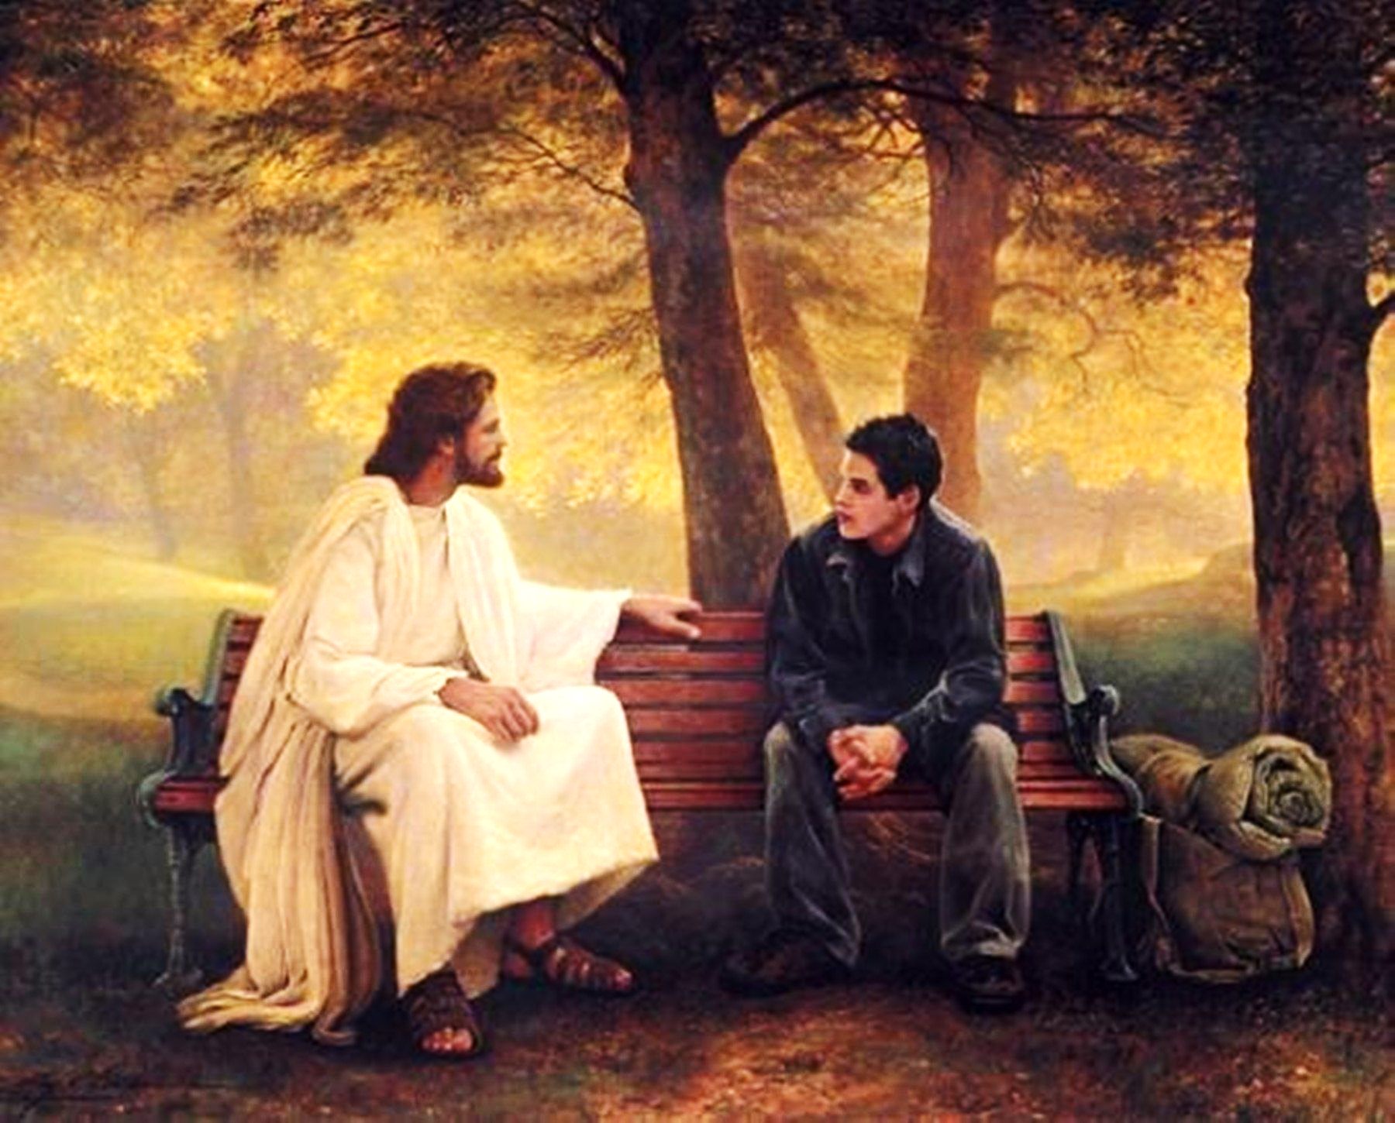
God is always there
Notes:
Romans 8:35 “Can anything separate us from Christ’s love? Can trouble or problems or persecution separate us from his love? If we have no food or clothes or face danger or even death, will that separate us from his love?” (ERV version)
Psalm 139 tells us all about how God is Always close by. Here is a the Lego version of Psalm 139

Slide 10
This Slide:
Video – Psalm 139 in Legos Download Here:
https://youtu.be/7eQ7D-A00Bw

Slide 11
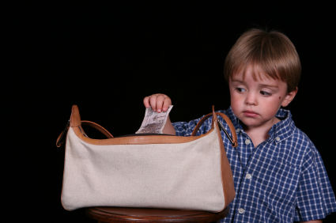
God is there, on our bad days
Notes:
When I was a child this happened to me and it was awful then, but good looking back at it
(Tell story)

Slide 12
Proverbs 15:3 "God doesn’t miss a thing— he’s alert to good and evil alike".

Slide 13
God is there, when we feel all alone
Notes:
This young boy is brave to stand up to the snickers and giggling going on behind him

Slide 14
Psalm 44:20-21 "We did not forget our God. We did not lift our hands in prayer to foreign gods. God would have known if we had. He knows what is in our hearts".

Slide 15
God is there, when people hurt us
Notes:
Kids can be really mean to eachother, but when we grow up it doesn’t necessarily end.
Adults can hurtful as well:
Cliques, Jobplace bullying, etc.

Slide 16
Luke 12:6-7 "What is the price of five sparrows? A couple of pennies? Not much more than that. Yet God does not forget a single one of them. And he knows the number of hairs on your head! Never fear, you are far more valuable to him than a whole flock of sparrows".

Slide 17
God is there, when we think no one’s looking
Notes:
My dog Sheba has a terrible habit of stealing my shoes. I sometimes have to discipline her her but also want her to know that I love her.
God wants us to do right but at the same time wants us to know that we are loved. God’s love does not ignore sin. Despite this picture, our sin is not cute to God. God sent His son Jesus to pay for our sins on the cross.

Slide 18
Hebrews 4:13 "Nothing in all the world can be hidden from God. Everything is clear and lies open before him. And to him we must explain the way we have lived".

Slide 19
God is there, in our darkest hour

Slide 20
God is there, in our darkest hour
Notes:
Fifty years ago I spent time in jail for selling drugs. It was the lowest point of my life. But soon after the love of God led me to a little church where I got save and turned by life over to Him.

Slide 21
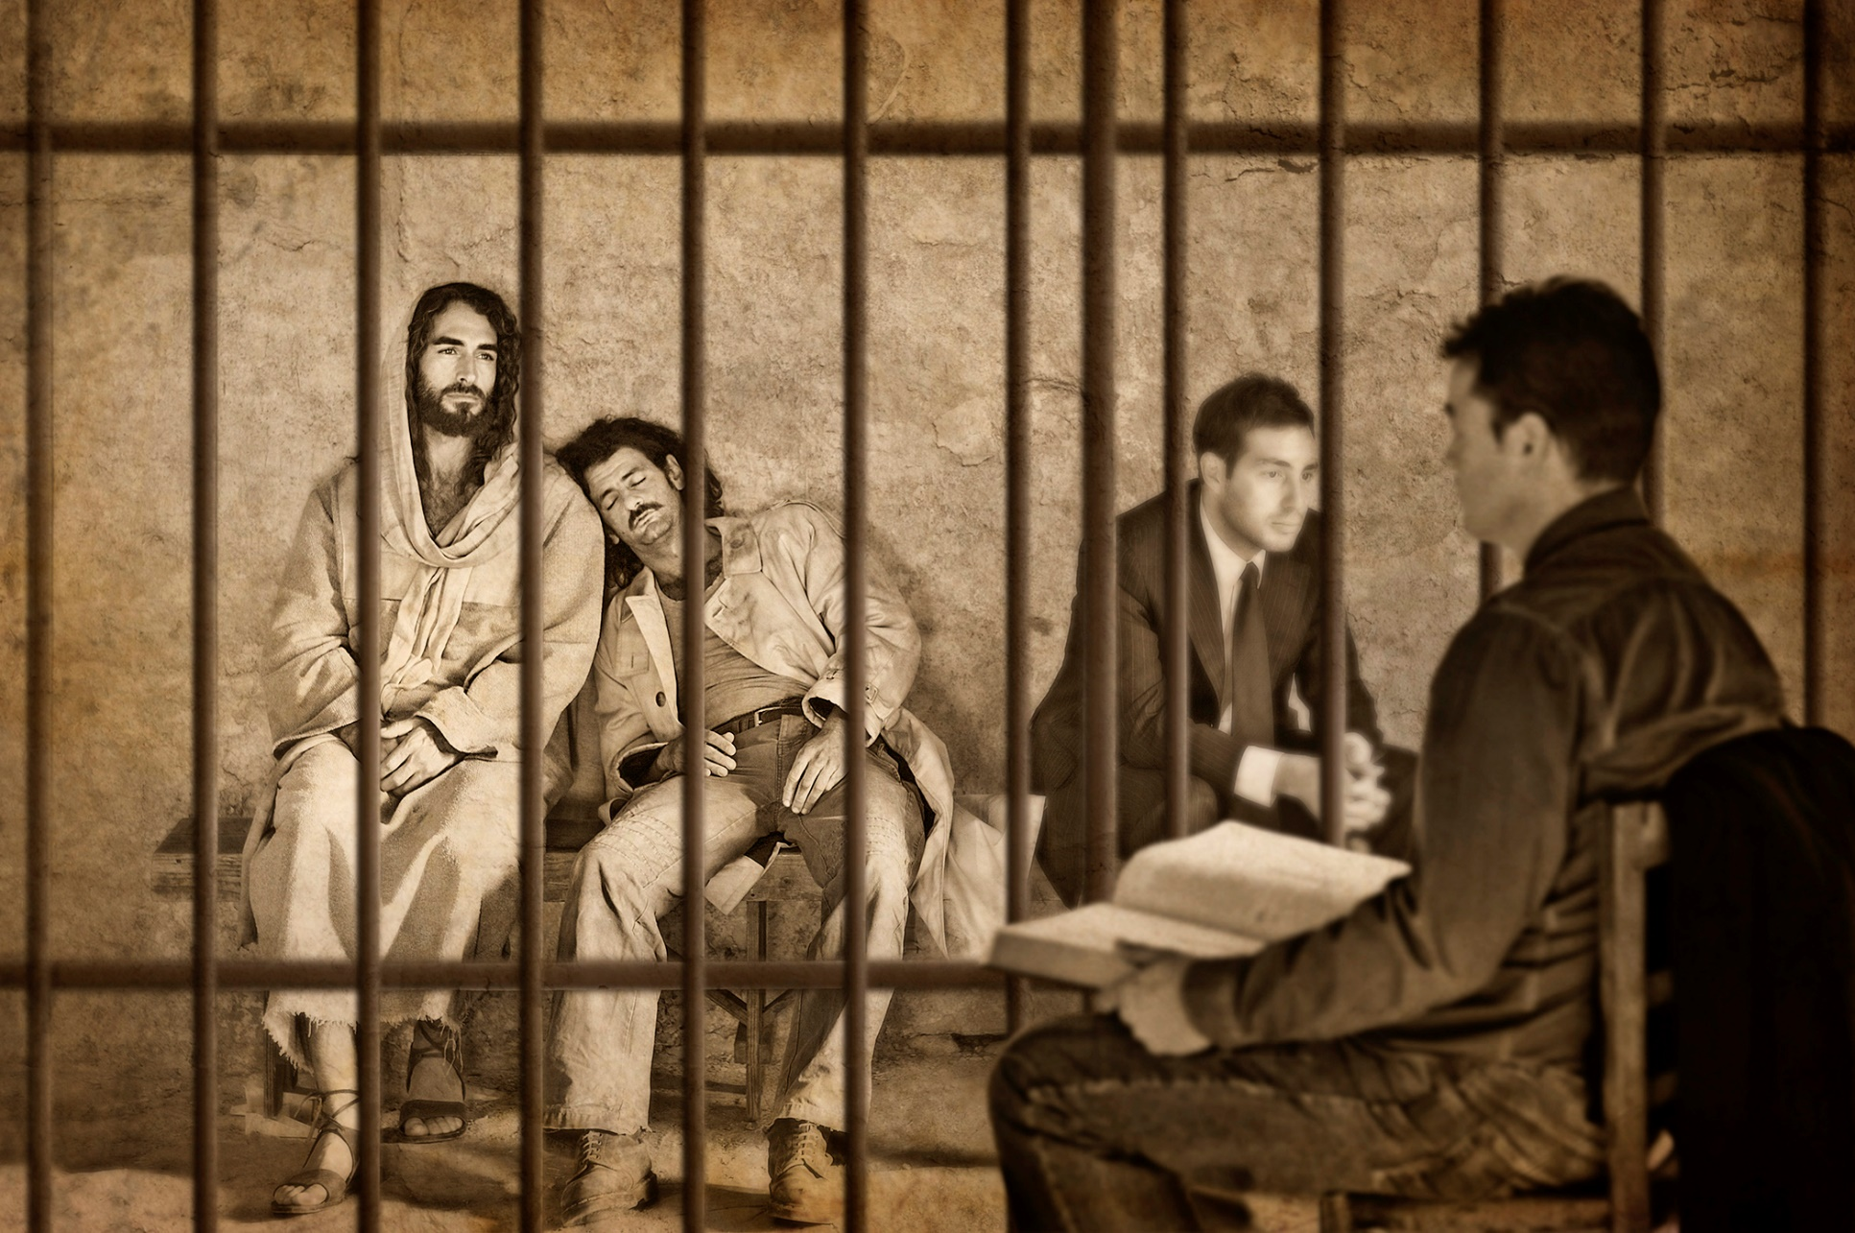
Psalm 139:7-8 “How can I get away from your Spirit? Where can I go to escape from you? If I go up to the heavens, you are there. If I lie down in the deepest parts of the earth, you are also there”.

Slide 22
God is there, checking our priorities
Notes:
It may not be a Ferrari, but we all struggle with spiritual vs material priorities. Kids or adults have the same problems. In this materialistic world we live in we hear it said, “The man with the most toys at the end, wins.” The question though, is “wins what?” And remember, the “end” of this life, is not the end!

Slide 23
Psalm 139:23-24 “God, see what is in my heart. Know what is there. Test me. Know what I’m thinking. See if there’s anything in my life you don’t like. Help me live in the way that is always right"

Slide 24
God is there when we’re tempted
Notes:
This is a picture of what has happened to every one of. It’s not about the wallet, its about the temptation to do something wrong that no one will every find out. But remember, God is omnipresent always there watching us to see which road we take when we get to the fork in the road called temptation.

Slide 25
Psalm 94:11 "The Lord knows what we think; he knows how senseless our reasoning is".

Slide 26
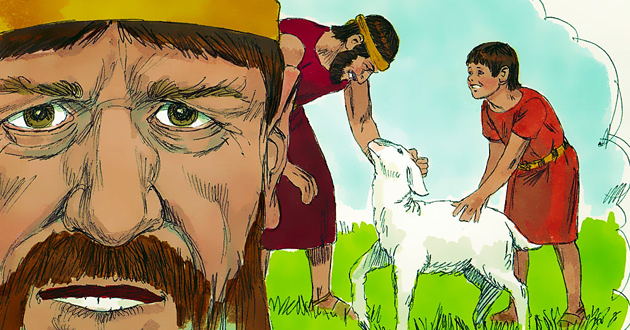
When King David committed adultery and murder, he thought no one knew. Then the prophet Nathan exposed his sin with a parable about a man who steals another man’s lamb.

Slide 27
This Slide:
Video - Nathan Exposes
David’s Sin Download Here:
http://campaignkerusso.org/wp-content/uploads/2017/04/NathanExposesDavid.wmv

Slide 28
God is there when temptation overtakes us
Notes:
We can sin at any age, young or old and we can repent and turn to God at any age as well. David, king if Israel thousands of years ago, was exposed his sins by the prophet Nathan

Slide 29
Psalm 51:1-4 "Written after Nathan the prophet had come to inform David of God’s judgment against him because of his adultery with Bathsheba, and his murder of Uriah, her husband. O loving and kind God, have mercy. Have pity upon me and take away the awful stain of my transgressions".

Slide 30
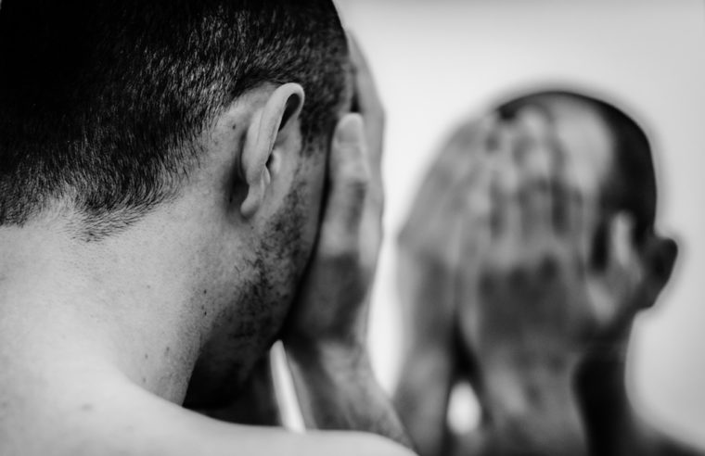
Wash away all my guilt and make me clean again".
"For I am fully aware of all I have done wrong, and my guilt is there, staring me in the face".
"You are really the one I have sinned against; I have disobeyed you and have done wrong. So it is right and fair for you to correct and punish me".
Notes:
It is God’s mercy to expose our sin. David’s response in Psalm 51 reveals that, in spite of his awful moral failure, he still had a heart after God.
When our sin is exposed we must run toward God for His mercy, never away from Him, because we can never truly hide.

Slide 31
God is there, when we brag
Notes:
We love to brag, but God desires a humble heart. Ever hear of your left hand telling your right what to do? Here’s a picture of how a good right hand does the right thing

Slide 32
Do the “Right hand, Left hand” thing

Slide 33
Mat 6:1-6 “Be especially careful when you are trying to be good so that you don’t make a performance out of it. It might be good theater, but the God who made you won’t be applauding. When you do something for someone else, don’t call attention to yourself”.

Slide 34
God is there, in our daily life
Notes:
There is no part of our existance that God is not concerned with. He wants to and is able to be there of every moment of day

Slide 35
Psalm 139:3-5 You know when I go out to work and when I come back home. You know exactly how I live. Lord, even before I speak a word, you know all about it. You are all around me, behind me and in front of me. You hold me safe in your hand.

Slide 36
God is there to teach us the right way to think
Notes:
A changed life goes a lot farther than the standard laundry list of do’s and don’ts. He really does want to transform us into the image of His own son
Romans 8:28
“We know that in everything God works for the good of those who love him. These are the people God chose, because that was his plan. ²⁹ God knew them before he made the world. And he decided that they would be like his Son. Then Jesus would be the firstborn of many brothers and sisters.”

Slide 37
Psalm 139:23 God, see what is in my heart. Know what is there. Test me. Know what I’m thinking.

Slide 38
God witnesses everything
Notes:
God is the eternal witness to all that is life, our actions, our thoughts, our dreams, our hopes, our disappointments—He is always there as the Witness to all life.

Slide 39
II Chronicles 16:9 The Lord is constantly watching everyone, and he gives strength to those who faithfully obey him
Notes:
In closing, lets watch this great video about our Omnipresent God

Slide 40
Place Next Slide Here:
Song – Your Love Download Here:
https://youtu.be/Ngb5z3ANfxo

Slide 41
Is Jesus
Speaking to You?
“They said to each other, ‘Did not our hearts burn within us while he talked to us on the road, while he opened to us the Scriptures?’”
John Wesley Said:
“…the preacher was describing the change which God works in the heart through faith in Christ and I felt my heart strangely warmed.”
Jesus makes His presence Known by a small voice!

Slide 43
What is the Sinner‘s Prayer?
This is a prayer we can pray when we are ready to admit we are sinners and need Christ’s forgiveness.
It must be prayed with faith in our hearts and a readiness to have a life-changing encounter with Jesus Christ.

Slide 44
A prayer of faith → Pray this prayer if :
If you never have before
You have in the past, but you think it would mean more today
You have been walking afar off and you want to come back
You want to set an example & show others how it is done
You just like to give your heart to Jesus again & again
Faith

Slide 45
We Declare Our Faith Publicly Because Jesus Declared His LOVE Publicly
“If you stand before others and are willing to say you believe in me, then I will tell my Father in heaven that you belong to me.” Mat 10:32

Slide 46
Three Important Questions
Do you want to know Jesus as your Savior right now?
Do you believe He died to save you from your sins & that He rose from the dead?
Do you believe that He is here, waiting to save you right now?

Slide 47
The Prayer of a Sinner Turning to Jesus
Dear Jesus, I know that I have sinned against You and that my sins separate me from You.
I am truly sorry.
Right now, I turn away from my sinful past .
Please forgive me, and help me to keep from sin.
I believe You died for my sins.
I Believe You rose from the dead, you are alive, and you hear this prayer from my heart.
I invite You Jesus to be both my Savior and the Lord of my life.
I want You to rule my life from now on.

Slide 48
“But some people did accept him. They believed in him, and he gave them the right to become children of God.”
John 1:12

Slide 50
“If you openly say, ‘Jesus is Lord’ and believe in your heart that God raised him from death, you will be saved.”
Rom. 10:9
What did you learn today?
What did you learn today about God with us?
What have you been thinking about God lately?
What do you want to tell others about Jesus?

Slide 51
Let’s Close in Prayer

Slide 52
Note: After you download the slideshow, you may also need to download some videos from YouTube & add them into this PowerPoint. This tool can help you: Free YouTube Download
We present these messages in outdoor venues using the SonShineTent. Watch the video of our service that goes with this message, click here: http://campaignkerusso.org/?p=14035
We would love to know more about the people who download our lessons & sermons. We invite you to email us & let us know where & how you use them.
info@campaignkerusso.org

