Slide 1
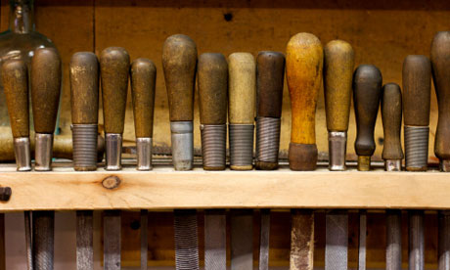

Slide 2
Note: Any videos in this presentation will only play online. After you download the slideshow, you will need to also download the videos from YouTube & add them back into your PowerPoint.
We present these messages at outdoor events around Texas. If you would like to watch the video of the service with this message, click here:
http://campaignkerusso.org/?p=11368
We would love to know more about the people who download our lessons & sermons. We invite you to email us & let us know where & how you use them.
info@ckbrazos.org

Slide 3
Welcome All

Slide 4
Let’s Begin with Prayer

Slide 6
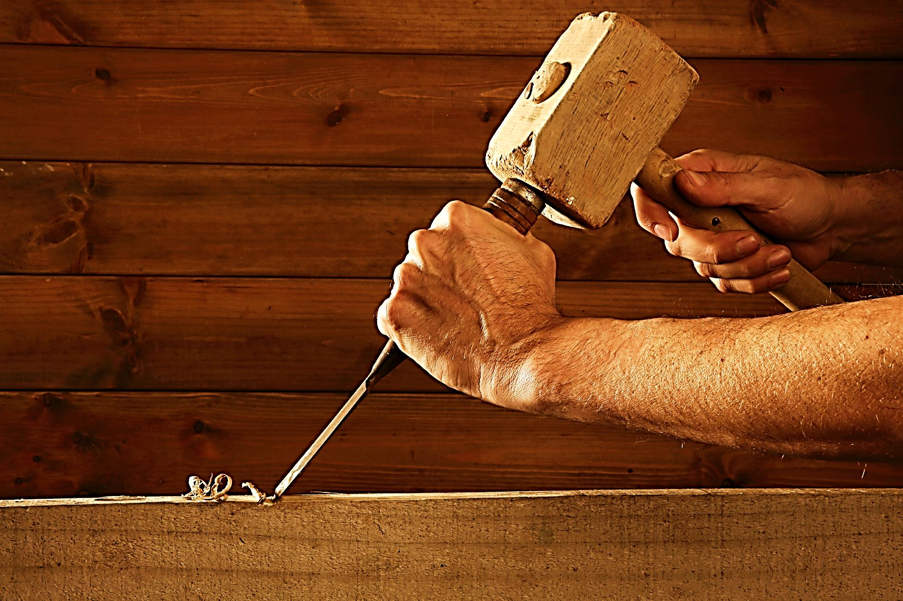
“For we are his workmanship”
Eph. 2:10

Slide 7
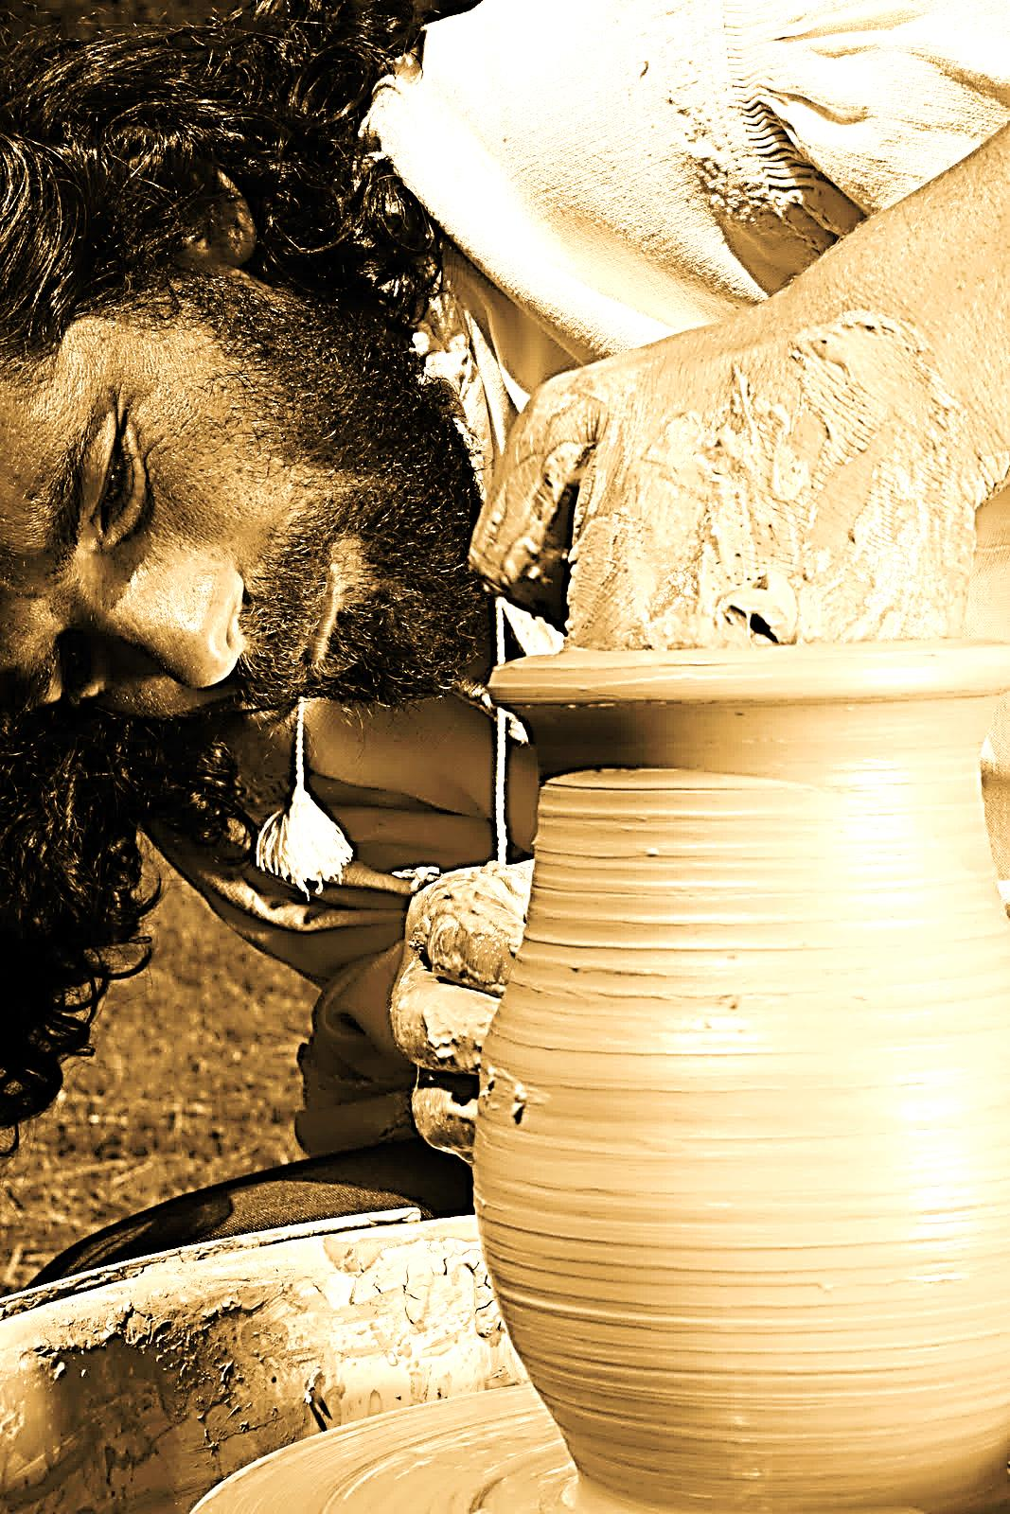
“The Lord will fulfill His purpose for me.
Lord, Your love is eternal; do not abandon the work of Your hands.”
Psalm 138:8

Slide 8
This Slide - Song: He Who Began a Good Work in You Download Here: http://youtu.be/eNjZlHARnEk

Slide 9
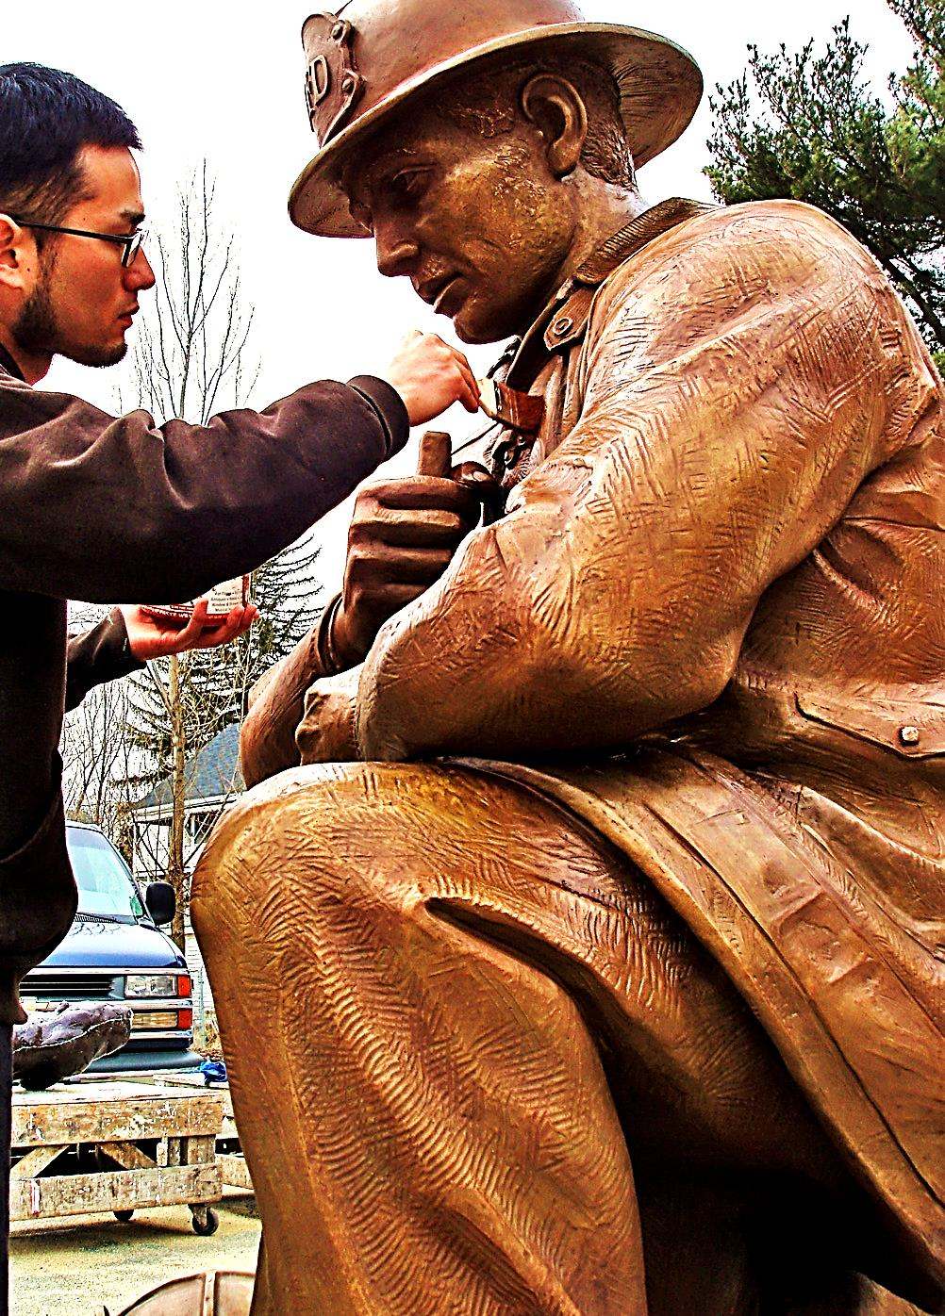
“God is the one who began this good work in you, and I am certain that he won’t stop before it is complete…
on the day that Christ Jesus returns.” Phil. 1:6

Slide 10
This Slide - Video: Potter and Clay Download Here: https://youtu.be/7WZ9DOnQAMw

Slide 11
This Slide - Song: Have Thine Own Way Lord Download Here: http://youtu.be/bYWY7w6HUcg

Slide 12
We are the work of His hands
Jesus is The Creator
Building things is His nature
He is described as a potter and we the clay
He has plans for us

Slide 13
Craftsmanship is a Gift from God
He gifted the builders of His
Tabernacle & Temple
(places where His presence would dwell).
The work had to be beautiful!

Slide 14
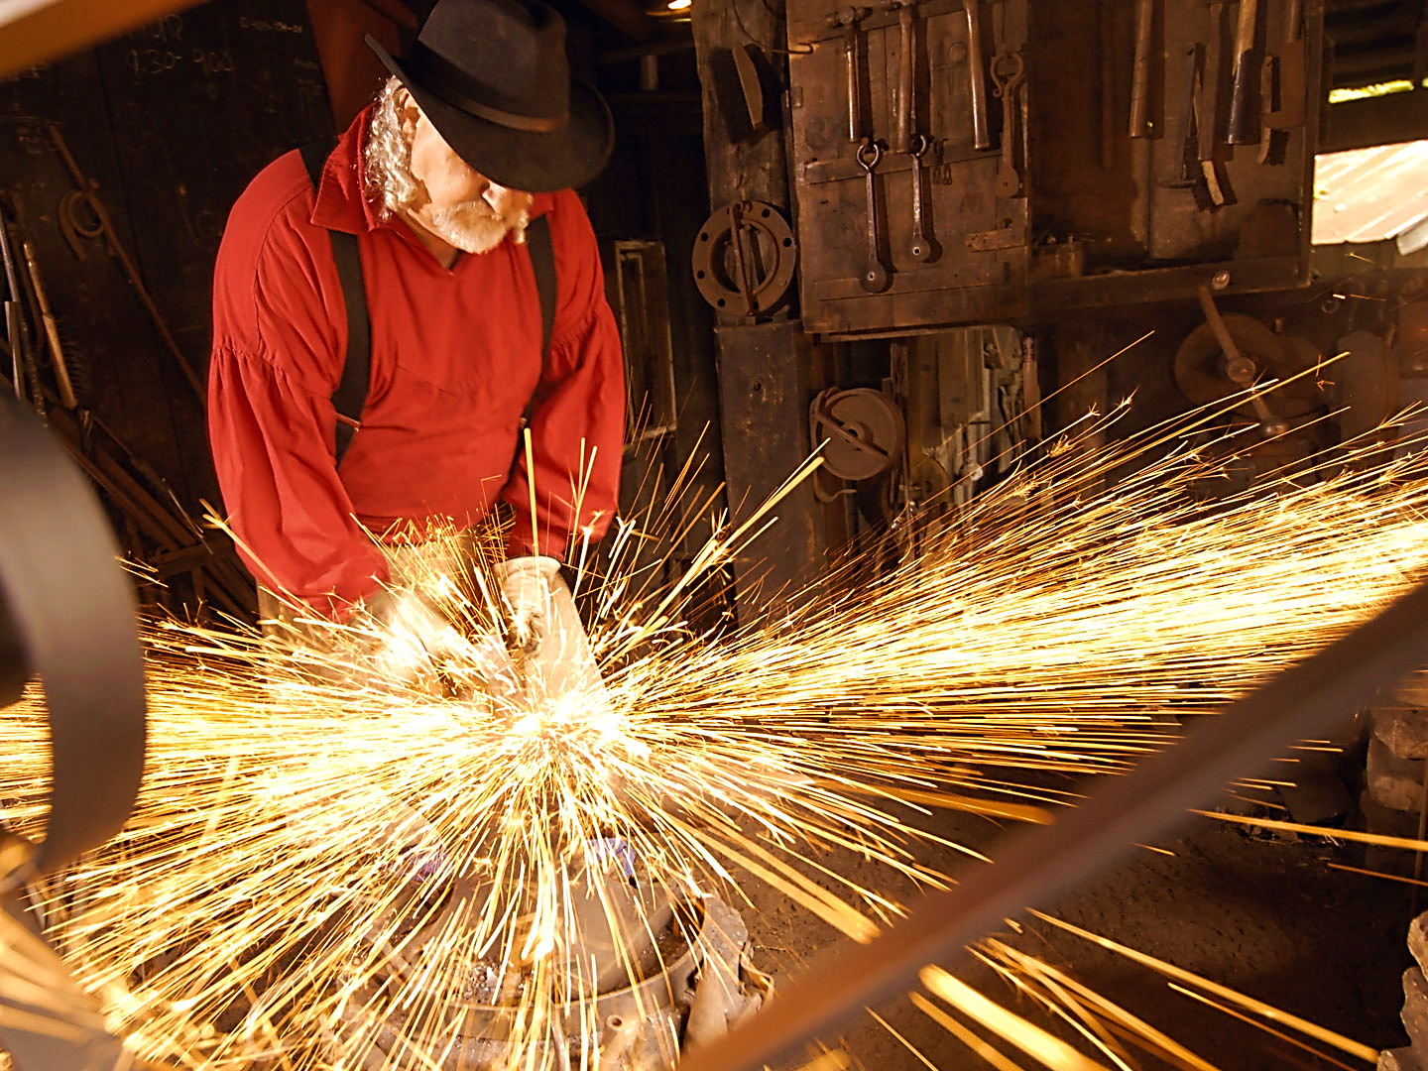
“He has filled them with skill to do every kind of work done by an artisan or by a designer or by an embroiderer in blue, purple, and crimson yarns, and in fine linen, or by a weaver—by any sort of artisan or skilled designer.”
Ex. 35:35

Slide 15
Making a House Fit for a King

Slide 16
He’s Making a House Fit for the King of Kings to live in!
“Don’t you know that your body is a temple of the Holy Spirit who is in you, whom you have from God? You are not your own.” 1 Cor. 6:19

Slide 17
Jesus
was
raised
by one of these gifted
Artisans.

Slide 18
Joseph was a skilled craftsman who worked not only with wood but with stone masonry.
The usual term translated as "carpenter" in the Bible is misleading. The Greek term is “tekton,” which has a much broader meaning.
The Greek word “tekton,” in Mark 6:3, has the root meaning of an “artisan.”

Slide 19
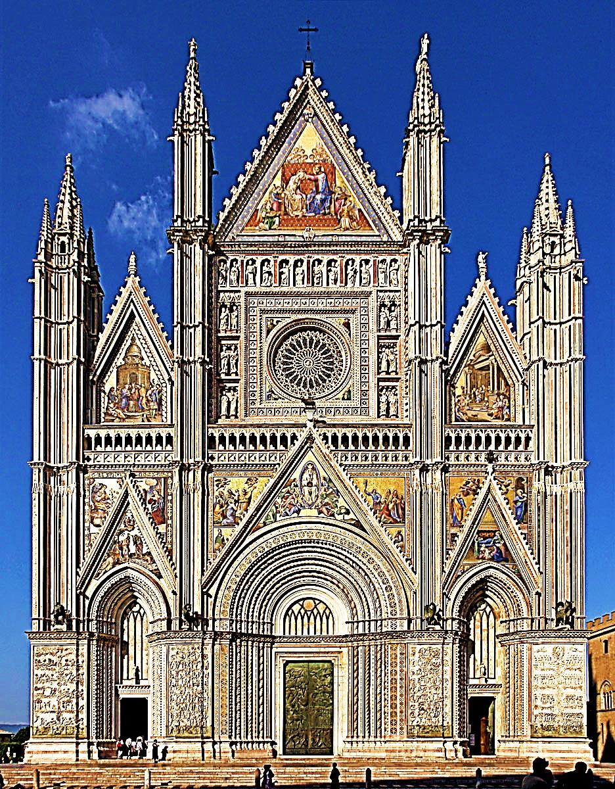
Jesus the Master Craftsman is Working on Us
Three men were pouring concrete on a construction site. “What are you making?” a passerby asked.
The first said, “I’m making $300 a week!”
The second said, “I’m making a foundation.”

Slide 20
Jesus the Master Craftsman is Working on Us
The third, with a gleam in his eye and a note of excitement in his voice, said,
“I’m building a great cathedral.”
That is God’s outlook – He is making a Himself temple.

Slide 21
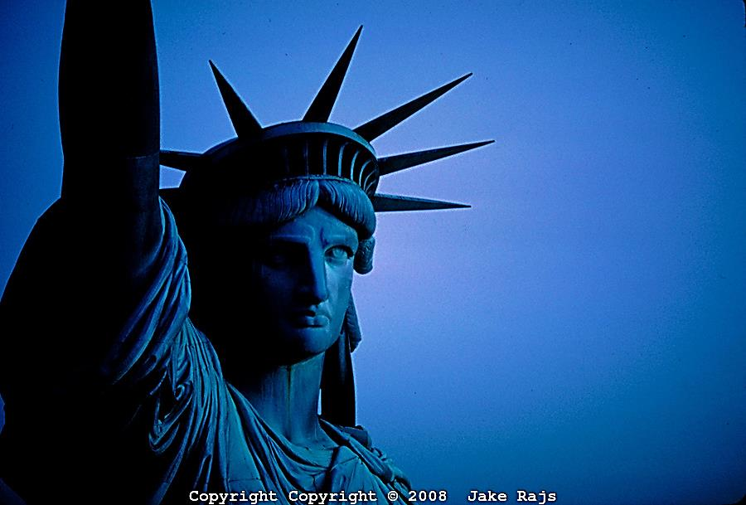
Oscar Hammerstein II told this story:
"A year or so ago, on the cover of the New York Herald Tribune Sunday magazine, I saw a picture of the Statue of Liberty... taken from a helicopter and it showed the top of the statue's head…

Slide 22
I was amazed at the detail there. The sculptor had done a painstaking job with the lady's hair, and yet he must have been pretty sure that the only eyes that would ever see this detail would be the uncritical eyes of sea gulls…

Slide 23
He could not have dreamt that any man would ever fly over this head.
He was artist enough, however, to finish off this part of the statue with as much care as he had devoted to her face and her arms, and the torch and everything that people can see as they sail up the bay…

Slide 24
When you are creating a work of art, or any other kind of work, finish the job off perfectly. You never know when a helicopter, or some other instrument not at the moment invented, may come along and find you out.”

Slide 25
“God has made us what we are. He has created us in Christ Jesus to live lives filled with good works that he has prepared for us to do.” Eph. 2:10 (GW)

Slide 26
This Slide - Song: You Make Beautiful Things Download Here: https://youtu.be/LvQxsVM9Y0s

Slide 27
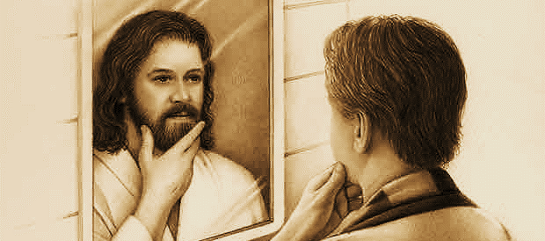
“…All of us can see the Lord’s glory and think deeply about it. So we are being changed to become more like him…” 2 Cor. 3:18

Slide 28
This Slide - Song: He Didn’t Throw Away the Clay Download Here: https://youtu.be/Rx6yctegzjY

Slide 29
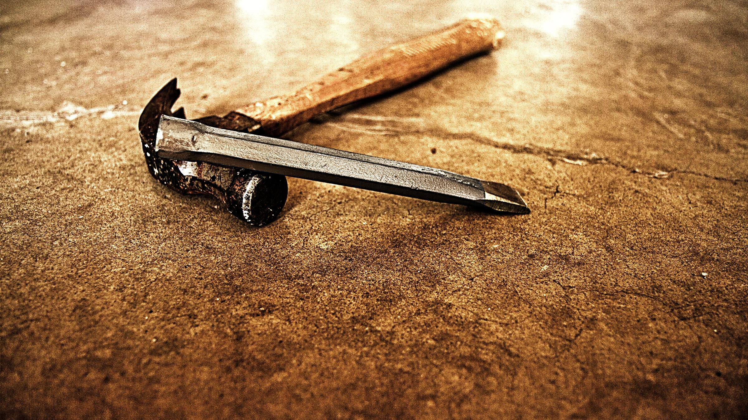
Our Jesus is a “tekton” or Master Craftsman
He is working on you & me
He will never throw us away
He will do a great job and make something of you according to His plan
He is patient and always willing to start over
He finishes what He starts

Slide 30
This Slide - Song: The Potter Knows the Clay Download Here: https://youtu.be/0d71dZNP9pQ

Slide 31
Is Jesus
Speaking to You?
“They said to each other, ‘Did not our hearts burn within us while he talked to us on the road, while he opened to us the Scriptures?’”
John Wesley Said:
“…the preacher was describing the change which God works in the heart through faith in Christ and I felt my heart strangely warmed.”
Jesus makes His presence Known by a small voice!

Slide 33
What is the Sinner‘s Prayer?
This is a prayer we can pray when we are ready to admit we are sinners and need Christ’s forgiveness.
It must be prayed with faith in our hearts and a readiness to have a life-changing encounter with Jesus Christ.

Slide 34
A prayer of faith → Pray this prayer if :
If you never have before
You have in the past, but you think it would mean more today
You have been walking afar off and you want to come back
You want to set an example & show others how it is done
You just like to give your heart to Jesus again & again
Faith

Slide 35
We Declare Our Faith Publicly Because Jesus Declared His LOVE Publicly
“If you stand before others and are willing to say you believe in me, then I will tell my Father in heaven that you belong to me.” Mat 10:32

Slide 36
Three Important Questions
Do you want to know Jesus as your Savior right now?
Do you believe He died to save you from your sins & that He rose from the dead?
Do you believe that He is here, waiting to save you right now?

Slide 37
The Prayer of a Sinner Turning to Jesus
Dear Jesus, I know that I have sinned against You and that my sins separate me from You.
I am truly sorry.
Right now, I turn away from my sinful past .
Please forgive me, and help me to keep from sin.
I believe You died for my sins.
I Believe You rose from the dead, you are alive, and you hear this prayer from my heart.
I invite You Jesus to be both my Savior and the Lord of my life.
I want You to rule my life from now on.

Slide 38
“But some people did accept him. They believed in him, and he gave them the right to become children of God.”
John 1:12

Slide 40
“If you openly say, ‘Jesus is Lord’ and believe in your heart that God raised him from death, you will be saved.”
Rom. 10:9
What did you learn today?
What about Jesus, our Master Craftsman
What have you been thinking about God lately?
What do you want to tell others about Jesus?

Slide 41
Let’s Close in Prayer

Slide 42
Note: Any videos in this presentation will only play online. After you download the slideshow, you will need to also download the videos from YouTube & add them back into your PowerPoint.
We present these messages at outdoor events around Texas. If you would like to watch the video of the service with this message, click here:
http://campaignkerusso.org/?p=11368
We would love to know more about the people who download our lessons & sermons. We invite you to email us & let us know where & how you use them.
info@ckbrazos.org

