Slide 1
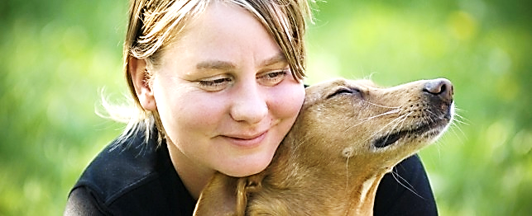
Puppy Love Faith pt.2
Called to be Crazy in Love with Jesus (While We Wait)

Slide 2
Note: Any videos in this presentation will only play online. After you download the slideshow, you will need to also download the videos from YouTube & add them back into your PowerPoint.
We present these messages at Bee Creek Park in College Station, TX. If you would like to watch the video of the service with this message, click here:
http://campaignkerusso.org/?p=13252
We would love to know more about the people who download our lessons & sermons. We invite you to email us & let us know where & how you use them.
info@campaignkerusso.org

Slide 3
Puppy Love Faith pt.2
Called to be Crazy in Love with Jesus (While We Wait)

Slide 4
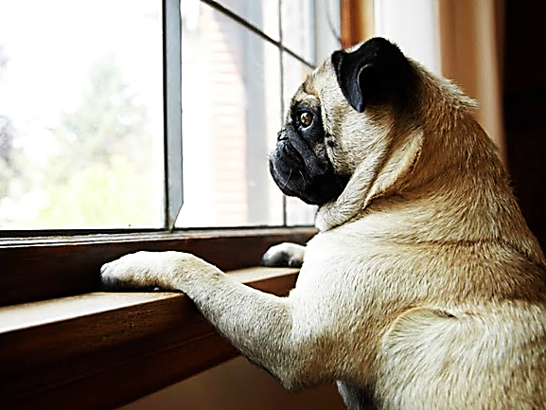
Puppies
eagerly
wait and
watch for
their masters to come Home.

Slide 5
“They said, `You men from Galilee, why do you stand there looking at the sky? Jesus has gone up into heaven. In the same way that you saw him go up, he will come again.” Acts 1:11 (WE)

Slide 6
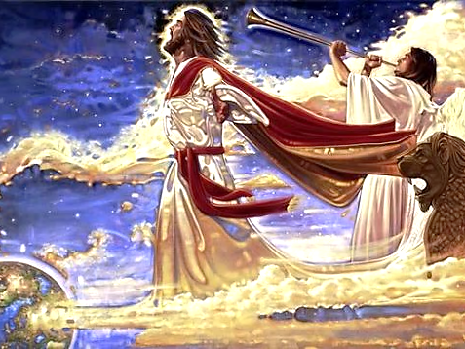
“One word of command, one shout from the archangel, one blast from the trumpet of God and the Lord himself will come down from Heaven! … And after that we shall be with him for ever.”
1 Thes. 4:16-17 (Phillips)

Slide 7
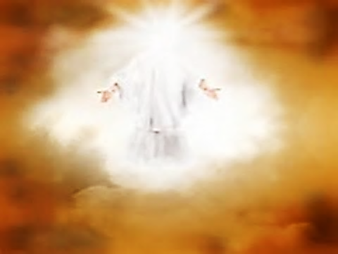
“It will happen in an instant, in a split second at the sound of the last trumpet. Indeed, that trumpet will sound, and then the dead will come back to life. They will be changed so that they can live forever.” 1 Cor. 15:52 (GW)

Slide 8
“So Christ, having been offered… once for all… will appear a second time [when he returns to earth], not to deal with sin, but to bring salvation to those who are eagerly and confidently waiting for Him.” Heb. 9:28 (AMP)

Slide 9
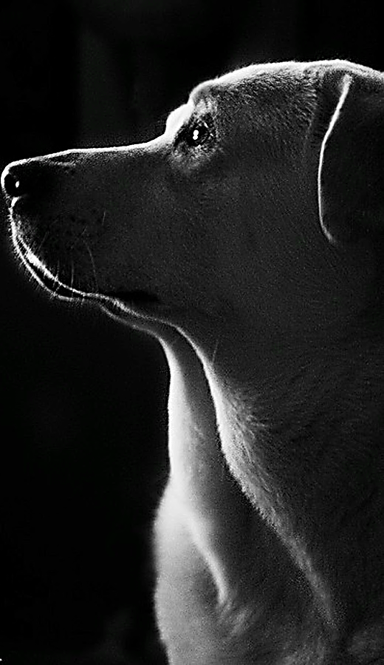
Though our hearts are filled with love for our master, we can’t simply wait for Jesus to return, we are also called to be workers and ambassadors who understand that the time is short.

Slide 10
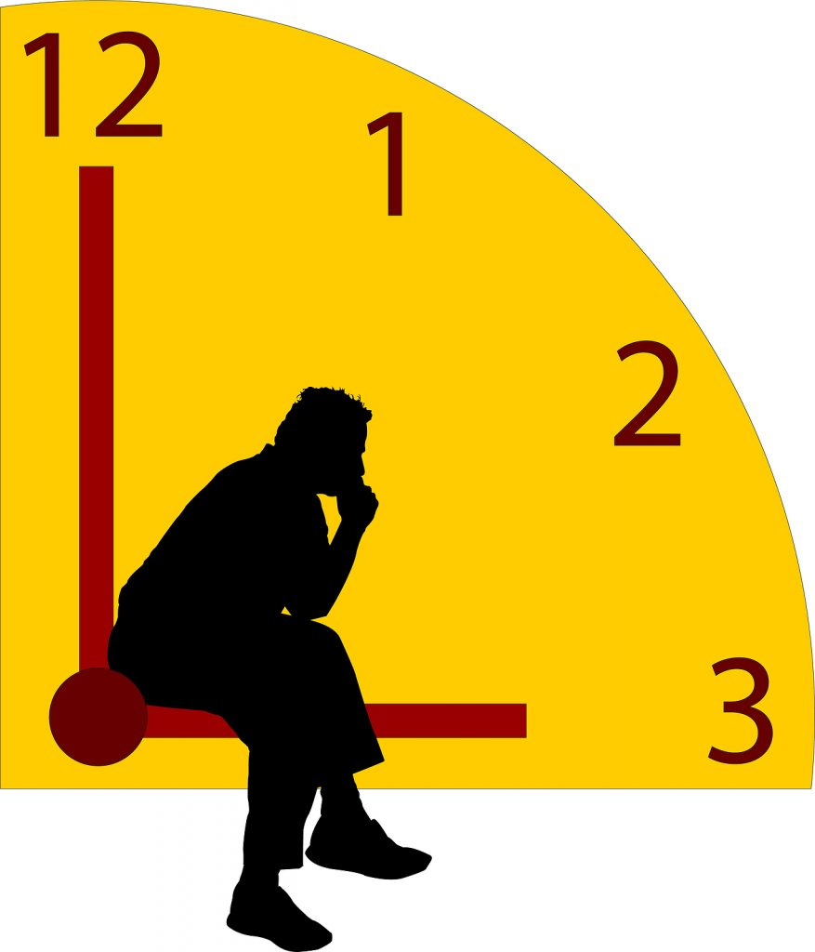
While We Wait
We Pray

Slide 11
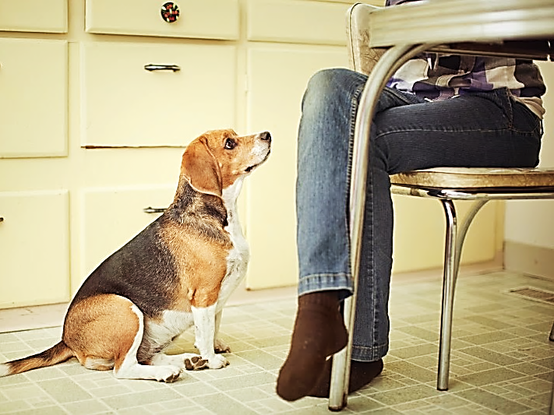
Like puppies, we look to our master to with expectation….
“The end of the world is coming soon. Therefore be earnest, thoughtful men of prayer.”
1 Pet. 4:7 (TLB)

Slide 12
While We Wait
We Resist Worldliness & Temptation

Slide 13
“But we are citizens of Heaven; our outlook goes beyond this world to the hopeful expectation of the savior who will come from Heaven, the Lord Jesus Christ.”
Phil. 3:20 (Phillips)

Slide 14
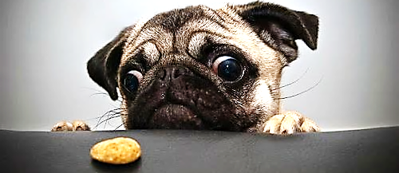
“It teaches us to say no to the things that are not true of God, and to the things of this world. It teaches us to use good sense, to do what is right, and to please God while we live in this world….

Slide 15
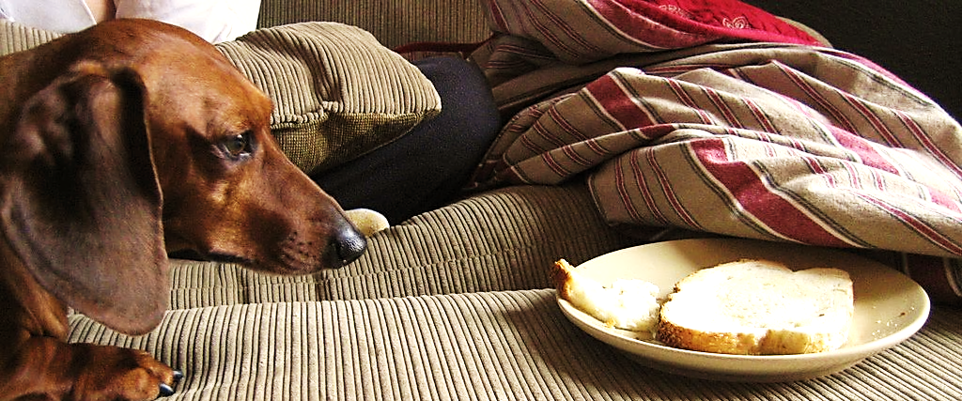
“…be patient; strengthen your hearts [keep them energized and firmly committed to God], because the coming of the Lord is near.”
James 5:8 (AMP)

Slide 16
While We Wait
We Serve

Slide 17
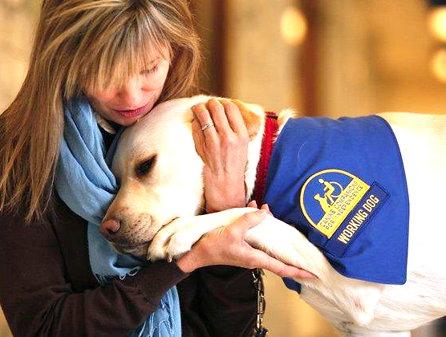
It is a time to seek God, stay committed to His work, and use His gifts.

Slide 18
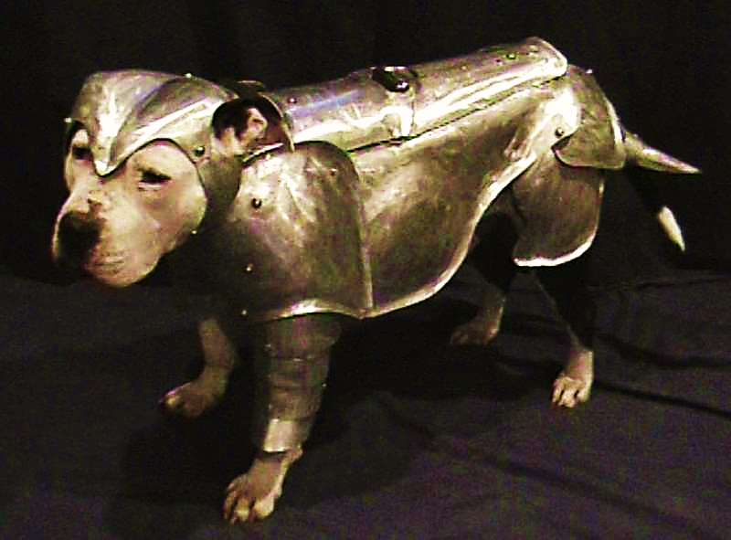
“The night [this present evil age] is almost gone and the day [of Christ’s return] is almost here. So let us fling away the works of darkness and put on the [full] armor of light.” Rom. 13:12 (AMP)

Slide 19
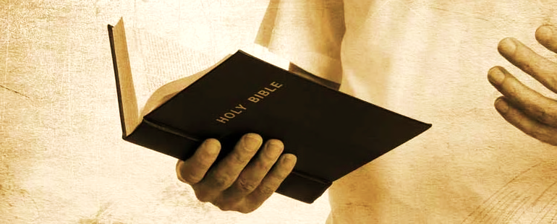
“You have the gifts of the Holy Spirit that you need while you wait for the Lord Jesus Christ to come again.” 1 Cor. 1:7 (NLV)

Slide 20
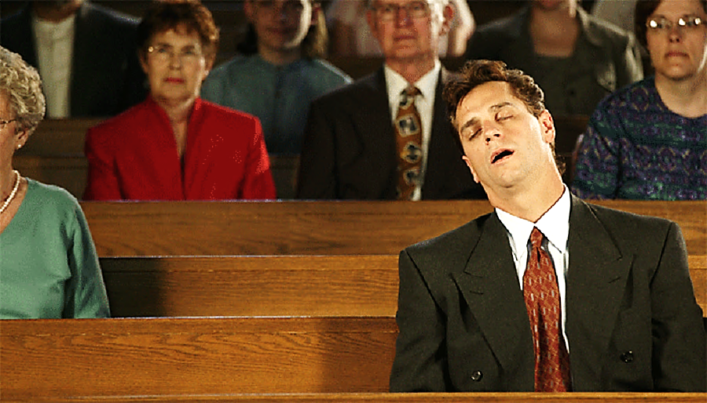
“This is all the more urgent, for you know how late it is; time is running out. Wake up, for our salvation is nearer now than when we first believed.”
Rom. 13:11 (NLT)

Slide 21
It’s a Long Distance Love Story
…All this is while we wait and hope… We are waiting for our great God to come in Jesus Christ. He is the One who will save us. He is wonderful!” Tit. 2:12-13 (WE)

Slide 22
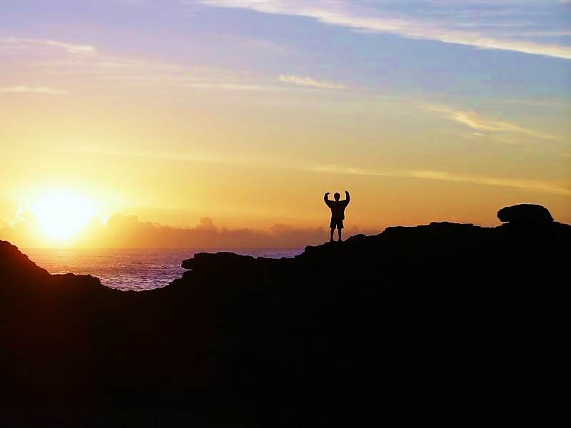
“So think clearly. Keep awake. When Jesus Christ comes, he will bring you blessing. Set all your hope on that.”
1 Pet. 1:13

Slide 23
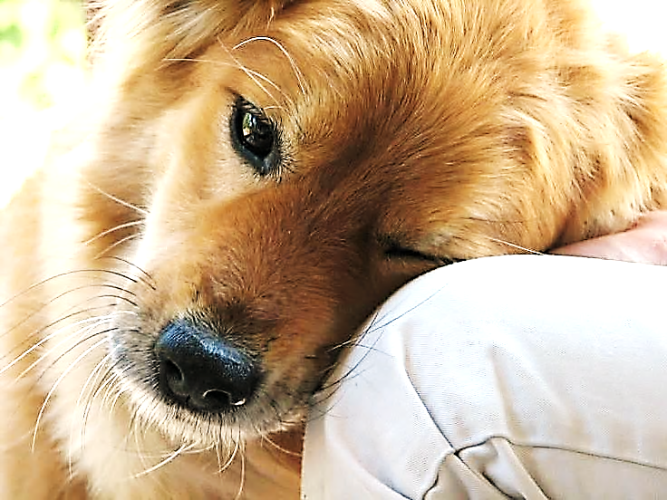
“Lord, the righteous Judge, will award me on that great day… and all those who have loved and longed for and welcomed His appearing.”
2 Tim. 4:8 (AMP)
He, Himself is Our Reward!

Slide 24
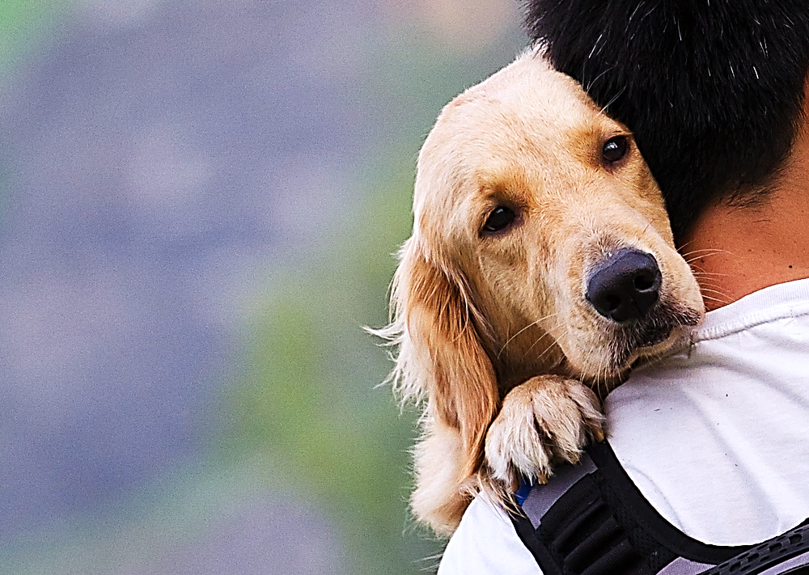
Sometimes the Lord needs to call us back the love we once had !
“ But this is what I
have against you:
you do not love me now as you did at first. Think how far you have fallen! Turn from your sins and do what you did at first.” Rev. 2:4, 5 GNT)

Slide 25
Is Jesus Speaking to You?
“They said to each other, ‘Did not our hearts burn within us while he talked to us on the road, while he opened to us the Scriptures?’”
John Wesley Said:
“…the preacher was describing the change which God works in the heart through faith in Christ and I felt my heart strangely warmed.”
Jesus makes His presence Known by a small voice!

Slide 27
What is the Sinner‘s Prayer?
This is a prayer we can pray when we are ready to admit we are sinners and need Christ’s forgiveness.
It must be prayed with faith in our hearts and a readiness to have a life-changing encounter with Jesus Christ.

Slide 28
A prayer of faith → Pray this prayer if :
If you never have before
You have in the past, but you think it would mean more today
You have been walking afar off and you want to come back
You want to set an example & show others how it is done
You just like to give your heart to Jesus again & again
Faith

Slide 29
We Declare Our Faith Publicly Because Jesus Declared His LOVE Publicly
“If you stand before others and are willing to say you believe in me, then I will tell my Father in heaven that you belong to me.” Mat 10:32

Slide 30
Important Questions
Do you want to know Jesus as your Savior right now?
Do you believe He died to save you from your sins & that He rose from the dead?
Do you believe that He is here, waiting to save you right now?

Slide 31
The Prayer of a Sinner Turning to Jesus
Dear Jesus, I know that I have sinned against You and that my sins separate me from You.
I am truly sorry.
Right now, I turn away from my sinful past .
Please forgive me, and help me to keep from sin.
I believe You died for my sins.
I Believe You rose from the dead, you are alive, and you hear this prayer from my heart.
I invite You Jesus to be both my Savior and the Lord of my life.
I want You to rule my life from now on.

Slide 32
“But some people did accept him. They believed in him, and he gave them the right to become children of God.”
John 1:12

Slide 34
“If you openly say, ‘Jesus is Lord’ and believe in your heart that God raised him from death, you will be saved.”
Rom. 10:9
What did you learn today?
What have you been thinking about God lately?
What do you want to tell others about Jesus?

Slide 35
“Draw near to God, and He will draw near to you…
Altar Time
…Cleanse your hands, you sinners, and make your hearts pure, you who are half-hearted towards God.” James 4:8 WNT

Slide 36
Close in Prayer

Slide 37
Note: Any videos in this presentation will only play online. After you download the slideshow, you will need to also download the videos from YouTube & add them back into your PowerPoint.
We present these messages at Bee Creek Park in College Station, TX. If you would like to watch the video of the service with this message, click here:
http://campaignkerusso.org/?p=13252
We would love to know more about the people who download our lessons & sermons. We invite you to email us & let us know where & how you use them.
info@campaignkerusso.org

