Slide 1
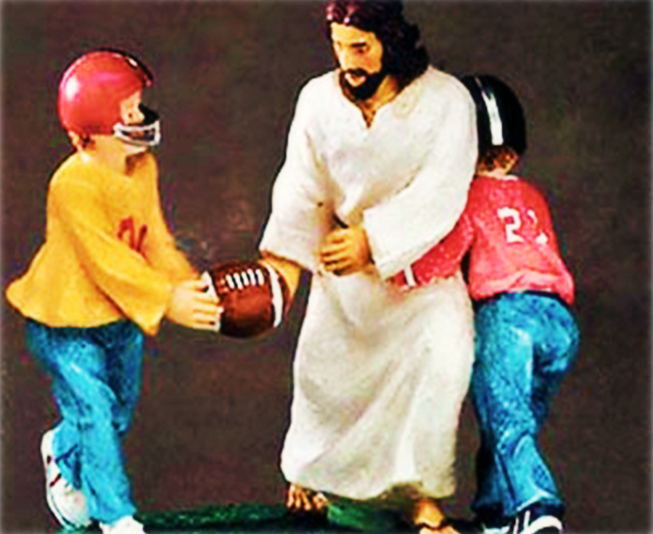
Leave it On the Field for Jesus

Slide 2
Note: After you download the slideshow, you may also need to download some videos from YouTube & add them into this PowerPoint. This tool can help you: Free YouTube Download
We present these messages in outdoor venues using the SonShineTent. Watch the video of our service that goes with this message, click here: http://campaignkerusso.org/?p=6995
We would love to know more about the people who download our lessons & sermons. We invite you to email us & let us know where & how you use them.
info@campaignkerusso.org

Slide 3
Welcome All

Slide 4
Let’s Begin with Prayer

Slide 5
Song: Love the Lord Your God
Video Goes Here Title: Love the Lord Your God Download Here:
https://youtu.be/bKVZ_olNkHE

Slide 6
Leave it On the Field for Jesus

Slide 7
Leave it on the Field
This is an
expression
coaches use
to motivate
their players.

Slide 8
This means that all that is in you… whatever energy, whatever ounce of life, whatever thoughts, hopes or passion you bring to the game…

Slide 9
…you don’t hold back, not one bit, not one moment, until you are completely spent in the effort.
All your heart, mind & strength should be left on that field without reservation…
When the game is over you should be spent, flattened, with heart & soul left on the field.

Slide 10
Christianity is the Ultimate Super-Bowl
We are fighting to bring lost souls to Jesus
“The field is the world…” Mat. 13:38

Slide 11
Every believer is Important to the Team.
Coach Jesus will give you a job to do.
There is no sitting on the side-lines.

Slide 12
There has already been blood on the field: It is the blood of those who have gone before.
“Even as the Son of man did not come to have servants, but to be a servant, and to give his life for the salvation of men.” Mat. 20:28

Slide 13
We Were Created for this Battle
Coach Jesus wants us, “All In”
No holding back!
Leave it on the field!

Slide 14
“Love the Lord your God with all your heart and with all your soul and with all your mind and with all your strength.” Mk 12:30

Slide 15
The Game Time is Limited
“Only one life, so soon it will pass…
Only what’s done for Christ will last”

Slide 16
The Key to Giving Your All is Love
“For God loved the world so much that he gave his only Son…” John 3:16
“This letter is from Paul, Jesus Christ's slave…” Rom. 1:1
It was Paul’s debt of love to leave it all on the field for Jesus.

Slide 17
Paul Left it on the Field!

Slide 18
Paul Suffered for the Gospel
Imprisoned
Whipped
Beaten with rods
Stoned & left for dead
Shipwrecked
Labored without food, sleep or proper clothing

Slide 19
Paul Gave His ALL for Jesus !!!
“I am suffering now because I tell the Good News, but I am not ashamed, because I know Jesus, the One in whom I have believed.” 2 Tim. 1:12

Slide 20
“Some were laughed at and beaten. Others were put in chains and thrown into prison…
They were
stoned to
death,
they were
cut in half,
and they were killed with swords…
They were poor, abused, and treated badly.
The world was not good enough for them!”
Heb. 11

Slide 21
No Benched Christians! Let’s Get Serious and…

Slide 22
Video: The Duty of a Christian
Video Goes Here Title: The Duty of a Christian Download Here:
https://youtu.be/YQ5IlwWu5fs

Slide 23
Song: Love the Lord Your God
Video Goes Here Title: Love the Lord Your God Download Here:
https://youtu.be/bKVZ_olNkHE

Slide 24
Is Jesus
Speaking to You?
“They said to each other, ‘Did not our hearts burn within us while he talked to us on the road, while he opened to us the Scriptures?’”
John Wesley Said:
“…the preacher was describing the change which God works in the heart through faith in Christ and I felt my heart strangely warmed.”
Jesus makes His presence Known by a small voice!

Slide 26
What is the Sinner‘s Prayer?
This is a prayer we can pray when we are ready to admit we are sinners and need Christ’s forgiveness.
It must be prayed with faith in our hearts and a readiness to have a life-changing encounter with Jesus Christ.

Slide 27
A prayer of faith → Pray this prayer if :
If you never have before
You have in the past, but you think it would mean more today
You have been walking afar off and you want to come back
You want to set an example & show others how it is done
You just like to give your heart to Jesus again & again
Faith

Slide 28
We Declare Our Faith Publicly Because Jesus Declared His LOVE Publicly
“If you stand before others and are willing to say you believe in me, then I will tell my Father in heaven that you belong to me.” Mat 10:32

Slide 29
Three Important Questions
Do you want to know Jesus as your Savior right now?
Do you believe He died to save you from your sins & that He rose from the dead?
Do you believe that He is here, waiting to save you right now?

Slide 30
The Prayer of a Sinner Turning to Jesus
Dear Jesus, I know that I have sinned against You and that my sins separate me from You.
I am truly sorry.
Right now, I turn away from my sinful past .
Please forgive me, and help me to keep from sin.
I believe You died for my sins.
I Believe You rose from the dead, you are alive, and you hear this prayer from my heart.
I invite You Jesus to be both my Savior and the Lord of my life.
I want You to rule my life from now on.

Slide 31
“But some people did accept him. They believed in him, and he gave them the right to become children of God.”
John 1:12

Slide 33
“If you openly say, ‘Jesus is Lord’ and believe in your heart that God raised him from death, you will be saved.”
Rom. 10:9
What did you learn today?
How do we leave it on the field for Jesus.
What have you been thinking about God lately?
What do you want to tell others about Jesus?

Slide 34
Let’s Close in Prayer

Slide 35
Note: After you download the slideshow, you may also need to download some videos from YouTube & add them into this PowerPoint. This tool can help you: Free YouTube Download
We present these messages in outdoor venues using the SonShineTent. Watch the video of our service that goes with this message, click here: http://campaignkerusso.org/?p=6995
We would love to know more about the people who download our lessons & sermons. We invite you to email us & let us know where & how you use them.
info@campaignkerusso.org

