Slide 1
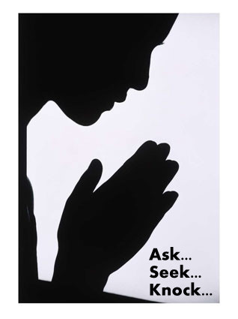
Prayer is Knocking on God’s Door
vv

Slide 2



Note: After you download the slideshow, you may also need to download some videos from YouTube & add them into this PowerPoint. This tool can help you:
Free YouTube Download
We present these messages in outdoor venues using the SonShineTent.
Watch the video of our service that goes with this message, click here: http://campaignkerusso.org/?p=7719
We would love to know more about the people who download our lessons & sermons. We invite you to email us & let us know where & how you use them.
info@campaignkerusso.org

Slide 3

Welcome All

Slide 4

Let’s Begin with Prayer

Slide 5
Prayer is Knocking on God’s Door
vv

Slide 6
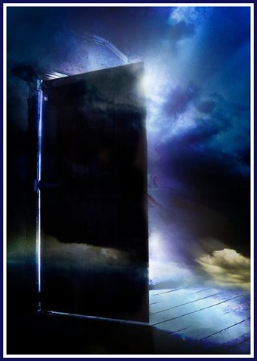
We Must Ask With a Pure Heart

Slide 7
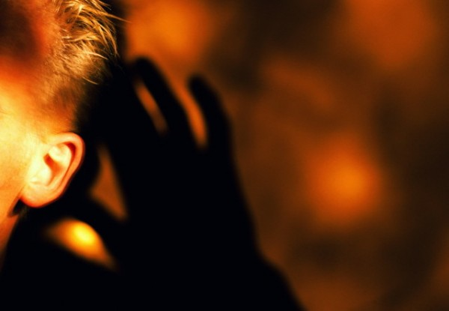
Ask God for Good Things
“We are sure that if we ask anything that He wants us to have, He will hear us.” 1 John 5:14

Slide 8

“Or if you do ask, you do not receive because your reasons for asking are wrong. You want these things only to please yourselves.” James 4:3

Slide 9


We Must Ask With a Pure Heart
Not a Selfish Heart

Slide 10
We Must Ask With Believing Heart

Slide 11
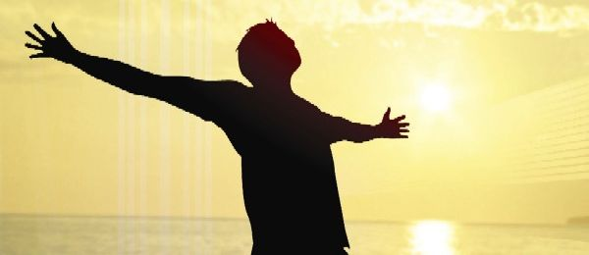
Ask With Faith
“All things you ask for in prayer, you will receive if you have faith.”
Mat. 21:22

Slide 12


We Must Ask With a Faith-Filled
Heart
Not a Doubt – Filled Heart

Slide 13
We Must Ask and Never Quit

Slide 14
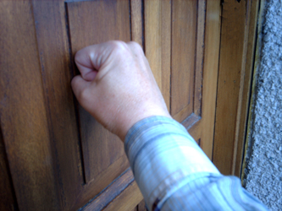
Keep Asking and Don’t Give Up

Slide 15
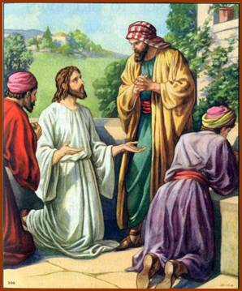
“Then Jesus said to them, ‘Suppose someone has a friend. He goes to him at midnight. He says, 'Friend, lend me three loaves of bread.
A friend of mine on a journey has come to stay with me. I have nothing for him to eat.'

Slide 16
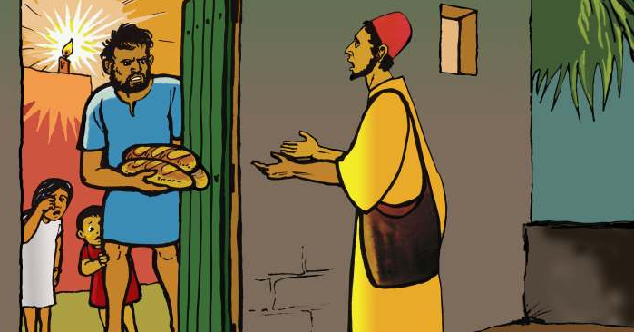
"Then the one inside answers, 'Don't bother me. The door is already locked. My children are with me in bed. I can't get up and give you anything.'
"I tell you, that person will not get up. And he won't give the man bread just because he is his friend. But because the man keeps on asking, he will get up. He will give him as much as he needs.

Slide 17
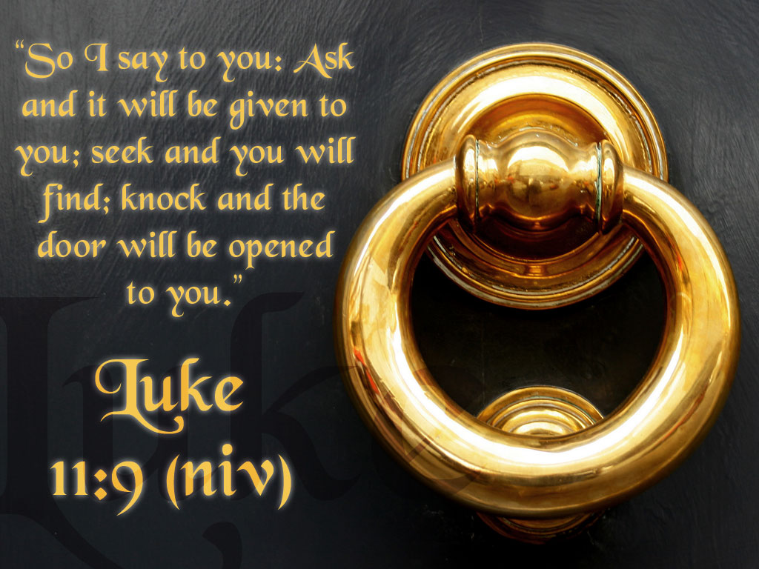
Ask and it will be given to you
Seek and you will find
Knock and the door will be opened to you

Slide 18
Video: A Friend at Midnight
Video Goes Here
Title: A Friend at Midnight
Download Here:
https://youtu.be/1fnElIVTOrs

Slide 19
Video: A Midnight Snack
Video Goes Here
Title: Midnight Snack
Download Here:
https://youtu.be/yIeQVvFfeug

Slide 20
Video: The Persistent Friend
Video Goes Here
Title: The Persistent Friend
Download Here:
https://youtu.be/QDY7SrwbDh8

Slide 21


We Must Ask With Persistent Heart
Not a Quitters Heart

Slide 22
Ask Friends to Join You

Slide 23
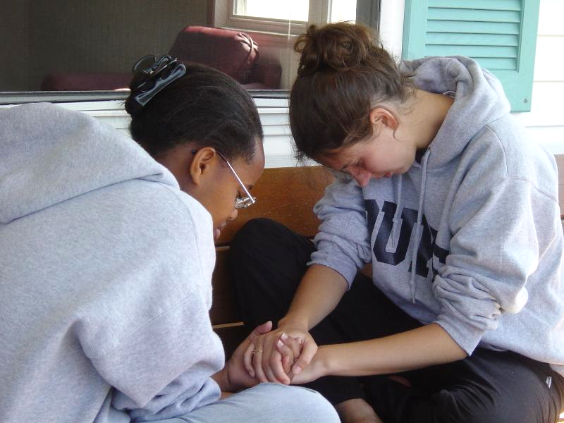
“Where two or three people meet together in my name, I am there with them." Matthew 18:20

Slide 24

Ask Friends to Join You in Prayer

Slide 25
Pray With Your Whole Heart

Slide 26

“The earnest (heartfelt, continued) prayer of a righteous man makes tremendous power available.” James 5:16

Slide 27


We Must Ask With a Whole Heart
Not
Half-Hearted

Slide 28
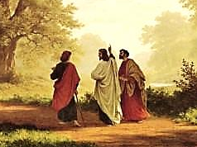
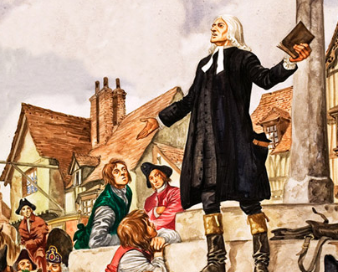
Is Jesus
Speaking to You?
“They said to each other, ‘Did not our hearts burn within us while he talked to us on the road, while he opened to us the Scriptures?’”
John Wesley Said:
“…the preacher was describing the change which God works in the heart through faith in Christ and I felt my heart strangely warmed.”
Jesus makes His presence Known by a small voice!

Slide 29
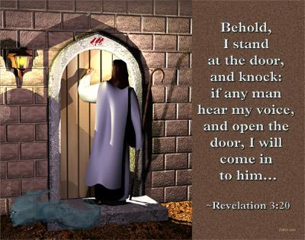

Slide 30
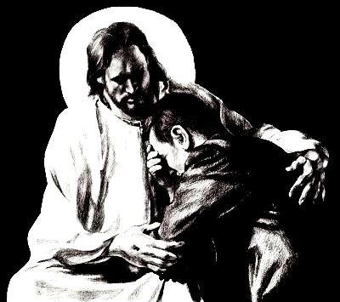
What is the Sinner‘s Prayer?
This is a prayer we can pray when we are ready to admit we are sinners and need Christ’s forgiveness.
It must be prayed with faith in our hearts and a readiness to have a life-changing encounter with Jesus Christ.

Slide 31

A prayer of faith → Pray this prayer if :
If you never have before
You have in the past, but you think it would mean more today
You have been walking afar off and you want to come back
You want to set an example & show others how it is done
You just like to give your heart to Jesus again & again
Faith

Slide 32
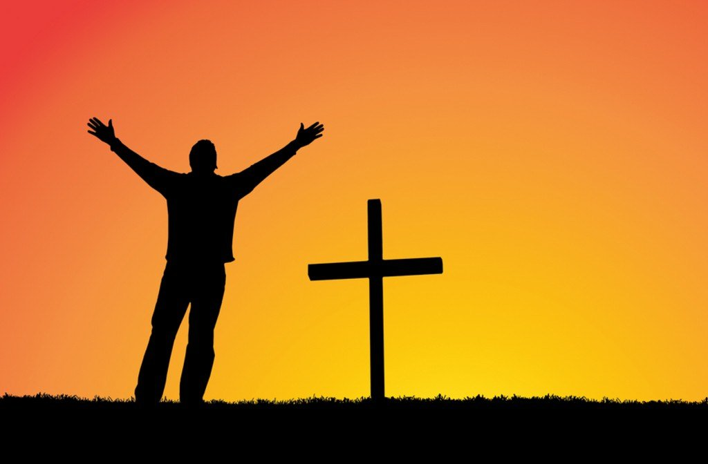
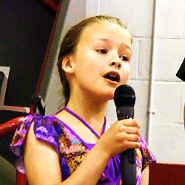
We Declare Our Faith Publicly Because Jesus Declared His LOVE Publicly
“If you stand before others and are willing to say you believe in me, then I will tell my Father in heaven that you belong to me.” Mat 10:32

Slide 33

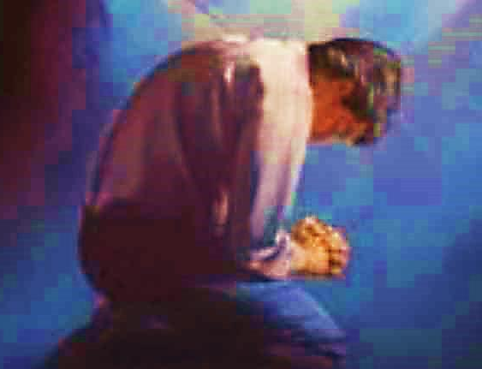
Three Important Questions
Do you want to know Jesus as your Savior right now?
Do you believe He died to save you from your sins & that He rose from the dead?
Do you believe that He is here, waiting to save you right now?

Slide 34
The Prayer of a Sinner Turning to Jesus
Dear Jesus, I know that I have sinned against You and that my sins separate me from You.
I am truly sorry.
Right now, I turn away from my sinful past .
Please forgive me, and help me to keep from sin.
I believe You died for my sins.
I Believe You rose from the dead, you are alive, and you hear this prayer from my heart.
I invite You Jesus to be both my Savior and the Lord of my life.
I want You to rule my life from now on.

Slide 35


“But some people did accept him. They believed in him, and he gave them the right to become children of God.”
John 1:12

Slide 36



Slide 37


“If you openly say, ‘Jesus is Lord’ and believe in your heart that God raised him from death, you will be saved.”
Rom. 10:9
What did you learn today?
How should we pray?
What have you been thinking about God lately?
What do you want to tell others about Jesus?

Slide 38
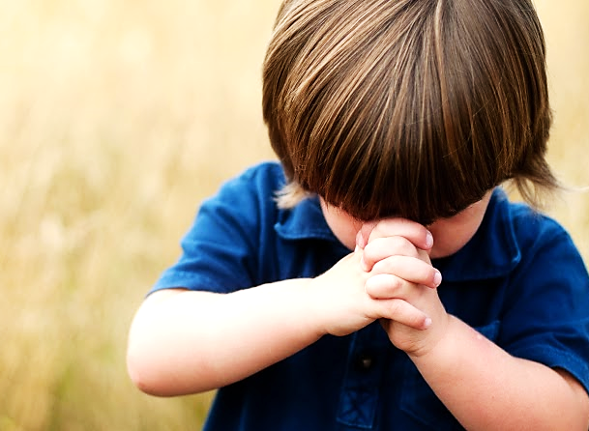
Let’s Close in Prayer

Slide 39
Note: After you download the slideshow, you may also need to download some videos from YouTube & add them into this PowerPoint. This tool can help you:
Free YouTube Download
We present these messages in outdoor venues using the SonShineTent.
Watch the video of our service that goes with this message, click here: http://campaignkerusso.org/?p=7719
We would love to know more about the people who download our lessons & sermons. We invite you to email us & let us know where & how you use them.
info@campaignkerusso.org

