Slide 1
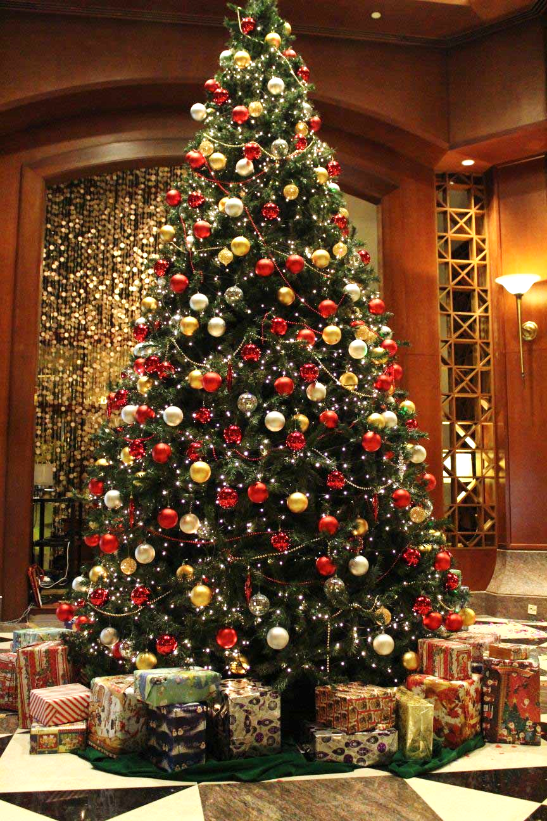
The Most Beautiful Christmas Tree

Slide 2
Note: After you download the slideshow, you may also need to download some videos from YouTube & add them into this PowerPoint. This tool can help you: Free YouTube Download
We present these messages in outdoor venues using the SonShineTent. Watch the video of our service that goes with this message, click here: http://campaignkerusso.org/?p=6658
We would love to know more about the people who download our lessons & sermons. We invite you to email us & let us know where & how you use them.
info@campaignkerusso.org

Slide 3
Welcome All

Slide 4
Let’s Begin with Prayer

Slide 5
Song: Christmas is About the Cross
Video Goes Here Title: It’s About the Cross Download Here:
https://youtu.be/5yhucU3EvzE

Slide 6
What is the prettiest Christmas tree you remember?

Slide 7
Impressive New York City Tree (2016)
94 Feet Tall
How Tall?
How Wide?
56 Feet Wide
115 Foot long Flat Bed Truck
Size of Truck?
How many lights?
30,000 LED Lights
Its milled into lumber and donated to Habitat for Humanity to build homes for those in need.
What happens to the tree after Christmas?

Slide 8
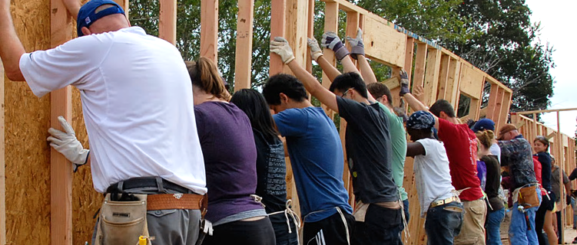
As the Time Square tree is eventually brought down to became lumber for the needy, so Jesus came down from Heaven and let His body be broken for the lost.

Slide 9
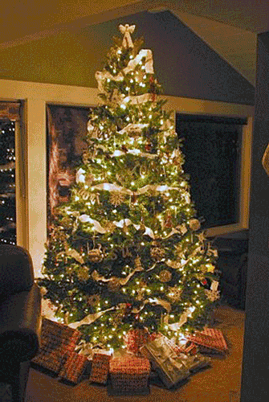
The most beautiful Christmas tree looks more like this!!!

Slide 10
Song: The Cross is My Christmas Tree
Video Goes Here Title: The Cross is
My Christmas Tree Download Here:
https://youtu.be/nugZyi4OfA0

Slide 11
What did we just see?
What happens to the tree?
The Tree is laid bare and a Cross is formed
What does a tree, turning into a cross, tell us, about Christmas and the Christmas Story?
God became a man, to give His life for mankind
Why do we forget what Christmas is about?
We look at all the shiny gifts but forget about the Heavenly Giver who is God.
What is the greatest gift that God has given us?
His Son Jesus, to die on the Cross for our sins

Slide 12
“Who, though he was God, did not demand and cling to his rights as God, but laid aside his mighty power and glory, taking the disguise of a slave and becoming like men.
And he humbled himself even further, going so far as actually to die a criminal’s death on a cross.” Phil. 2:6-8

Slide 13
The Cross is the World’s Most Beautiful Tree

Slide 14
It was not made of fragrant spruce or pine, but rather, old scrap wood.
“…Christ, who loved us and gave himself for us. He was a sacrificial offering that smelled sweet to God.” Eph.5:2 (CEB)

Slide 15
There were no ornaments hanging
on this tree, but rather the suffering body of a loving Savior:
“He Himself bore our sins in His body on the tree” I Pet. 2:24

Slide 16
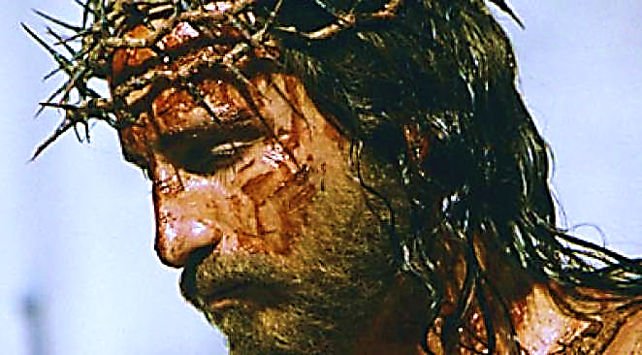
...instead, a crown of thorns encircled His brow.
There was no garland wrapped around this tree…

Slide 17
Rather than streams of festive tinsel,
the Lord’s blood cascaded down this tree—the price paid to cleanse us of our sins.

Slide 18
…but a sign which read “Jesus of Nazareth, King of the Jews.” The King of all Creation became a man, and died for man’s sins.
There was no star at the top…

Slide 19
Song: The Three Trees
Video Goes Here Title: The Three Trees Download Here:
https://youtu.be/xmY1EcYU5ew

Slide 20
The Most Beautiful Tree
Nothing will ever surpass this tree, for beauty.
Nothing will ever touch our hearts so deeply…
Or fulfill our lives so completely.

Slide 21
He loved us then, and He loves us now!

Slide 22
Song: Let Us Not Forget
Video Goes Here Title: Let Us Not Forget Download Here:
https://youtu.be/HQLPx0pK9d4

Slide 23
Is Jesus
Speaking to You?
“They said to each other, ‘Did not our hearts burn within us while he talked to us on the road, while he opened to us the Scriptures?’”
John Wesley Said:
“…the preacher was describing the change which God works in the heart through faith in Christ and I felt my heart strangely warmed.”
Jesus makes His presence Known by a small voice!

Slide 25
What is the Sinner‘s Prayer?
This is a prayer we can pray when we are ready to admit we are sinners and need Christ’s forgiveness.
It must be prayed with faith in our hearts and a readiness to have a life-changing encounter with Jesus Christ.

Slide 26
A prayer of faith → Pray this prayer if :
If you never have before
You have in the past, but you think it would mean more today
You have been walking afar off and you want to come back
You want to set an example & show others how it is done
You just like to give your heart to Jesus again & again
Faith

Slide 27
We Declare Our Faith Publicly Because Jesus Declared His LOVE Publicly
“If you stand before others and are willing to say you believe in me, then I will tell my Father in heaven that you belong to me.” Mat 10:32

Slide 28
Three Important Questions
Do you want to know Jesus as your Savior right now?
Do you believe He died to save you from your sins & that He rose from the dead?
Do you believe that He is here, waiting to save you right now?

Slide 29
The Prayer of a Sinner Turning to Jesus
Dear Jesus, I know that I have sinned against You and that my sins separate me from You.
I am truly sorry.
Right now, I turn away from my sinful past .
Please forgive me, and help me to keep from sin.
I believe You died for my sins.
I Believe You rose from the dead, you are alive, and you hear this prayer from my heart.
I invite You Jesus to be both my Savior and the Lord of my life.
I want You to rule my life from now on.

Slide 30
“But some people did accept him. They believed in him, and he gave them the right to become children of God.”
John 1:12

Slide 32
“If you openly say, ‘Jesus is Lord’ and believe in your heart that God raised him from death, you will be saved.”
Rom. 10:9
What did you learn today?
Tell me about the most beautiful Christmas Tree?
What have you been thinking about God lately?
What do you want to tell others about Jesus?

Slide 33
Let’s Close in Prayer

Slide 34
Note: After you download the slideshow, you may also need to download some videos from YouTube & add them into this PowerPoint. This tool can help you: Free YouTube Download
We present these messages in outdoor venues using the SonShineTent. Watch the video of our service that goes with this message, click here: http://campaignkerusso.org/?p=6658
We would love to know more about the people who download our lessons & sermons. We invite you to email us & let us know where & how you use them.
info@campaignkerusso.org

