Slide 1
(Including: Signs of a Dying Church)
Part 1 – The Long Race

Slide 2
Note: After you download the slideshow, you may also need to download some videos from YouTube & add them into this PowerPoint. This tool can help you: Free YouTube Download
We present these messages in outdoor venues using the SonShineTent. Watch the video of our service that goes with this message, click here: http://campaignkerusso.org/?p=14739
We would love to know more about the people who download our lessons & sermons. We invite you to email us & let us know where & how you use them.
info@campaignkerusso.org

Slide 3
Welcome All

Slide 4
Let’s Begin with Prayer

Slide 5
(Including: Signs of a Dying Church)
Part 1 – The Long Race

Slide 6
The same day we are saved,
we are also called to His work.
“He is the One Who saved us from the punishment of sin. He is the One Who chose us to do His work….” 2 Tim. 1:9 (NLV)

Slide 7
“I strive to lay hold of that for which Christ Jesus also laid hold of me.” Phil. 3:12 (NET)
We are each called to far more than salvation from sin. We are called to be used of Him in reaching the lost.
“I am single-minded: Forgetting the things that are behind and reaching out for the things that are ahead.’ Phil. 3:13 (NET)

Slide 8
Every believer is in a race…
…and what is the prize?
To be used
of God as
fully as we
are called
of God.

Slide 9
But I don’t place any value on my life, if only I can finish my race and the ministry that I received from the Lord Jesus of testifying to the gospel of God’s grace.”
Acts 20:24 (ISV)

Slide 10
“I strive toward the prize of the upward call of God in Christ Jesus.” Phil. 3:14 (NET)
“If you think otherwise, God will reveal to you the error of your ways.” Phil. 3:15 (NET)
The goal is to reach our full potential in service to Christ—our recruiter.

Slide 12
“You know that many runners enter a race, and only one of them wins the prize. So, run to win!” 1 Cor. 9:24 (CEV)
It is possible to run and live (barely), and not receive any reward!

Slide 13
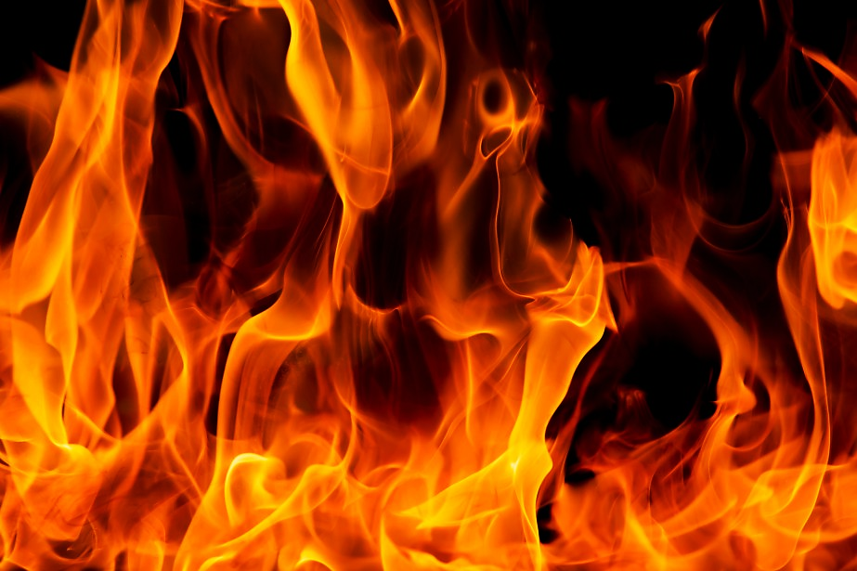
Judgement of the Saint’s Works
“Anyone who builds on that foundation may use a variety of materials—gold, silver, jewels, wood, hay, or straw.
But on the judgment day, fire will reveal what kind of work each builder has done.
The fire will show if a person’s work has any value…

Slide 14
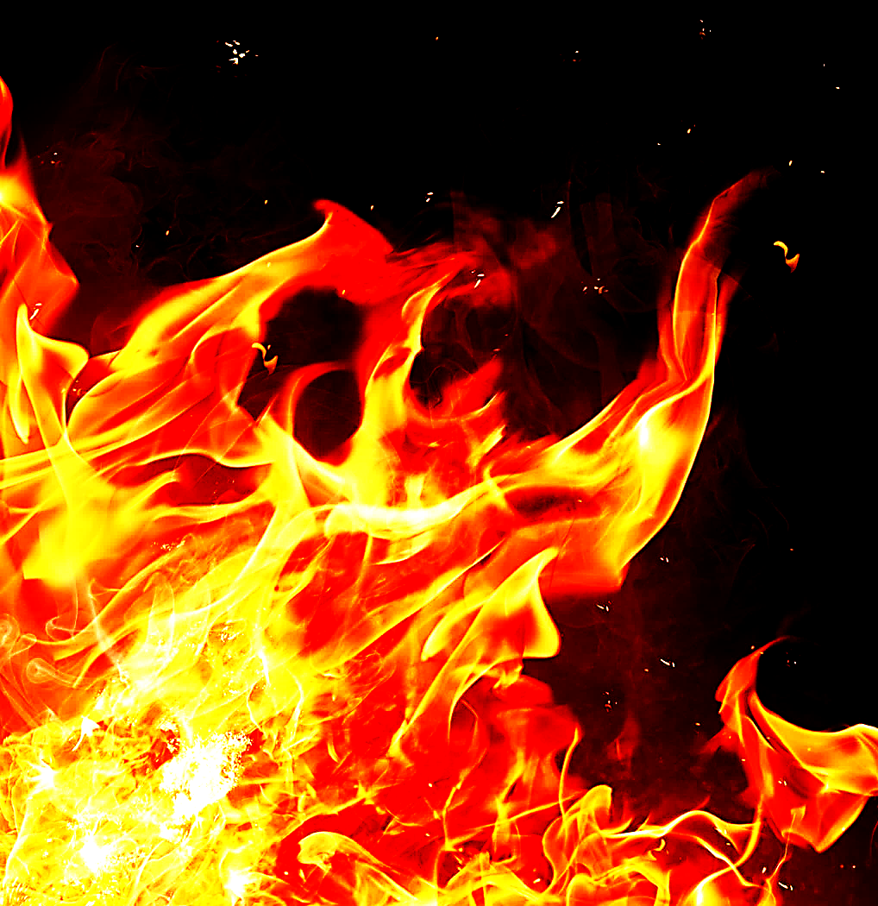
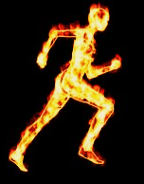
If the work survives, that builder will receive a reward.
But if the work is burned up, the builder will suffer great loss.
The builder will be saved, but like someone barely escaping through a wall of flames.” 1 Cor. 3:12-15

Slide 15
C. T. Studd

Slide 16
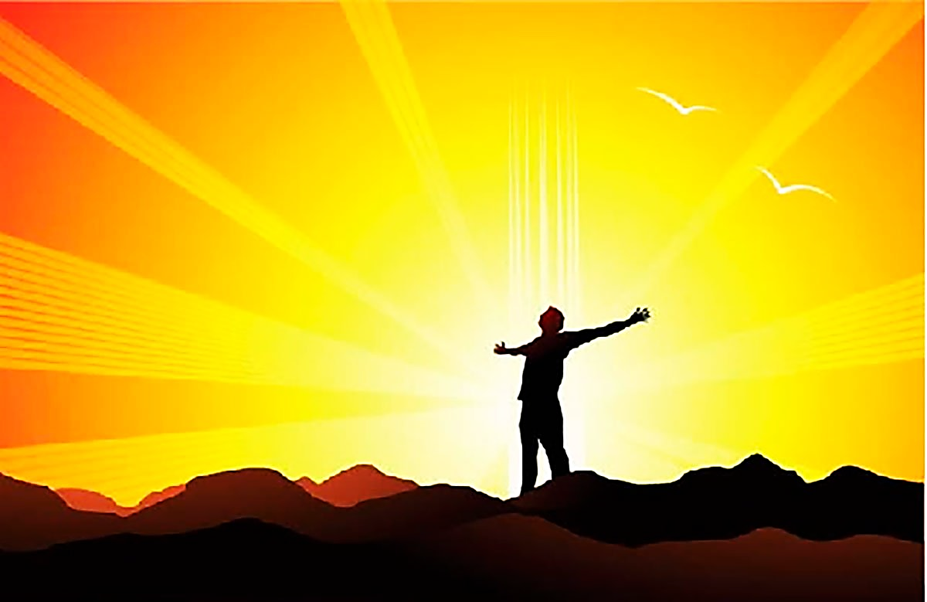
Our reward is not for serving God.
Serving God IS our reward!!!

Slide 17
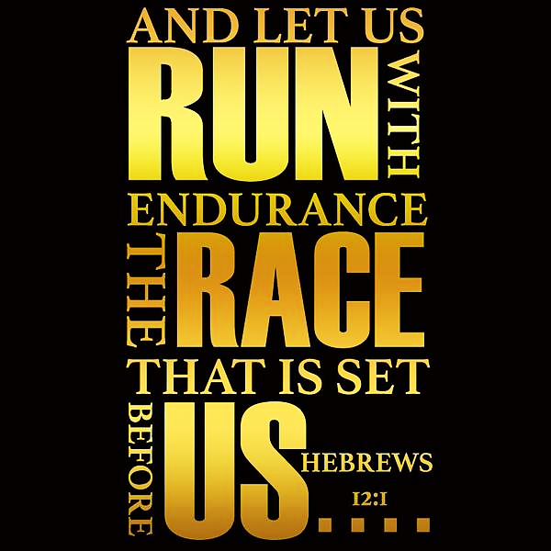
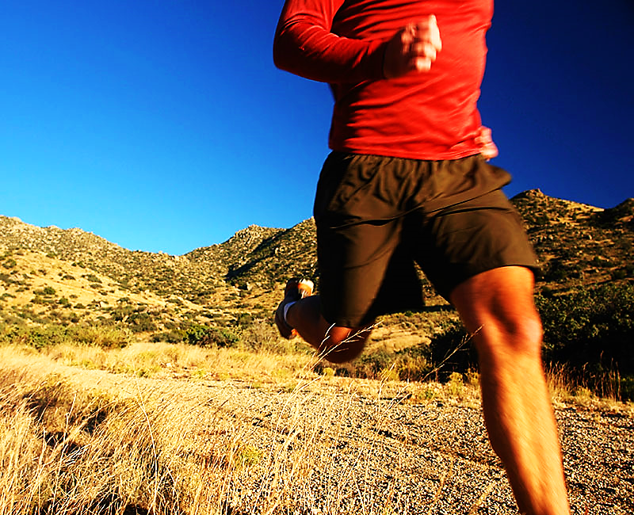

Slide 18
The Christian calling is a race that must be run with vigor and endurance all the way to the finish line.

Slide 19
“That’s what I mean when I say, ‘Many get invited; only a few make it.’” Mat. 22:14 (MSG)

Slide 20
“Athletes work hard to win a crown that cannot last, but we do it for a crown that will last forever… I keep my body under control and make it my slave…” 1 Cor.9:25, 27 (CEV)

Slide 21
"As a prisoner for the Lord, then, I urge you to live a life worthy of the calling you have received." Eph. 4:1 (NIV)

Slide 22
Paul actually crossed his finish line!
“I have fought the good fight, finished the race, and kept the faith.”
2 Tim. 4:7 (CEB)
He had done all that the Lord had called him to and he was ready to be with Jesus in Heaven.

Slide 23
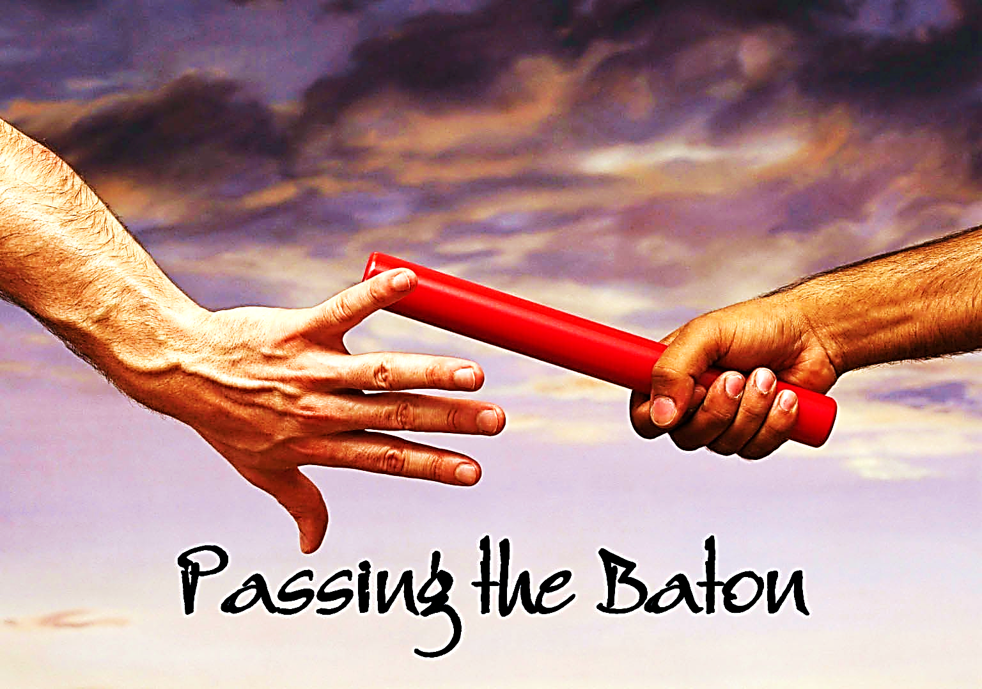
Faithful believers who died spreading the Gospel of Jesus Christ have passed our generation the baton.

Slide 24
“Since we are surrounded by so many examples of faith, we must get rid of everything that slows us down, especially sin that distracts us. We heer us on!must run the race that lies ahead of us and never give up.”
Heb. 12:1 (GW)
History’s Faithful Cheer Us On

Slide 25
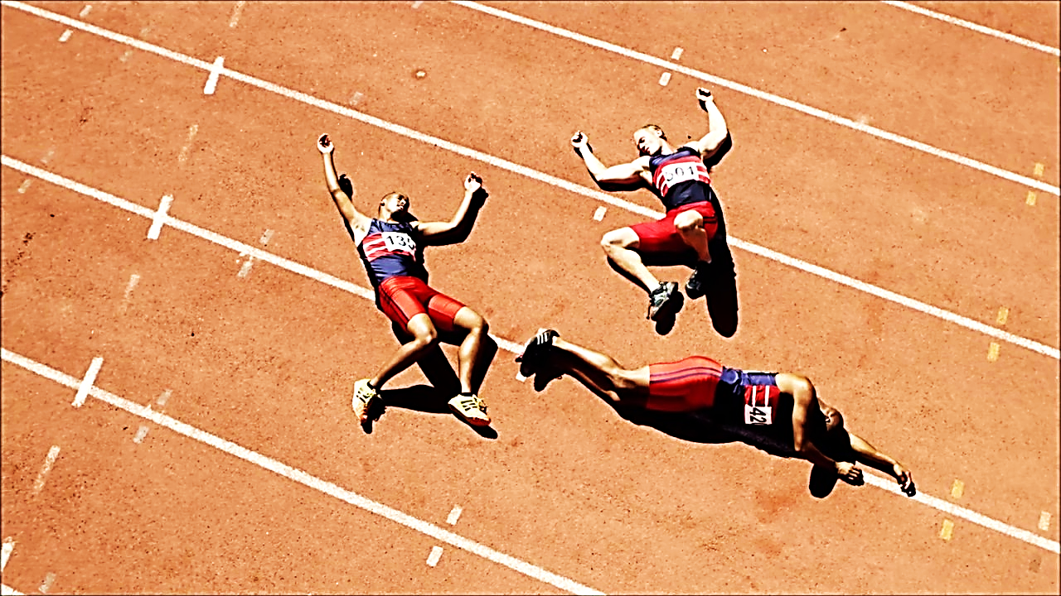
Believers (and whole churches) who are not moving forward in God’s call to spread the Gospel, are in the process of dying on the track.

Slide 26
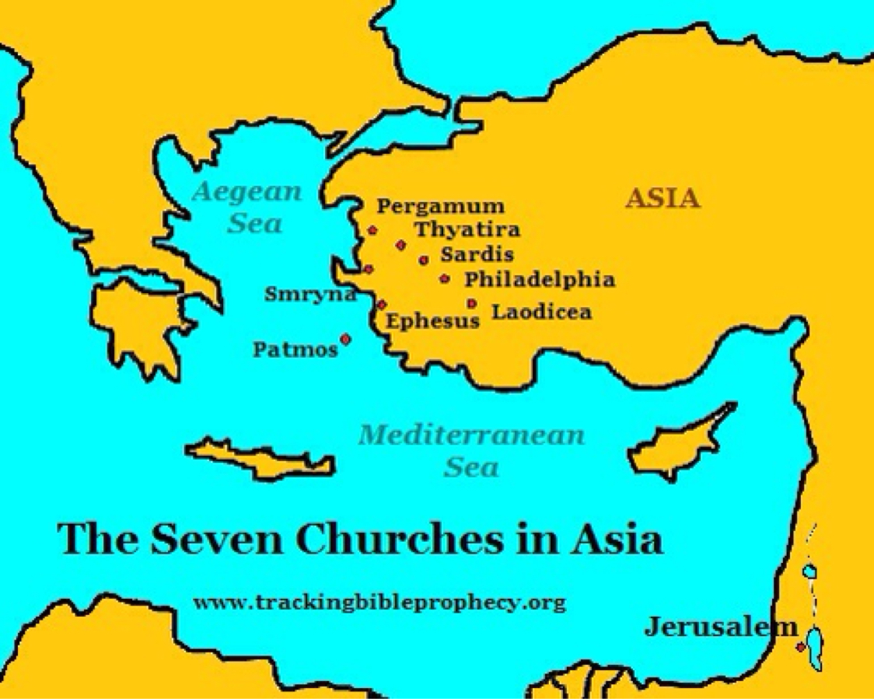
The letters to the Seven Churches (in the book of Revelation) show us five churches that are dying and two that are continuing in God’s calling.

Slide 27
Of these, the grandest, richest church is a dying church.

Slide 28
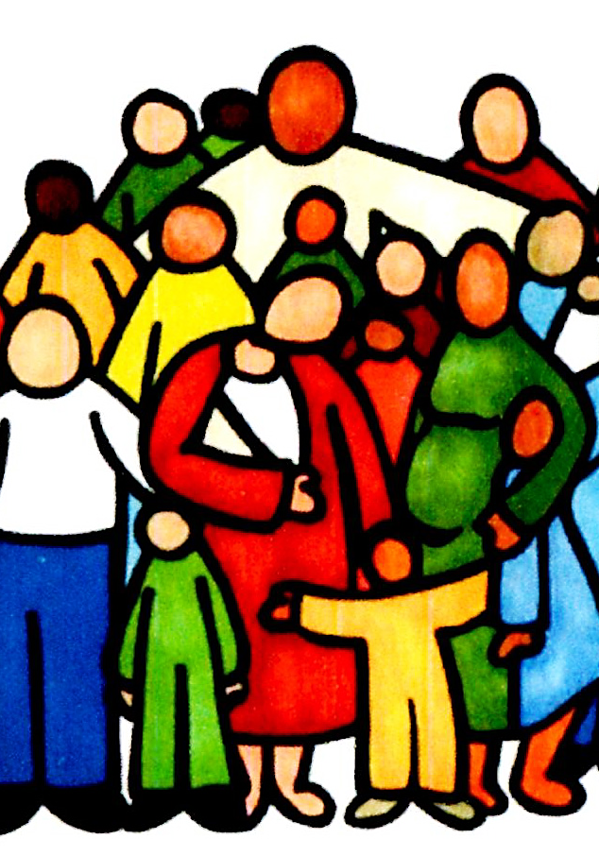
In contrast, the church about to lose everything and perish from the earth, is the strongest runner.

Slide 29
Each church started with real zeal for Christ’s work, but eventually they became cool and even corrupt— most were dying.

Slide 30
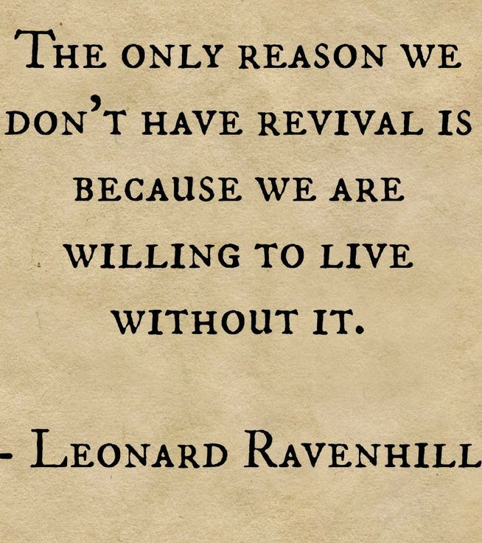
Likewise, carnal interests have eventually decayed every revival movement in history.

Slide 31
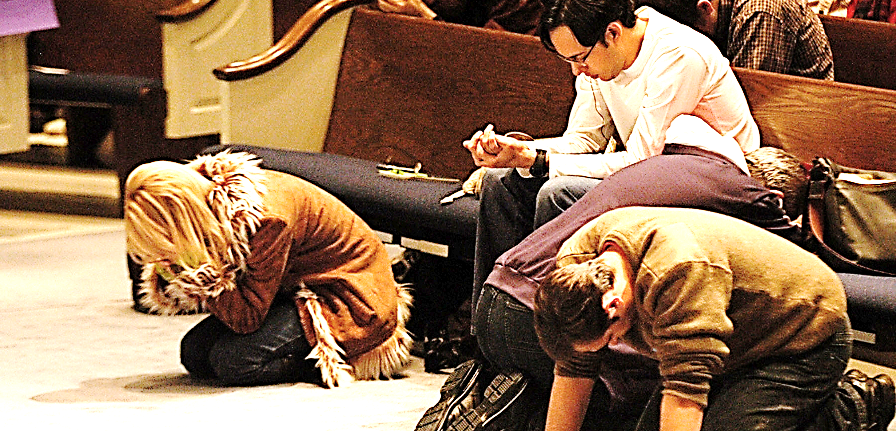
Unless there is prayer, repentance & strong intervention, every growing church and denomination, is subject to sin’s decay.

Slide 32
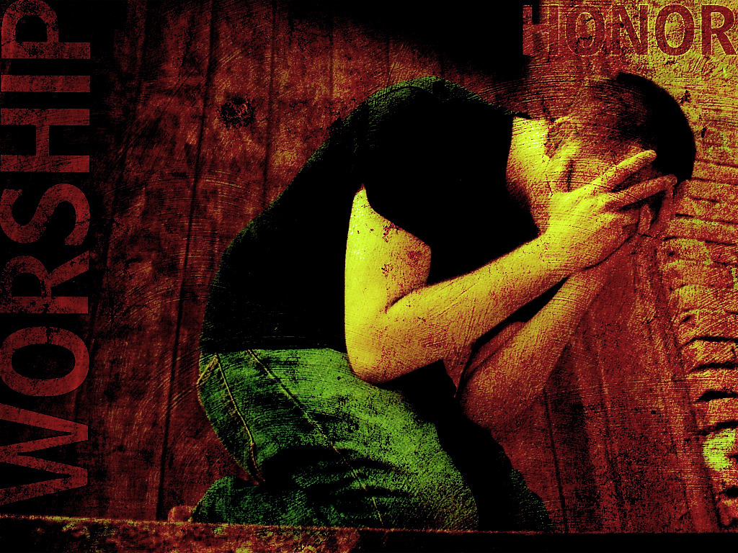
We must then repent and seek God for both cleansing from our sin and renewal of zeal for Christ’s work.

Slide 33
A Vision of Jesus
While John was in exile on the island of Patmos. He saw Jesus who gave him a message for each of the seven churches of Asia. Churches just like ours today.

Slide 34
Upon examination of the Revelation text, we will see that John’s description of Jesus shows that Jesus, Himself, is exactly what each of these churches needs to get healthy and be strong to the finish.

Slide 35
The Vision
“…I saw seven golden lampstands, and in the midst of the lampstands (churches) one like a son of man, clothed with a long robe and with a golden sash around his chest…

Slide 36
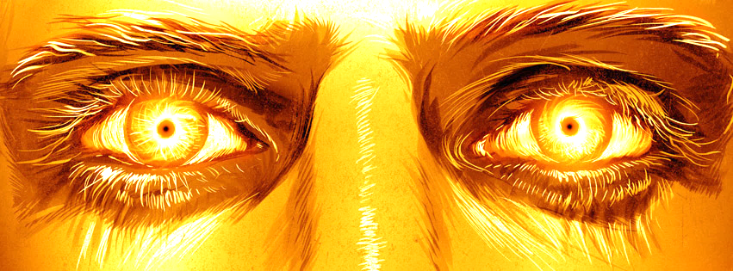
The hairs of his head were white, like white wool, like snow. His eyes were like a flame of fire, his feet were like burnished bronze, refined in a furnace, and his voice was like the roar of many waters…

Slide 37
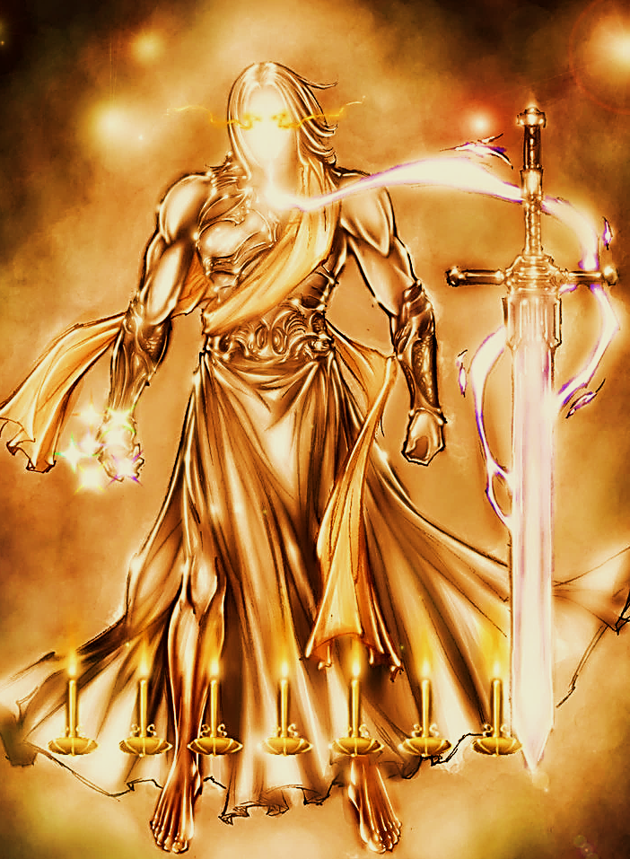
In his right hand he held seven stars, from his mouth came a sharp two-edged sword, and his face was like the sun shining in full strength…

Slide 38
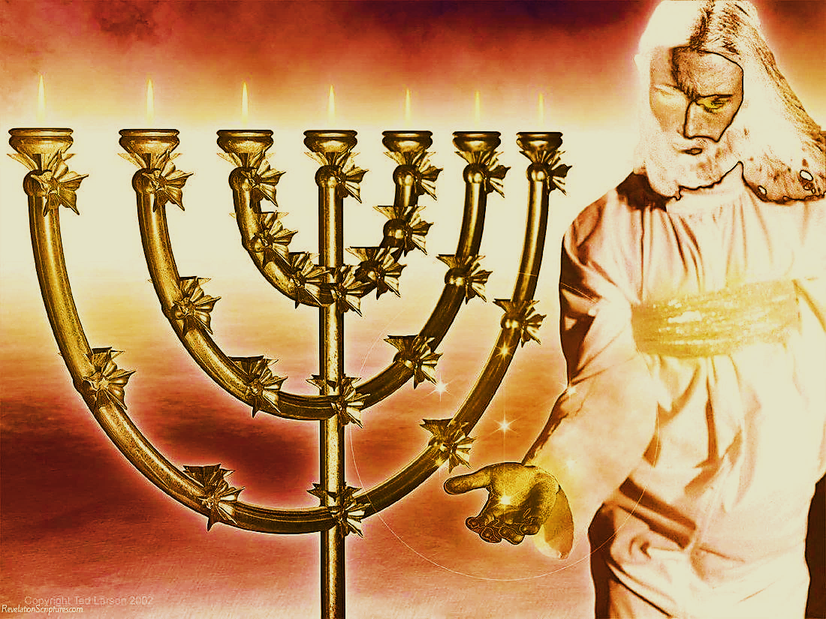
When I saw him, I fell at his feet as though dead. But he laid his right hand on me, saying, “Fear not, I am the first and the last, and the living one. I died, and behold I am alive forevermore, and I have the keys of Death and Hades…

Slide 39
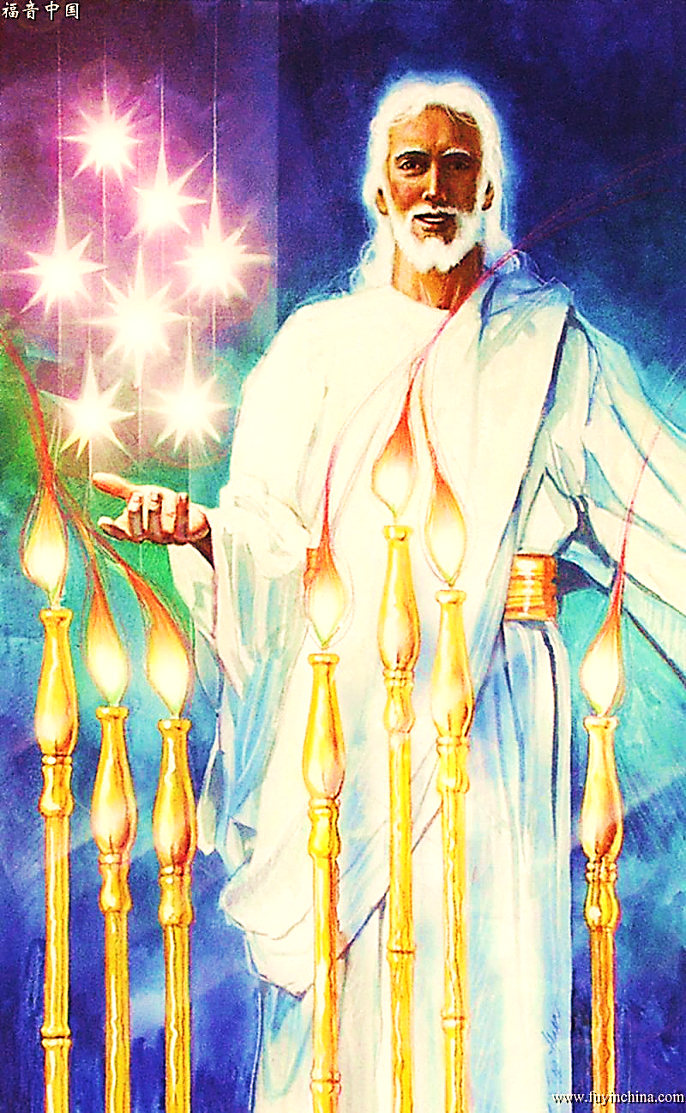
As for the mystery of the seven stars that you saw in my right hand, and the seven golden lampstands, the seven stars are the angels of the seven churches, and the seven lampstands are the seven churches.”
Rev. 1:11-18, 20 (ESV)

Slide 41
The Early Good Days:
“I know your works, your labor, your patience, and that you cannot bear those who are evil.
And you have tested those who say they are apostles and are not, and have found them liars
and you have persevered and have patience, and have labored for My name’s sake and have not become weary…

Slide 42
Ignored Spiritual Pride
Opposed Immorality
“But this you have, that you hate the deeds of the Nicolaitans, which I also hate.” Rev. 2:2, 3,6 (NKJV)
1) They worked hard, patiently & tirelessly
2) They hated sin, including immorality (the Nicolaitans) & spiritual pride (the professing apostles).

Slide 43
The Growing Problem
“Nevertheless, I have this against you, that you have left your first love.” Rev. 2:4 (NKJV)
Like someone who is married, dutiful, and committed, but no longer in love.

Slide 44
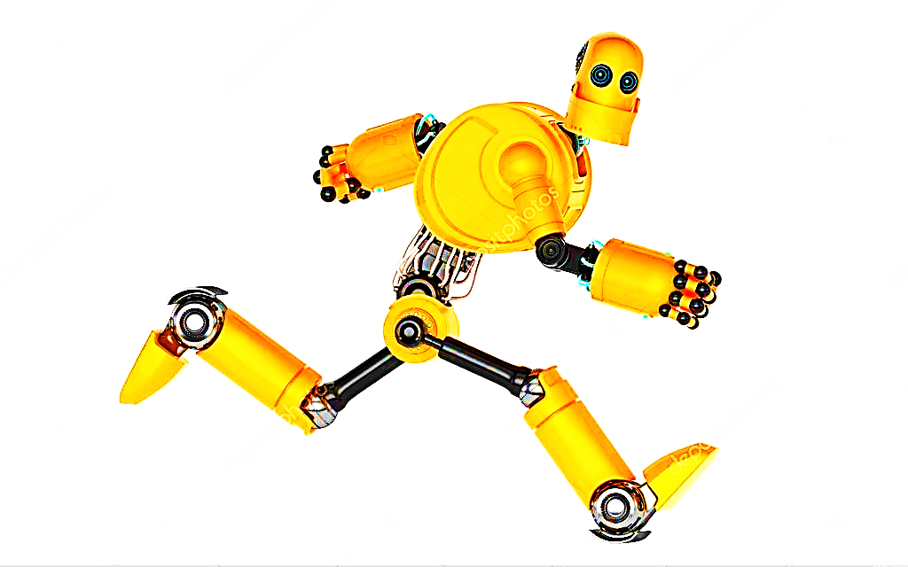
Runner Type
This runner is just going through the motions with a fixed “Christian” smile, but his heart is not engaged. His chest is empty.

Slide 45
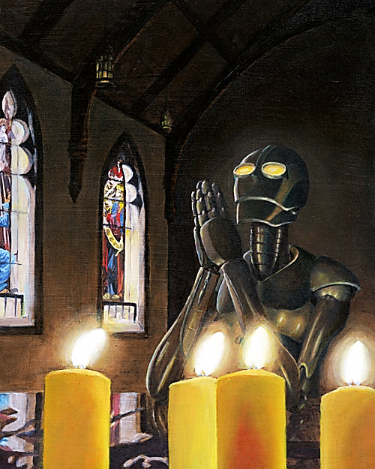
He is doing Christian works for works sake alone. These works are nothing more than heartless form and ritual with no feeling.

Slide 46
First Steps Back to God
“Remember therefore from where you have fallen; repent and do the first works…”
Rev. 2:5 (NKJV)

Slide 47
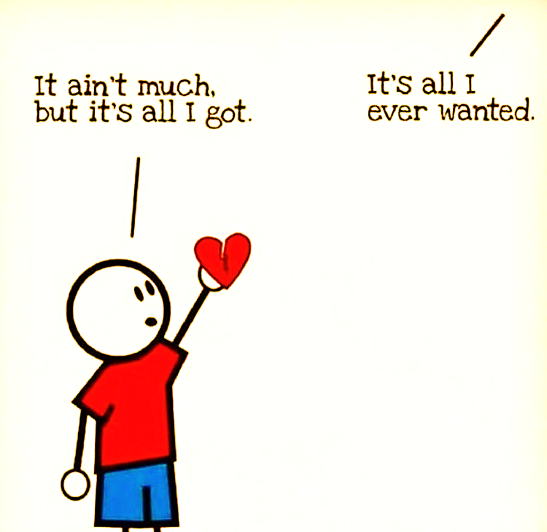
Jesus invites us to fall in love with him again.

Slide 48
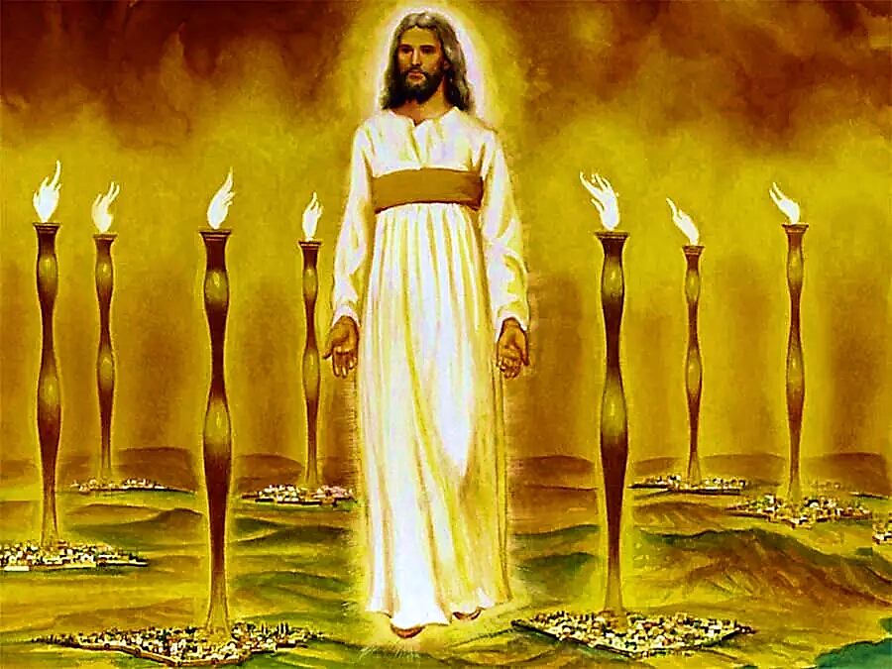
Christ, The Ultimate Motivation
He reminds them of His Presence
“These things says He who holds the seven stars in His right hand, who walks in the midst of the seven golden lampstands.” Rev. 2:1 (NKJV)

Slide 49
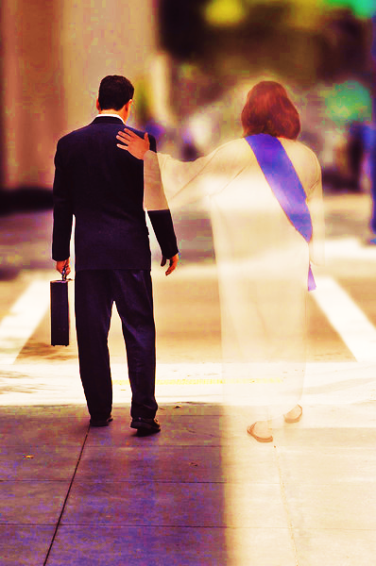
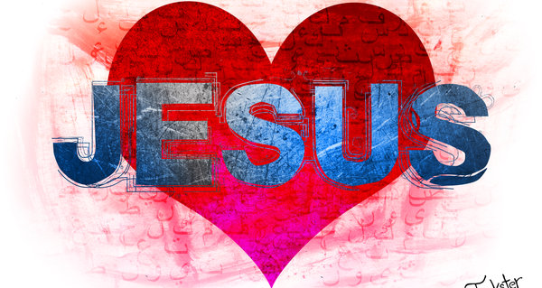
We need to remember that He walks beside us. He is a very present Savior. We must love Him from our hearts.

Slide 50
Song: We Press On
Video Goes Here Title: We Press On Download Here:
https://youtu.be/COIdnloge8A

Slide 51
Is Jesus
Speaking to You?
“They said to each other, ‘Did not our hearts burn within us while he talked to us on the road, while he opened to us the Scriptures?’”
John Wesley Said:
“…the preacher was describing the change which God works in the heart through faith in Christ and I felt my heart strangely warmed.”
Jesus makes His presence Known by a small voice!

Slide 53
What is the Sinner‘s Prayer?
This is a prayer we can pray when we are ready to admit we are sinners and need Christ’s forgiveness.
It must be prayed with faith in our hearts and a readiness to have a life-changing encounter with Jesus Christ.

Slide 54
A prayer of faith → Pray this prayer if :
If you never have before
You have in the past, but you think it would mean more today
You have been walking afar off and you want to come back
You want to set an example & show others how it is done
You just like to give your heart to Jesus again & again
Faith

Slide 55
We Declare Our Faith Publicly Because Jesus Declared His LOVE Publicly
“If you stand before others and are willing to say you believe in me, then I will tell my Father in heaven that you belong to me.” Mat 10:32

Slide 56
Three Important Questions
Do you want to know Jesus as your Savior right now?
Do you believe He died to save you from your sins & that He rose from the dead?
Do you believe that He is here, waiting to save you right now?

Slide 57
The Prayer of a Sinner Turning to Jesus
Dear Jesus, I know that I have sinned against You and that my sins separate me from You.
I am truly sorry.
Right now, I turn away from my sinful past .
Please forgive me, and help me to keep from sin.
I believe You died for my sins.
I Believe You rose from the dead, you are alive, and you hear this prayer from my heart.
I invite You Jesus to be both my Savior and the Lord of my life.
I want You to rule my life from now on.

Slide 58
“But some people did accept him. They believed in him, and he gave them the right to become children of God.”
John 1:12

Slide 60
“If you openly say, ‘Jesus is Lord’ and believe in your heart that God raised him from death, you will be saved.”
Rom. 10:9
What did you learn today?
What about the race before us?
What have you been thinking about God lately?
What do you want to tell others about Jesus?

Slide 61
Let’s Close in Prayer

Slide 62
Note: After you download the slideshow, you may also need to download some videos from YouTube & add them into this PowerPoint. This tool can help you: Free YouTube Download
We present these messages in outdoor venues using the SonShineTent. Watch the video of our service that goes with this message, click here: http://campaignkerusso.org/?p=14739
We would love to know more about the people who download our lessons & sermons. We invite you to email us & let us know where & how you use them.
info@campaignkerusso.org

