Slide 1
(Including: Signs of a Dying Church)
Part 2 – Four More Churches
Running Out of Steam

Slide 2
Note: After you download the slideshow, you may also need to download some videos from YouTube & add them into this PowerPoint. This tool can help you: Free YouTube Download
We present these messages in outdoor venues using the SonShineTent. Watch the video of our service that goes with this message, click here: http://campaignkerusso.org/?p=14739
We would love to know more about the people who download our lessons & sermons. We invite you to email us & let us know where & how you use them.
info@campaignkerusso.org

Slide 3
Welcome All

Slide 4
Let’s Begin with Prayer

Slide 5
(Including: Signs of a Dying Church)
Part 2 – Four More Churches
Running Out of Steam

Slide 6
First, a Review…

Slide 7
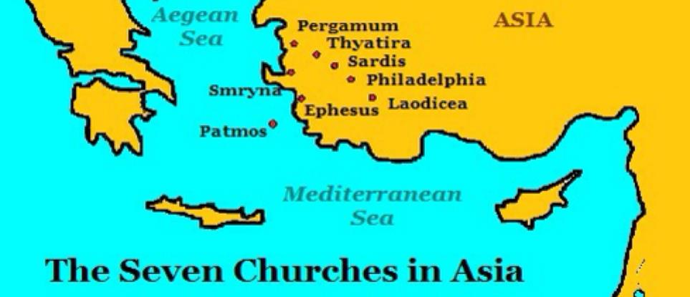
While John was in exile on the island of Patmos. He saw Jesus who gave him a message for each of the seven churches of Asia. Churches just like ours today.

Slide 8
Upon examination of the Revelation text, we will see that John’s description of Jesus shows that Jesus, Himself is exactly what each of these churches needs to get healthy and be strong to the finish.

Slide 9
The Vision
“…I saw seven golden lampstands, and in the midst of the lampstands (churches) one like a son of man, clothed with a long robe and with a golden sash around his chest…

Slide 10
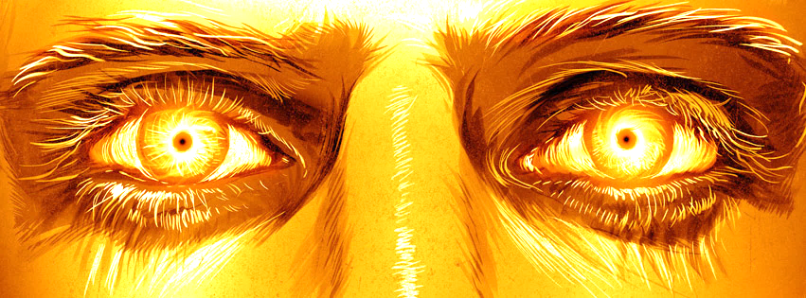
The hairs of his head were white, like white wool, like snow. His eyes were like a flame of fire, his feet were like burnished bronze, refined in a furnace, and his voice was like the roar of many waters…

Slide 11
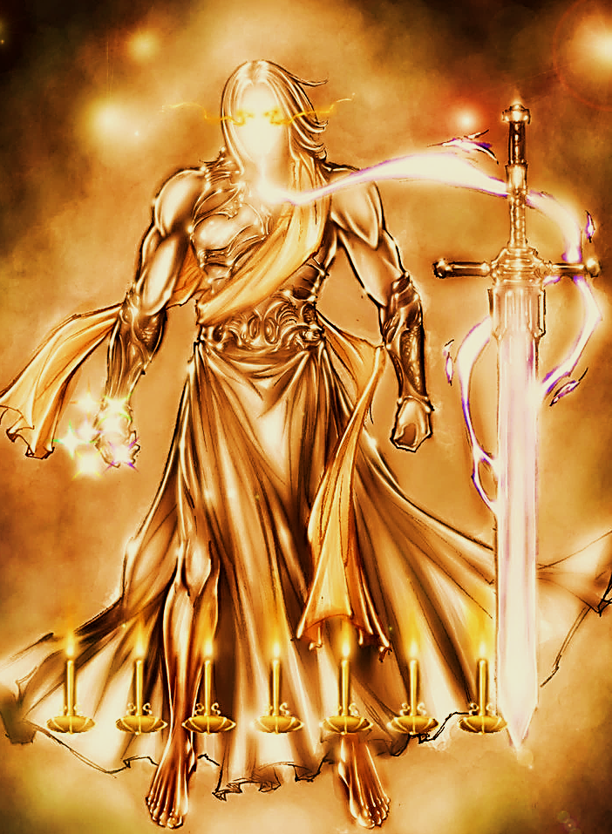
In his right hand he held seven stars, from his mouth came a sharp two-edged sword, and his face was like the sun shining in full strength…

Slide 12
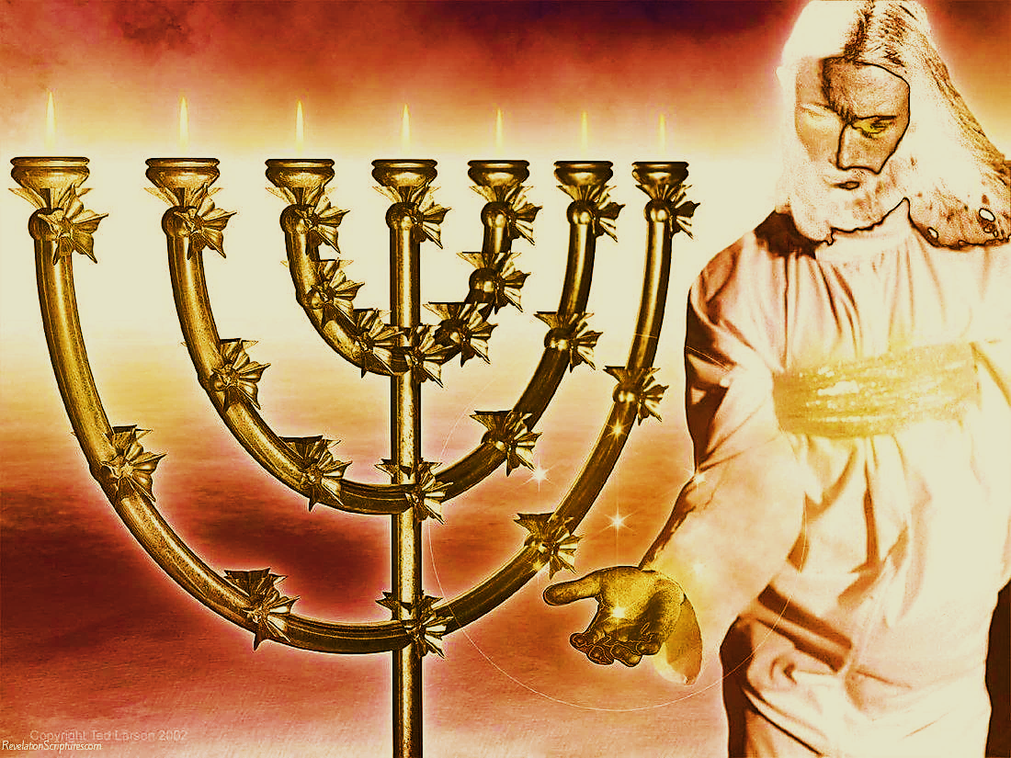
When I saw him, I fell at his feet as though dead. But he laid his right hand on me, saying, “Fear not, I am the first and the last, and the living one. I died, and behold I am alive forevermore, and I have the keys of Death and Hades…

Slide 13
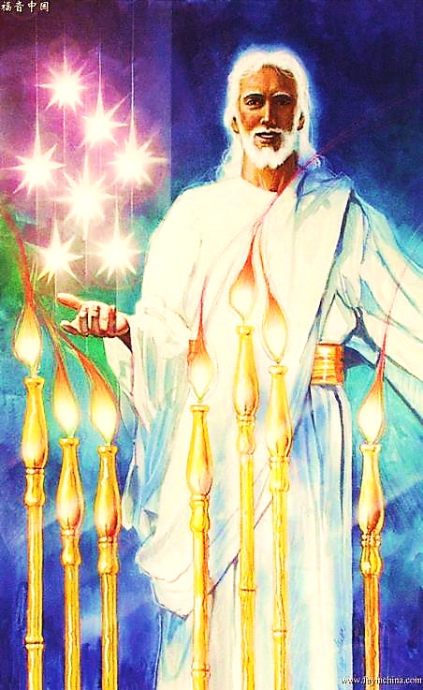
As for the mystery of the seven stars that you saw in my right hand, and the seven golden lampstands, the seven stars are the angels of the seven churches, and the seven lampstands are the seven churches.”
Rev. 1:11-18, 20 (ESV)

Slide 14
Done
Now

Slide 16
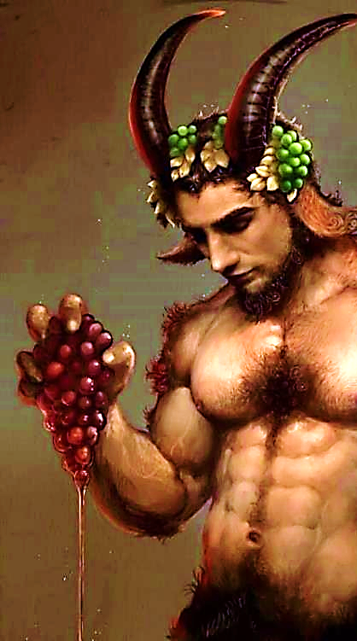
The Early Good Days
“I know your works, and where you dwell, where Satan’s throne is. And you hold fast to My name, and did not deny My faith even in the days in which Antipas was My faithful martyr, who was killed among you, where Satan dwells.” Rev. 2:13

Slide 17
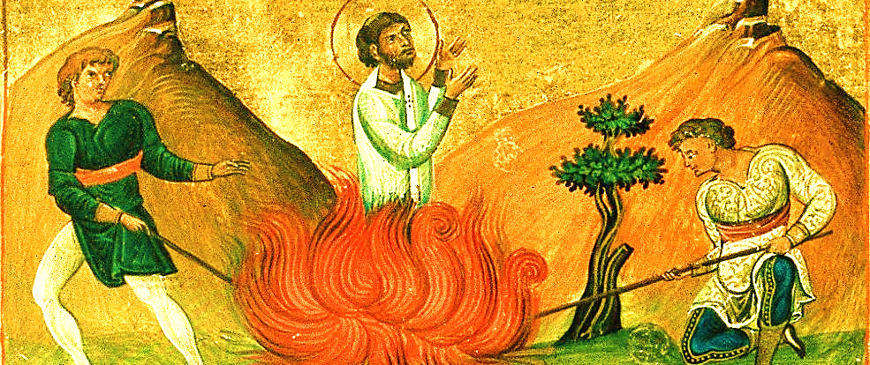
Although they were surrounded by immorality and idol worship, they held to the faith.
One brother (Antipas) even died for the faith.

Slide 18
The Growing Problem
“I do have a few things against you. Some of you are following the teaching of Balaam. Long ago he told Balak to teach the people of Israel to eat food that had been offered to idols and to be immoral.” Rev. 2:14 (CEV)

Slide 19
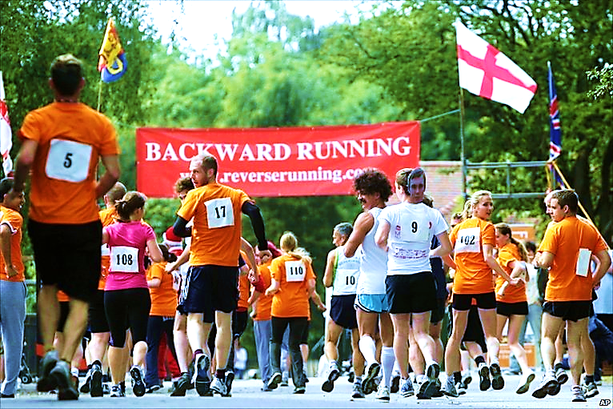
Runner Type
This runner is running backward.
He is slipping back into his old life.
“…I myself don’t think I’ve reached it, but I do this one thing: I forget about the things behind me and reach out for the things ahead of me.”
Phil. 3:13

Slide 20
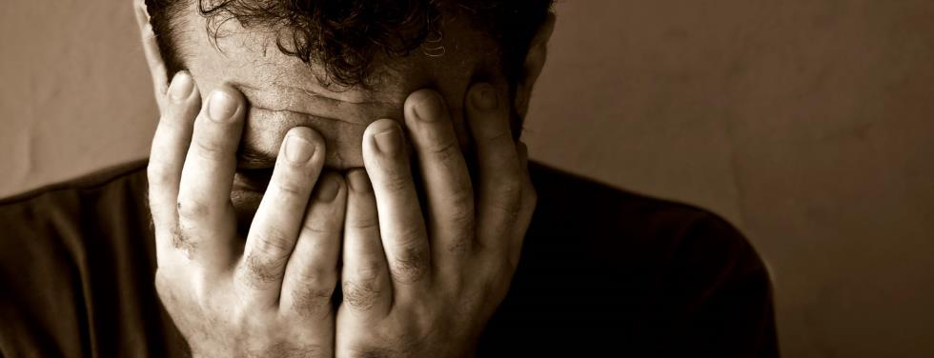
First Steps Back to God
“Repent, or else I will come to you quickly and will fight against them with the sword of My mouth.” Rev. 2:13 (NKJV)
“For the word of God is living and active, sharper than any double-edged sword, piercing until it divides soul and spirit, joints and marrow, as it judges the thoughts and purposes of the heart.”
Or… No More Excuses! Heb. 4:12

Slide 21
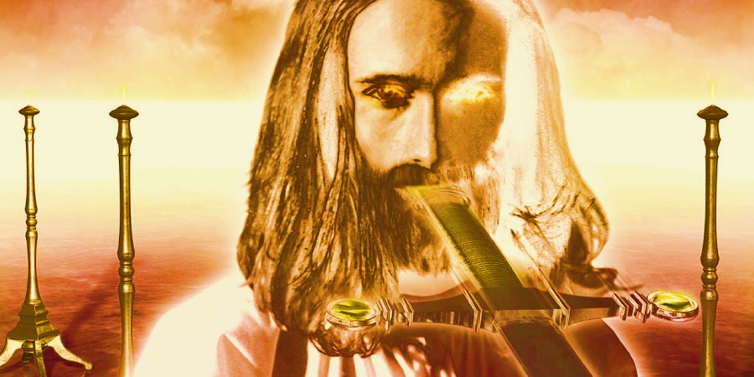
Christ, The Ultimate Motivation
He reminds them of His Sharp Word
“And to the angel of the church in Pergamos write; These things saith he which hath the sharp sword with two edges” Rev. 2:1 (NKJV)

Slide 23
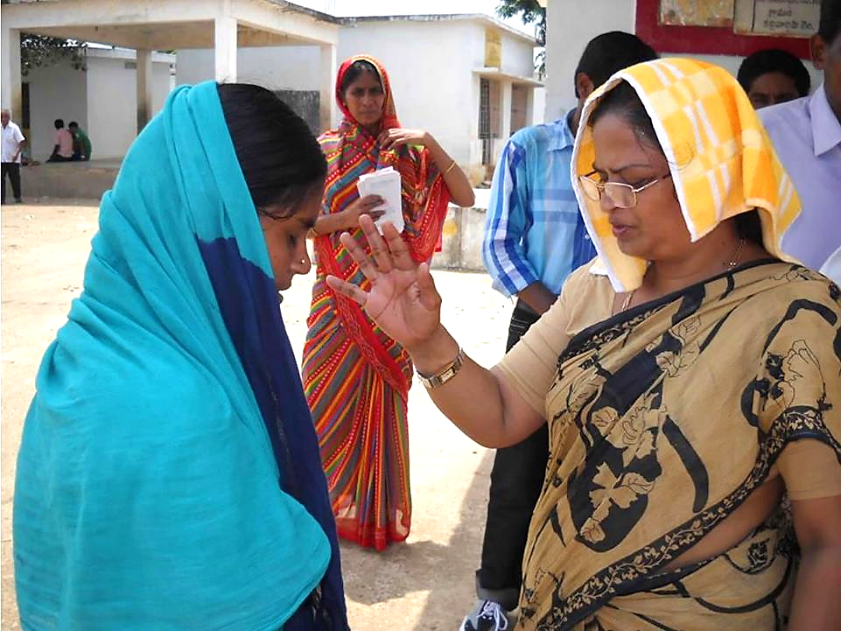
The Early Good Days
“I know thy works, and charity, and service, and faith, and thy patience, and thy works; and the last to be more than the first.” Rev. 2:19 (NKJV)

Slide 24
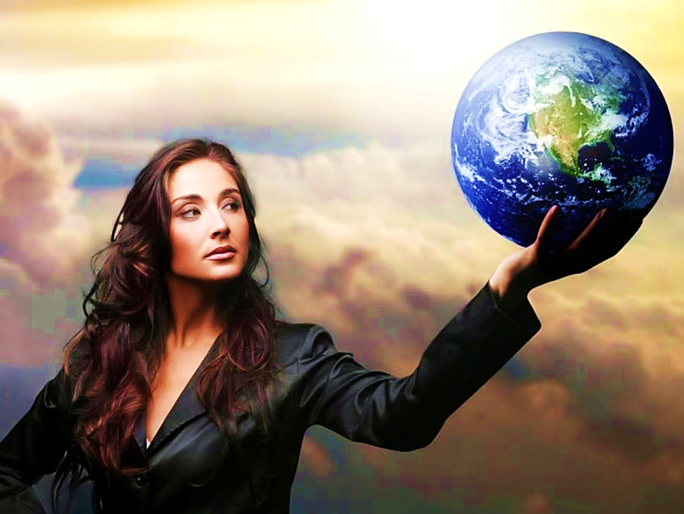
The Growing Problem: Spiritual Pride
“Notwithstanding I have a few things against thee, because thou sufferest that woman Jezebel, which calleth herself a prophetess, to teach and to seduce my servants to commit fornication…idols” Rev. 2:20 (NKJV)
Spiritual Pride always leads to idolatry!

Slide 25
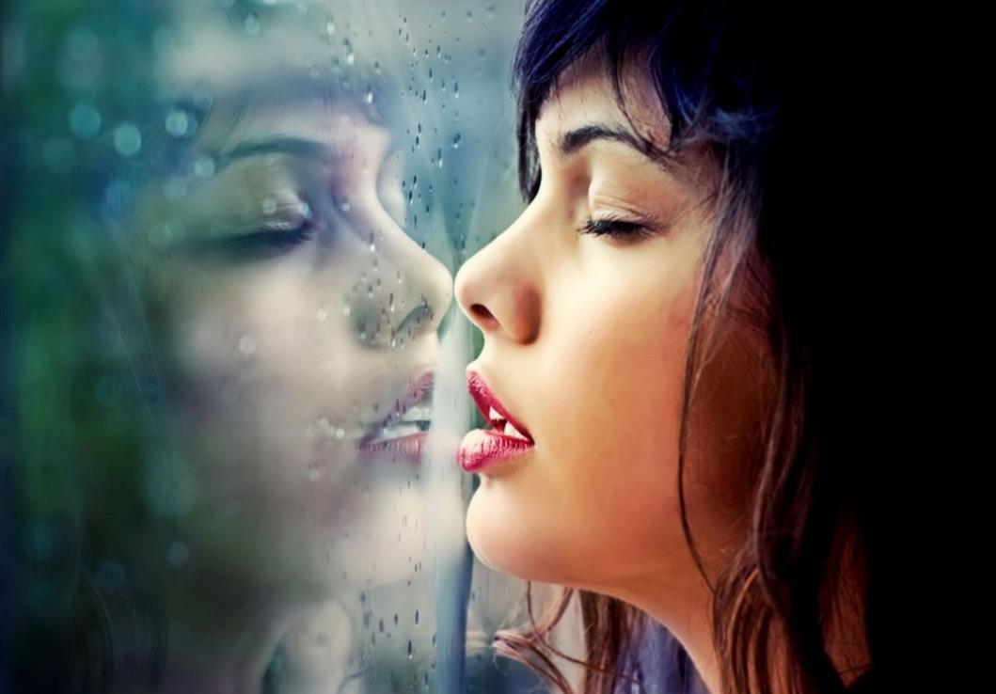
Runner Type
Along the way, this runner got distracted by her own reflection.
She spent so much time idolizing herself, she forgot about the Lord’s race.
Spiritual Pride is a deep & dark sin… and extremely difficult to overcome.

Slide 26
Back to God:
He simply tells the rest of the church to maintain their good works.
“…unto the rest in Thyatira, as many as have not this doctrine, and which have not known the depths of Satan, …I will
put upon you none other burden.
But that which ye have already… hold fast till I come.
And he that… keepeth my works unto the end, to him will I give power…
Rev.2:24-26

Slide 27
“These things saith the Son of God, who hath his eyes like unto a flame of fire, and his feet are like fine brass.” Rev. 1:18
Brass feet are a symbol of God’s judgement.
He tells those with spiritual pride that
He alone is God!
Christ, The Ultimate Motivation

Slide 28
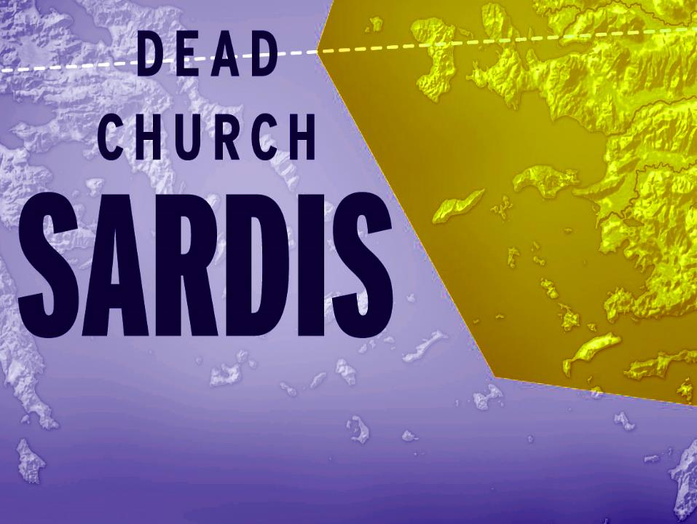

Slide 29
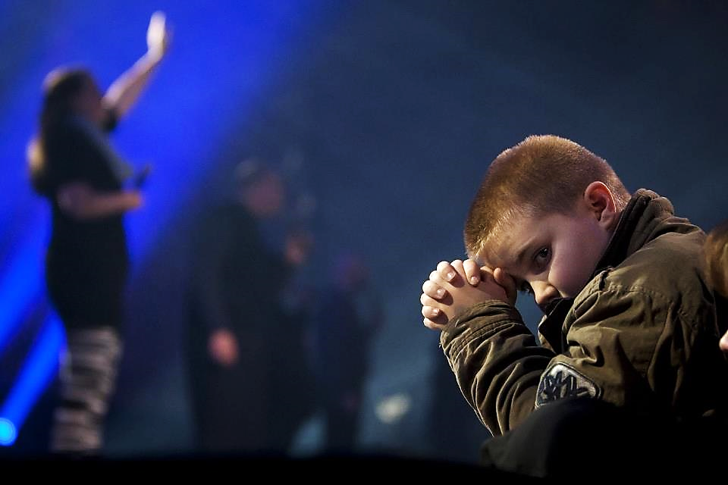
The Early
Good Days:
“…you have received and heard.”
That’s it—period!
They had not grown one bit or done one thing for the gospel since the day they professed Christ!

Slide 30
The Growing Problem
“You have a reputation for being alive, but in fact you are dead!
Wake up, and strengthen what remains, before it dies too!
For I have found what you are doing…
incomplete in the sight of my God.” Rev. 4:1 (CJB)

Slide 31
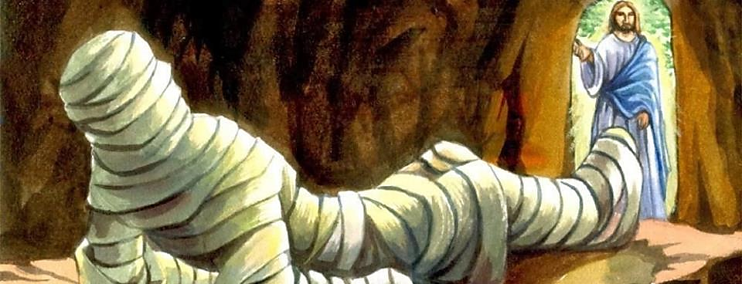
But God Can Turn Death Into “Sleep.”
“Then he said, ‘Our friend Lazarus has gone to sleep, but now I will go and waken him!’ The disciples, thinking Jesus meant Lazarus was having a good night’s rest, said, “That means he is getting better!” But Jesus meant Lazarus had died.” John 11:11-13 (TLB)

Slide 32
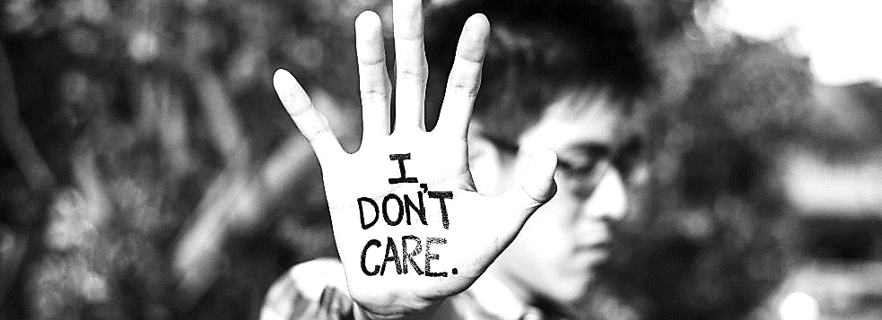
Dead Christians go by the name Christian, but…
They don’t care much about The Cross.
They don’t care about bible study.
They don’t care about prayer or worship.
They don’t’ care about evangelism.

Slide 33
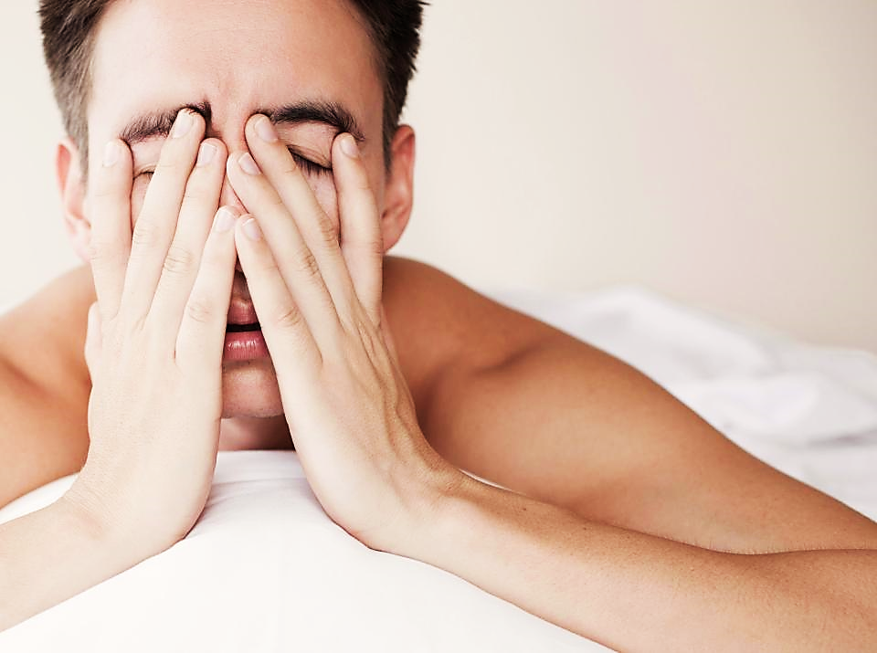
First Steps Back to God:
“Wake up, and strengthen what remains, before it dies too! Rev. 3:2 (CJB)

Slide 34
Sardis means “What Remains”:

Slide 35
Sardis means “What Remains”:
Start with your profession of faith and re-commit your life.

Slide 36
Sardis means “What Remains”:
Start with your profession of faith and re-commit your life.
Add Repentance of Sin

Slide 37
Sardis means “What Remains”:
Start with your profession of faith and re-commit your life.
Add Repentance of Sin
Add Study of God’s Word

Slide 38
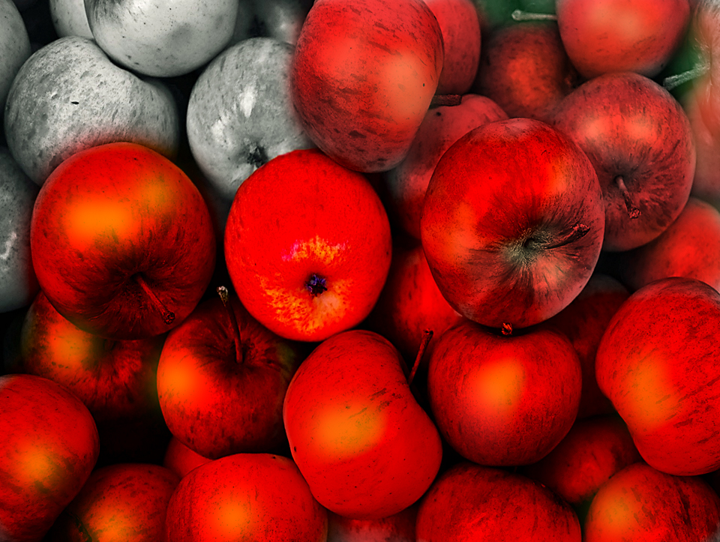
Sardis means “What Remains”:
Start with your profession of faith and re-commit your life.
Add Repentance of Sin
Add Study the Word of God
Add Prayer & Worship

Slide 39
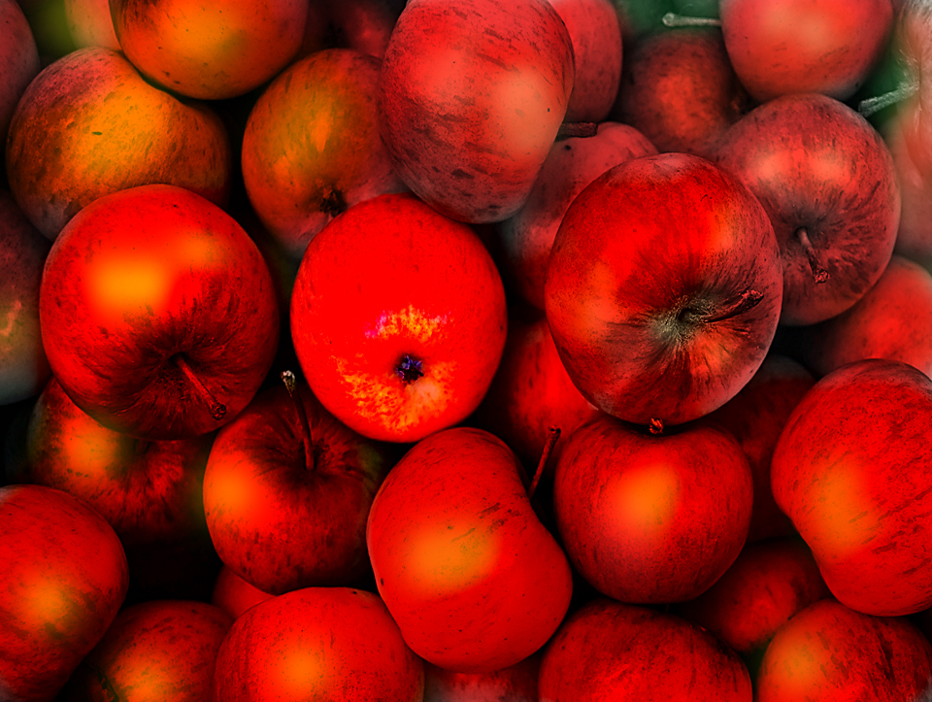
Sardis means “What Remains”:
Start with your profession of faith and re-commit your life.
Add Repentance of Sin
Add Study the Word of God
Add Prayer & Worship
Add Spreading the Gospel

Slide 40
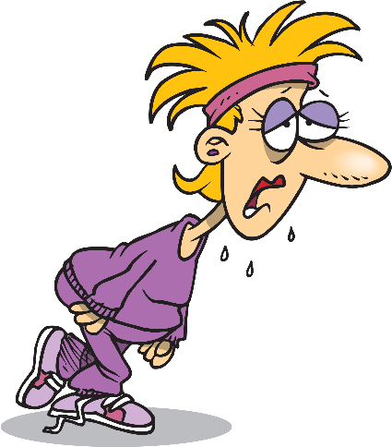
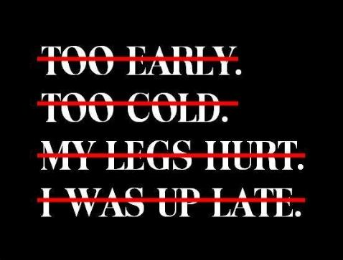
Runner Type
“For I have found what you are doing incomplete in the sight of my God.” Rev. 3:2 (CJB)
The Lazy Runner
She fell asleep on the track.

Slide 41
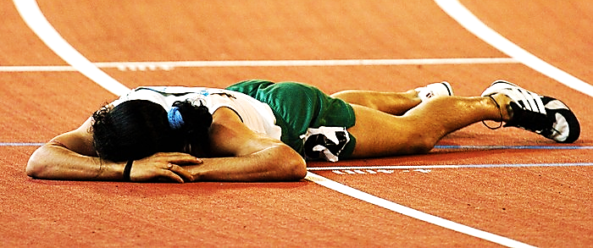
Wake Up or Die
“Wake up, and strengthen what remains, before it dies too!...
For if you don’t wake up, I will come like a thief; and you don’t know at what moment I will come upon you.” Rev. 3:2,3 (CJB)

Slide 42
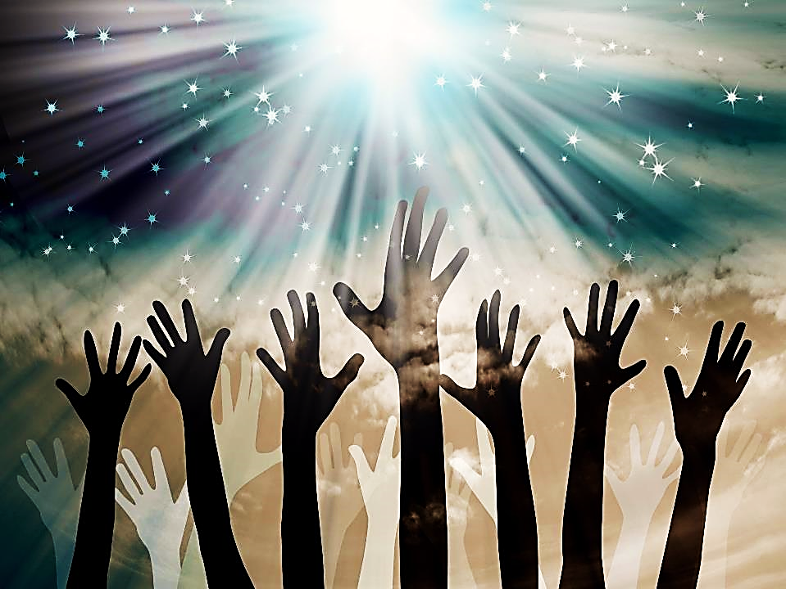
Christ, The Ultimate Motivation
“These things says He who has the seven Spirits of God and the seven stars.” Rev. 3:1
This is the Holy Spirit represented as seven spirits.
There is enough Holy Spirit for each of the seven churches to have their very own Holy Ghost revival.
Only the Holy Ghost can waken a sleeping church!

Slide 44
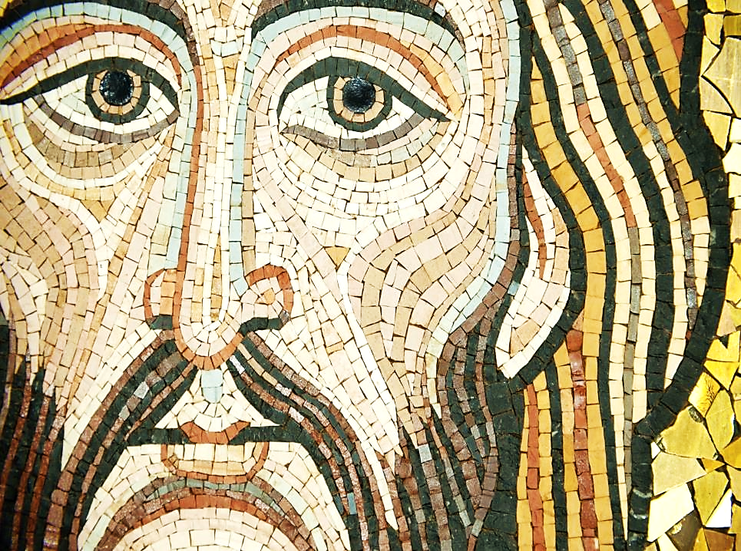
The Early Good Days?
This is the only church that Jesus doesn’t have one good thing to say about!

Slide 45
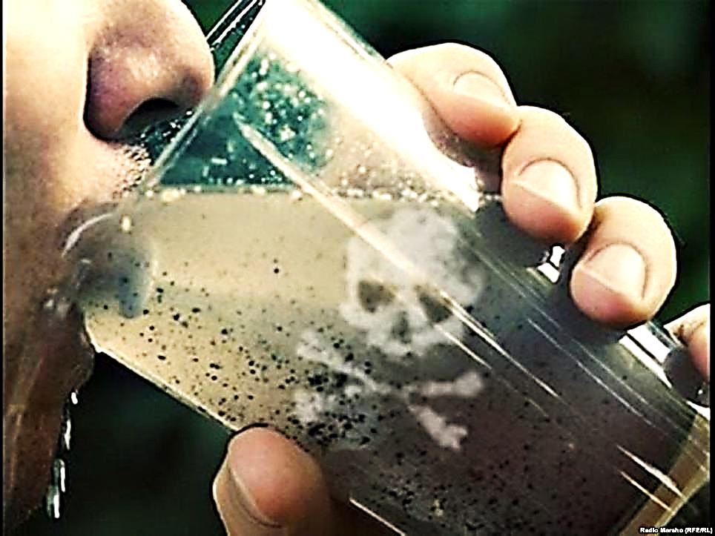
The Growing Problem:
Complacency!
“I know what you do. You are not hot or cold. I wish that you were hot or cold!
But you are only warm—not hot, not cold. So I am ready to spit you out of my mouth.” Rev. 3:15, 16
The City of Laodicea Had Bad Water

Slide 46
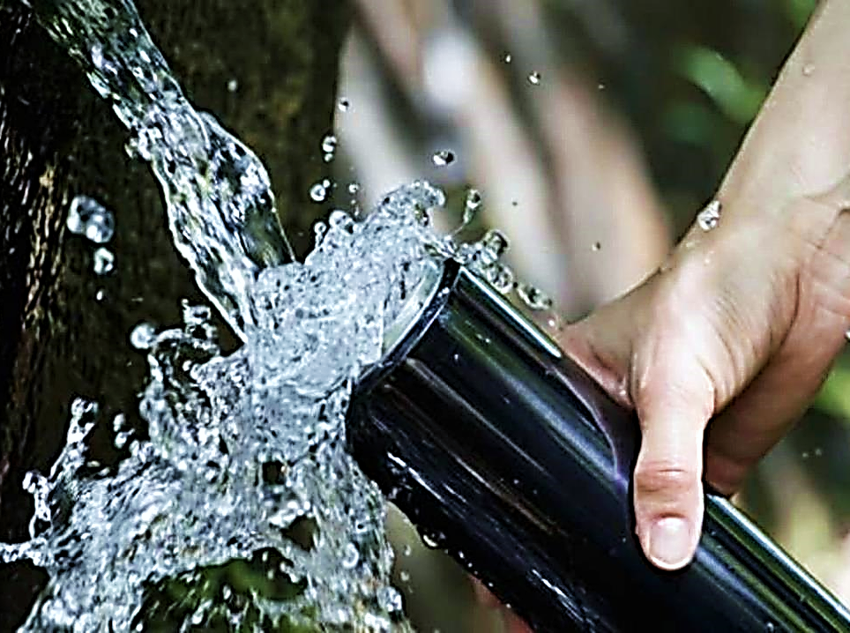
Nearby cities had hot or cold springs.
These extreme conditions purified their water.
Laodicea had warm, germy, unsafe water.

Slide 47
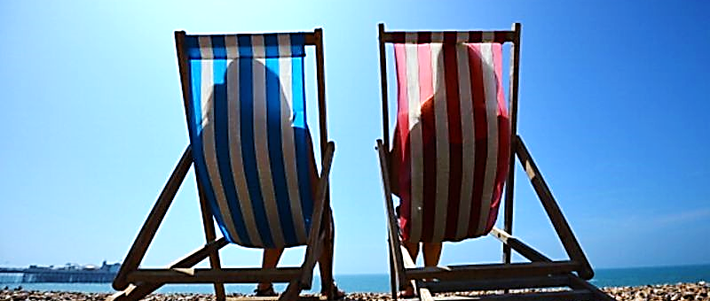
Laodicea was prosperous. A powerful and “successful” church of it’s time.
“You say you are rich. You think you have become wealthy and do not need anything. Rev. 3:17

Slide 48
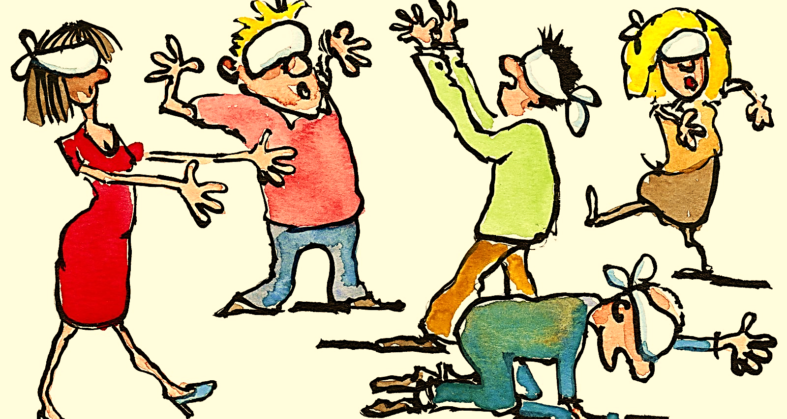
“But you do not know that you are really miserable, pitiful, poor, blind, and naked.” Rev. 3:17

Slide 49
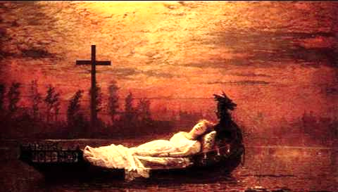
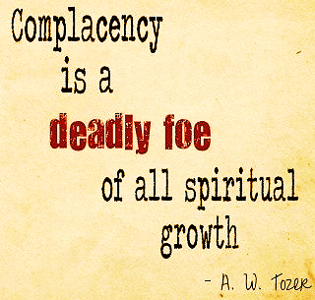
This person isn’t lazy, just complacent. She feels she is “blessed by God” and has served Him so well she can coast a while.

Slide 50
Germs grow in tepid conditions, but extreme environments (heat, cold) can cleanse them.
Likewise, sin grows when we loiter about, complacent, in our comfort zone.

Slide 51
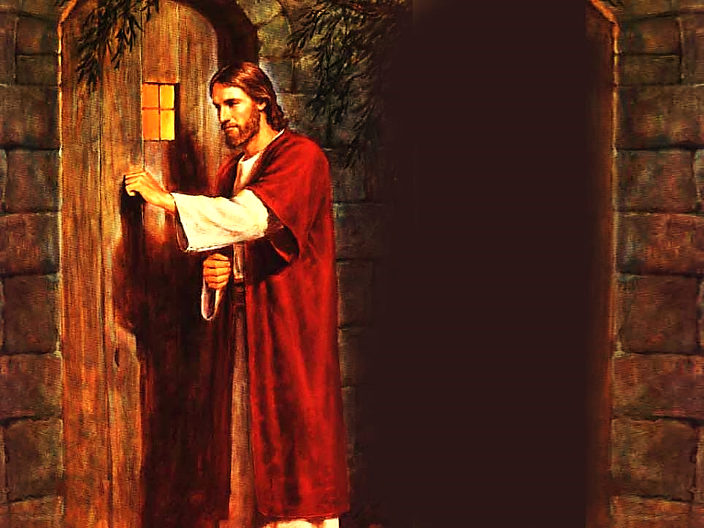
“Look! I am standing at the door and knocking. If anyone listens to my voice and opens the door, I will come in to him…” Rev. 3:20 (ISV)
They were the most “successful” church in the area, but Jesus never got in the door.

Slide 52
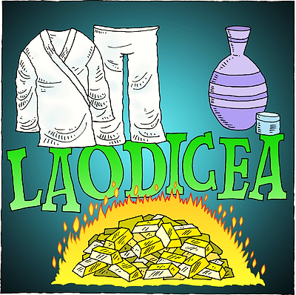
Most Still Needed Salvation:
“Therefore, I advise you to buy from me gold purified in fire so you may be rich, white clothes to wear so your shameful nakedness won’t show, and ointment to put on your eyes so you may see.” Rev. 3:18

Slide 53
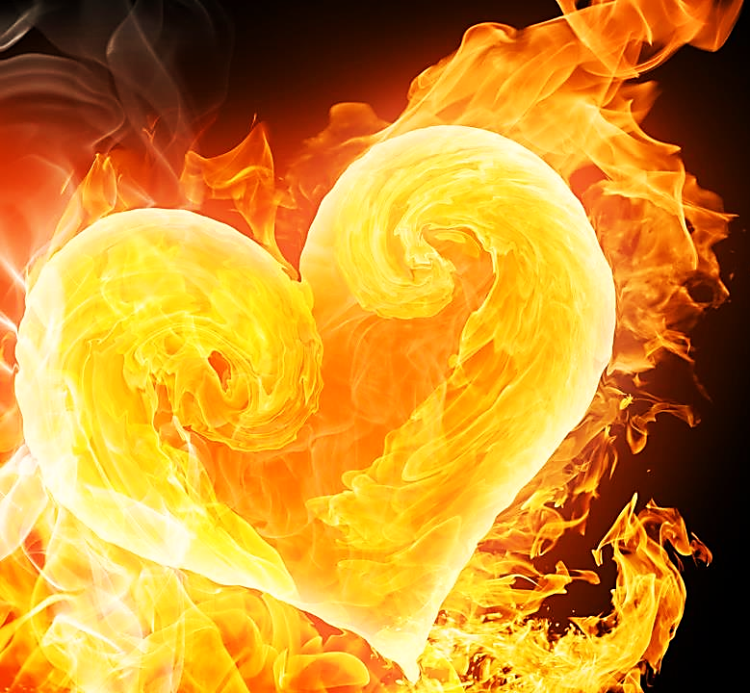
First Steps
Back to God:
Embrace Trials
“I advise you to buy gold from me—gold made pure in fire. Then you can be truly rich.”
Rev.3:18

Slide 54
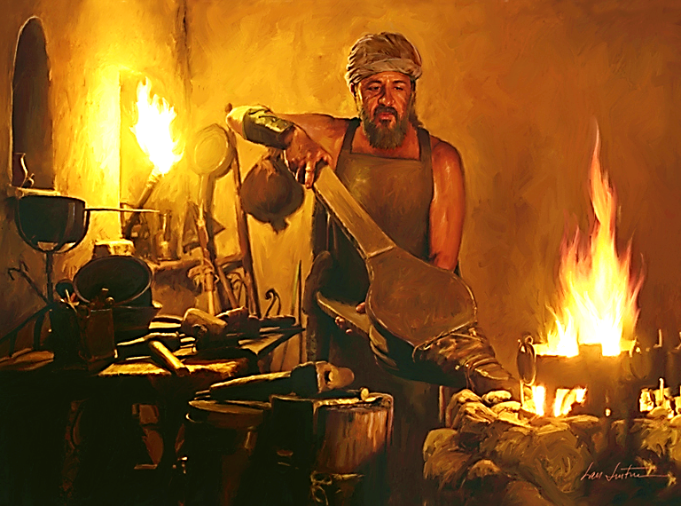
“He will act like a refiner and purifier of silver and will cleanse the Levites and refine them like gold and silver. Then they will offer the Lord a proper offering.
Mal. 3:3 (NET)

Slide 55
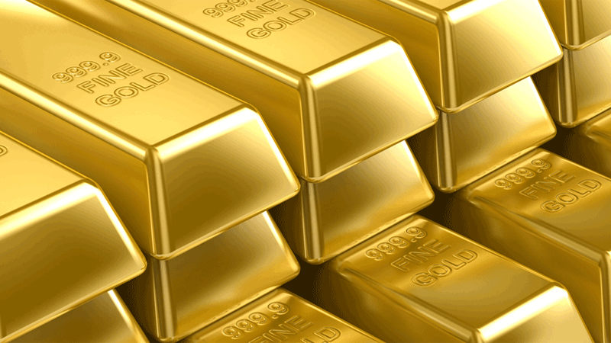
“That the trial of your faith (much more precious than gold which is tried by the fire) may be found unto praise and glory and honor at the appearing of Jesus Christ.” 1 Pet. 1:7 (DRA)
Sometimes, it takes trials to shake us up and bring closer to God.

Slide 56
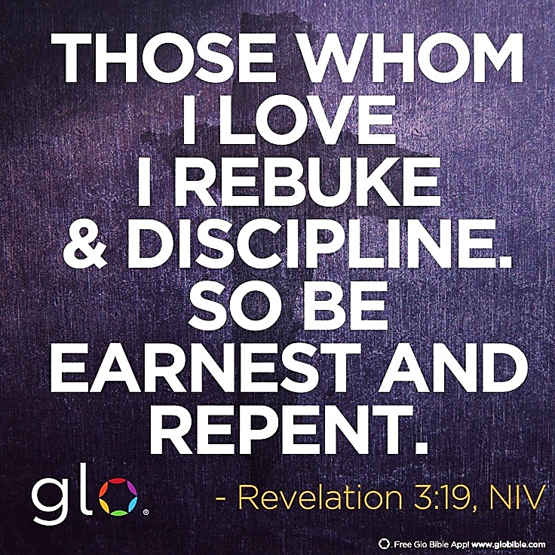

Slide 57
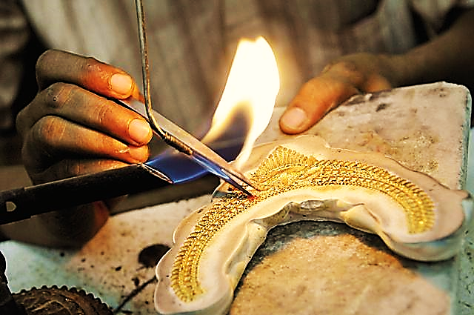
The gold is melted into formlessness so that the goldsmith might then be able to make something beautiful from it.
Sometimes the contaminated, lukewarm, complacent soul must be deconstructed so that he can be remade by our Maker.

Slide 58
Runner Type:
This runner stopped on the race track to do some “glamping” (glamor camping).
She will not be finishing the real race because she feels sure that, once they see what she was able to build all by herself, the judges will give her the prize.

Slide 59
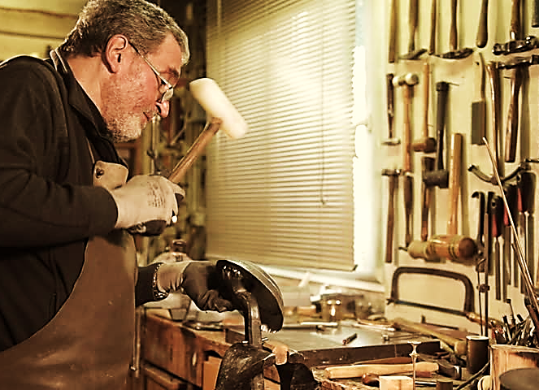
“These things says the Amen, the Faithful and True Witness, the Beginning of the creation of God.”
Rev. 3:14 (NKJV)
Our Creator can break us, melt us and make us again as worthy vessels.
Christ, The
Ultimate Motivation:

Slide 60
Song: Refiner’s Fire
Video Goes Here Title: Refiner’s Fire Download Here:
https://youtu.be/t6awdZ1cekk

Slide 61
Is Jesus
Speaking to You?
“They said to each other, ‘Did not our hearts burn within us while he talked to us on the road, while he opened to us the Scriptures?’”
John Wesley Said:
“…the preacher was describing the change which God works in the heart through faith in Christ and I felt my heart strangely warmed.”
Jesus makes His presence Known by a small voice!

Slide 63
What is the Sinner‘s Prayer?
This is a prayer we can pray when we are ready to admit we are sinners and need Christ’s forgiveness.
It must be prayed with faith in our hearts and a readiness to have a life-changing encounter with Jesus Christ.

Slide 64
A prayer of faith → Pray this prayer if :
If you never have before
You have in the past, but you think it would mean more today
You have been walking afar off and you want to come back
You want to set an example & show others how it is done
You just like to give your heart to Jesus again & again
Faith

Slide 65
We Declare Our Faith Publicly Because Jesus Declared His LOVE Publicly
“If you stand before others and are willing to say you believe in me, then I will tell my Father in heaven that you belong to me.” Mat 10:32

Slide 66
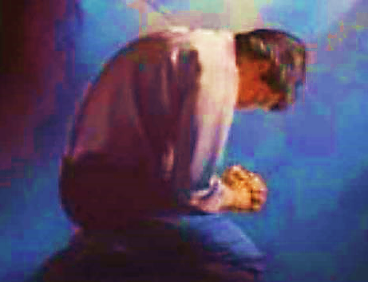
Three Important Questions
Do you want to know Jesus as your Savior right now?
Do you believe He died to save you from your sins & that He rose from the dead?
Do you believe that He is here, waiting to save you right now?

Slide 67
The Prayer of a Sinner Turning to Jesus
Dear Jesus, I know that I have sinned against You and that my sins separate me from You.
I am truly sorry.
Right now, I turn away from my sinful past .
Please forgive me, and help me to keep from sin.
I believe You died for my sins.
I Believe You rose from the dead, you are alive, and you hear this prayer from my heart.
I invite You Jesus to be both my Savior and the Lord of my life.
I want You to rule my life from now on.

Slide 68
“But some people did accept him. They believed in him, and he gave them the right to become children of God.”
John 1:12

Slide 70
“If you openly say, ‘Jesus is Lord’ and believe in your heart that God raised him from death, you will be saved.”
Rom. 10:9
What did you learn today?
What about…
What have you been thinking about God lately?
What do you want to tell others about Jesus?

Slide 71
Let’s Close in Prayer

Slide 72
Note: After you download the slideshow, you may also need to download some videos from YouTube & add them into this PowerPoint. This tool can help you: Free YouTube Download
We present these messages in outdoor venues using the SonShineTent. Watch the video of our service that goes with this message, click here: http://campaignkerusso.org/?p=14739
We would love to know more about the people who download our lessons & sermons. We invite you to email us & let us know where & how you use them.
info@campaignkerusso.org

