Slide 2
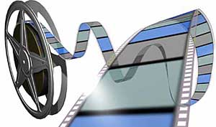
Note: After you download the slideshow, you may also need to download some videos from YouTube & add them into this PowerPoint. This tool can help you: Free YouTube Download
We present these messages in outdoor venues using the SonShineTent. Watch the video of our service that goes with this message here: http://campaignkerusso.org/?p=13908
We would love to know more about the people who download our lessons & sermons. We invite you to email us & let us know where & how you use them.
info@campaignkerusso.org

Slide 3
Welcome All

Slide 4
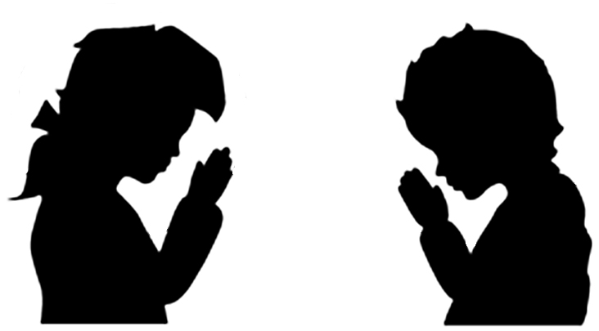
Let’s Begin with Prayer

Slide 6
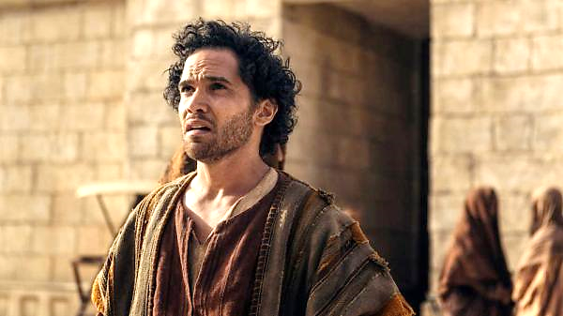
Four People Who Honored God with Their Very Lives

Slide 7
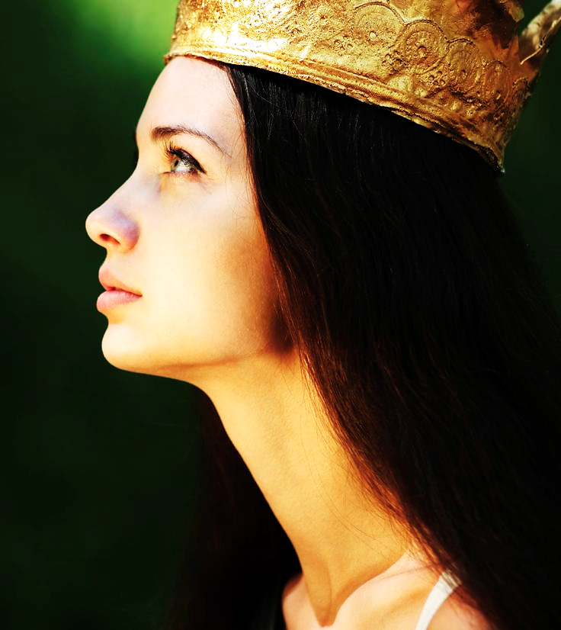
Book of Esther Esther was called upon to intervene for her people, the Jews, who were about to be slaughtered.
Notes:
Esther and Uncle Mordecai are Jews in captive Persia .
She becomes queen to king Ahesuerus, but a Jew
uncle refuses to bow to the Kings assistant Haman
10,000 sliver talents to destroy Jews-Esther also Jew
Esther called upon to enter Kings court (without permission)
Esther goes anyway to intercede for her people “for such a time as this”

Slide 8
Next Slide – Video: Esther Honors God Download Here:
https://youtu.be/eWHokANW6Dw

Slide 9
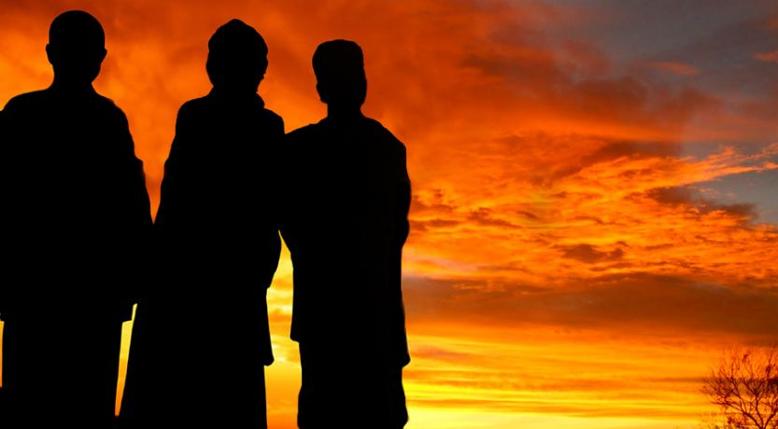
Book of Daniel
Daniel’s friends took a stand against idol worship.
Notes:
Daniel, a Jew in Babylon
King Nebuchadnezzar
Three friends, Shadrach Meshach Abed-Nego
Giant Golden idol of the King
At sound of the trumpet all must bow
The three friends won’t bow
Thrown in furnace
Nebuchadnezzar:
Didn’t I put three in furnace? Fourth man, looks like God!

Slide 10
Next Slide – Video: Hebrew Children Honor God Download Here:
https://youtu.be/GJ3ipCxp2KY

Slide 11
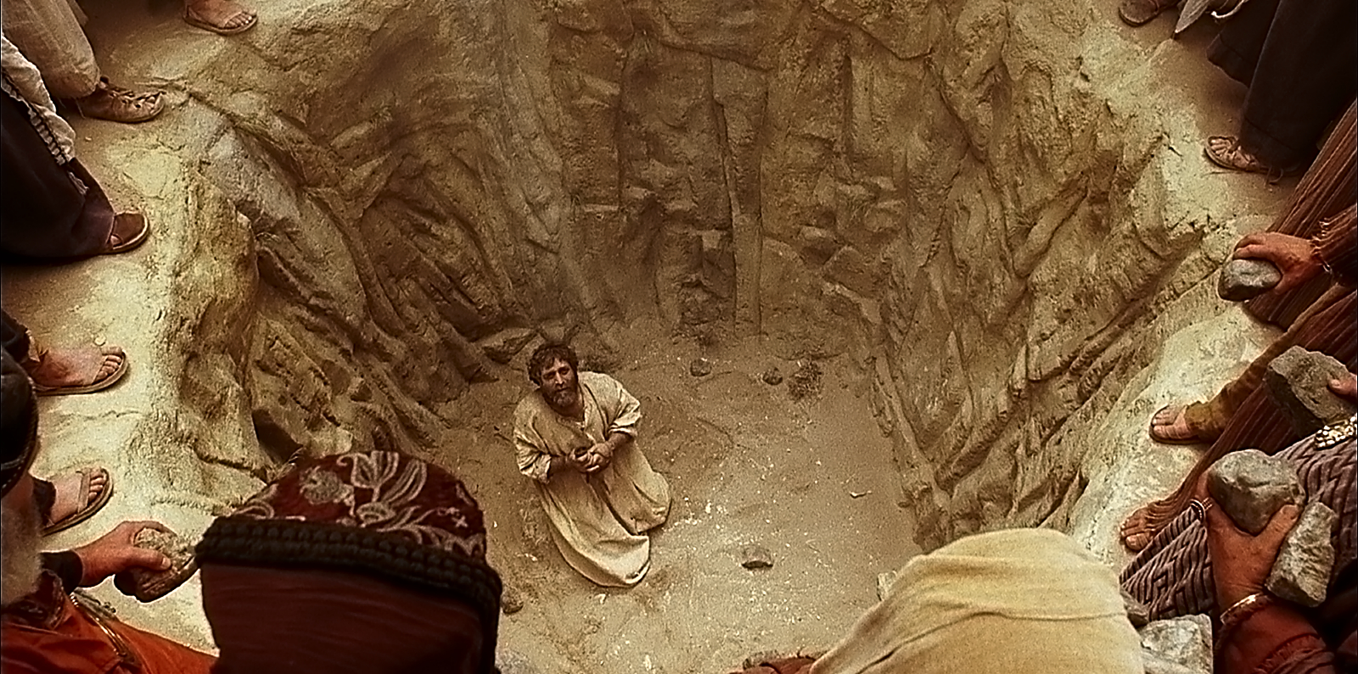
Book of Acts
Stephen preached the gospel
to a murderous crowd.
Notes:
Book of Acts
After Jesus resurrection and ascension
Preacher, starts out just serving tables
Faithful in small, be given great
Angers Religious leaders Pharisees
They stone him
Lay not this sin to their charge (like Jesus)

Slide 12
Next Slide –Video: Stephen Honors God Download Here:
https://youtu.be/r0wd4dfVzQY

Slide 13
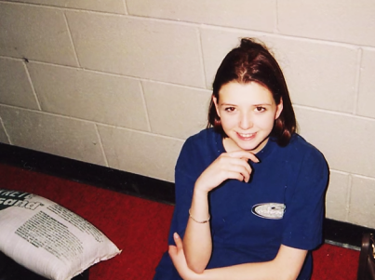
Rachel Joy Scott
She spent her last day on earth proclaiming her faith in God at Columbine High School.
Notes:
The shootings occurred on April 20, 1999, when two senior students Eric Harris and Dylan Klebold killed twelve students and a teacher, and wounded 23 others, before they both committed suicide. Rachel Joy Scott, just another young another teenage Christian at Columbine High. Had no idea of what was to come. But she was ready, by the grace of God

Slide 14
Next Slide – Video: Rachel Honors God Download Here:
https://youtu.be/l2k2GrrHXiQ

Slide 15
They are our examples

Slide 18
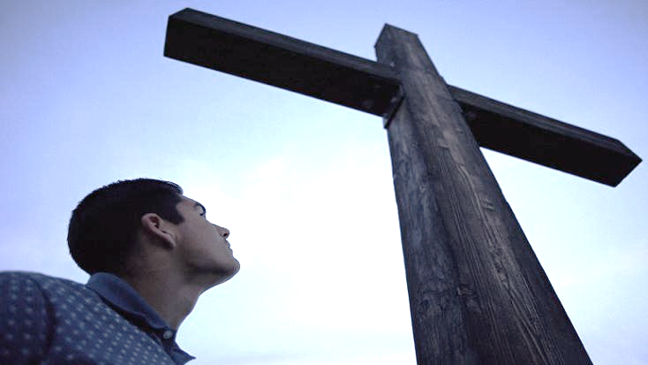
What moves a Christian to honor God with his/her life?
Notes:
The Cross is at the of center of the history God’s people
Looking forward or looking back.
We all have been bought with a price.

Slide 19
A revelation of our own sinful condition.
…plus an understanding
of Christ’s
sacrifice…
…makes us realize that we owe Him our
very lives.

Slide 21
“for God bought you with a high price. So you must honor God with your body”. I Cor. 6:20

Slide 22
Next Slide – Song: We Are the Reason Download Here:
https://youtu.be/eWHokANW6Dw

Slide 23
Is Jesus Speaking
to You?
“They began telling each other how their hearts had felt strangely warm as he talked with them…”
Lk.24:32 (TLB)
John Wesley Said:
“…the preacher was describing the change which God works in the heart… and I felt my heart strangely warmed.”
Jesus makes His presence Known by a small voice!

Slide 25
What is the Sinner‘s Prayer?
This is a prayer we can pray when we are ready to admit we are sinners and need Christ’s forgiveness.
It must be prayed with faith in our hearts and a readiness to have a life-changing encounter with Jesus Christ.

Slide 26
A prayer of faith → Pray this prayer if :
If you never have before
You have in the past, but you think it would mean more today
You have been walking afar off and you want to come back
You want to set an example & show others how it is done
You just like to give your heart to Jesus again & again
Faith

Slide 27
3 Important Questions
Do you want to know Jesus as your Savior right now?
Do you believe He died to save you from your sins & that He rose from the dead?
Do you believe that He is here, waiting to save you right now?

Slide 28
We Declare Our Faith Publicly Because Jesus Declared His LOVE Publicly
“If you stand before others and are willing to say you believe in me, then I will tell my Father in heaven that you belong to me.” Mat 10:32

Slide 29
The Prayer of a Sinner Turning to Jesus
Dear Jesus, I know that I have sinned against You and that my sins separate me from You.
I am truly sorry.
Right now, I turn away from my sinful past .
Please forgive me, and help me to keep from sin.
I believe You died for my sins.
I believe You rose from the dead, you are alive, and you hear this prayer from my heart.
I invite You Jesus to be both my Savior and the Lord of my life.
I want You to rule my life from now on.

Slide 30
“But some people did accept him. They believed in him, and he gave them the right to become children of God.”
John 1:12

Slide 32
“If you openly say, ‘Jesus is Lord’ and believe in your heart that God raised him from death, you will be saved.”
Rom. 10:9
What did you learn today?
Tell me about honoring God with your life.
What have you been thinking about God lately?
What do you want to tell the world about Jesus?

Slide 33
Let’s Close in Prayer

Slide 34
Note: After you download the slideshow, you may also need to download some videos from YouTube & add them into this PowerPoint. This tool can help you: Free YouTube Download
We present these messages in outdoor venues using the SonShineTent. Watch the video of our service that goes with this message here: http://campaignkerusso.org/?p=13908
We would love to know more about the people who download our lessons & sermons. We invite you to email us & let us know where & how you use them.
info@campaignkerusso.org

