Slide 1
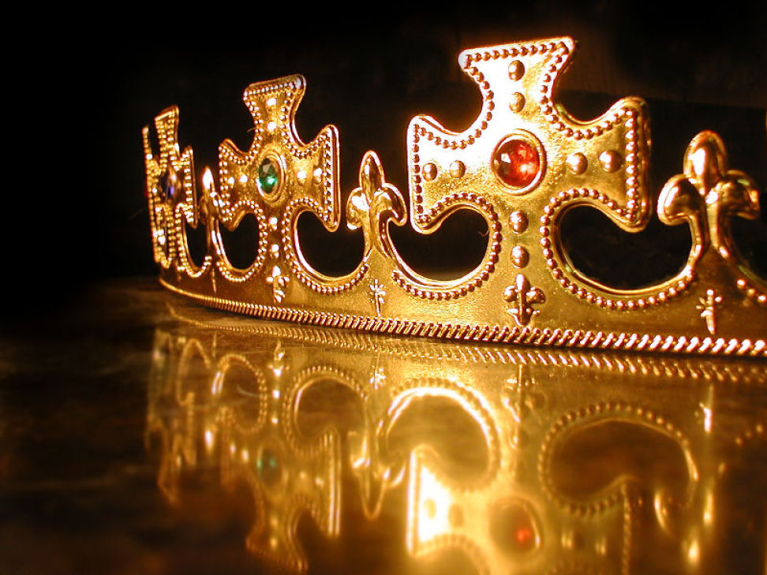
Crown Him, Crown Him

Slide 2
Welcome All

Slide 3
Let’s Begin with Prayer

Slide 4
Note: After you download the slideshow, you may also need to download some videos from YouTube & add them into this PowerPoint. This tool can help you: Free YouTube Download
We present these messages in outdoor venues using the SonShineTent. Watch the video of our service that goes with this message, click here: http://campaignkerusso.org/?p=13976
We would love to know more about the people who download our lessons & sermons. We invite you to email us & let us know where & how you use them.
info@campaignkerusso.org

Slide 5
Crown Him, Crown Him

Slide 6
Next Slide – Song: Worth is the Lamb-Crown Him Download Here:
https://youtu.be/sBAu9sLGras

Slide 7
Before time began, the Father, the Son, and the Holy Spirit lived together in Heaven.
They decided to make the world and to fill it with animals and people.

Slide 8
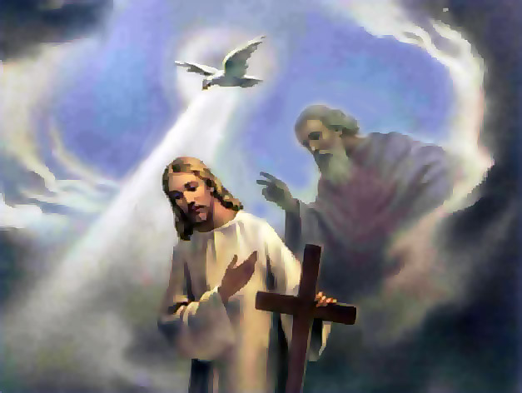
The Father had Jesus speak His Word and at the Word of Jesus, the world was created.
“… He has spoken to us through his Son Jesus… who made the World and everything there is.” Heb. 1:2 TLB

Slide 9
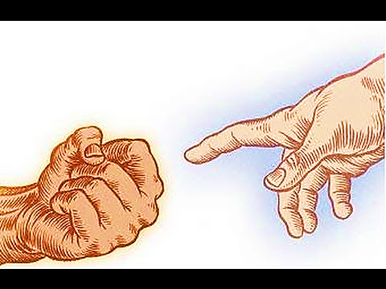
Jesus made the world, all the animals and people, but there was a problem.
God knew that people were going to do bad things. They would rebel against Him and they would eventually be destroyed by sin.

Slide 10
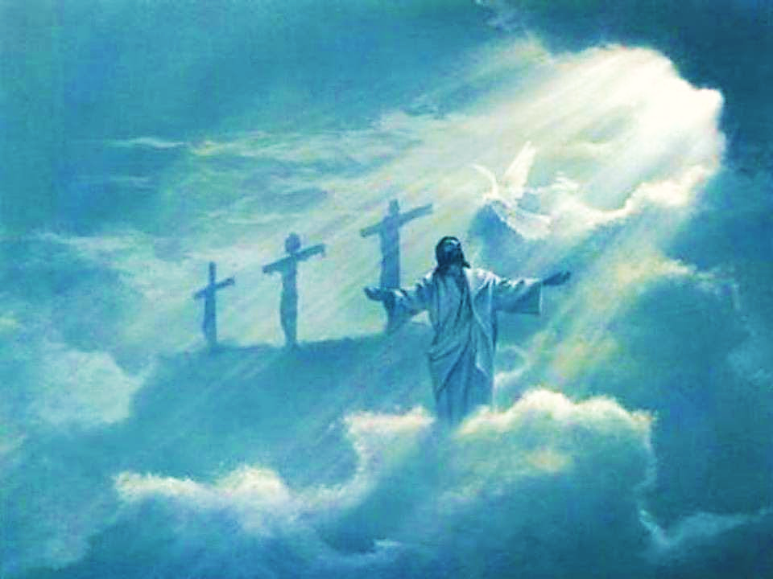
So the Father and Jesus agreed to help people at whatever the personal cost.
Jesus would go down to Earth and lay down His life. He would die to save people from their sin.
It was the only way!

Slide 11
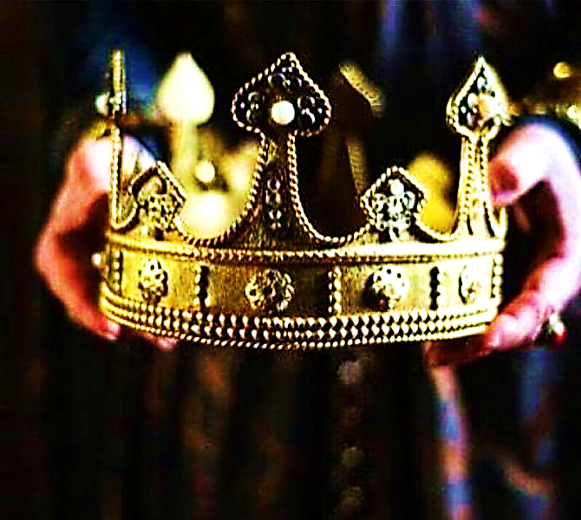
Jesus stood up from His throne, took off the crown
that He had worn for eternity, laid it aside, and left His Heavenly home.

Slide 12
Jesus went down to Earth as a human baby. He wanted to live with people that He might save them.

Slide 13
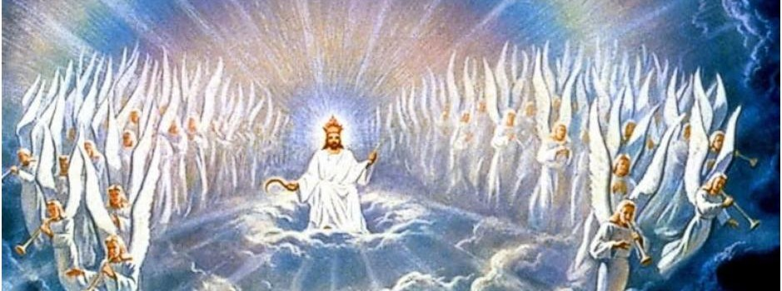
“Long before the world was made, God chose Christ to be given…” 1 Pet.1:20 NL
“And Christ became a human being and lived here on earth among us…”
1 John 1:14 TLB

Slide 14
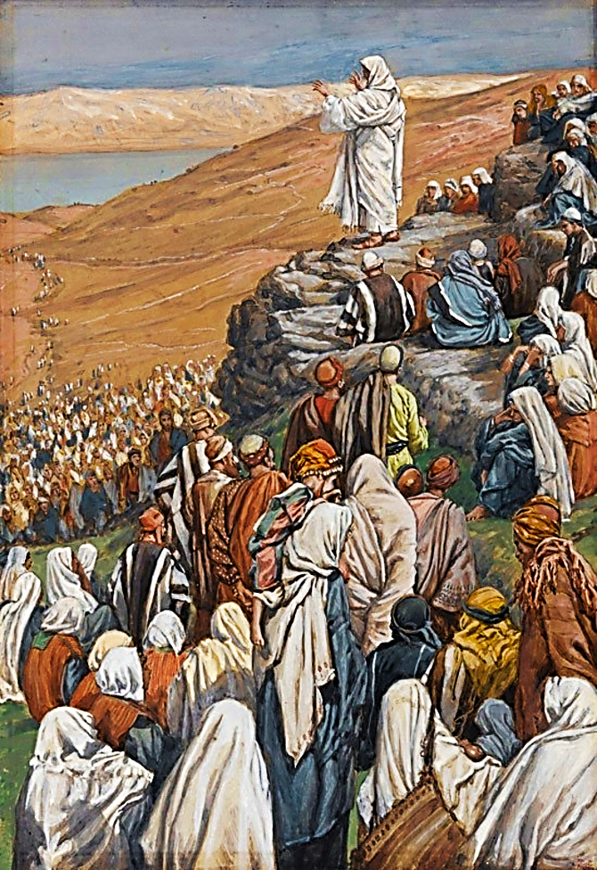
Jesus spent His days on Earth teaching people the truth about God and healing them.
“… He taught in their meeting places and preached…”
“..Jesus also healed every kind of disease and sickness.”
Mat. 9:35 CEV

Slide 15
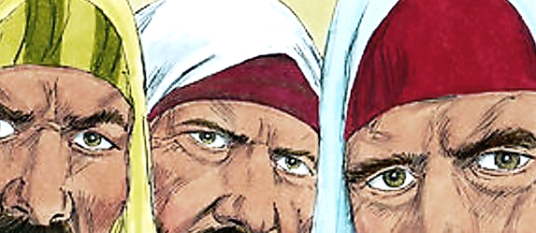
Some people were very jealous of Jesus, and they wanted to hurt Him. They wanted to kill Him.

Slide 16
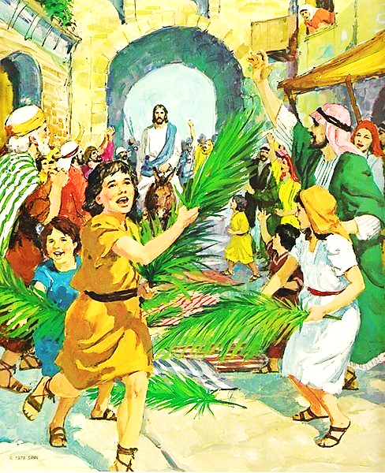
But most of the people liked Him—at first—and when He came to town riding on a donkey, they wanted to make Him their King.

Slide 17
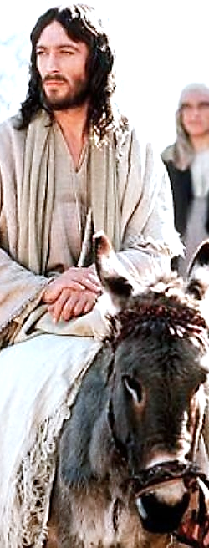
“Your King is coming to you… He is riding on a young donkey… They brought the donkey… They put their clothes on the donkey and Jesus sat on it. Many people put their coats down on the road. Other people cut branches from the trees and put them along the way. The people… called out, “Greatest One! … Greatest One in the highest heaven.” Mat. 21: 5-9 NLV

Slide 18
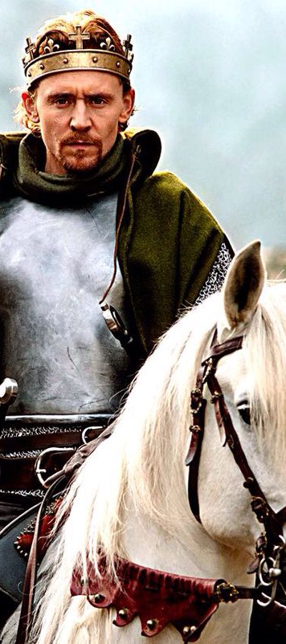
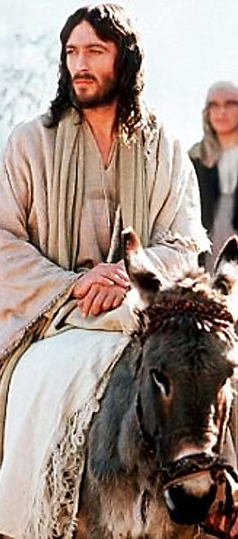
Jesus is the Greatest One of all. He is the King of
all Kings. But, He didn’t look like a King that day because He wasn’t wearing His Heavenly crown.

Slide 19
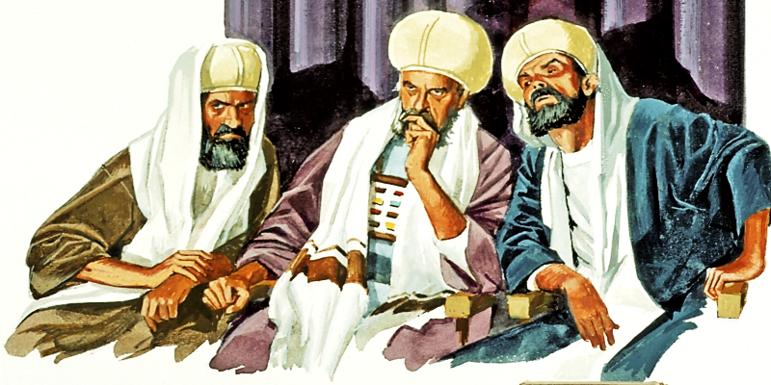
Sadly, not long after Jesus rode into town on a donkey, people began listening to the lies and bad things the jealous men were saying.

Slide 20
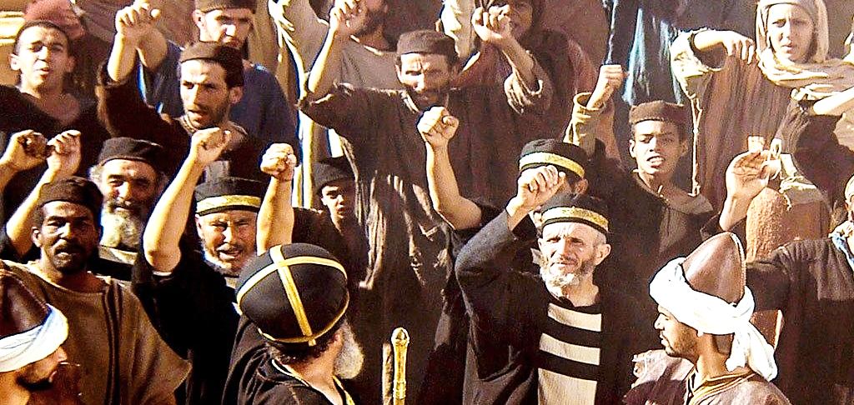
Soon, more and more people hated Jesus and wanted to kill Him. They shouted, “Crucify Him, crucify Him!”

Slide 21
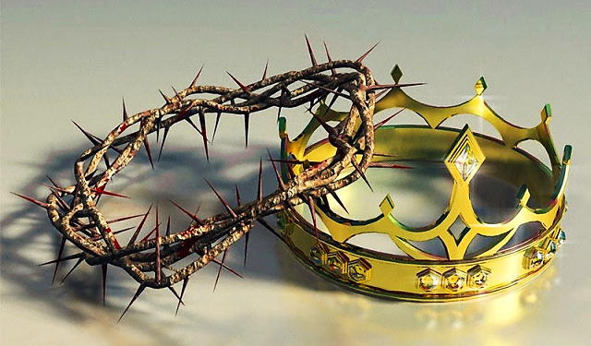
They gave Him a very different crown! An ugly crown of long, painful, sharp thorns.

Slide 22
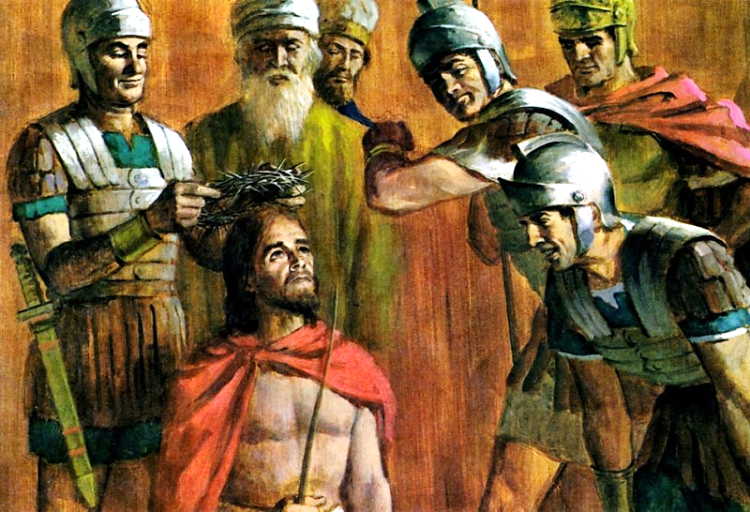
They began to laugh and make fun of Jesus. They acted like He was a fool to ever think He could be their King.

Slide 23
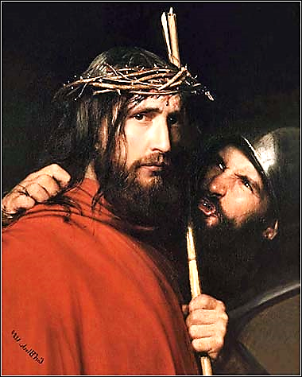
“… They twisted some thorn-twigs into a crown and put it on his head and put a stick in his right hand. They bowed low before him and jeered at him with the words, “Hail, your majesty, king of the Jews!””

Slide 24
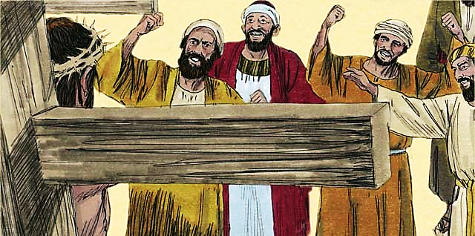
“Then they spat on him, took the stick and hit him on the head with it. And when they had finished their fun, they… led him off for crucifixion.” Mat 27:28-31 Phillips

Slide 25
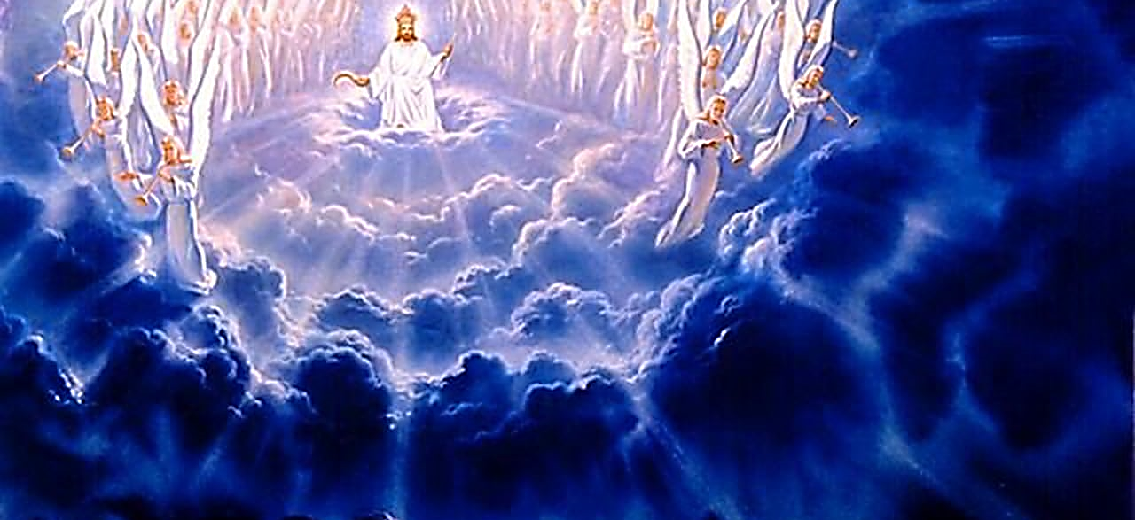
From before time, all of Heaven worshipped Jesus around His throne. They worshipped Him all day, every day!

Slide 26
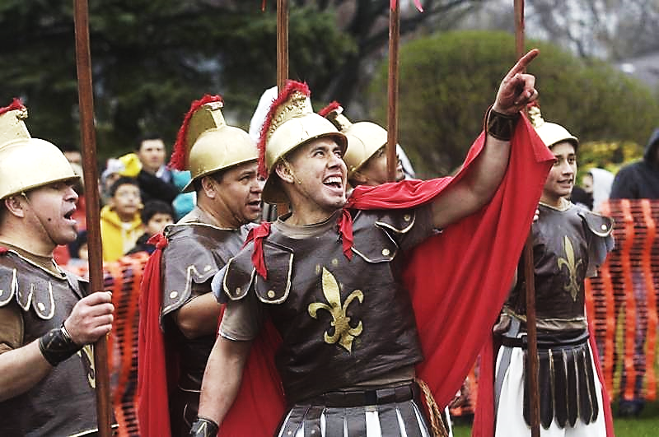
But now, He wears an ugly, cruel and hateful crown of thorns. The people are jeering, mocking and having a laugh at Jesus’ expense. How dare He call Himself a King?!

Slide 27
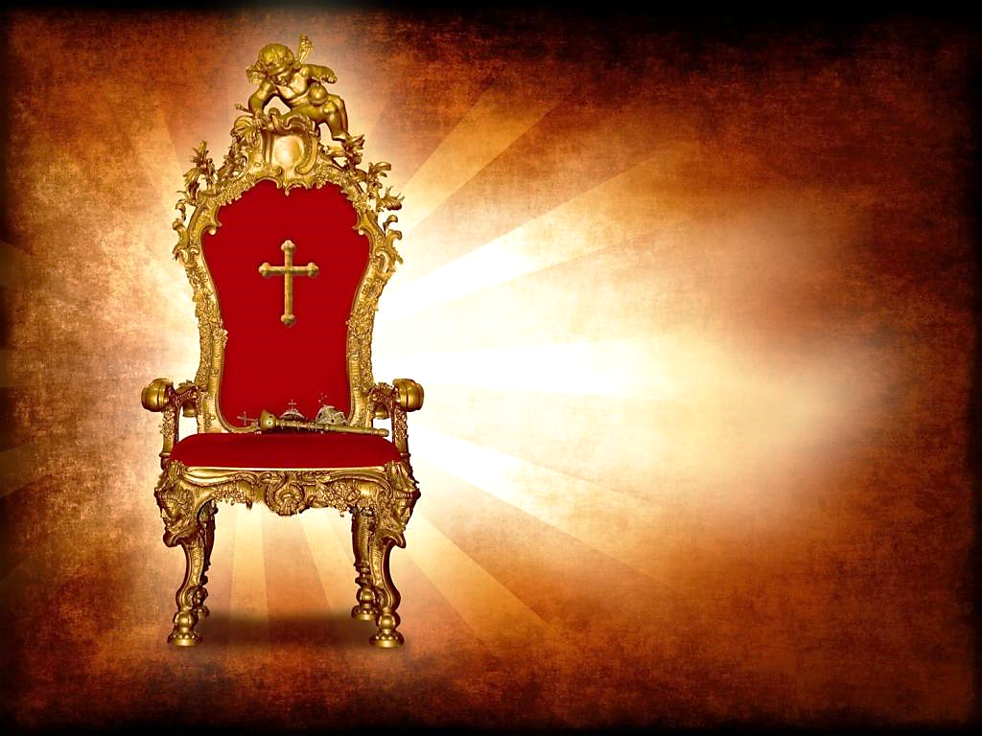
But, Jesus is The King!
Even on the cross, wearing that mocking crown of thorns, He knew it in His heart.

Slide 28
“Jesus said, ‘My kingdom is not from this world. My kingdom is from another place.’
‘So you are a king, then!’ said Pilate. Jesus answered, ‘You say that I am a king. In fact, that’s the reason I was born…”
John 18:36, 37 NIRV

Slide 29
They didn’t make Jesus their King, instead they killed Him and they put Him in a tomb.
But, He didn’t stay in that tomb. Just three days later, he came back to life and walked out of the tomb.

Slide 30
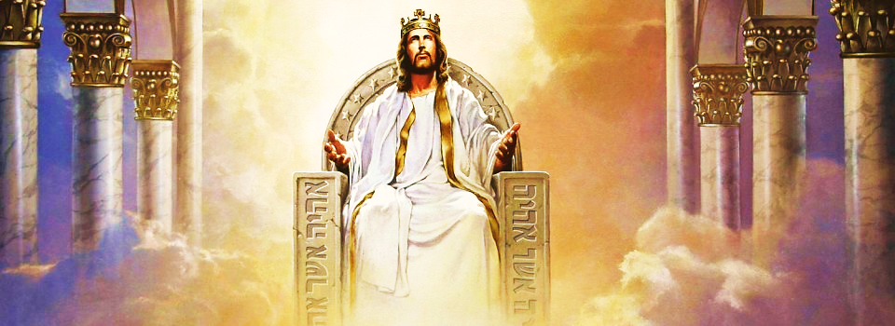
Jesus went back to His home in Heaven, sat on His throne, and placed His rightful crown back on His head.
“The one who sat there shone like jasper and ruby. Around the throne was a rainbow shining like an emerald… From the throne came flashes of lightning, rumblings and thunder.” Rev. 4:2-5 NIRV

Slide 31
“…It’s Jesus! He’s the one who is now crowned with glory and honor because of the suffering of his death.” Heb. 2:9 CEB

Slide 32
“And when he was a man, he was humble. He was even willing to die, yes, to die on a cross. That is why God has made him very great. God has given him a name above every name.” Phil. 2:8, 9 CEB

Slide 33
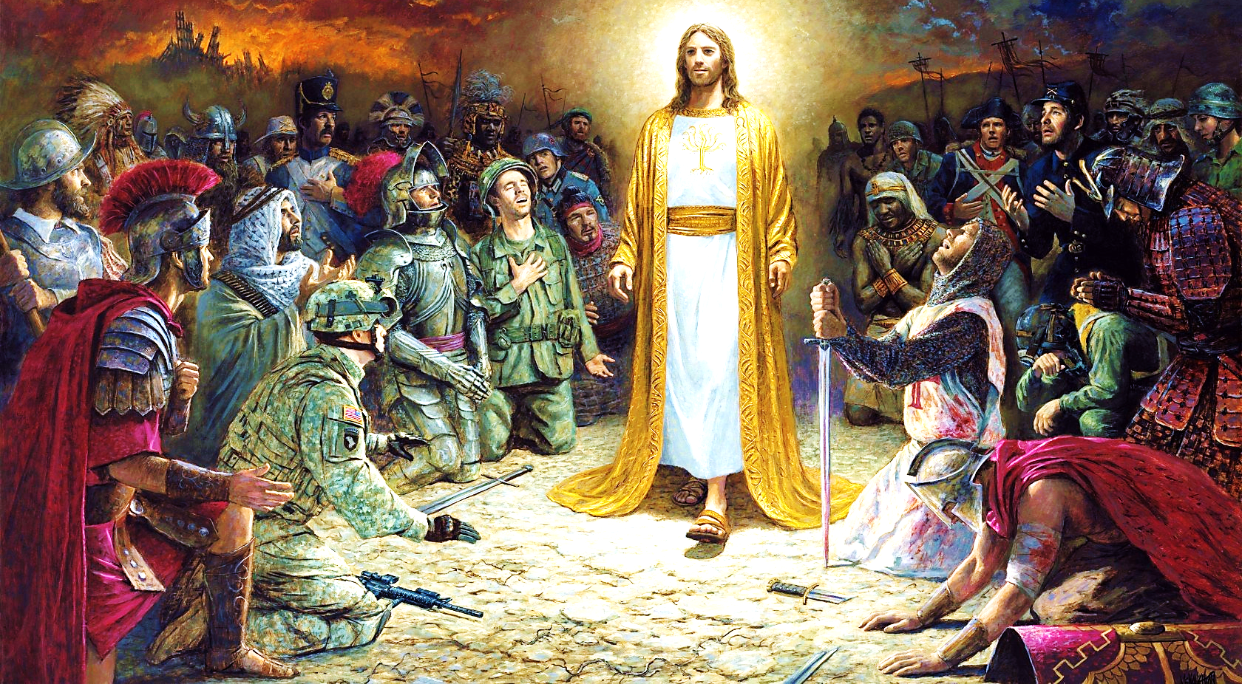
“Everyone in heaven, everyone on earth, and everyone under the earth will kneel before the name of Jesus.” Phil. 2:10 CEB

Slide 35
“His eyes were as a flame of fire, and on his head were many crowns…”
Rev. 19:12 KJV
“…for he is Lord of lords, and King of kings…”
Rev. 19:12 KJV

Slide 36
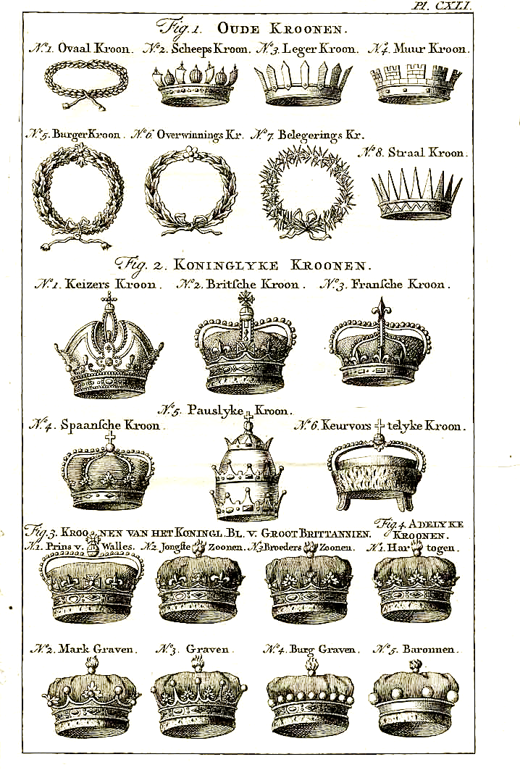
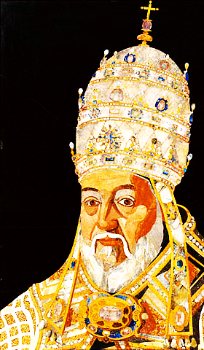
All sorts
of crowns have been worn all over the world and throughout history.

Slide 37
We are tempted to “crow” about our abilities and worldly achievements. We strut about wearing our crowns.

Slide 38
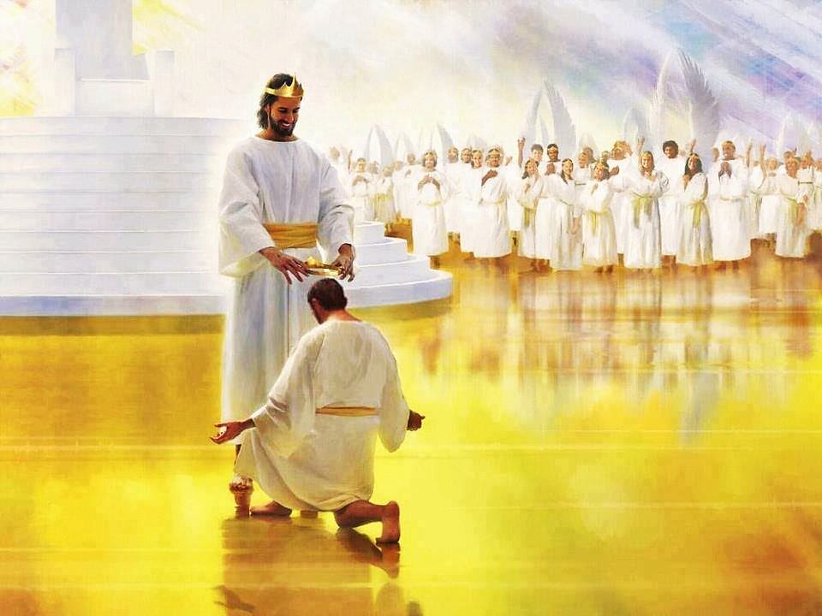
There are also crowns that Jesus Himself will give to faithful believers.

Slide 39
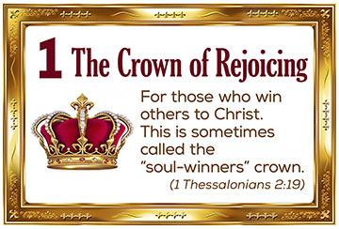
According to the New Testament, five potential crowns await Christians…
ccc

Slide 41
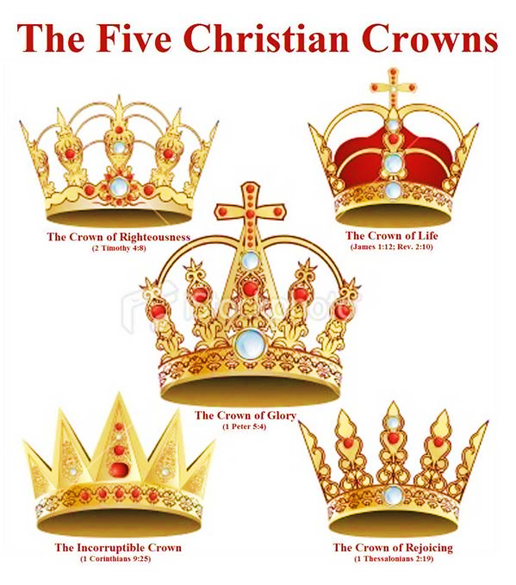
Plus, several human crowns, adds up to a
lot of crowns…
both Heavenly & meritless.

Slide 42
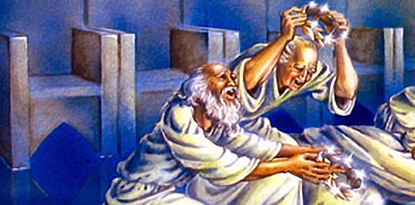
The twenty-four leaders get down before Him and worship Him Who lives forever. They lay their crowns before Him and say, “Our Lord and our God, it is right for You to have the shining-greatness and the honor and the power. You made all things. Rev. 4:10, 11 NLV

Slide 43
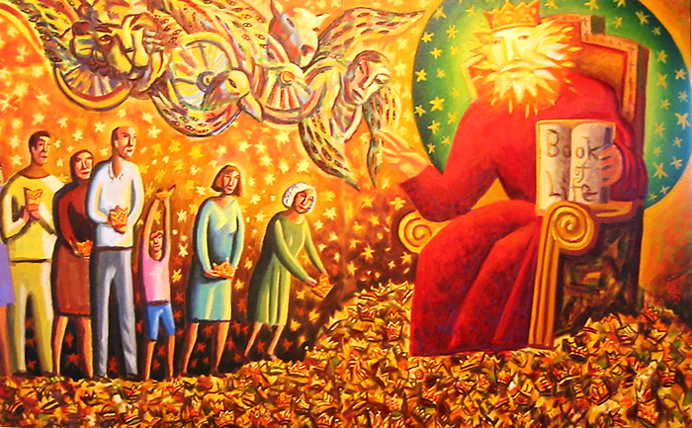
The crowns on Jesus’s head are surely the crowns that we all lay at His feet.

Slide 44
With this act, we affirm that Jesus is the only true King.
Consider all the things we are proud of, who we are, what we do, and things we have accomplished and remember…

Slide 45
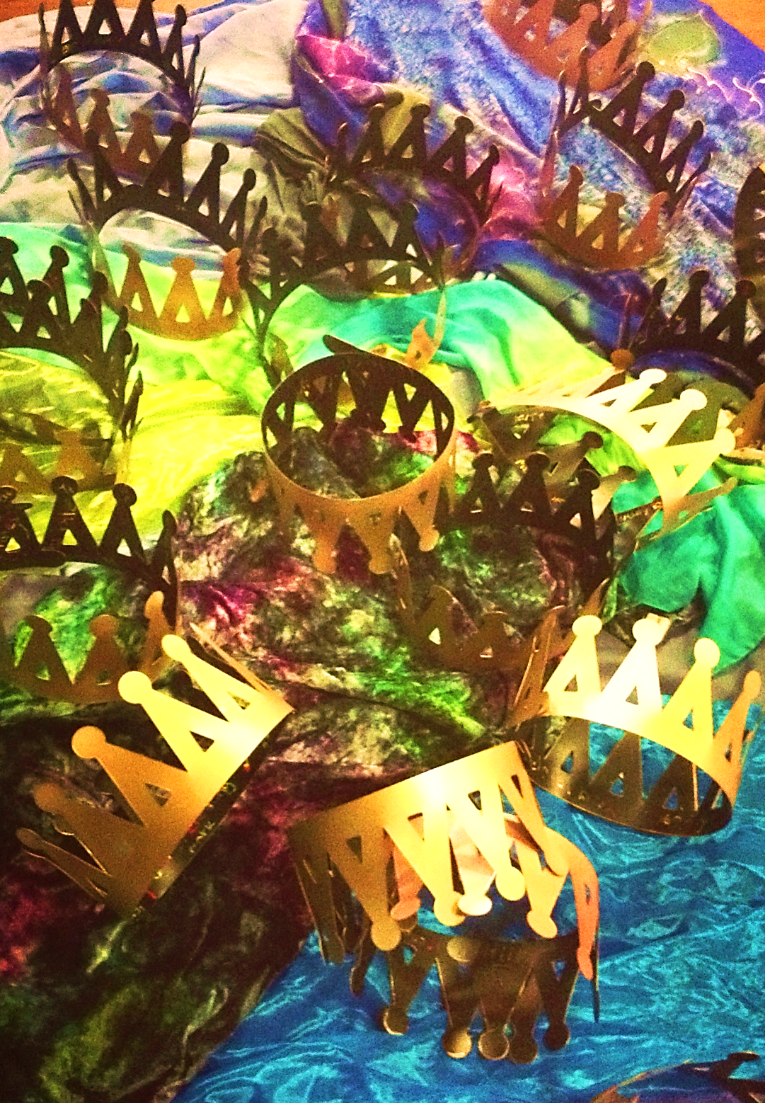
…Jesus is far better!
To save us, He traded His rightful crown for a crown of thorns.
Now, are we willing to give up our small crowns (the things we are proud about, who we are, what we do) and lay them at the feet of Jesus?

Slide 46
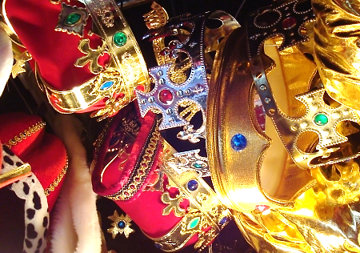
The only One truly worthy of any crown is Jesus Christ, the Lord of Lords and King of Kings.

Slide 47
Crown Him, Crown Him

Slide 48
Next Slide – Song: We Fall Down Download Here:
https://youtu.be/wo69WR6IASg

Slide 49
Is Jesus
Speaking to You?
“They said to each other, ‘Did not our hearts burn within us while he talked to us on the road, while he opened to us the Scriptures?’”
John Wesley Said:
“…the preacher was describing the change which God works in the heart through faith in Christ and I felt my heart strangely warmed.”
Jesus makes His presence Known by a small voice!

Slide 51
What is the Sinner‘s Prayer?
This is a prayer we can pray when we are ready to admit we are sinners and need Christ’s forgiveness.
It must be prayed with faith in our hearts and a readiness to have a life-changing encounter with Jesus Christ.

Slide 52
A prayer of faith → Pray this prayer if :
If you never have before
You have in the past, but you think it would mean more today
You have been walking afar off and you want to come back
You want to set an example & show others how it is done
You just like to give your heart to Jesus again & again
Faith

Slide 53
We Declare Our Faith Publicly Because Jesus Declared His LOVE Publicly
“If you stand before others and are willing to say you believe in me, then I will tell my Father in heaven that you belong to me.” Mat 10:32

Slide 54
Three Important Questions
Do you want to know Jesus as your Savior right now?
Do you believe He died to save you from your sins & that He rose from the dead?
Do you believe that He is here, waiting to save you right now?

Slide 55
The Prayer of a Sinner Turning to Jesus
Dear Jesus, I know that I have sinned against You and that my sins separate me from You.
I am truly sorry.
Right now, I turn away from my sinful past .
Please forgive me, and help me to keep from sin.
I believe You died for my sins.
I Believe You rose from the dead, you are alive, and you hear this prayer from my heart.
I invite You Jesus to be both my Savior and the Lord of my life.
I want You to rule my life from now on.

Slide 56
“But some people did accept him. They believed in him, and he gave them the right to become children of God.”
John 1:12

Slide 58
“If you openly say, ‘Jesus is Lord’ and believe in your heart that God raised him from death, you will be saved.”
Rom. 10:9
What did you learn today?
What about…
What have you been thinking about God lately?
What do you want to tell others about Jesus?

Slide 59
Let’s Close in Prayer

Slide 60
Note: After you download the slideshow, you may also need to download some videos from YouTube & add them into this PowerPoint. This tool can help you: Free YouTube Download
We present these messages in outdoor venues using the SonShineTent. Watch the video of our service that goes with this message, click here: http://campaignkerusso.org/?p=13976
We would love to know more about the people who download our lessons & sermons. We invite you to email us & let us know where & how you use them.
info@campaignkerusso.org

