Slide 1
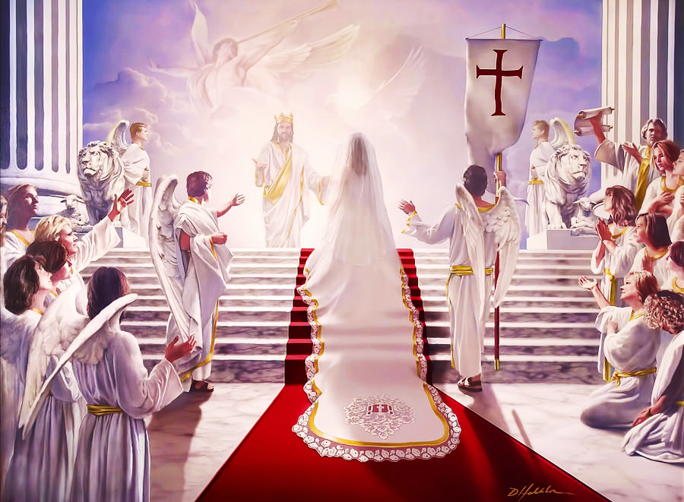
Best Wedding Ever!
The Marriage of the Lamb
Pt. 1 – The Bride and Her Dress

Slide 2
Note: After you download the slideshow, you may also need to download some videos from YouTube & add them into this PowerPoint. This tool can help you: Free YouTube Download
We present these messages in outdoor venues using the SonShineTent. Watch the video of our service that goes with this message, click here: http://campaignkerusso.org/?p=14783
We would love to know more about the people who download our lessons & sermons. We invite you to email us & let us know where & how you use them.
info@campaignkerusso.org

Slide 3
Welcome All

Slide 4
Let’s Begin with Prayer

Slide 5
Best Wedding Ever!
The Marriage of the Lamb
Pt. 1 – The Bride and Her Dress

Slide 6
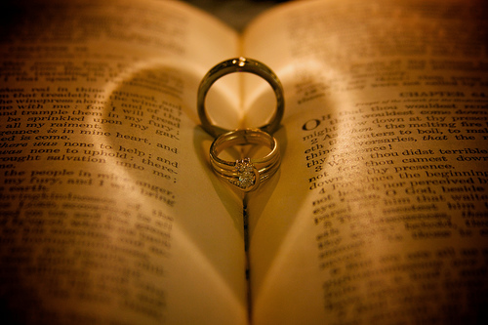
Today, we are going to look at the wedding at the end of the book.
The bible begins & ends with a wedding.

Slide 7
Song: Oh, The Wedding of the Lamb
Video Goes Here Title: Oh, The Wedding of the Lamb Download Here:
https://youtu.be/otEgXJRTLSg

Slide 8
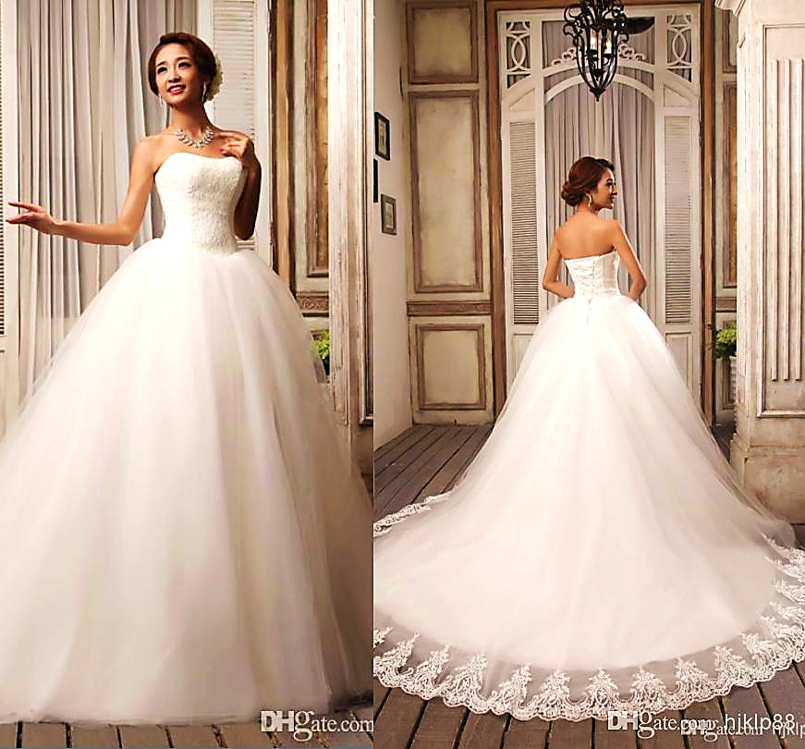
The Bride and Her Dress

Slide 9
Message Slide

Slide 10
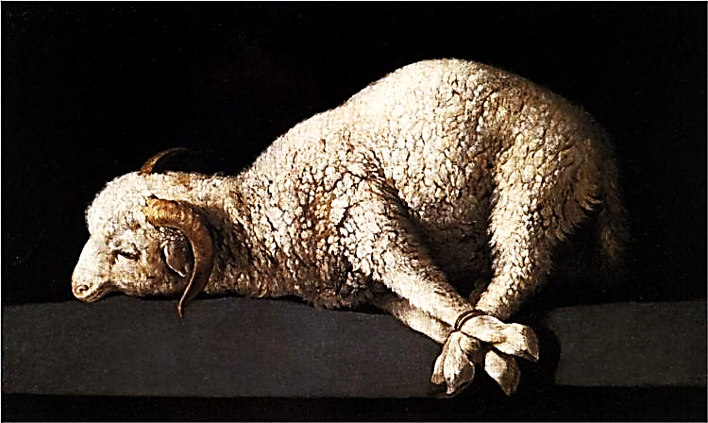
Who is the lamb?
Before Jesus died on the cross, one lamb was sacrificed, once a year, for the sins of Israel.

Slide 11
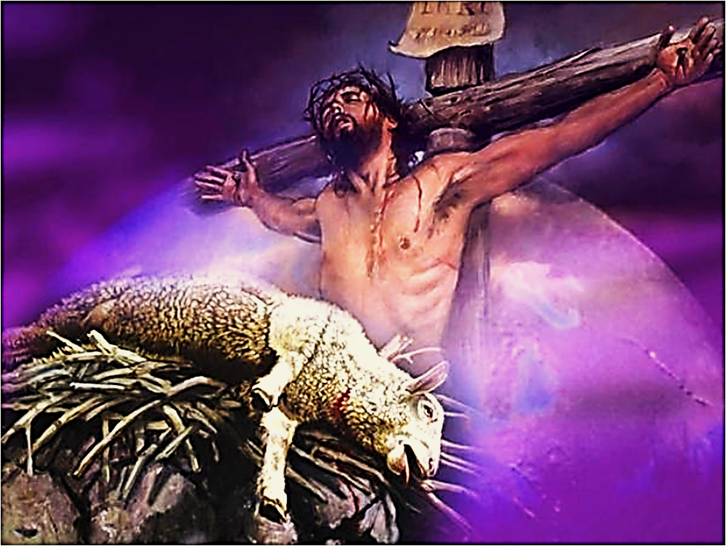
The lamb was sacrificed for the sins of one nation, for one year.
Jesus was sacrificed for all the sins, of the whole world, forever.

Slide 13
Who is the bride?
“Husbands, love your wives, just as Christ loved the church and gave himself for her.”
Eph. 5:25 (CSB)
“… As a bridegroom rejoices over his bride, so your God will rejoice over you.” Isa. 62:5 (GW)
The believers
– the Church – is the bride.

Slide 14
“Let us rejoice and be happy and give God glory, because the wedding of the Lamb has come. And the Lamb’s bride has made herself ready.”
Rev. 19:7 ERV
So, how did she make herself ready?

Slide 15
The bride is bathed in two things…
The Lamb’s blood…

Slide 16
And the Lamb’s Word
“to make her holy, cleansing her with the washing of water by the word.” Eph. 5:26

Slide 17
The Groom covers His bride with a white linen garment.
White linen represents righteousness- holiness-purity.

Slide 18
Our bride (the Church) was given her garment by the groom.
It was a free gift – GRACE!
(God’s Riches at Christ’s Expense)

Slide 19
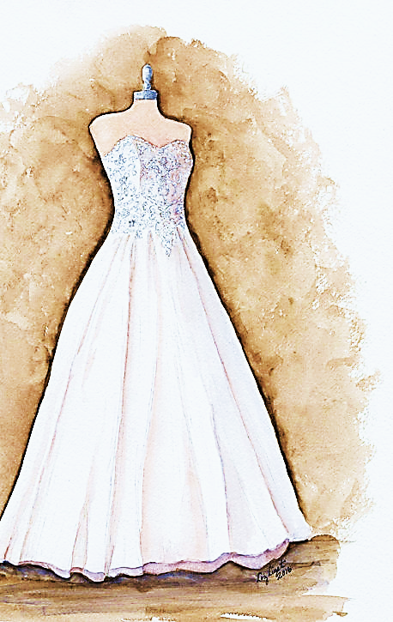
Fine linen was given to the bride for her to wear. The linen was bright and clean.”
Rev. 19:8
And to her was granted that she should be arrayed in fine linen, clean and white: for the fine linen is the righteousness of saints.
Rev. 19:9
“This righteousness is given through faith in Jesus Christ to all who believe…”
Rom. 3:22

Slide 20
Song: Wedding Day
Video Goes Here Title: Wedding Day Download Here:
https://youtu.be/S_as9yxrf6E

Slide 21
Consider the following questions:
Who is the Lamb?
Who is His Bride?
Why is she dressed in white linen?

Slide 22
Note: After you download the slideshow, you may also need to download some videos from YouTube & add them into this PowerPoint. This tool can help you: Free YouTube Download
We present these messages in outdoor venues using the SonShineTent. Watch the video of our service that goes with this message, click here: http://campaignkerusso.org/?p=14783
We would love to know more about the people who download our lessons & sermons. We invite you to email us & let us know where & how you use them.
info@campaignkerusso.org

Slide 23
Is Jesus
Speaking to You?
“They said to each other, ‘Did not our hearts burn within us while he talked to us on the road, while he opened to us the Scriptures?’”
John Wesley Said:
“…the preacher was describing the change which God works in the heart through faith in Christ and I felt my heart strangely warmed.”
Jesus makes His presence Known by a small voice!

Slide 25
What is the Sinner‘s Prayer?
This is a prayer we can pray when we are ready to admit we are sinners and need Christ’s forgiveness.
It must be prayed with faith in our hearts and a readiness to have a life-changing encounter with Jesus Christ.

Slide 26
A prayer of faith → Pray this prayer if :
If you never have before
You have in the past, but you think it would mean more today
You have been walking afar off and you want to come back
You want to set an example & show others how it is done
You just like to give your heart to Jesus again & again
Faith

Slide 27
We Declare Our Faith Publicly Because Jesus Declared His LOVE Publicly
“If you stand before others and are willing to say you believe in me, then I will tell my Father in heaven that you belong to me.” Mat 10:32

Slide 28
Three Important Questions
Do you want to know Jesus as your Savior right now?
Do you believe He died to save you from your sins & that He rose from the dead?
Do you believe that He is here, waiting to save you right now?

Slide 29
The Prayer of a Sinner Turning to Jesus
Dear Jesus, I know that I have sinned against You and that my sins separate me from You.
I am truly sorry.
Right now, I turn away from my sinful past .
Please forgive me, and help me to keep from sin.
I believe You died for my sins.
I Believe You rose from the dead, you are alive, and you hear this prayer from my heart.
I invite You Jesus to be both my Savior and the Lord of my life.
I want You to rule my life from now on.

Slide 30
“But some people did accept him. They believed in him, and he gave them the right to become children of God.”
John 1:12

Slide 32
“If you openly say, ‘Jesus is Lord’ and believe in your heart that God raised him from death, you will be saved.”
Rom. 10:9
What did you learn today?
What about the bride & her dress?
What have you been thinking about God lately?
What do you want to tell others about Jesus?

Slide 33
Let’s Close in Prayer

Slide 34
Note: After you download the slideshow, you may also need to download some videos from YouTube & add them into this PowerPoint. This tool can help you: Free YouTube Download
We present these messages in outdoor venues using the SonShineTent. Watch the video of our service that goes with this message, click here: http://campaignkerusso.org/?p=14783
We would love to know more about the people who download our lessons & sermons. We invite you to email us & let us know where & how you use them.
info@campaignkerusso.org

