Slide 1
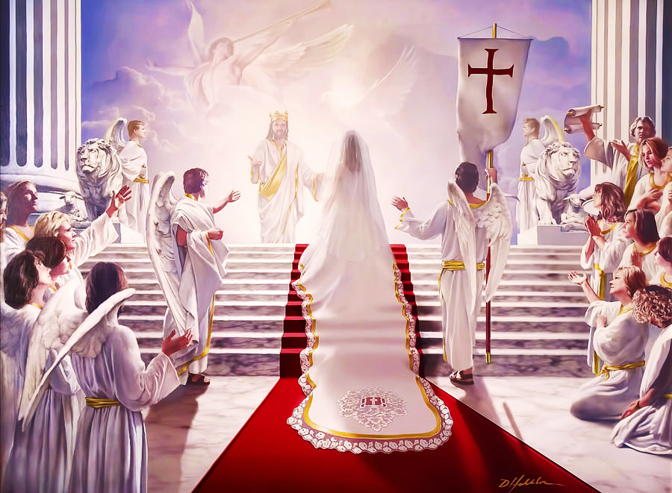
Best Wedding Ever!
The Marriage of the Lamb
Pt. 4 – Best Banquet Ever

Slide 2
Note: After you download the slideshow, you may also need to download some videos from YouTube & add them into this PowerPoint. This tool can help you: Free YouTube Download
We present these messages in outdoor venues using the SonShineTent. Watch the video of our service that goes with this message, click here: http://campaignkerusso.org/?p=14783
We would love to know more about the people who download our lessons & sermons. We invite you to email us & let us know where & how you use them.
info@campaignkerusso.org

Slide 3
Welcome All

Slide 4
Let’s Begin with Prayer

Slide 5
Best Wedding Ever!
The Marriage of the Lamb
Pt. 4 – Best Banquet Ever

Slide 6
Song: The Bride of Christ
Video Goes Here Title: The Bride of Christ Download Here:
https://youtu.be/A48I_nW7nCE

Slide 7
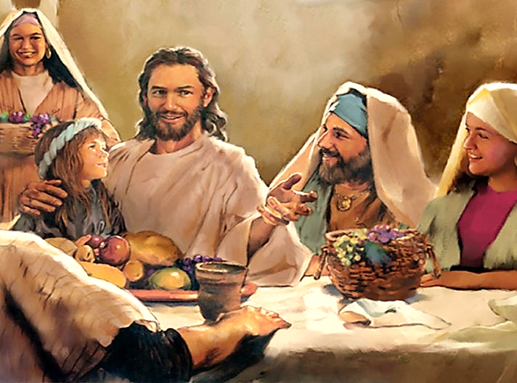
The Meal
Jesus loves to share a meal with His friends.

Slide 8
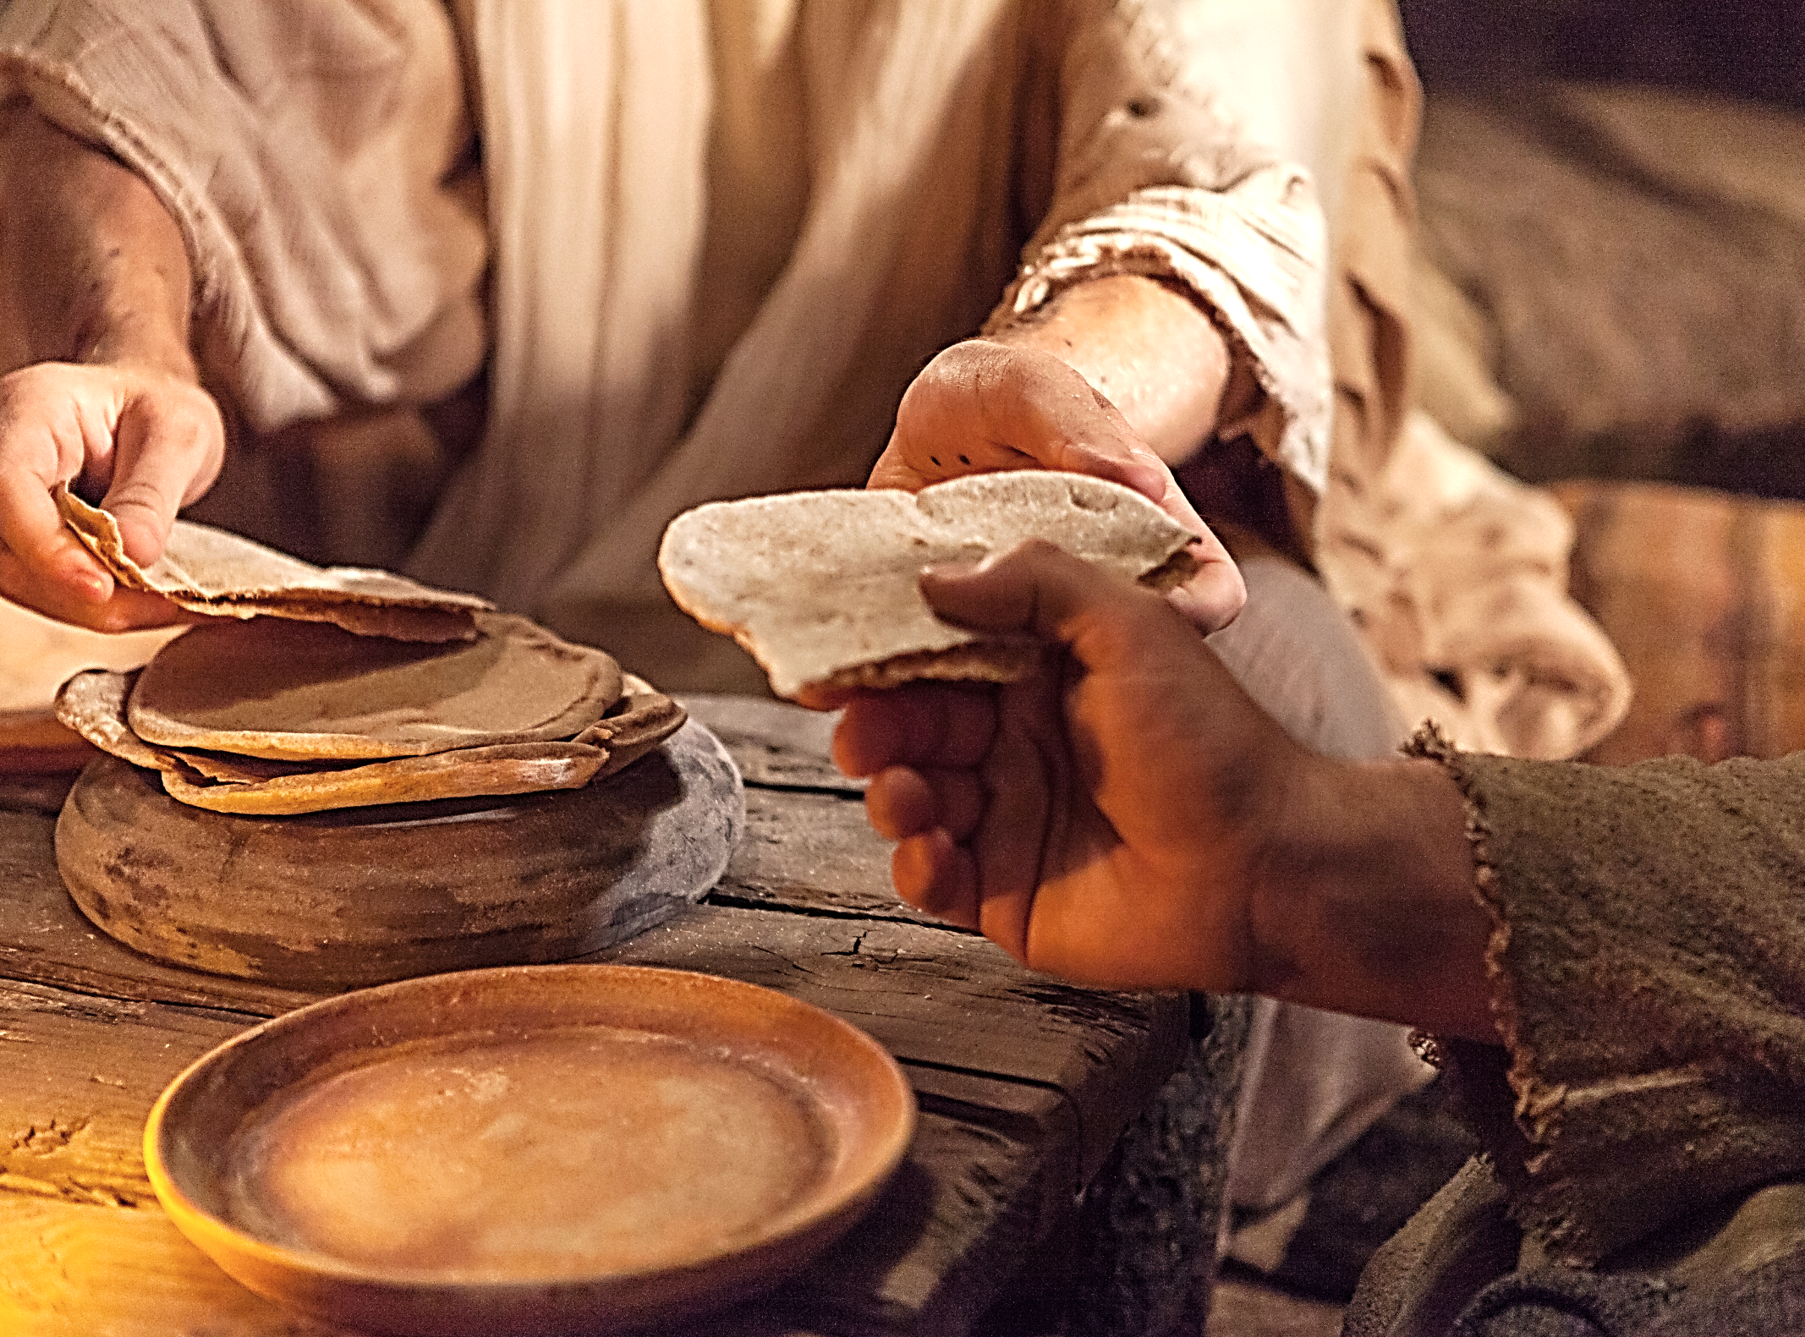
“I will not drink again from the fruit of the vine until God’s kingdom comes.” Lk. 22:18 NCV
“When he had given thanks, he broke it, and said, ‘Take, eat. This is my body, which is broken for you. Do this in memory of me.’” 1 Cor. 11:24 WEB

Slide 9
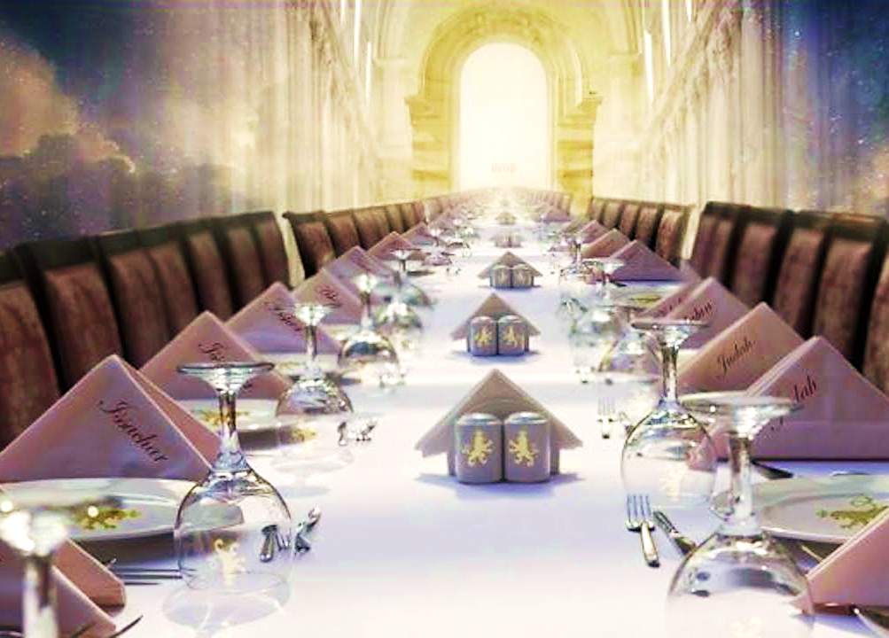
We are all invited to the biggest, fanciest meal ever.

Slide 10
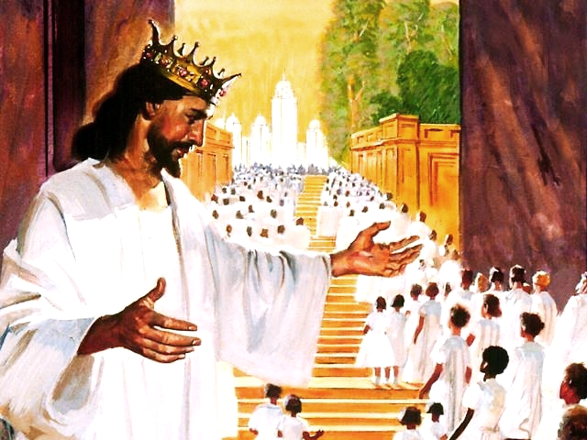
Jesus is
the Host

Slide 11
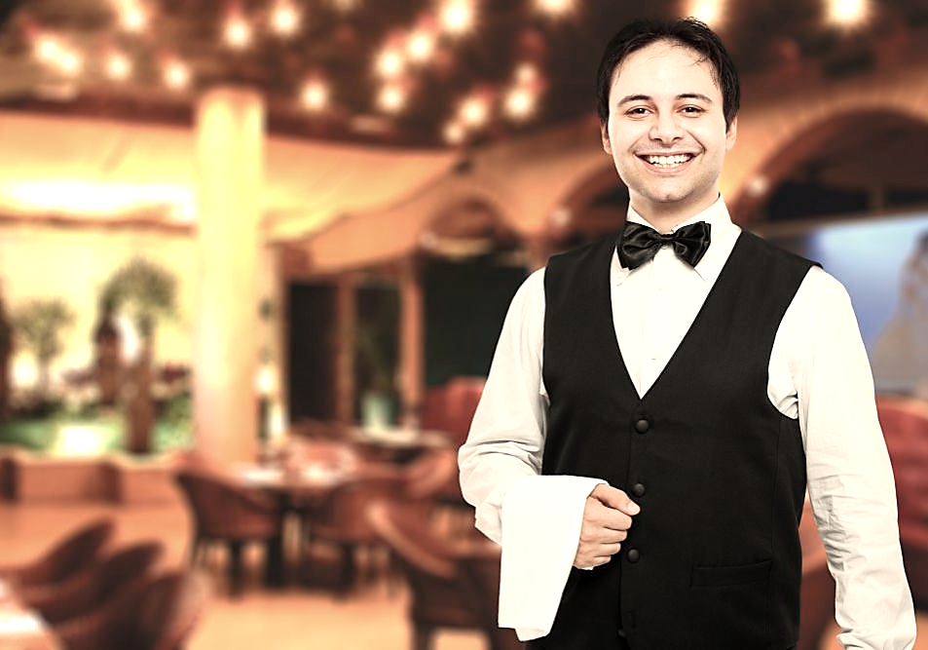
“And Jesus, the Groom Himself, is also the Server”

Slide 12
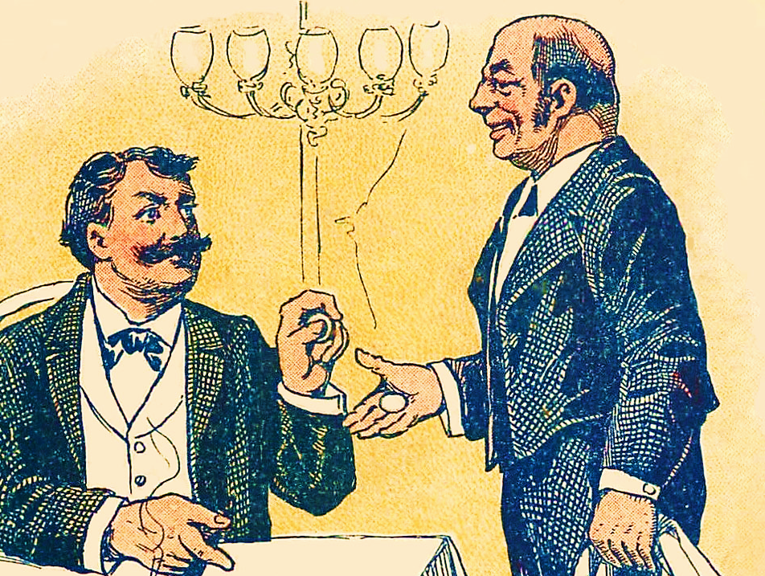
“For who is greater, he that sitteth at table, or he that serveth? is not he that sitteth at table? And I am among you as he that serveth.” Lk. 22:27 GNV

Slide 13
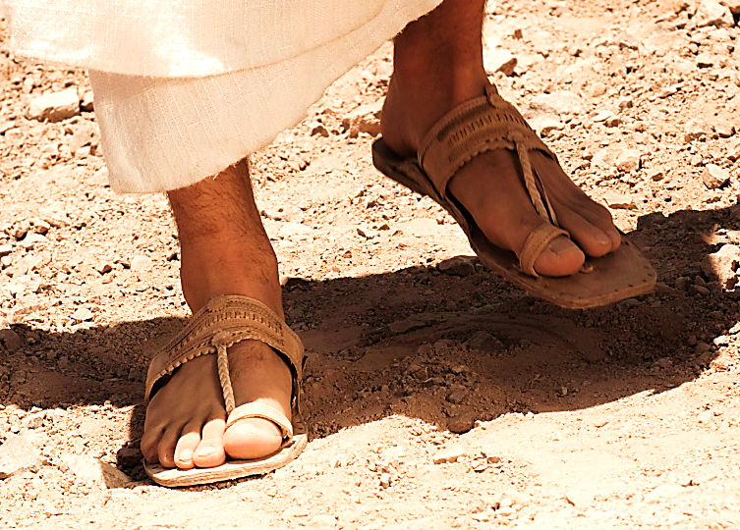
“And if you want to be first, you must be the slave of the rest. The Son of Man did not come to be a slave master, but a slave who will give his life to rescue many people.” Mat. 20:27, 28 CEV
Serving has always been, is now, and will forever be - His very nature !!!

Slide 14
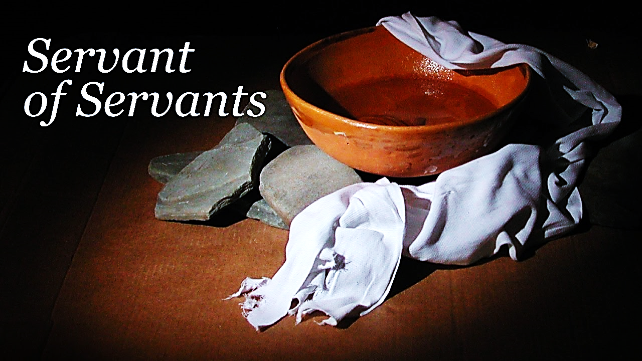
“Jesus knew that the Father had given him authority over everything and that he had come from God and would return to God…”
(He had nothing to prove. He followed His heart.)

Slide 15
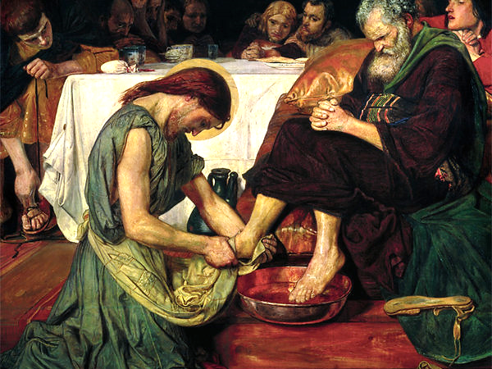
Then he began to wash the disciples’ feet, drying them with the towel he had around him.” John 13:3-5 NLT
“…So he got up from the table, took off his robe, wrapped a towel around his waist, and poured water into a basin…

Slide 16
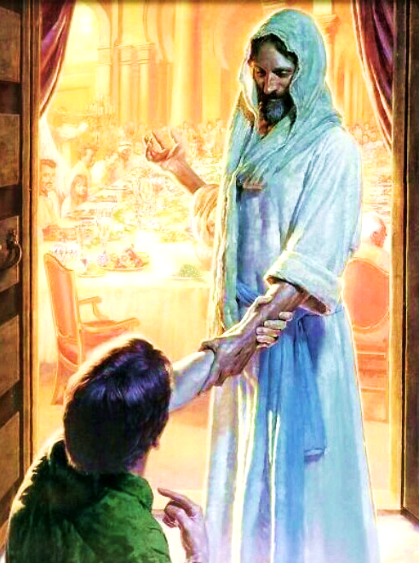
“There will be great joy for those who are ready and waiting for his return.
He himself will seat them and put on a waiter’s uniform and serve them as they sit and eat!”
Luke 12:37 TLB

Slide 17
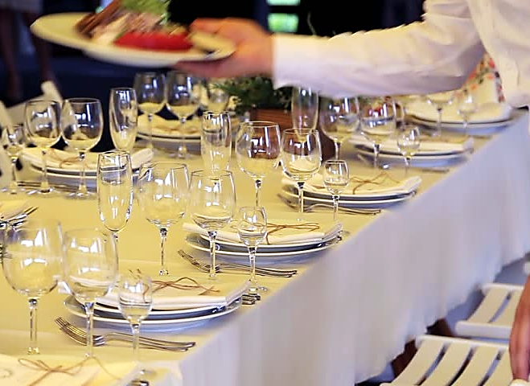
Feasting on Jesus
Over and above any food for the belly, Jesus Himself is, in a real sense, the soul-satisfying meal.

Slide 18
“When he had given thanks, he broke it, and said, “Take, eat. This is my body, which is broken for you. Do this in memory of me.” 1 Cor. 11:24 WEB

Slide 19
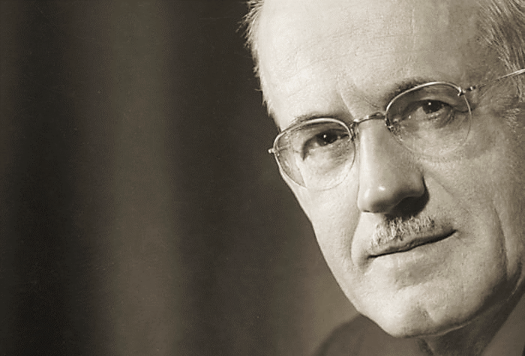
Consider
the following
passage from
A.W. Tozer,
in his book
“The Art of
True Worship.”

Slide 20
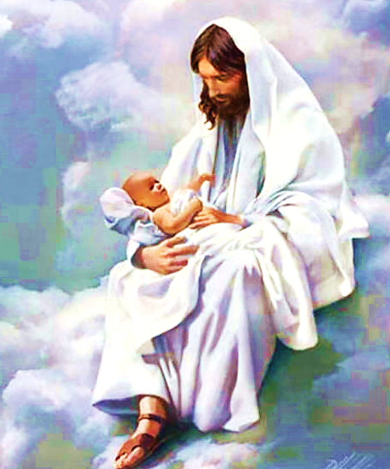
“As long as the worshiper is engrossed with himself and his good fortune, he is a babe.
We begin to grow up when our worship passes from thanksgiving to admiration...

Slide 21
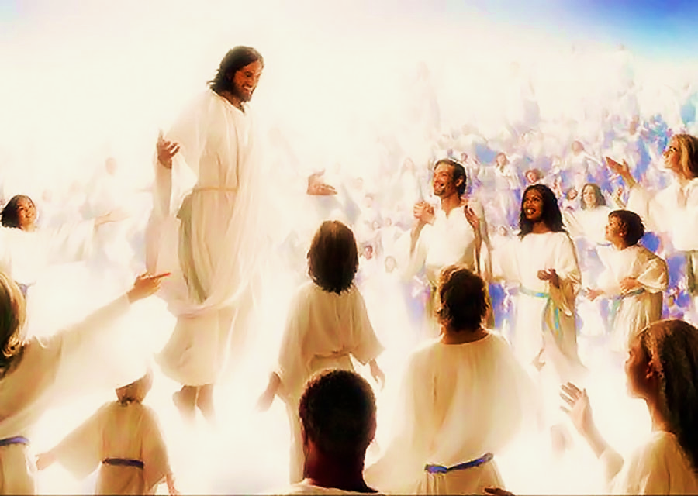
…How different and how wonderful are the emotions aroused by a true and Spirit-incited love for Christ.
Think about it, friend. A true bride is not just thankful she is getting married, but she loves the groom…

Slide 22
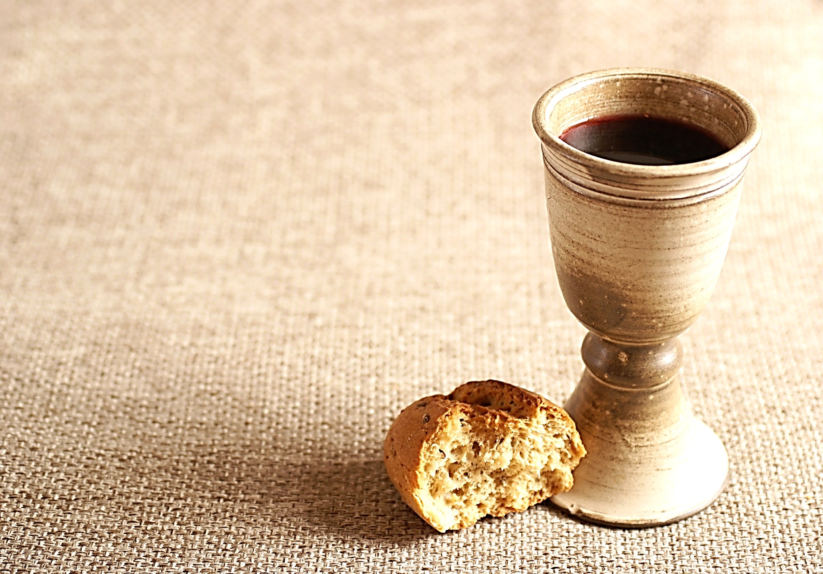
…Similarly, when you observe the Lord's Supper, you should not only be thankful Jesus broke his body and shed his blood for you…
…you should also see in that action that "greater love has no one than this, that one lay down his life for his friends" (John 15:13) ….

Slide 23
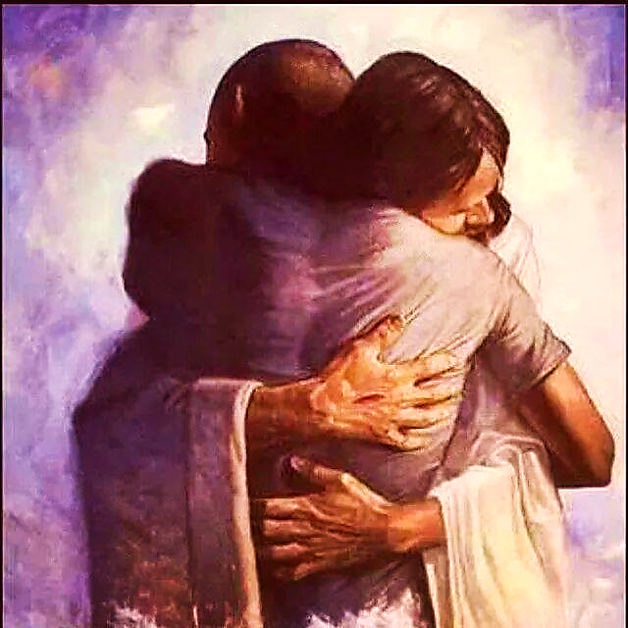
…You should see Jesus declaring his love for you, and you should do likewise.
If participating in the Lord's Supper helps you grow in your love for Jesus like a bride loving her groom,
then you are making yourself ready for that greater feast that yet awaits you.” A. W. Tozer

Slide 24
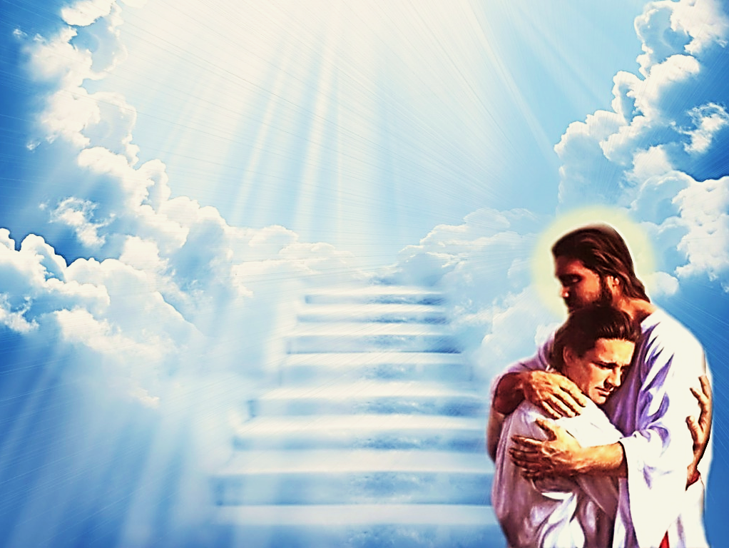
For a season on Earth we learn to love Jesus and His sacrifice for us through the Lord’s supper.
Then we will finally be able to worship Him in person and feast on His love at the great Marriage Supper of the Lamb !
We will be forever celebrating His broken body and shed blood.

Slide 25
Consider the following questions:
What is the purpose of the Last Supper?
What all will happen at the Marriage Supper of the Lamb?
Why does Jesus serve His servants?
What is the real meal that satisfies the soul?

Slide 26
Song: Remember Me
Video Goes Here Title: Remember Me Download Here:
https://youtu.be/d53V3OO9ihU

Slide 27
Note: After you download the slideshow, you may also need to download some videos from YouTube & add them into this PowerPoint. This tool can help you: Free YouTube Download
We present these messages in outdoor venues using the SonShineTent. Watch the video of our service that goes with this message, click here: http://campaignkerusso.org/?p=14783
We would love to know more about the people who download our lessons & sermons. We invite you to email us & let us know where & how you use them.
info@campaignkerusso.org

Slide 28
Is Jesus
Speaking to You?
“They said to each other, ‘Did not our hearts burn within us while he talked to us on the road, while he opened to us the Scriptures?’”
John Wesley Said:
“…the preacher was describing the change which God works in the heart through faith in Christ and I felt my heart strangely warmed.”
Jesus makes His presence Known by a small voice!

Slide 30
What is the Sinner‘s Prayer?
This is a prayer we can pray when we are ready to admit we are sinners and need Christ’s forgiveness.
It must be prayed with faith in our hearts and a readiness to have a life-changing encounter with Jesus Christ.

Slide 31
A prayer of faith → Pray this prayer if :
If you never have before
You have in the past, but you think it would mean more today
You have been walking afar off and you want to come back
You want to set an example & show others how it is done
You just like to give your heart to Jesus again & again
Faith

Slide 32
We Declare Our Faith Publicly Because Jesus Declared His LOVE Publicly
“If you stand before others and are willing to say you believe in me, then I will tell my Father in heaven that you belong to me.” Mat 10:32

Slide 33
Three Important Questions
Do you want to know Jesus as your Savior right now?
Do you believe He died to save you from your sins & that He rose from the dead?
Do you believe that He is here, waiting to save you right now?

Slide 34
The Prayer of a Sinner Turning to Jesus
Dear Jesus, I know that I have sinned against You and that my sins separate me from You.
I am truly sorry.
Right now, I turn away from my sinful past .
Please forgive me, and help me to keep from sin.
I believe You died for my sins.
I Believe You rose from the dead, you are alive, and you hear this prayer from my heart.
I invite You Jesus to be both my Savior and the Lord of my life.
I want You to rule my life from now on.

Slide 35
“But some people did accept him. They believed in him, and he gave them the right to become children of God.”
John 1:12

Slide 37
“If you openly say, ‘Jesus is Lord’ and believe in your heart that God raised him from death, you will be saved.”
Rom. 10:9
What did you learn today?
What about the wedding meal?
What have you been thinking about God lately?
What do you want to tell others about Jesus?

Slide 38
Let’s Close in Prayer

Slide 39
Note: After you download the slideshow, you may also need to download some videos from YouTube & add them into this PowerPoint. This tool can help you: Free YouTube Download
We present these messages in outdoor venues using the SonShineTent. Watch the video of our service that goes with this message, click here: http://campaignkerusso.org/?p=14783
We would love to know more about the people who download our lessons & sermons. We invite you to email us & let us know where & how you use them.
info@campaignkerusso.org

