Slide 1
(Including: Signs of a Dying Church)
Part 3 – Two Churches Run the
Course & Win the Prize!!

Slide 2
Note: After you download the slideshow, you may also need to download some videos from YouTube & add them into this PowerPoint. This tool can help you: Free YouTube Download
We present these messages in outdoor venues using the SonShineTent. Watch the video of our service that goes with this message, click here: http://campaignkerusso.org/?p=14739
We would love to know more about the people who download our lessons & sermons. We invite you to email us & let us know where & how you use them.
info@campaignkerusso.org

Slide 3
Welcome All

Slide 4
Let’s Begin with Prayer

Slide 5
(Including: Signs of a Dying Church)
Part 3 – Two Churches Run the
Course & Win the Prize!!

Slide 6
First, a Review…

Slide 7
Every believer is in a race…
…and what is the prize?
To be used
of God as
fully as we
are called
of God.

Slide 8
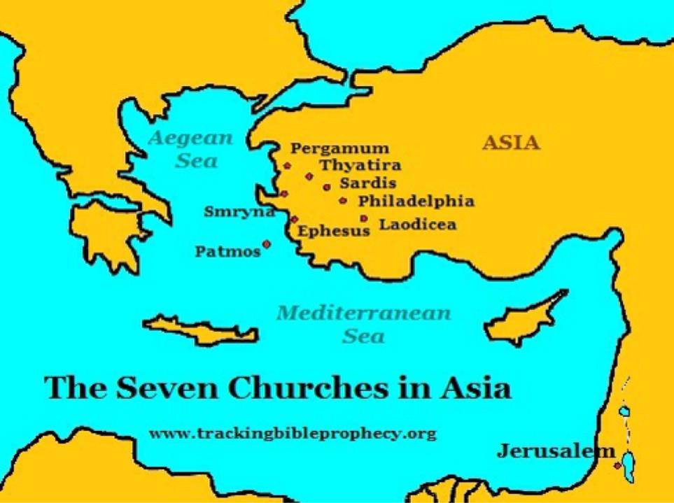
The letters to the Seven Churches (in the book of Revelation) show us five churches that are dying and two that are continuing in God’s calling.

Slide 9
Upon examination of the Revelation text, we will see that John’s description of Jesus shows that Jesus, Himself is exactly what each of these churches needs to get healthy and be strong to the finish.

Slide 11
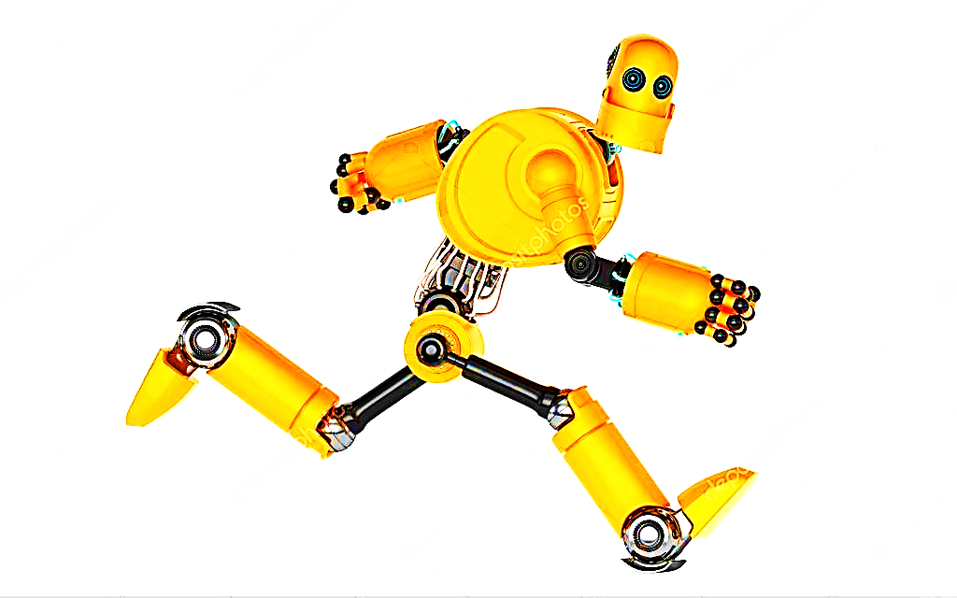
Runner Type
This runner is just going through the motions with a fixed “Christian” smile, but his heart is not engaged. His chest is empty.

Slide 12
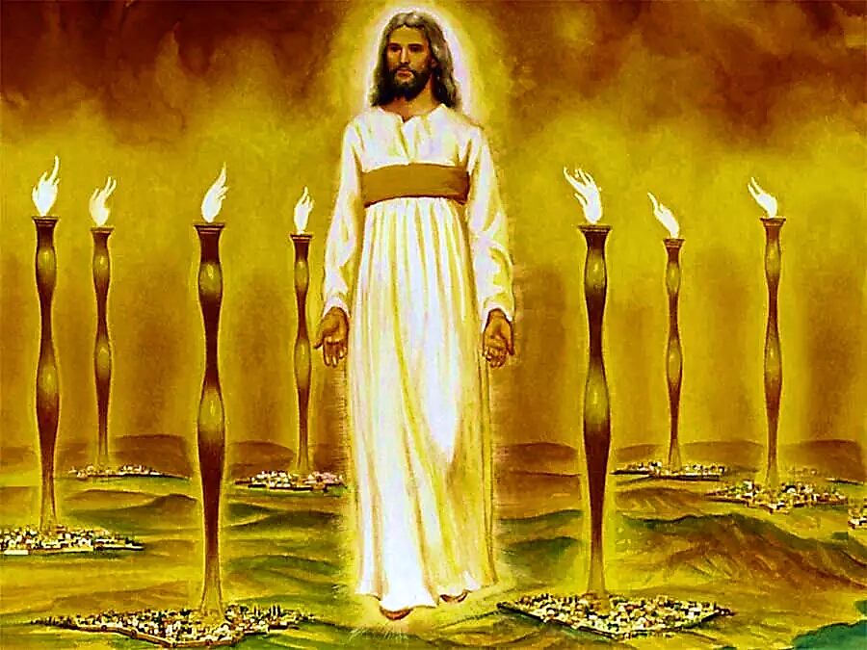
Christ, The Ultimate Motivation
He reminds them of His Presence
“These things says He who holds the seven stars in His right hand, who walks in the midst of the seven golden lampstands.” Rev. 2:1 (NKJV)

Slide 13
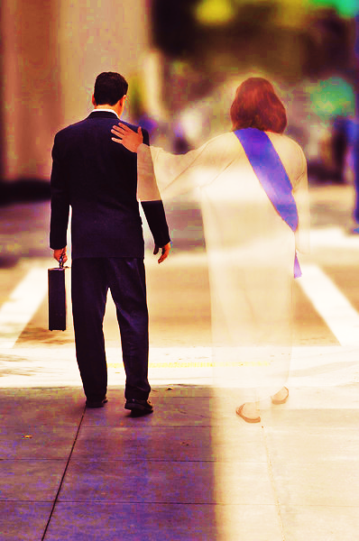
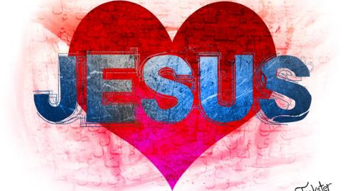
We need to remember that He walks beside us. He is a very present Savior. We must love Him from our hearts.

Slide 15
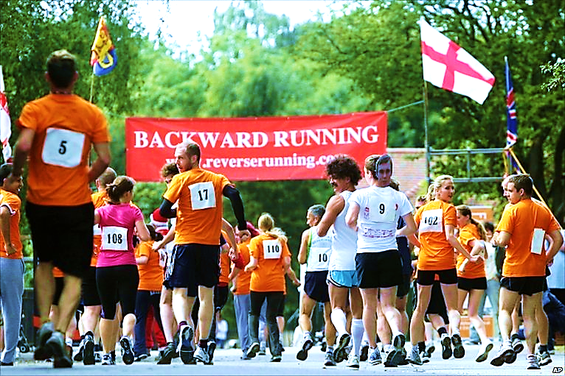
Runner Type
This runner is running backward.
He is slipping back into his old life.
“…I myself don’t think I’ve reached it, but I do this one thing: I forget about the things behind me and reach out for the things ahead of me.”
Phil. 3:13

Slide 16
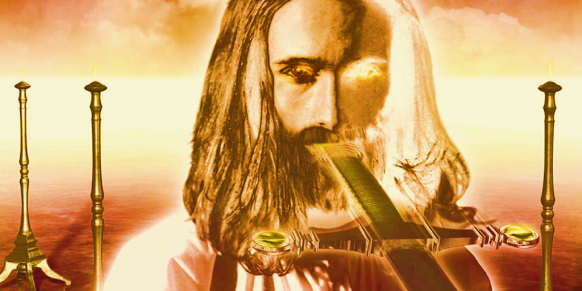
Christ, The Ultimate Motivation
He reminds them of His Sharp Word
“And to the angel of the church in Pergamos write; These things saith he which hath the sharp sword with two edges” Rev. 2:1 (NKJV)

Slide 18
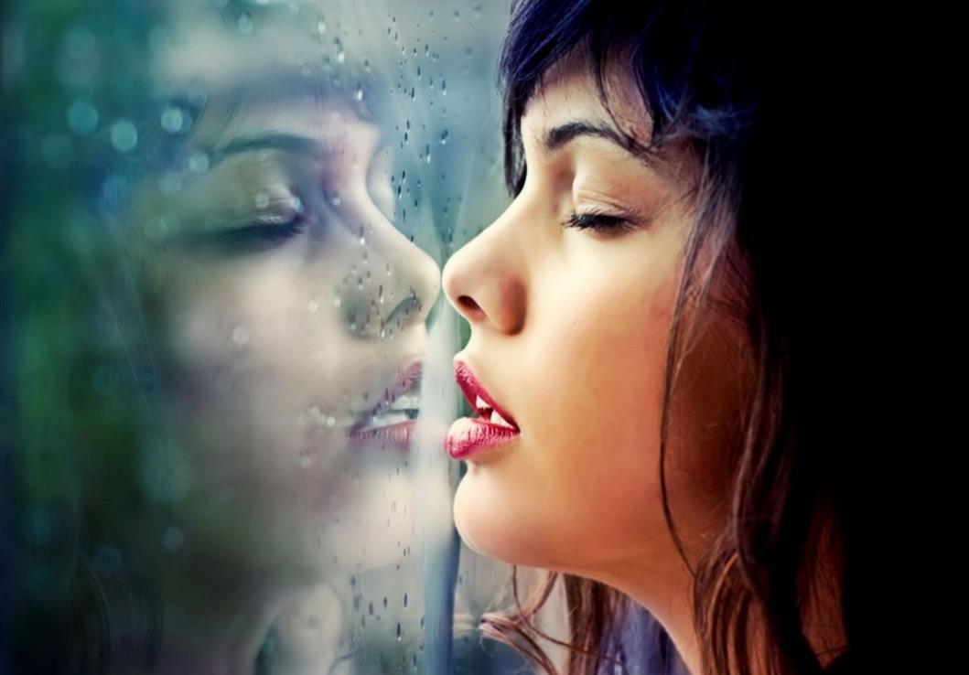
Runner Type
Along the way, this runner got distracted by her own reflection.
She spent so much time idolizing herself, she forgot about the Lord’s race.
Spiritual Pride is a deep & dark sin… and extremely difficult to overcome.

Slide 19
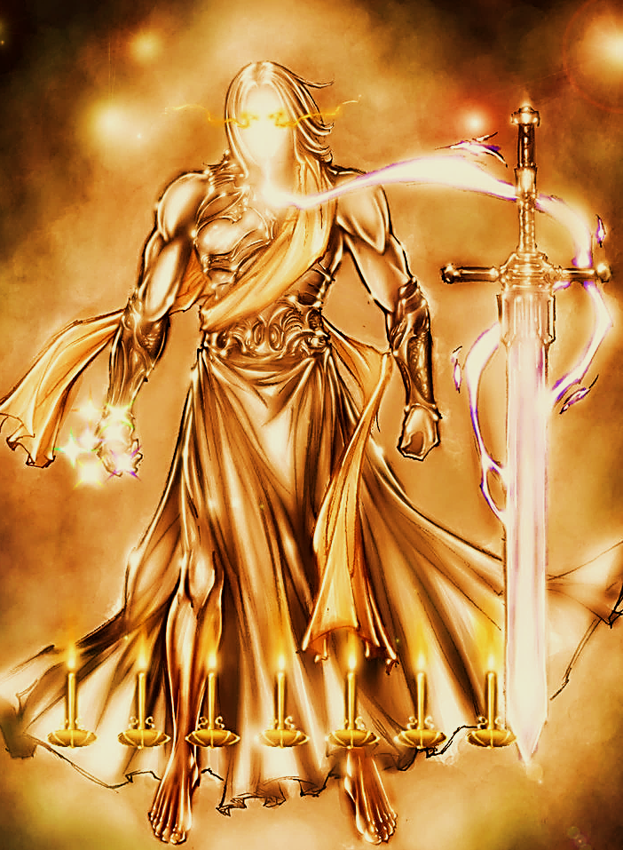
“These things saith the Son of God, who hath his eyes like unto a flame of fire, and his feet are like fine brass.” Rev. 1:18
Brass feet are a symbol of God’s judgement.
He tells those with spiritual pride that
He alone is God!
Christ, The Ultimate Motivation

Slide 21
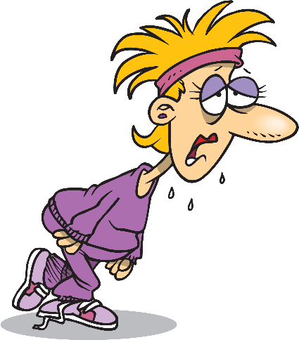
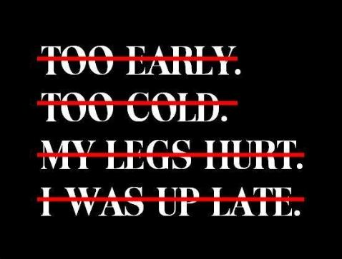
Runner Type
“For I have found what you are doing incomplete in the sight of my God.” Rev. 3:2 (CJB)
The Lazy Runner
She fell asleep on the track.

Slide 22
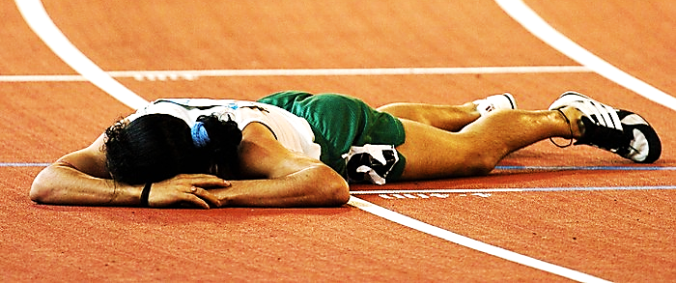
Wake Up or Die
“Wake up, and strengthen what remains, before it dies too!...
For if you don’t wake up, I will come like a thief; and you don’t know at what moment I will come upon you.” Rev. 3:2,3 (CJB)

Slide 23
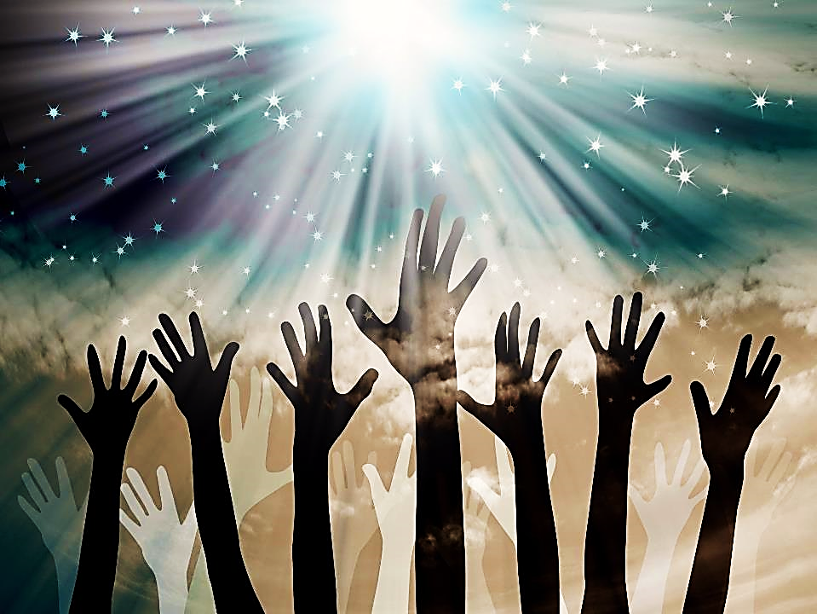
Christ, The Ultimate Motivation
“These things says He who has the seven Spirits of God and the seven stars.” Rev. 3:1
This is the Holy Spirit represented as seven spirits.
There is enough Holy Spirit for each of the seven churches to have their very own Holy Ghost revival.
Only the Holy Ghost can waken a sleeping church!

Slide 25
Runner Type:
This runner stopped on the race track to do some “glamping” (or, glamor camping).
She will not be finishing the real race because she feels sure that, once they see what she was able to build all by herself, the judges will give her the prize.

Slide 26
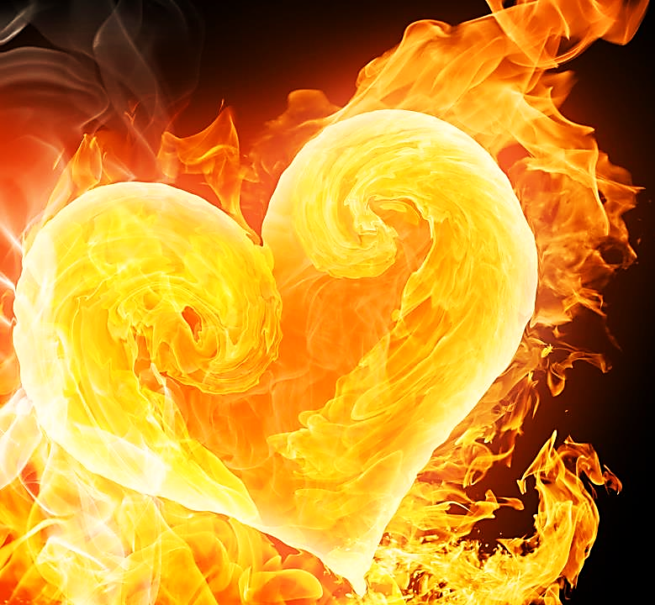
First Steps
Back to God:
Embrace Trials
“I advise you to buy gold from me—gold made pure in fire. Then you can be truly rich.”
Rev.3:18

Slide 27
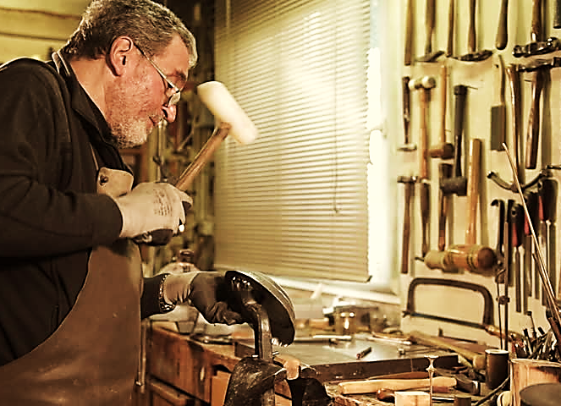
“These things says the Amen, the Faithful and True Witness, the Beginning of the creation of God.”
Rev. 3:14 (NKJV)
Our Creator can break us, melt us and make us again as worthy vessels.
Christ, The
Ultimate Motivation:

Slide 28
Done
Now

Slide 31
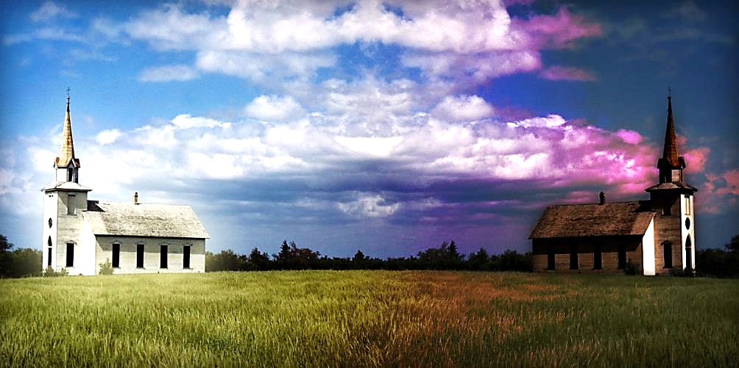
Philadelphia
Smyrna
Only two Churches Ran Well
and Finished the Race!
Both were persecuted. One was delivered from all it’s enemies. The other one was destroyed by them. But, Jesus praises them both equally!

Slide 32
Philadelphia
Smyrna
Sometimes God delivers His children from trials.
Sometimes He gives them grace in the midst of the trials.

Slide 33
Philadelphia
Smyrna
Sometimes He calms the storm.
Sometimes He calms the saint.

Slide 34
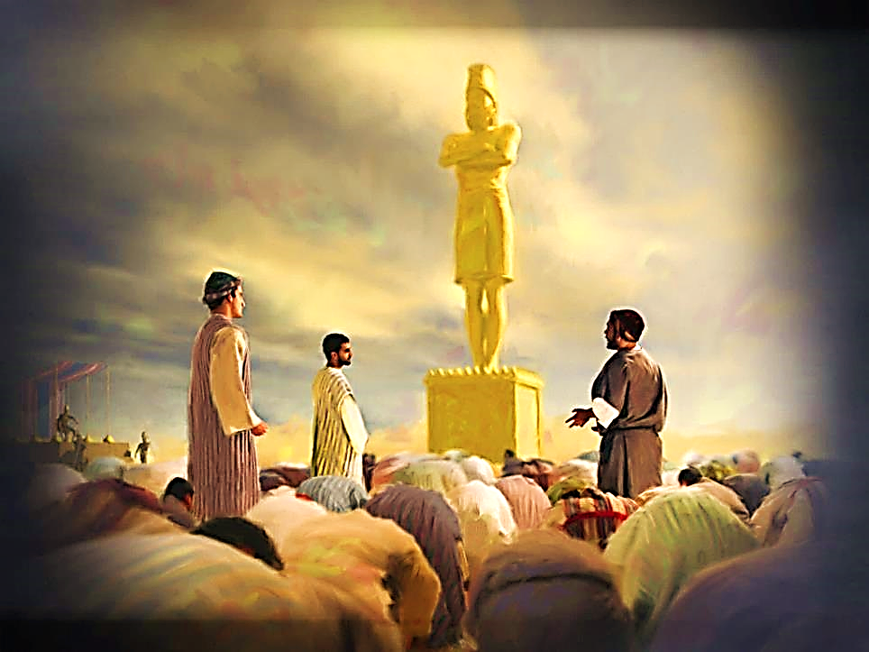
“Shadrach, Meshach, and Abednego answered, “Your Majesty, we will not try to defend ourselves. If the God…
…whom we serve is able to save us from the blazing furnace and from your power, then he will…
…But even if he doesn't, Your Majesty may be sure that we will not worship your god, and we will not bow down to the gold statue that you have set up.” Dan. 3:18. 18 (GNT)

Slide 35
“You have only a little strength, but you have obeyed my word and have not denied my name…
…those who belong to the synagogue of Satan—those who claim to be Jews and aren’t, but are lying…” Rev. 3:7, 9
Philadelphia
This church was persecuted by the Jews and was delivered by God.

Slide 36
“I know of your troubles. I know you are poor… I know the bad things spoken against you by those who say they are Jews. But they are not Jews. They belong to the devil.” Rev. 3:7, 9 (NLV)
Smyrna
This church was also persecuted by the Jews and suffered great loss.

Slide 38
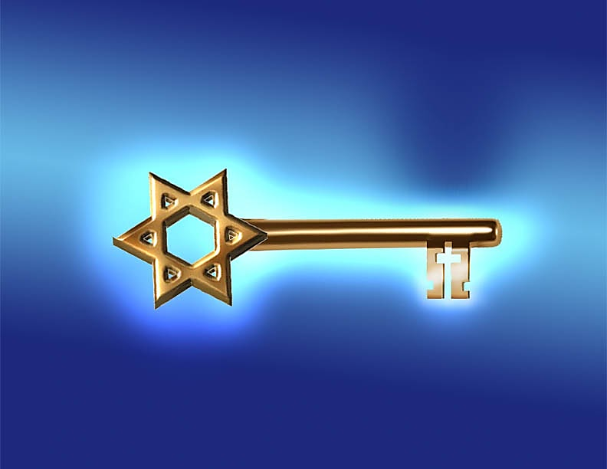
Jesus describes himself as…
“The one who is holy, who is true, who has the key of David.” Rev. 3:7
Key of David is about Jesus’ Gospel replacing Moses’ law.

Slide 39
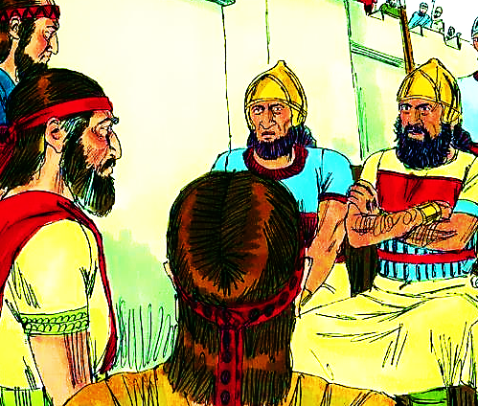
“The Lord God All-Powerful told me to go to Shebna, the palace manager, and say this: “…What a big man you are!
But the Lord will crush you… I will force you out of your position here. Your new leader will take you away from your important job…
An Old Testament story about a man named Shebna predicted this coming change.

Slide 40
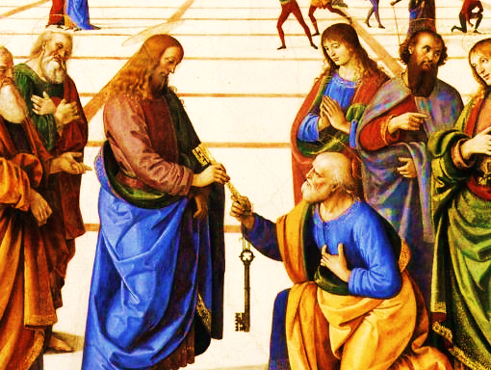
…At that time I will call for my servant Eliakim… I will take your robe and put it on him. I will give him your scepter. I will give him the important job you have…
I will put the key to David’s house around his neck. If he opens a door, no one will be able to close it. If he closes a door, no one will be able to open it.” Isa. 22:21, 22 (ICB)
Eliakim (a type of Christ) would replace Shebna—the former, bad palace manager— (a type of the law) and would receive the “Key of David.”

Slide 41
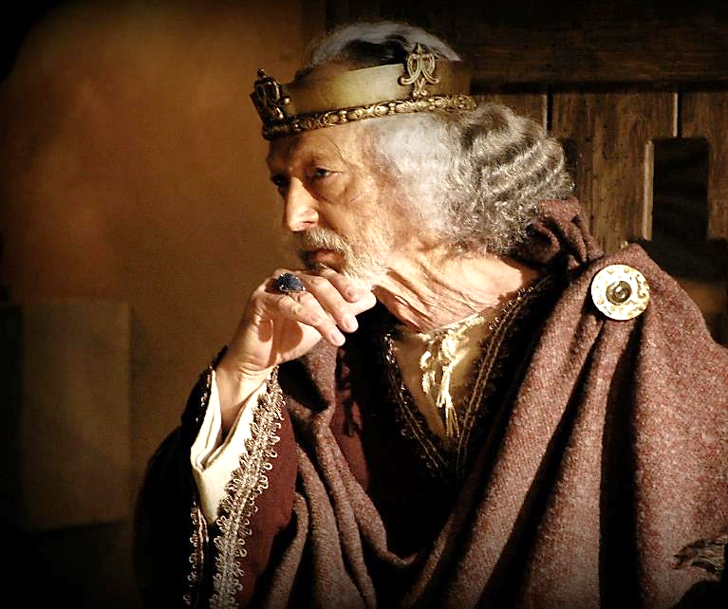
David was the Jewish King who was promised that the coming Christ would be born through
his blood line.
Like Eliakim,
His offspring
was promised great authority.

Slide 42
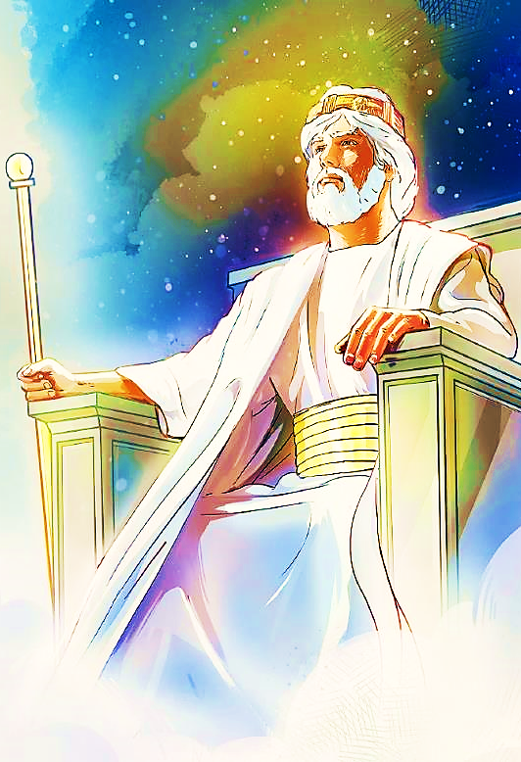
“…I will make your son’s family rule forever…. I will put him in charge of my house and kingdom forever. His rule will continue forever!” 1 Chron. 17:12, 14 (ERV)
“The Lord God will give him the throne of his forefather, David, and he will be king over the people of Jacob forever. His reign shall never end.” Lk. 1:32 (Phil)

Slide 43
Jesus, like Eliakim, would be given the official position and put in charge. Jesus would be put in charge of everything!
Like Shebna’s job, the time of Moses’ Law ended because it had failed (to save mankind).

Slide 44
He promised David that a son from his line would inherit the key to everything (the key of David).
That was Jesus! He
His gospel would
replace the failing old
law of
Moses.

Slide 45
“But Christ has a
more perfect work…
The New Way of
Worship promises
better things. If the Old
Way of Worship had been perfect, there would have been no need for another one…” Heb. 8:6, 7 (NLV)

Slide 46
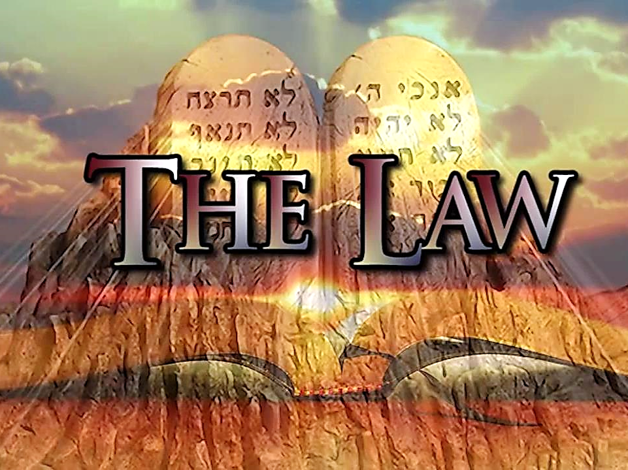
The idea of Jesus and His Gospel replacing the law made the Jewish leaders very angry.

Slide 47
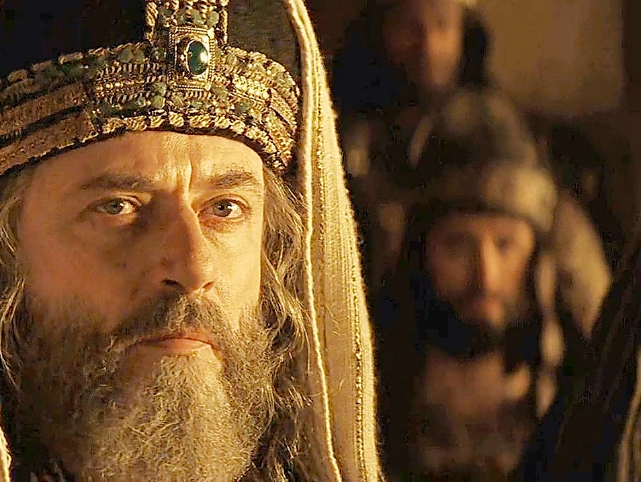
“I tell you that God’s kingdom will be taken from you and given to people who will do what he demands…
When the chief priests and the Pharisees heard these stories, they knew that Jesus was talking about them. So, they looked for a way to arrest Jesus.”Mat. 21:43, 45 (CEV)

Slide 48
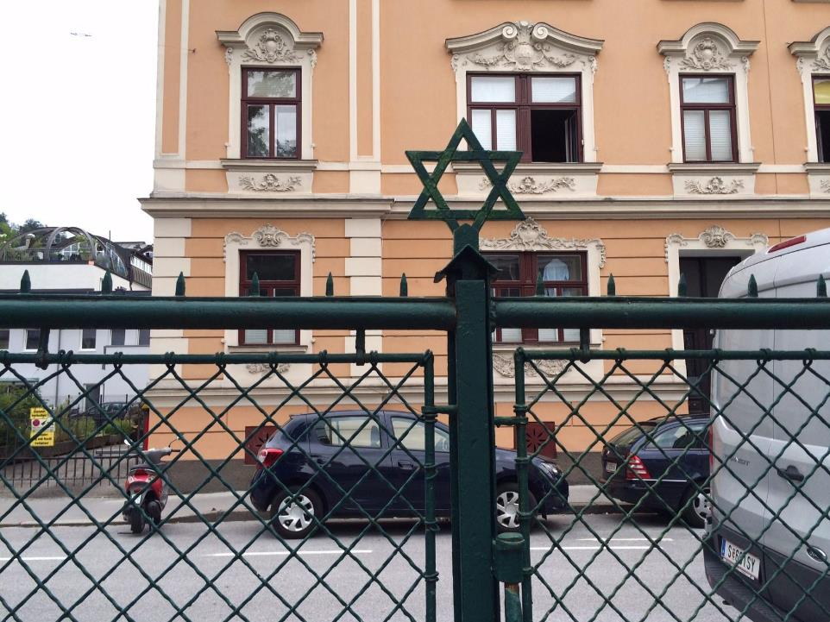
Perhaps the Jewish leaders even locked the Christians out of the synagogues.

Slide 49
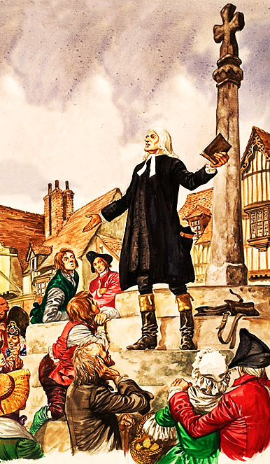
John Wesley was excluded from the Church of England, so he preached atop his father’s gravestone.
The crowds grew and he continued his preaching ministry in nearby fields, and on horseback through the highways and byways.
He was used in a great move of God.
When men shut doors, God opens them!

Slide 50
Christ, The
Ultimate Motivation:
“He who has the key of David, He who opens and no one shuts, and shuts and no one opens…” Rev. 3:8
No one can keep the gospel from going forth. Jesus has the key and He will open doors of gospel opportunity for His name’s sake!

Slide 51
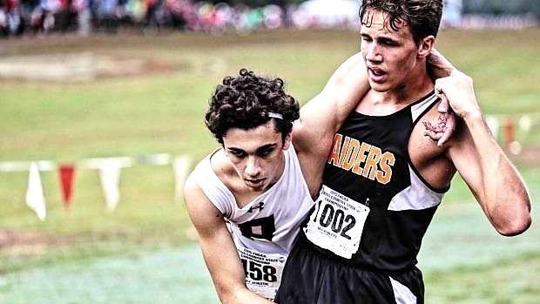
Runner Type
This runner is tired and sore but someone stronger is helping him get to the end.

Slide 53
Remember that the church at Laodicea thought they were rich, but they were poor.
The church at Smyrna was poor, but God says they were rich!
I know your hardship and poverty (though you are actually rich). I also know the hurtful things that have been spoken about you…
Don’t be afraid of what you are going to suffer. Look! The devil is going to throw some of you into prison in order to test you…” Rev. 2: 9, 10

Slide 54
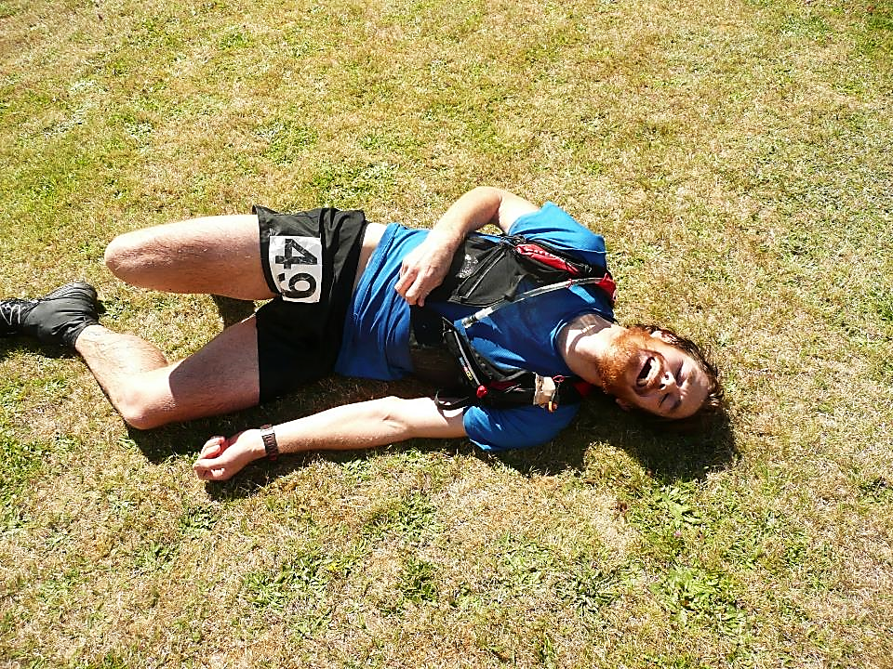
Unlike the saints at Philadelphia, the saints at Smyrna would not be delivered from persecution.
This runner type died on the field—a martyr!

Slide 55
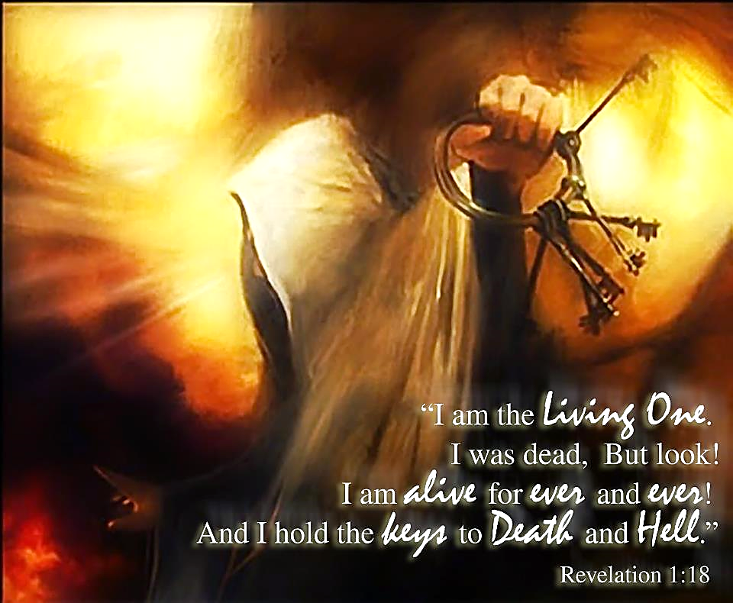
Christ, The
Ultimate Motivation:
More keys,
But not the keys that open doors, rather the keys that open graves.

Slide 56
The Ultimate Lifetime Achievement Award

Slide 57
To be used of God as fully
as we are called of God.

Slide 58
Song: The Voice of the Martyrs
Video Goes Here Title: The Voice of the Martyrs Download Here:
https://youtu.be/DiMeyIV3I80

Slide 59
Is Jesus
Speaking to You?
“They said to each other, ‘Did not our hearts burn within us while he talked to us on the road, while he opened to us the Scriptures?’”
John Wesley Said:
“…the preacher was describing the change which God works in the heart through faith in Christ and I felt my heart strangely warmed.”
Jesus makes His presence Known by a small voice!

Slide 61
What is the Sinner‘s Prayer?
This is a prayer we can pray when we are ready to admit we are sinners and need Christ’s forgiveness.
It must be prayed with faith in our hearts and a readiness to have a life-changing encounter with Jesus Christ.

Slide 62
A prayer of faith → Pray this prayer if :
If you never have before
You have in the past, but you think it would mean more today
You have been walking afar off and you want to come back
You want to set an example & show others how it is done
You just like to give your heart to Jesus again & again
Faith

Slide 63
We Declare Our Faith Publicly Because Jesus Declared His LOVE Publicly
“If you stand before others and are willing to say you believe in me, then I will tell my Father in heaven that you belong to me.” Mat 10:32

Slide 64
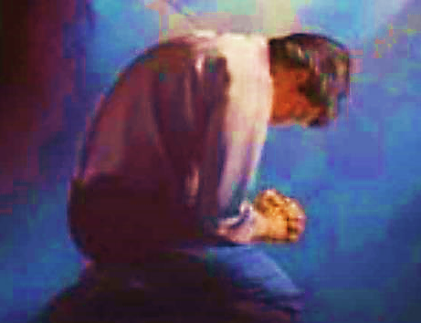
Three Important Questions
Do you want to know Jesus as your Savior right now?
Do you believe He died to save you from your sins & that He rose from the dead?
Do you believe that He is here, waiting to save you right now?

Slide 65
The Prayer of a Sinner Turning to Jesus
Dear Jesus, I know that I have sinned against You and that my sins separate me from You.
I am truly sorry.
Right now, I turn away from my sinful past .
Please forgive me, and help me to keep from sin.
I believe You died for my sins.
I Believe You rose from the dead, you are alive, and you hear this prayer from my heart.
I invite You Jesus to be both my Savior and the Lord of my life.
I want You to rule my life from now on.

Slide 66
“But some people did accept him. They believed in him, and he gave them the right to become children of God.”
John 1:12

Slide 68
“If you openly say, ‘Jesus is Lord’ and believe in your heart that God raised him from death, you will be saved.”
Rom. 10:9
What did you learn today?
What about Christian Martyrs?
What have you been thinking about God lately?
What do you want to tell others about Jesus?

Slide 69
Let’s Close in Prayer

Slide 70
Note: After you download the slideshow, you may also need to download some videos from YouTube & add them into this PowerPoint. This tool can help you: Free YouTube Download
We present these messages in outdoor venues using the SonShineTent. Watch the video of our service that goes with this message, click here: http://campaignkerusso.org/?p=14739
We would love to know more about the people who download our lessons & sermons. We invite you to email us & let us know where & how you use them.
info@campaignkerusso.org

