Slide 1
Help, I Have a Hole in My Soul

Slide 2
Note: After you download the slideshow, you may also need to download some videos from YouTube & add them into this PowerPoint. This tool can help you: Free YouTube Download
We present these messages in outdoor venues using the SonShineTent. Watch the video of our service that goes with this message, click here: http://campaignkerusso.org/?p=6044
We would love to know more about the people who download our lessons & sermons. We invite you to email us & let us know where & how you use them.
info@campaignkerusso.org

Slide 3
Welcome All

Slide 4
Let’s Begin with Prayer

Slide 5
Next Slide →
Song: Only You Can Satisfy
Download Here: https://youtu.be/ZeGQzpFCePk

Slide 6
Help, I Have a Hole in My Soul

Slide 7
Many know what it is like to feel empty, alone, misunderstood… like they don’t belong.
It feels like a big hole in the middle of your being.
It’s an emptiness that never gets completely filled… an insatiable hole.

Slide 8
Mankind was Created Full of God’s Breath
God created us in His Image.
We were given life by an infilling of God’s breath.
We were made spiritual beings.

Slide 9
“And the LORD God formed man of the dust of the ground, and breathed into his nostrils the breath of life; and man became a living soul.” Gen. 2:7
“The Spirit of God has made me; the breath of the Almighty gives me life.” Job 33:4

Slide 10
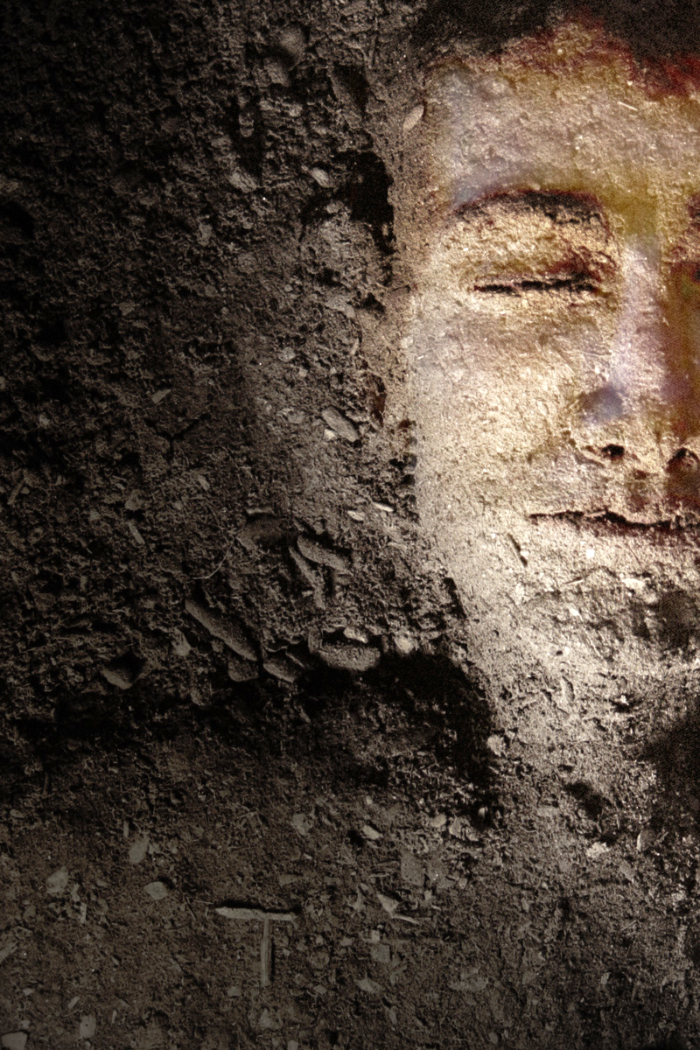
Man’s outer shell was made with dirt from the earth, but his inner soul was infused with God’s Spirit.

Slide 11
Sadly, we push God out of our lives. We make ourselves empty!

Slide 12
We try to fill the hole (originally made for God’s Spirit) with more & more earthly matter (material things and sensory experiences).

Slide 13
We try to fill the emptiness with:
Relation-ships,
Parties,
Money,
Long Life, (yes, long, but oh so empty).

Slide 14
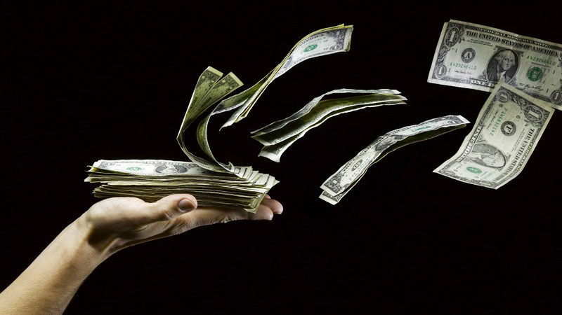
“Why spend money on what does not satisfy? Why spend your wages and still be hungry? Listen to me and do what I say, and you will enjoy the best food of all.” Isa. 55:2

Slide 15
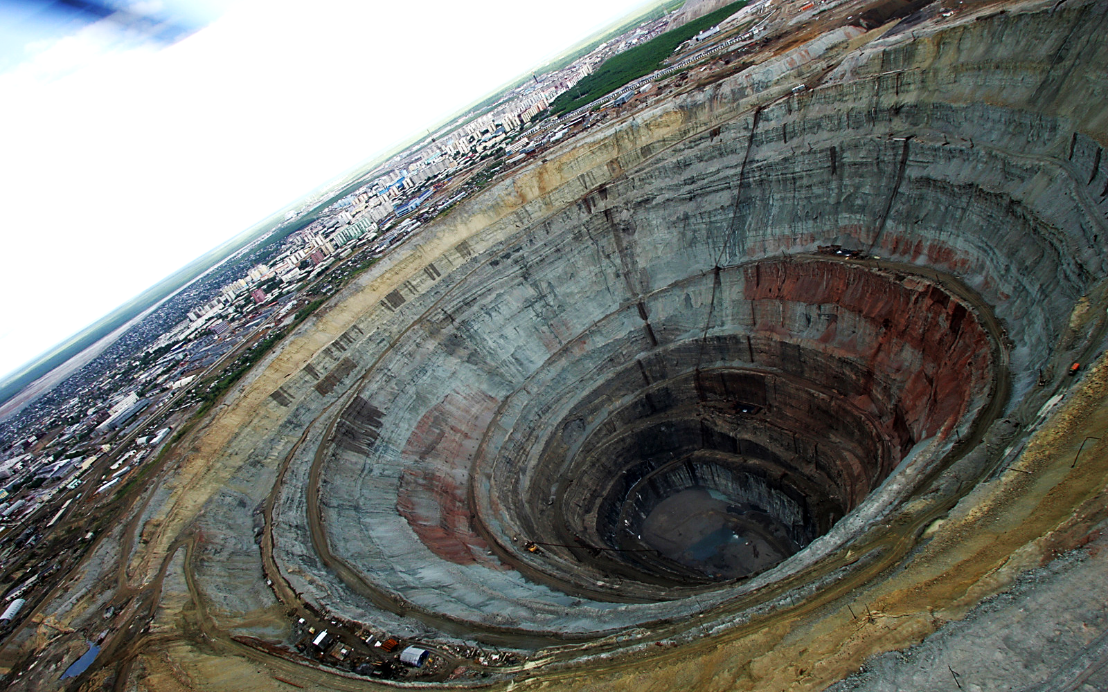
True Story:
Mirny Diamond Mine (in Russia) is the biggest hole in the world.
At its peak, it produced over 10 million carats of diamonds per year.
It helped Russia become a World power.

Slide 16
Its depth of about 1,722 ft. and its diameter of about 3,900 ft.
It’s now tapped out and closed.
All that is left is this giant hole in the ground.

Slide 17
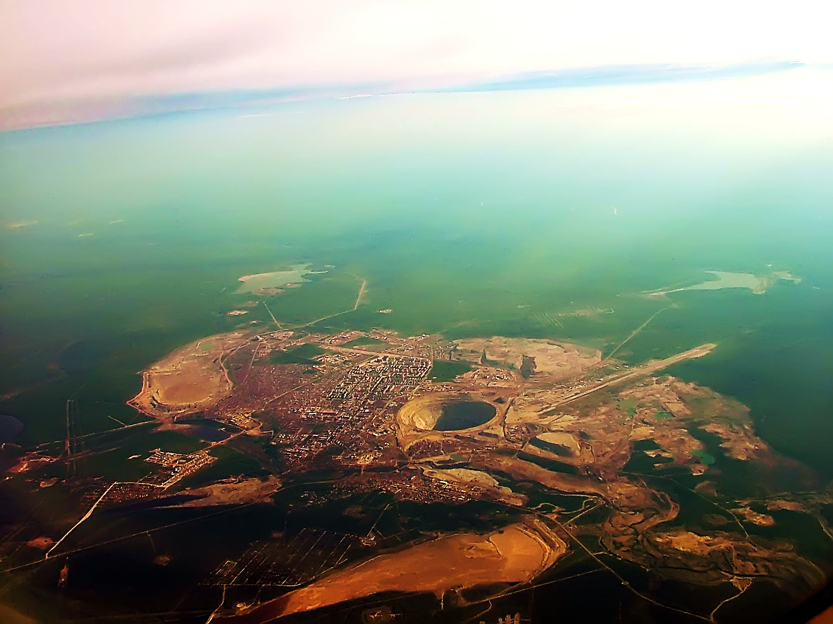
Because of its size, the atmospheric suction just above the hole has caused several helicopters to actually go down.
Now it’s officially a “No Fly Zone,” no flights are allowed above the hole.

Slide 18
God has given us life, but when we spend that life on power, pleasures, fame and worldly goods, we are left with nothing but a giant hole where there should be a living soul.

Slide 19
That hole can be so large it sucks in and damages anyone flying near us.
Others may even start to proclaim us a “No Fly Zone.”

Slide 20
“I became very famous, even greater than anyone who had lived in Jerusalem before me. My wisdom helped me in all this. Anything I saw and wanted, I got for myself; I did not miss any pleasure I desired. I was pleased with everything I did, and this pleasure was the reward for all my hard work.” Eccl. 2:9,10

Slide 21
“But then I looked at what I had done, and I thought about all the hard work. Suddenly I realized it was useless, like chasing the wind. There is nothing to gain from anything we do here on earth.” Eccl. 2:11

Slide 22
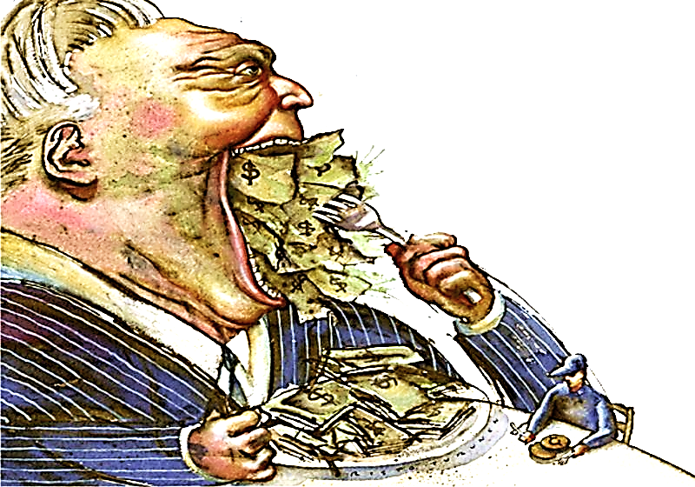
“Those who love money will never have enough. How meaningless to think that wealth brings true happiness!”
Eccl. 5:10

Slide 23
Some try to fill that Heavenly Spiritual hole (made by God and for God) with so called, “spiritual things.” All they really end up with is false spirituality or worse—evil spirits.
“The Holy Spirit clearly says that in the last days some people will leave the faith. They will follow spirits that will fool them. They will believe things that demons will teach them.”
1 Tim. 4:1
“Dear Christian friends, do not believe every spirit. But test the spirits to see if they are from God for there are many false preachers in the world.”
1 John 4:1

Slide 24
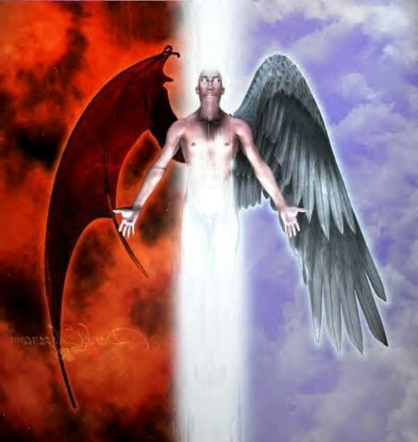
“That comes as no surprise. Even Satan himself pretends to be an angel of light.”
1 Cor. 11:14

Slide 25
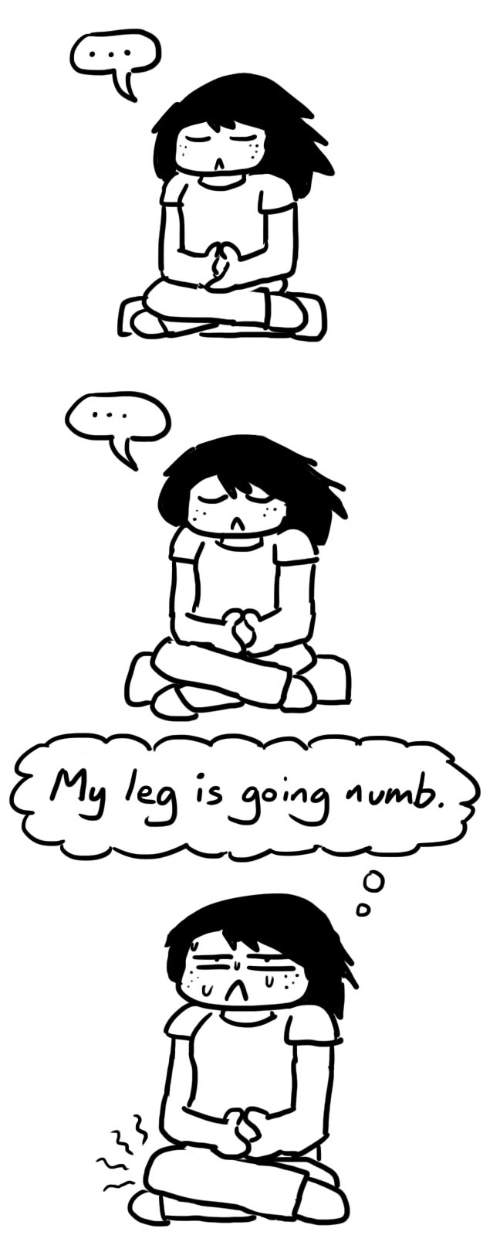
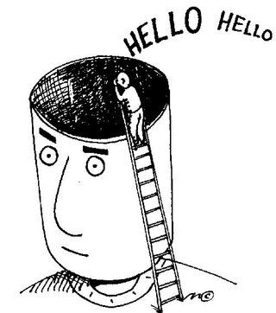
Many are attracted to false spiritually because they feel they are full of toxic junk and they hope to be
cleansed and enlightened.
Unfortunately, these teachings often stress emptiness as the way to bliss, but God never intended for us to be empty. He intended us to be full of Him.

Slide 26
Jesus warned of the danger
of a spiritual vacuum in a man’s soul.
“When the evil spirit comes out of a man, it wanders through waterless places looking for rest, and when it fails to find any, it says, ‘I will go back to my house from which I came.’ When it arrives, it finds it cleaned and all in order…

Slide 27
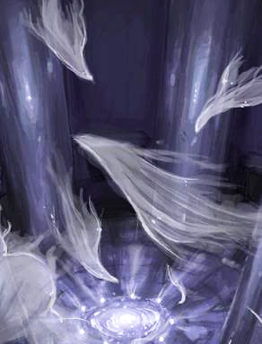
…Then it goes and collects seven other spirits more evil than itself to keep it company, and they all go in and make themselves at home. The last state of that man is worse than the first.” Luke 11:24-26

Slide 28
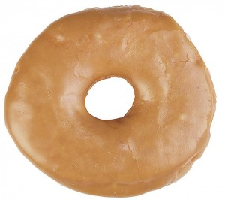
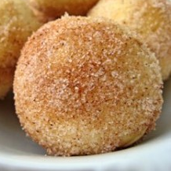
Jesus is like our ‘Doughnut’ Hole
As the doughnut hole is made of the same stuff as the doughnut, so God (Who is Living Spirit) is the only thing that belongs in the Human soul. That which was taken out (God) must be put back in!

Slide 29
Next Slide →
Song: Life Without Jesus Download Here:
https://youtu.be/BiHIuU7kDRs

Slide 30
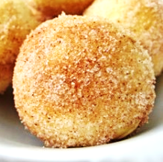
Rejecting God left an ETERNAL sized hole in us.
Everything in the World cannot fill us because it is all just TEMPERAL.
Only the ETERNAL Son of God can fill the emptiness of our Lives.

Slide 31
“If I find in myself a desire which no experience in this world can satisfy, the most probable explanation is that I was made for another world.”
CS Lewis

Slide 32
Jesus Fills the Hole in My Soul

Slide 33
“I am the living bread that came down from heaven. Whoever eats this bread will live forever. This bread is my flesh, which I will give for the life of the world.” John 6:51
“Poor people, come eat and be satisfied. You who have come looking for the Lord, praise him! May your hearts be happy forever.” Ps. 22:26
“Satisfy us with your faithful love every morning. Then we can sing for joy and be glad all our days.” Ps. 90:14

Slide 34
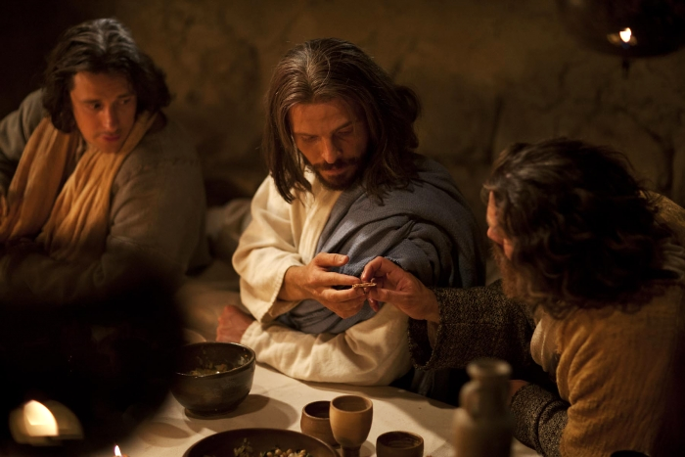
Jesus Fills the Hole in My Soul!
Nothing Can Fill our Lives but the Life Giver Himself!
As bread fills our bellies, so Jesus fills our souls!

Slide 35
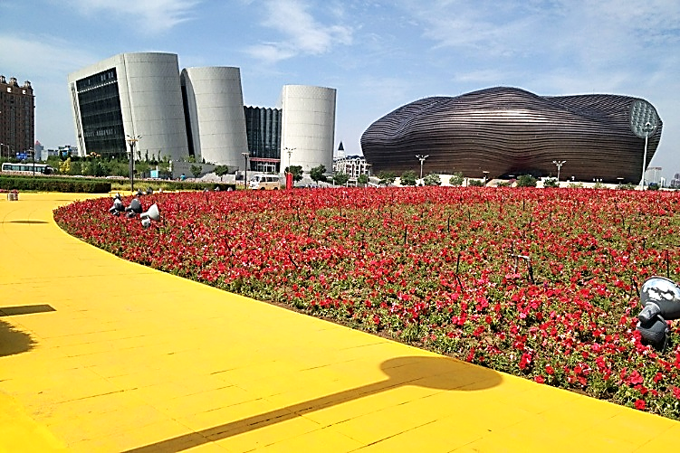
True Story:
Ordos, China is known as “The World’s Largest Ghost City.”
It was built for over a million people and designed to be the crowning glory of Inner Mongolia.
This futuristic (but empty) metropolis now rises over Northern China.

Slide 36
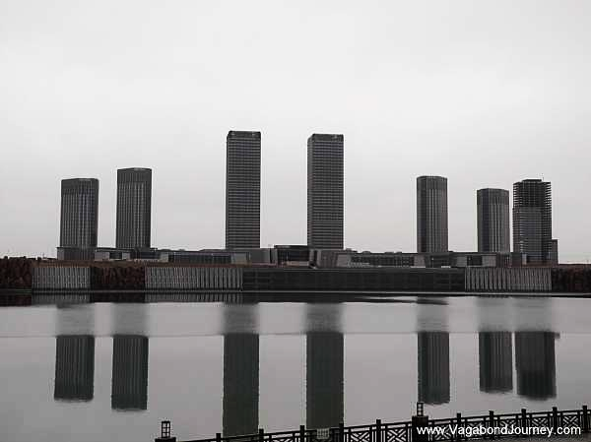
Deadlines weren’t met, loans went unpaid, and investors pulled out.
Less than 2% of its buildings were occupied.
Abandoned mid-construction, it’s been left to decay.
Well-lit restaurants & shops keep their doors open but there are no customers.
A statue’s sad inscription reads “The Outstanding Tourism City of China.”

Slide 37
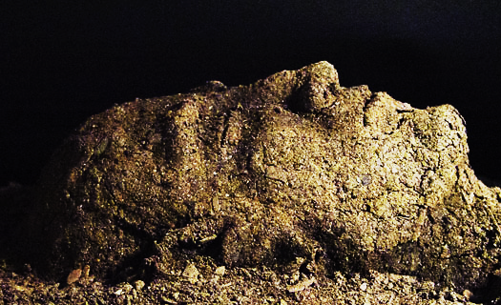
Like Ordos, we were created for a purpose—to be inhabited, but like that sad, lonely, decaying city, deprived of of its intended residency, we are nothing but empty fancy “houses” destined to eventually crumble back into Earth.
“…You will work hard until the day you die, and then you will become dust again. I used dust to make you, and when you die, you will become dust again.” Gen. 3:19

Slide 38
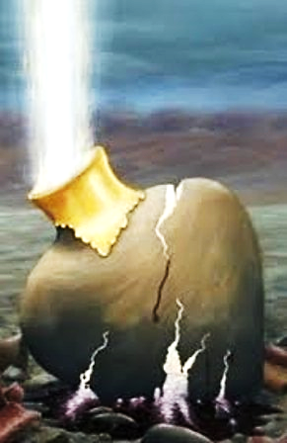
“We are like clay jars in which this treasure is stored. The real power comes from God and not from us.” 2 Cor. 4:7
“We know that if the tent that we live in on earth is torn down, we have a building from God. It’s a house that isn’t handmade, which is eternal and located in heaven.” 2 Cor. 5:1
Heaven Bound
Spirit
Full of God

Slide 39
“Then the dust will return to the earth as it was. And the spirit will return to God Who gave it.” Eccl. 12:7
Unbelievers are Soul Dead & Empty Within.
Heaven Bound
Spirit
Jesus gives Believers the Spirit of God. They are Living Souls-- Citizens of Heaven.

Slide 40
Next Slide →
Song: Jesus at the Center Download Here:
https://youtu.be/y6JYHnMsqp0

Slide 41
Is Jesus
Speaking to You?
“They said to each other, ‘Did not our hearts burn within us while he talked to us on the road, while he opened to us the Scriptures?’”
John Wesley Said:
“…the preacher was describing the change which God works in the heart through faith in Christ and I felt my heart strangely warmed.”
Jesus makes His presence Known by a small voice!

Slide 43
What is the Sinner‘s Prayer?
This is a prayer we can pray when we are ready to admit we are sinners and need Christ’s forgiveness.
It must be prayed with faith in our hearts and a readiness to have a life-changing encounter with Jesus Christ.

Slide 44
A prayer of faith → Pray this prayer if :
If you never have before
You have in the past, but you think it would mean more today
You have been walking afar off and you want to come back
You want to set an example & show others how it is done
You just like to give your heart to Jesus again & again
Faith

Slide 45
We Declare Our Faith Publicly Because Jesus Declared His LOVE Publicly
“If you stand before others and are willing to say you believe in me, then I will tell my Father in heaven that you belong to me.” Mat 10:32

Slide 46
Three Important Questions
Do you want to know Jesus as your Savior right now?
Do you believe He died to save you from your sins & that He rose from the dead?
Do you believe that He is here, waiting to save you right now?

Slide 47
The Prayer of a Sinner Turning to Jesus
Dear Jesus, I know that I have sinned against You and that my sins separate me from You.
I am truly sorry.
Right now, I turn away from my sinful past .
Please forgive me, and help me to keep from sin.
I believe You died for my sins.
I Believe You rose from the dead, you are alive, and you hear this prayer from my heart.
I invite You Jesus to be both my Savior and the Lord of my life.
I want You to rule my life from now on.

Slide 48
“But some people did accept him. They believed in him, and he gave them the right to become children of God.”
John 1:12

Slide 50
“If you openly say, ‘Jesus is Lord’ and believe in your heart that God raised him from death, you will be saved.”
Rom. 10:9
What did you learn today?
What about…
What have you been thinking about God lately?
What do you want to tell others about Jesus?

Slide 51
Let’s Close in Prayer

