Slide 1
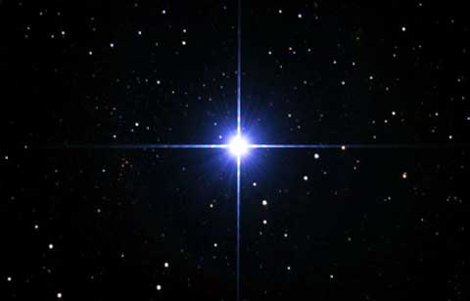
The Stars & Stripes of Jesus

Slide 2
Note: After you download the slideshow, you may also need to download some videos from YouTube & add them into this PowerPoint. This tool can help you: Free YouTube Download
We present these messages in outdoor venues using the SonShineTent. Watch the video of our service that goes with this message, click here: http://campaignkerusso.org/?p=5054
We would love to know more about the people who download our lessons & sermons. We invite you to email us & let us know where & how you use them.
info@campaignkerusso.org

Slide 3
Welcome All

Slide 4
Let’s Begin with Prayer

Slide 5
The Stars & Stripes of Jesus

Slide 6
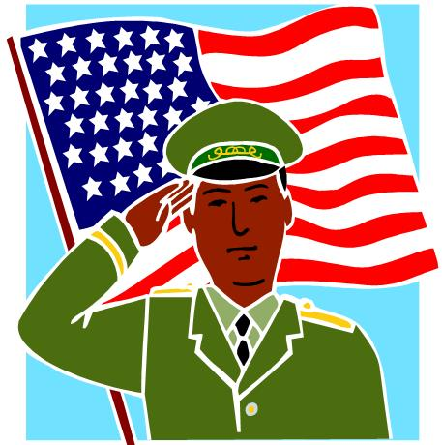
A nation’s flag is its banner – its identity.
It represents its history & values.

Slide 7
On the battlefield, men use to identify themselves by the flag they stood under.
They were saying, “This is my tribe and I am willing to die for it.”

Slide 8
Martyrs
The bible likens the church to
A marching army:
“Who is this woman? …She is as majestic as troops carrying their banners.” Song 6:10

Slide 9
Christians have their own banner
But this piece of flapping cloth isn’t it !
Our “banner” is a person.
Moses said:
“… The Lord Is My Banner” Ex. 17:15
Let’s Shout it out with Moses:

Slide 10
Christians have their own banner
But this piece of flapping cloth isn’t it !
Our “banner” is a person.
Moses said:
“… The Lord Is My Banner” Ex. 17:15
Let’s Shout it out with Moses:
The Lord is My Banner

Slide 11
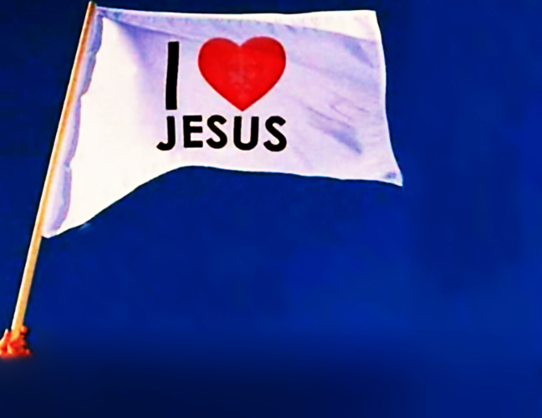
“Thou hast given a banner to
them that fear thee, that it may
be displayed because of the truth. Selah.” Ps. 60:4
“He brought me to the banqueting house, and his banner over me was love.” Song. 2:4

Slide 12
The Stars & Stripes of Jesus
Jesus was born under a star and He is called “The Morning Star”—His Heavenly nature.
He died after being tortured with 39 cruel stripes—what He suffered to win our freedom.

Slide 13
"Who Himself bore our sins in His own body on the tree… by whose stripes you were healed.”
1 Peter 2:24

Slide 14
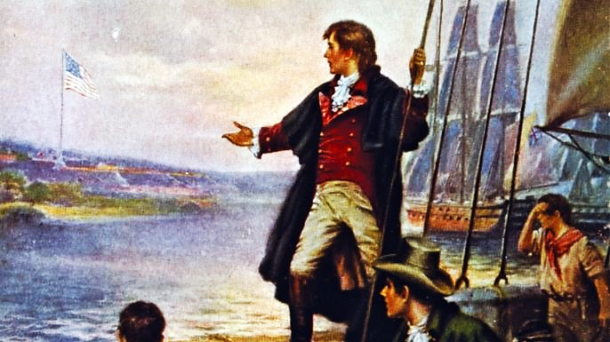
The Story behind the
Star Spangled Banner

Slide 15
Next Slide - Video: Story Behind Star Spangled Banner → Download Here: https://www.youtube.com/watch?v=YaxGNQE5ZLA

Slide 16
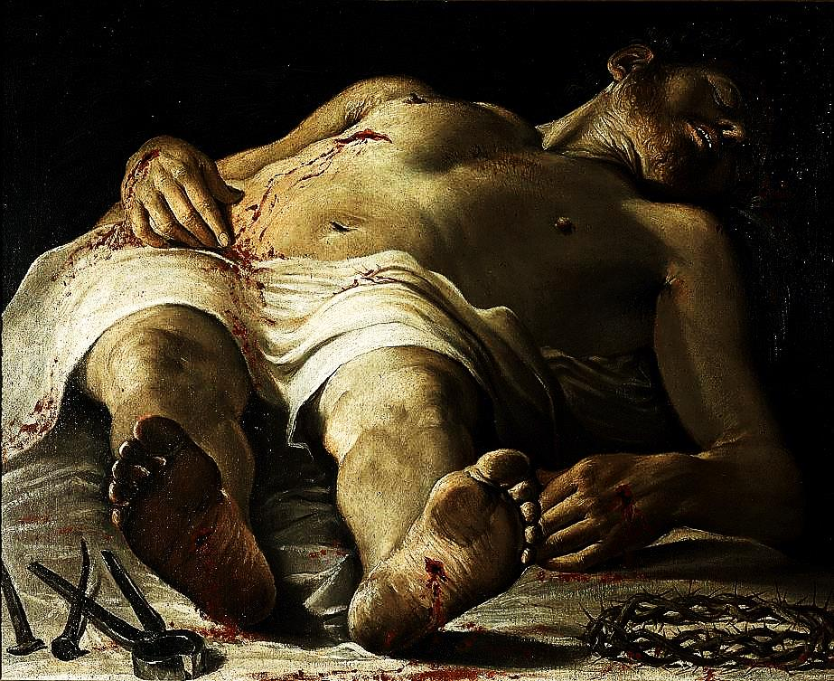
The Story of Christ, Our Banner
Our enemy took mankind prisoner.
A legal release had been negotiated at the cross—rendering the prisoners officially free.
However, one more, potentially devastating battle might render that deal irrelevant. Jesus still had to face the grave & Hell itself.
Mankind was watching. Will Jesus rise or remain in Hell—defeated? What will happen to our banner?

Slide 17
The prisoners are set free.
Praise God, after a long three day watch, Jesus did Rise on Easter Morning…
‘…by the dawn’s early light’
Indeed, our banner yet waves!

Slide 18
In the ‘Star Spangled Banner’ story, each group of loyalists took the flag and died holding it up, only to be replaced by another group willing to die to keep it flying.
Generation after generation, the church has proudly waved, stood for, and died for her glorious banner – the crucified & risen Christ.

Slide 19
As demonstrated by this famous moment in baseball history, a beloved banner will be fiercely defended by those who love it.

Slide 20
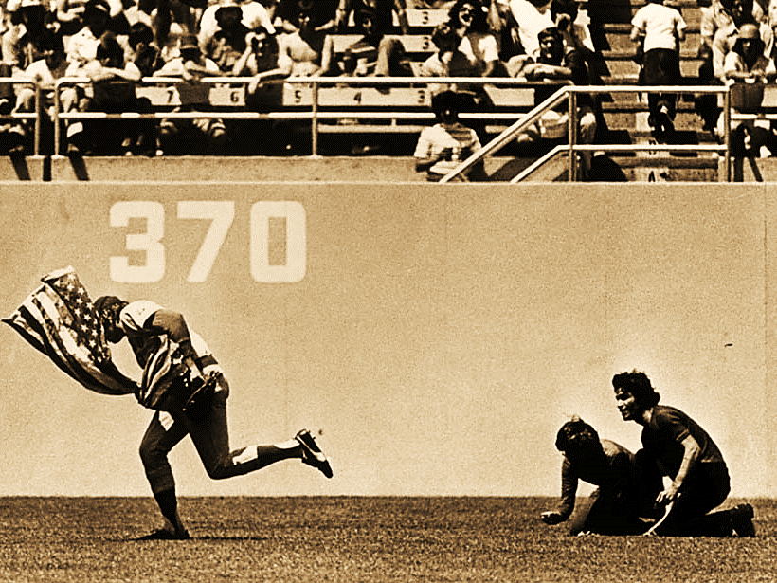
The Greatest Play in Baseball History Rick Monday saves the Flag.

Slide 21
Next Slide - Video: The Greatest Play in Baseball – Rick Monday saves the Flag → Download Here: https://www.youtube.com/watch?v=t0j1CpbC1t4 (***Note) This one takes a couple seconds to start playing.

Slide 22
If men will lay down their lives for love of a national flag…

Slide 23
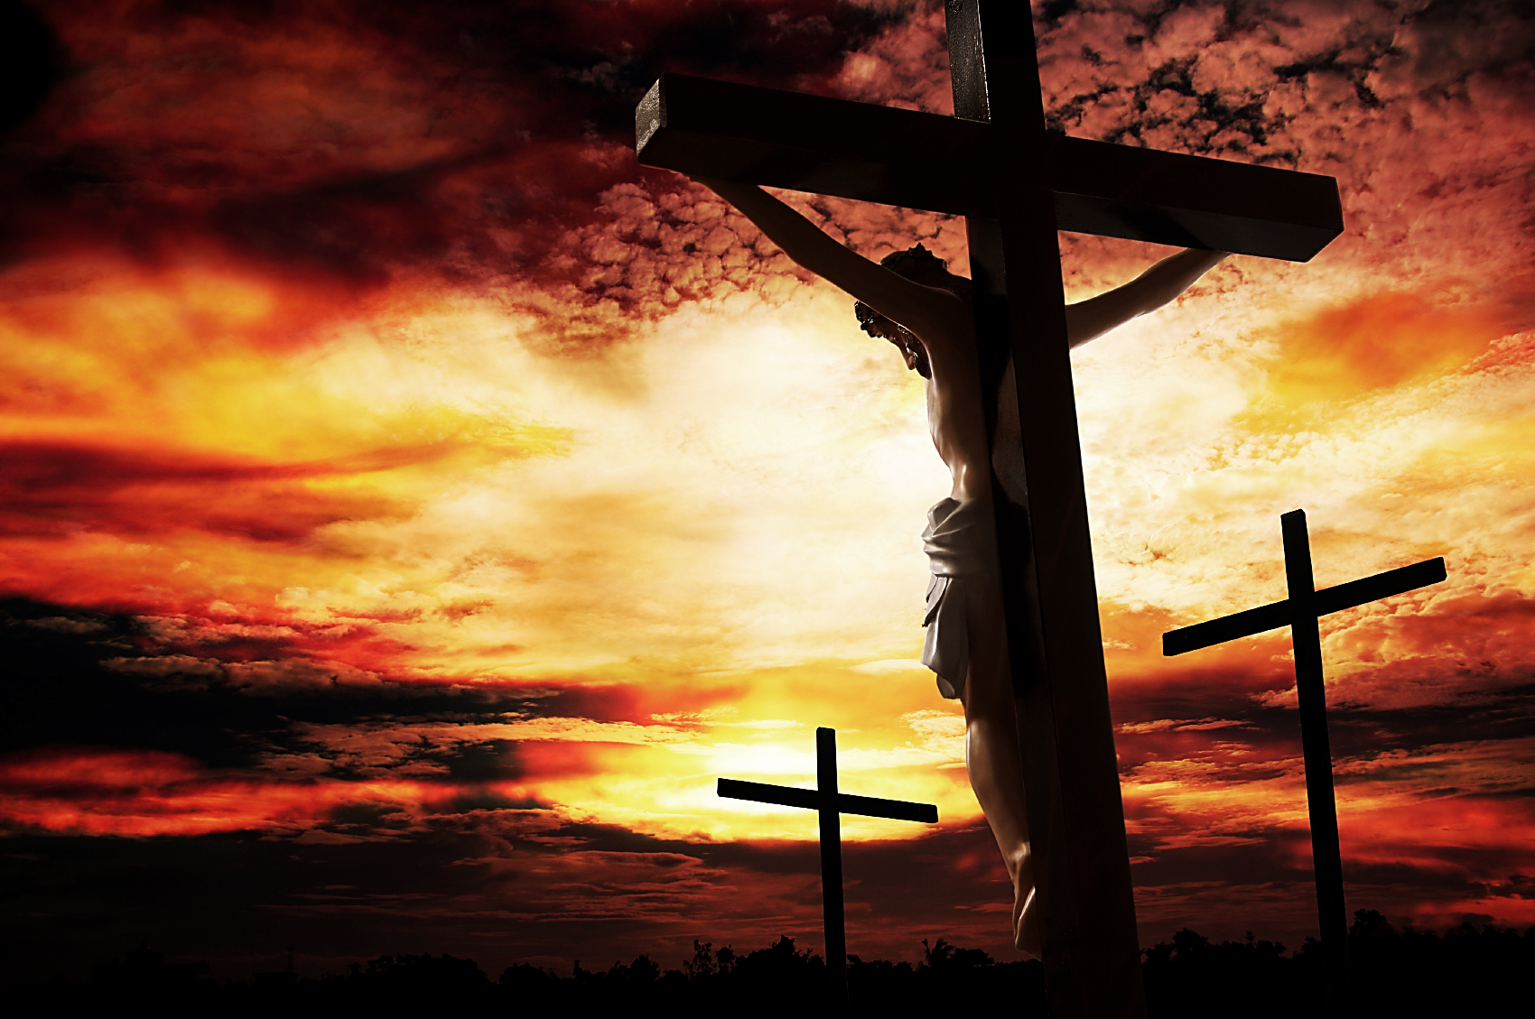
…how much more worthy of our devotion is the One who died to purchase our salvation?
What would we endure for His namesake?

Slide 24
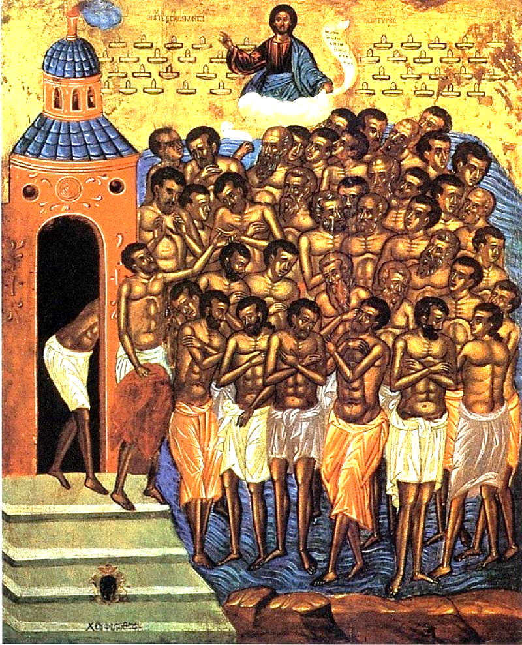
Listen to the true story of the Forty Martyrs of Sevaste— A story of fierce devotion to Christ.

Slide 25
Next Slide - Video: Amazing Story of Devotion—Forty Brave Soldiers → Download Here: https://www.youtube.com/watch?v=pXgEzauXUdc

Slide 26
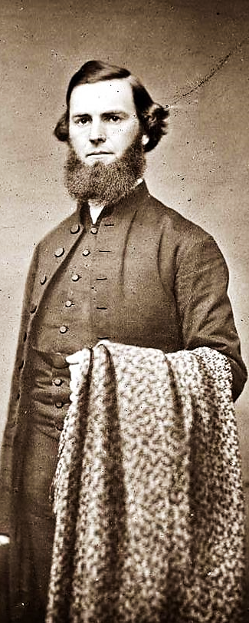
Rev. Dudley A. Tyng, a YMCA preacher, helped lead Philadelphia into major revival in the 1850’s.
During one service, while preaching on the text: “Ye that are men, go and serve the Lord” Ex.10:11, he shouted:
“I would rather this right arm were amputated at the trunk than that I should come short of my duty to you in delivering God’s message.”

Slide 27
Two weeks later, he accidently got his arm caught in a corn-thrasher where it was ripped out at the socket.
As he lay dying he said, “Tell my brethren… to stand up for Jesus.”
Upon hearing this story at Rev. Tyng’s funeral, his friend, Pastor George Duffield, was inspired to pen the words to this song: “Stand up for Jesus.”

Slide 28
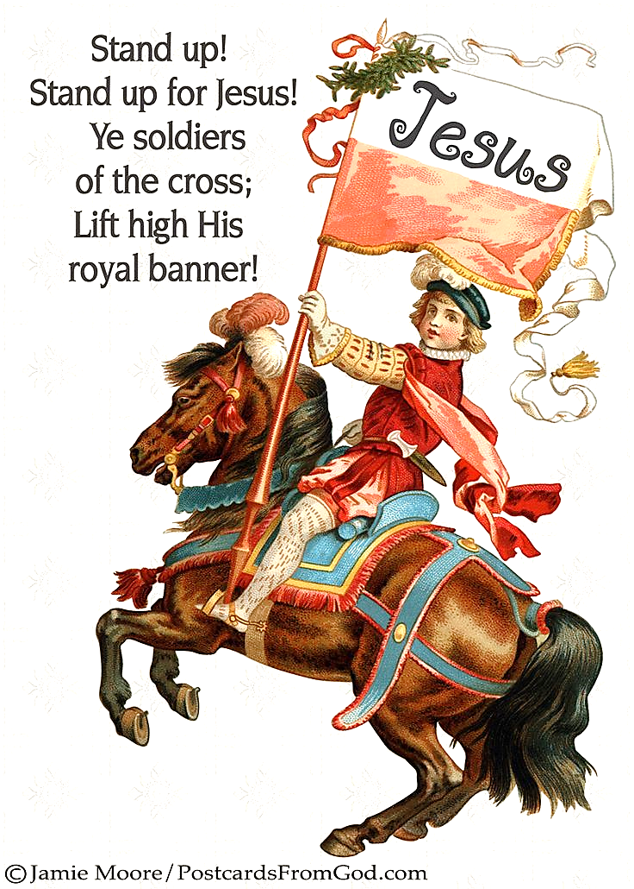
Be proud and wave our flag—We love Jesus, our Lord and Savior!
Let’s sing: Stand Up for Jesus.

Slide 29
Next Slide - Song: Stand Up, Stand Up → Download Here: https://www.youtube.com/watch?v=JcibPjUn4Fo

Slide 30
Is Jesus
Speaking to You?
“They said to each other, ‘Did not our hearts burn within us while he talked to us on the road, while he opened to us the Scriptures?’”
John Wesley Said:
“…the preacher was describing the change which God works in the heart through faith in Christ and I felt my heart strangely warmed.”
Jesus makes His presence Known by a small voice!

Slide 32
What is the Sinner‘s Prayer?
This is a prayer we can pray when we are ready to admit we are sinners and need Christ’s forgiveness.
It must be prayed with faith in our hearts and a readiness to have a life-changing encounter with Jesus Christ.

Slide 33
A prayer of faith → Pray this prayer if :
If you never have before
You have in the past, but you think it would mean more today
You have been walking afar off and you want to come back
You want to set an example & show others how it is done
You just like to give your heart to Jesus again & again
Faith

Slide 34
We Declare Our Faith Publicly Because Jesus Declared His LOVE Publicly
“If you stand before others and are willing to say you believe in me, then I will tell my Father in heaven that you belong to me.” Mat 10:32

Slide 35
Three Important Questions
Do you want to know Jesus as your Savior right now?
Do you believe He died to save you from your sins & that He rose from the dead?
Do you believe that He is here, waiting to save you right now?

Slide 36
The Prayer of a Sinner Turning to Jesus
Dear Jesus, I know that I have sinned against You and that my sins separate me from You.
I am truly sorry.
Right now, I turn away from my sinful past .
Please forgive me, and help me to keep from sin.
I believe You died for my sins.
I Believe You rose from the dead, you are alive, and you hear this prayer from my heart.
I invite You Jesus to be both my Savior and the Lord of my life.
I want You to rule my life from now on.

Slide 37
“But some people did accept him. They believed in him, and he gave them the right to become children of God.”
John 1:12

Slide 39
“If you openly say, ‘Jesus is Lord’ and believe in your heart that God raised him from death, you will be saved.”
Rom. 10:9
What did you learn today?
What about the Christian’s Banner?
What have you been thinking about God lately?
What do you want to tell others about Jesus?

Slide 40
Let’s Close in Prayer

Slide 41
Note: After you download the slideshow, you may also need to download some videos from YouTube & add them into this PowerPoint. This tool can help you: Free YouTube Download
We present these messages in outdoor venues using the SonShineTent. Watch the video of our service that goes with this message, click here: http://campaignkerusso.org/?p=5054
We would love to know more about the people who download our lessons & sermons. We invite you to email us & let us know where & how you use them.
info@campaignkerusso.org

