Slide 1


Slide 2



Note: Any videos in this presentation will only play online. After you download the slideshow, you will need to also download the videos from YouTube & add them back into your PowerPoint.
We present these messages at Bee Creek Park in College Station, TX.
If you would like to watch the video of the service with this message, click here:
http://campaignkerusso.org/?p=10932
We would love to know more about the people who download our lessons & sermons. We invite you to email us & let us know where & how you use them.
info@ckbrazos.org

Slide 3

Welcome All

Slide 4

Let’s Begin with Prayer

Slide 6

Just as there are physical laws that
govern the physical universe …
so are there spiritual laws which govern your relationship with God.

Slide 7

Law #1:
Law #1: God loves you and offers a wonderful plan for your life.
“We know and we believe that God loves us. God is love.” I Jn. 4:16

Slide 8
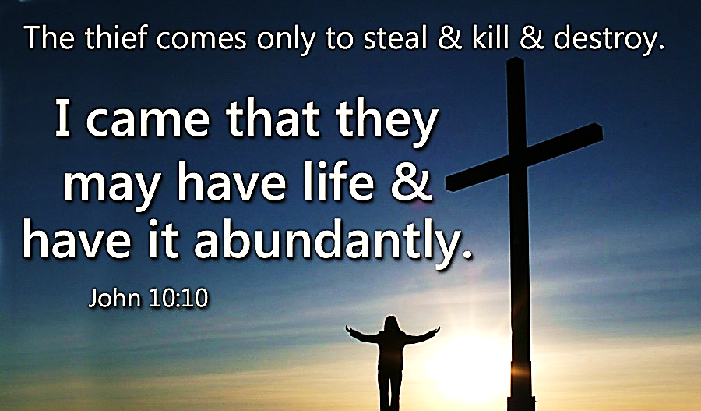
God Has a Plan for Your Life
Why is it that most people are not experiencing God’s abundant life?

Slide 9

Law #2:
Law #2: Man is SINFUL and SEPARATED from God.
Therefore, he cannot know and experience God's love and plan for his life.

Slide 10
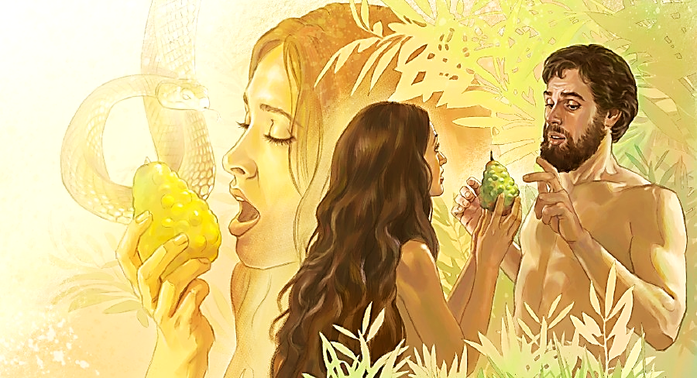
Man Is Sinful:
"All have sinned and fall short of God’s glory" Rom. 3:23

Slide 11
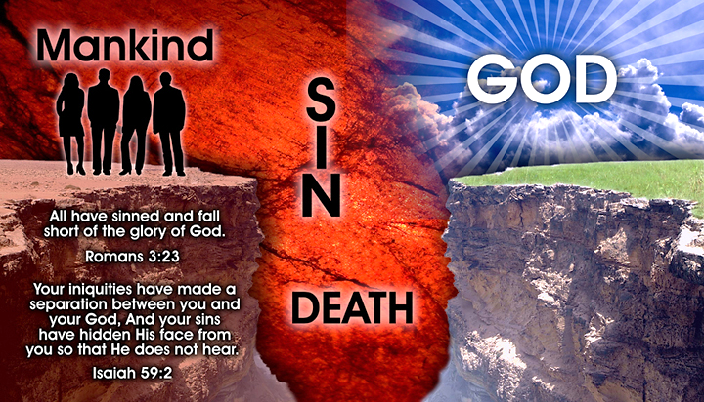
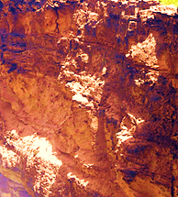
Man is Separated:
"When you sin, the pay you get is death..." (spiritual separation from God) Rom. 6:23
God is Holy:
“It is written, “Be holy, because I am holy.” 1 Pet. 1:16

Slide 12

God is holy and man is sinful.
A great gap separates the two.
Man is continually trying
to reach
God and
abundant life through his own efforts…
…for example: good works, ethics, philosophy, etc.

Slide 13

Law #3: Jesus Christ is God's ONLY provision for man's sin. Through Him you can know and experience God's love and plan for your life.
Law #3:

Slide 14

Law #4:
Law #4: We must individually RECEIVE Jesus Christ as Savior and Lord.
"But some people did accept him. They believed in him. To them he gave the right to become children of God." Jn. 1:12

Slide 15

We Receive Christ Through Faith
"For by grace are ye saved through faith, and that not of yourselves: it is the gift of God" Eph. 2:8

Slide 16
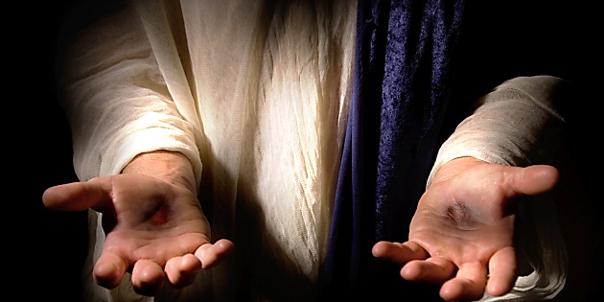
We Receive Christ by Personal Invitation
“Behold, I stand at the door and knock; if any one hears my voice and opens the door, I will come in to him.” Rev. 3:20

Slide 17

God allows us to choose who sits on the throne of our lives –
Christ or Self
bbbb

Slide 18

Self-Directed Life
Self is on the throne
Christ is outside the life
Interests are directed by self, often resulting in discord and frustration

Slide 19

Christ-Directed
Life
Christ is in the life and on the throne
Self is yielding to Christ, resulting in harmony with God's plan
Interests are directed by Christ, resulting in harmony with God's plan

Slide 20
Which Circle Best Represents Your Life?
bbbb

Slide 21
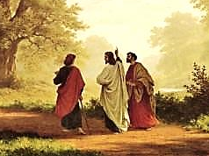
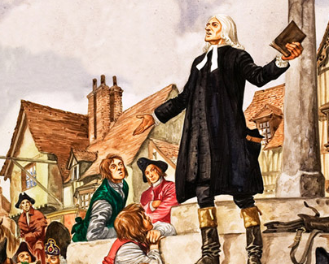
Is Jesus
Speaking to You?
“They said to each other, ‘Did not our hearts burn within us while he talked to us on the road, while he opened to us the Scriptures?’”
John Wesley Said:
“…the preacher was describing the change which God works in the heart through faith in Christ and I felt my heart strangely warmed.”
Jesus makes His presence Known by a small voice!

Slide 22
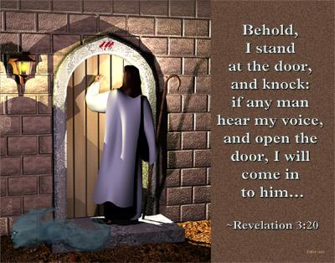

Slide 23
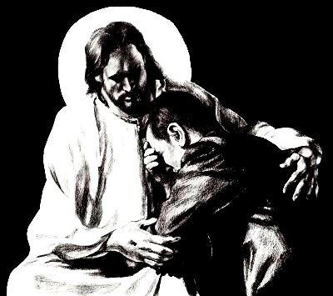
What is the Sinner‘s Prayer?
This is a prayer we can pray when we are ready to admit we are sinners and need Christ’s forgiveness.
It must be prayed with faith in our hearts and a readiness to have a life-changing encounter with Jesus Christ.

Slide 24

A prayer of faith → Pray this prayer if :
If you never have before
You have in the past, but you think it would mean more today
You have been walking afar off and you want to come back
You want to set an example & show others how it is done
You just like to give your heart to Jesus again & again
Faith

Slide 25
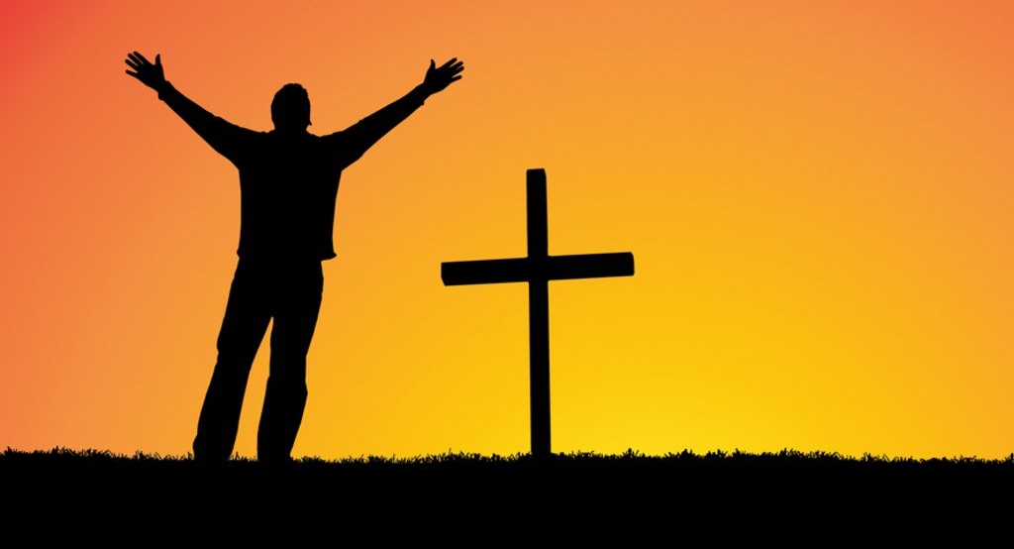
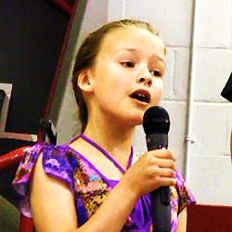
We Declare Our Faith Publicly Because
Jesus Declared His LOVE Publicly
“If you stand before others and are willing to say you believe in me, then I will tell my Father in heaven that you belong to me.” Mat 10:32
If you are ready to give your heart & life to Jesus right now, please come to the front as we pray this prayer together.

Slide 26

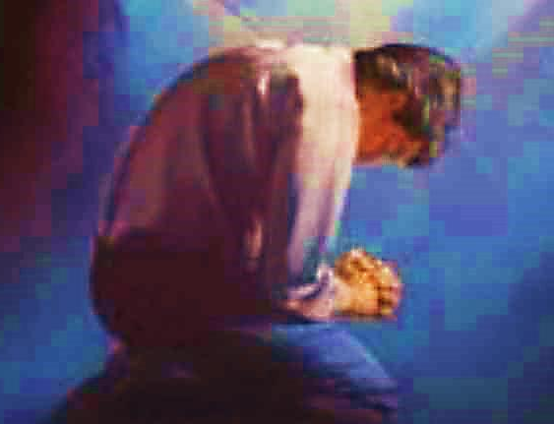
Three Important Questions
Do you want to know Jesus as your Savior right now?
Do you believe He died to save you from your sins & that He rose from the dead?
Do you believe that He is here, waiting to save you right now?

Slide 27
The Prayer of a Sinner Turning to Jesus
Dear Jesus, I know that I have sinned against You and that my sins separate me from You.
I am truly sorry.
Right now, I turn away from my sinful past .
Please forgive me, and help me to keep from sin.
I believe You died for my sins.
I Believe You rose from the dead, you are alive, and you hear this prayer from my heart.
I invite You Jesus to be both my Savior and the Lord of my life.
I want You to rule my life from now on.

Slide 28


“But some people did accept him. They believed in him, and he gave them the right to become children of God.”
John 1:12

Slide 29



Slide 30

Need a Volunteer (Kid or Adult) To:
Answer Lesson Questions

Slide 31


“If you openly say, ‘Jesus is Lord’ and believe in your heart that God raised him from death, you will be saved.”
Rom. 10:9
What did you learn today?
What about the 4 spiritual laws ?
What have you been thinking about God lately?
What do you want to tell others about Jesus?

Slide 32
Need a Volunteer (Kid or Adult) To:
Answer Lesson Questions
Explain the Gospel in a Nutshell Craft

Slide 33
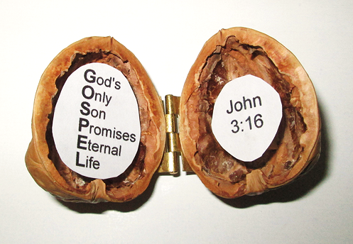
The Gospel
In a Nutshell

Slide 34
Need a Volunteer (Kid or Adult) To:
Answer Lesson Questions
Explain the Gospel in a Nutshell Craft
Explain the Big E-Cube

Slide 35
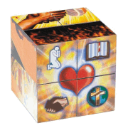

Evangecube
ss
This Evangelism Tool is Available Here:
Standard Size EvangeCube
Evangecube Big Cube (assembled)

Slide 36
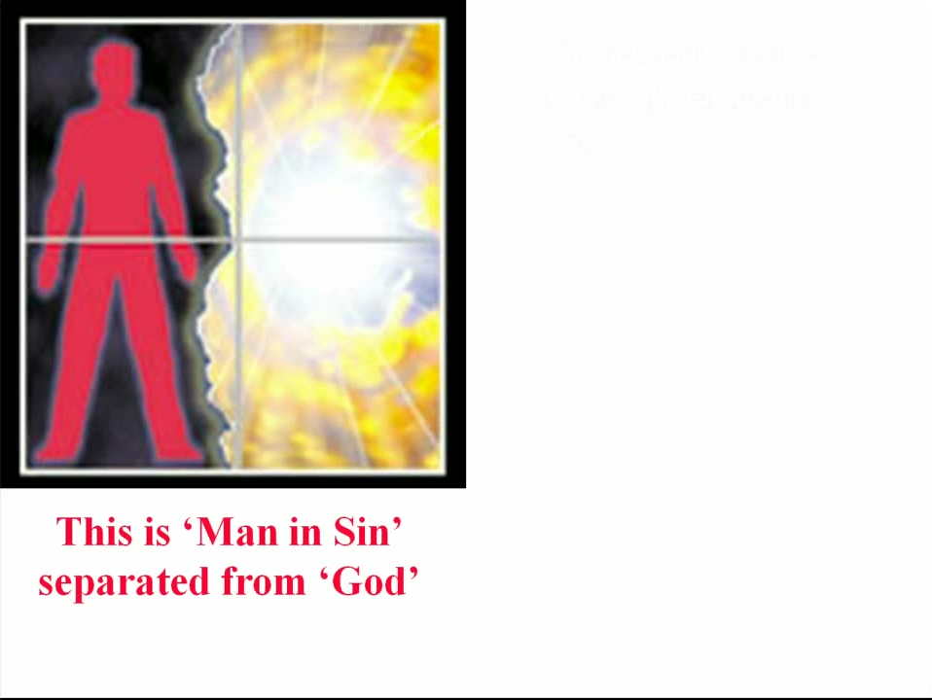

Slide 37
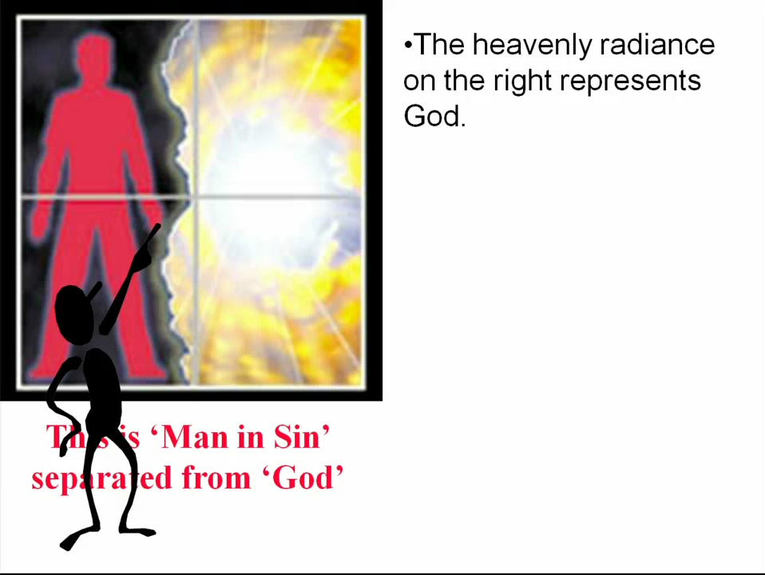

Slide 38
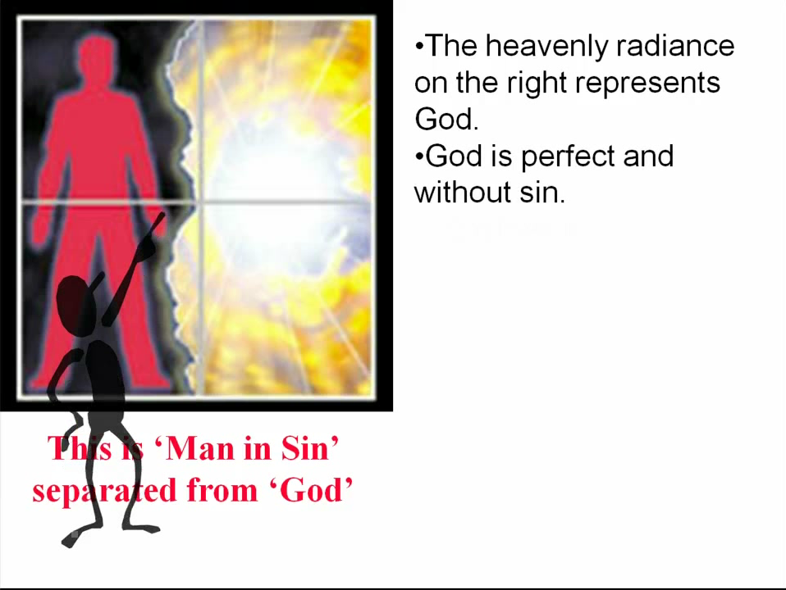

Slide 39
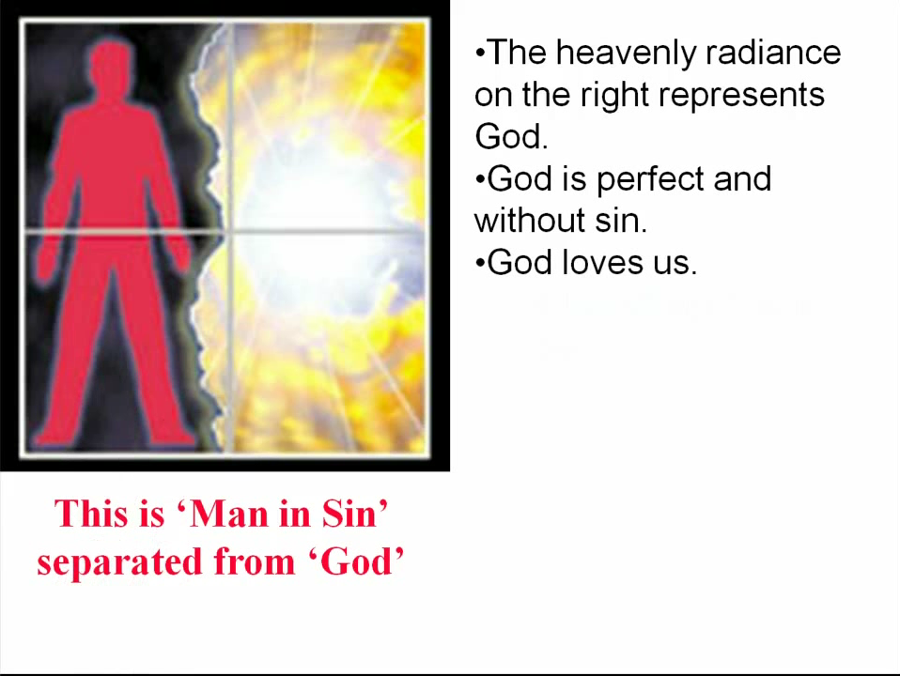

Slide 40
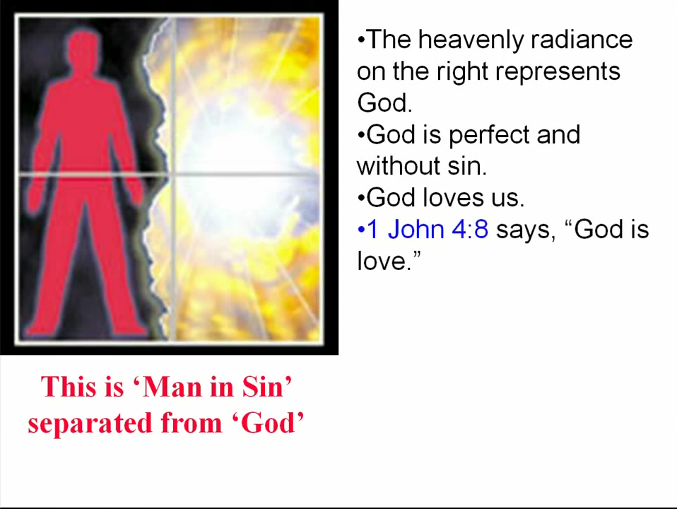

Slide 41
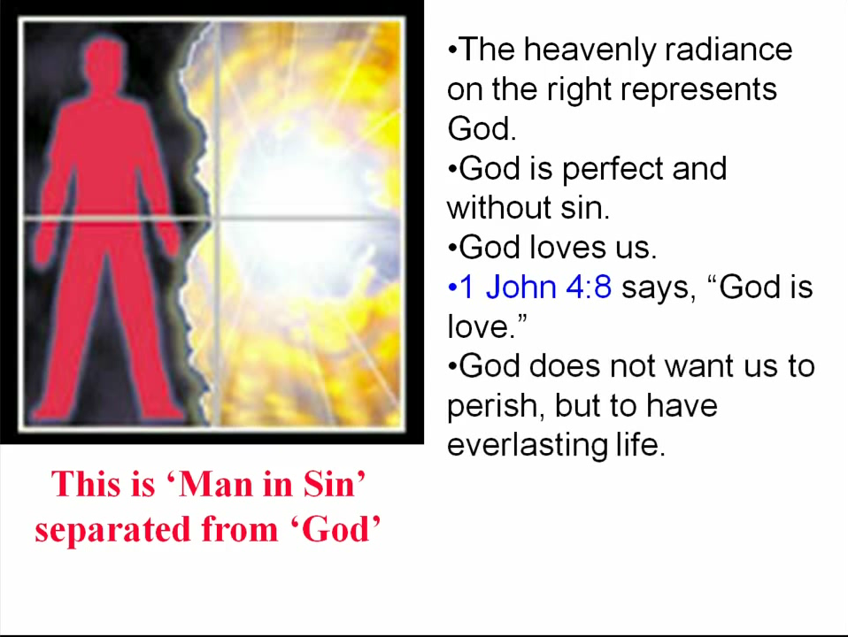

Slide 42
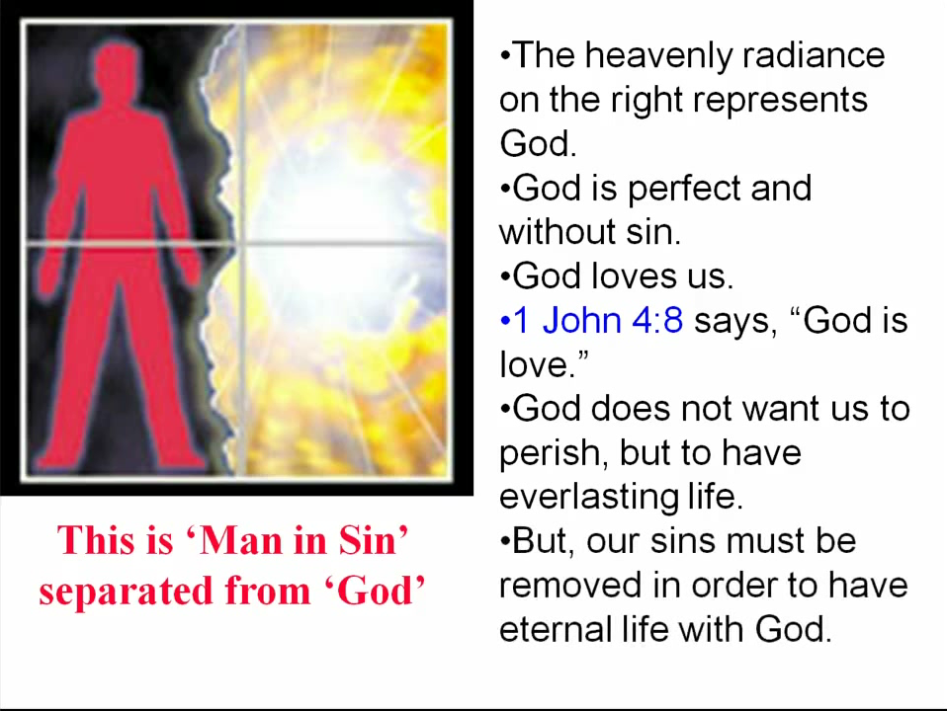

Slide 43
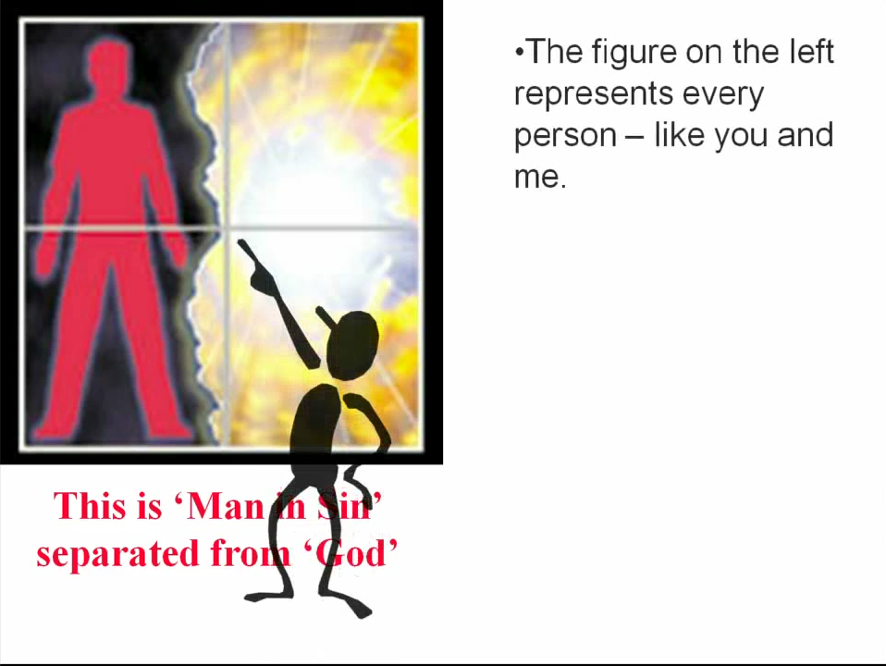

Slide 44
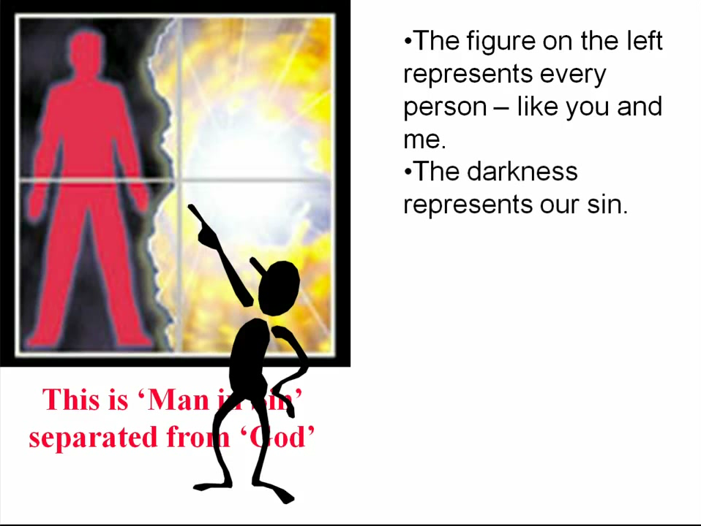

Slide 45
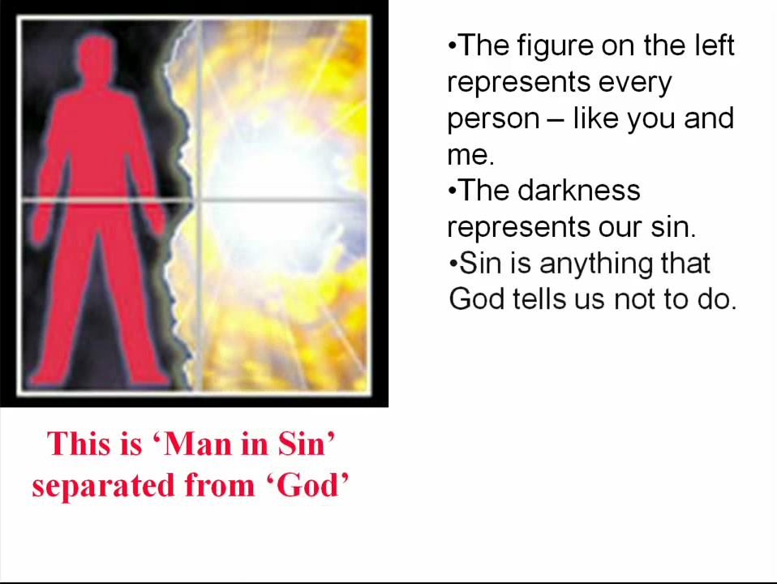

Slide 46
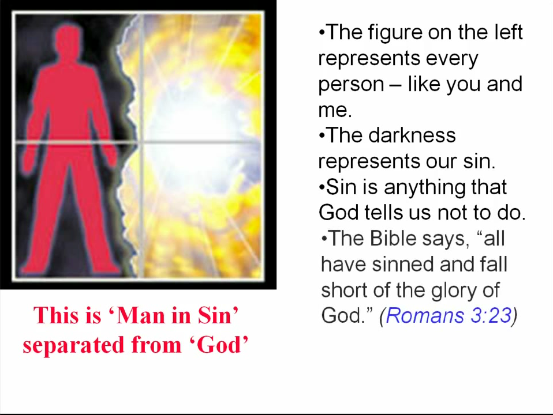

Slide 47
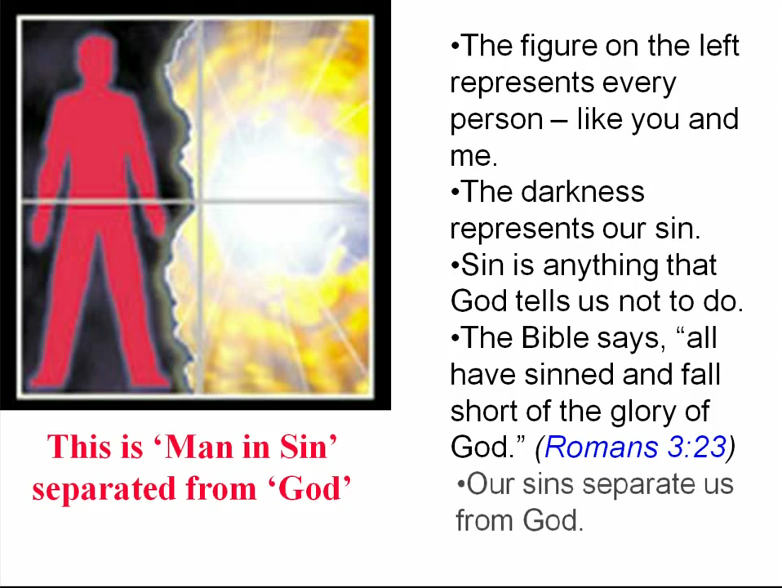

Slide 48
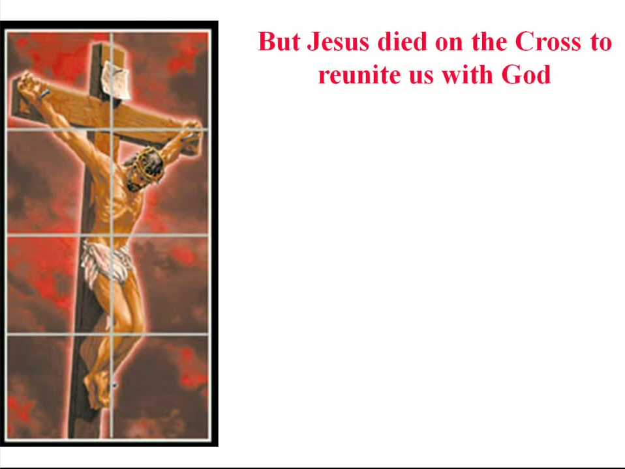

Slide 49
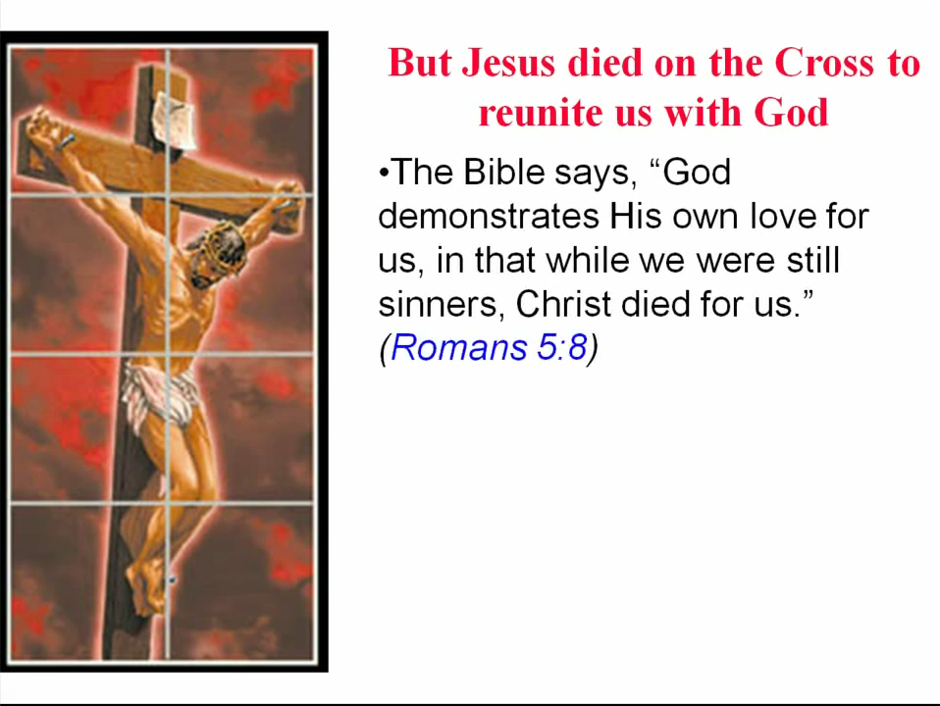

Slide 50
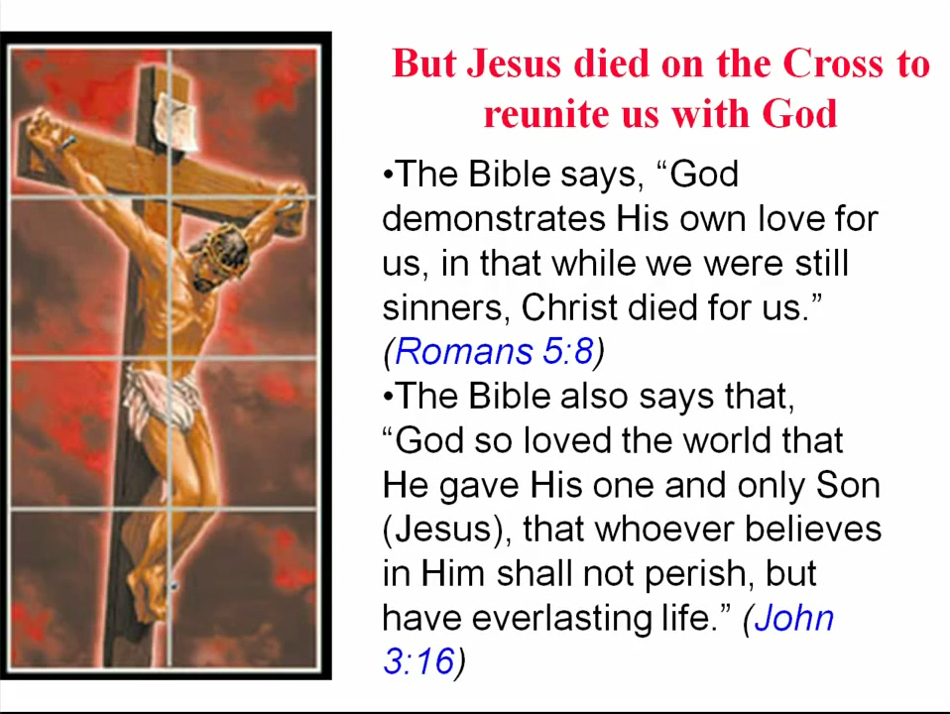

Slide 51
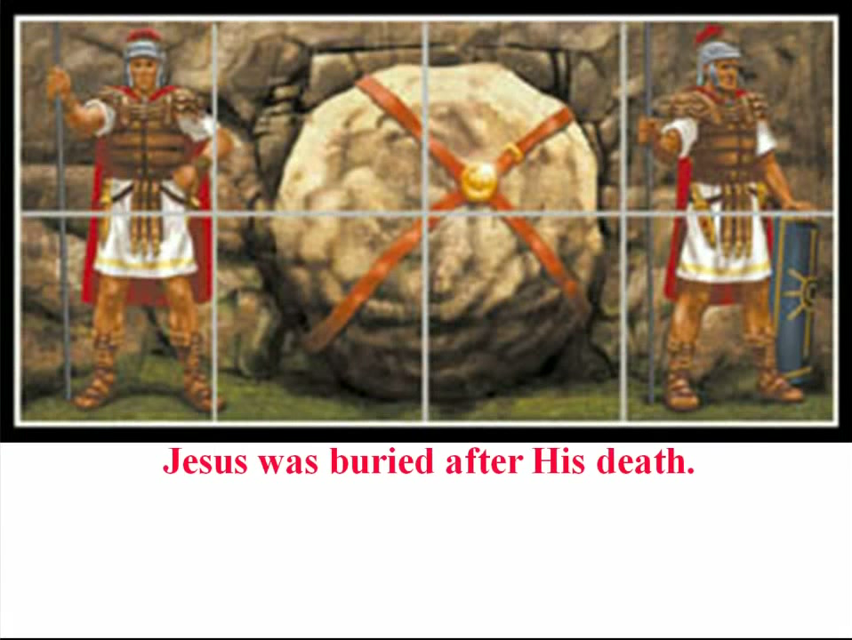

Slide 52
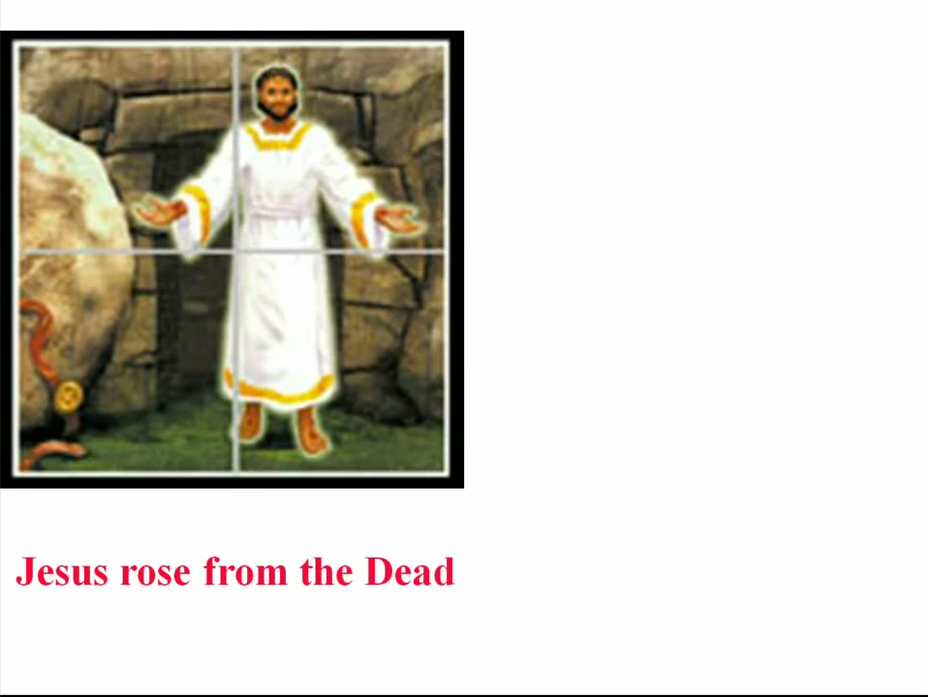

Slide 53


Slide 54
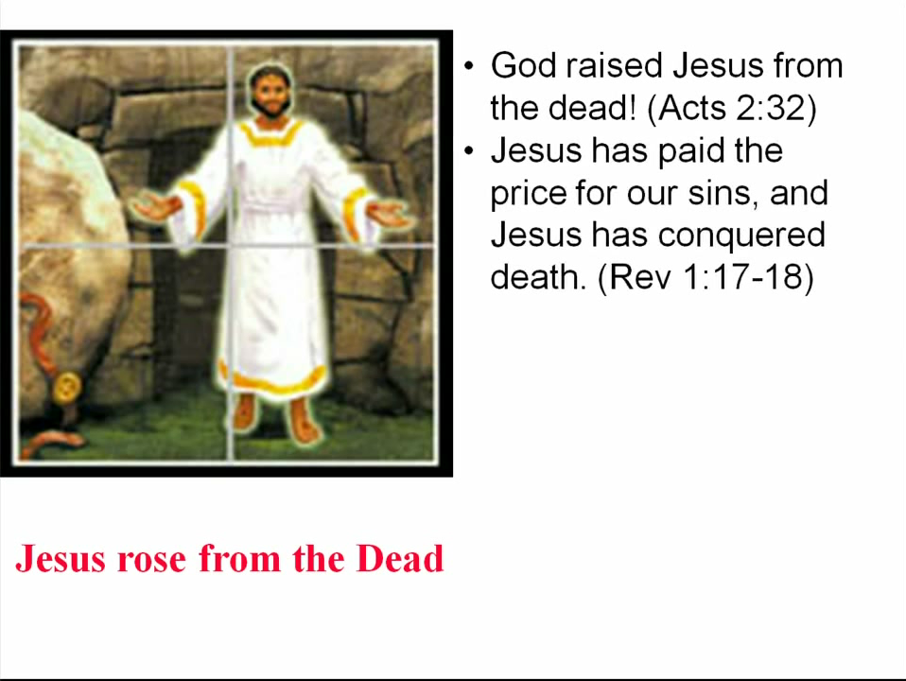

Slide 55
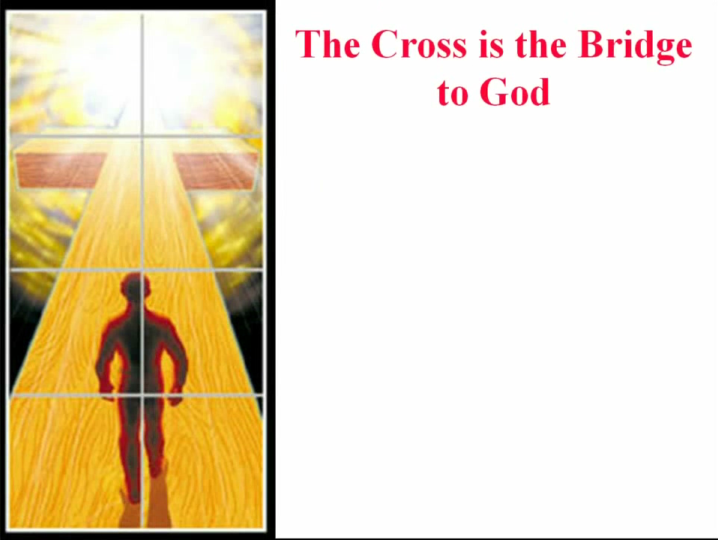

Slide 56
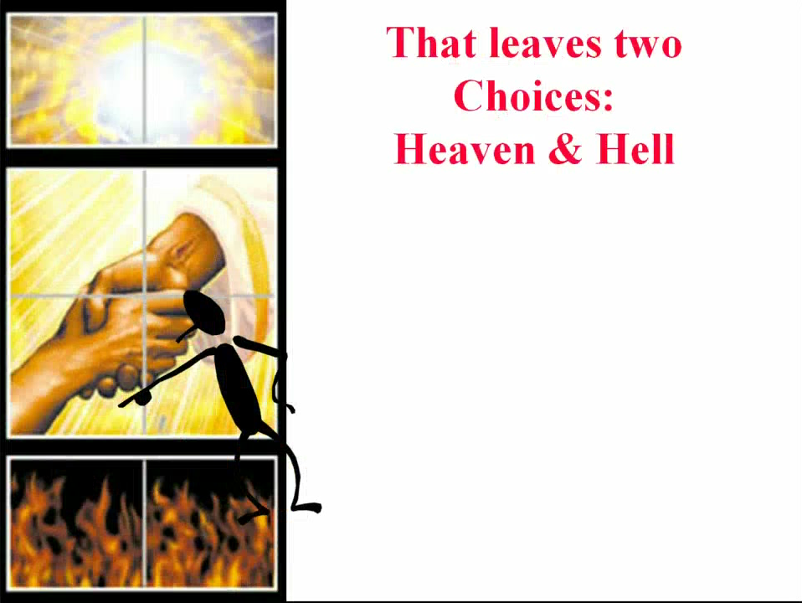

Slide 57
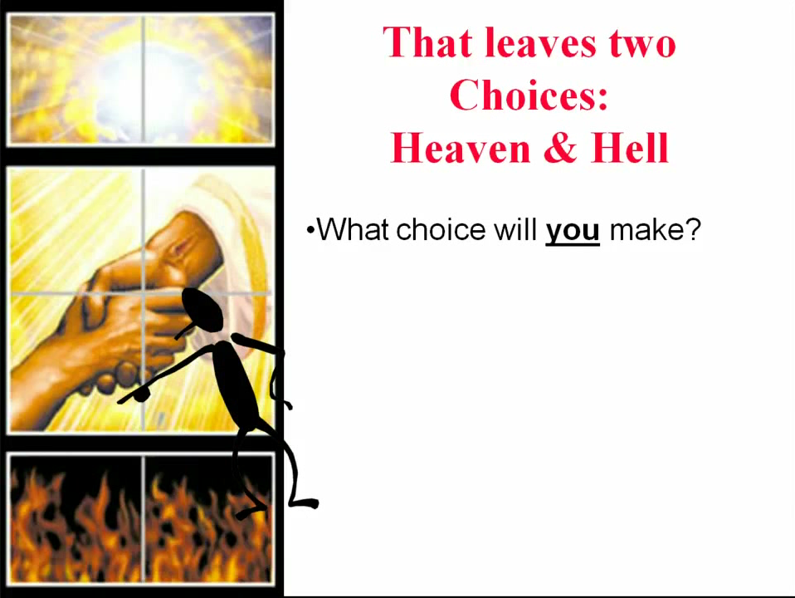

Slide 58
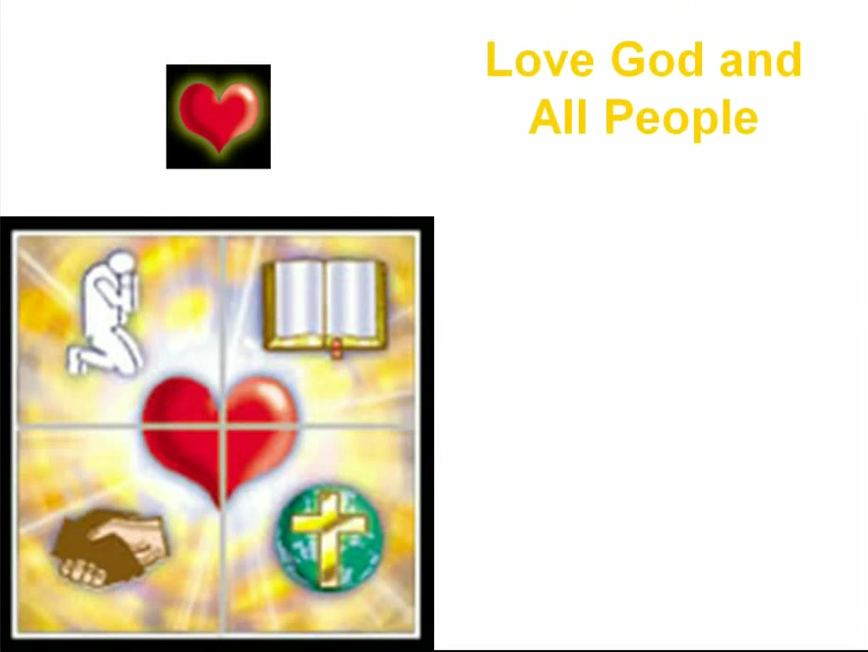

Slide 59
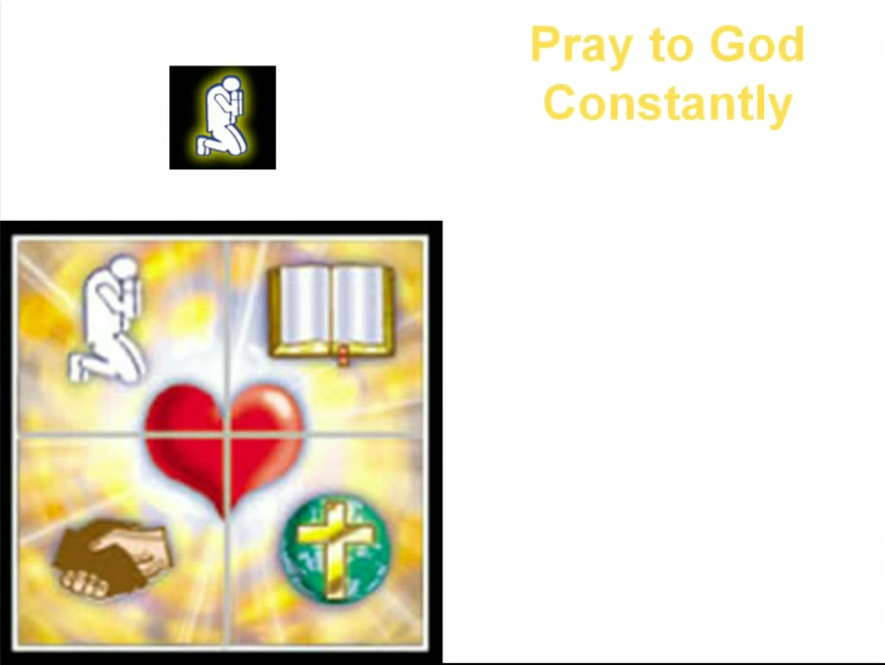

Slide 60
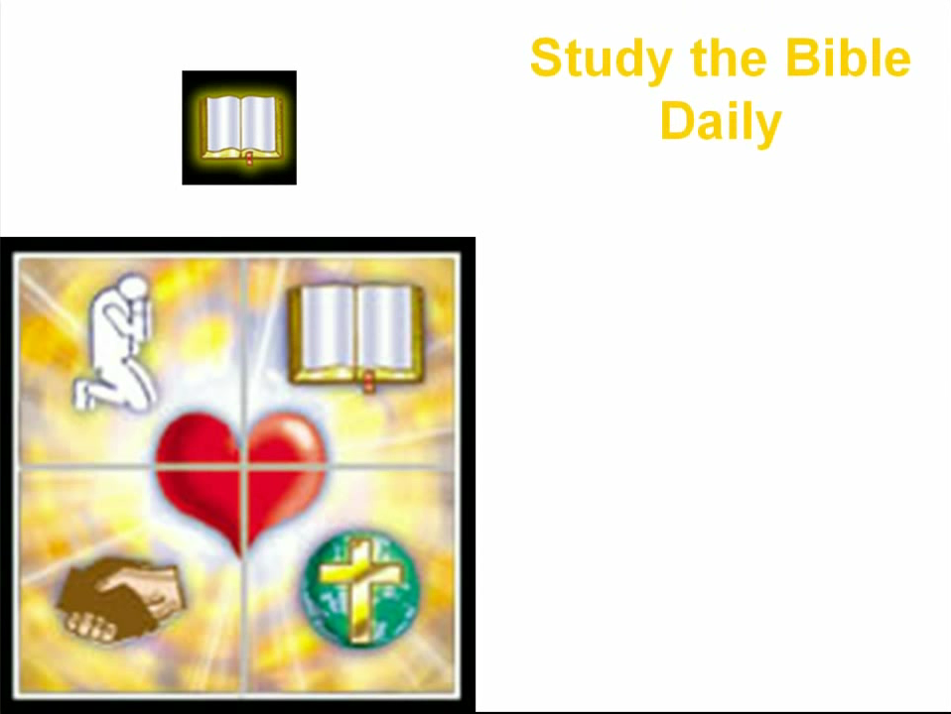

Slide 61


Slide 62


Slide 63
Need a Volunteer (Kid or Adult) To:
Answer Lesson Questions
Explain the Gospel in a Nutshell Craft
Explain the Big E-Cube
Explain the “Gospel in My Hand”

Slide 64
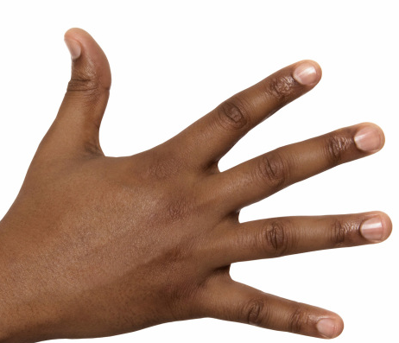
a
The Gospel
in
My
Hand

Slide 65
a
My Pointer:
Points to my sin. I don’t deserve Heaven.
My Thumb:
Like a hitchhiker, I need a free ride to Heaven.
My Longest Finger:
Reminds me of God. The greatest person in the universe.
My Ring Finger:
Reminds me of Jesus who loves me forever. He died to pay for my sin.
My Pinkie Finger:
It only take a little faith in Jesus (mustard seed size)
to give Him my heart and
my whole life.

Slide 66
This Coupon is Good for One
Free Prize at The SonShineTent
Give away 3 of these coupons to 3 different children. Then bring back the plastic bag for another prize for you.

Slide 67

A small gift from us to you.
Thank you for coming.

Slide 68
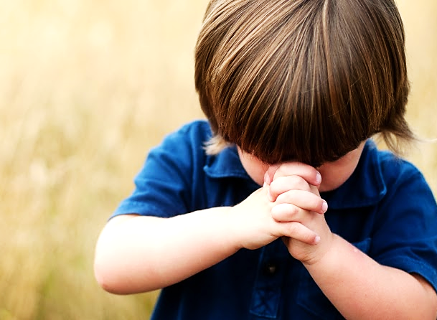
Let’s Close in Prayer

Slide 69
Note: Any videos in this presentation will only play online. After you download the slideshow, you will need to also download the videos from YouTube & add them back into your PowerPoint.
We present these messages at Bee Creek Park in College Station, TX.
If you would like to watch the video of the service with this message, click here:
http://campaignkerusso.org/?p=10932
We would love to know more about the people who download our lessons & sermons. We invite you to email us & let us know where & how you use them.
info@ckbrazos.org

