Slide 1
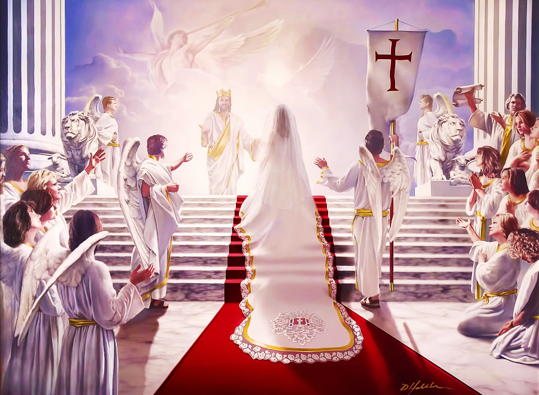
Best Wedding Ever!
The Marriage of the Lamb
Pt. 2 – The Kinsmen Redeemer

Slide 2
Note: After you download the slideshow, you may also need to download some videos from YouTube & add them into this PowerPoint. This tool can help you: Free YouTube Download
We present these messages in outdoor venues using the SonShineTent. Watch the video of our service that goes with this message, click here: http://campaignkerusso.org/?p=14783
We would love to know more about the people who download our lessons & sermons. We invite you to email us & let us know where & how you use them.
info@campaignkerusso.org

Slide 3
Welcome All

Slide 4
Let’s Begin with Prayer

Slide 5
Best Wedding Ever!
The Marriage of the Lamb
Pt. 2 – The Kinsman Redeemer

Slide 6
Song: The Bride of Christ
Video Goes Here Title: The Bride of Christ Download Here:
https://youtu.be/A48I_nW7nCE

Slide 7
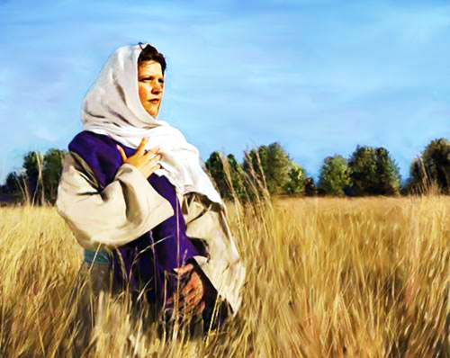
From where did the white linen garments come?
Let’s look at the story of Ruth and Boaz (her Kinsman Redeemer).

Slide 8
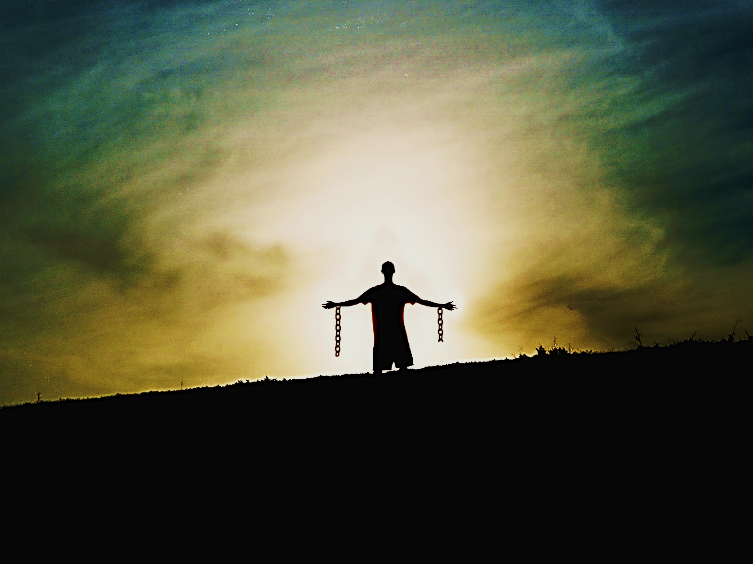
Relatives Could Redeem (buy back) Property & Slaves
“If anyone becomes poor and sells some of his land, then his nearest relatives may redeem it.” Lev. 25:25 TLB
“Even if some of you Israelites become so far in debt that you must sell yourselves... you still have the right to be set free by a relative.” Lev. 25:47-48 CEV

Slide 9
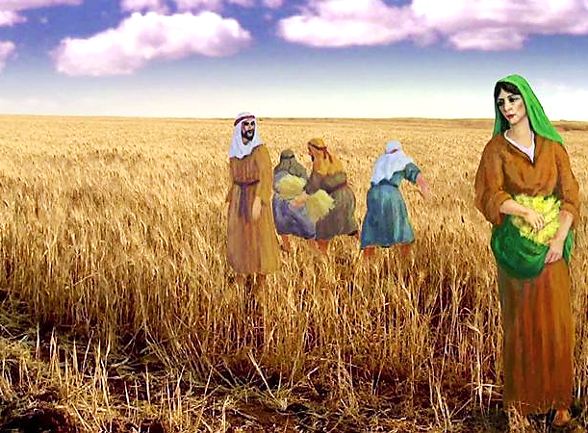
Ruth was a poor stranger who worked in Boaz’s fields.
He loved her from the moment he first saw her.

Slide 10
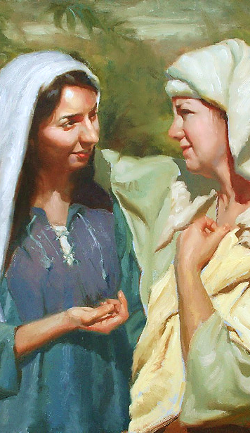
Naomi (mother of Ruth’s deceased husband) advised her.
He is our near Kinsman
When he lay by His wheat harvest (to protect it), note the place where he lay.
Lay at his feet.
Ask him to redeem you (pay your debt).
Do what he tells you.

Slide 11
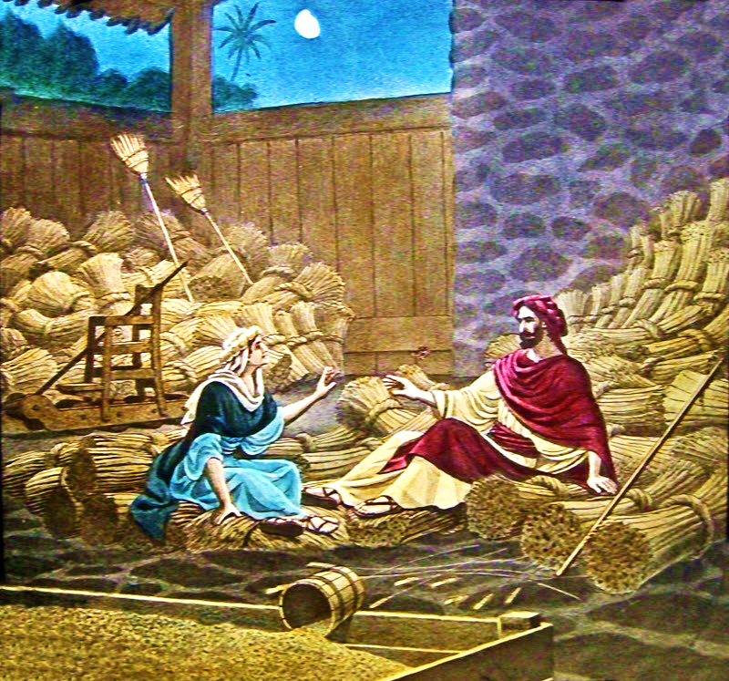
In those days, it was understood that it was the role of a servant to lay at their master’s feet and be ready for his commands.
She was to come very humbly with her request.

Slide 12
He was her “Kinsmen Redeemer,” meaning he could legally pay her debts and make her his bride.

Slide 13
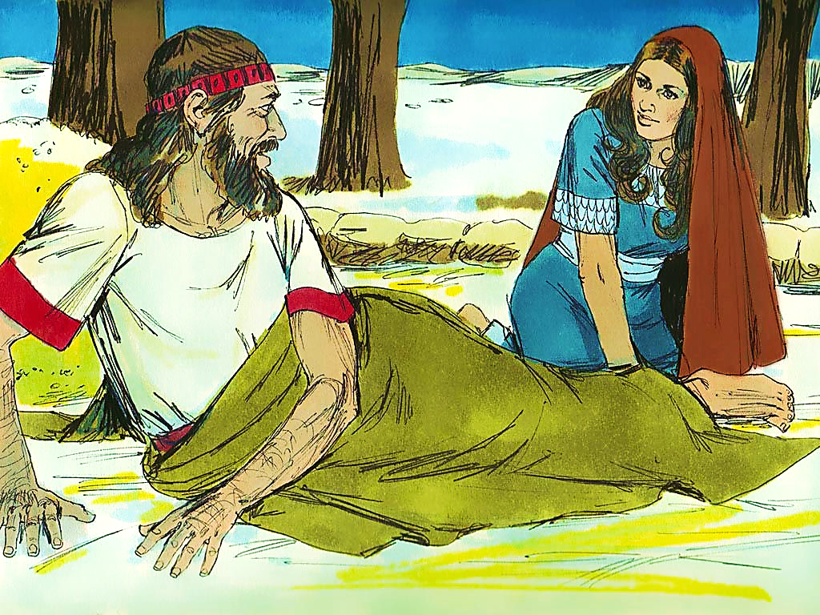
She was to ask him to redeem her (pay her debt and marry her).
“I am your servant Ruth. . . .
Spread the corner of your garment over me.”

Slide 14
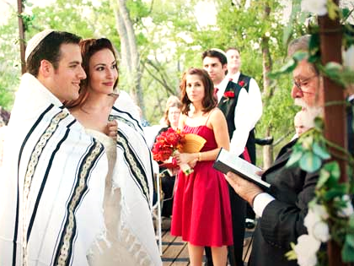
Even today, when a Jew marries a woman, he often throws the skirt or end of his “talith” over her, to signify that he has taken her under his protection.

Slide 15
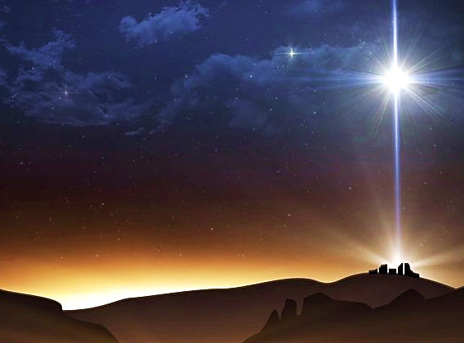
Jesus is Our Kinsman
“The Word became flesh and dwelt among us…” John 1:14 MEV
“But when the fulness of the time was come, God sent forth his Son, come of woman, come under law, that he might redeem those under law…” Gal. 4:4, 5 DAR
Now that He was human (a kinsman), He could legally be our Redeemer.

Slide 16
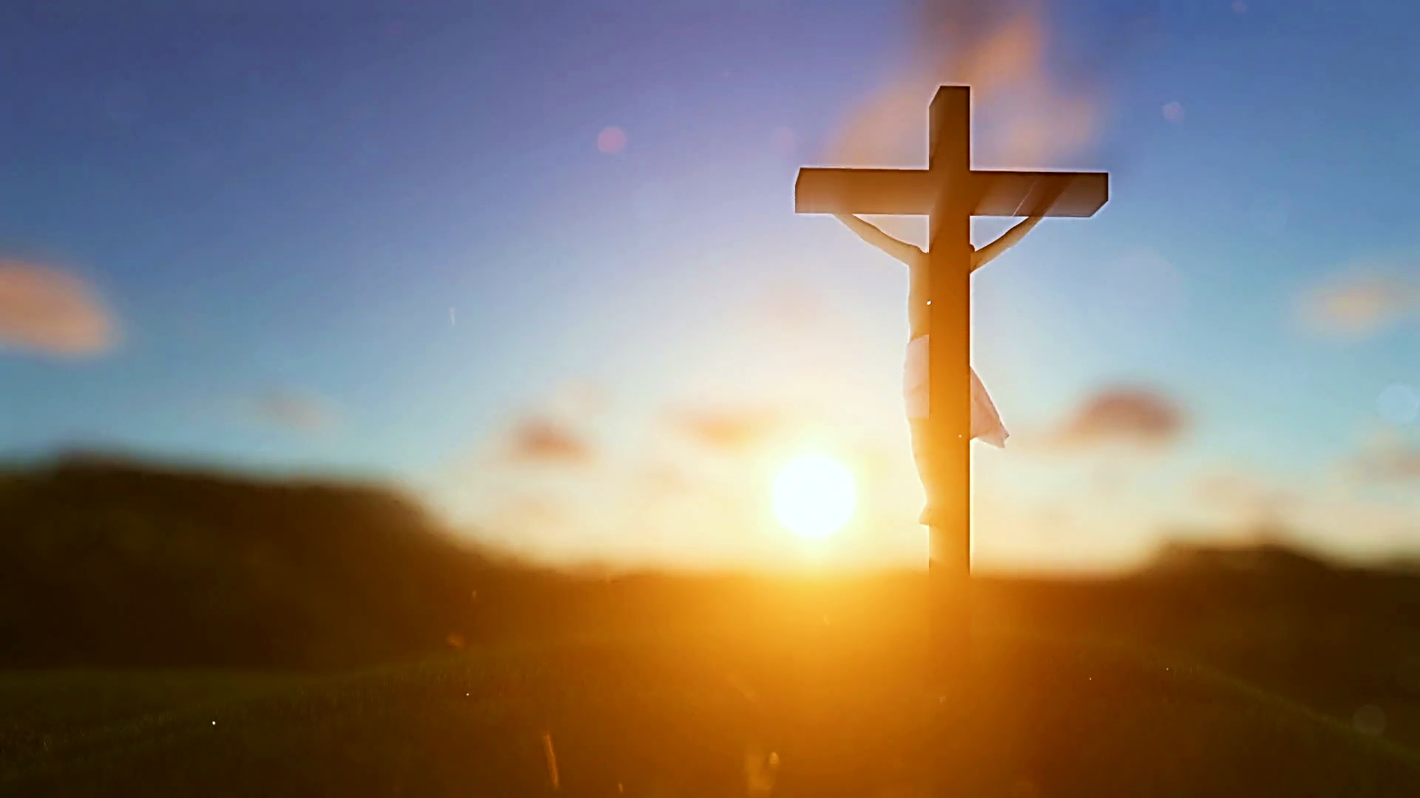
Jesus is Our Redeemer
The Price was His Death on the Cross
“Christ redeemed us from the curse of the law by becoming a curse for us.
As it is written, ‘Cursed is everyone who hangs on a tree.’ ” Gal. 3:13 EHV
“In Him we have redemption through His blood…” Eph. 1:7 ESV

Slide 17
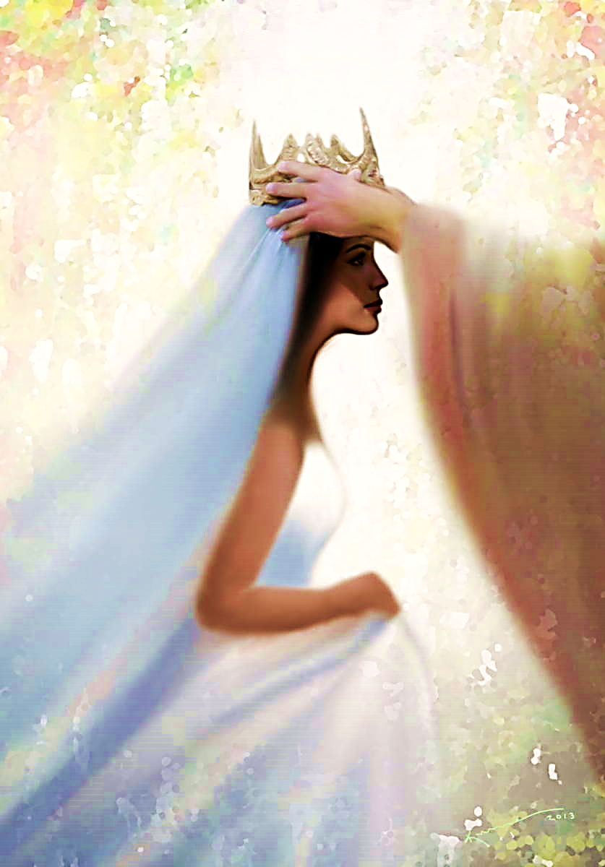
“He forgives all my sins and heals all my diseases. He redeems me from death and crowns me with love and tender mercies.”
Ps.103:3, 4 NLT
“…Do not fear, for I have redeemed you; I have called you by name; you are Mine! Isa 43:1 RSV
Jesus is Our Kinsman Redeemer

Slide 18
Jesus is the great redeemer of lost sinners and restorer of hopeless souls.
He paid our debt of sin with His very life’s blood and then made us His own.

Slide 20
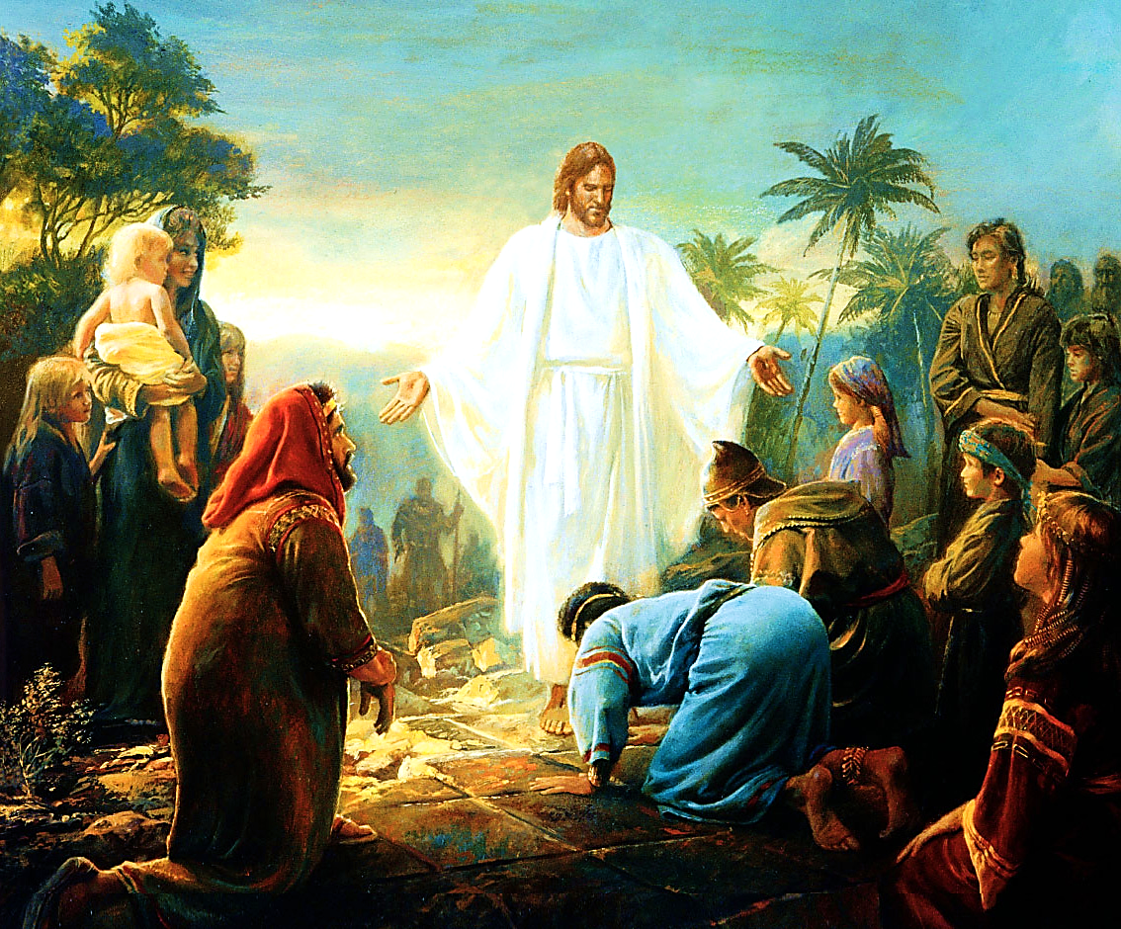
We were strangers to Him, slaves to sin, and spiritually impoverished, but He beheld us and He loved us deeply.

Slide 21
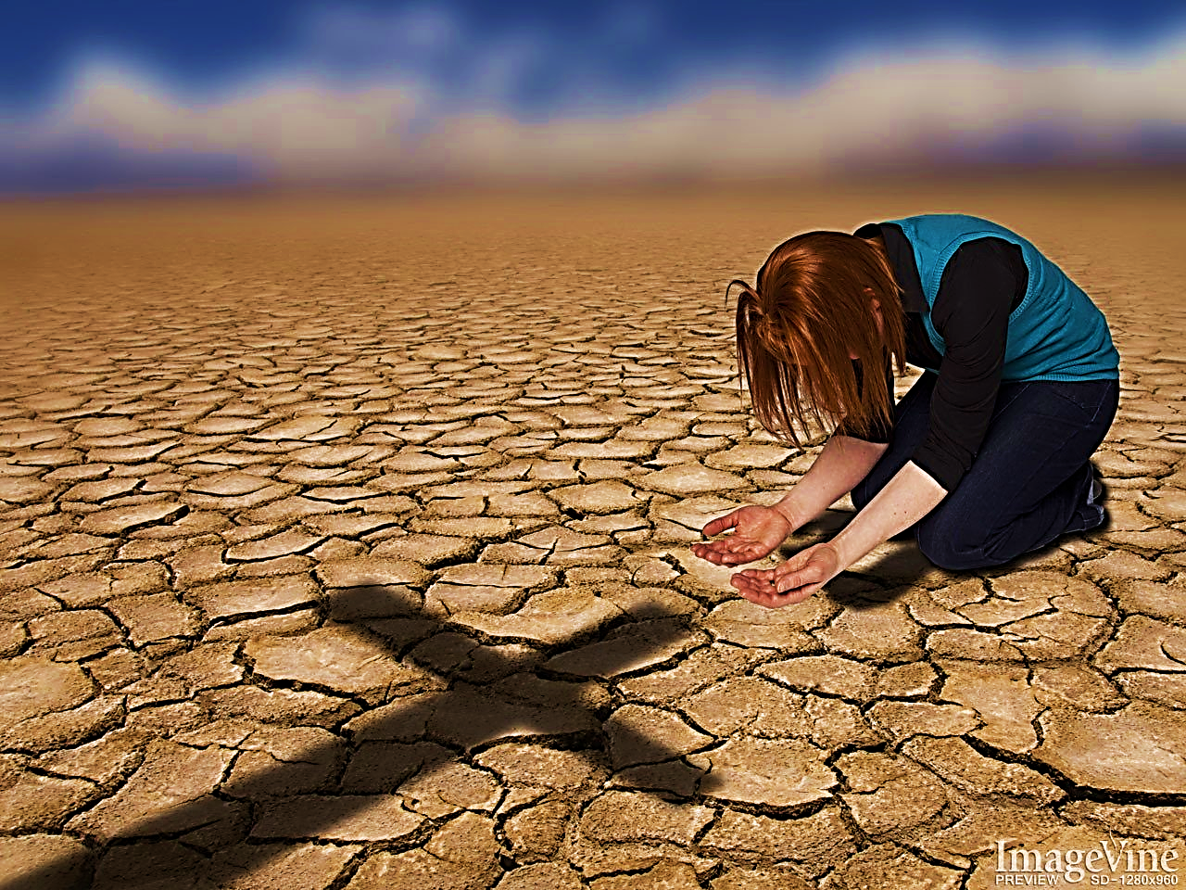
We come humbly to Him at the foot of the cross and, like Ruth, we ask for His mercy and redemption.
Like Ruth, we pray, “Cover me Lord.”
He alone is our “Kinsmen Redeemer” who paid our sin debt
that He might make us his own.

Slide 22
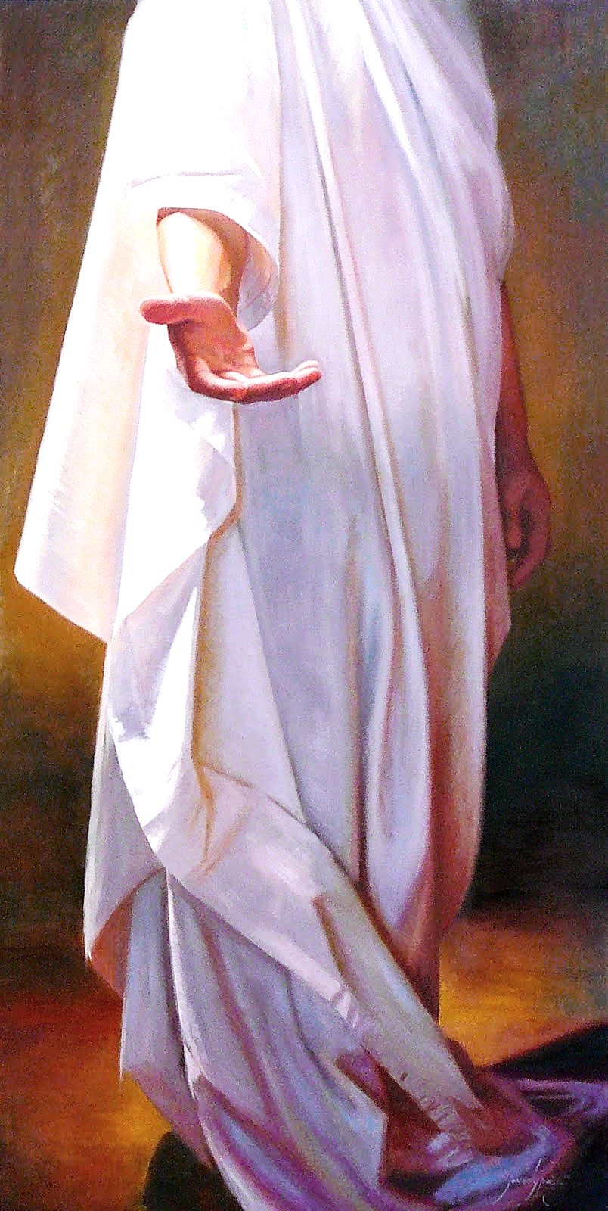
Jesus wears a white garment that represents His righteous holiness. He alone is sinless and perfect!
“…the One Who has lived forever took His seat. His clothing was as white as snow and the hair of His head was like pure wool.”
Dan. 7:9 NLV

Slide 23
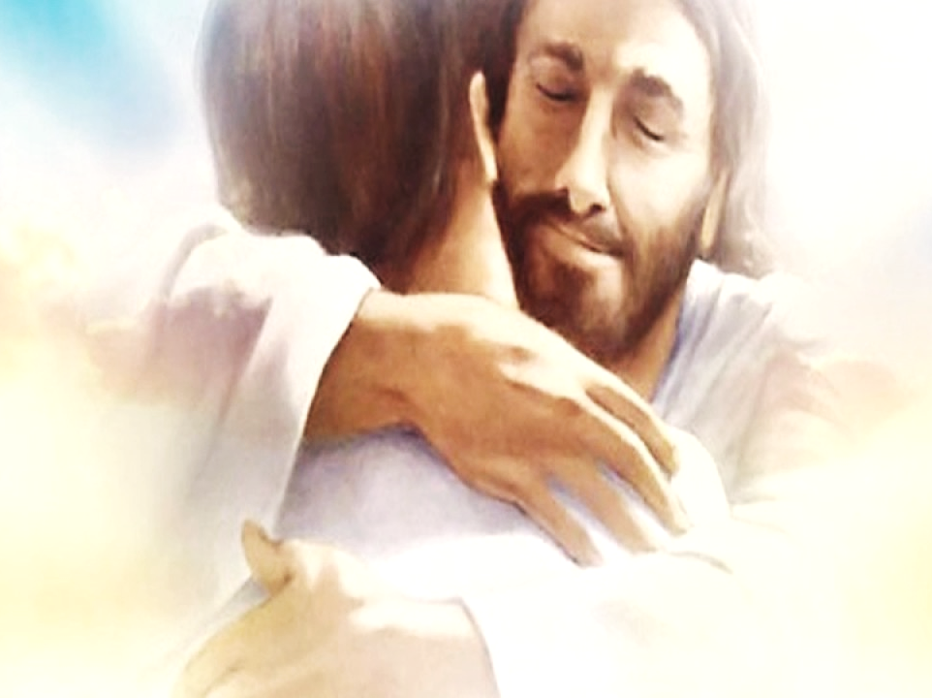
Like Boaz, Christ covers us with His garment.
“…my soul shall be joyful in my God: for he hath clothed me with the garments of salvation, and covered me with the robe of righteousness.” Isa. 61:10 GNV
“… I wrapped my cloak around you to legally declare my marriage vow. I signed a covenant with you, and you became mine.” Ezk. 16:8 TLB
"Clothe yourselves with the Lord Jesus Christ." Rom. 13:14

Slide 24
Song: Ruth’s Song - Cover Me
Video Goes Here Title: Ruth’s Song - Cover Me Download Here:
https://youtu.be/A08II9mkDAU

Slide 25
Song: There is a Redeemer
Video Goes Here Title: There is a Redeemer Download Here:
https://youtu.be/C_YM_hYzcPo

Slide 26
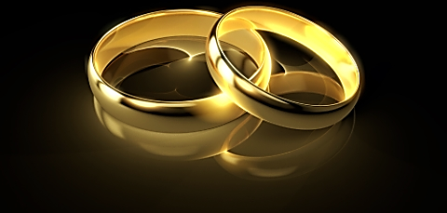
Consider the following questions:
Who was Boaz to Ruth?
Who is Jesus to us?
How should we approach Jesus for help?
Where does the bride get her garment?

Slide 27
Note: After you download the slideshow, you may also need to download some videos from YouTube & add them into this PowerPoint. This tool can help you: Free YouTube Download
We present these messages in outdoor venues using the SonShineTent. Watch the video of our service that goes with this message, click here: http://campaignkerusso.org/?p=14783
We would love to know more about the people who download our lessons & sermons. We invite you to email us & let us know where & how you use them.
info@campaignkerusso.org

Slide 28
Is Jesus
Speaking to You?
“They said to each other, ‘Did not our hearts burn within us while he talked to us on the road, while he opened to us the Scriptures?’”
John Wesley Said:
“…the preacher was describing the change which God works in the heart through faith in Christ and I felt my heart strangely warmed.”
Jesus makes His presence Known by a small voice!

Slide 30
What is the Sinner‘s Prayer?
This is a prayer we can pray when we are ready to admit we are sinners and need Christ’s forgiveness.
It must be prayed with faith in our hearts and a readiness to have a life-changing encounter with Jesus Christ.

Slide 31
A prayer of faith → Pray this prayer if :
If you never have before
You have in the past, but you think it would mean more today
You have been walking afar off and you want to come back
You want to set an example & show others how it is done
You just like to give your heart to Jesus again & again
Faith

Slide 32
We Declare Our Faith Publicly Because Jesus Declared His LOVE Publicly
“If you stand before others and are willing to say you believe in me, then I will tell my Father in heaven that you belong to me.” Mat 10:32

Slide 33
Three Important Questions
Do you want to know Jesus as your Savior right now?
Do you believe He died to save you from your sins & that He rose from the dead?
Do you believe that He is here, waiting to save you right now?

Slide 34
The Prayer of a Sinner Turning to Jesus
Dear Jesus, I know that I have sinned against You and that my sins separate me from You.
I am truly sorry.
Right now, I turn away from my sinful past .
Please forgive me, and help me to keep from sin.
I believe You died for my sins.
I Believe You rose from the dead, you are alive, and you hear this prayer from my heart.
I invite You Jesus to be both my Savior and the Lord of my life.
I want You to rule my life from now on.

Slide 35
“But some people did accept him. They believed in him, and he gave them the right to become children of God.”
John 1:12

Slide 37
“If you openly say, ‘Jesus is Lord’ and believe in your heart that God raised him from death, you will be saved.”
Rom. 10:9
What did you learn today?
What about the Kinsman Redeemer?
What have you been thinking about God lately?
What do you want to tell others about Jesus?

Slide 38
Let’s Close in Prayer

Slide 39
Note: After you download the slideshow, you may also need to download some videos from YouTube & add them into this PowerPoint. This tool can help you: Free YouTube Download
We present these messages in outdoor venues using the SonShineTent. Watch the video of our service that goes with this message, click here: http://campaignkerusso.org/?p=14783
We would love to know more about the people who download our lessons & sermons. We invite you to email us & let us know where & how you use them.
info@campaignkerusso.org

