Slide 1
Welcome To
Training

Slide 2



Note: After you download the slideshow, you may also need to download some videos from YouTube & add them into this PowerPoint. This tool can help you:
Free YouTube Download
We present these messages in outdoor venues using the SonShineTent.
Watch the video of our service that goes with this message, click here: http://campaignkerusso.org/?p=15711
We would love to know more about the people who download our lessons & sermons. We invite you to email us & let us know where & how you use them.
info@campaignkerusso.org

Slide 3

Let’s Begin with Prayer

Slide 4

Song/Video: ………….

Slide 5


10 Preaching Facts
1: Preaching is Jesus’ final commandment.
“Then he told them: Go and preach the good news to everyone in the world.” Mk. 16:15 CEV
“He sent them out to proclaim God’s kingdom and to heal the sick.” Lk. 9:2

Slide 6
10 Preaching Facts
2: Every believer is sent to preach.
“…He is the One Who brought us to Himself…Then He gave us the work of bringing others to Him.” 2 Cor. 5:18 NLV
“Preach the Good News. Be ready at all times, and tell people…”
2 Tim. 4:2NCV

Slide 7
10 Preaching Facts
3: Jesus preached.
From that time Jesus began to preach, and to say, Repent: for the kingdom of heaven is at hand. Mat. 4:17

Slide 8
10 Preaching Facts
4: The OT & NT believers preached.
“Then I heard the voice of the Lord. He said, “Who will I send? Who will go for us?” I said, “Here I am. Send me!” Isa. 6:8
“My aim is to evangelize where Christ has not been named…” Rom. 15:20 HCSB
“Woe to me if I do not preach the gospel!” I Cor. 9:16

Slide 9
10 Preaching Facts
5: History’s revivalists preached outdoors.
“It is no marvel that the devil does not love field preaching! Neither do I; I love a commodious (large) room, a soft cushion, a handsome pulpit. But where is my zeal if I do not trample all these underfoot in order to save one more soul?” John Wesley

Slide 10
10 Preaching Facts
5: History’s revivalists preached outdoors.
“Give me one hundred preachers who fear nothing but sin and desire nothing but God, and I care not whether they be clergymen or laymen, they alone will shake the gates of Hell and set up the kingdom of Heaven upon Earth.”
John Wesley

Slide 11
10 Preaching Facts
6: Jesus preached from town to town.
When Jesus had finished instructing his twelve disciples, he went on from there to teach and preach in their towns. Mat. 11:1
“Let’s go to the neighboring town,” he replied, “so I can preach there, too, because that’s why I came.” MK. 1:38 ISV

Slide 12
10 Preaching Facts
7: Preaching is God’s chosen way to save the lost.
“…he has used our foolish preaching to save those who believe. I Cor. 1:21 (NLT).
“Perhaps even yet they will turn from their evil ways and ask the Lord to forgive them before it is too late…” Jer. 36:7 TLB

Slide 13
10 Preaching Facts
8: Preaching is foolish in man’s eyes.
“Since God in his wisdom saw to it that the world would never know him through human wisdom, he has used our foolish preaching to save those who believe.” I Cor. 1:21 (NLT).
“For the preaching of the cross is foolishness to those who perish; but unto us who are saved, it is the power of God.” 1 Cor. 1:18

Slide 14
10 Preaching Facts
9: Obedience to the ‘Great Commission’ beautifies the believer in God’s eyes.
“How beautiful on the mountains are the feet of him who brings good news, who publishes peace… who proclaims salvation, who says to Zion, “Your God reigns!” Isa. 52:7 WEB

Slide 15
10 Preaching Facts
10: God will anoint during & after the preaching.
“The Spirit of the Lord God is upon me because the Lord has anointed me to preach good news Isa 61:1 MEV
“The Lord now chose seventy other disciples and sent them on ahead in pairs to all the towns and villages he planned to visit later.” LK. 10:1 NLT

Slide 16

Jesus Asks for Prayer
“…The harvest is huge and ripe. But there are not enough harvesters to bring it all in. As you go, plead with the….
Owner of the Harvest to drive out, into his harvest fields, many more workers.
Lk. 10:2 TPT

Slide 17
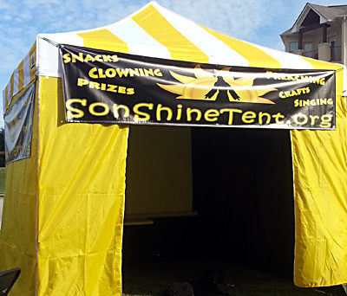
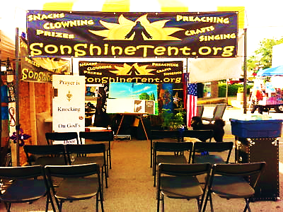
SonShineTent is a 10x10 gospel tent we take to public events with the purpose of obeying the Lord’s Great Commission.
We trust God to bless His Word and we expect the…
Burning Bush Principle

Slide 18
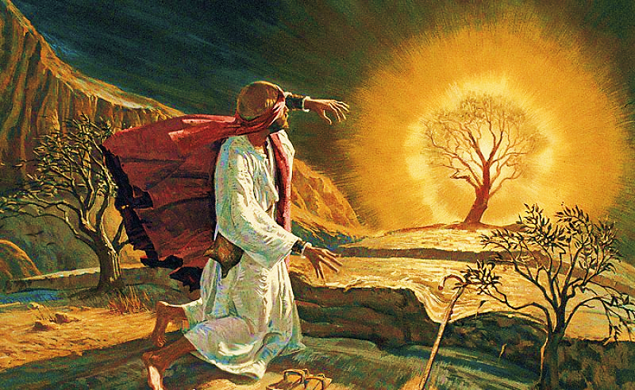
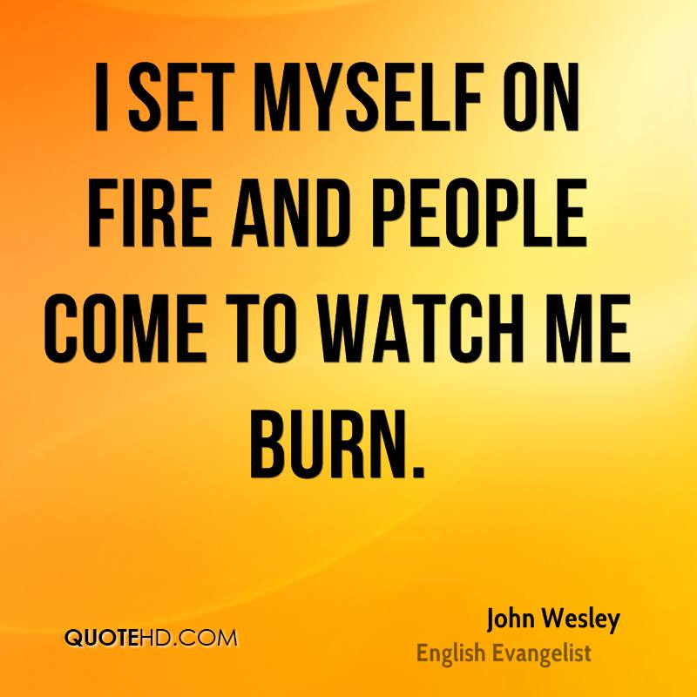

The Burning Bush Principle:
“He looked, and behold, the bush was burning…
And Moses said, “I will turn aside to see this great sight…
When the Lord saw that he turned aside to see, God called to him out of the bush...”Ex. 3:3-4

Slide 19
The Burning Bush Principle:
God can take the most humble of vessels,
a desert bush,
a gospel tent,
a human heart
and (if set on fire), use it to call men to Himself.

Slide 20

We’re going to sing a song called:
But first we need a little bible study!

Slide 21
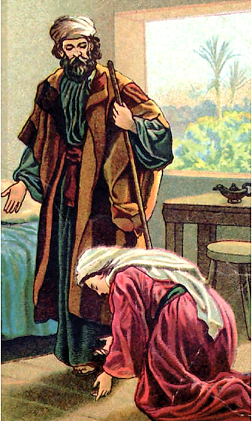
Elisha Counsels a Widow
“Sir, my husband is dead!... Now a creditor has come to take my two children as slaves.”
Elisha asked…Tell me, what do you have in your house?”
She answered, “I have nothing in the house except a jar of olive oil.”

Slide 22
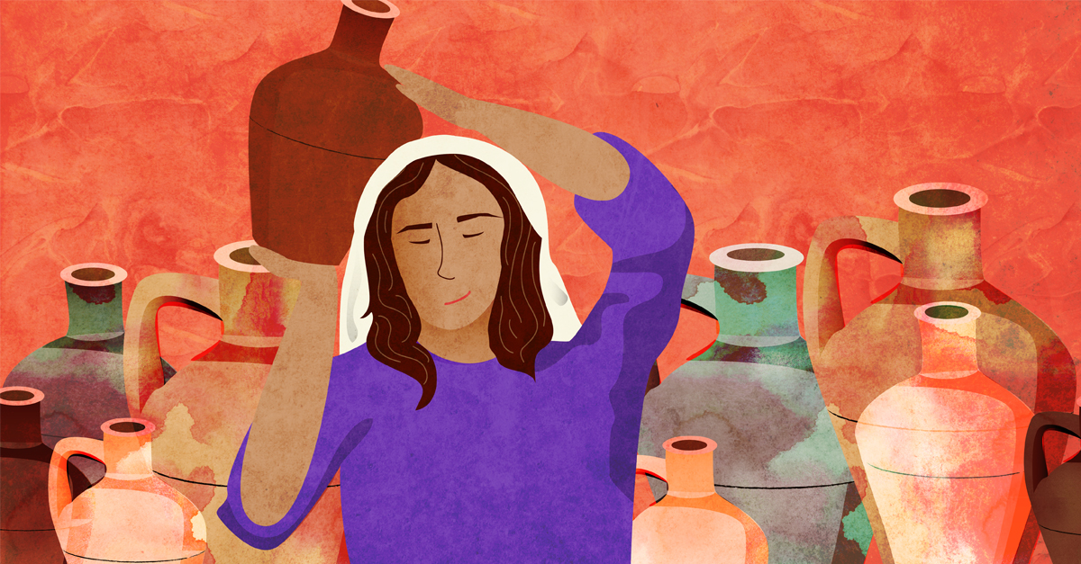
Elisha said, “Borrow many empty containers from all your neighbors… and pour oil into all those containers. When one is full, set it aside.”

Slide 23
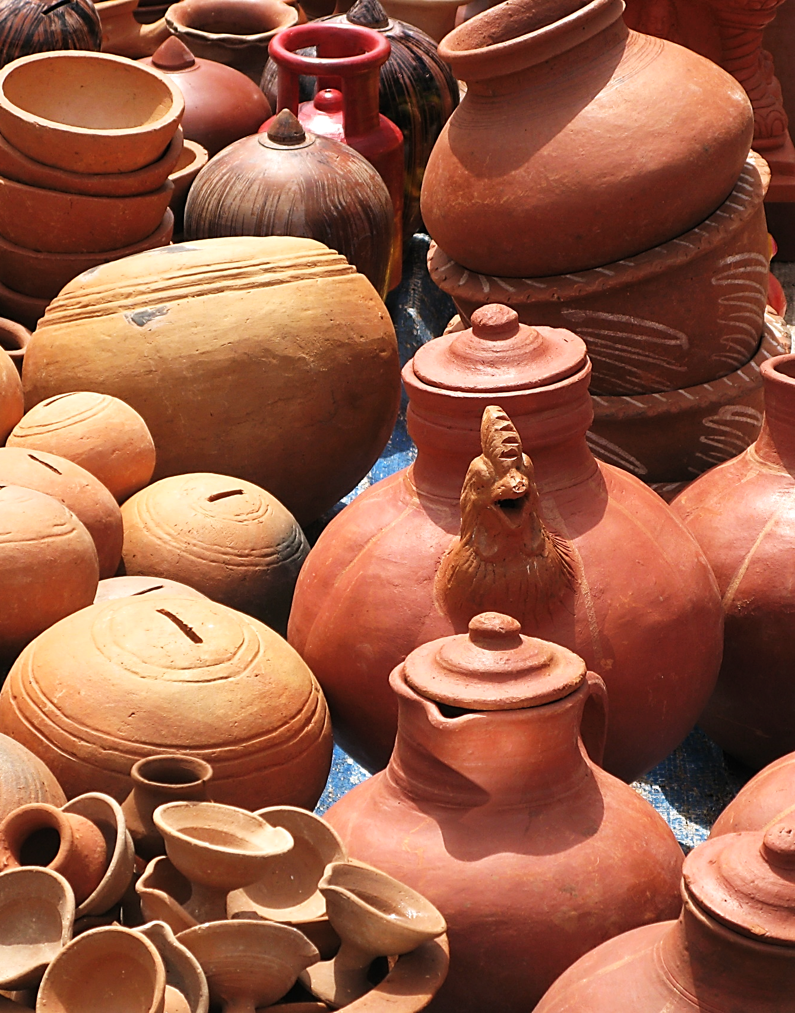
The children kept bringing containers to her, and she kept pouring. When the containers were full, she told her son, “Bring me another container.”
2 Kings 4:1-6

Slide 24
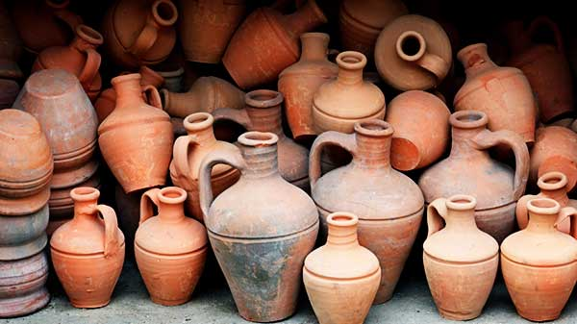
God Can Only Use Empty Vessels
1) We mustn't be trying to fill ourselves with the things of the world while leaving just a little room for serving Jesus.
2) We have nothing of ourselves to offer in His service. We have nothing to offer but our own empty vessel.
God needs people who are willing to offer themselves as empty vessels ready for Him to fill and to use for His Glory.

Slide 25
Song: I’m Available
Video Goes Here
Title: I’m Available
Download Here:
https://www.youtube.com/watch?v=tJznj1a8I1w

Slide 26


Slide 27

Reaching Children (& adults)
Student Interaction
  Get Student Feedback
  Have Student Play-act
  Have Students Teach
  Object Lessons
  Crafts/Games
  Prizes/Snacks

Slide 28
Reaching Children (& adults)
Ask Open Ended Questions
(not “yes’ or “no” questions)
Keep it Christ / cross / gospel centered. They need Jesus!
Use Relatable Stories
Use Multi-Media
Use Repetition

Slide 29
Video: Sharing the Gospel with Kids
Video Goes Here
Title: Oh, The Wedding of the Lamb
Download Here:
https://youtu.be/8dN7nGhOHnE
(Play this video from time stamp 0:18 – 4:52)
No need to play the entire video

Slide 30

1) Go around the event handing out "Prize Coupons" to any children you can find. Tell the kids to look for you at "The SonShineTent" to get a "Free Prize." Tell them what time you will be starting.
2) Give every child that comes to the table (and every parent who likes) a free prize. Take their coupon (if they have one). They must close their eyes, reach in and take only one prize quickly.

Slide 31
This Coupon is Good for One
Free Prize at The SonShineTent
Give away 3 of these coupons to 3 different children. Then bring back the plastic bag for another prize for you.

Slide 32
3) Give them a plastic baggie with 3 more coupons inside. Explain that if they give the 3 coupons to 3 different children (not adults), and bring back the empty baggie, they will get another prize.
4) Ask them if they want to do a craft. Do the "Gospel in a Nutshell" craft and explain the gospel as you do. When they finish the craft, ask them to explain the Gospel back to you. Let them keep the nut.

Slide 33
5) Ask them if they would like another prize. Tell them that you will show them how the E-Cube works and if they can explain it all back to you, they can get another prize. Pray with anyone who wants to be saved.
6) Give a baggie with 3 coupons to anyone who hasn't yet done the 3 coupons in a baggie challenge.

Slide 34
7) Ask if anyone has any prayer needs.
8) Tell them if they want more prizes to take a seat in the tent & wait to be called on to show their craft up front.
9) Tell them if they want to win an E-Cube to take a seat in the tent & wait to present the E-Cube up front.
10) Give the “Thank You” gift to anyone who sat through the whole lesson in the tent.

Slide 35

Interactive Fun & Learning

Slide 36

Need Volunteers (Kids or Adults) to:
Answer Lesson Questions

Slide 37


“If you openly say, ‘Jesus is Lord’ and believe in your heart that God raised him from death, you will be saved.”
Rom. 10:9
What did you learn today?
What about the widow’s vessels.
What have you been thinking about God lately?
What do you want to tell others about Jesus?

Slide 38
Need Volunteers (Kids or Adults) To:
Answer Lesson Questions
Explain the Gospel in a Nutshell Craft

Slide 39
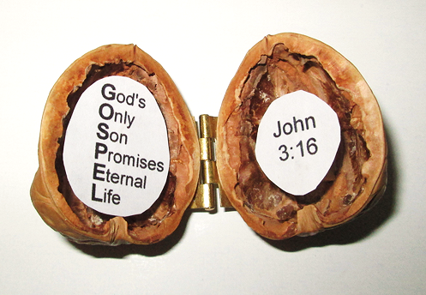
The Gospel
In a Nutshell

Slide 40
Need Volunteers (Kids or Adults) To:
Answer Lesson Questions
Explain the Gospel in a Nutshell Craft
Explain the Big E-Cube

Slide 41
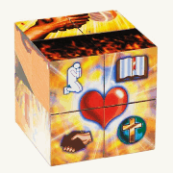
Evangecube
ss

Slide 42
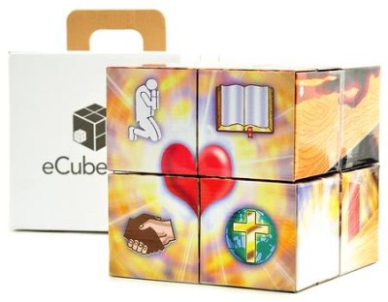
Evangecube
Buy a standard-sized EvangeCube here: EvangeCube
Buy a large sized EvangeCube here: Evangecube Big Cube

Slide 43
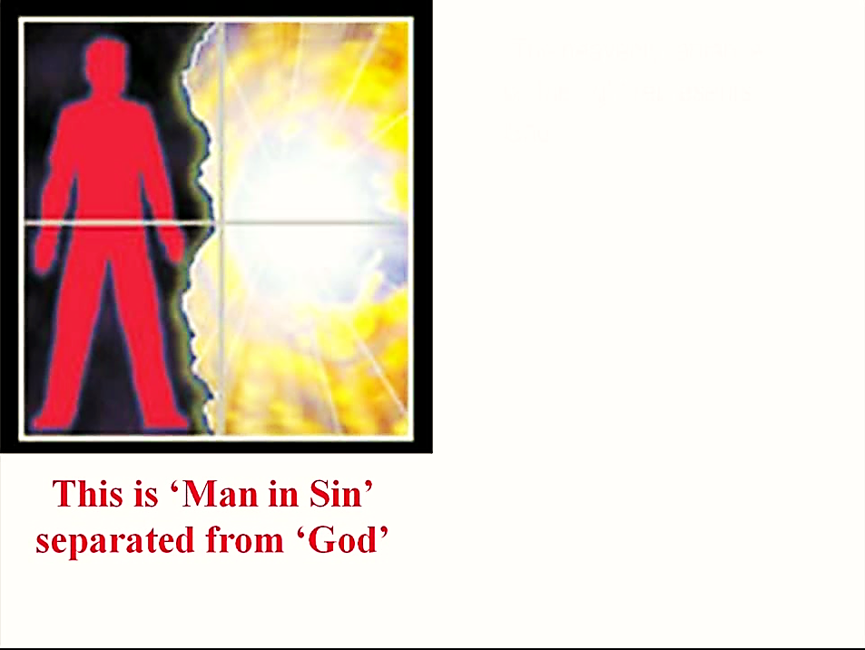

Slide 44
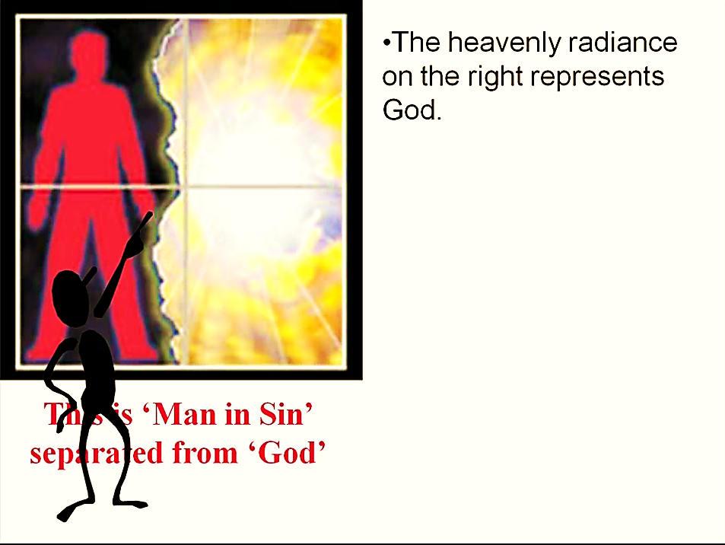

Slide 45
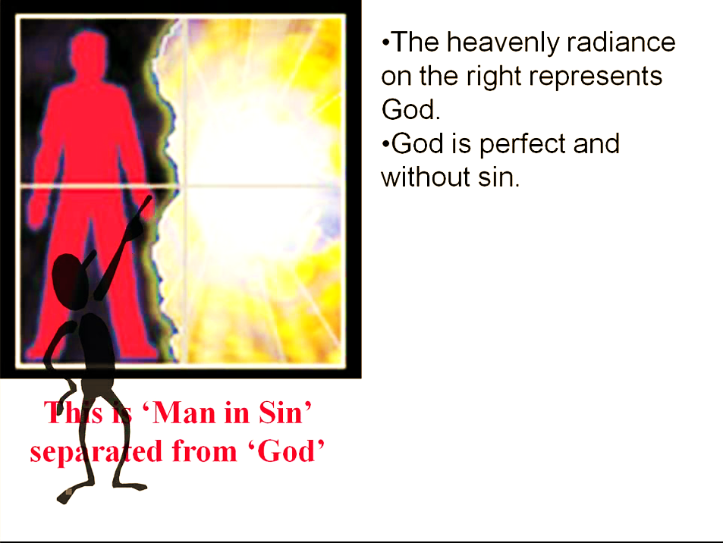

Slide 46
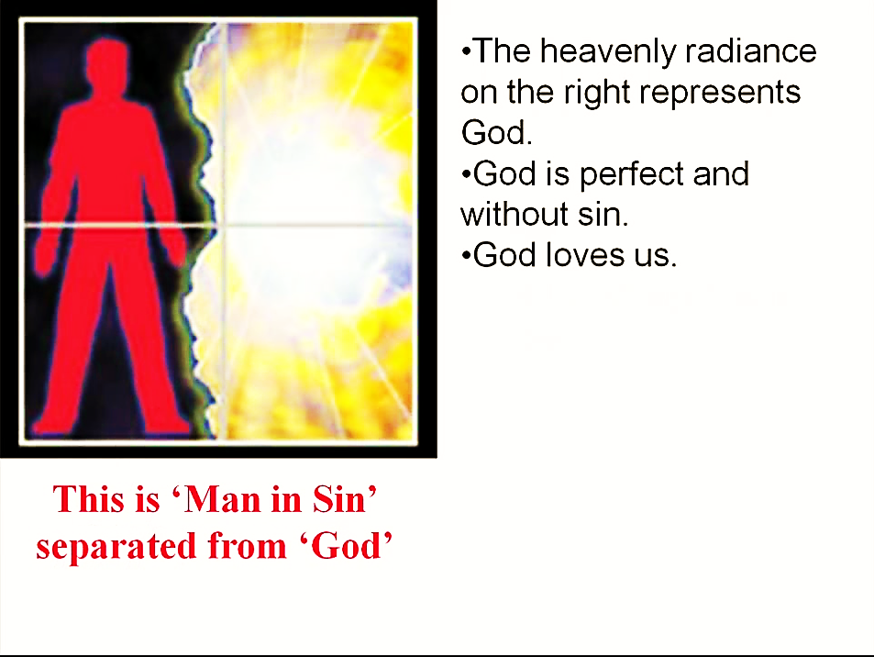

Slide 47
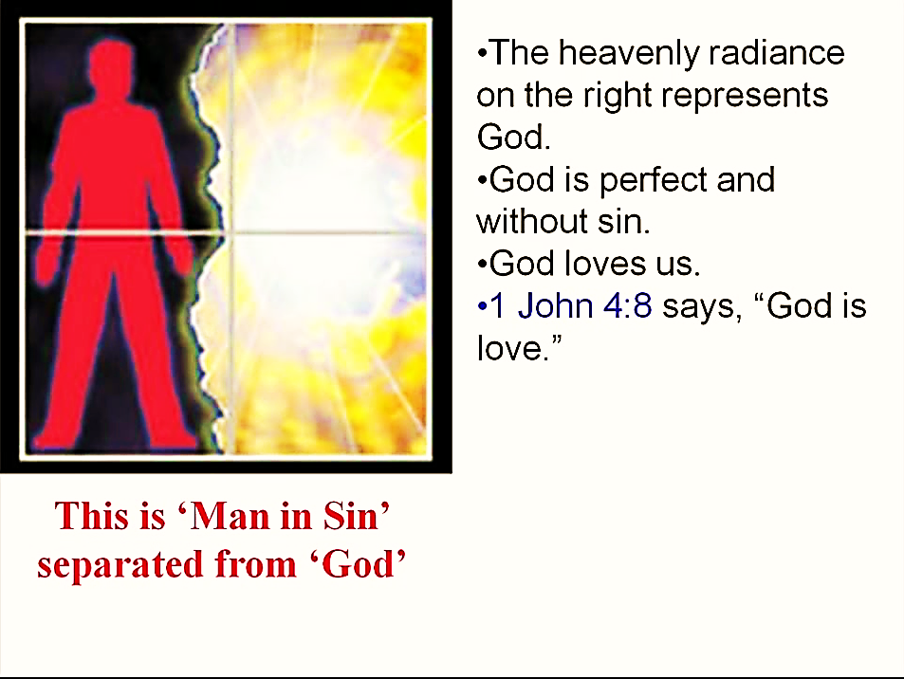

Slide 48
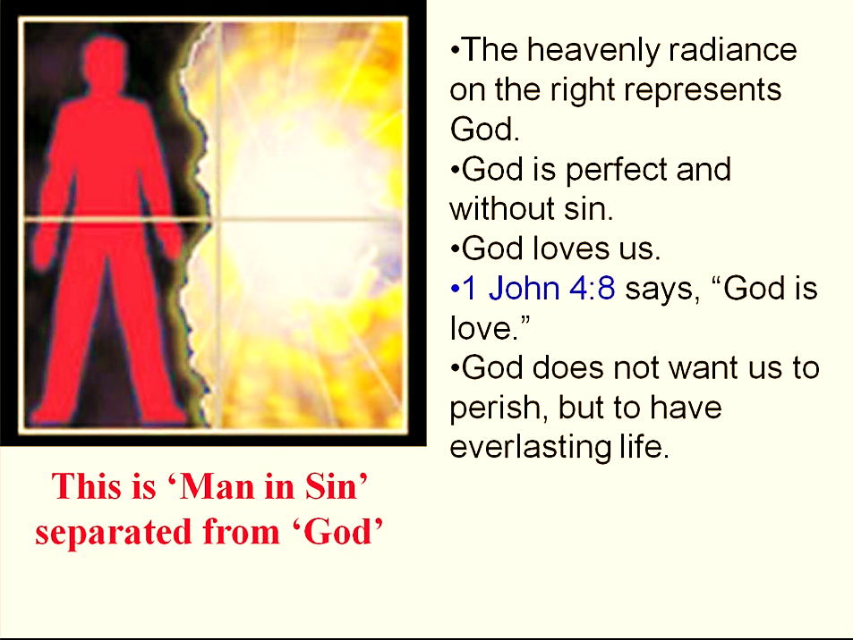

Slide 49
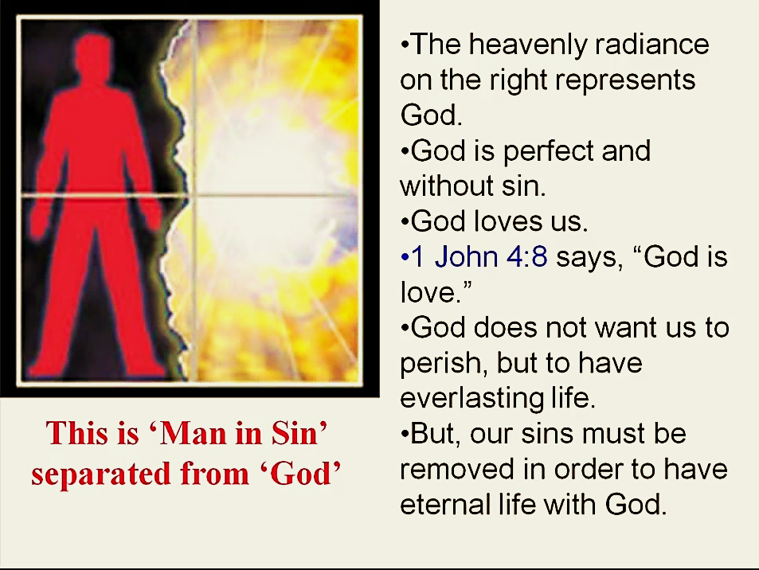

Slide 50
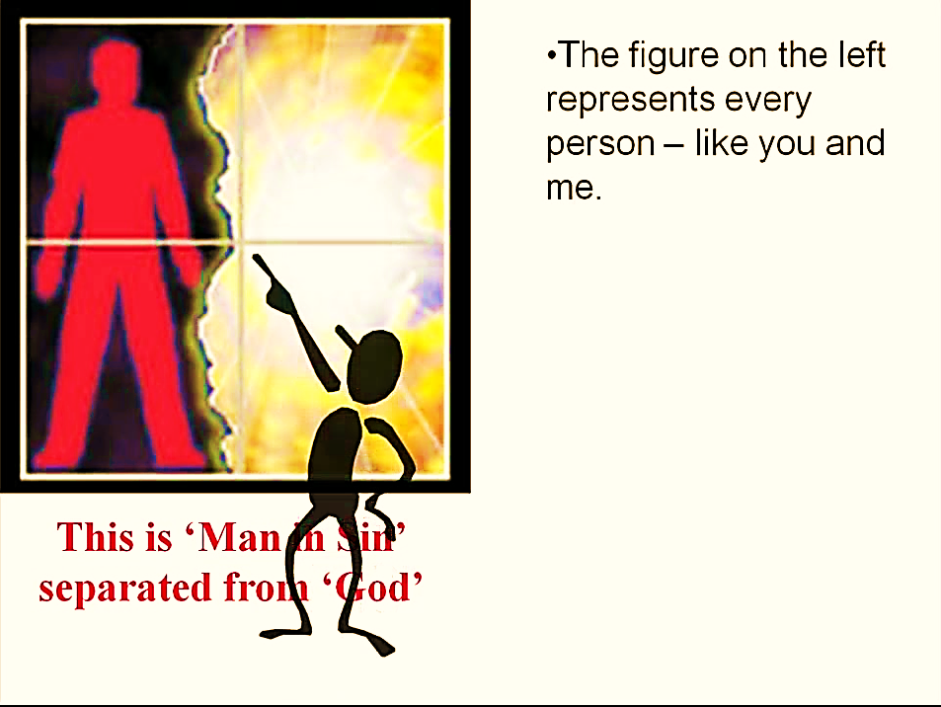

Slide 51
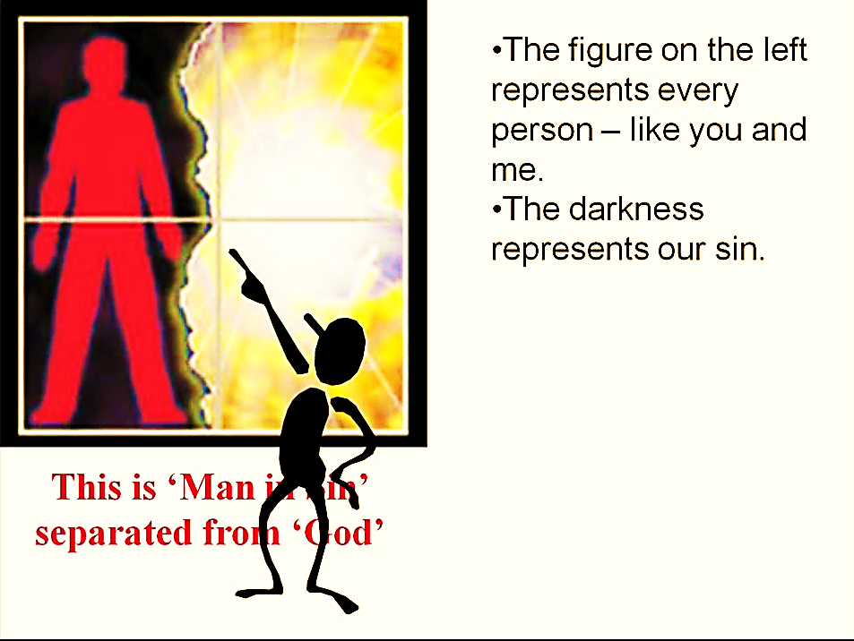

Slide 52
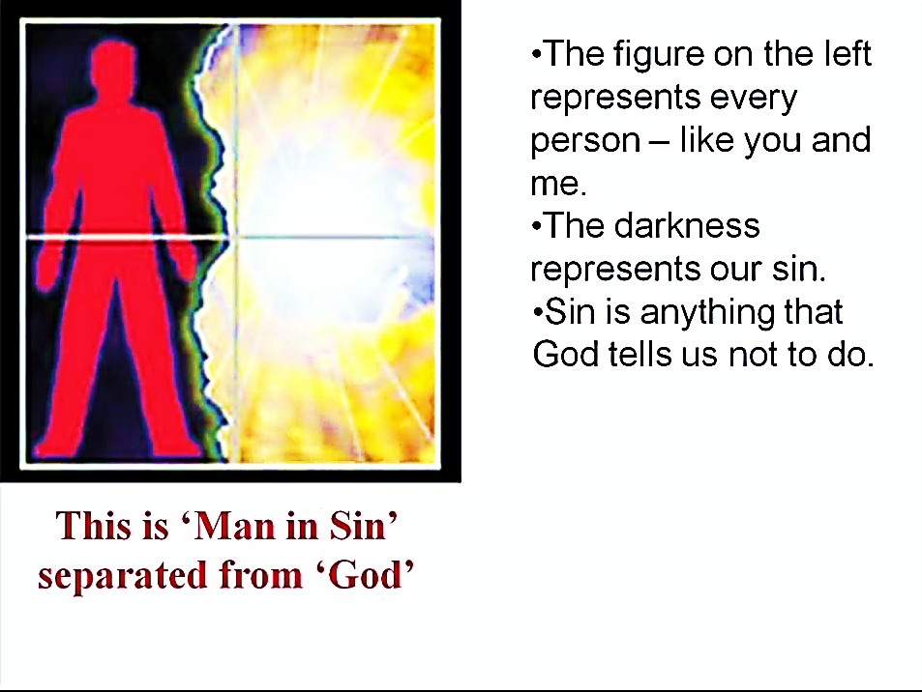

Slide 53
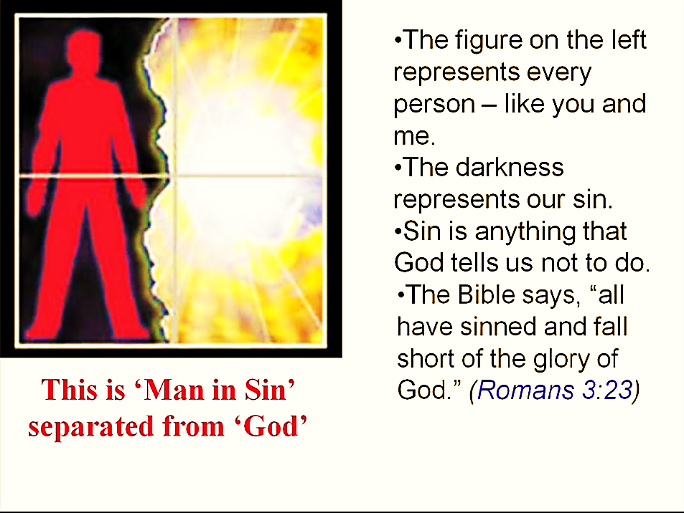

Slide 54
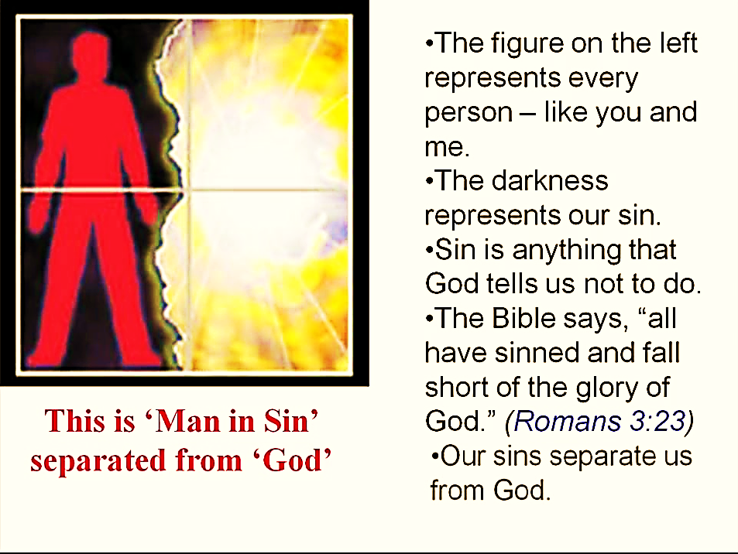

Slide 55
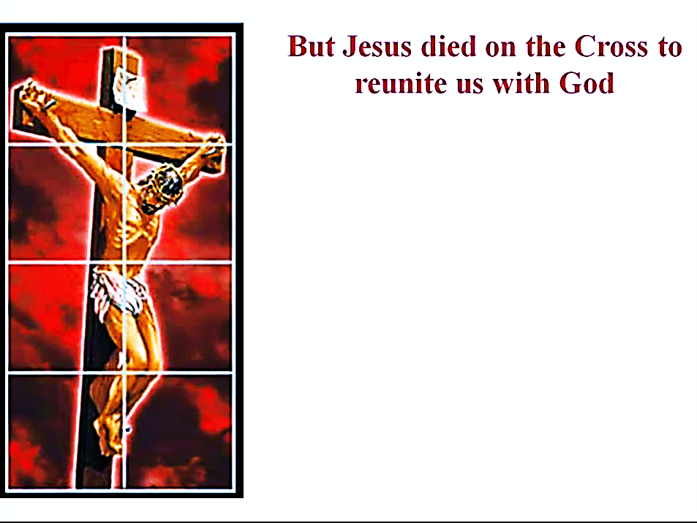

Slide 56
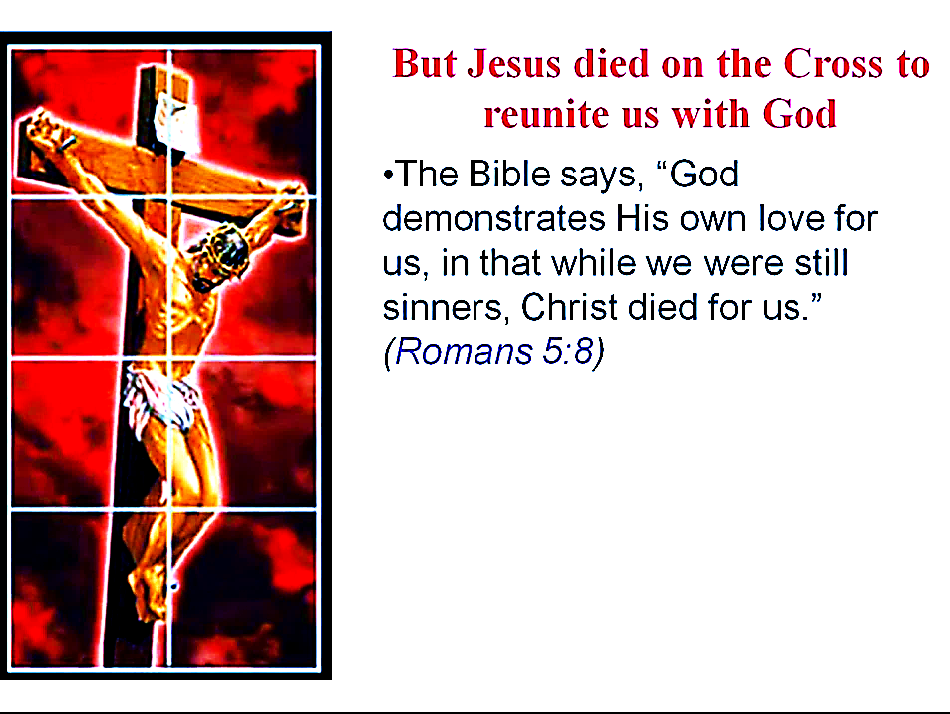

Slide 57
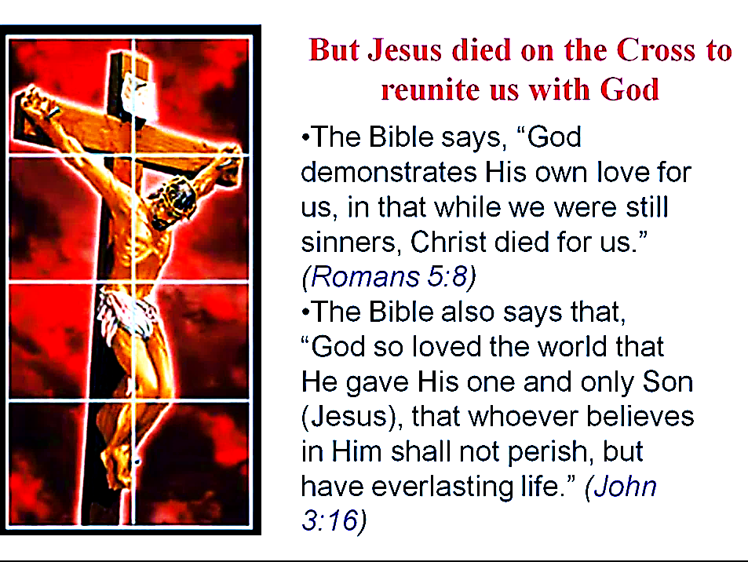

Slide 58
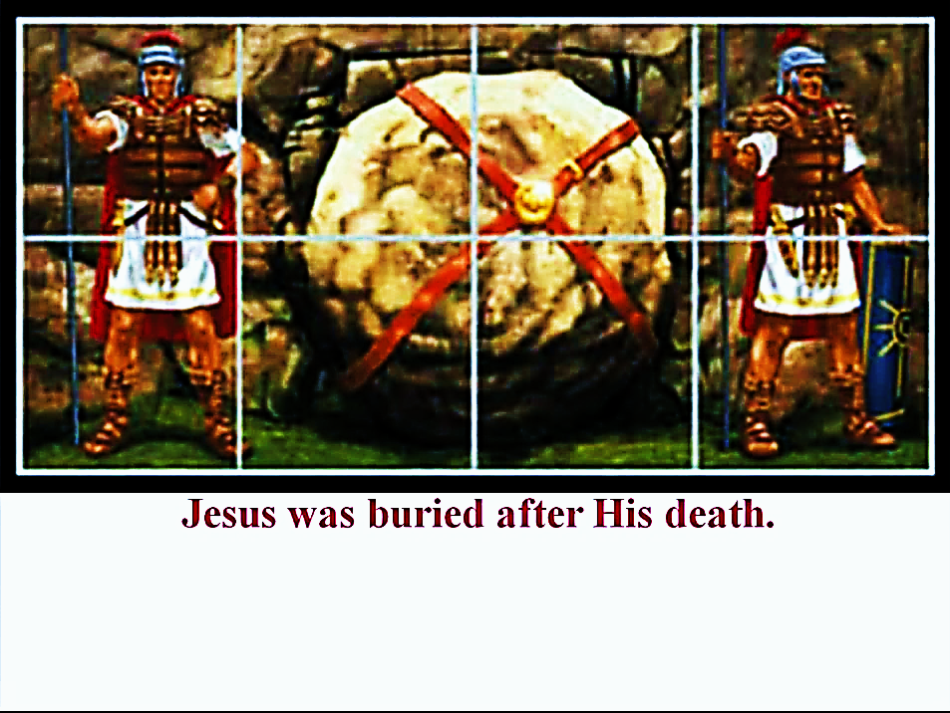

Slide 59
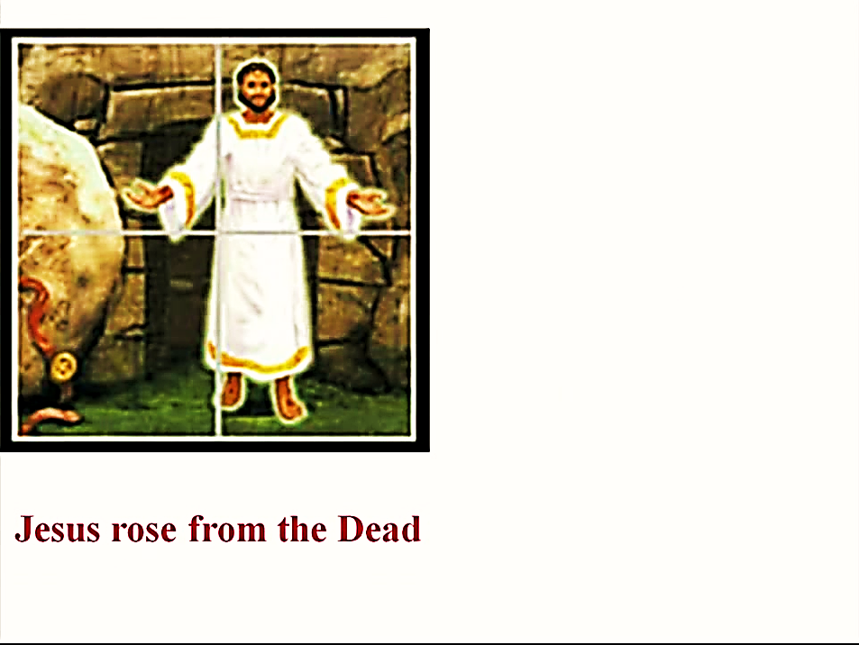

Slide 60
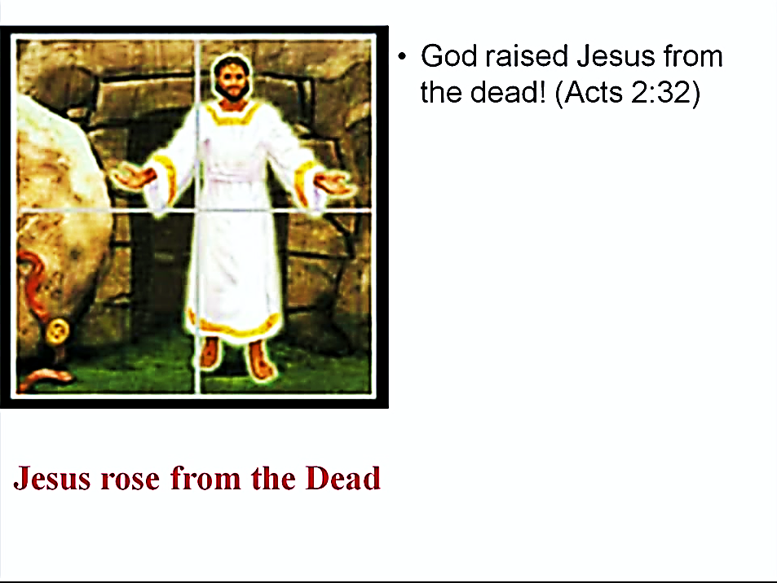

Slide 61
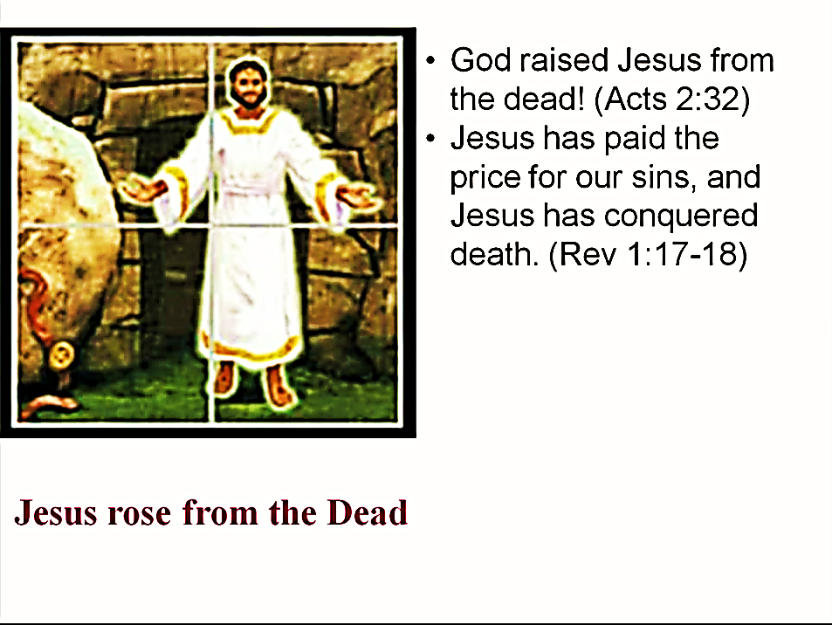

Slide 62


Slide 63
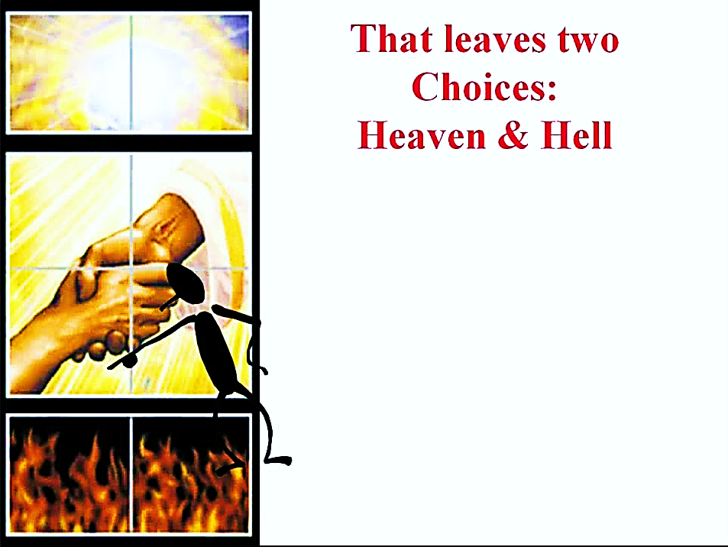

Slide 64
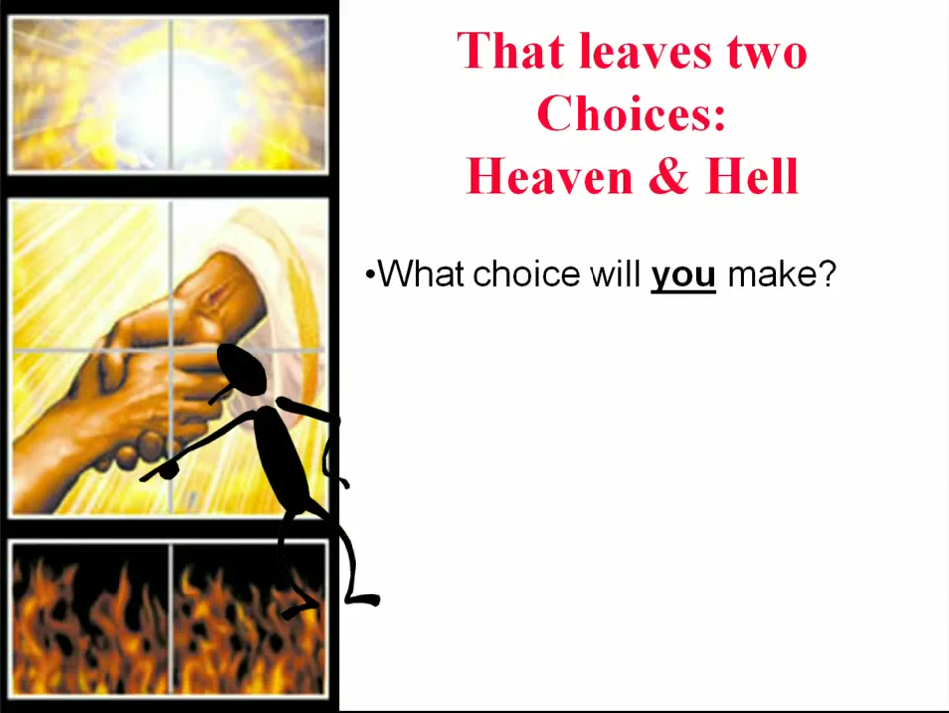

Slide 65


Slide 66
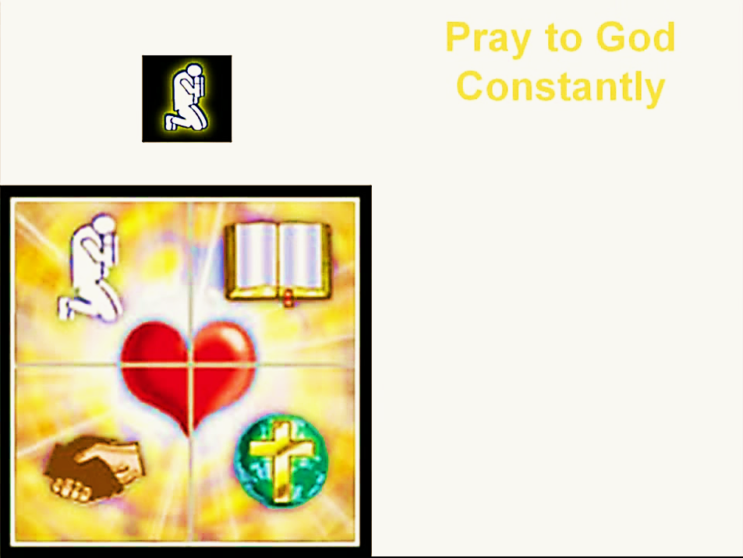

Slide 67
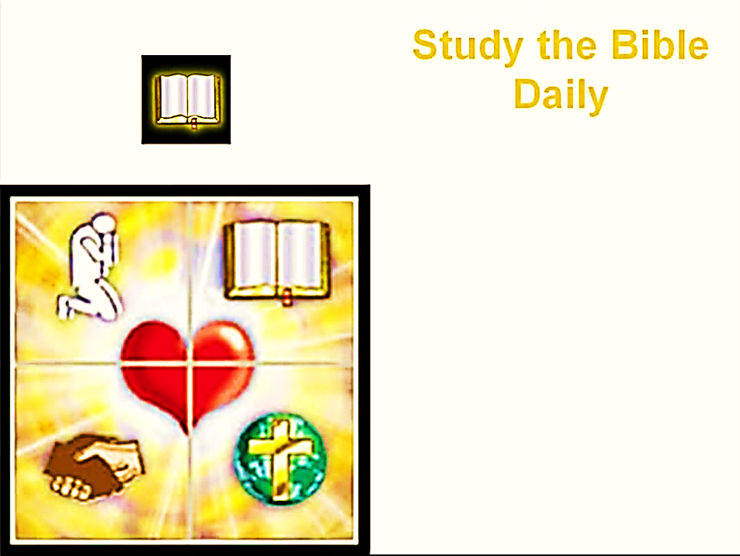

Slide 68
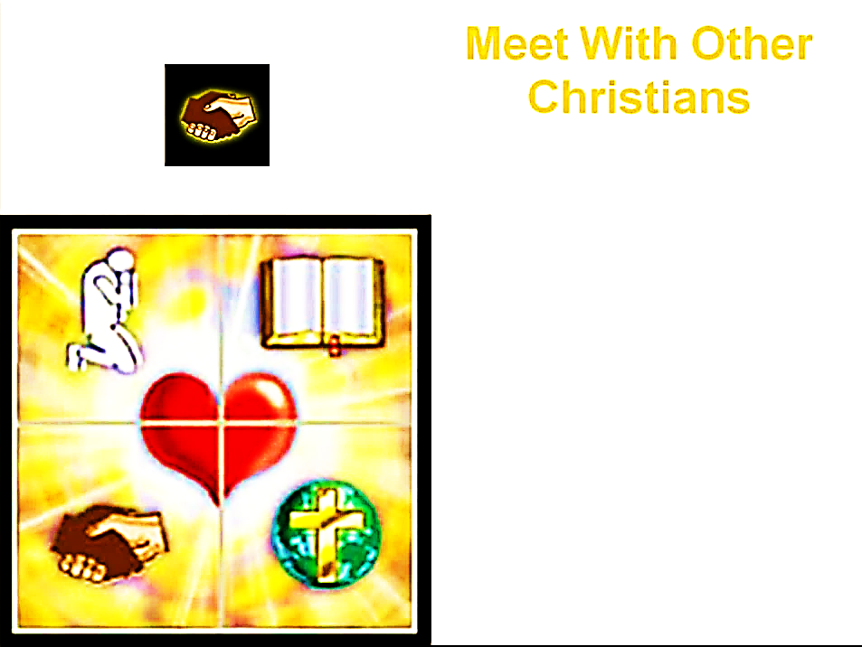

Slide 69
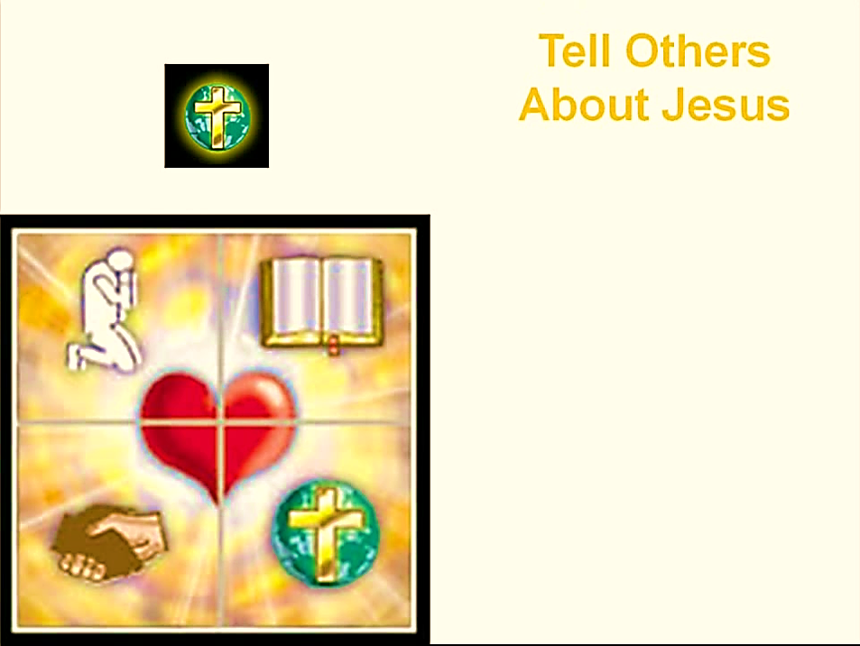

Slide 70
Need a Volunteer (Kid or Adult) To:
Answer Lesson Questions
Explain the Gospel in a Nutshell Craft
Explain the Big E-Cube
Explain the “Gospel in My Hand”

Slide 71

a
The Gospel
in
My
Hand

Slide 72
a
My Pointer:
Points to my sin. I don’t deserve Heaven.
My Thumb:
Like a hitchhiker, I need a free ride to Heaven.
My Longest Finger:
Reminds me of God. The greatest person in the universe.
My Ring Finger:
Reminds me of Jesus who loves me forever. He died to pay for my sin.
My Pinkie Finger:
It only take a little faith in Jesus (mustard seed size)
to give Him my heart and
my whole life.

Slide 73
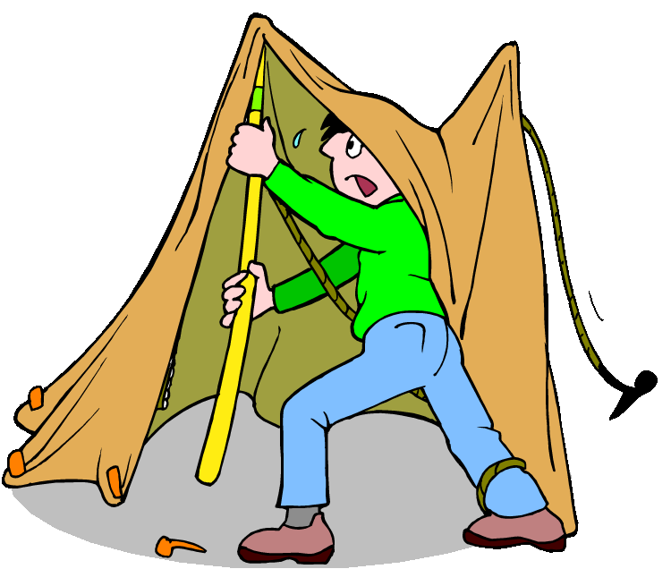
Workers can help with set-up and tear-down of the tent and equipment.

Slide 74


Workers can share their salvation testimony or sing a song.

Slide 75
“They overcame him by the blood of the Lamb and by the word of their testimony, and they loved not their lives unto the death.”
Rev. 12:11 MEV

Slide 76
“About midnight Paul and Silas were praying and singing hymns to God, and the prisoners were listening to them,”
Acts 16:25

Slide 77
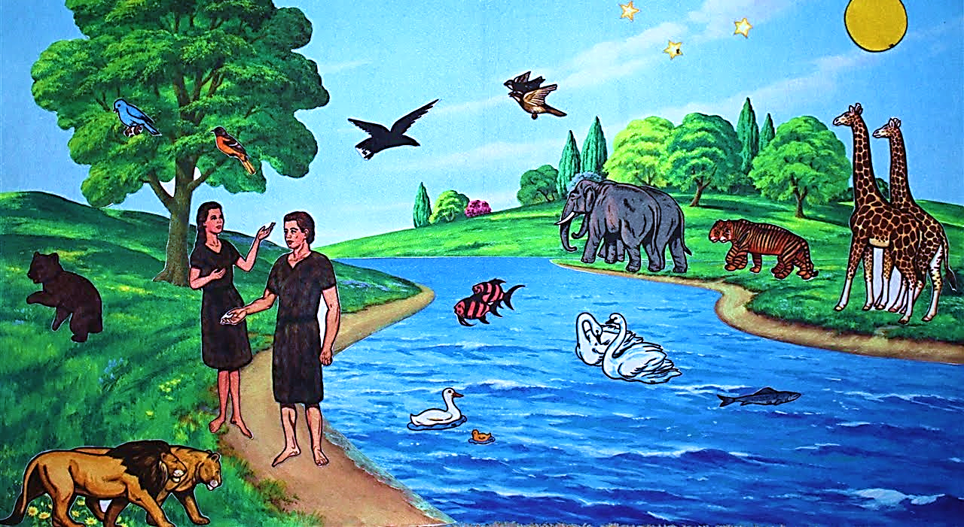
Workers can tell bible stories using the Betty Lukins flannels, then let the children tell the same story.

Slide 78
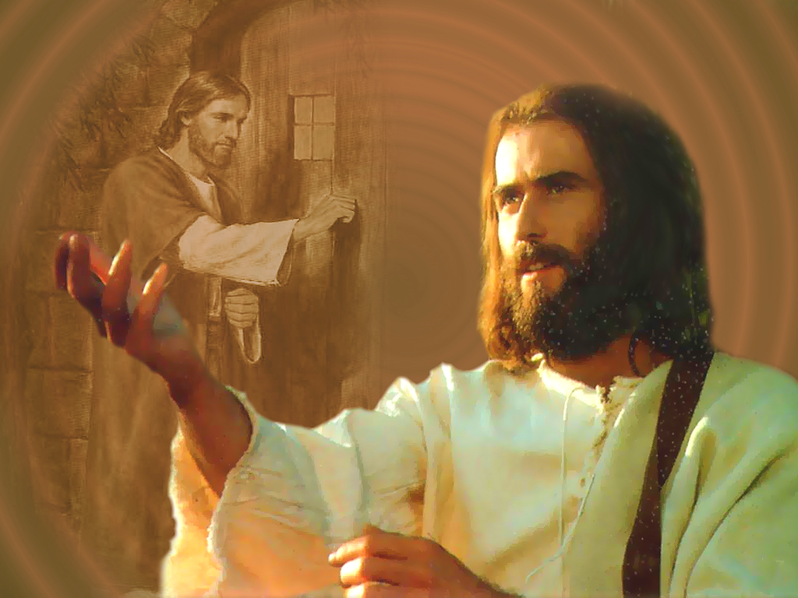
Workers can present the altar call.

Slide 79

Start with a few comments to connect the sermon to the altar call text.
Deliver the altar call with energy & confidence.
Take your time, don’t rush it.
Call people to the front to pray with you.
Send them to the hospitality table for a free gift & prayer.

Slide 80
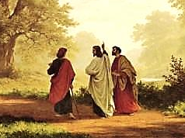
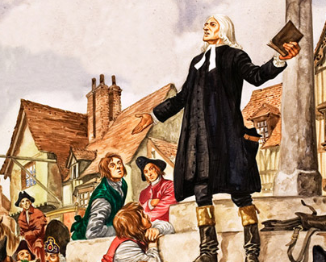
Is Jesus
Speaking to You?
“They said to each other, ‘Did not our hearts burn within us while he talked to us on the road, while he opened to us the Scriptures?’”
John Wesley Said:
“…the preacher was describing the change which God works in the heart through faith in Christ and I felt my heart strangely warmed.”
Jesus makes His presence Known by a small voice!

Slide 81
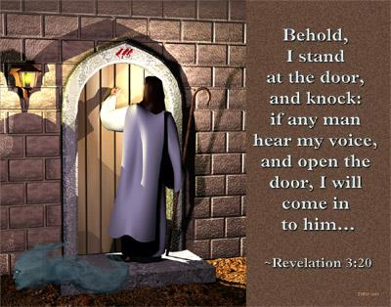

Slide 82
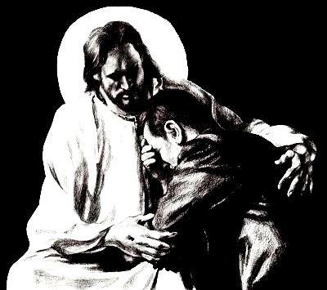
What is the Sinner‘s Prayer?
This is a prayer we can pray when we are ready to admit we are sinners and need Christ’s forgiveness.
It must be prayed with faith in our hearts and a readiness to have a life-changing encounter with Jesus Christ.

Slide 83

A prayer of faith → Pray this prayer if :
If you never have before
You have in the past, but you think it would mean more today
You have been walking afar off and you want to come back
You want to set an example & show others how it is done
You just like to give your heart to Jesus again & again
Faith

Slide 84
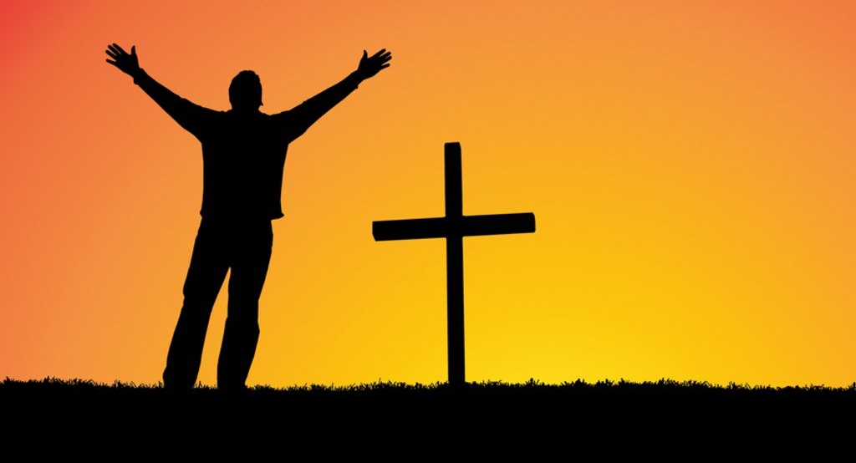
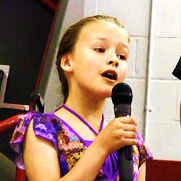
We Declare Our Faith Publicly Because
Jesus Declared His LOVE Publicly
“If you stand before others and are willing to say you believe in me, then I will tell my Father in heaven that you belong to me.” Mat 10:32
If you are ready to give your heart & life to Jesus right now, please come to the front as we pray this prayer together.

Slide 85

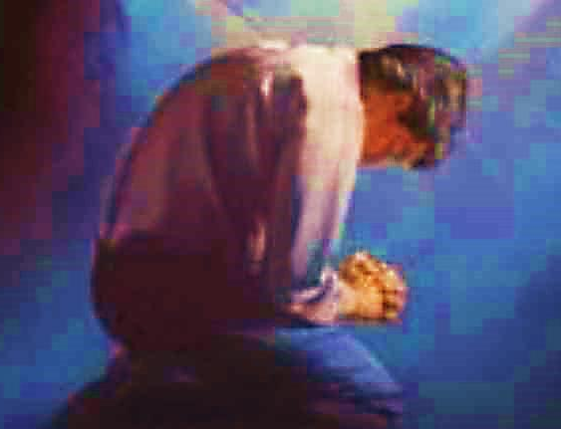
Three Important Questions
Do you want to know Jesus as your Savior right now?
Do you believe He died to save you from your sins & that He rose from the dead?
Do you believe that He is here, waiting to save you right now?

Slide 86
The Prayer of a Sinner Turning to Jesus
Dear Jesus, I know that I have sinned against You and that my sins separate me from You.
I am truly sorry.
Right now, I turn away from my sinful past .
Please forgive me, and help me to keep from sin.
I believe You died for my sins.
I Believe You rose from the dead, you are alive, and you hear this prayer from my heart.
I invite You Jesus to be both my Savior and the Lord of my life.
I want You to rule my life from now on.

Slide 87


“But some people did accept him. They believed in him, and he gave them the right to become children of God.”
John 1:12

Slide 88



Slide 89

A small gift from us to you at the hospitality table.
Thank
you for coming.

Slide 90

Workers can preach any previously prepared PowerPoint Slideshow, starting with the “Four Spiritual Laws” PowerPoint.

Slide 91
Song: I’m Yours
Video Goes Here
Title: I’m Yours
Download Here:
https://youtu.be/9DwQgSZ287A

Slide 92
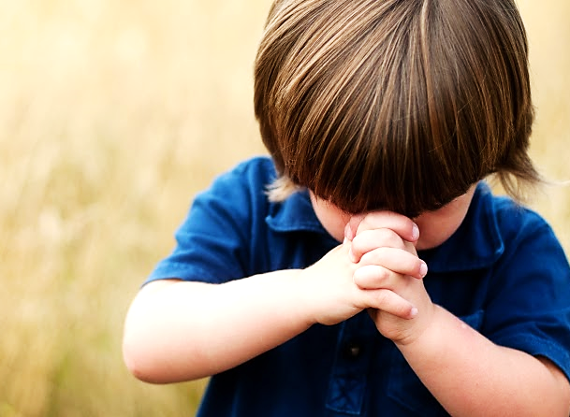
Let’s Close in Prayer

Slide 93
Note: After you download the slideshow, you may also need to download some videos from YouTube & add them into this PowerPoint. This tool can help you:
Free YouTube Download
We present these messages in outdoor venues using the SonShineTent.
Watch the video of our service that goes with this message, click here: http://campaignkerusso.org/?p=15711
We would love to know more about the people who download our lessons & sermons. We invite you to email us & let us know where & how you use them.
info@campaignkerusso.org

