Slide 1
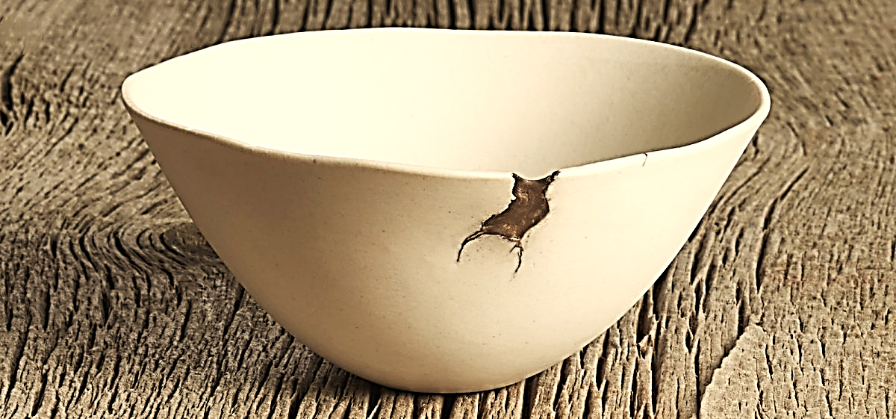
My Wabi-Sabi World
A Message of
Thanksgiving Love

Slide 2



Note: After you download the slideshow, you may also need to download some videos from YouTube & add them into this PowerPoint. This tool can help you:
Free YouTube Download
We present these messages in outdoor venues using the SonShineTent.
Watch the video of our service that goes with this message, click here: http://campaignkerusso.org/?p=15919
We would love to know more about the people who download our lessons & sermons. We invite you to email us & let us know where & how you use them.
info@campaignkerusso.org

Slide 3

Let’s Begin with Prayer

Slide 4
My Wabi-Sabi World
A Message of
Thanksgiving Love

Slide 5
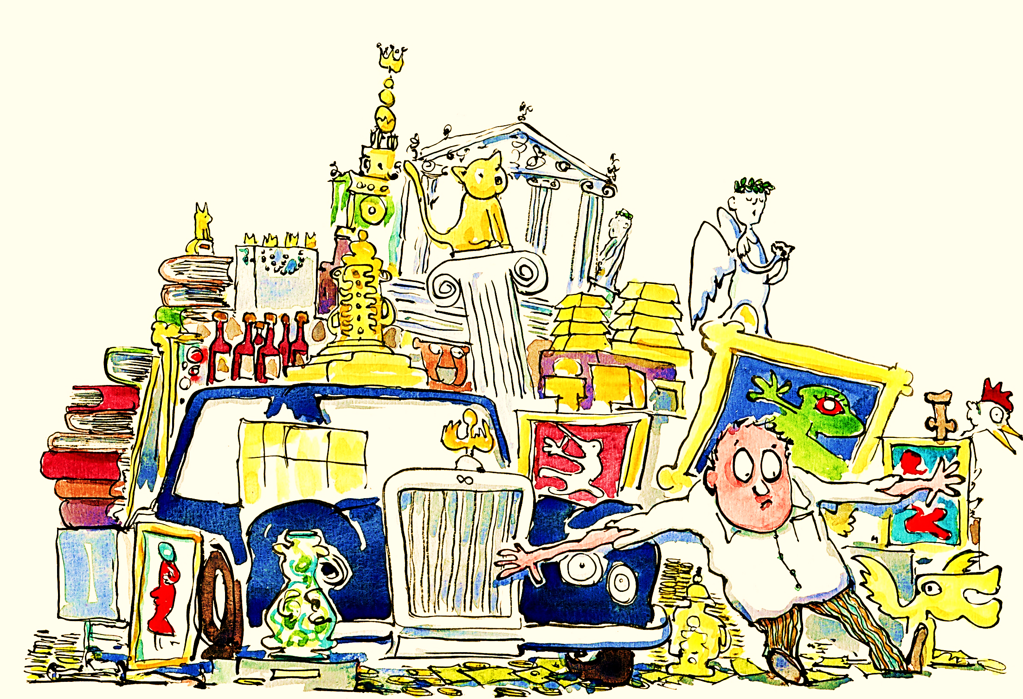
In general, polite society considers the love of things to be nothing more than greedy materialism...

Slide 6
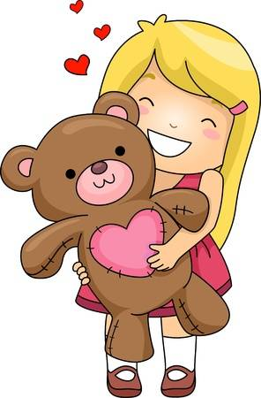
…however, it might not be such a bad thing to love ‘a thing.’

Slide 7

Consider the following bible verse:
“And the Lord said unto him (Moses), what is that (thing) in your hand? And he said, ‘A rod’.” Ex. 4:2

Slide 8
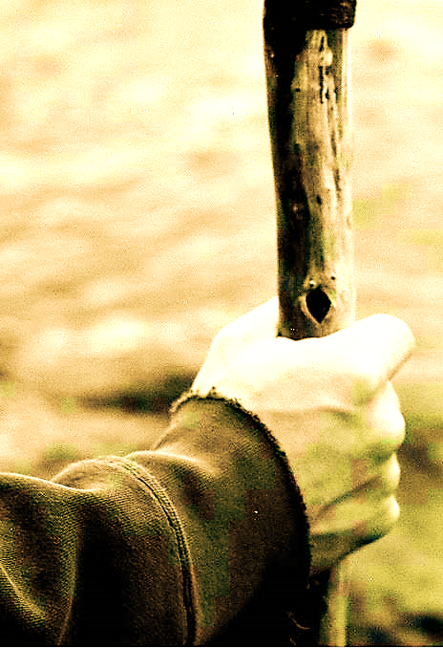
God seemed particularly interested in the well-worn rod (held almost unconsciously) in the weathered hand of a simple shepherd.
A stiff branch from a common tree, with gnarly bends & dark knots…
The only “jewels” that would ever embellish this working-class tool

Slide 9
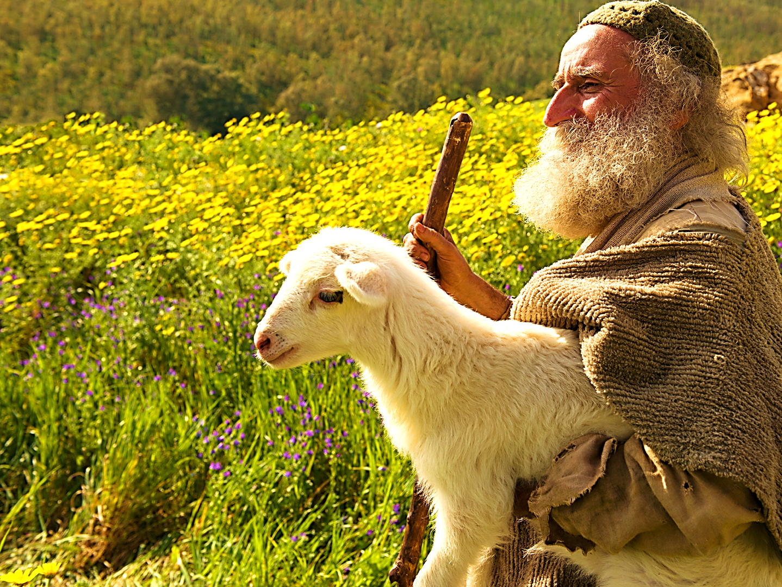
Yet, on this auspicious occasion, God
didn’t promise
Moses an
upgrade.
Rather, He
focused on the humble tool Moses had already been leaning his weight on for years.

Slide 10
In Japanese philosophy, there is a principle called “wabi-sabi.”
It is an art aesthetic & worldview of appreciating flaws as an integral part of something’s beauty.

Slide 11
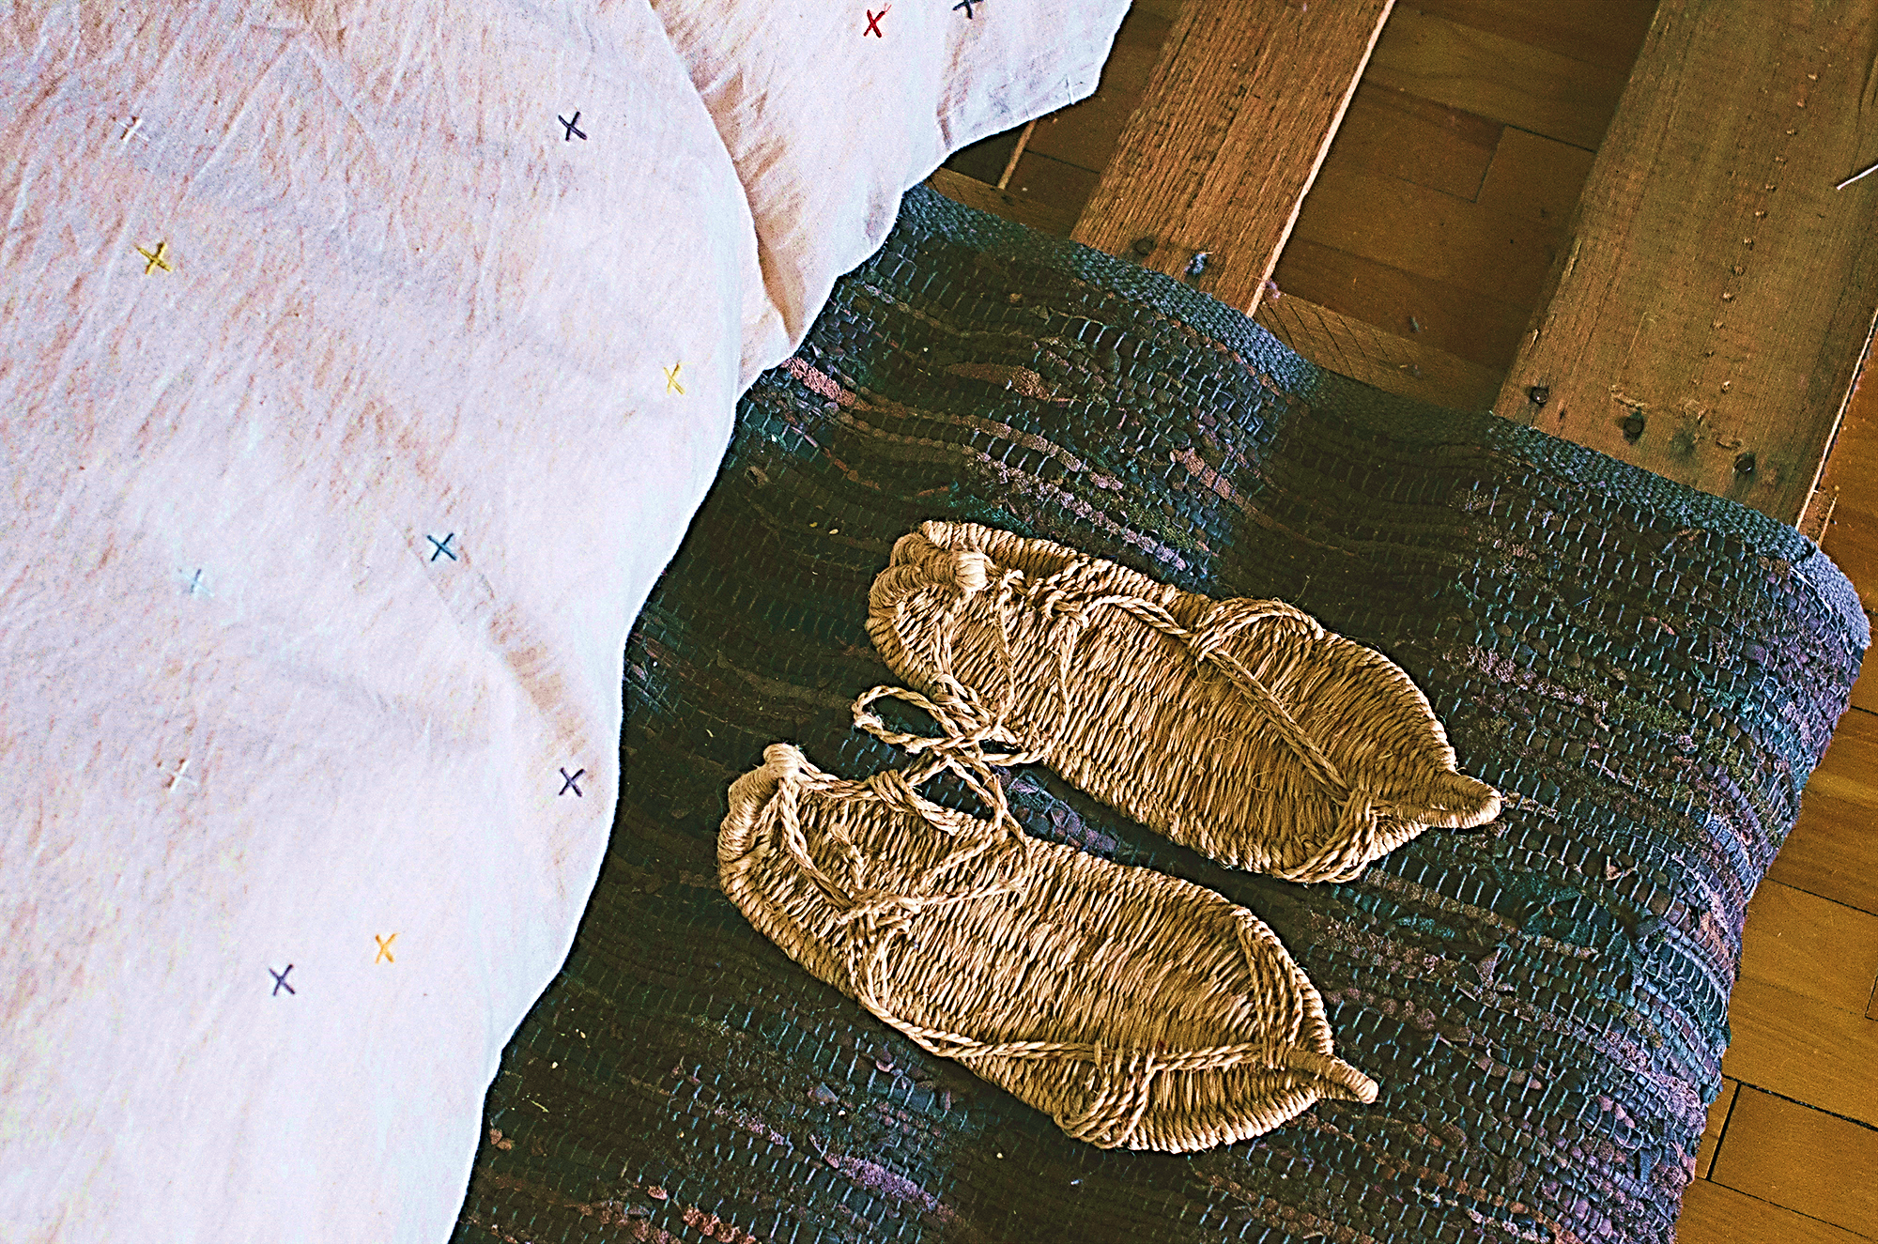
To the Japanese it is, “…the acceptance of transience, the beauty that is imperfect, impermanent,
& incomplete.”
(Wikipedia).

Slide 12
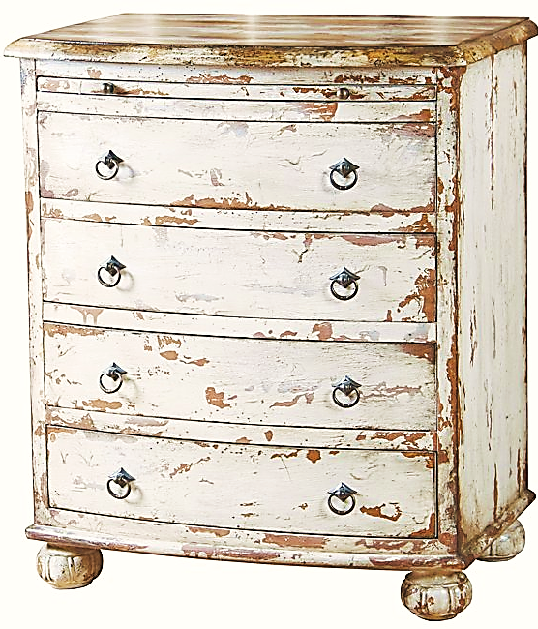
In the spirit of wabi-sabi, we stonewash our jeans & distress our furniture,
thus adding value through feigned imperfection.

Slide 13
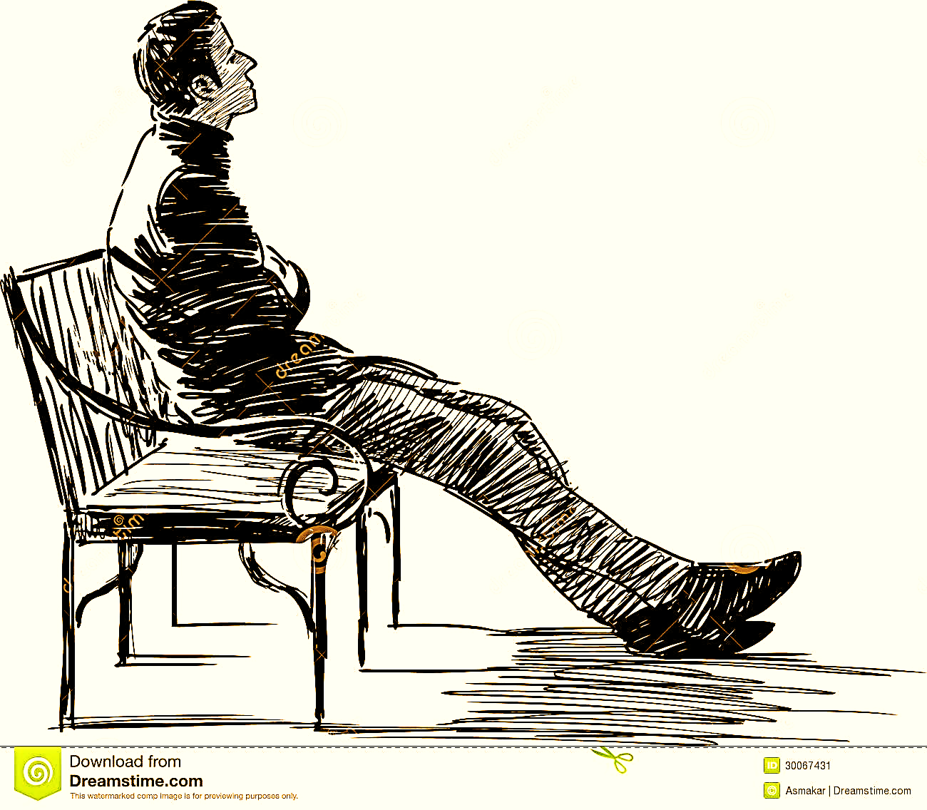
In Christianity it’s…
The “weakness” for which Paul thanked his God
The “last” that Jesus said shall be “first”
The blessed “poor in spirit” that shall “see God”
The beauty of the flawed made perfect in Christ

Slide 14
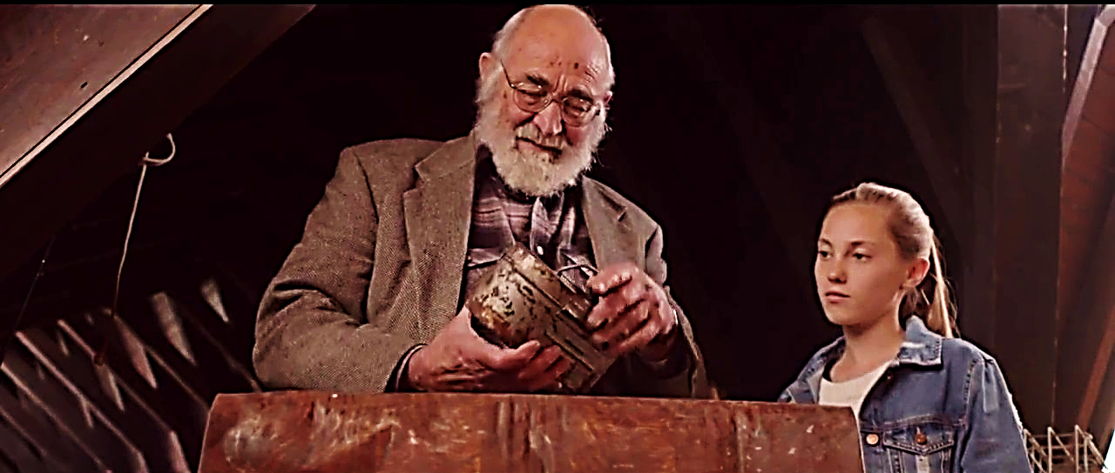
Yes, we can love our old sticks—our worn, use-tattered things—they are our estate.
We can embrace our wabi-sabi worlds.
We can begin to perceive the meaning of “value” differently.

Slide 15
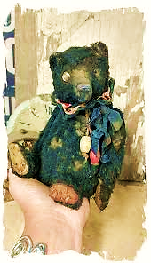
If we learn to appreciate the “rods” already in our hands—
If we open our hearts to cherish all that is ours—
This grateful perspective can ripple beyond material possessions.

Slide 16

In an episode of the TV show, “Frasier,” a son, living in a posh Seattle apartment, is asked to take in his aging father—tacky, duct-taped
recliner and all.
Soon, the son secretly rid his life of the chair,

Slide 17
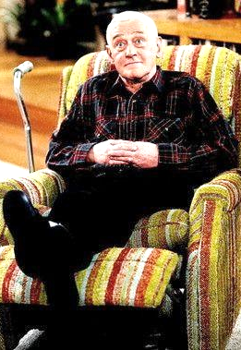
…but it is the father who felt rejected, perceiving it as a signal that his own flaws were equally objectionable.
As we begin to embrace the flaws in our things & understand the inherent beauty of flaws in general, we can begin to love people as God loves them—flawed.

Slide 18

If we change our verse to read “who” rather than “what,” it would read, “Who is in your hands?”
Do we really see those whom, like Moses & his rod, we have leaned on for many years, worn somewhat by our needs, & changed by our weight?

Slide 19
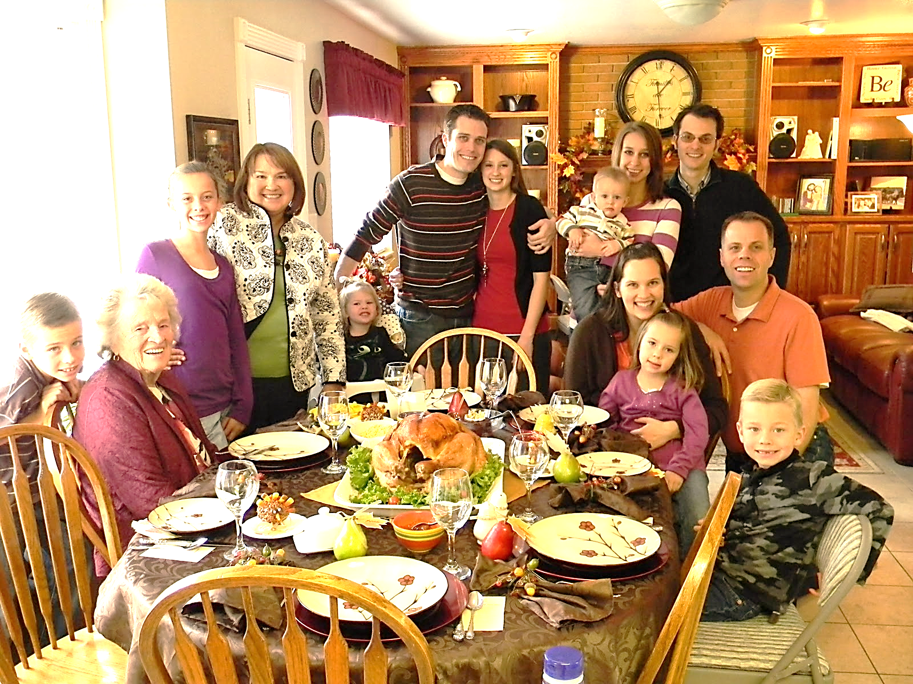
Are we noticing who is already
there in our lives—in our hand?
Will we let them slip through unmindful fingers, or will we awaken to both see & care for the beloved souls God has entrusted to us—embrace their flaws &
love what is already our own?

Slide 20
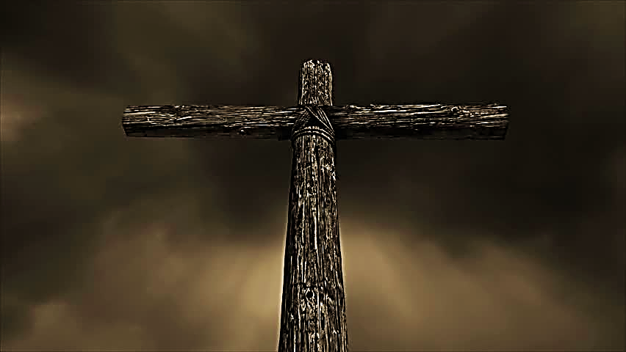
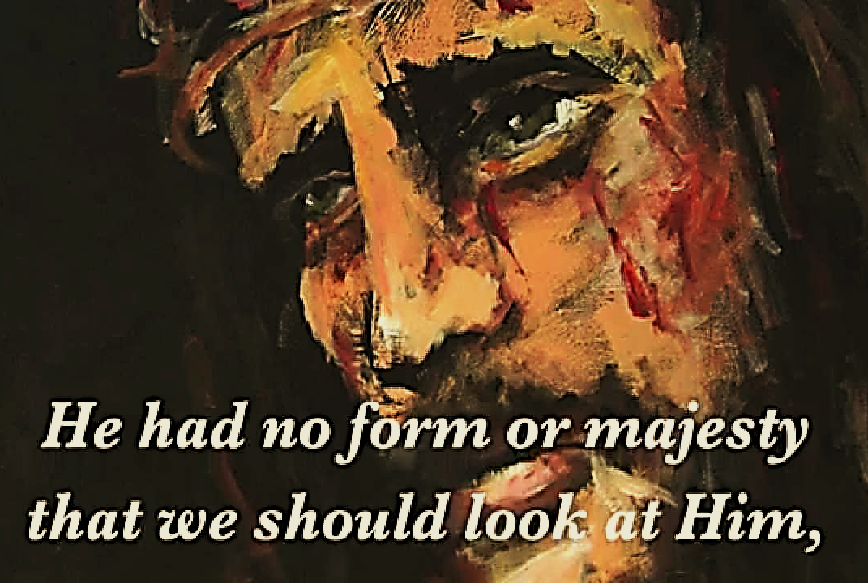
We must also remember that another gnarled stick, the one rejected of men, held our beloved Savior & bought our salvation.

Slide 21


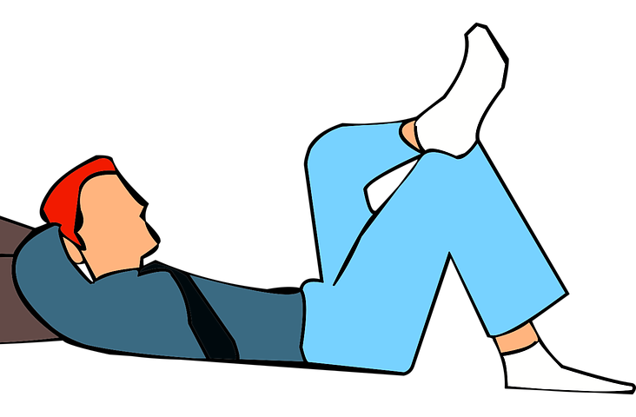
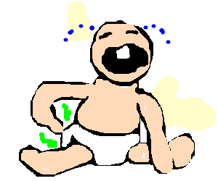
Thank you, God, for that crooked chair, that cat, that crying child, and that man asleep on the couch.

Slide 22
Song: Give Thanks
Video Goes Here
Title: Give Thanks
Download Here:
https://youtu.be/k9uZI4w4xgM

Slide 23
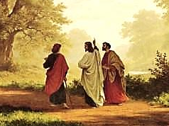
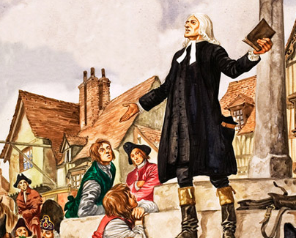
Is Jesus
Speaking to You?
“They said to each other, ‘Did not our hearts burn within us while he talked to us on the road, while he opened to us the Scriptures?’”
John Wesley Said:
“…the preacher was describing the change which God works in the heart through faith in Christ and I felt my heart strangely warmed.”
Jesus makes His presence Known by a small voice!

Slide 24
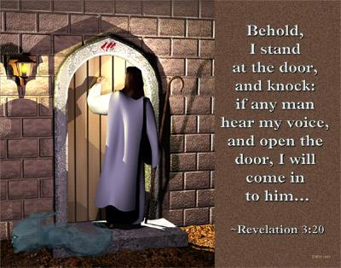

Slide 25
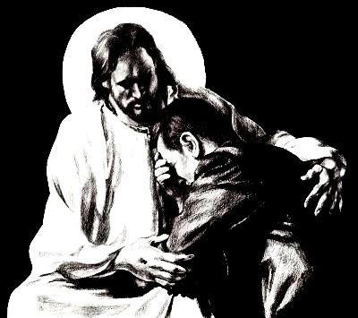
What is the Sinner‘s Prayer?
This is a prayer we can pray when we are ready to admit we are sinners and need Christ’s forgiveness.
It must be prayed with faith in our hearts and a readiness to have a life-changing encounter with Jesus Christ.

Slide 26

A prayer of faith → Pray this prayer if :
If you never have before
You have in the past, but you think it would mean more today
You have been walking afar off and you want to come back
You want to set an example & show others how it is done
You just like to give your heart to Jesus again & again
Faith

Slide 27
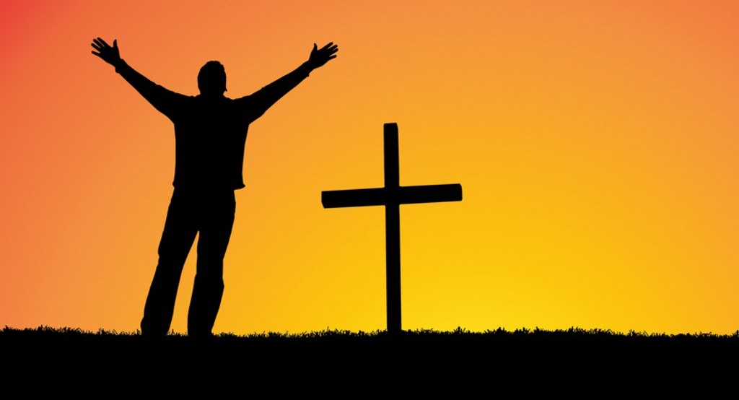
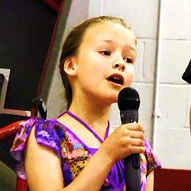
We Declare Our Faith Publicly Because
Jesus Declared His LOVE Publicly
“If you stand before others and are willing to say you believe in me, then I will tell my Father in heaven that you belong to me.” Mat 10:32
If you are ready to give your heart & life to Jesus right now, please come to the front as we pray this prayer together.

Slide 28

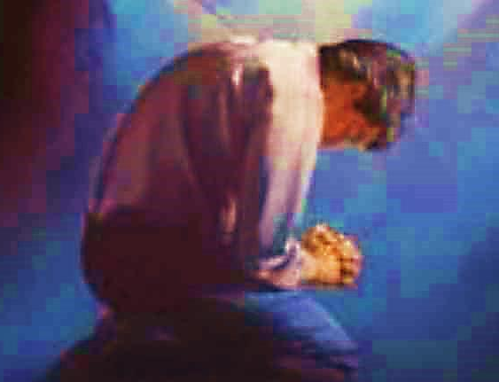
Three Important Questions
Do you want to know Jesus as your Savior right now?
Do you believe He died to save you from your sins & that He rose from the dead?
Do you believe that He is here, waiting to save you right now?

Slide 29
The Prayer of a Sinner Turning to Jesus
Dear Jesus, I know that I have sinned against You and that my sins separate me from You.
I am truly sorry.
Right now, I turn away from my sinful past .
Please forgive me, and help me to keep from sin.
I believe You died for my sins.
I Believe You rose from the dead, you are alive, and you hear this prayer from my heart.
I invite You Jesus to be both my Savior and the Lord of my life.
I want You to rule my life from now on.

Slide 30


“But some people did accept him. They believed in him, and he gave them the right to become children of God.”
John 1:12

Slide 31



Slide 32

Need a Volunteer (Kid or Adult) To:
Answer Lesson Questions

Slide 33


“If you openly say, ‘Jesus is Lord’ and believe in your heart that God raised him from death, you will be saved.”
Rom. 10:9
What did you learn today?
What about wabi-sabi love?
What have you been thinking about God lately?
What do you want to tell others about Jesus?

Slide 34
Need a Volunteer (Kid or Adult) To:
Answer Lesson Questions
Explain the Gospel in a Nutshell Craft

Slide 35
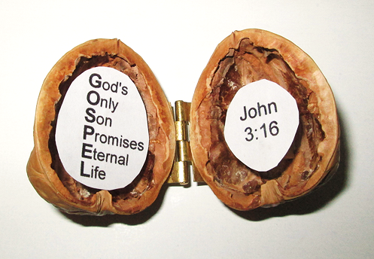
The Gospel
In a Nutshell

Slide 36
Need a Volunteer (Kid or Adult) To:
Answer Lesson Questions
Explain the Gospel in a Nutshell Craft
Explain the Big E-Cube

Slide 37
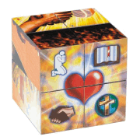
Evangecube
ss

Slide 38

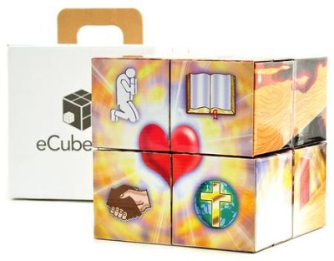
Evangecube
Buy a standard-sized EvangeCube here: EvangeCube
Buy a large sized EvangeCube here: Evangecube Big Cube

Slide 39
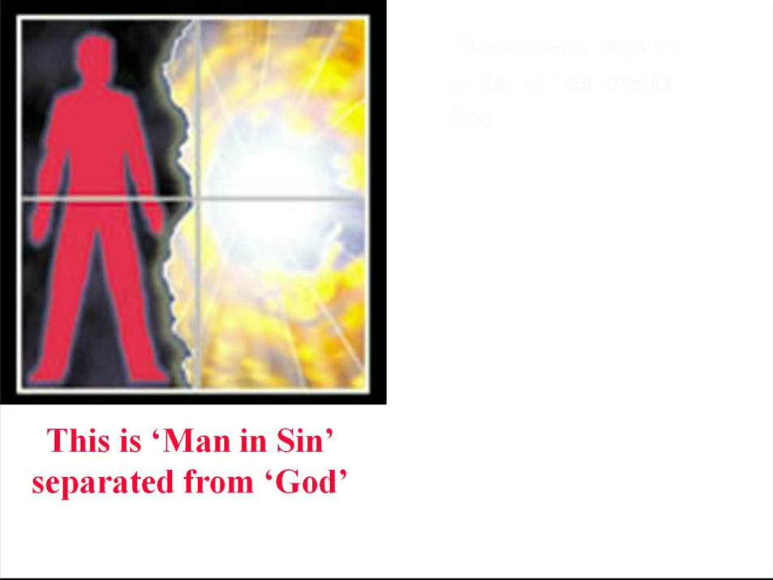

Slide 40
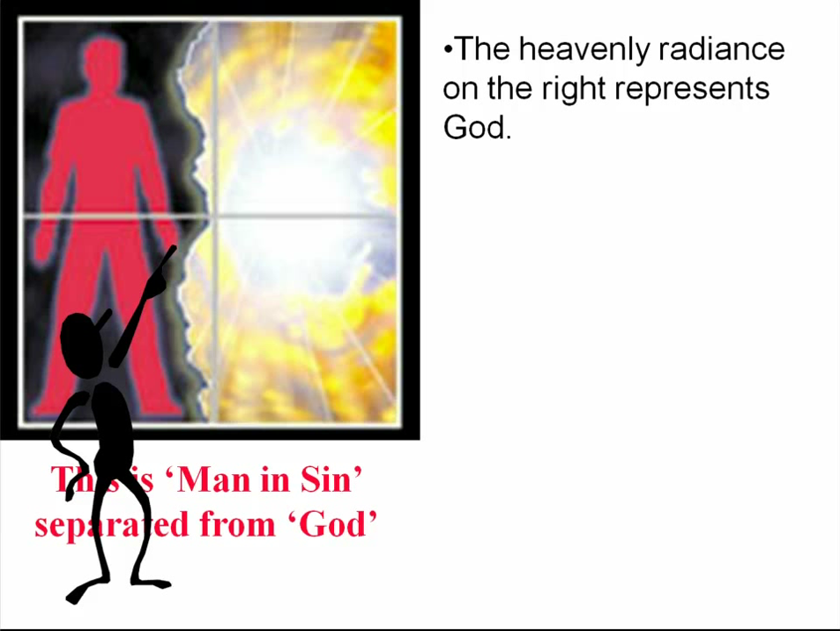

Slide 41
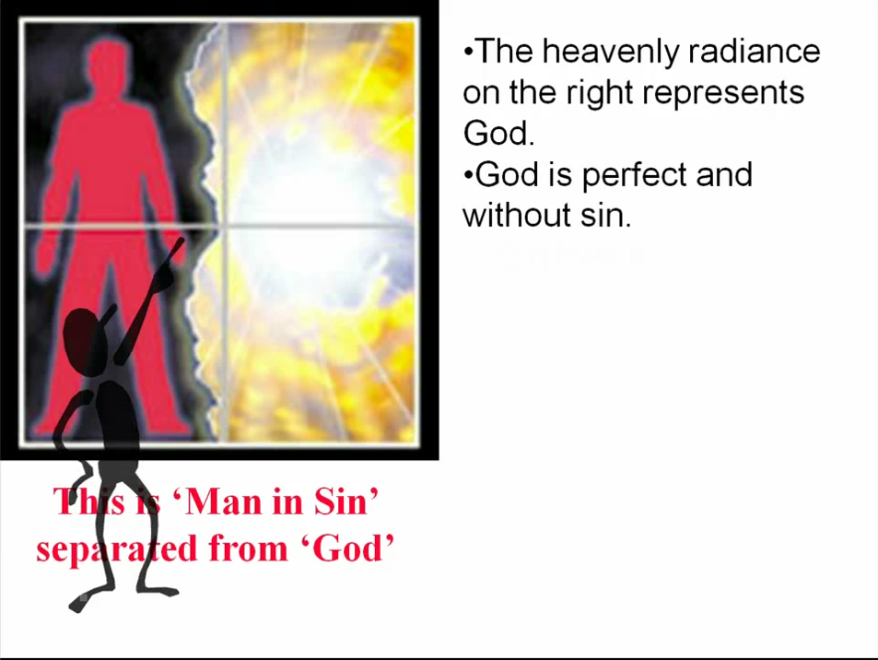

Slide 42
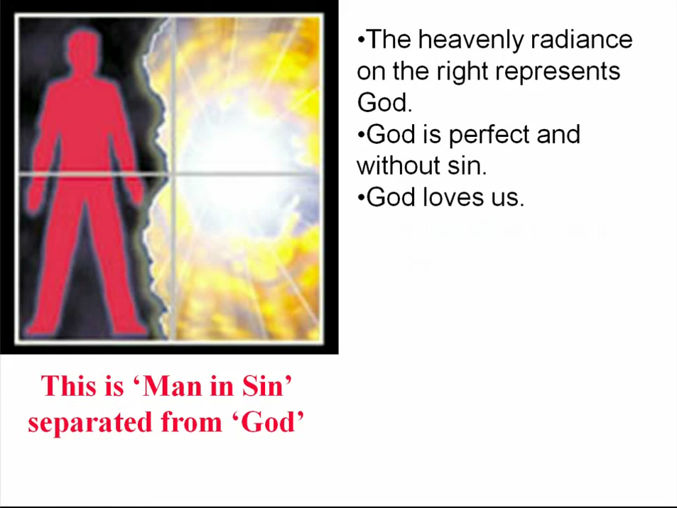

Slide 43
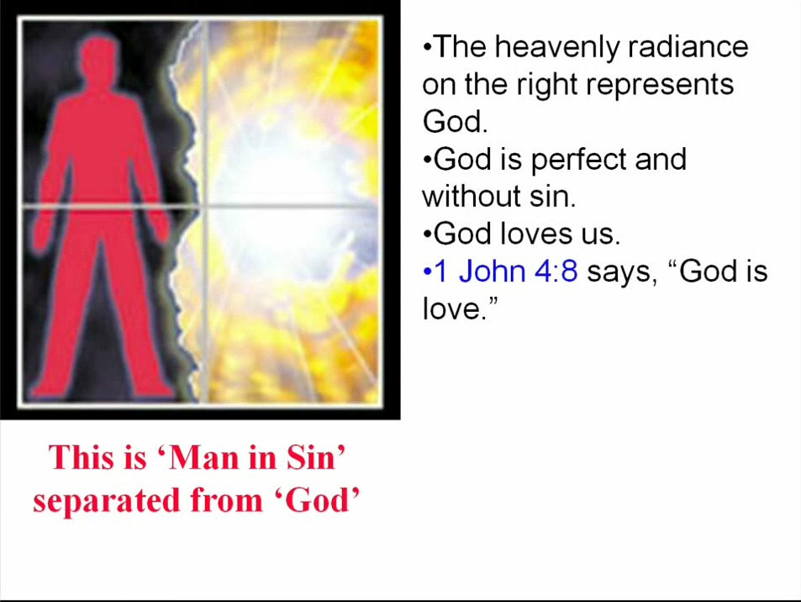

Slide 44
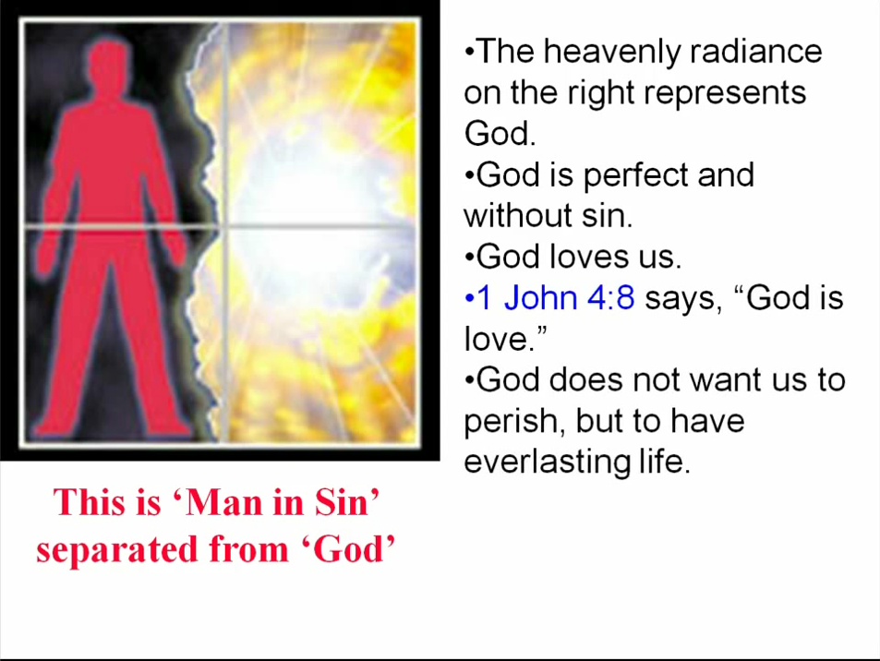

Slide 45
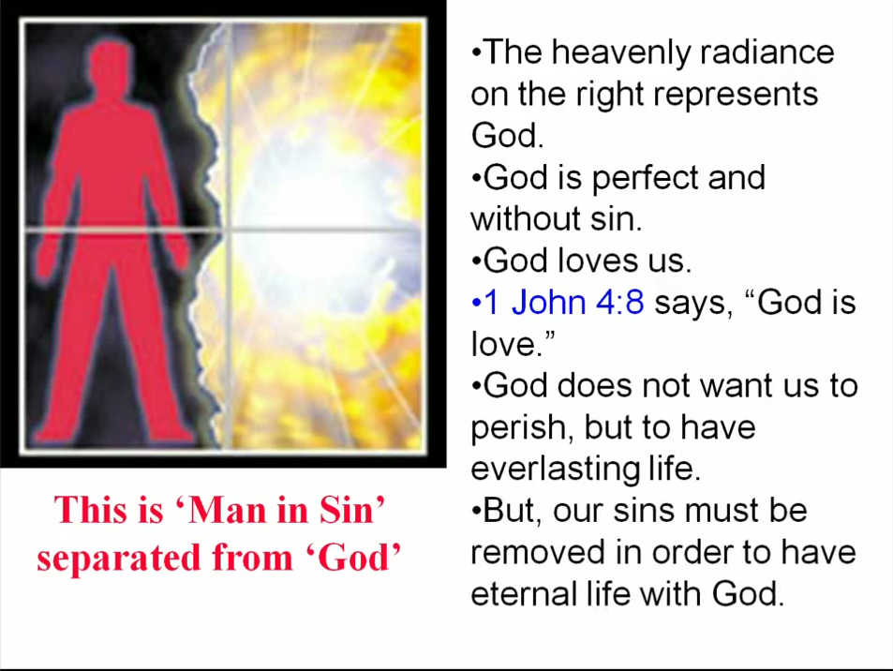

Slide 46
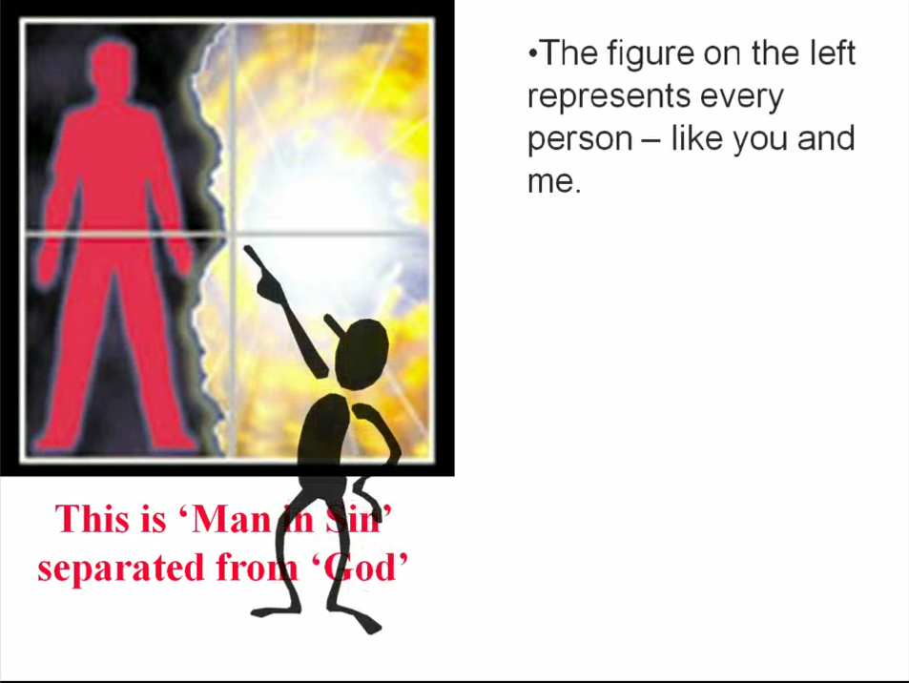

Slide 47
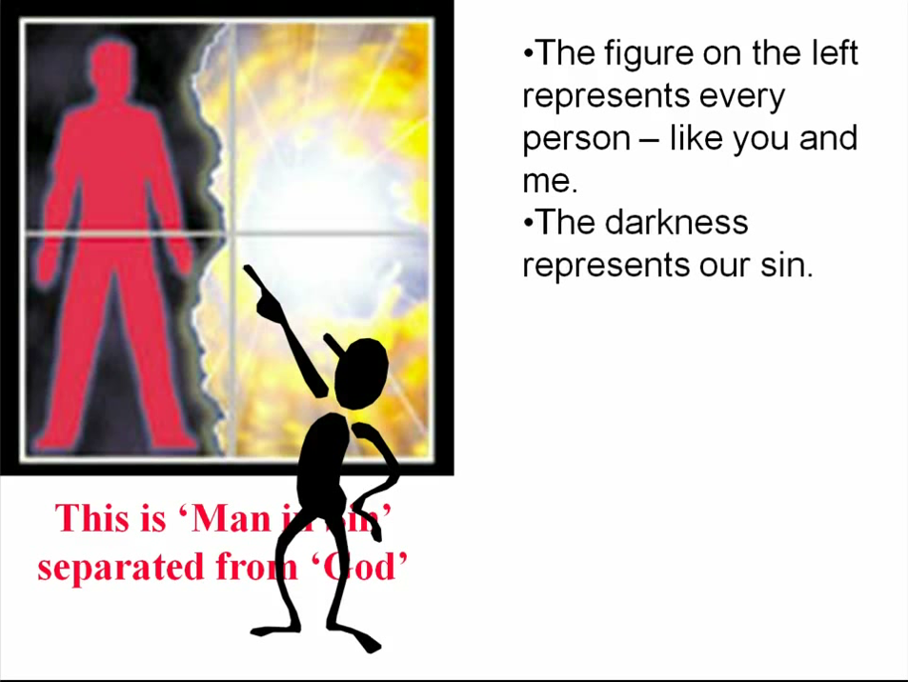

Slide 48
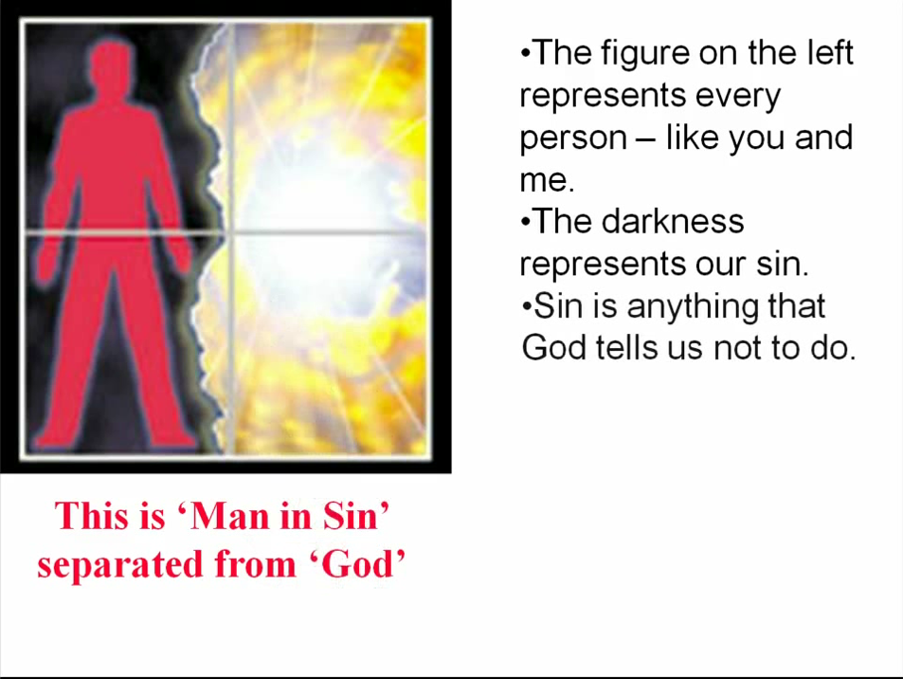

Slide 49
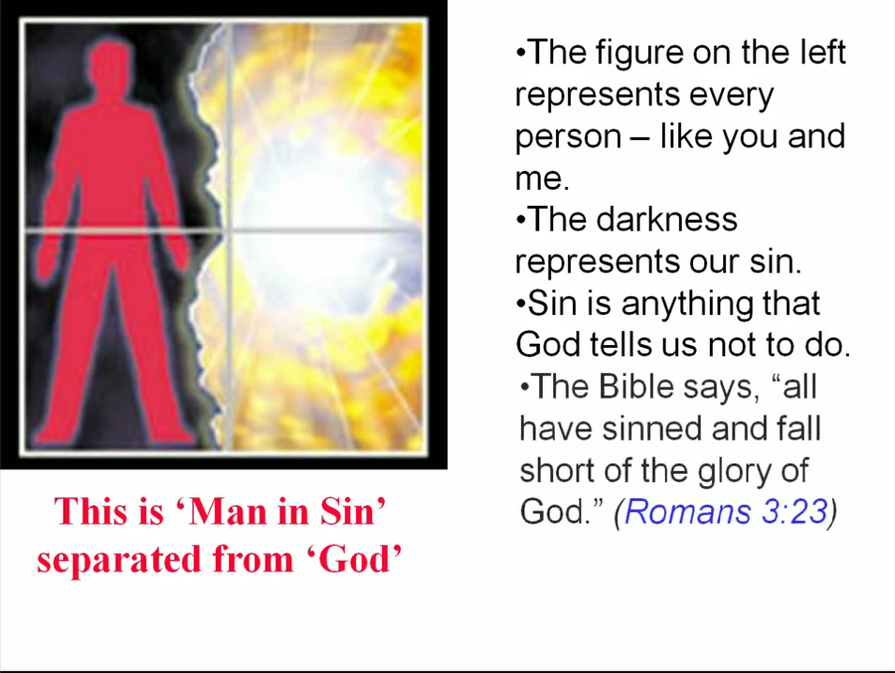

Slide 50
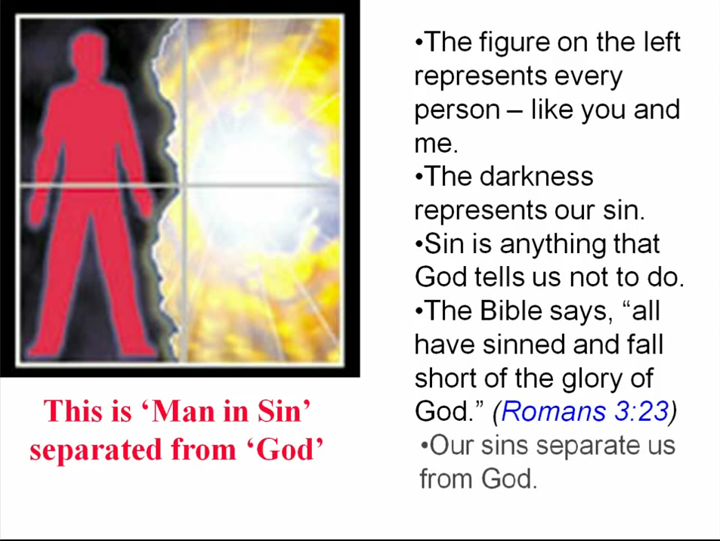

Slide 51
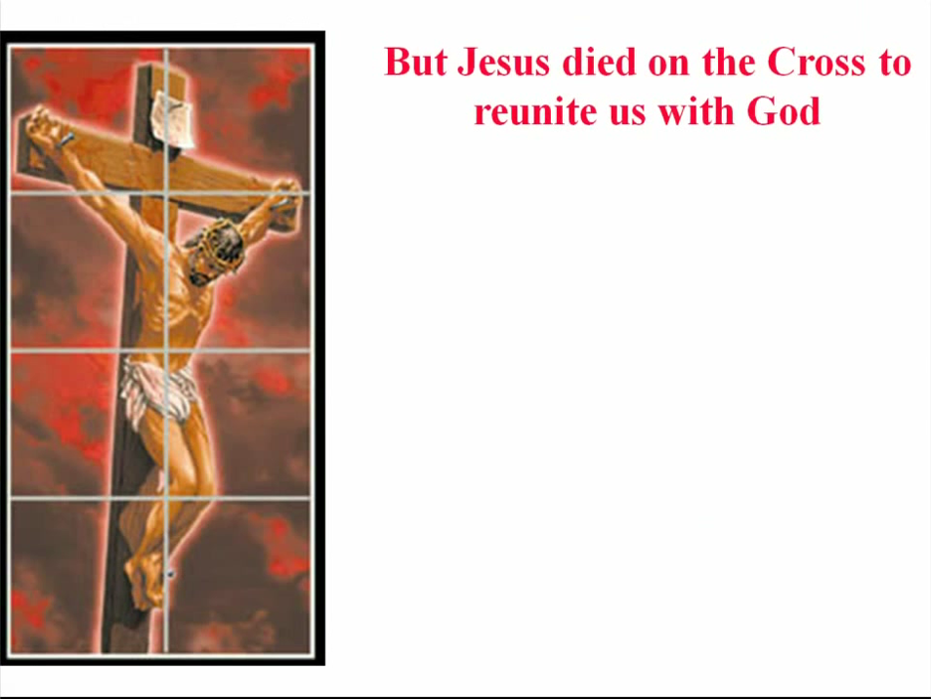

Slide 52
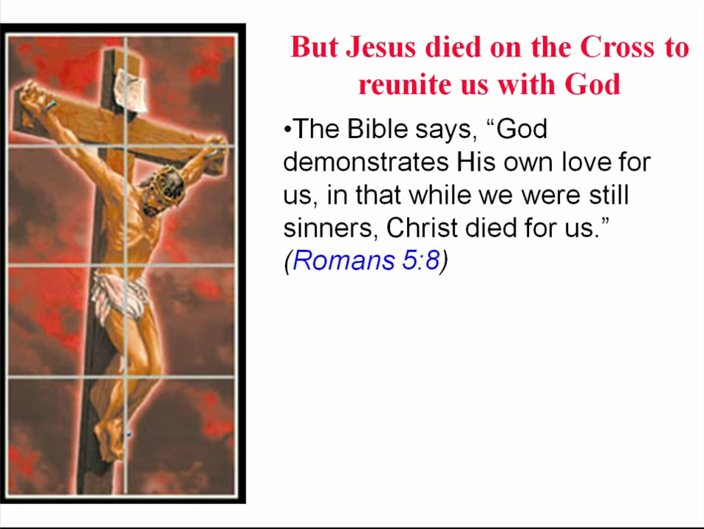

Slide 53
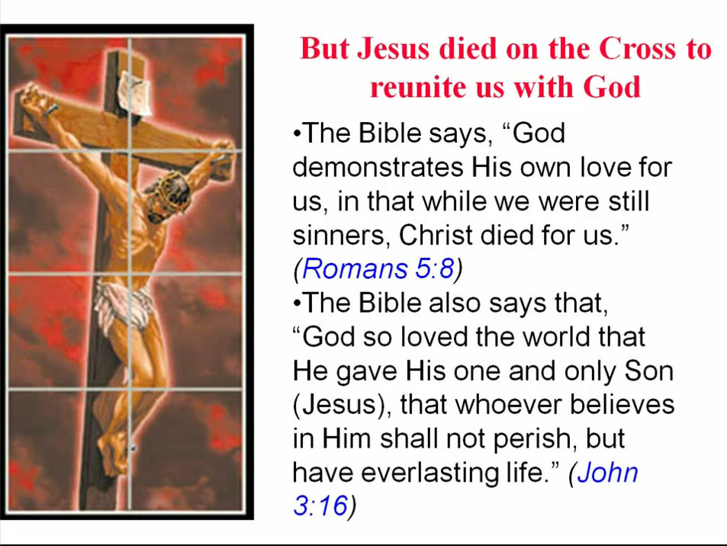

Slide 54
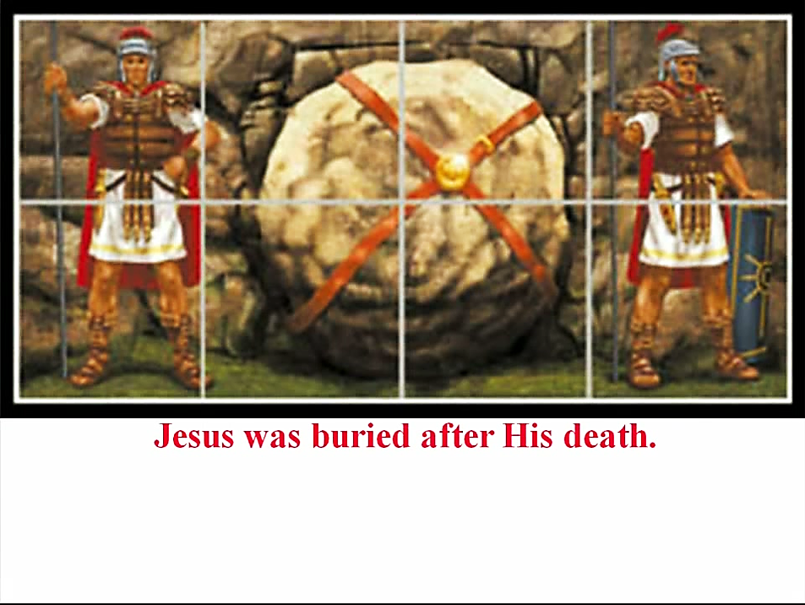

Slide 55
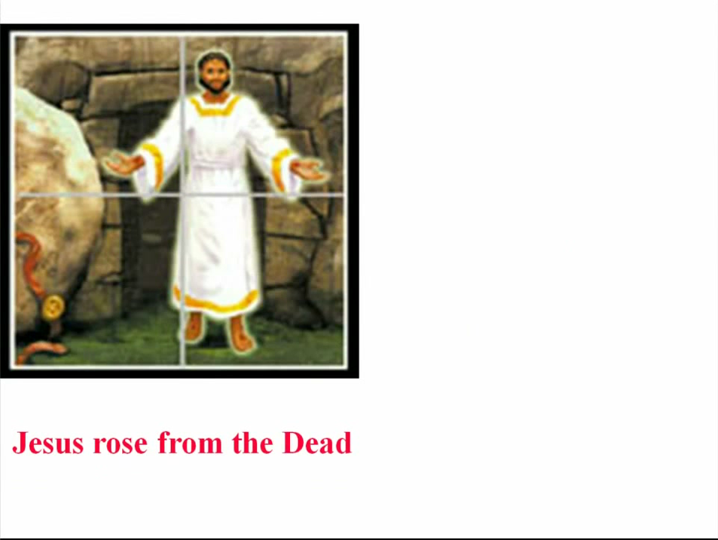

Slide 56
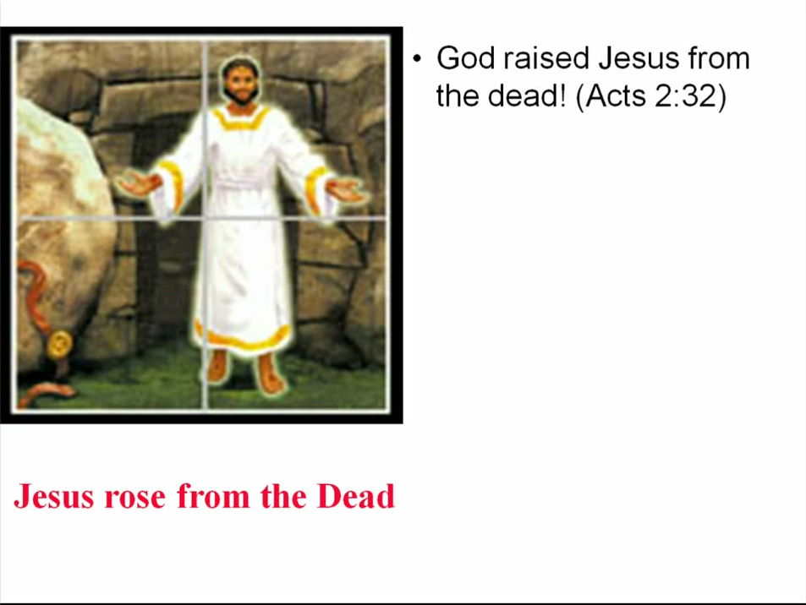

Slide 57
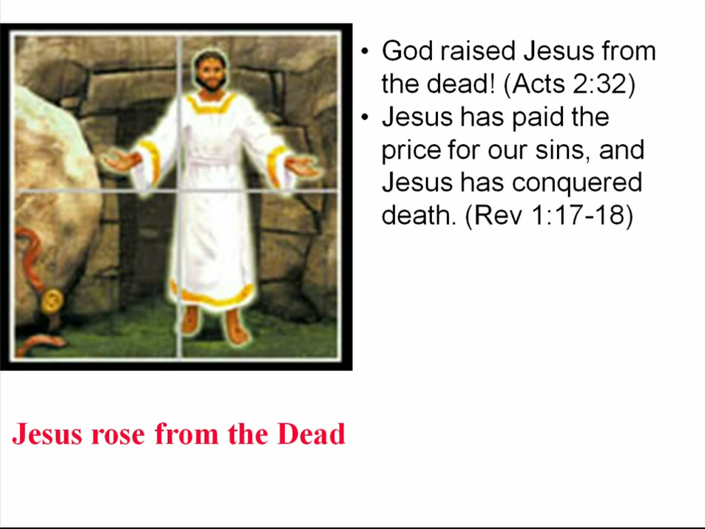

Slide 58
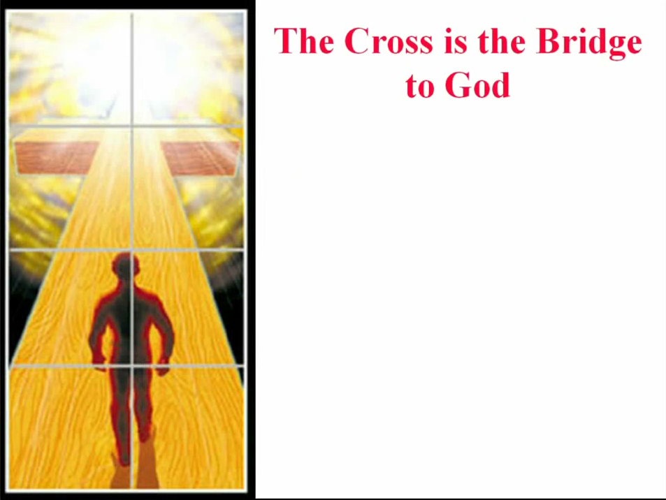

Slide 59
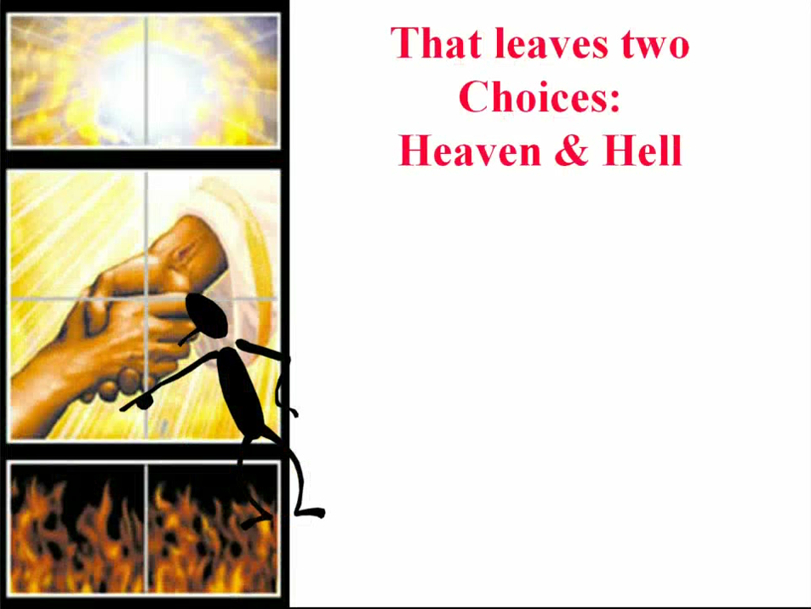

Slide 60
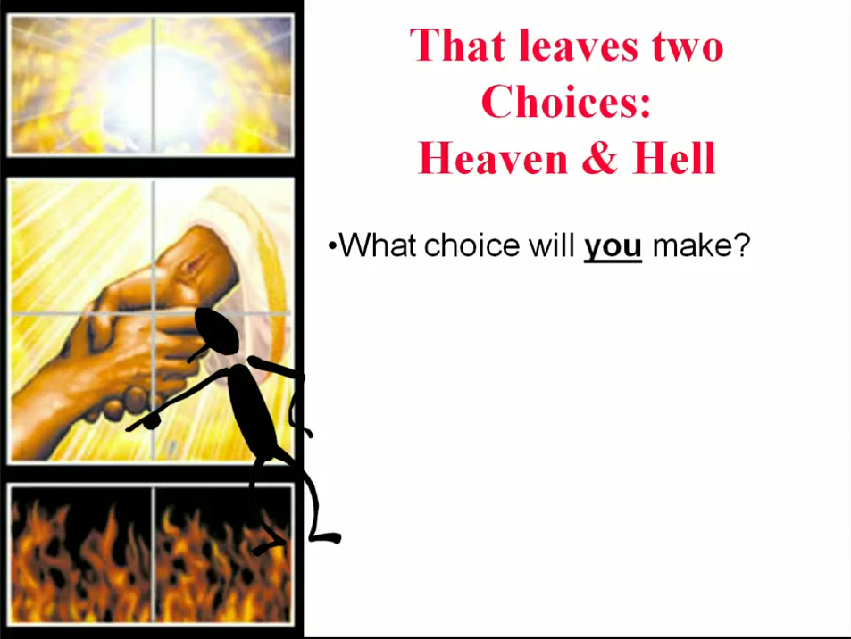

Slide 61


Slide 62
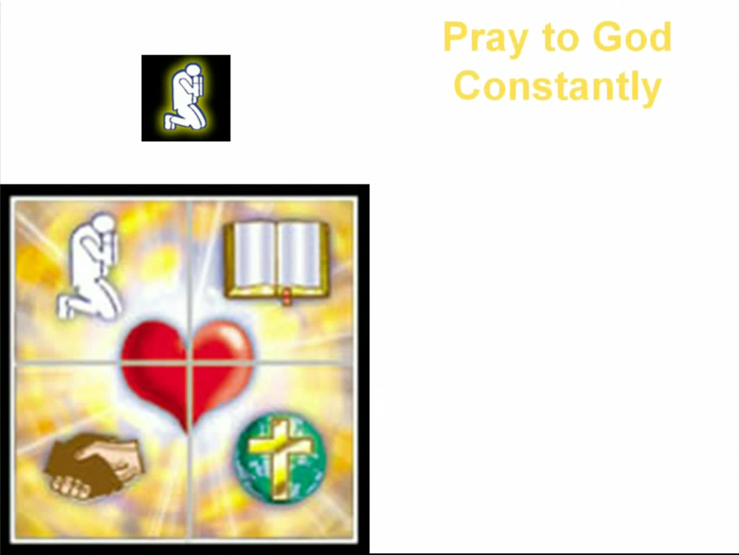

Slide 63
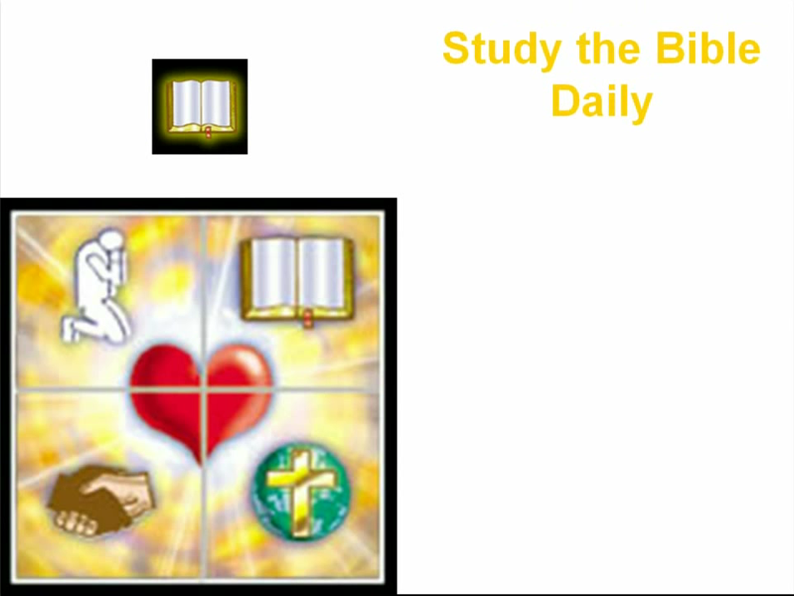

Slide 64


Slide 65


Slide 66
Need a Volunteer (Kid or Adult) To:
Answer Lesson Questions
Explain the Gospel in a Nutshell Craft
Explain the Big E-Cube
Explain the “Gospel in My Hand”

Slide 67

a
The Gospel
in
My
Hand

Slide 68
a
My Pointer:
Points to my sin. I don’t deserve Heaven.
My Thumb:
Like a hitchhiker, I need a free ride to Heaven.
My Longest Finger:
Reminds me of God. The greatest person in the universe.
My Ring Finger:
Reminds me of Jesus who loves me forever. He died to pay for my sin.
My Pinkie Finger:
It only take a little faith in Jesus (mustard seed size)
to give Him my heart and
my whole life.

Slide 69
This Coupon is Good for One
Free Prize at The SonShineTent
Give away 3 of these coupons to 3 different children. Then bring back the plastic bag for another prize for you.

Slide 70

A small gift from us to you at the hospitality table.
Thank
you for coming.

Slide 71

Let’s Close in Prayer

Slide 72
Note: After you download the slideshow, you may also need to download some videos from YouTube & add them into this PowerPoint. This tool can help you:
Free YouTube Download
We present these messages in outdoor venues using the SonShineTent.
Watch the video of our service that goes with this message, click here: http://campaignkerusso.org/?p=15919
We would love to know more about the people who download our lessons & sermons. We invite you to email us & let us know where & how you use them.
info@campaignkerusso.org

