Slide 1
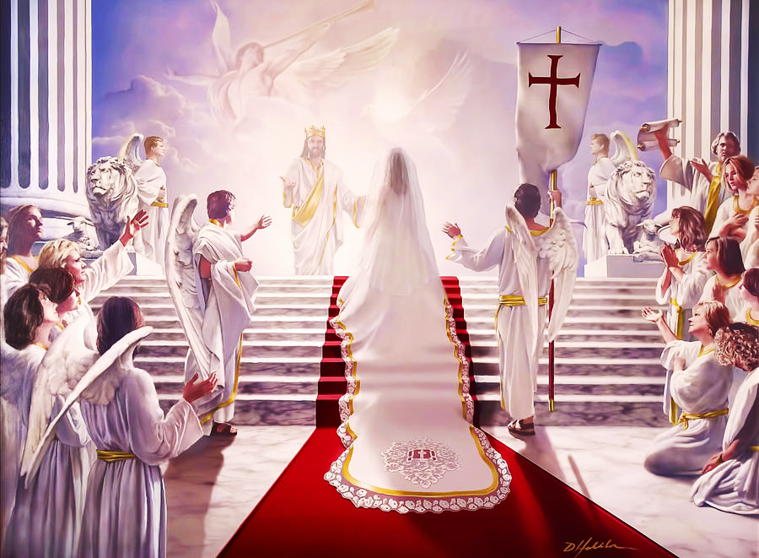
Best Wedding Ever!
The Marriage of the Lamb
Pt. 5 – Some Unworthy Guests

Slide 2
Note: After you download the slideshow, you may also need to download some videos from YouTube & add them into this PowerPoint. This tool can help you: Free YouTube Download
We present these messages in outdoor venues using the SonShineTent. Watch the video of our service that goes with this message, click here: http://campaignkerusso.org/?p=14783
We would love to know more about the people who download our lessons & sermons. We invite you to email us & let us know where & how you use them.
info@campaignkerusso.org

Slide 3
Welcome All

Slide 4
Let’s Begin with Prayer

Slide 5
Best Wedding Ever!
The Marriage of the Lamb
Pt. 5 – Some Unworthy Guests

Slide 6
Song: Are you Dressed for the Wedding
Video Goes Here Title: Are you Dressed for the Wedding Download Here:
https://youtu.be/Urjh7mNuYfw

Slide 7
Video: Jesus on Man Without Wedding Garment
Video Goes Here Video: Jesus on Man Without Wedding Garment
Download Here:
https://youtu.be/vUxZ2o2yIDg

Slide 8
The King sent invitations, but no one came.
Then he said, “Tell them about the great meal that is already fully prepared”—but they mocked the meal (as they mock Jesus today).
They returned to their lives, then attacked & killed the king’s messengers (as they do today).

Slide 9
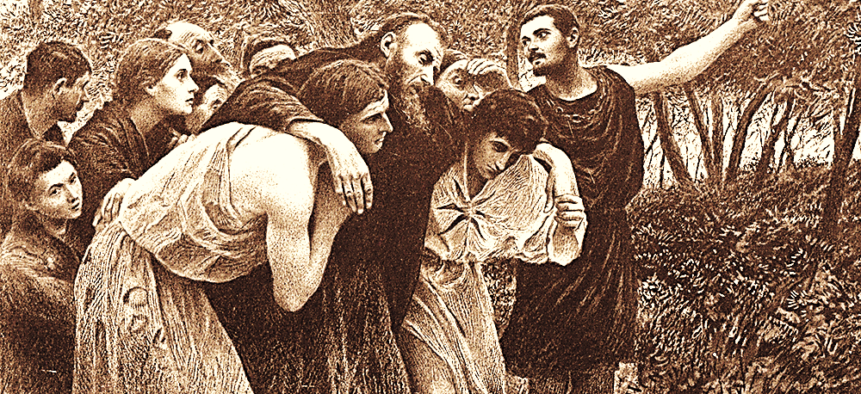
So the king sent his messengers to the poor, the lame, even the criminals on the highways and byways to partake of his glorious feast.
“Notice among yourselves, dear brothers, that few of you who follow Christ have big names or power or wealth.” 1 Cor 1:26 TLB

Slide 10
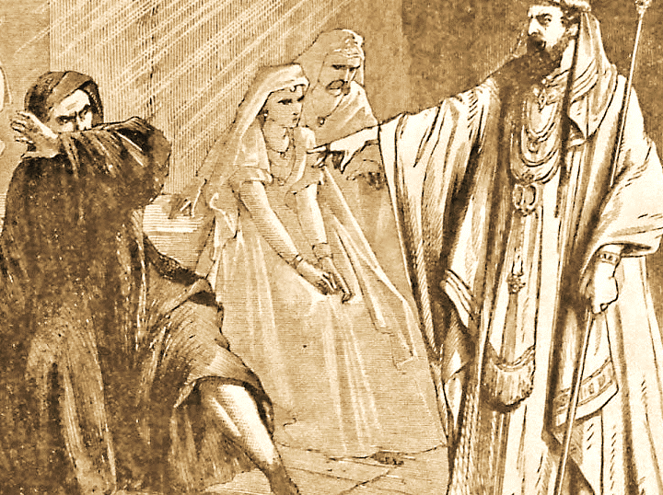
But some unworthy guests came without proper wedding garments.

Slide 11
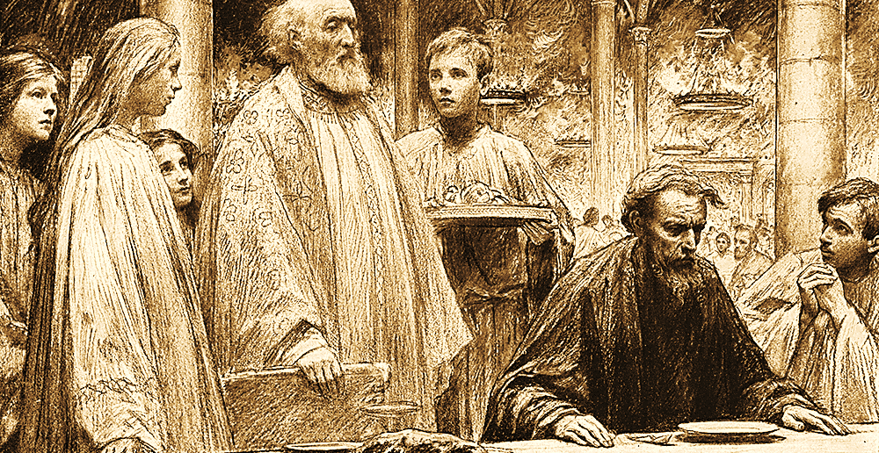
“But when the king came in to look at the guests, he saw there a man who had no wedding garment; and he said to him, ‘Friend, how did you get in here without a wedding garment?’ And he was speechless…

Slide 12
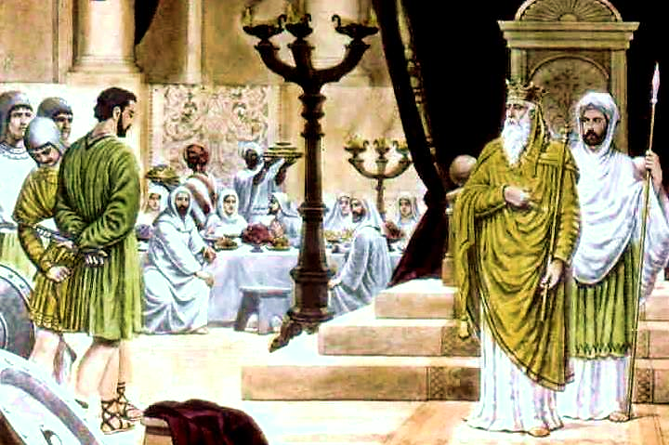
…Then the king said to the attendants, ‘Bind him hand and foot, and cast him into the outer darkness; there men will weep and gnash their teeth.” Mat.22:12 RSV

Slide 13
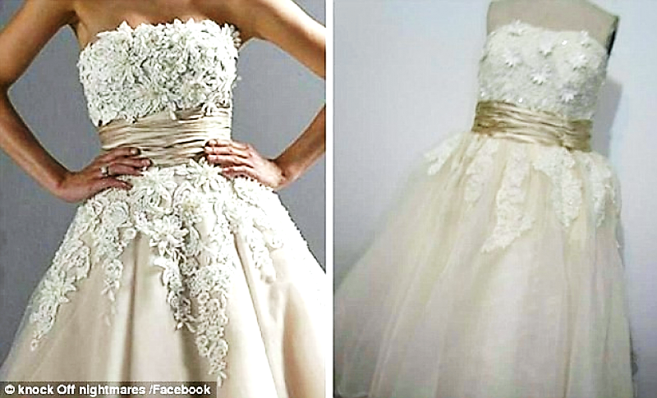
When seeking a
wedding gown, beware
of cheap knock-offs.

Slide 14
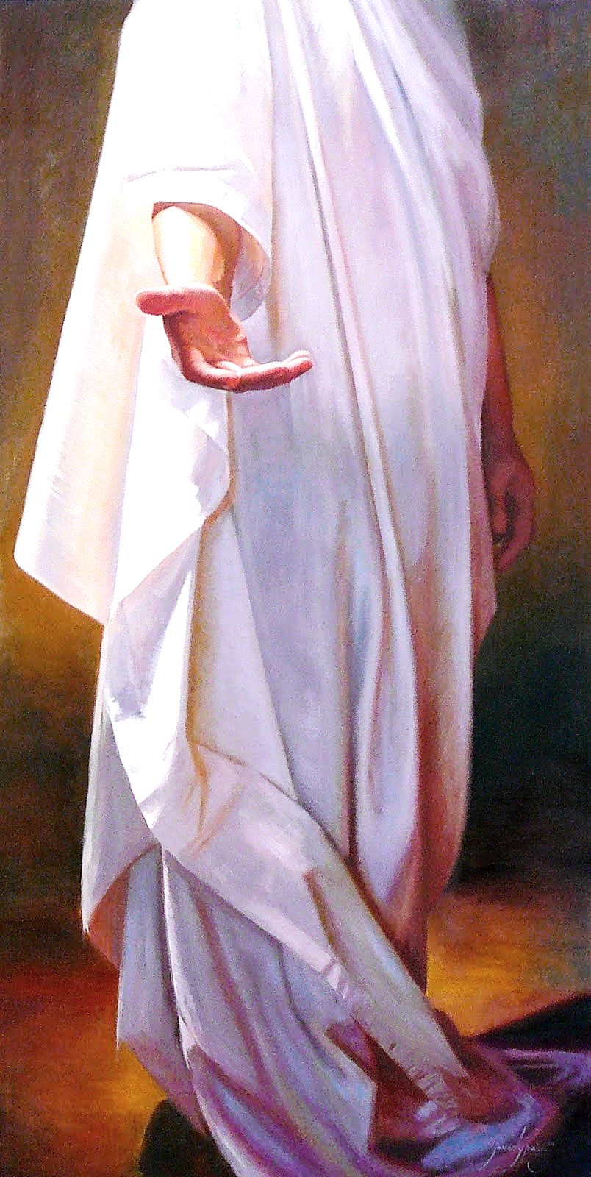
Likewise, beware of cheap
knock-offs for true righteousness!
Raised in Church
Quoting Scriptures
Good Works, etc.
“Not everyone who says to me, ‘Lord, Lord,’ will enter into the Kingdom of Heaven; but he who does the will of my Father who is in heaven.
Many will tell me in that day, ‘Lord, Lord, didn’t we prophesy in your name, in your name cast out demons, and in your name do many mighty works?’
Then I will tell them, ‘I never knew you. Depart from me, you who work iniquity.’”
Mat. 7:21-23 WEB

Slide 15
Remember
“This righteousness is given through faith in Jesus Christ to all who believe…” Rom. 3:22

Slide 16
Song: Parable of Man Without Wedding Garment
Video Goes Here Title: Parable of Man Without Wedding Garment Download Here:
https://youtu.be/eSzvxlXU56E

Slide 17
Also, Many Have Soiled Their Garments
But, “…some haven’t soiled their garments with the world’s filth; they shall walk with me in white, for they are worthy.
Rev. 3:5 TLB

Slide 18
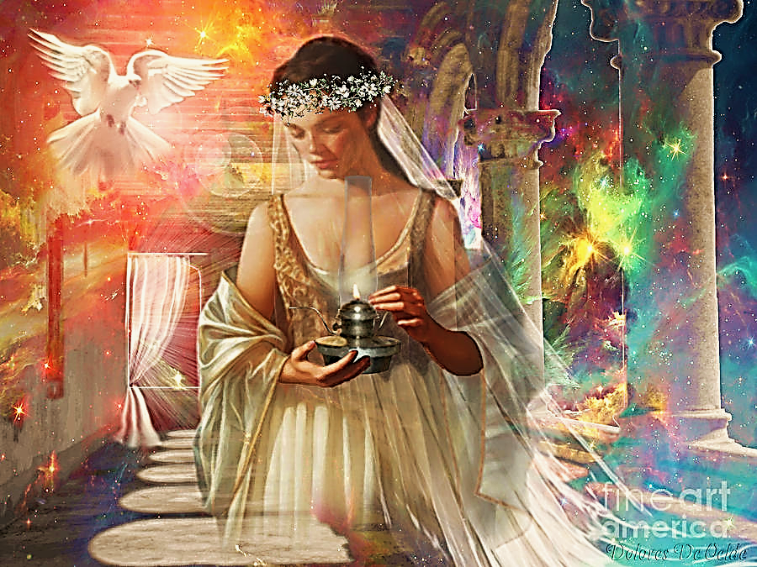
Many Just Don’t Get Ready on Time
She must be properly dressed and carry a light powered by oil (or the Holy Spirit).
She is to be properly dressed and carry a lamp powered by oil.
Be ready! Be fully dressed and have your lights shining.
Be like servants who are waiting for their master to come home.
Those servants might have to wait until midnight or later for their master. But they will be glad they did when he comes in and finds them still waiting.” Luke 12: 35-40 ERV

Slide 19
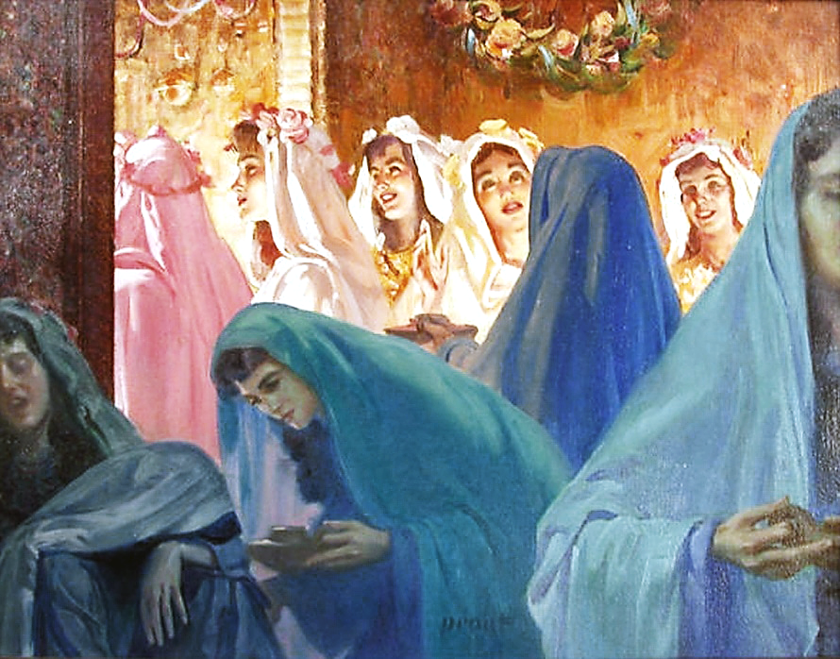
Five Who Were Not Ready On Time
“At that time God’s kingdom will be like ten girls who went to wait for the bridegroom. They took their lamps with them.
Five of the girls were foolish, and five were wise. The foolish girls took their lamps with them, but they did not take extra oil for the lamps.
The wise girls took their lamps and more oil in jars.”Luke 25:1-4 ERV

Slide 20
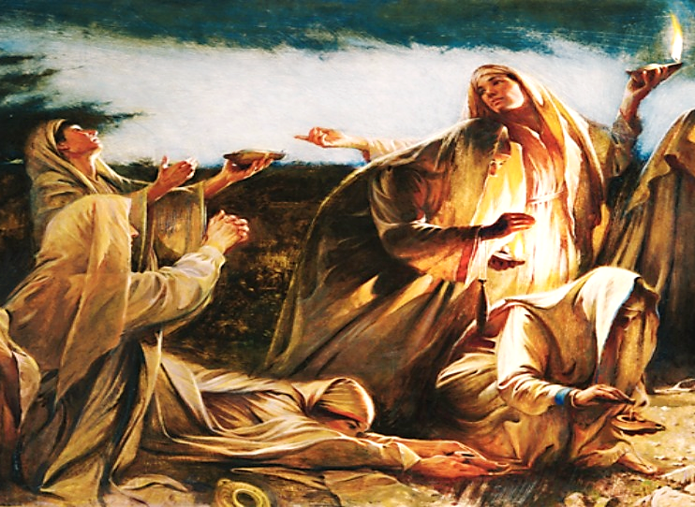
You Can’t Use Someone Else's Light
“When the bridegroom was very late, the girls could not keep their eyes open, and they all fell asleep.
At midnight someone announced, ‘The bridegroom is coming! Come and meet him!’
Then all the girls woke up. They made their lamps ready.
But the foolish girls said to the wise girls, ‘Give us some of your oil. The oil in our lamps is all gone.’” Mat. 25:1-13

Slide 21
She must be dressed, keep her garment clean, and keep her lamp burning.
She must wait and wait while staying ready and watching.
“So you also must be ready, because the Son of Man will come at a time when you don’t expect him!”
Luke 12:40 ERV

Slide 22
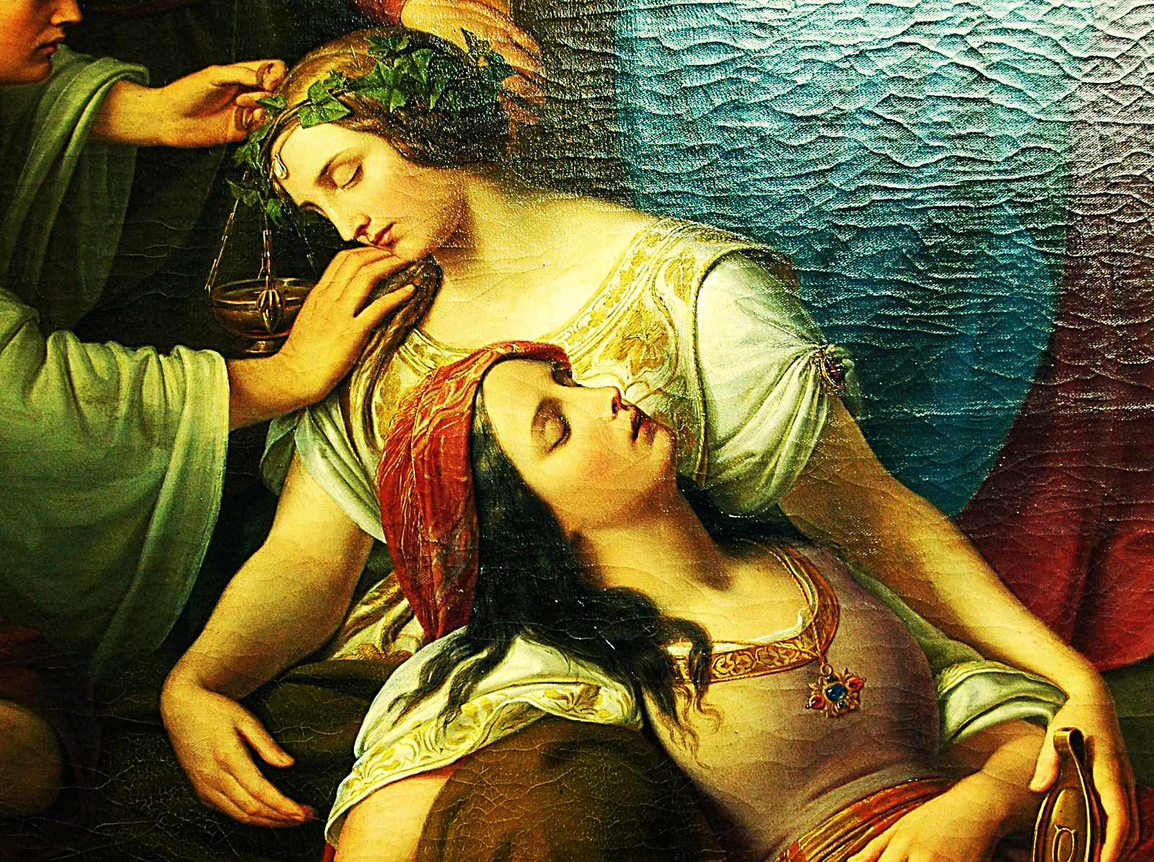
We must prioritize our spiritual condition.
Are we right with God?
Are we filled with the Spirit?
When it comes to our spiritual needs, procrastination is a death sentence.

Slide 23
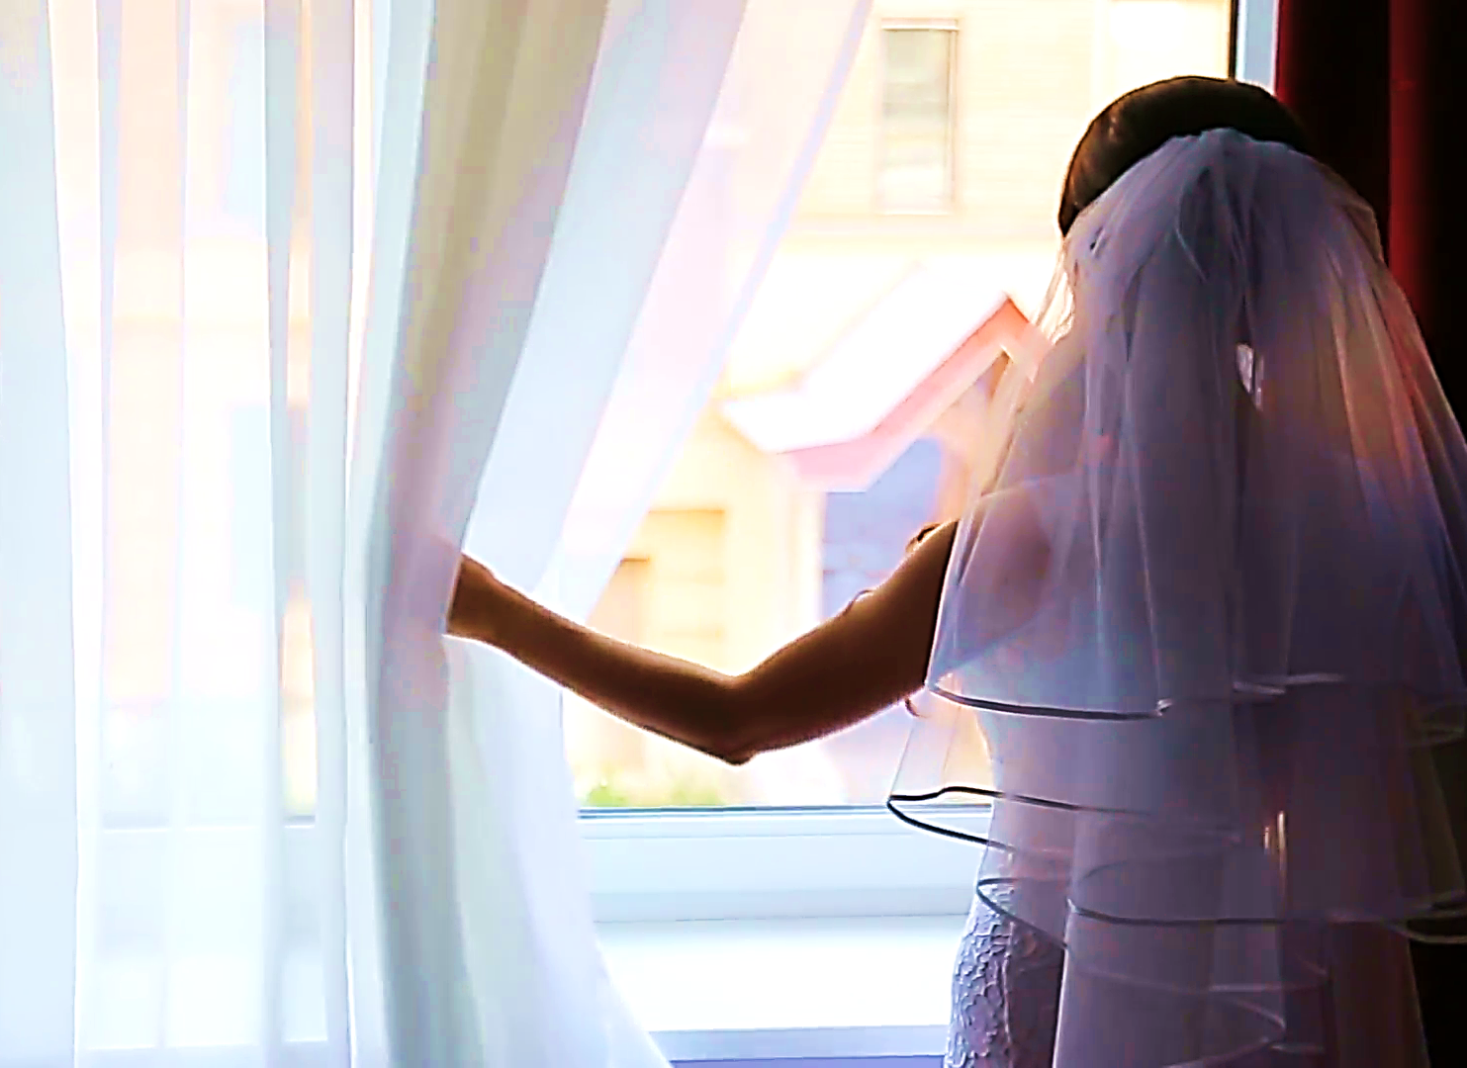
“So always be ready. You don’t know the day or the time when the Son of Man will come. Mat. 25:13 ERV

Slide 24
Consider the following questions:
Explain cheap, knock-off righteousness?
What can happen to our garments if we dabble in worldliness?
Why were the five girls not ready?
What must we do till the Lord comes?

Slide 25
Video: Marriage Supper: Wilkerson
Video Goes Here Video: Marriage Supper: Wilkerson
Download Here:
https://youtu.be/KqIuDEWrHrs

Slide 26
Song: Song: Even So Come
Video Goes Here Title: Song: Even So Come Download Here:
https://youtu.be/4s0Zb189Sco

Slide 27
Note: After you download the slideshow, you may also need to download some videos from YouTube & add them into this PowerPoint. This tool can help you: Free YouTube Download
We present these messages in outdoor venues using the SonShineTent. Watch the video of our service that goes with this message, click here: http://campaignkerusso.org/?p=14783
We would love to know more about the people who download our lessons & sermons. We invite you to email us & let us know where & how you use them.
info@campaignkerusso.org

Slide 28
Is Jesus
Speaking to You?
“They said to each other, ‘Did not our hearts burn within us while he talked to us on the road, while he opened to us the Scriptures?’”
John Wesley Said:
“…the preacher was describing the change which God works in the heart through faith in Christ and I felt my heart strangely warmed.”
Jesus makes His presence Known by a small voice!

Slide 30
What is the Sinner‘s Prayer?
This is a prayer we can pray when we are ready to admit we are sinners and need Christ’s forgiveness.
It must be prayed with faith in our hearts and a readiness to have a life-changing encounter with Jesus Christ.

Slide 31
A prayer of faith → Pray this prayer if :
If you never have before
You have in the past, but you think it would mean more today
You have been walking afar off and you want to come back
You want to set an example & show others how it is done
You just like to give your heart to Jesus again & again
Faith

Slide 32
We Declare Our Faith Publicly Because Jesus Declared His LOVE Publicly
“If you stand before others and are willing to say you believe in me, then I will tell my Father in heaven that you belong to me.” Mat 10:32

Slide 33
Three Important Questions
Do you want to know Jesus as your Savior right now?
Do you believe He died to save you from your sins & that He rose from the dead?
Do you believe that He is here, waiting to save you right now?

Slide 34
The Prayer of a Sinner Turning to Jesus
Dear Jesus, I know that I have sinned against You and that my sins separate me from You.
I am truly sorry.
Right now, I turn away from my sinful past .
Please forgive me, and help me to keep from sin.
I believe You died for my sins.
I Believe You rose from the dead, you are alive, and you hear this prayer from my heart.
I invite You Jesus to be both my Savior and the Lord of my life.
I want You to rule my life from now on.

Slide 35
“But some people did accept him. They believed in him, and he gave them the right to become children of God.”
John 1:12

Slide 37
“If you openly say, ‘Jesus is Lord’ and believe in your heart that God raised him from death, you will be saved.”
Rom. 10:9
What did you learn today?
What should the Bride do while she waits for the Groom?
What have you been thinking about God lately?
What do you want to tell others about Jesus?

Slide 38
Let’s Close in Prayer

Slide 39
Note: After you download the slideshow, you may also need to download some videos from YouTube & add them into this PowerPoint. This tool can help you: Free YouTube Download
We present these messages in outdoor venues using the SonShineTent. Watch the video of our service that goes with this message, click here: http://campaignkerusso.org/?p=14783
We would love to know more about the people who download our lessons & sermons. We invite you to email us & let us know where & how you use them.
info@campaignkerusso.org

