Slide 1
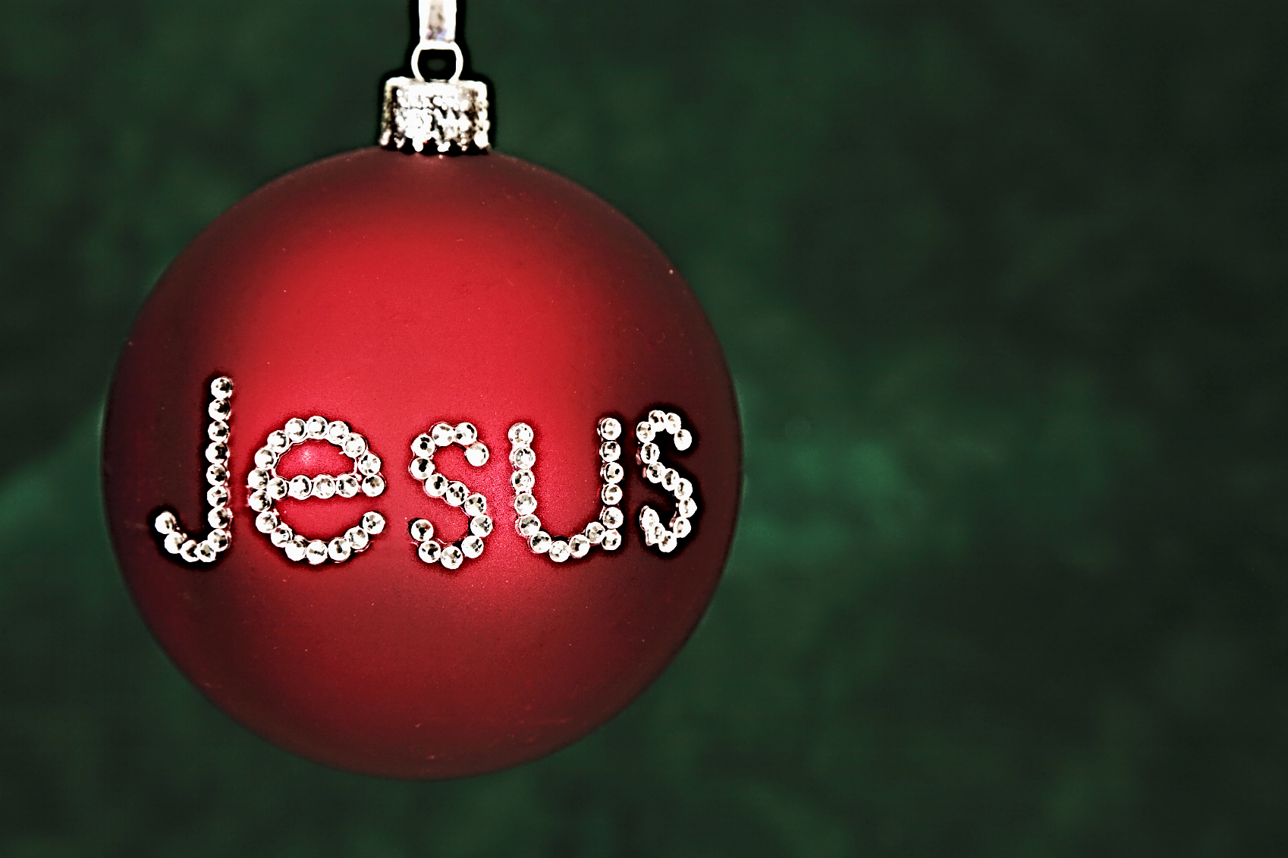

Please Don’t
My Name

Slide 2



Note: After you download the slideshow, you may also need to download some videos from YouTube & add them into this PowerPoint. This tool can help you:
Free YouTube Download
We present these messages in outdoor venues using the SonShineTent.
Watch the video of our service that goes with this message, click here: http://campaignkerusso.org/?p=15984
We would love to know more about the people who download our lessons & sermons. We invite you to email us & let us know where & how you use them.
info@campaignkerusso.org

Slide 3

Let’s Begin with Prayer

Slide 4
Song: Jesus Name Above All Names
Video Goes Here
Title: Jesus Name Above All Names
Download Here:
https://youtu.be/iBVFvtM9SzM

Slide 5
Please Don’t
My Name

Slide 6

Believers are concerned that the name of Jesus is being squeezed out of Christmas.
Jesus has become common and is taken for granted.

Slide 7
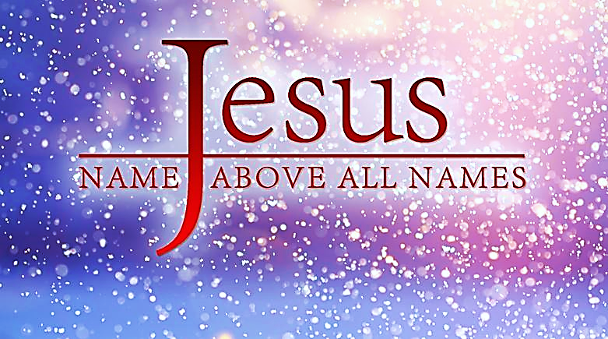
Why is His name
so important?

Slide 8


Jesus’ name is
not a mere formula element (as in some rituals).
Jesus’ name is not a magic wand for our prayers & wishes, (as in, “In the Name of Jesus”).

Slide 9
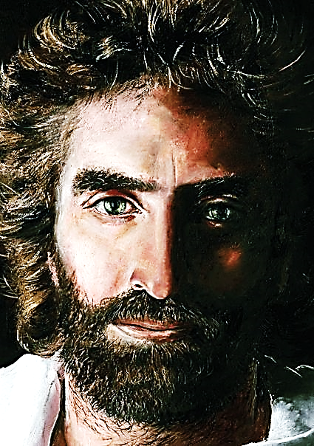
Jesus is the name of the most important person in the universe…ever!
“The Lord Jesus Christ” is His title forever!

Slide 10

There is a sad tendency today to avoid Jesus’ name.
Jesus is called:
“my faith”
“being thankful”
“Christmas spirit”
“thoughts & prayers, etc.”
Even saying, “God” or “Heavenly Father” can be ways to sidestep proudly proclaiming the Savior’s name.

Slide 11
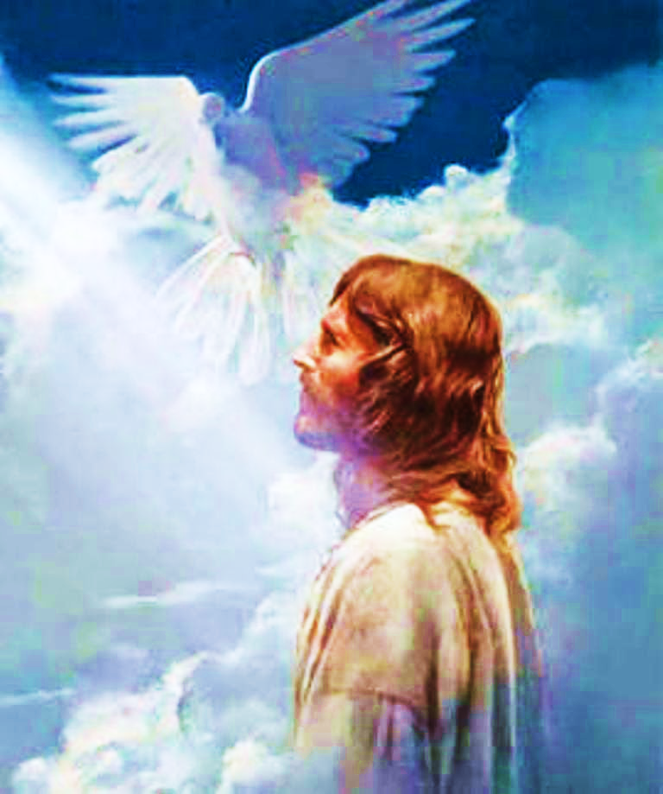
The Father, and the Holy Spirit point our attention to Jesus.

Slide 12
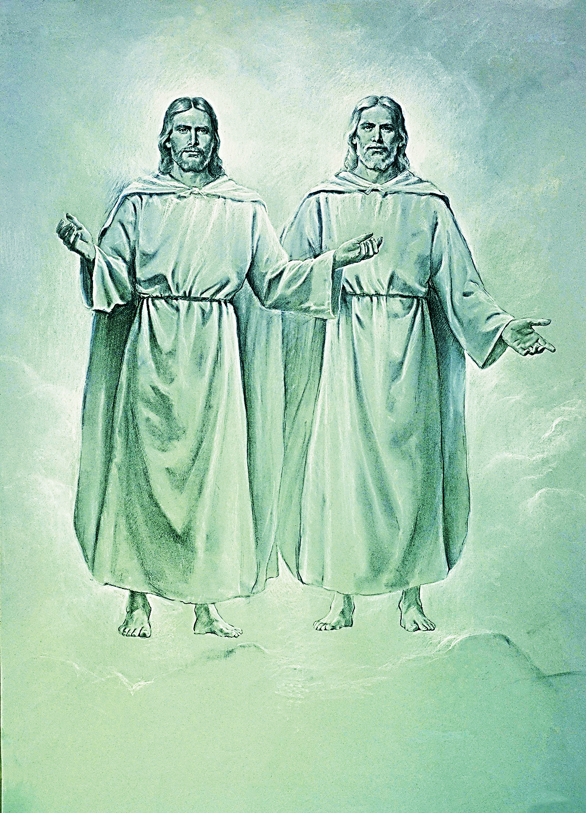
“…that all may honor the Son, even as they honor the Father. He who does not honor the Son does not honor the Father who sent him. John 5:23 RSV

Slide 13
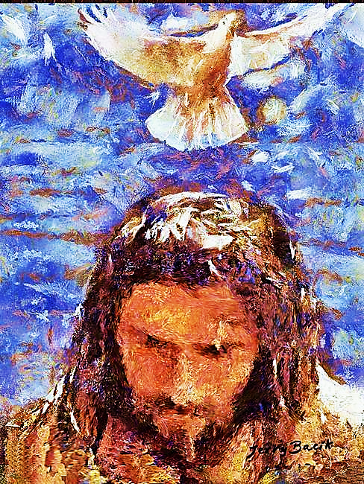
Here is My Servant, whom I uphold, My Chosen One, in whom My soul delights. I will put My Spirit on Him, and He will bring justice to the nations. Isa. 42:1

Slide 14
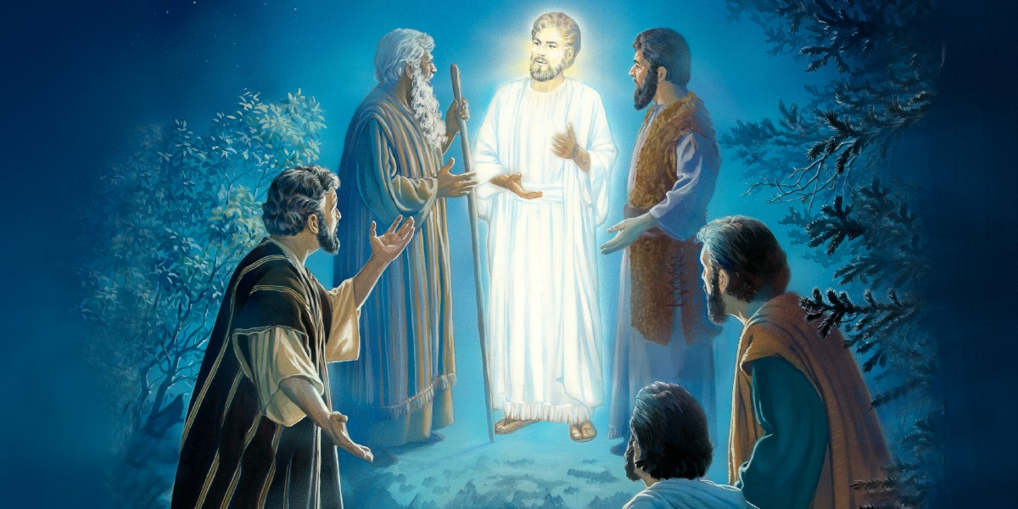
While Peter was still speaking, a bright cloud enveloped them, and a voice from the cloud said, "This is My beloved Son, in whom I am well pleased. Listen to Him! Mat. 17:5

Slide 15
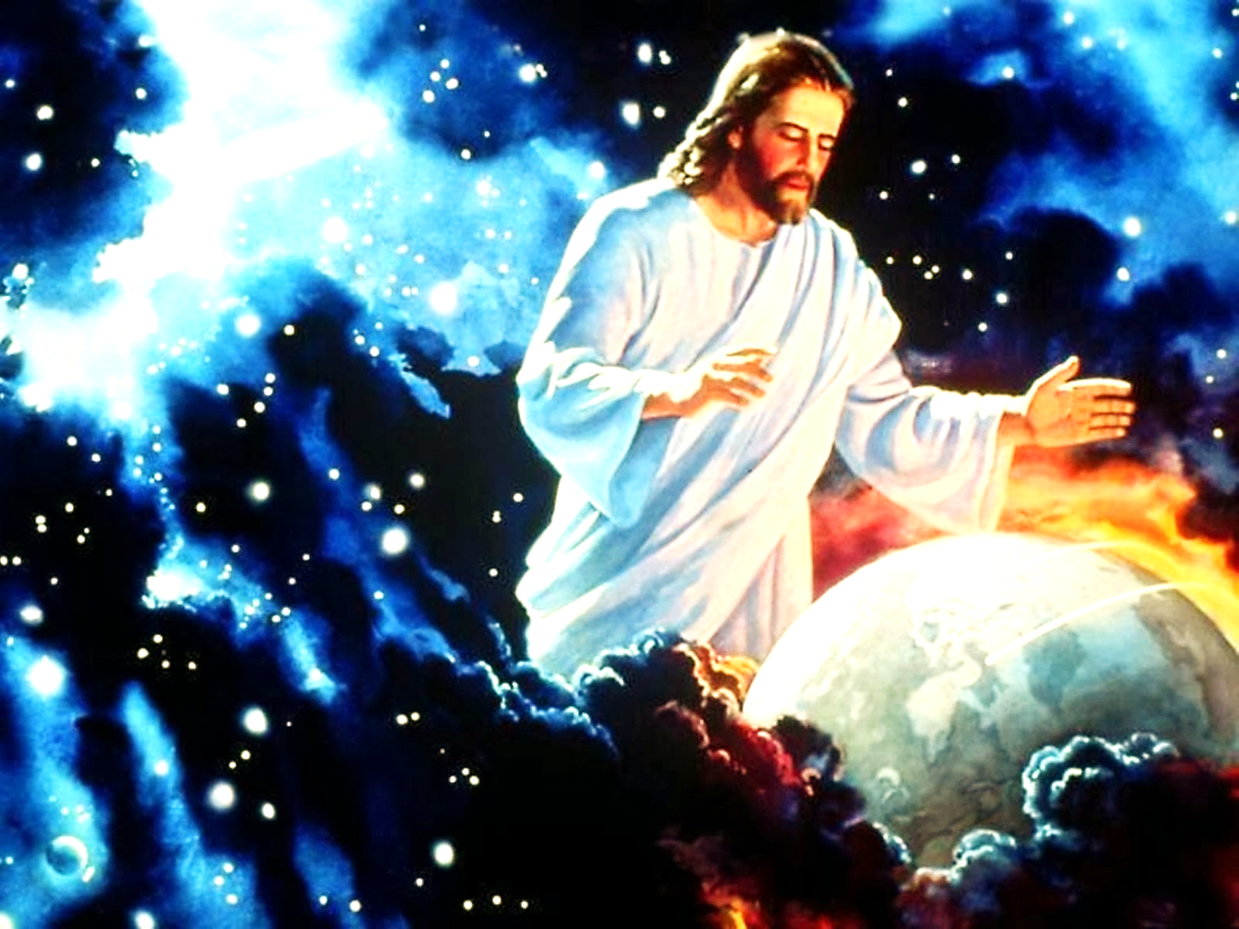
“The Father loveth the Son, and hath given all things into his hand.” Jn. 3:35

Slide 16
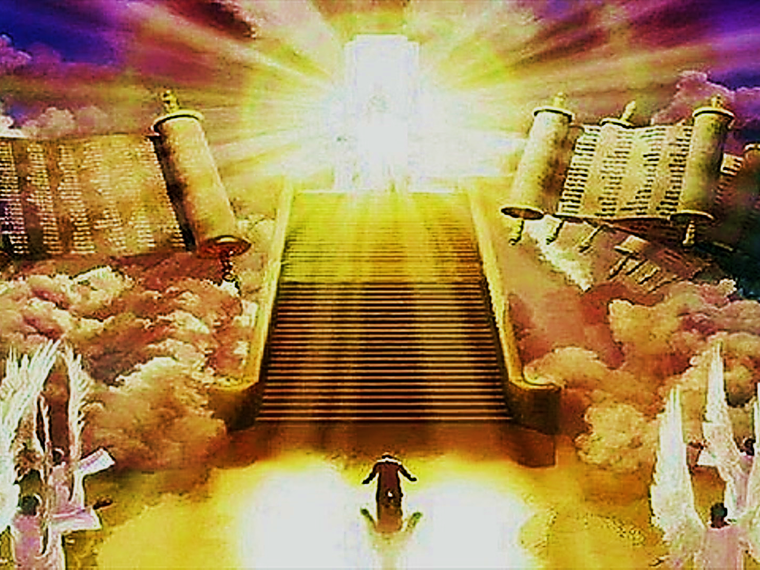
It is because Jesus Christ is fearsome, & mankind (even Christians) are not fully submitted to His authority!!!
Why is Jesus’ name avoided?
Why do we marginalize His name?

Slide 17
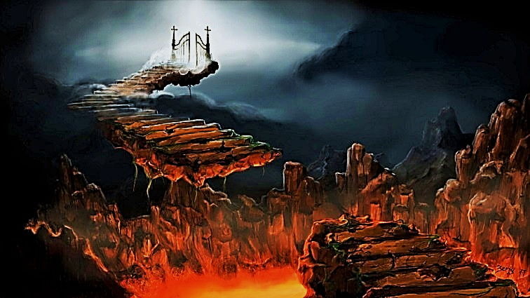
“The people who did not believe you became angry.
But now you are angry. It is time for dead people to be judged. And it is time to reward your servants, the prophets of God, and your holy people and all
who respect
your name…

Slide 18
“…those who are great and those who are not so great.
It is time to destroy those who destroy the earth.” Rev. 11:18 WE
This is the truth about Jesus that we tend to avoid or ignore.

Slide 19
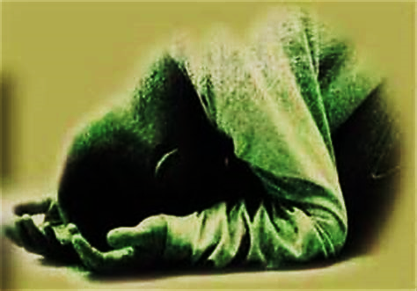
“Lord, who will not fear and glorify
your name?
For you alone are holy. All nations will come and worship before you, for your judgments have been revealed.”
Rev. 15:4 NRSV

Slide 20
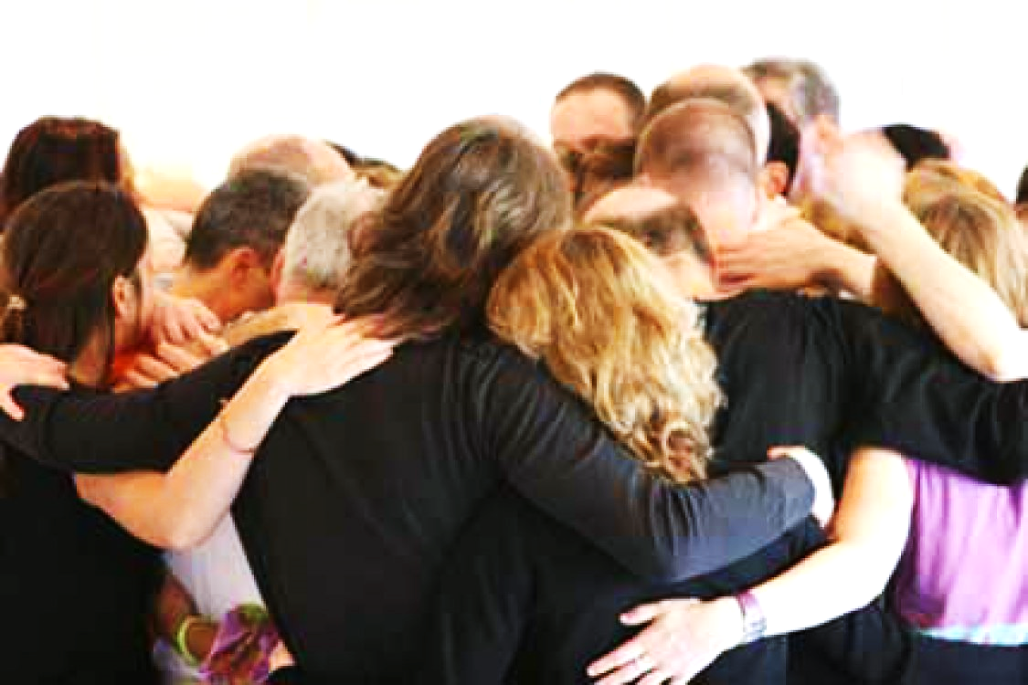
We try to make the Lord Jesus Christ more palatable (to our natural man) by only equating Him with good thoughts, family ties, fellowship, blessings, church attendance, etc.

Slide 21
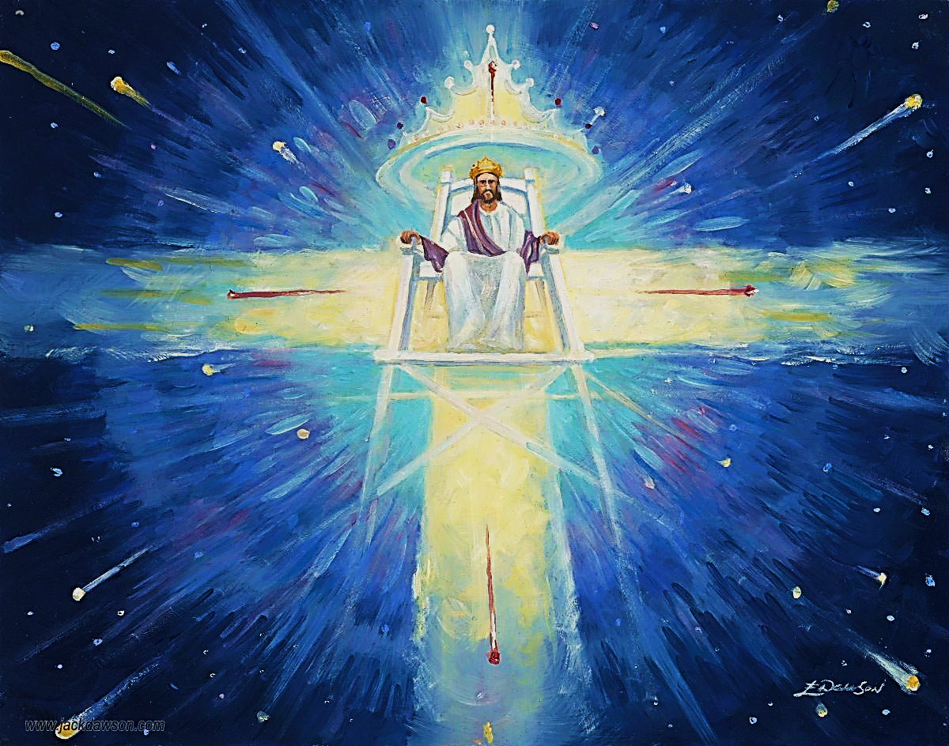
But, when we speak repeatedly about the Lord Jesus Christ, it denotes submission to the authority of the One and only individual worthy of our reverence, devotion and unquestioning obedience.

Slide 22
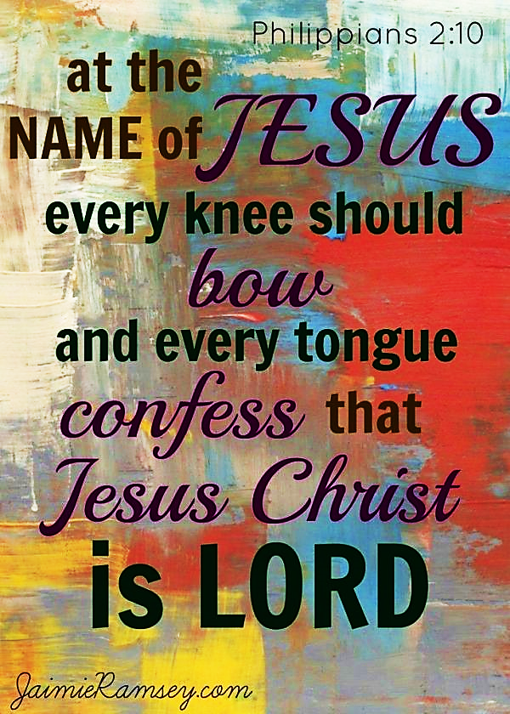
Unbelievers cringe at the name of Jesus and even believers often sidestep its implications.

Slide 23
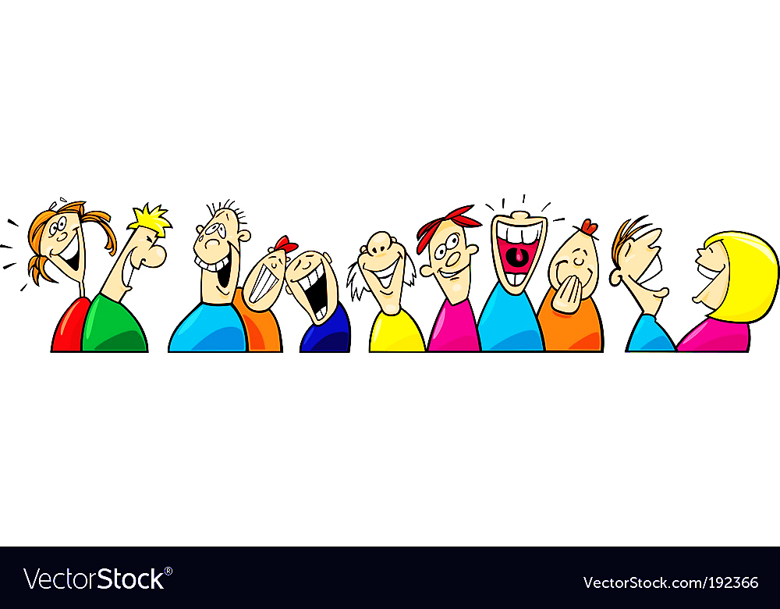
Sadly, in self-justifying response to Jesus’ power & authority, unbelievers make His name foolish, common, laughable — even contemptable.

Slide 24
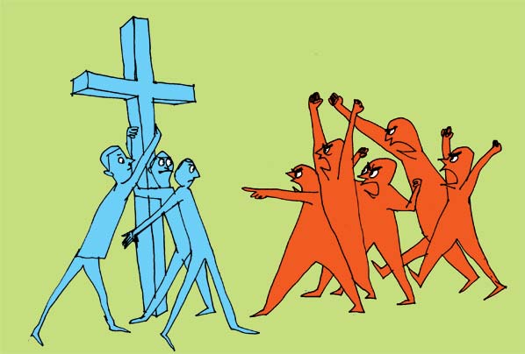
Believers often fear the reproach of unbelievers.
“…For you have only a little strength, yet you have kept My word and have not denied My name.” Rev. 3:8

Slide 25
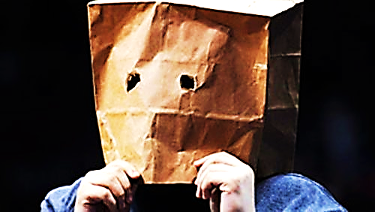
“Don’t be ashamed of me and my teaching. If that happens, I will be ashamed of you when I come with my divine greatness and that of the Father and the holy angels.” Lk. 9:26 ERV

Slide 26
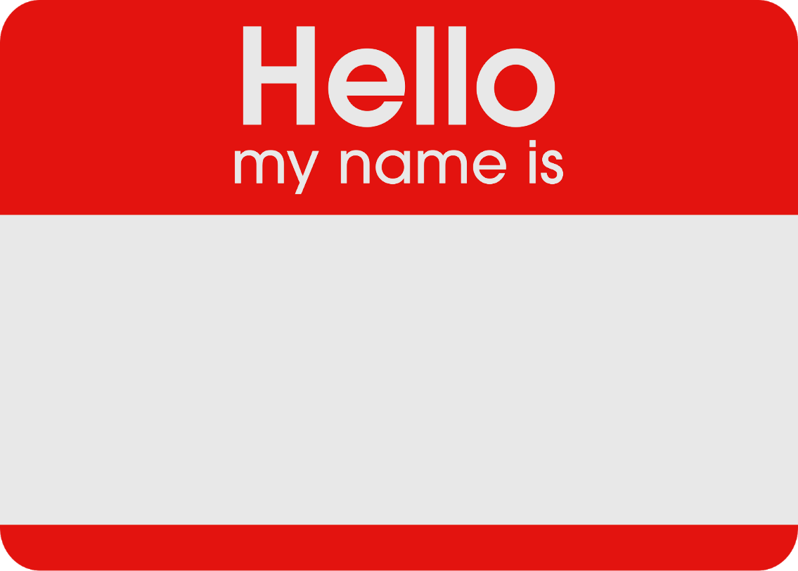
We love our names.
“Hey, I have a name you know!”
“My name is mud.”
“ My name up in lights”

Slide 27
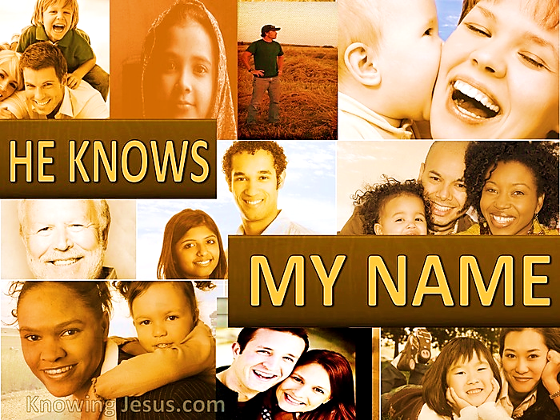
“…the Lord who created you says, “Do not be afraid—I will save you. I have called you by name—you are mine.”
Isa. 43:1 GNT
“…The sheep hear his voice, and he calls his own sheep by name and leads them out.” Jn. 10:3 ESV

Slide 28
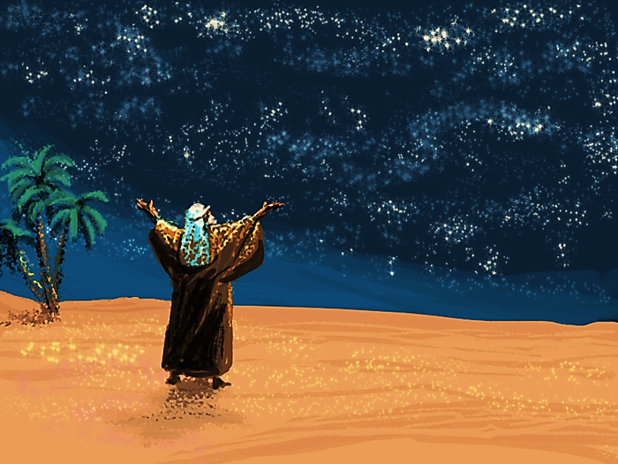
“…no longer shall your name be called Abram, but your name shall be Abraham; for I have made you a father of many nations Gen. 17:5
He gives us a name that depicts whom we really are in Him!

Slide 29
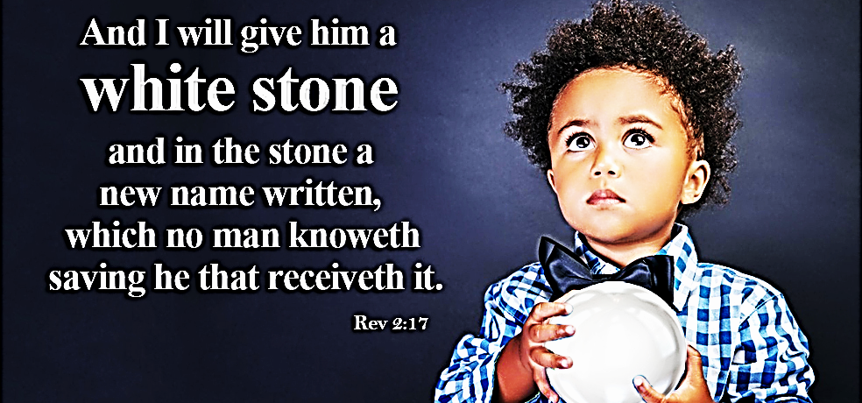
What will your new name be?
It will describe your heart, your calling, your ministry, and your relationship with Him.
You will recognize it the moment you read it and wonder at His amazing intimacy with you.

Slide 30
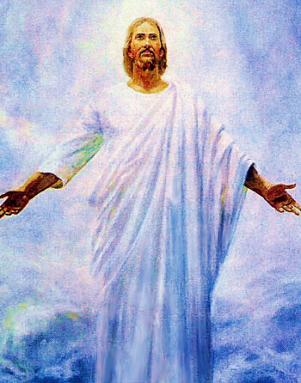
Jesus is pleased to declare the believer’s name.
“…I will never blot his name out of the book of life. I will confess his name before my Father and before his angels.” Rev. 3:5 ESV

Slide 31
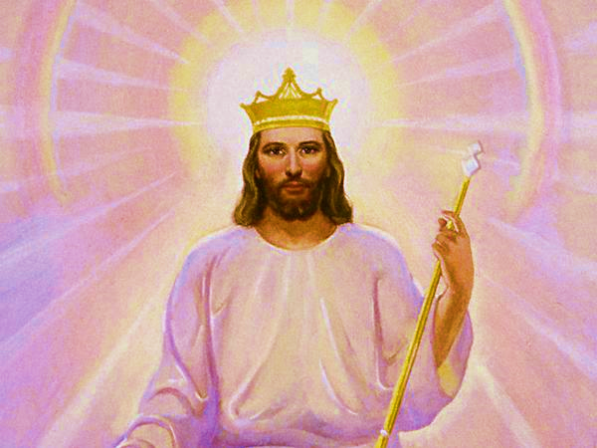
If He so honors our name, can we not honor His?
“…far above every ruler and authority, power and dominion, and every title given, not only in this age but also in the one to come.” Eph. 1:21

Slide 32


Slide 33
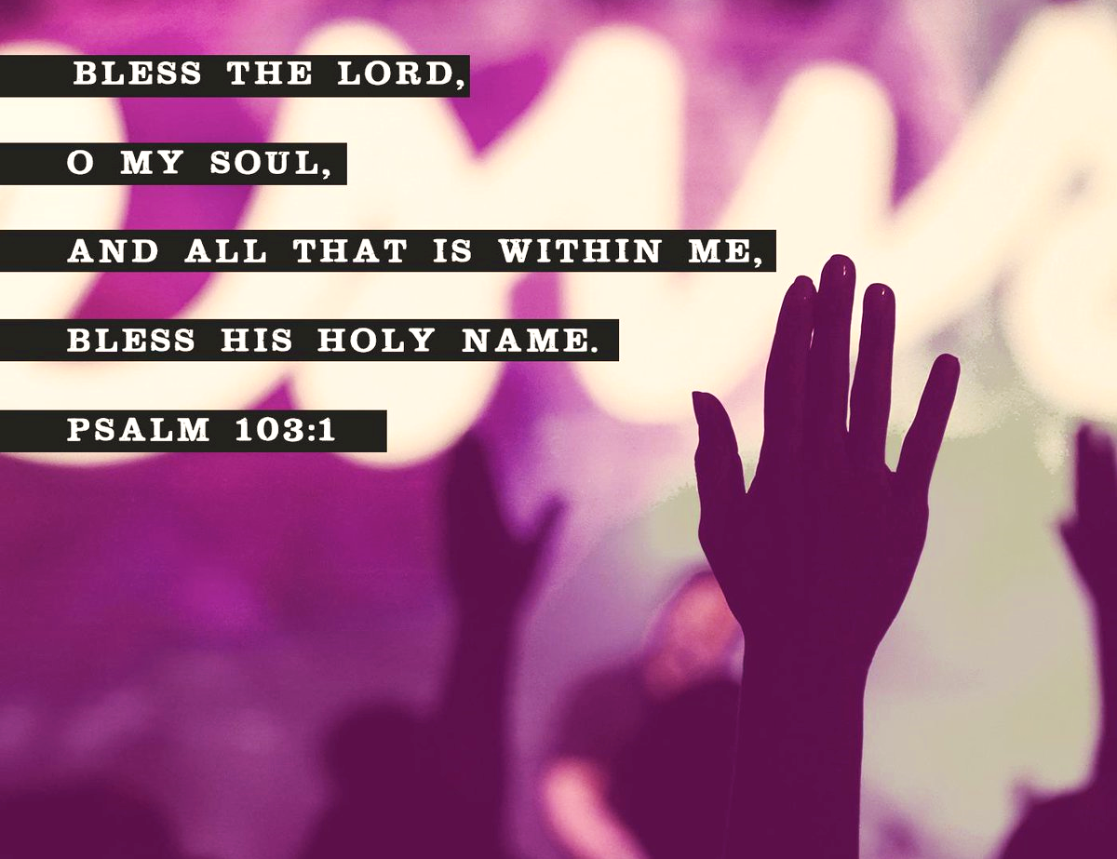
It starts with us, say His name, praise His name shout His Name!

Slide 34
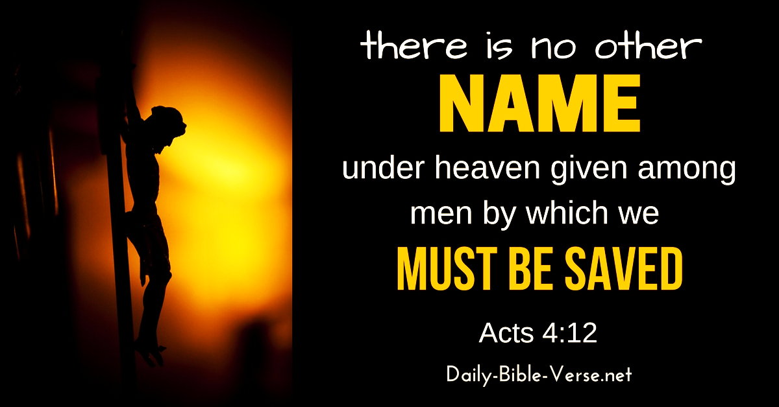

Slide 35
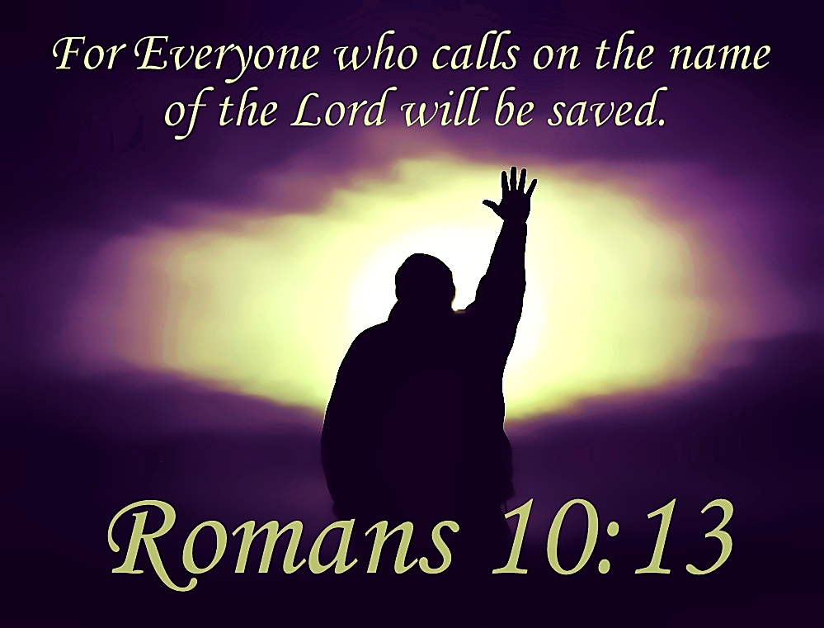

Slide 36
Song: I’m Yours
Video Goes Here
Title: I’m Yours
Download Here:
https://youtu.be/9DwQgSZ287A

Slide 37
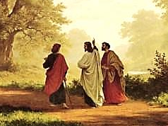
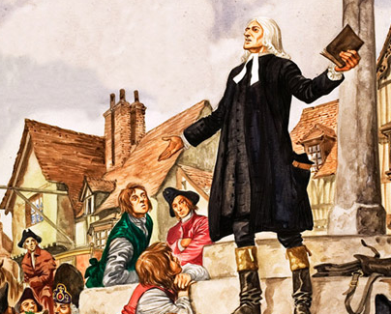
Is Jesus
Speaking to You?
“They said to each other, ‘Did not our hearts burn within us while he talked to us on the road, while he opened to us the Scriptures?’”
John Wesley Said:
“…the preacher was describing the change which God works in the heart through faith in Christ and I felt my heart strangely warmed.”
Jesus makes His presence Known by a small voice!

Slide 38
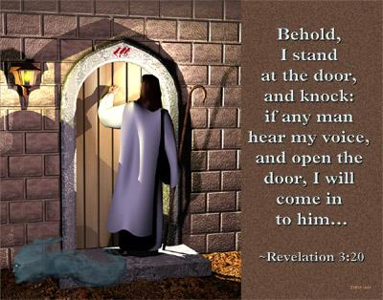

Slide 39
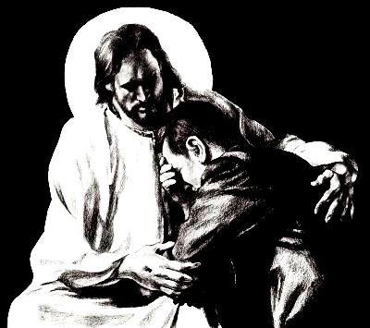
What is the Sinner‘s Prayer?
This is a prayer we can pray when we are ready to admit we are sinners and need Christ’s forgiveness.
It must be prayed with faith in our hearts and a readiness to have a life-changing encounter with Jesus Christ.

Slide 40

A prayer of faith → Pray this prayer if :
If you never have before
You have in the past, but you think it would mean more today
You have been walking afar off and you want to come back
You want to set an example & show others how it is done
You just like to give your heart to Jesus again & again
Faith

Slide 41
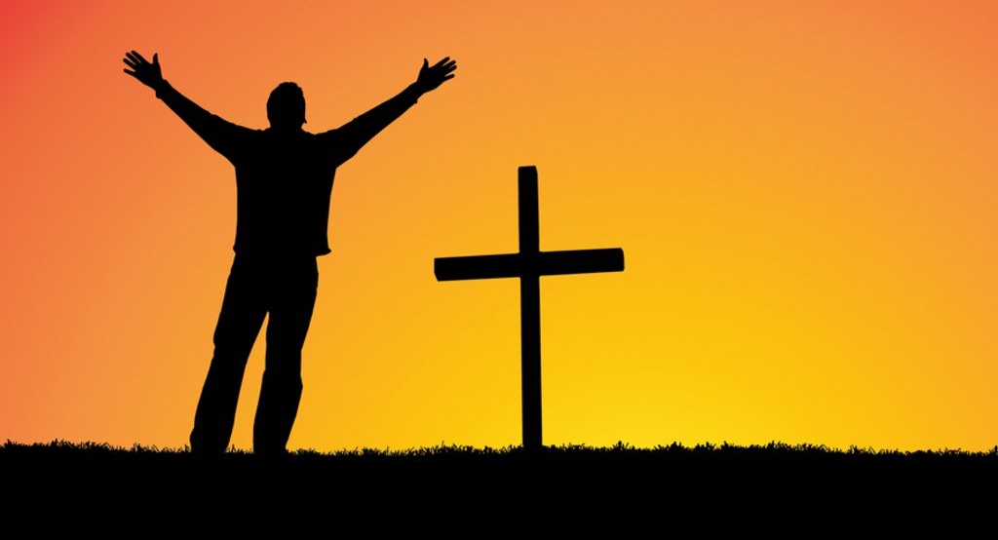
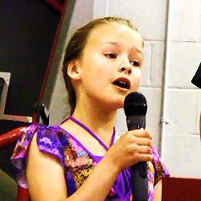
We Declare Our Faith Publicly Because
Jesus Declared His LOVE Publicly
“If you stand before others and are willing to say you believe in me, then I will tell my Father in heaven that you belong to me.” Mat 10:32
If you are ready to give your heart & life to Jesus right now, please come to the front as we pray this prayer together.

Slide 42

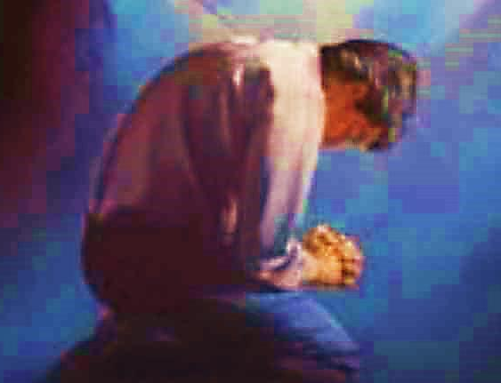
Three Important Questions
Do you want to know Jesus as your Savior right now?
Do you believe He died to save you from your sins & that He rose from the dead?
Do you believe that He is here, waiting to save you right now?

Slide 43
The Prayer of a Sinner Turning to Jesus
Dear Jesus, I know that I have sinned against You and that my sins separate me from You.
I am truly sorry.
Right now, I turn away from my sinful past .
Please forgive me, and help me to keep from sin.
I believe You died for my sins.
I Believe You rose from the dead, you are alive, and you hear this prayer from my heart.
I invite You Jesus to be both my Savior and the Lord of my life.
I want You to rule my life from now on.

Slide 44


“But some people did accept him. They believed in him, and he gave them the right to become children of God.”
John 1:12

Slide 45



Slide 46

Need a Volunteer (Kid or Adult) To:
Answer Lesson Questions

Slide 47


“If you openly say, ‘Jesus is Lord’ and believe in your heart that God raised him from death, you will be saved.”
Rom. 10:9
What did you learn today?
What about the 4 spiritual laws ?
What have you been thinking about God lately?
What do you want to tell others about Jesus?

Slide 48
Need a Volunteer (Kid or Adult) To:
Answer Lesson Questions
Explain the Gospel in a Nutshell Craft

Slide 49
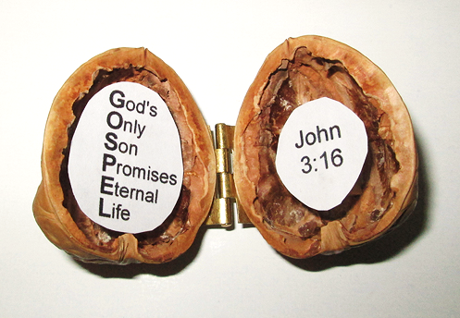
The Gospel
In a Nutshell

Slide 50
Need a Volunteer (Kid or Adult) To:
Answer Lesson Questions
Explain the Gospel in a Nutshell Craft
Explain the Big E-Cube

Slide 51
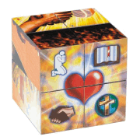
Evangecube
ss

Slide 52
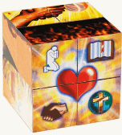
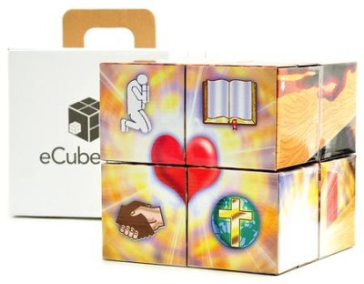
Evangecube
Buy a standard-sized EvangeCube here: EvangeCube
Buy a large sized EvangeCube here: Evangecube Big Cube

Slide 53
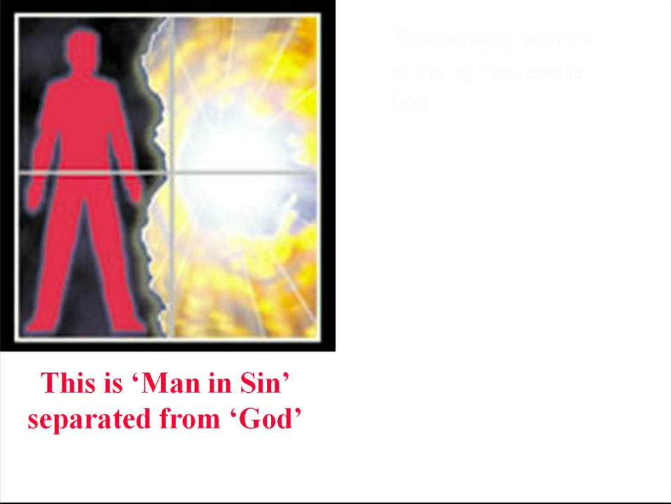

Slide 54
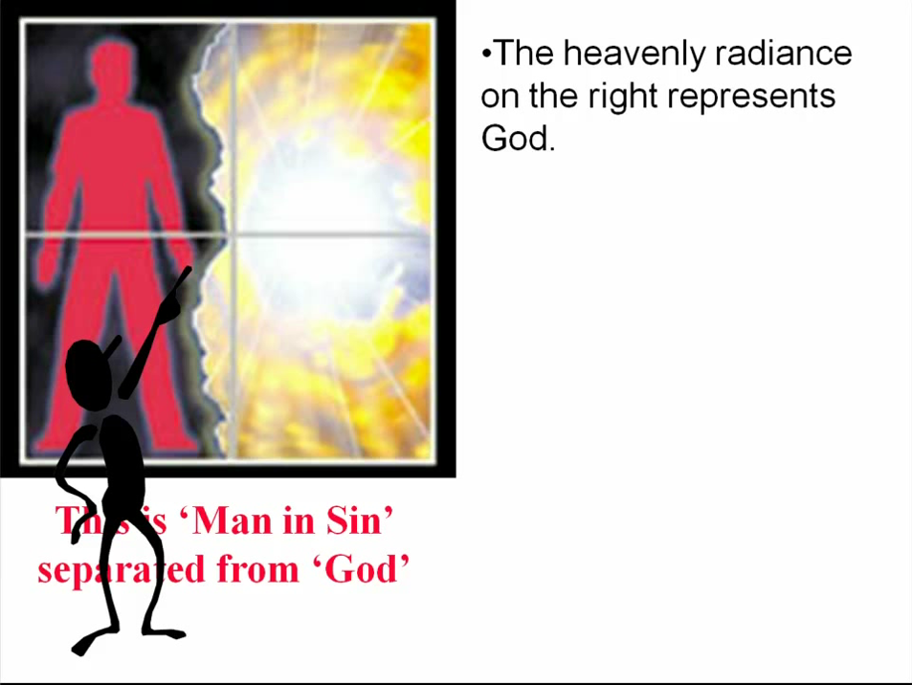

Slide 55
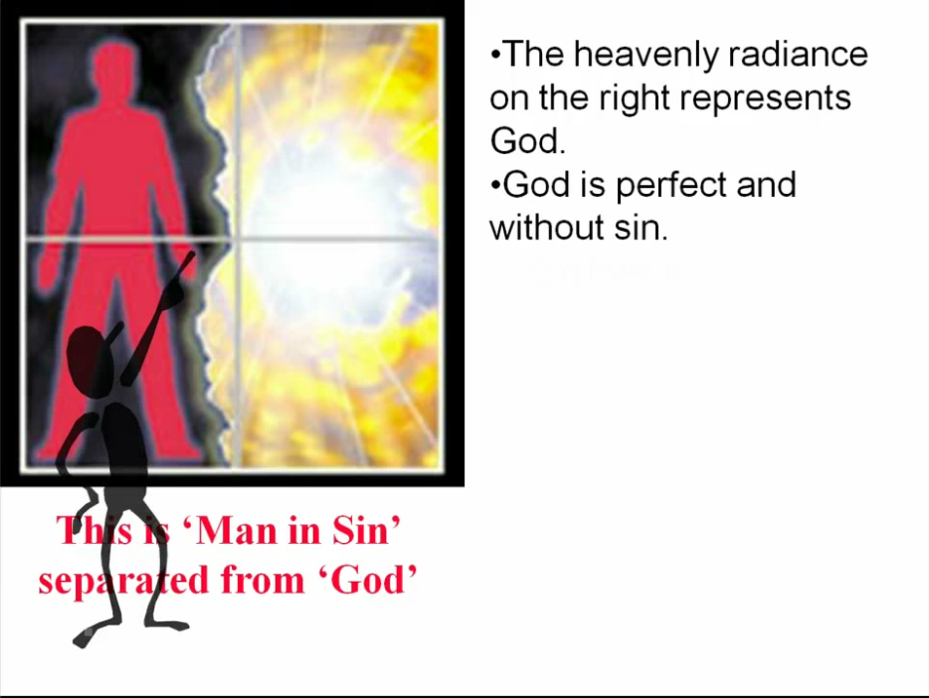

Slide 56
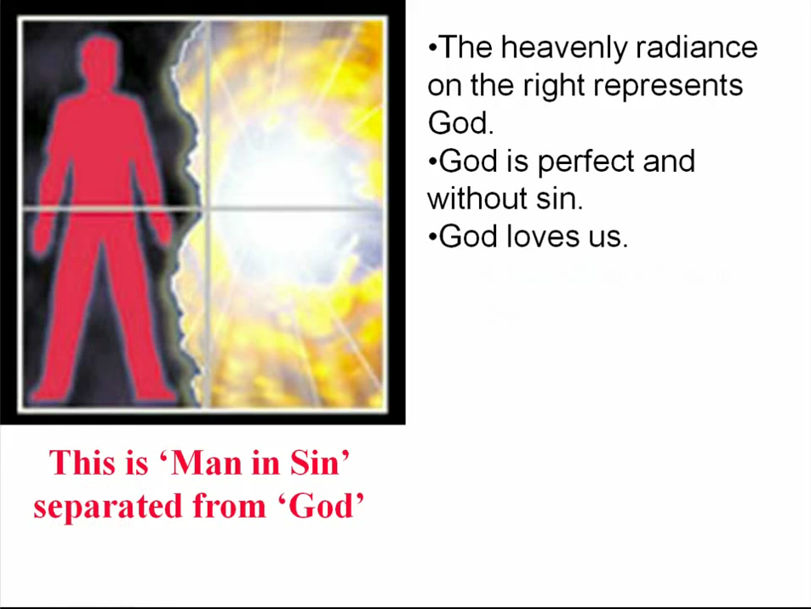

Slide 57
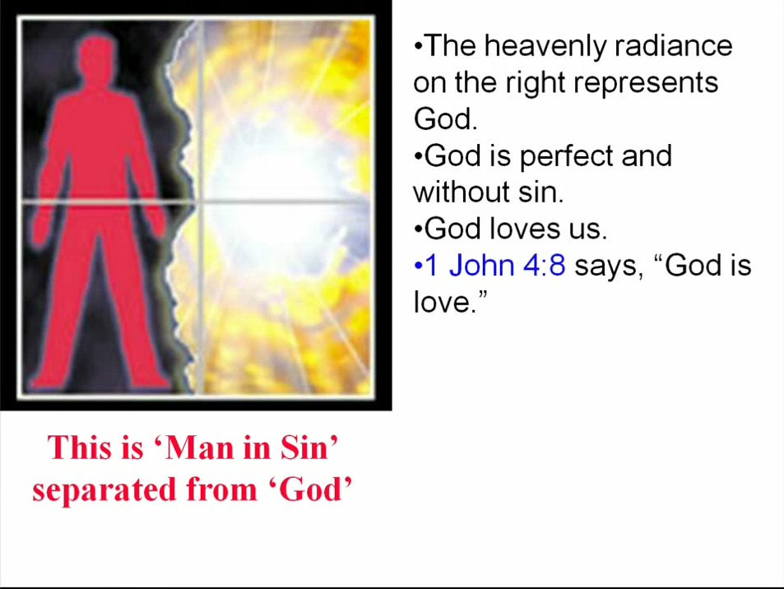

Slide 58
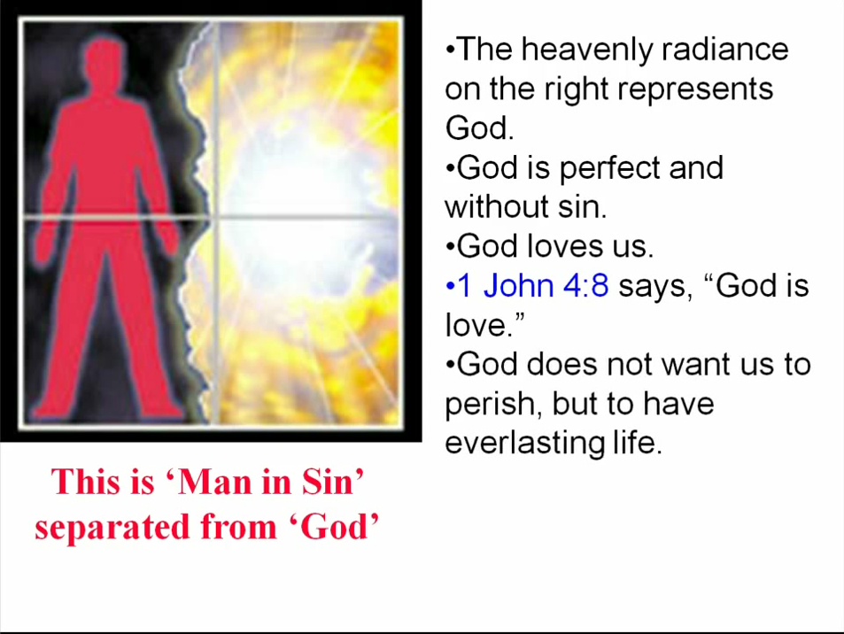

Slide 59
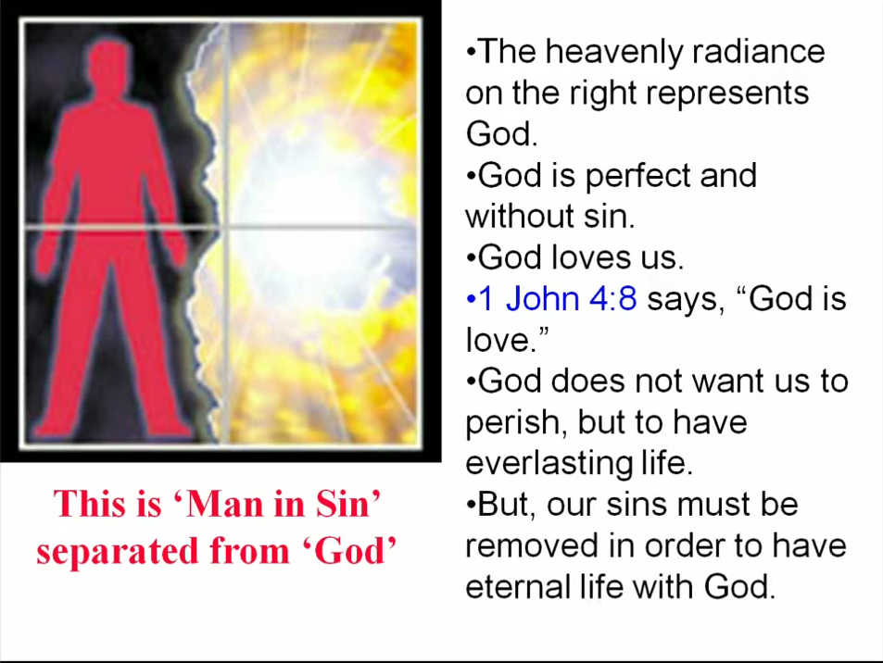

Slide 60
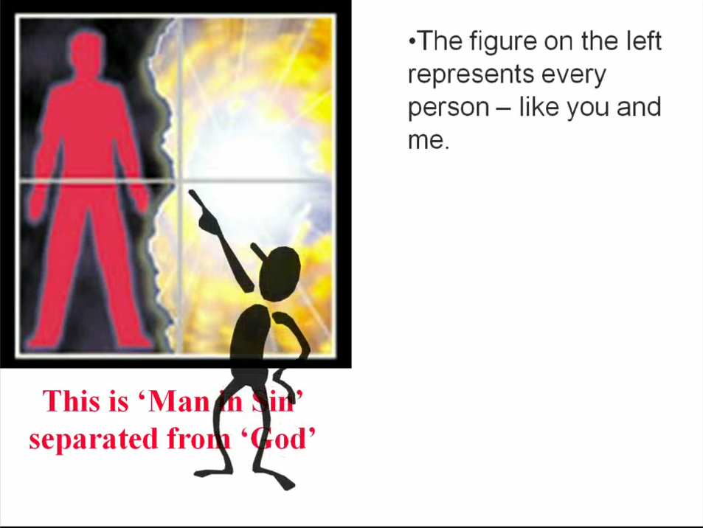

Slide 61
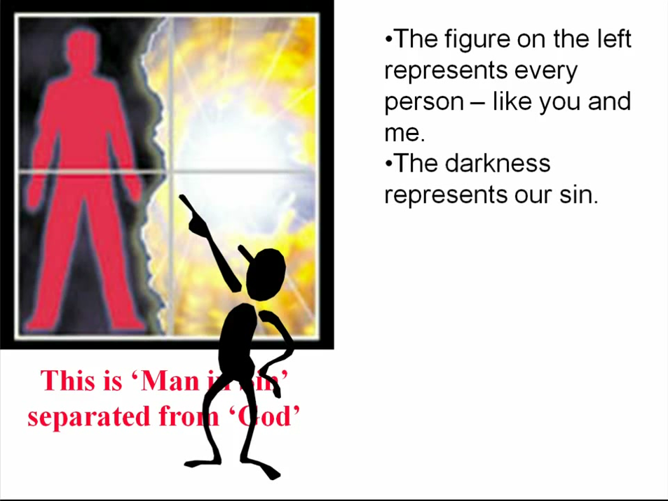

Slide 62
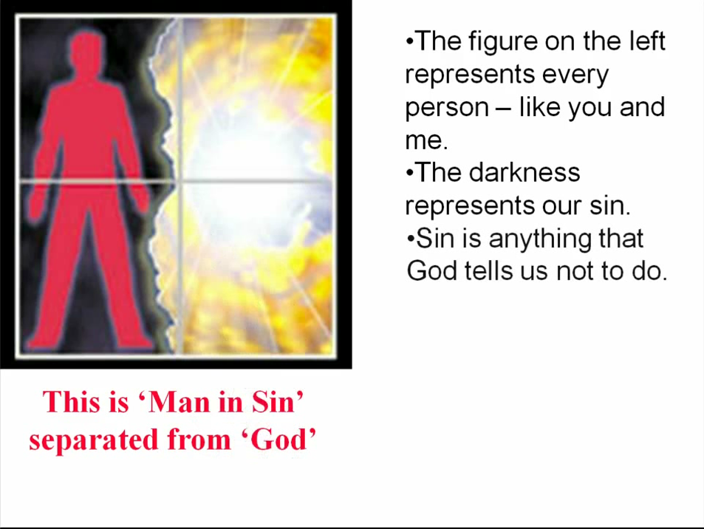

Slide 63
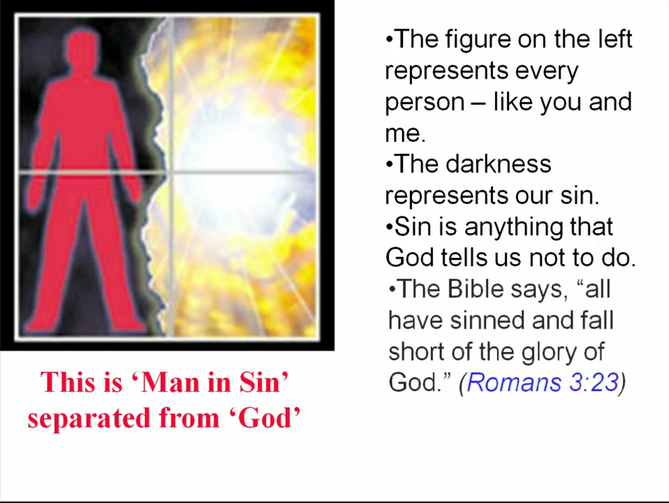

Slide 64
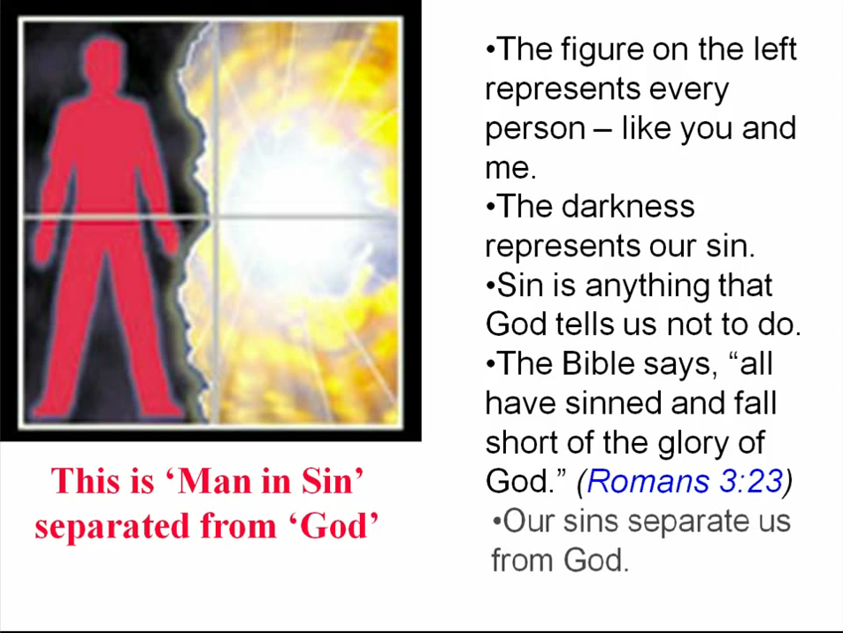

Slide 65
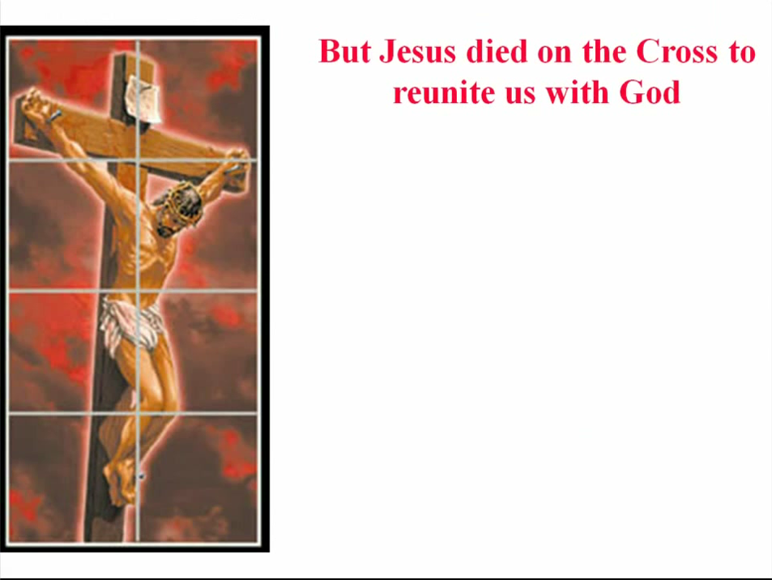

Slide 66


Slide 67


Slide 68


Slide 69


Slide 70


Slide 71


Slide 72


Slide 73


Slide 74


Slide 75


Slide 76


Slide 77


Slide 78


Slide 79


Slide 80
Need a Volunteer (Kid or Adult) To:
Answer Lesson Questions
Explain the Gospel in a Nutshell Craft
Explain the Big E-Cube
Explain the “Gospel in My Hand”

Slide 81

a
The Gospel
in
My
Hand

Slide 82
a
My Pointer:
Points to my sin. I don’t deserve Heaven.
My Thumb:
Like a hitchhiker, I need a free ride to Heaven.
My Longest Finger:
Reminds me of God. The greatest person in the universe.
My Ring Finger:
Reminds me of Jesus who loves me forever. He died to pay for my sin.
My Pinkie Finger:
It only take a little faith in Jesus (mustard seed size)
to give Him my heart and
my whole life.

Slide 83
This Coupon is Good for One
Free Prize at The SonShineTent
Give away 3 of these coupons to 3 different children. Then bring back the plastic bag for another prize for you.

Slide 84

A small gift from us to you at the hospitality table.
Thank
you for coming.

Slide 85

Let’s Close in Prayer

Slide 86
Note: After you download the slideshow, you may also need to download some videos from YouTube & add them into this PowerPoint. This tool can help you:
Free YouTube Download
We present these messages in outdoor venues using the SonShineTent.
Watch the video of our service that goes with this message, click here: http://campaignkerusso.org/?p=15984
We would love to know more about the people who download our lessons & sermons. We invite you to email us & let us know where & how you use them.
info@campaignkerusso.org

