Slide 1
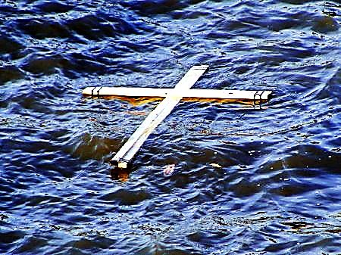
Water Baptism is a Picture of Jesus

Slide 2



Note: After you download the slideshow, you may also need to download some videos from YouTube & add them into this PowerPoint. This tool can help you:
Free YouTube Download
We present these messages in outdoor venues using the SonShineTent.
Watch the video of our service that goes with this message, click here: http://campaignkerusso.org/?p=9955
We would love to know more about the people who download our lessons & sermons. We invite you to email us & let us know where & how you use them.
info@campaignkerusso.org

Slide 3

Welcome All

Slide 4

Let’s Begin with Prayer

Slide 5
Water Baptism is a Picture of Jesus

Slide 6

The Bible Says
These Four Things are Alike
Noah’s Ark
Moses Parting the Red Sea
Jesus Rising from the Grave
A Newly Baptized Believer
Let’s Take a Look at Each and See…

Slide 7
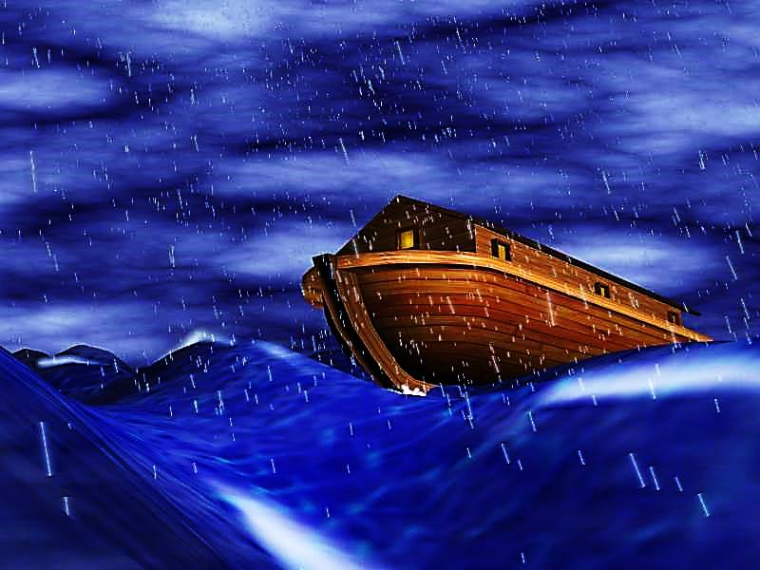

Slide 8
#1 - Noah
The world was sinful and under God’s judgment.
Noah’s family entered the ark by faith.
The waters of death came.
They came out of the waters with a new life.
Their old life was left behind.

Slide 9
“…Eight people went into that boat and were brought safely through the flood.
Those flood waters were like baptism that now saves you…” I Peter 3:20-21
Passing through water is a picture of being buried and coming alive again.

Slide 10
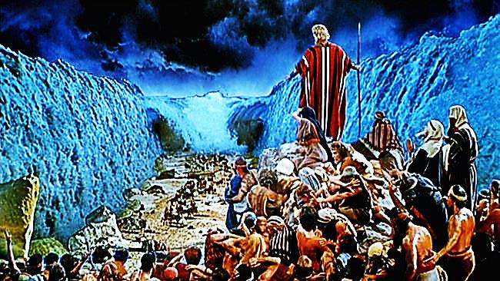

Slide 11
#2 Moses
Egypt was sinful and under God’s judgment.
Moses led the Hebrew Children out by faith.
The waters of death came.
They came out of the waters with a new life.
Their old life was left behind.

Slide 12
“Because of their faith, the people walked through the Red Sea on dry land. But when the Egyptians tried to do it, they were drowned.” Heb. 11:29
“Friends, I want to remind you that all of our ancestors walked under the cloud and went through the sea. This was like being baptized and becoming followers of Moses.” 1 Co. 10:1-2

Slide 13
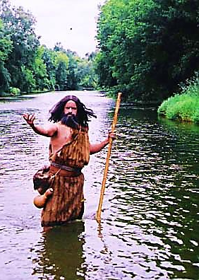
#3 Jesus Death & Resurrection
People are sinful and under God’s judgment.
John led the people to repent & believe.
The symbolic ‘waters of death’ came over them.
They came out of the waters with a new life.
Their old life was left behind.
John the Baptist

Slide 14
Next Slide → Video: Jesus is Baptized
Download Here: http://www.youtube.com/watch?v=DoMBvmHS88g

Slide 15
“So John the Baptist showed up in the desert and told everyone, ‘Turn back to God and be baptized! Then your sins will be forgiven.’…crowds of people went to John. They told how sorry they were for their sins, and he baptized them in the Jordan River.” Mark 1:4-5
#3 Jesus Death & Resurrection
John the Baptist

Slide 16
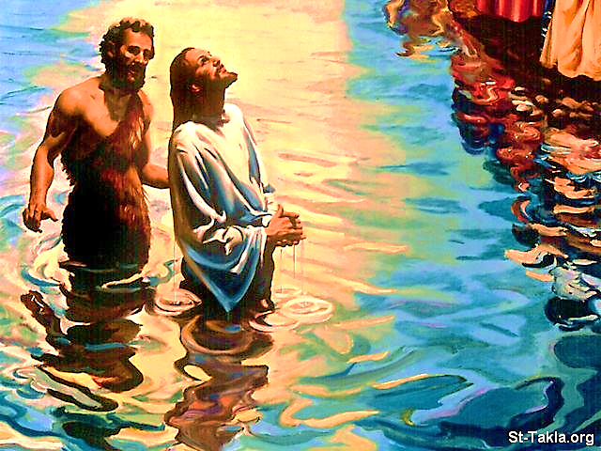
Baptism of Jesus
A picture of Salvation!
Jesus didn’t need to die to an old sinful life or rise up to a new life, but He wanted to set the example for us to follow.
#3 Jesus Death & Resurrection

Slide 17
#3 Jesus Death & Resurrection
“So Jesus was baptized. And as soon as he came out of the water, the sky opened, and he saw the Spirit of God coming down on him like a dove. Then a voice from heaven said, ‘This is my own dear Son, and I am pleased with him.’” Mat.3:17

Slide 18
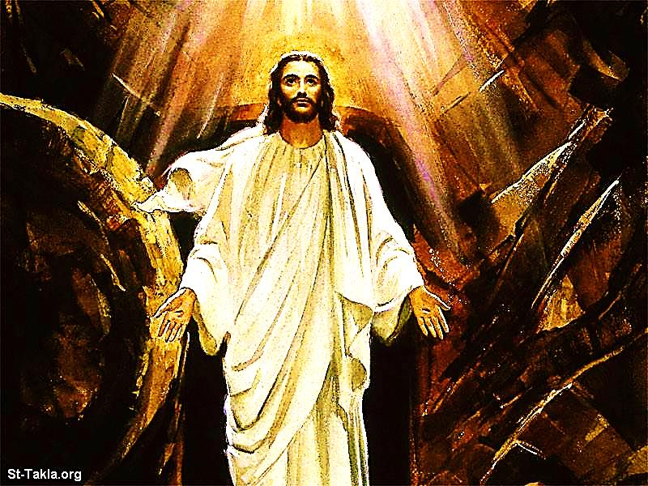

Slide 19
#3 Jesus Death & Resurrection
Jesus took our sin upon Him & placed Himself under God’s judgment in our place.
He went down into death & the grave.
He rose up out of the grave with a new life to give to all who believe.
He left our sins down in the grave.

Slide 20
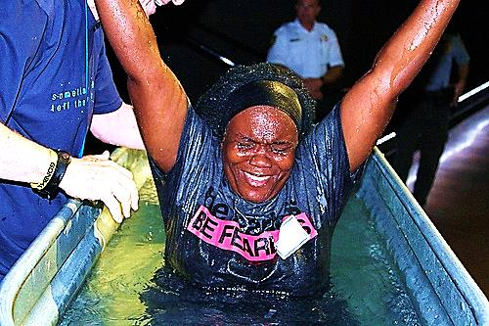

Slide 21
#4 Death & Resurrection of Jesus
#4 A Believer’s Water Baptism
We are sinful and under God’s judgment.
Jesus teaches us to repent & believe.
The symbolic ‘waters of death’ came over us in baptism.
We came out of the waters with a new life.
Our old life is symbolically left behind in the water.

Slide 22
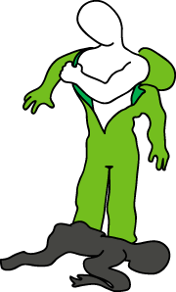
#4 Death & Resurrection of Jesus
“And when you were baptized, it was the same as being buried with Christ. Then you were raised to life…” Col. 2:12
“And when you were baptized, it was as though you had put on Christ in the same way you put on new clothes.” Gal.3:27

Slide 23
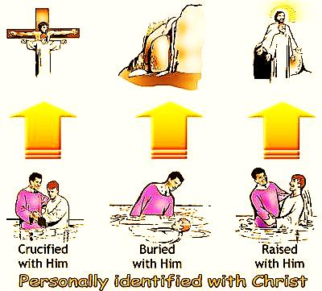

Slide 24
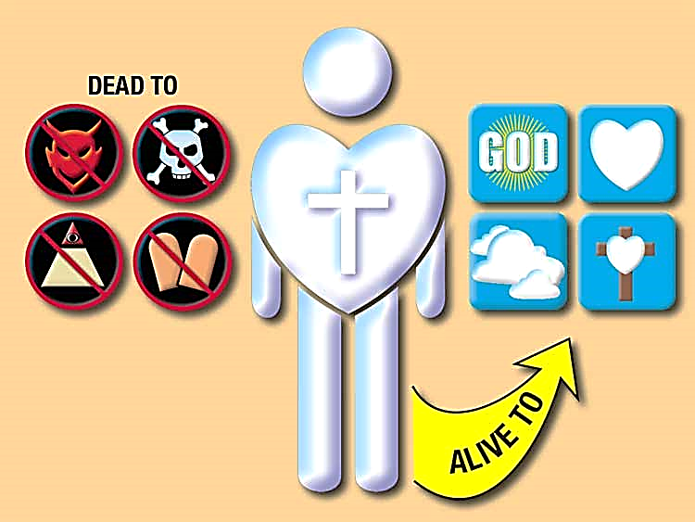
Dead to Sin: Sin loses it’s hold on us – we don’t have to do it anymore.
Alive to God: Our relationship with God is awakened – a new life begins.

Slide 25

“…Should we keep on sinning…? No, we should not! If we are dead to sin, how can we go on sinning?
…When we were baptized, we died and were buried with Christ. We were baptized, so that we would live a new life, as Christ was raised to life…”
If we shared in Jesus' death by being baptized, we will be raised to life with him.” Rom. 6:1-4

Slide 26

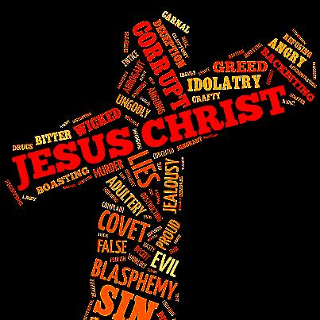
“we shared in Jesus' death by being baptized, AND we will be raised to life with him.
The person we were in the past is nailed to the cross with Jesus. We are no longer slaves of sin.
…sin doesn’t have power over dead people.” Rom. 6:5-7

Slide 27
Next Slide → Kids Get Baptized
Download Here: http://www.youtube.com/watch?v=o4i7gucZ67Q

Slide 28
Next Slide → Video: What Baptism is Not!
Download Here: https://www.youtube.com/watch?v=8a8FprDRmOs

Slide 29
Next Slide → Song: Take Me to the Water
Download Here: https://www.youtube.com/watch?v=pqpiRBDeRBI

Slide 30
Next Slide → Song: Take Me to the Water
Download Here: http://youtu.be/q1x4jRVxYxc

Slide 31
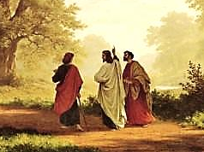
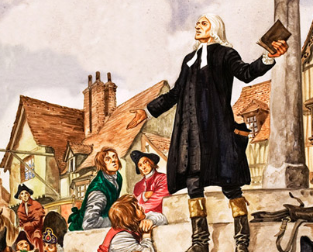
Is Jesus
Speaking to You?
“They said to each other, ‘Did not our hearts burn within us while he talked to us on the road, while he opened to us the Scriptures?’”
John Wesley Said:
“…the preacher was describing the change which God works in the heart through faith in Christ and I felt my heart strangely warmed.”
Jesus makes His presence Known by a small voice!

Slide 32
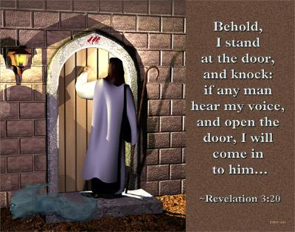

Slide 33
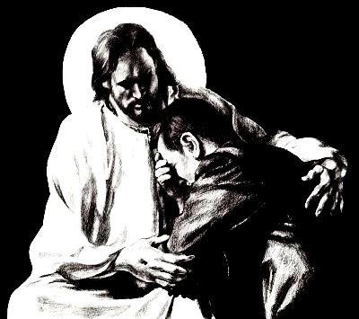
What is the Sinner‘s Prayer?
This is a prayer we can pray when we are ready to admit we are sinners and need Christ’s forgiveness.
It must be prayed with faith in our hearts and a readiness to have a life-changing encounter with Jesus Christ.

Slide 34

A prayer of faith → Pray this prayer if :
If you never have before
You have in the past, but you think it would mean more today
You have been walking afar off and you want to come back
You want to set an example & show others how it is done
You just like to give your heart to Jesus again & again
Faith

Slide 35
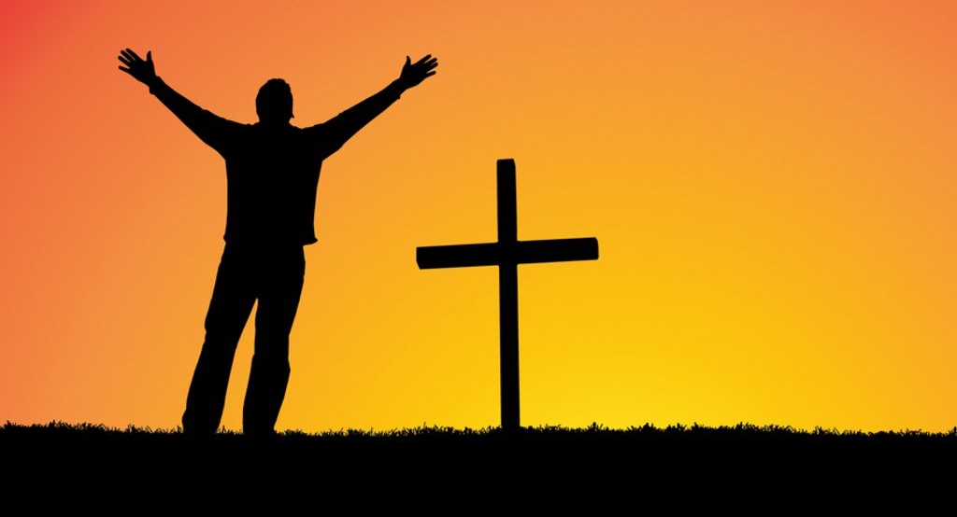
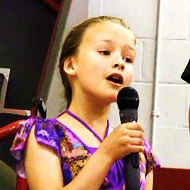
We Declare Our Faith Publicly Because
Jesus Declared His LOVE Publicly
“If you stand before others and are willing to say you believe in me, then I will tell my Father in heaven that you belong to me.” Mat 10:32
If you are ready to give your heart & life to Jesus right now, please come to the front as we pray this prayer together.

Slide 36

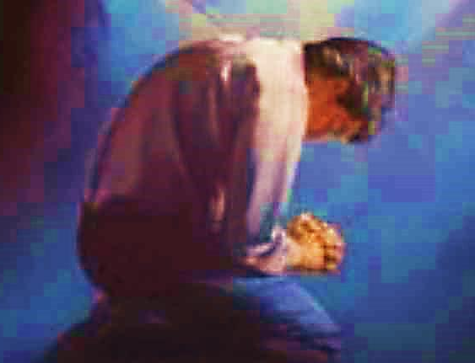
Three Important Questions
Do you want to know Jesus as your Savior right now?
Do you believe He died to save you from your sins & that He rose from the dead?
Do you believe that He is here, waiting to save you right now?

Slide 37
The Prayer of a Sinner Turning to Jesus
Dear Jesus, I know that I have sinned against You and that my sins separate me from You.
I am truly sorry.
Right now, I turn away from my sinful past .
Please forgive me, and help me to keep from sin.
I believe You died for my sins.
I Believe You rose from the dead, you are alive, and you hear this prayer from my heart.
I invite You Jesus to be both my Savior and the Lord of my life.
I want You to rule my life from now on.

Slide 38


“But some people did accept him. They believed in him, and he gave them the right to become children of God.”
John 1:12

Slide 39



Slide 40

Need a Volunteer (Kid or Adult) To:
Answer Lesson Questions

Slide 41


“If you openly say, ‘Jesus is Lord’ and believe in your heart that God raised him from death, you will be saved.”
Rom. 10:9
What did you learn today?
What about the 4 spiritual laws ?
What have you been thinking about God lately?
What do you want to tell others about Jesus?

Slide 42
Need a Volunteer (Kid or Adult) To:
Answer Lesson Questions
Explain the Gospel in a Nutshell Craft

Slide 43
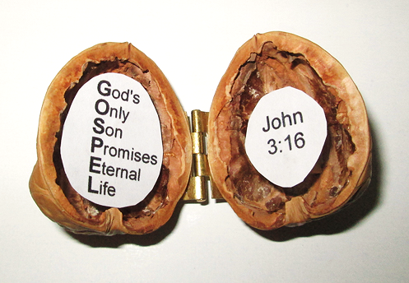
The Gospel
In a Nutshell

Slide 44
Need a Volunteer (Kid or Adult) To:
Answer Lesson Questions
Explain the Gospel in a Nutshell Craft
Explain the Big E-Cube

Slide 45
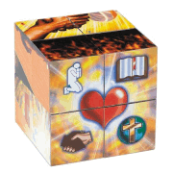
Evangecube
ss

Slide 46
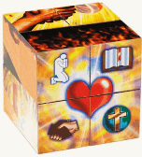
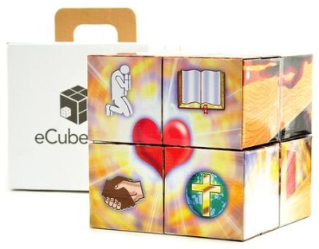
Evangecube
Buy a standard-sized EvangeCube here: EvangeCube
Buy a large sized EvangeCube here: Evangecube Big Cube

Slide 47
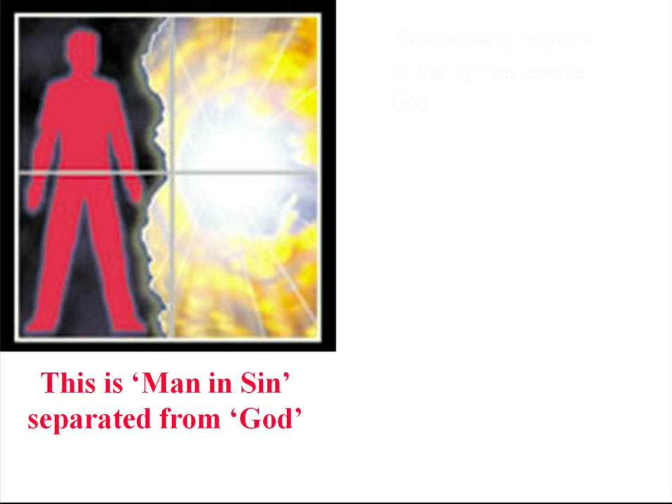

Slide 48
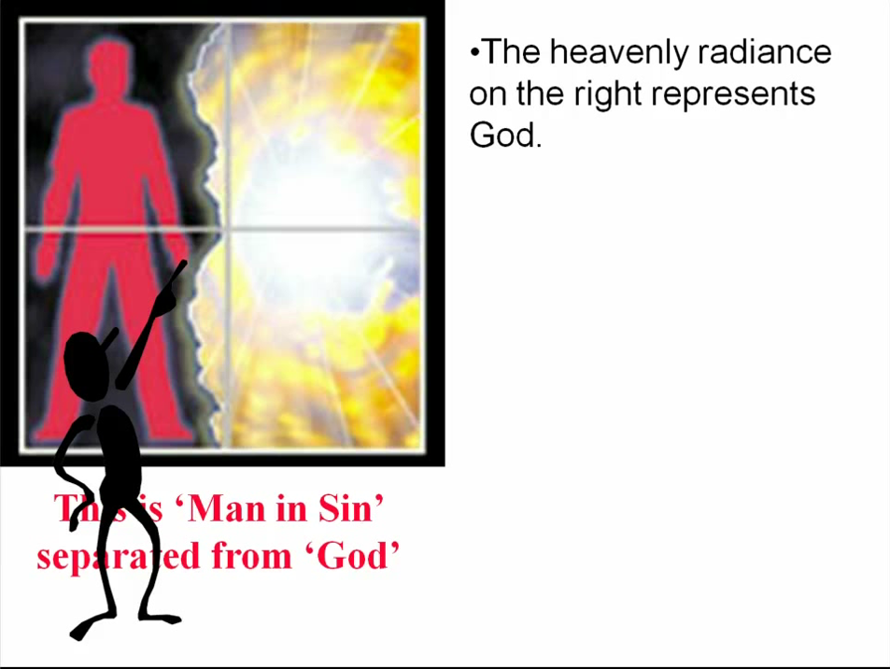

Slide 49
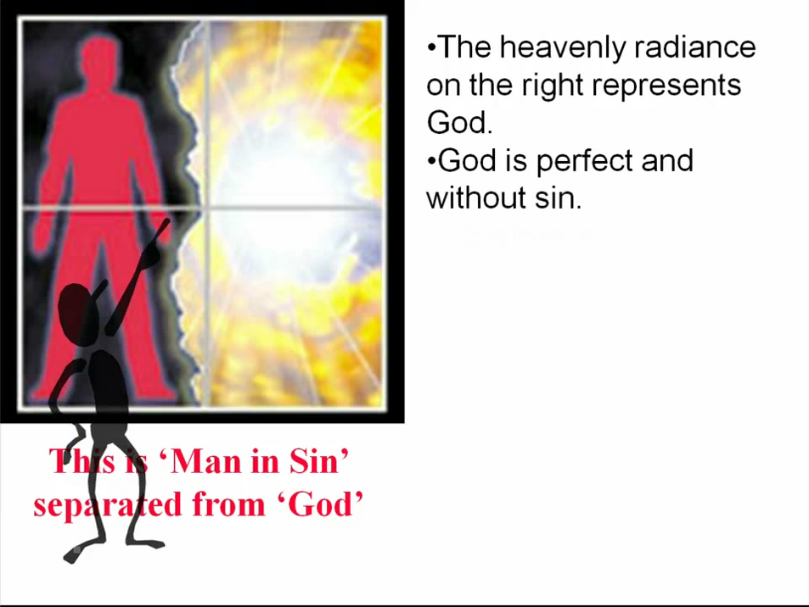

Slide 50
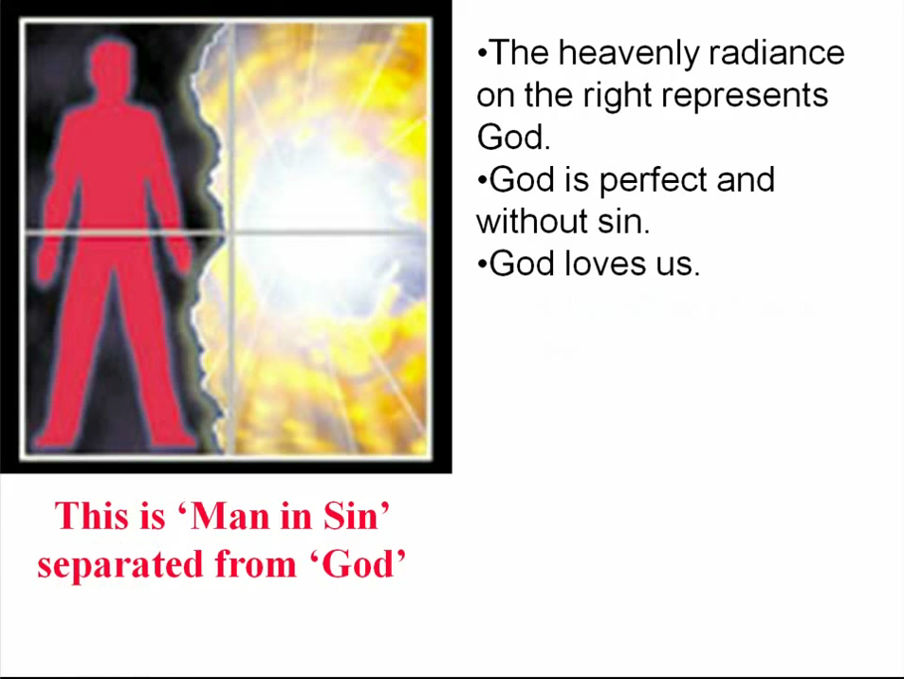

Slide 51
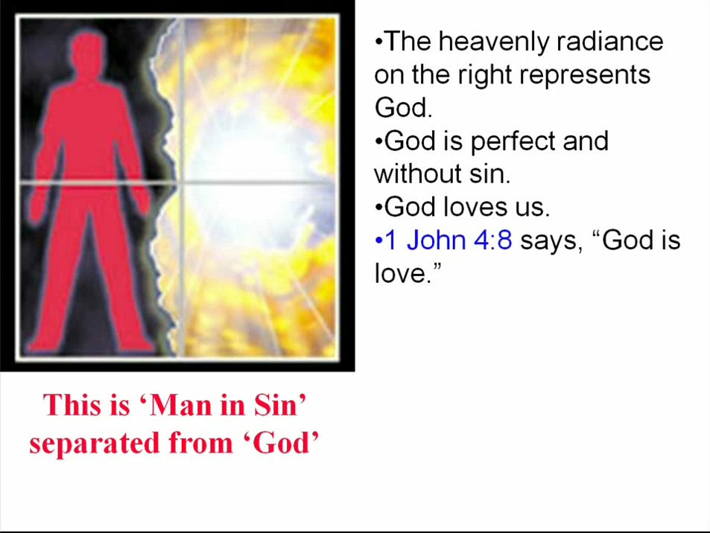

Slide 52
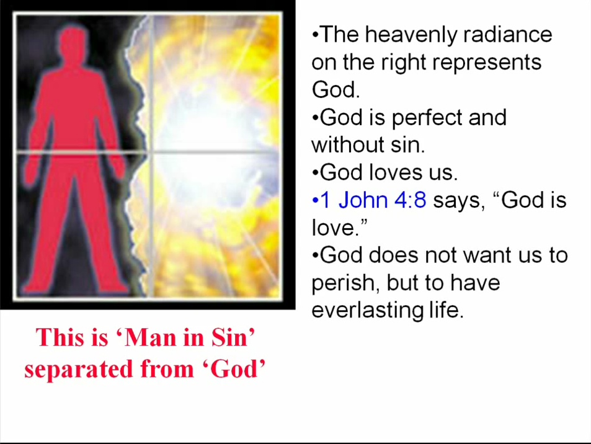

Slide 53
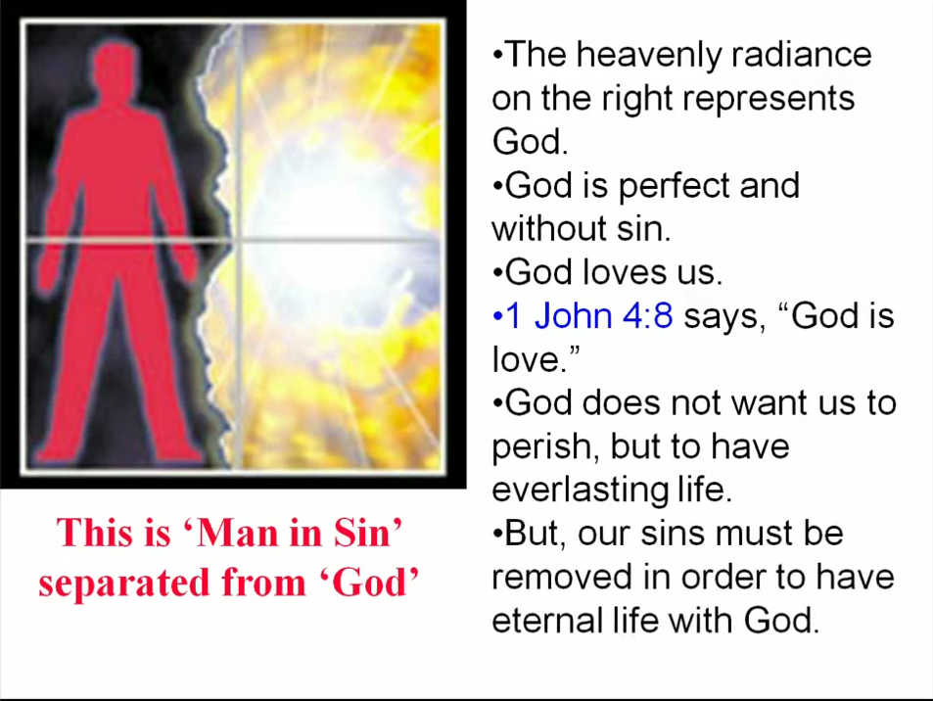

Slide 54
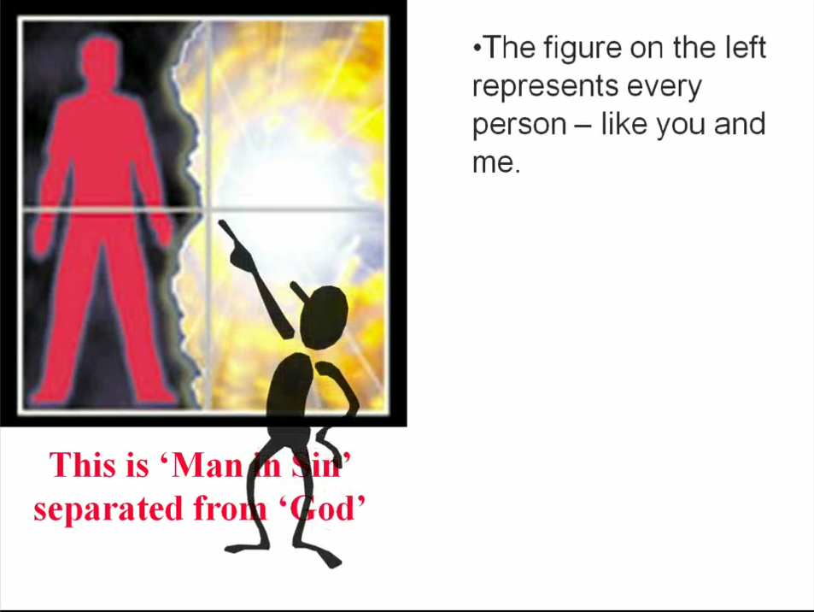

Slide 55
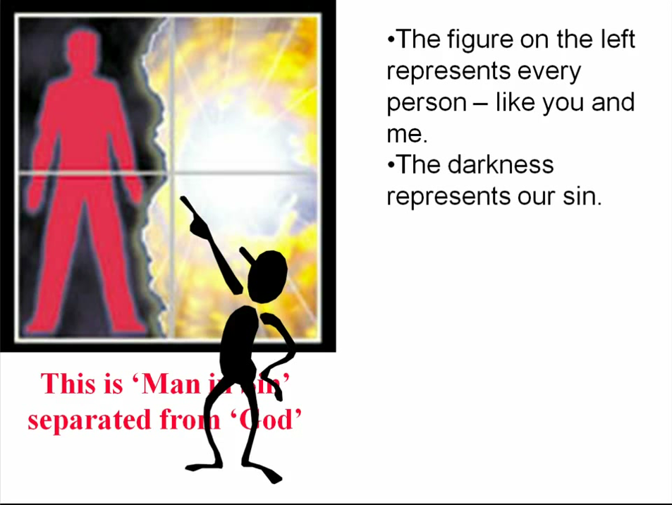

Slide 56
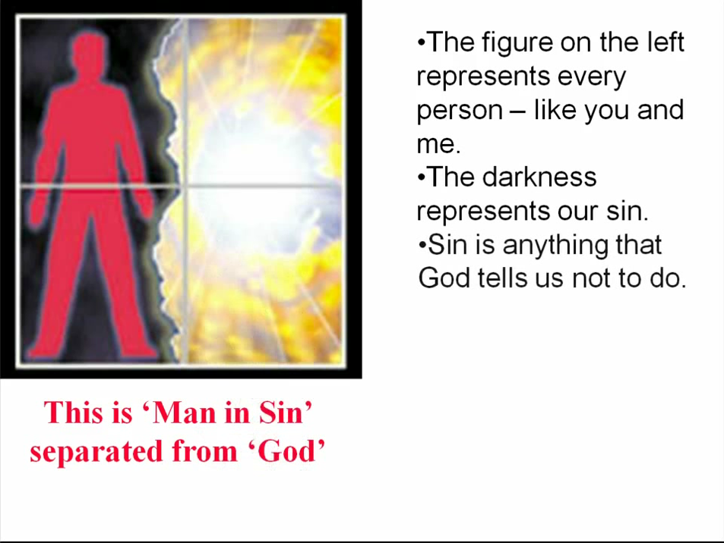

Slide 57
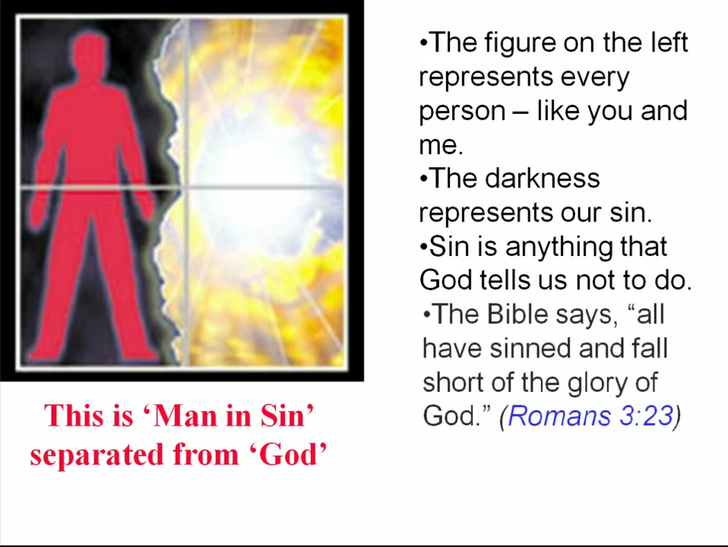

Slide 58
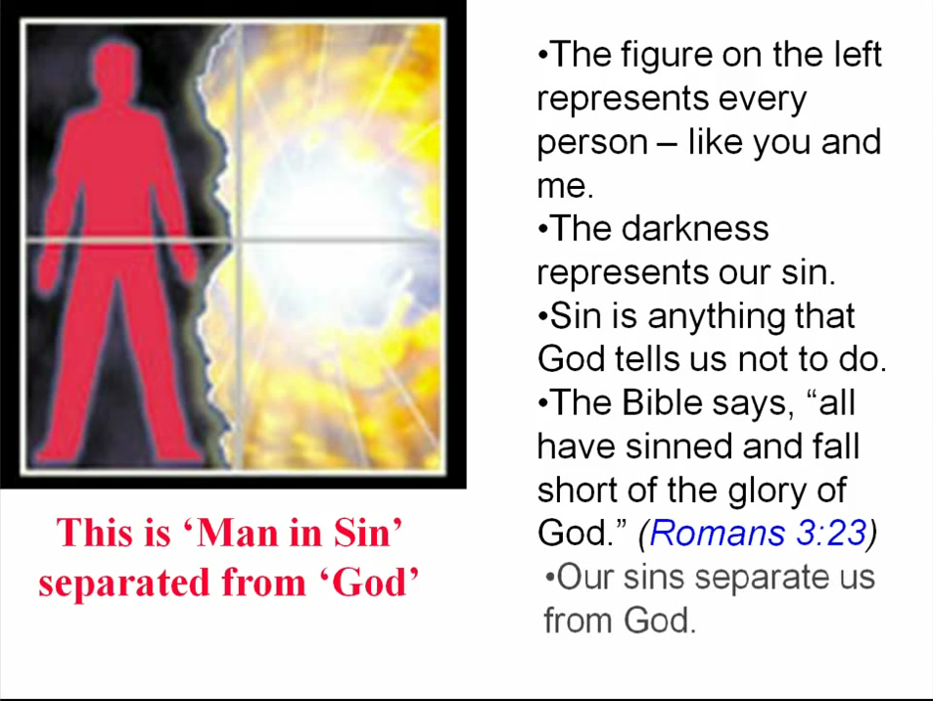

Slide 59
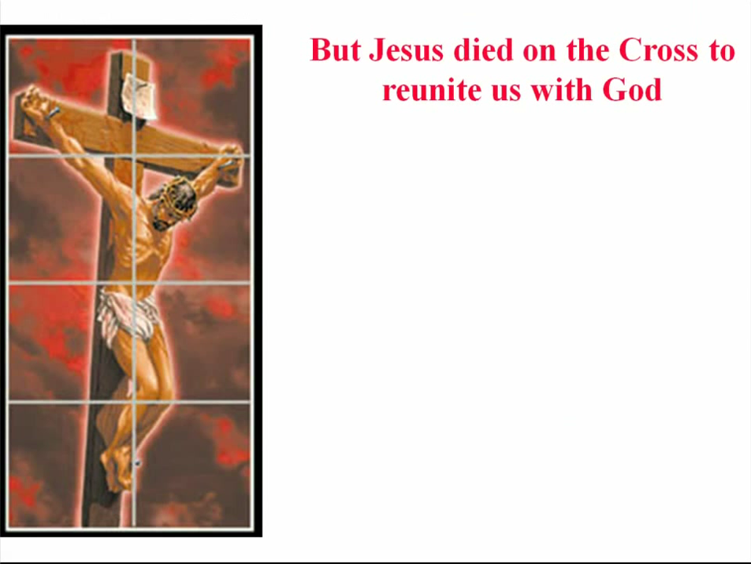

Slide 60
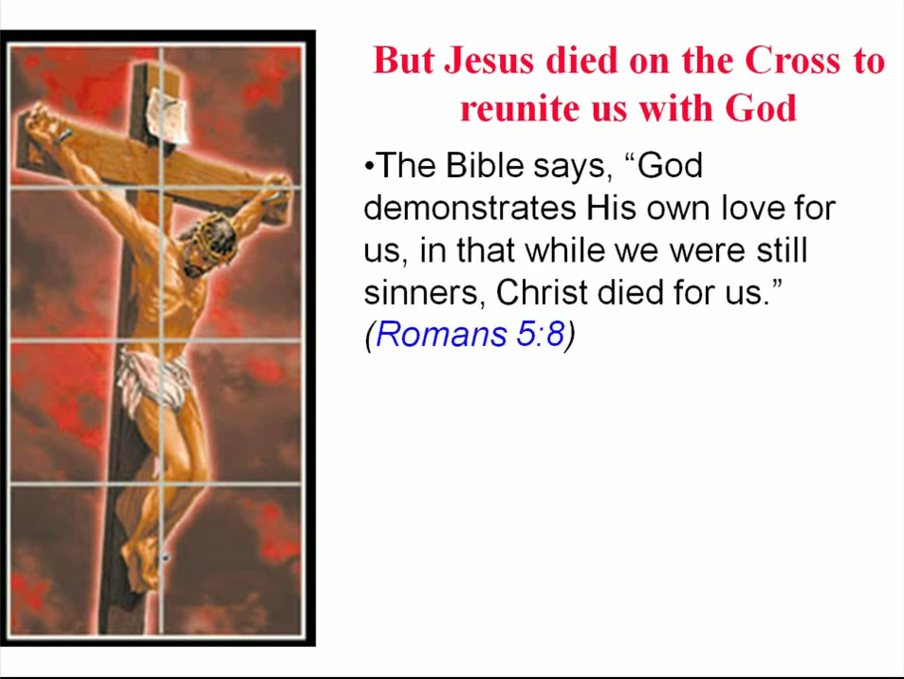

Slide 61
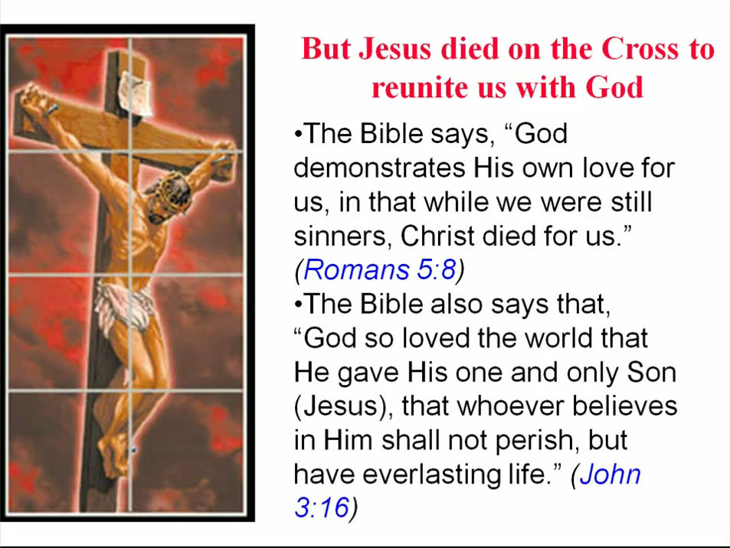

Slide 62
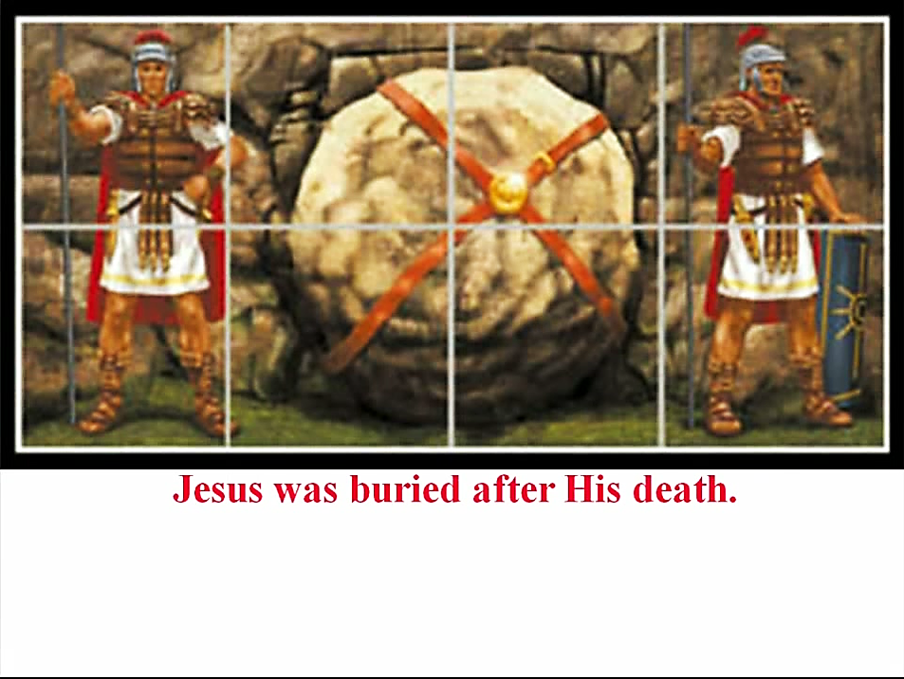

Slide 63
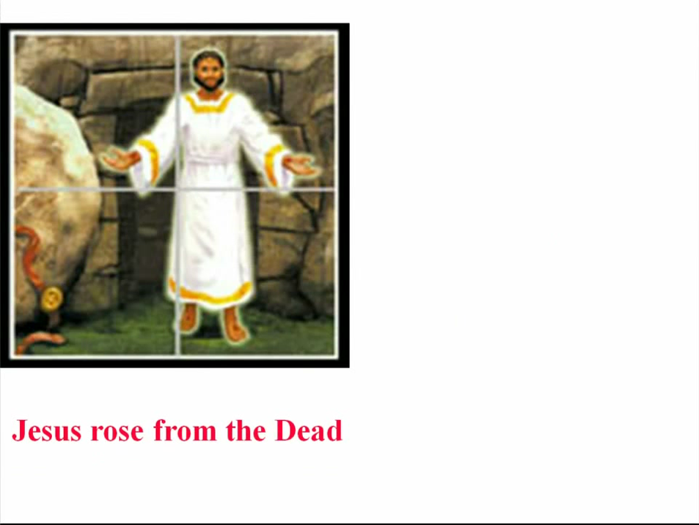

Slide 64
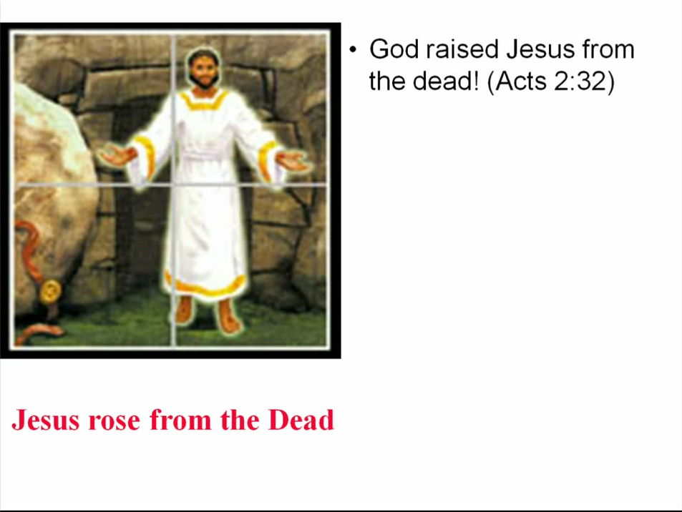

Slide 65
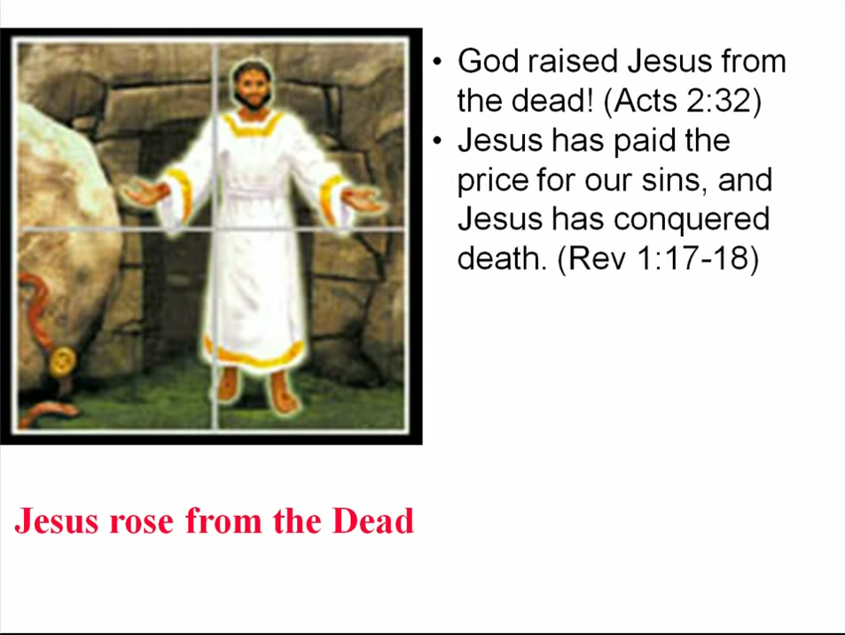

Slide 66
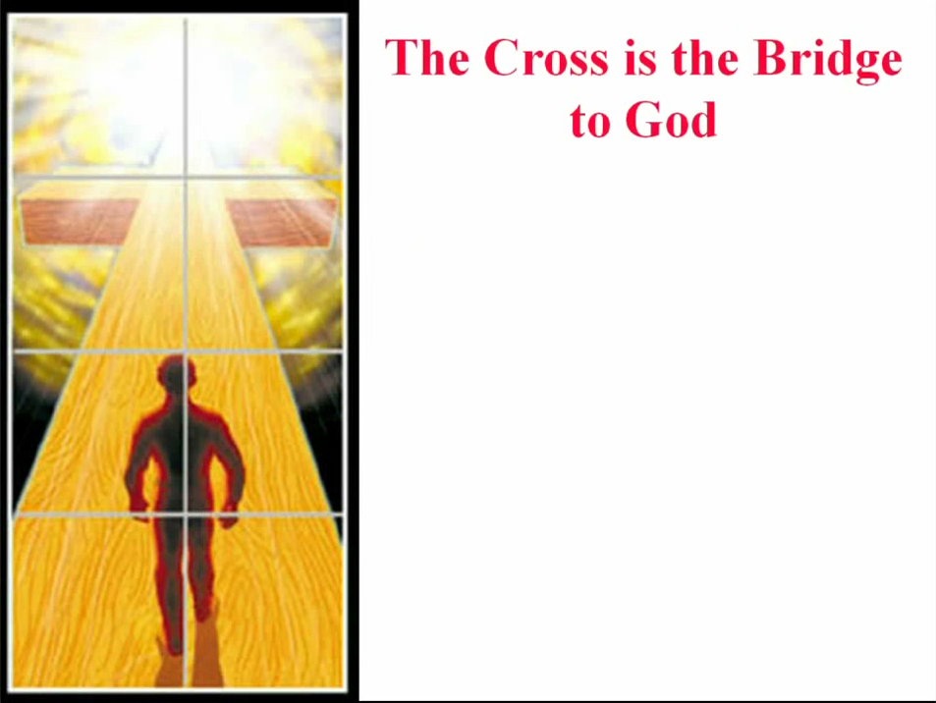

Slide 67
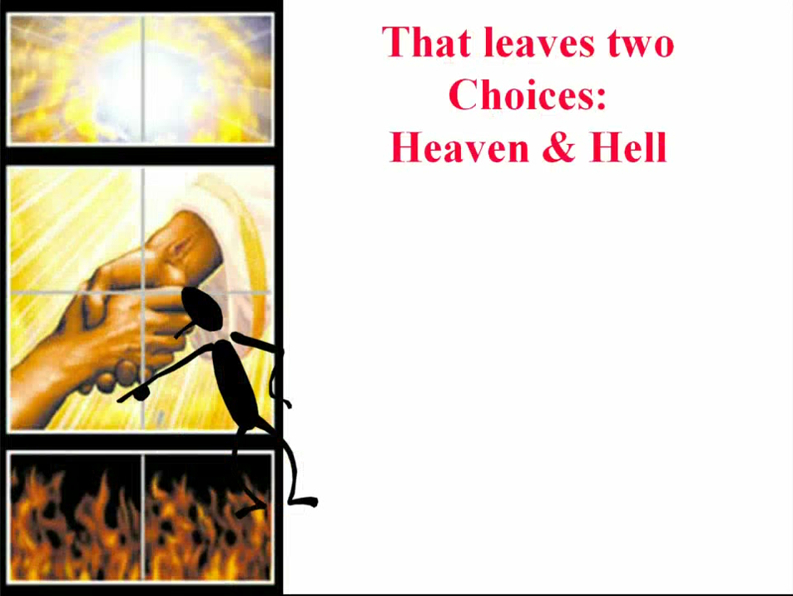

Slide 68
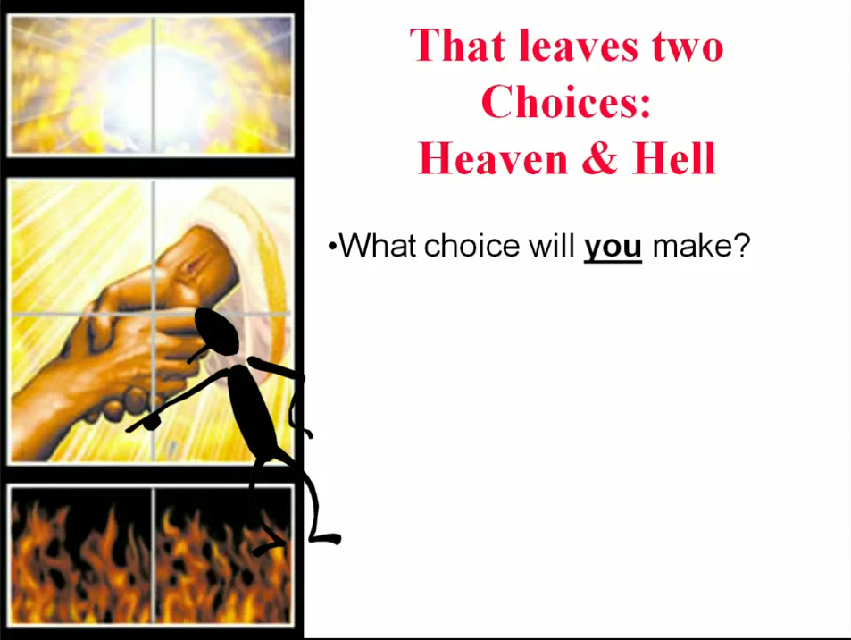

Slide 69
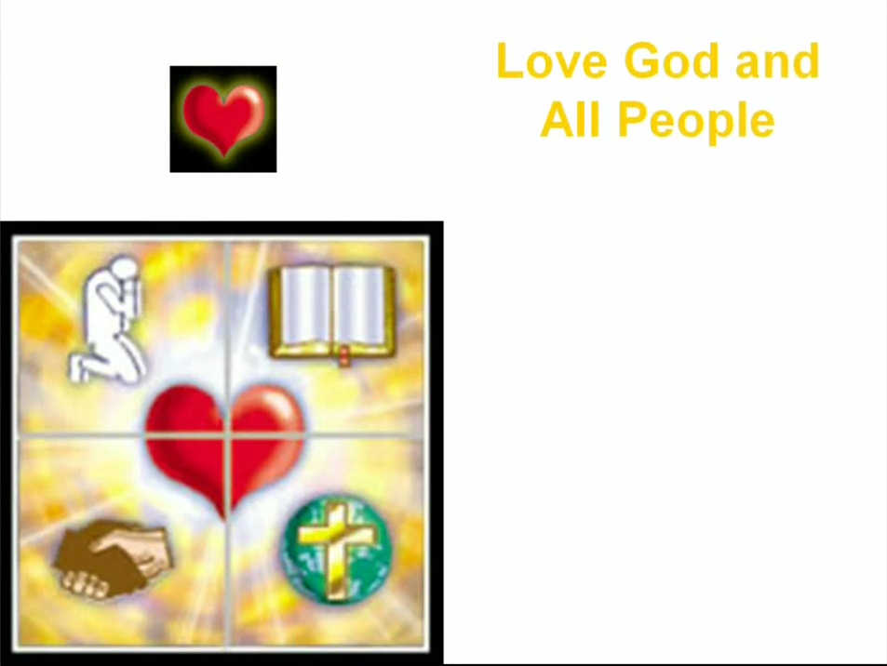

Slide 70
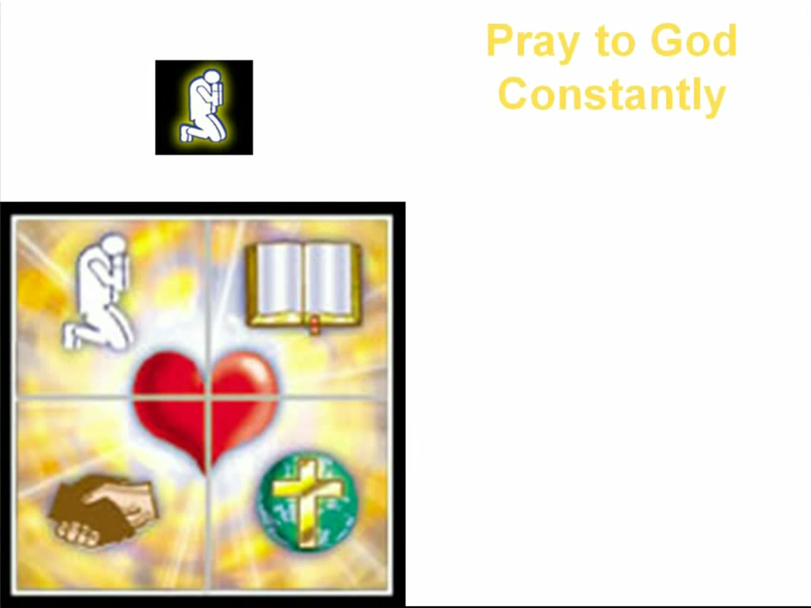

Slide 71
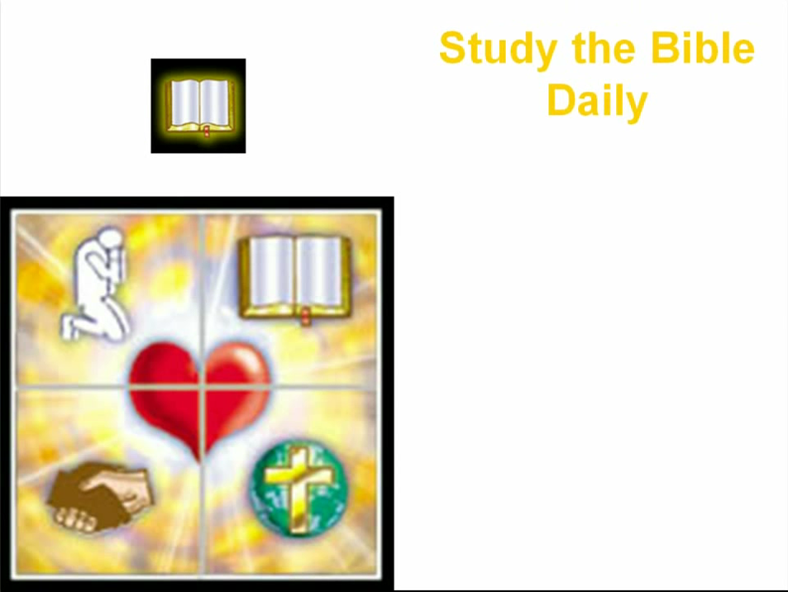

Slide 72


Slide 73


Slide 74
Need a Volunteer (Kid or Adult) To:
Answer Lesson Questions
Explain the Gospel in a Nutshell Craft
Explain the Big E-Cube
Explain the “Gospel in My Hand”

Slide 75
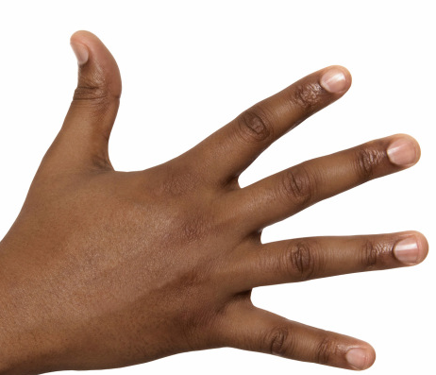
a
The Gospel
in
My
Hand

Slide 76
a
My Pointer:
Points to my sin. I don’t deserve Heaven.
My Thumb:
Like a hitchhiker, I need a free ride to Heaven.
My Longest Finger:
Reminds me of God. The greatest person in the universe.
My Ring Finger:
Reminds me of Jesus who loves me forever. He died to pay for my sin.
My Pinkie Finger:
It only take a little faith in Jesus (mustard seed size)
to give Him my heart and
my whole life.

Slide 77
This Coupon is Good for One
Free Prize at The SonShineTent
Give away 3 of these coupons to 3 different children. Then bring back the plastic bag for another prize for you.

Slide 78

A small gift from us to you at the hospitality table.
Thank
you for coming.

Slide 79
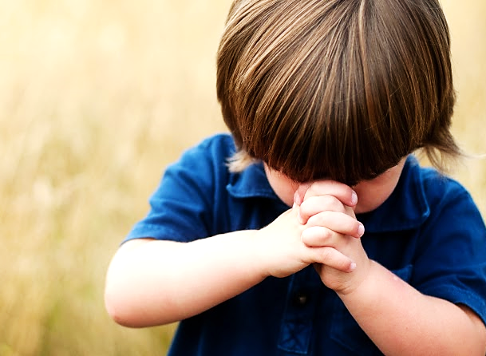
Let’s Close in Prayer

Slide 80
Note: After you download the slideshow, you may also need to download some videos from YouTube & add them into this PowerPoint. This tool can help you:
Free YouTube Download
We present these messages in outdoor venues using the SonShineTent.
Watch the video of our service that goes with this message, click here: http://campaignkerusso.org/?p=9955
We would love to know more about the people who download our lessons & sermons. We invite you to email us & let us know where & how you use them.
info@campaignkerusso.org

