Slide 2
In 2014, a minister named Dann Spader wrote a book called, “4 Chair Discipling.”
It has been used by many pastors and evangelists to illustrate the progression of Christian growth.

Slide 3
No two ministers teach it alike, each one puts his/her own spin on it. This is our spin.
Usually, four chairs are set on the platform and it is explained that each one represents a stage in a believer’s growth.

Slide 4
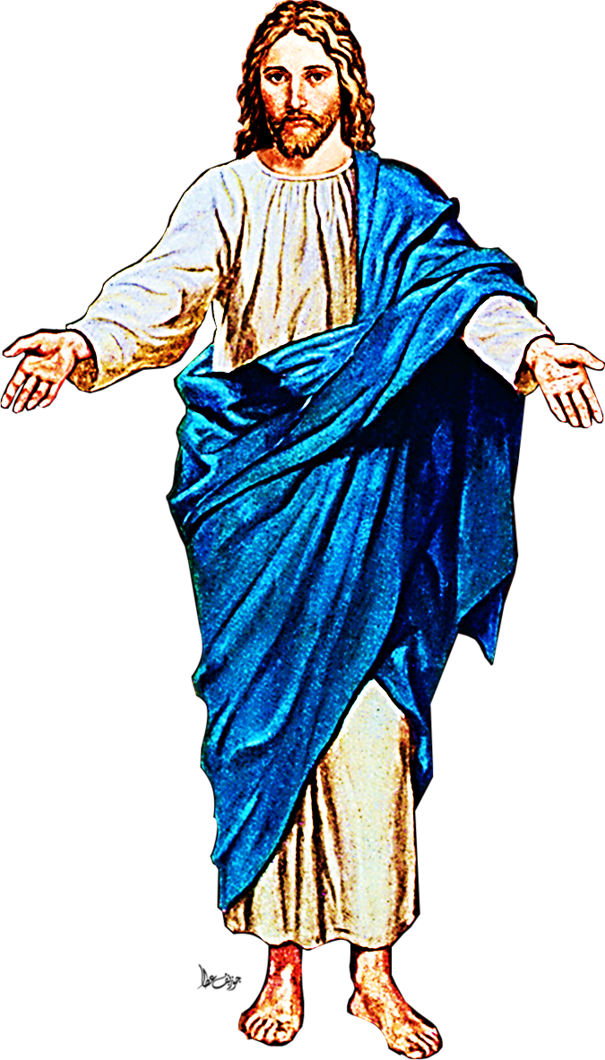
About 2000 Years ago Jesus preached a message about the four stages of wheat growth….
Today we are going to look at…

Slide 6
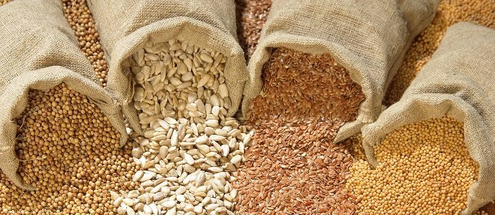
But, before we get into our take on the four chairs, let’s look at Mark chapter 4 and Jesus’ take on the four stages of seed growth.
The book of Mark, chapter 4, contains three parables about seeds.

Slide 7
Mark 4:30-32 WB
“And Jesus said, `What is the kingdom of God like? What shall I say it is like? It is like this. A mustard seed is the smallest seed that is ever planted in the earth…

Slide 8
“…But the plant that grows from that seed is bigger than any other plant. It puts out very big branches. The birds come and live in its branches.”

Slide 9
First, is the parable of the tiny mustard seed that grows into a great tree.

Slide 10
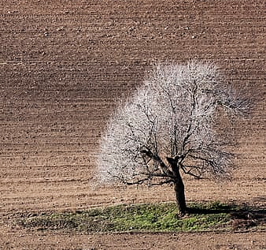
It reminds us that a tiny seed of the Gospel can blossom into a world harvest of souls.

Slide 11
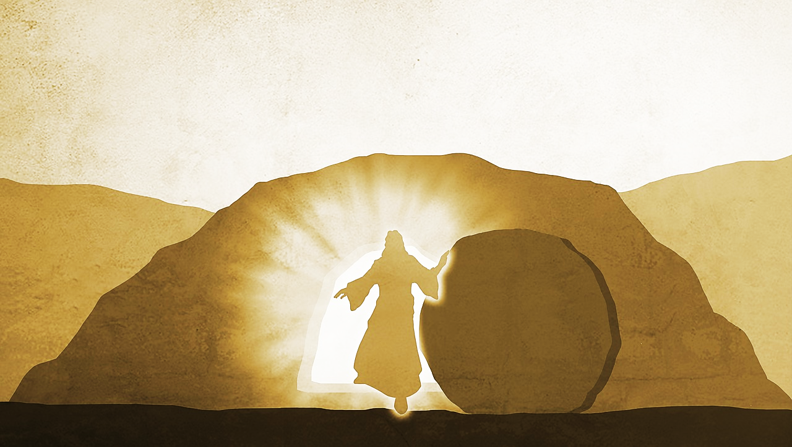
Also, it reminds us that, although Jesus was but one small man buried in the ground (average height of Jewish men in bible days is 5’5”)…
He rose again and became the great Head of the Kingdom of God and we are all its citizens.

Slide 12
Mark 4:3-8 (ESV)
“Listen! Behold, a sower went out to sow. And as he sowed, some seed fell along the path, and the birds came and devoured it. Other seed fell on rocky ground, where it did not have much soil…

Slide 13
…and immediately it sprang up, since it had no depth of soil. And when the sun rose, it was scorched, and since it had no root, it withered away…

Slide 14
…Other seed fell among thorns, and the thorns grew up and choked it, and it yielded no grain. And other seeds fell into good soil and produced grain, growing up and increasing and yielding thirtyfold and sixtyfold and a hundredfold.”

Slide 15
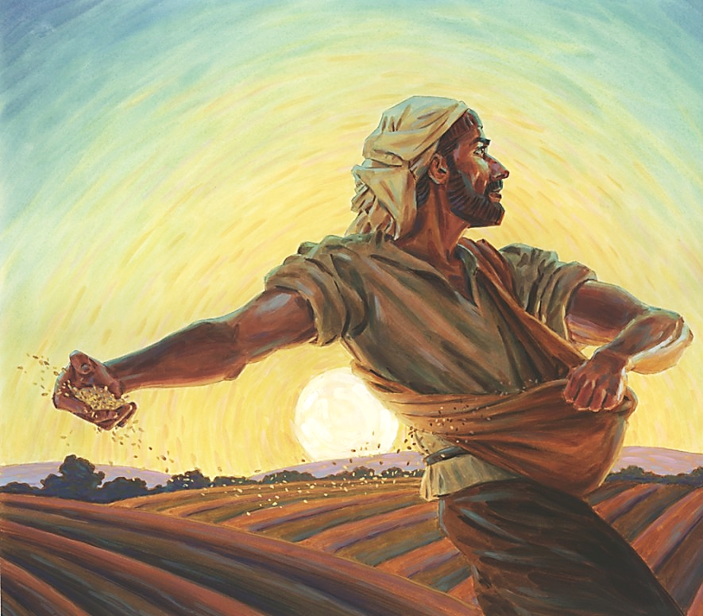
Our Second Parable is about the four types of soil.
1) The hard-beaten path,
2) The gravel mixed with shallow soil,
3) The thorn & weed infested soil and,
4) The rich, good soil
(which can only be created by breaking up the fallow ground, plenty of water and soil nutrients).

Slide 16
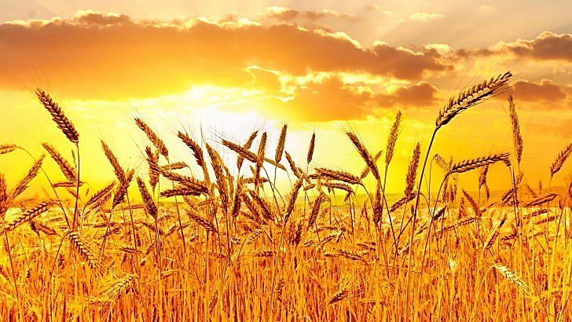
In Our Third Parable, and the one we are most interested in today:
The Lord Jesus teaches about four stages of Christian growth.
He uses the parable of a growing wheat seed.

Slide 17
Mark 4:26-28 (TPT)
“Jesus told this parable:
‘God’s kingdom realm is like someone spreading seed on the ground. He goes to bed and gets up, day after day, and…

Slide 18
(1) The seed sprouts and…
(2) Grows tall, though he knows not how. All by itself it sprouts, and the soil produces a crop; first the green stem, then
(3) The head on the stalk, and then…
(4) The fully developed grain in the head.”

Slide 19
The end of the wheat’s journey to maturity is told to us in these two verses:
Mark 4:26-29 (TPT)
“Then, when the grain is ripe, he immediately puts the sickle to the grain, because harvest time has come.”

Slide 20
John 12:24 (HCSB)
“I assure you: Unless a grain of wheat falls to the ground and dies, it remains by itself. But if it dies, it produces a large crop.”

Slide 21
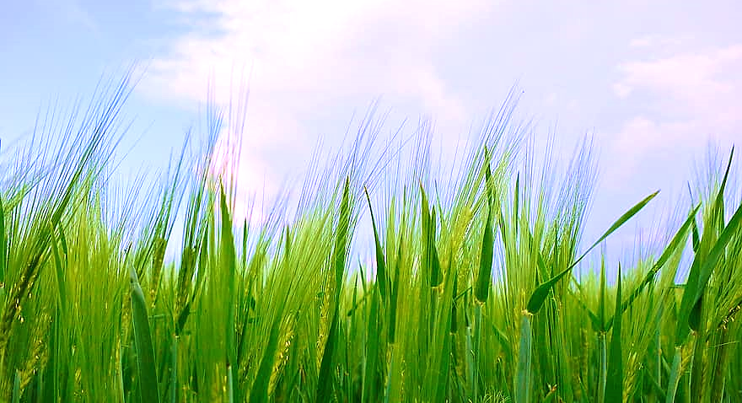
Today, farmers use what is called the “Feekes Scale” to determine which of four levels of maturity the wheat has reached.

Slide 22
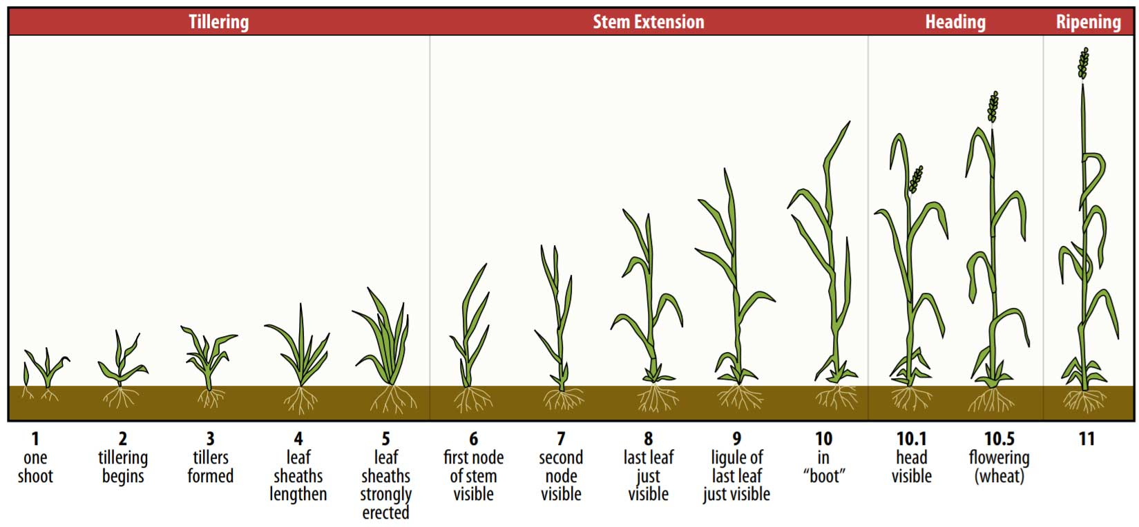
FEEKES SCALE

Slide 23
THE FIRST STAGE
The one where Jesus says, “the seed sprouts”
In Feekes terms - the “tillering” stage.
When the wheat first emerges from the ground and starts to wave around a few baby leaves.
Care must be taken at this stage that the tender plants are not damaged by insects or seedling disease.

Slide 24
THE SECOND STAGE
The one where Jesus says, it “grows tall,” is called by Feekes, the “stem extension” stage.
During this stage, the stem elongates and learns to stand upright.
It grows thick, strong, straight and tall—always growing toward the sun.
It is vulnerable to weeds, weather and other stresses.

Slide 25
THE THIRD STAGE
The one where Jesus says, “then the head on the stalk” is called by Feekes, the “heading stage.”
This is a flowering stage where the wheat head, full of young wheat kernels, emerges from deep within the stalk.
Just as the nature of Christ emerges from deep within every believer.
Wheat is self-pollenating—it is responsible for its own flowering.

Slide 26
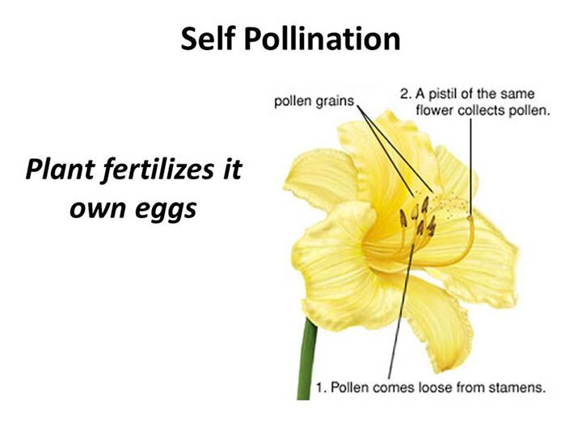
…but God has given us everything we need to be fruitful and allow the nature of Christ to emerge.
We have His powerful, life-giving Word, His Holy Spirit, and the transforming power of prayer and worship.
it’s
The pastor and church may provide support and opportunities for us to grow…

Slide 27
…
…
…

Slide 28
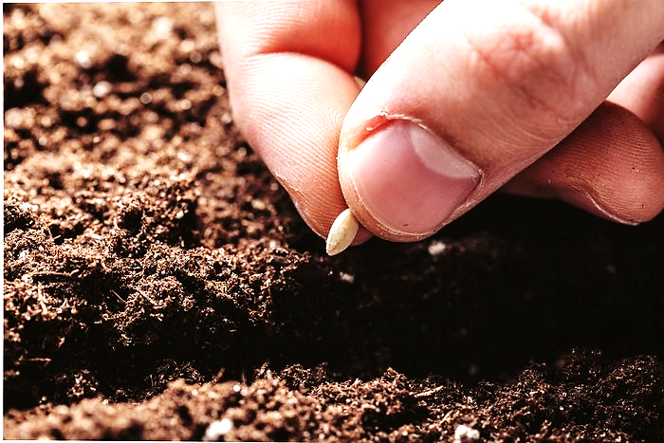
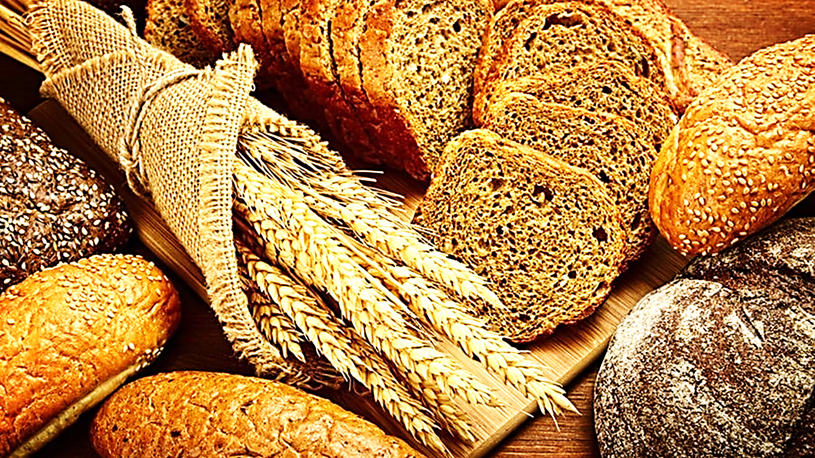
The fourth & final stage, where Jesus says, “then the fully developed grain in the head” is called by Feekes the “ripening stage.”
The wheat turns a golden color & the kernels become firm, hard & strong.
Now the wheat is ready to be harvested, then crushed into flour to feed the hungry or sown into the ground to die and bring forth a new generation of wheat.

Slide 29
Mature wheat is destined to face the sickle. There is no other way to reproduce.

Slide 30
Now, Our Four Chairs

Slide 31
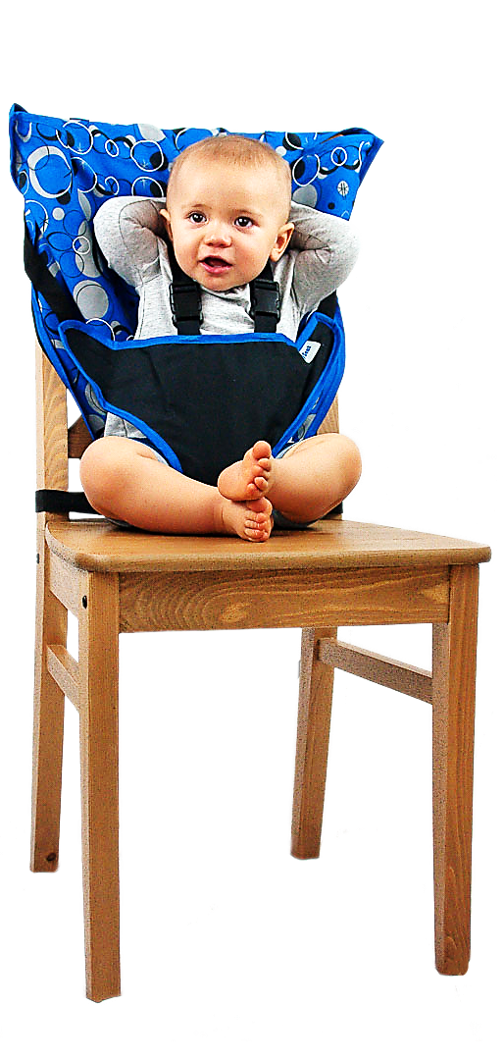
Chair #1 is the Baby Stage (tillering stage)
Saved, forgiven, water baptized & we wave our hands with the joy of the Lord.
But we also have vulnerabilities:
Lack of knowledge in God’s Word.
Old life baggage such as addictions, poor lifestyle choices, carnal thinking, etc.

Slide 32
We need to walk away
from the things which
hinder our growth &
testimony for Christ.
We need to wash with God’s Word & maintain a
repentant heart.

Slide 33
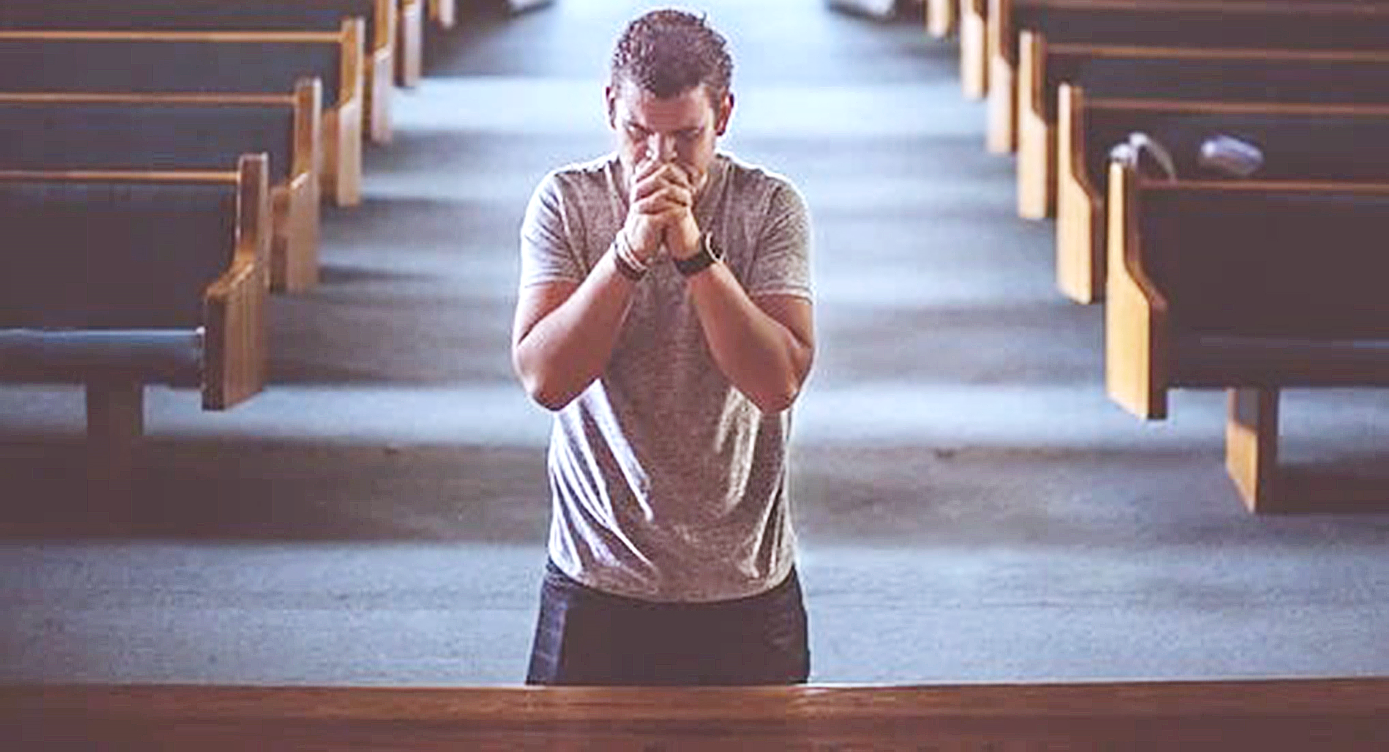
For the babes in Christ, the altar is a place of repentance, deliverance from sin & seeking the baptism of the Holy Spirit.

Slide 34
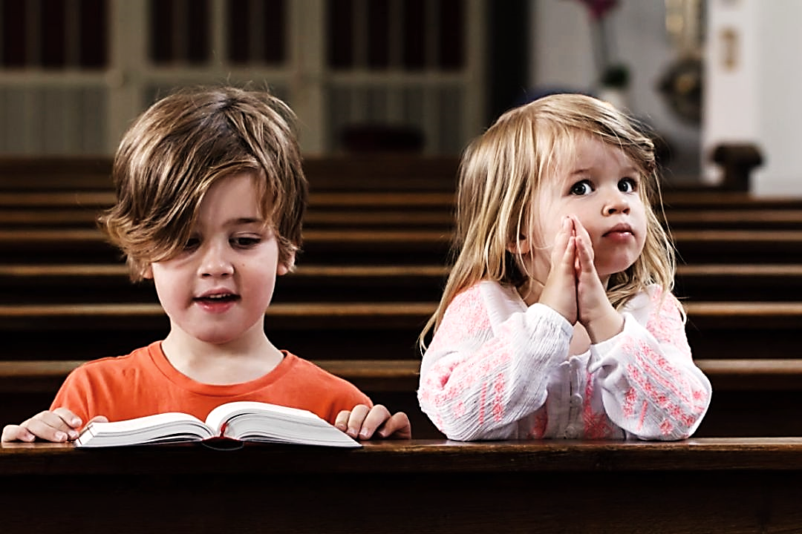
Chair #2 is the Kid Stage
(stem extension)
Outward clean living, a good testimony,
regular church attendance, giving, prayer, bible reading, worship during worship songs & fellowship

Slide 35
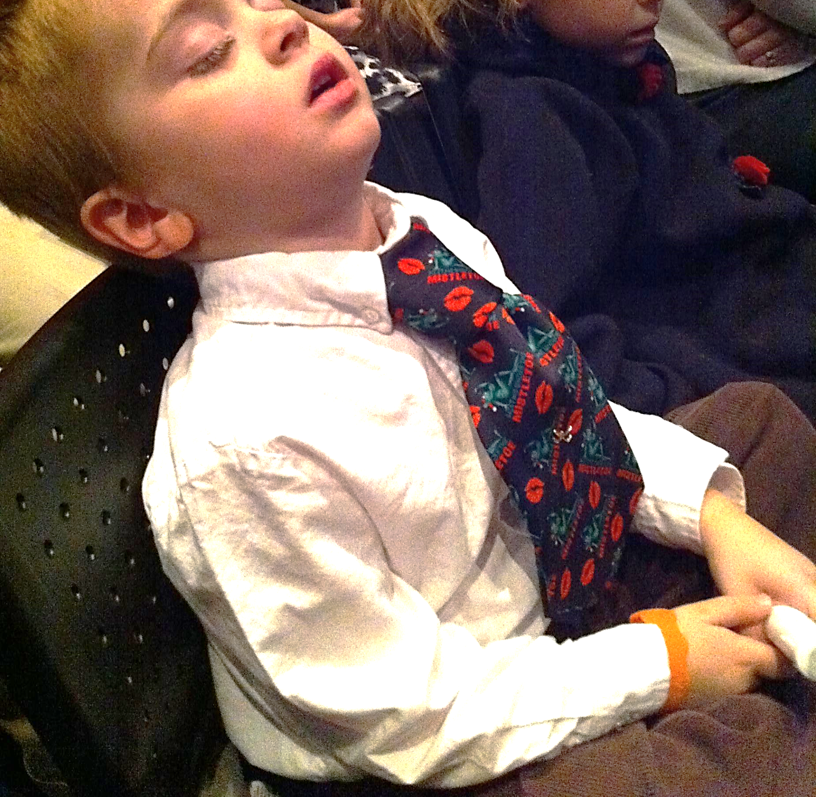
A Faithful Pew Warmer
Chair #2 is also in danger—we can get too comfortable in this chair.

Slide 36
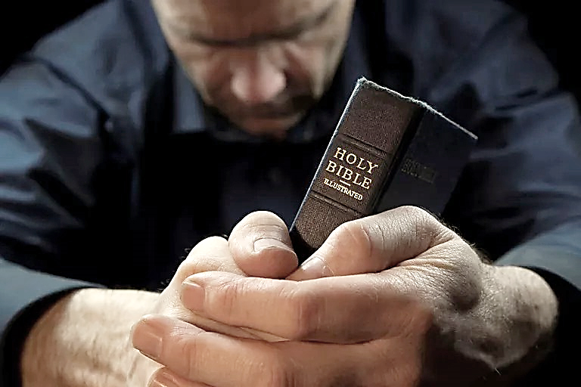
For the Kid in Christ, the altar is a place of repentance, petitions & worship.

Slide 37
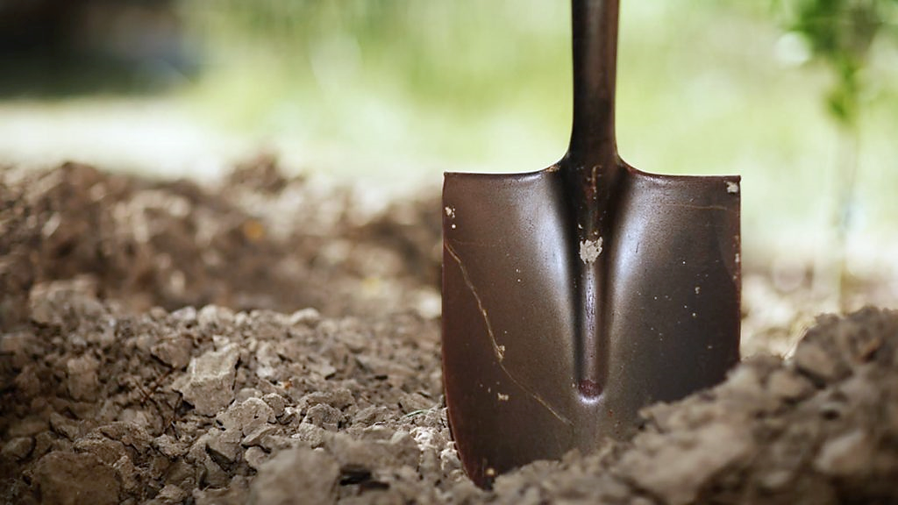
At the Chair #2 Altar, We Dig Deeper.
In chair #1 we prayed for deliverance from outward sins and the bondage of addictions.
Now, we go deeper. We pray about sinful attitudes ie., anger, petty jealousy, lust etc.

Slide 38
Chair #3 – Young Adult Stage (heading)
We are beginning to bear fruit and to reach and teach others.
Serious bible study as preparation for ministry
Learn whole bible (several times over)
Teach your family and friends.

Slide 39
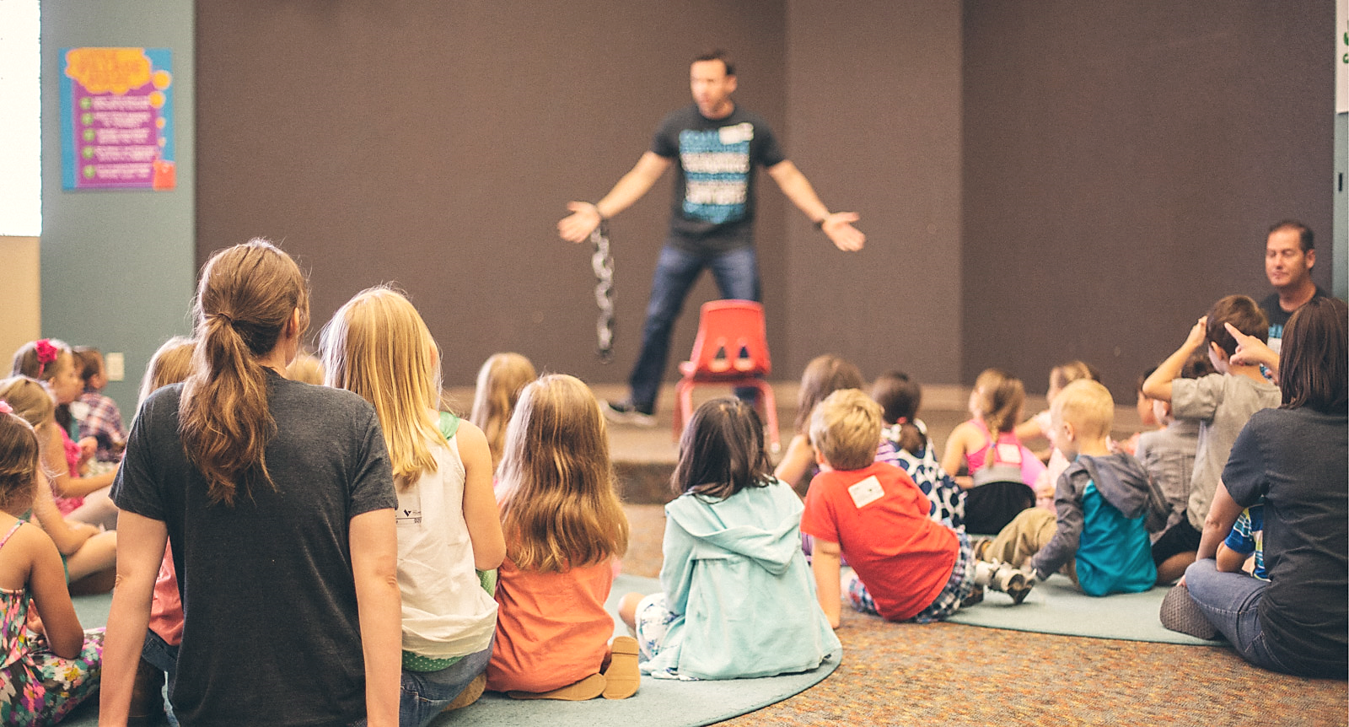
Men & Women:
Do the work of the ministry (as needed)
in your church.
Always be available & able to be counted on.
More than available→BE → Bible-able.

Slide 40
Becoming more and more loving, patient and courteous without compromising the truth of the Gospel.

Slide 41
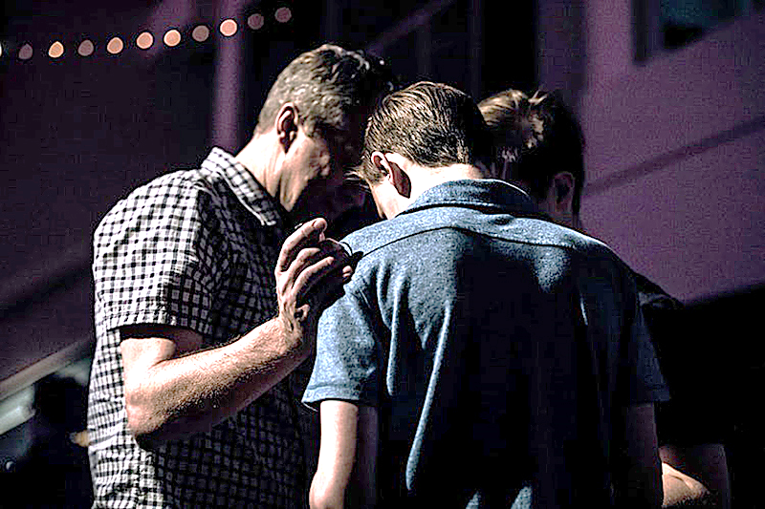
For chair #3, the altar is a place of deeper cleansing, petitions and ministry to others.

Slide 42
At the Chair #3 Altar,
We Dig Yet Deeper.
In chair #2 we prayed for deliverance from
obvious bad attitudes.
Now, we go deeper.
We pray about personal
hypocracy, false-humility,
personal agendas disguised as works for God, etc.

Slide 43
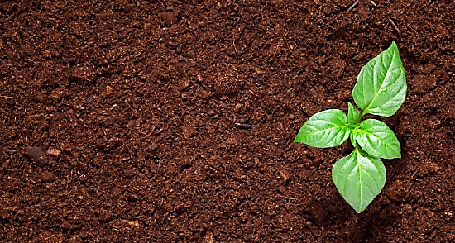
This is a level of maturity based on the growth that springs from good soil.
In chair #3 we respond to the Word, we love it, and let it break up the hardness in our hearts.

Slide 44
We daily pluck the weeds in our soul’s soil so that THE SEED (the nature of Christ) can grow there.

Slide 45
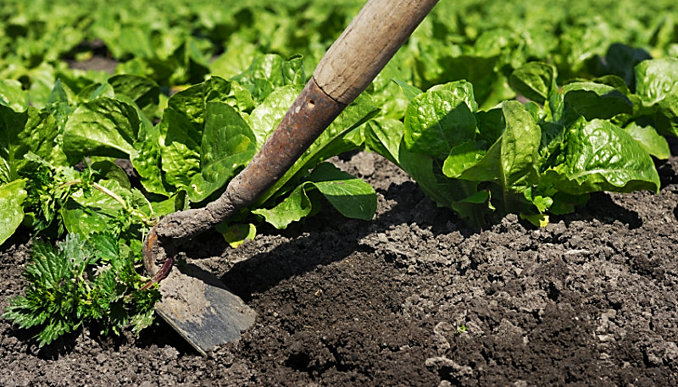
When it comes to spiritual maturity, the number of years we have been saved means nothing.
Our job is to prepare the ground to receive and grow the seed.
The seed WILL mature in good soil.
Fallow soil needs to be broken by the Lord to be fruitful.

Slide 46
Jer. 4:3 (NET)
“Yes, the LORD has this to say to the people of Judah and Jerusalem: "Like a farmer breaking up hard unplowed ground, you must break your rebellious will and make a new beginning…

Slide 47
…just as a farmer must clear away thorns lest the seed is wasted, you must get rid of the sin that is ruining your lives.”

Slide 48
Mark 4:28 (KJV)
“For the earth bringeth forth fruit of herself; first the blade, then the ear, after that the full corn in the ear.”
A good heart that is well kept is destined to mature.

Slide 49
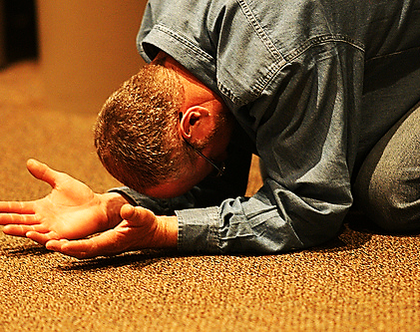
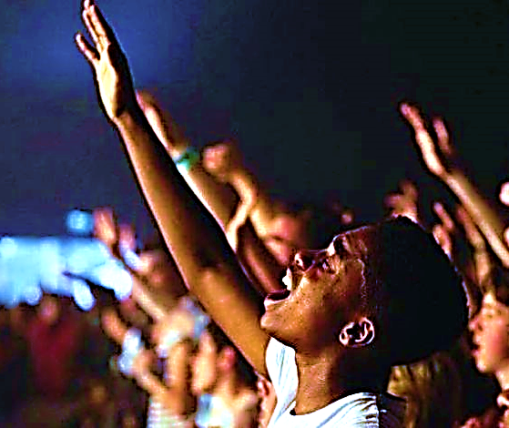
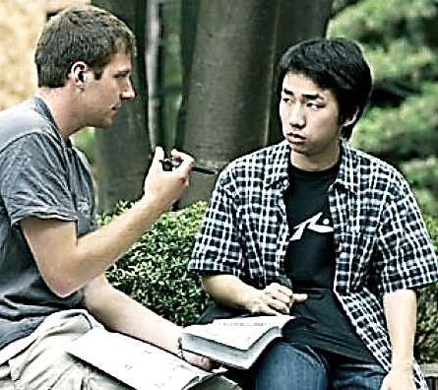
Chair #4 – Mature Adult Stage (ripening stage)
These are prayer warriors who spend hours in fervent prayer.
They are fervent worshippers who often get lost in worship.
They go boldly to preach the Gospel to the lost.

Slide 50
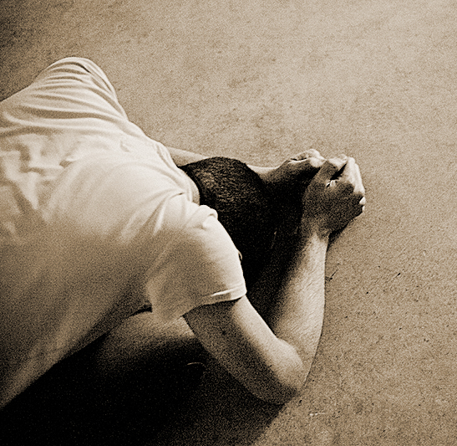
For chair #4, the altar is a place of deep, heart-felt intercession for the lost and all-encompassing worship.
Forsaking all, they lay down their lives for the cause of Christ.

Slide 51
1 Cor. 15:36 (GNT)
“You fool! When you plant a seed in the ground, it does not sprout to life unless it dies.”
Mark 8:35 (WE)
“Anyone who tries to keep his life will lose it. And anyone who gives up his life for my sake and for the sake of the good news will find it.”

Slide 52
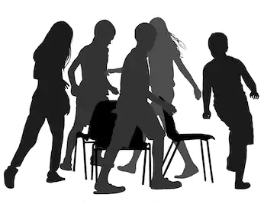
Most of us visit each of the four chairs at different times.
But then we go back to our usual seat.
Or we just stay in our regular seat & stick a hand or foot over on another chair.
Or we move to a new chair but leave unfinished work from the earlier chair...
For example, holiness, bible study, Holy Spirit baptism, etc.
This unfinished business will always pull us back until we finish our business in that chair.

Slide 53
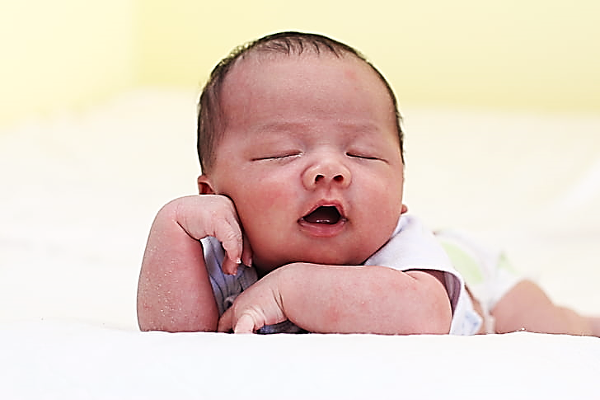
Let’s look at the life Jesus on the Feekes Scale:
“Tillering:” A baby drinking milk & waving His arms in a manger.

Slide 54
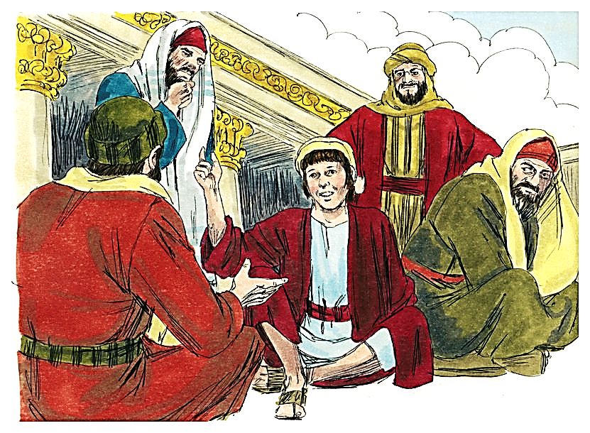
“Stem Extension:”
A faithful boy growing up strong, tall and obedient.
A 12-year-old scholar entering His teen years more studious than the bible teachers in His Temple.

Slide 55
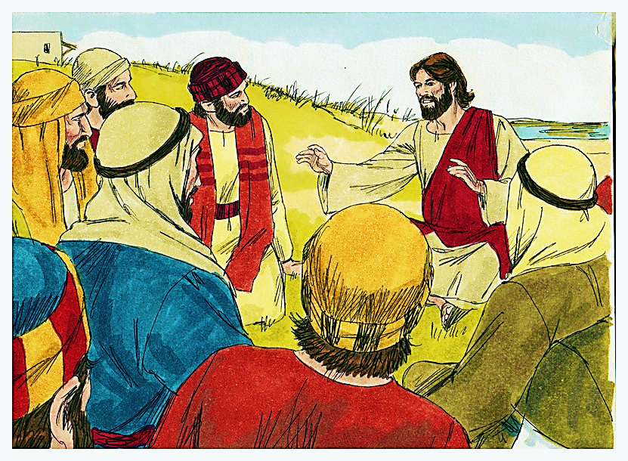
“Heading:”
A prayer warrior every day…
…a preacher / teacher to all who would listen

Slide 56
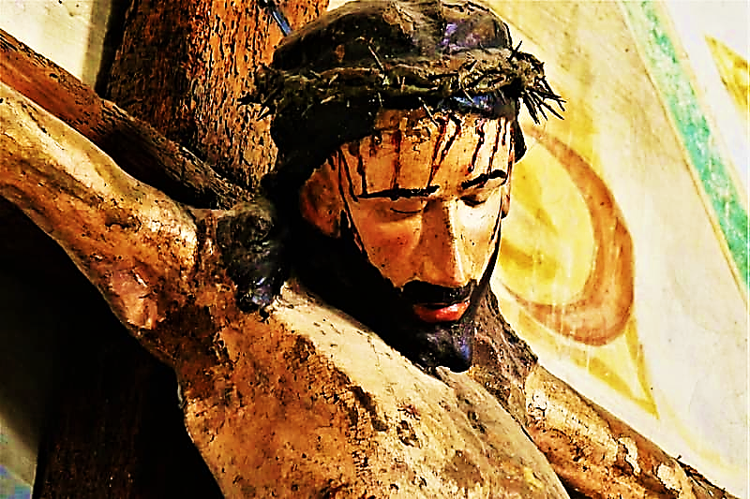
“Ripening:”
And finally, a human sacrifice, dying & giving life to the lost

Slide 57
Mat. 20:28 (ICB)
“…The Son of Man did not come for other people to serve him. He came to serve others. The Son of Man came to give his life to save many people.”

Slide 58
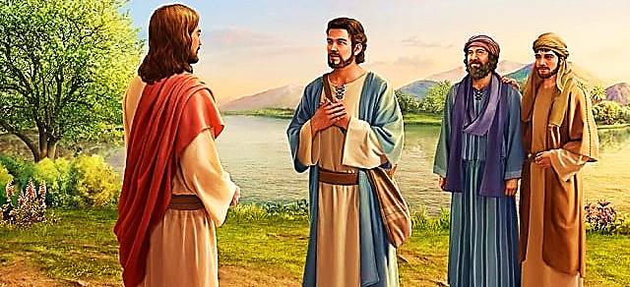
Mat. 16:21,22 (GWT)
“From that time on Jesus began to inform his disciples that he had to go to Jerusalem. There he would have to suffer a lot because of the leaders, chief priests, and scribes. He would be killed…

Slide 59
…but on the third day he would be brought back to life. Peter took him aside and objected to this. He said, "Heaven forbid, Lord! This must never happen to you!"

Slide 60
But Jesus explained that sacrifice and death to self is the calling of every believer.
Mat. 16:24,25 (GWT)
“Then Jesus said to his disciples, ‘Those who want to come with me must say no to the things they want, pick up their crosses, and follow me. Those who want to save their lives will lose them. But those who lose their lives for me will find them.’”

Slide 61
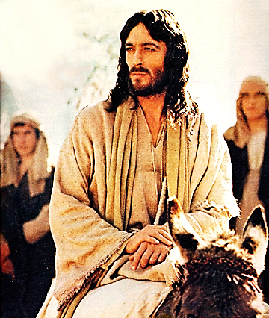
Isa. 50:7 (ESV)
“… I have set my face like a flint, and I know that I shall not be put to shame.”

Slide 62
John 12:17 (TLB)
“Now my soul is deeply troubled. Shall I pray, ‘Father, save me from what lies ahead’? But that is the very reason why I came!”

Slide 63
The Jim & Elizabeth
Elliot Story
At six Jim told his mother:
“Now, mama, the Lord Jesus can come whenever He wants. He could take our whole family because I’m saved now, and Jane is too young to know Him yet.”
As a teen, Jim quoted the Bible to the president of the student body to explain why he would not go to a school party.
Tillering Stage

Slide 64
Young Jim dreamt of reaching people who had never even heard of Jesus.
He was inspired by missionaries such as David Brainerd, William Carey, and Amy Carmichael.
He worked on the school newspaper, the wrestling team, school drama, and public speaking club.
Stem Extension
Stage

Slide 65
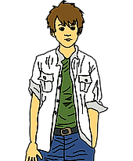
He was so good at acting that some of the teachers suggested that he pursue a career as an actor…
…however, Jim knew that he was called to be a missionary.
Stem Extension cont.

Slide 66
Jim attended Wheaton College hoping to pursue his goal of full-time ministry overseas.
He would start each morning with prayer and Bible study and studied both Greek and Hebrew.
During that time, he became more and more passionate about the unreached and was baffled that no one was doing much about them.
Heading Stage

Slide 67
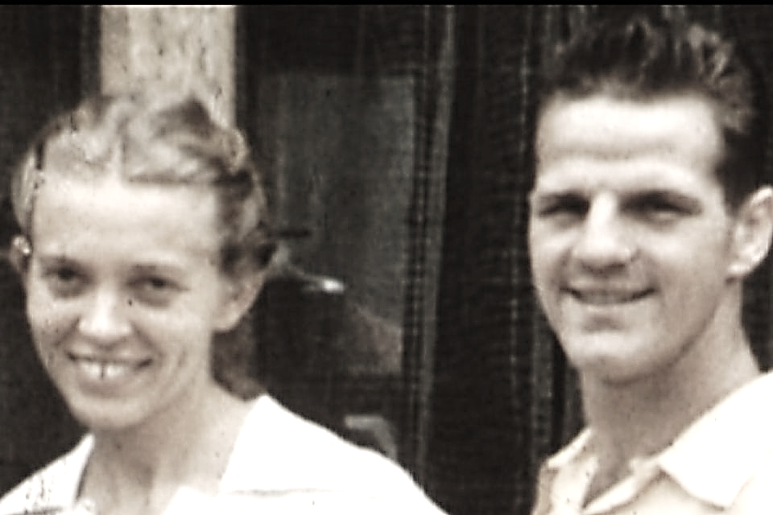
He went to Mexico on a short-term mission trip.
This influenced his decision to go to Central America as a missionary after college.
However, his plan of being a single missionary for the rest of his life was interrupted by someone he met on his college campus—Elizabeth.
Heading Stage cont.
A missionary from Ecuador wrote to him because he and his wife had been in a plane accident and needed help at the mission.

Slide 68
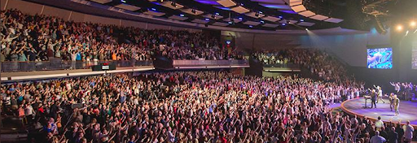
His parents and friends suggested that Jim Elliot might be more effective in youth ministry in the United States, but he considered the Western church to be ‘well-fed’ and that international missions among the unreached must be the #1 priority for Christians.

Slide 69
Ripening Stage
Jim and four other men ventured into the Ecuadorian jungle to preach to the unreached Auca people.
They left their wives in the village and flew into the jungle where the Auca people were camped.

Slide 70
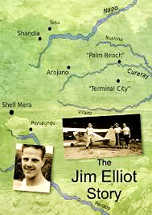
But rather than receive the Gospel, the men of the Auca tribe speared all five of the missionary men in the back – killing them.
Regarding the death of her husband and the other four men, Elizabeth, his wife of only two years said this:
Ripening Stage cont.

Slide 71
“They went simply because they knew they belonged to God, because He was their Creator and their Redeemer. They had no choice but to willingly obey Him, and that meant obeying His command to take the good news to every nation.”

Slide 72
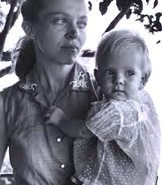
But that’s just the beginning of the story.
Two of the men’s wives, Elizabeth & Rachel took the next two years to learn the tribe’s language.
Then the two of them plus
Elisabeth's three-year-old daughter went to live with the Auca peoples and began to daily teach them the bible.
They taught them about forgiveness… and they lived it.

Slide 73
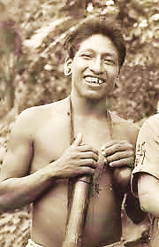
One of the first men to receive Jesus as his Lord and Savior, was Mincaye, the man who personally speared two of the five men (including Rachael’s own husband).
After Mincaye was saved, virtually the entire tribe repented, and it has since become a Christian tribe to this day.

Slide 74
As Christians, we may start in the baby chair but, like Jesus, and like Jim & Elizabeth Elliot, we are all called into the spiritual Feekes process.
It is a process of growth, increasing spiritual understanding, maturity, responsibility, and sacrifice for the Gospel’s sake.

Slide 75
The final stage of a mature wheat kernel is to fall
into the ground, die and bear fruit for a new harvest.

Slide 76
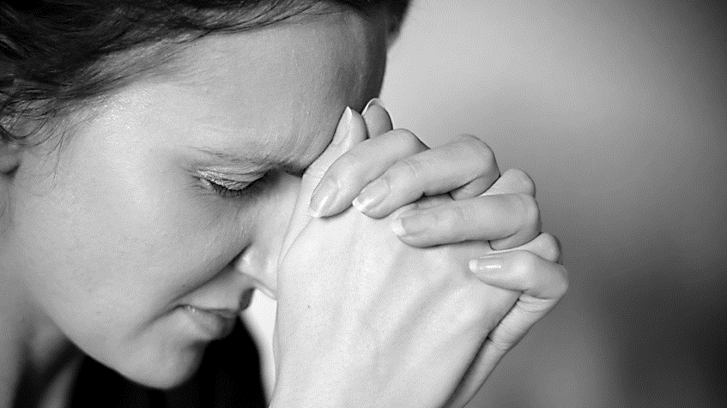
Which ever chair we are sitting in at this stage in our lives, we all have plenty of business to do at the altars after any service.

