Slide 1
Joseph & His Brothers – They Hate the Good One

Slide 2
We presented this message at Bee Creek Park in College Station, TX.
If you would like to watch the video of the service, click here:
http://campaignkerusso.org/2012/11/free-powerpoint-sermon-joseph-god-has-the-plan/
We would love to know more about the people who download our lessons & sermons. We invite you to email us & let us know where & how you use them.
info@ckbrazos.org

Slide 3
Watch this Related Song: As Long as I Got King Jesus→ Here: http://www.youtube.com/watch?v=XRfCO8wGUfU

Slide 4
Watch this Related Video: “Joseph the Slave”→ Here:
http://www.youtube.com/watch?v=vAQ_LS1p2HM

Slide 5
Joseph was a good and kind teenager.
He had a relationship with God.
He told his father when his brothers were bad → he loved his brothers!
“…He was taking care of the flocks with some of his brothers… Joseph brought their father a bad report about them.” Gen. 37:2

Slide 6
Good Joseph was favored of his father.
Just like Jesus:
“You have loved what is right and hated what is evil. So, your God has placed you above your companions.” Heb. 1:9

Slide 7
Joseph was hated by his brothers for being good, and for being favored by his father and by God.
Just like Jesus:
"Does the world hate you? Remember that it hated me first. .” John 15:18

Slide 8
God had plans to make good Joseph a world leader.
“…Do you truly think you will rule over us?" His brothers hated him even more because of his dreams and what he had said. Gen.37:8
Just like Jesus:
“…he humbled himself and was fully obedient to God, even when that caused his death -- death on a cross. So God raised him to the highest place. God made his name greater than every other name.” Phil. 2:8,9

Slide 9
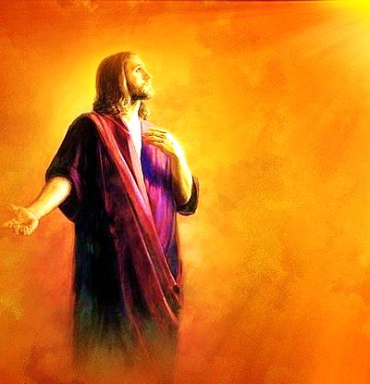
His Father sent him to his brothers to make sure they were all right.
Just like Jesus:
“…he sent his son to them. 'They will respect my son.’” Mat. 21:37, 38

Slide 10
“But they saw him a long way off. Before he reached them, they made plans to kill him.” Gen.37:18
Just like Jesus:
“So, from that day on, the Jewish rulers planned to kill Jesus.” John 11:53

Slide 11
They stripped his coat, tried to kill him, put him in a pit and sold him for money.
Just like Jesus:
They sold him for money, stripped his coat, killed Him, and then He went into the pit of Hell.

Slide 12
They dipped Joseph’s coat in goat’s blood and said he was dead.
Just like Jesus:
“He is dressed in a robe dipped in blood. His name is The Word of God.” Rev. 19:13

Slide 13
They wrongly thought they could change God’s plan for Joseph.
“Jacob's sons were jealous of their brother Joseph. So, they sold him as a slave. He was taken to Egypt. But God was with him.” Gen. 39:23
Just like Jesus:
“You did not want the One who is holy and good but asked Pilate to give you a murderer instead.
And so, you killed the One who gives life, but God raised him from the dead…” Acts 3:14,15

Slide 14
Tell me How Joseph was Just like Jesus do Far:
Good, kind obedient child
Relationship with God
Exposed sin
Took good care of his father’s sheep
Favored by his father
Hated by his brothers
God had plans to make him a world leader
His brothers were jealous
His brothers hated his WORDS about God’s destiny for Him

Slide 15
His father sent him out to the fields to make sure his brothers were okay
His brothers made plans to kill him
They stripped off his coat
His coat was dipped in blood
His brothers thought they could change God’s plans for Joseph
They could not change God’s plans – God raised him up anyway
His brothers persecuted him because he was a good young man who was favored by God

Slide 16
“Does the world hate you? Remember that it hated me first.” John 15:18
“In fact, everyone who wants to live a godly life in Christ Jesus will be treated badly.” 2 Tim. 3:12
“Remember, it is better to suffer for doing good (if that is what God wants) than to suffer for doing wrong!” 1 Pet. 3:17
"People will hate you, shut you out, insult you, and say you are evil because you follow the Son of Man. But when they do, you will be happy.” LK. 6:22

Slide 17
Watch this Related Song: “Above All”→ Here:
http://www.youtube.com/watch?v=4rBX9B4jxEY

Slide 18
What is the Sinner‘s Prayer?
This is a prayer we can pray when we are ready to admit we are sinners and need Christ’s forgiveness.
It must be prayed with faith in our hearts and a readiness to have a life-changing encounter with Jesus Christ.

Slide 20
John Wesley’s Testimony
“…the preacher was describing the change which God works in the heart through faith in Christ and I felt my heart strangely warmed.”
Disciple’s Testimony
“They said to each other, ‘Did not our hearts burn within us while he talked to us on the road, while he opened to us the Scriptures?’”

Slide 21
A Prayer of Faith → Pray this rayer if :
If you never have before
You have in the past, but you think it would mean more today.
You have been walking afar off and you want to come back.
You want to set an example & show others how it is done.
You just like to give your heart to Jesus again & again.
Faith

Slide 22
We Declare Our Faith Publicly Because Jesus Declared His LOVE Publicly
“If you stand before others and are willing to say you believe in me, then I will tell my Father in heaven that you belong to me.” Mat 10:32

Slide 23
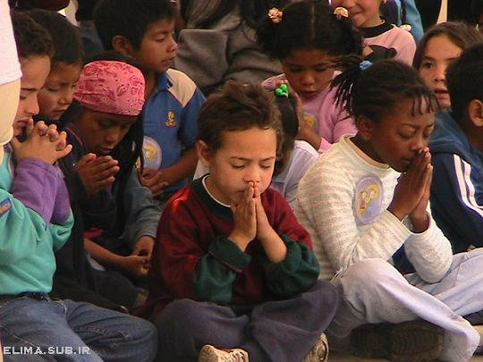
Dear Jesus,
I know I am a sinner & need your forgiveness.
I believe you died for my sins.
I now turn from sin.
Come into my heart I pray.
Please wash away my sin.
Do you want to meet Jesus as your savior right now?
Do you believe He died to save you from your sins & that He rose from the dead?
Do you believe that He is waiting to save you right now?

Slide 24
“But some people did accept him. They believed in him, and he gave them the right to become children of God.” John 1:12

Slide 26
“If you openly say, ‘Jesus is Lord’ and believe in your heart that God raised him from death, you will be saved.”
Rom. 10:9
What did you learn today?
What have you been thinking about God lately?
What do you want to tell the world about Jesus?

Slide 27
“Draw near to God, and He will draw near to you…
…Cleanse your hands, you sinners, and make your hearts pure, you who are half-hearted towards God.” James 4:8 WNT

Slide 28
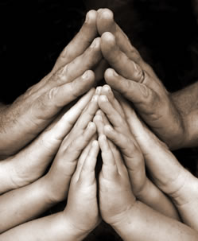
Close in Prayer

