Slide 1
God is with Joseph

Slide 2
We presented this message at Bee Creek Park in College Station, TX.
If you would like to watch the video of the service, click here:
http://campaignkerusso.org/2012/11/free-powerpoint-sermon-joseph-god-has-the-plan/
We would love to know more about the people who download our lessons & sermons. We invite you to email us & let us know where & how you use them.
info@ckbrazos.org

Slide 4
Joseph as a Picture
of Jesus:
Good, kind obedient child
Relationship with God
Exposed sin
Took good care of his father’s sheep
Favored by his father
Hated by his brothers
God had plans to make him a world leader
His brothers were jealous
His brothers hated his WORDS about God’s destiny for Him

Slide 5
His father sent him out to the fields to make sure his brothers were okay
His brothers made plans to kill him
They stripped off his coat
His coat was dipped in blood
His brothers thought they could change God’s plans for Joseph
They could not change God’s plans – God raised him up anyway
His brothers persecuted him because he was a good young man who was favored by God

Slide 6
They wrongly thought they could change God’s plan for Joseph.
“Jacob's sons were jealous of their brother Joseph. So, they sold him as a slave. He was taken to Egypt. But God was with him.” Gen. 39:23
Just like Jesus:
“You did not want the One who is holy and good but asked Pilate to give you a murderer instead.
And so, you killed the One who gives life, but God raised him from the dead…” Acts 3:14,15

Slide 7
“But God,” these words found several times in the bible, are what we must remember whenever we reach the end of our rope !

Slide 8
Watch this Related Video: “God is with Joseph ”→ Here: http://youtu.be/833zZOZcpQ8

Slide 9
“But God, was with Joseph”

Slide 10
Betrayed by His Own → Like Jesus

Slide 11
Falsely Accused → Like Jesus

Slide 12
“He took Joseph and threw him into the prison where the king's prisoners were held.”
Gen. 39:20
They also arrested and bound Jesus.

Slide 13
“But the LORD was with Joseph there, too, and he granted Joseph favor with the chief jailer.
Before long, the jailer put Joseph in charge of all the other prisoners and over everything that happened in the prison…”
Genesis 39:21, 22 NLT

Slide 14
“…The chief jailer had no more worries after that, because Joseph took care of everything.
The LORD was with him, making everything run smoothly and successfully.”
Gen. 39:21-23

Slide 15
God blessed him with gifts which he used to help other people.
Here he is explaining what a friend’s dream means.
Someday, this favor will be remembered and the Pharaoh himself will ask Joseph to explain a dream.

Slide 16
He is brought up out of prison to explain Pharaoh’s dream.

Slide 17
Just like Jesus:
Jesus was in the worst kind of prison → “death and the grave” but God raised Him from the dead.

Slide 18
Pharaoh put Joseph in charge of managing the famine and feeding the world.
Just like Jesus →
“And Jesus said unto them, I am the bread of life: he that cometh to me shall never hunger ; and he that believeth on me shall never thirst.” John 6:35

Slide 19
Everyone in the world would bow down to him.

Slide 21
“But God raised him from death, setting him free from its power, because it was impossible that death should hold him prisoner.” Acts 2:24
“He raised Him from the dead, and set Him at His own right hand in the heavenly places…and has put all things under His feet…” Eph. 1:20, 22

Slide 23
What is the Sinner‘s Prayer?
This is a prayer we can pray when we are ready to admit we are sinners and need Christ’s forgiveness.
It must be prayed with faith in our hearts and a readiness to have a life-changing encounter with Jesus Christ.

Slide 25
John Wesley’s Testimony
“…the preacher was describing the change which God works in the heart through faith in Christ and I felt my heart strangely warmed.”
Disciple’s Testimony
“They said to each other, ‘Did not our hearts burn within us while he talked to us on the road, while he opened to us the Scriptures?’”

Slide 26
A Prayer of Faith → Pray this rayer if :
If you never have before
You have in the past, but you think it would mean more today.
You have been walking afar off and you want to come back.
You want to set an example & show others how it is done.
You just like to give your heart to Jesus again & again.
Faith

Slide 27
We Declare Our Faith Publicly Because Jesus Declared His LOVE Publicly
“If you stand before others and are willing to say you believe in me, then I will tell my Father in heaven that you belong to me.” Mat 10:32

Slide 28
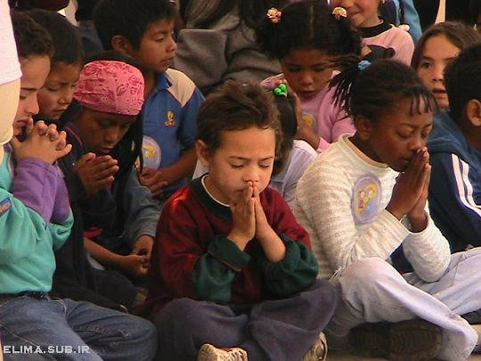
Dear Jesus,
I know I am a sinner & need your forgiveness.
I believe you died for my sins.
I now turn from sin.
Come into my heart I pray.
Please wash away my sin.
Do you want to meet Jesus as your savior right now?
Do you believe He died to save you from your sins & that He rose from the dead?
Do you believe that He is waiting to save you right now?

Slide 29
“But some people did accept him. They believed in him, and he gave them the right to become children of God.” John 1:12

Slide 31
“If you openly say, ‘Jesus is Lord’ and believe in your heart that God raised him from death, you will be saved.”
Rom. 10:9
What did you learn today?
What have you been thinking about God lately?
What do you want to tell the world about Jesus?

Slide 32
“Draw near to God, and He will draw near to you…
…Cleanse your hands, you sinners, and make your hearts pure, you who are half-hearted towards God.” James 4:8 WNT

Slide 33
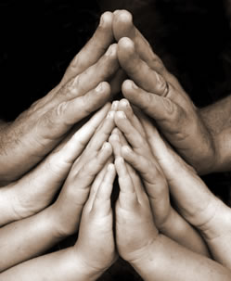
Close in Prayer

