Slide 1
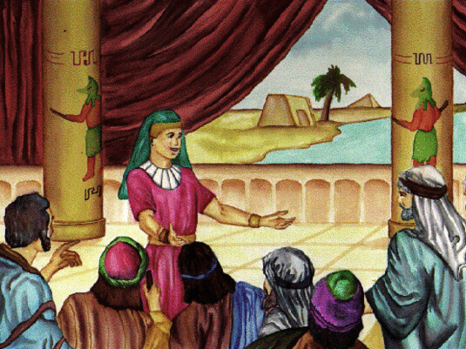
Joseph Reveals Himself & Forgives His Brothers

Slide 2
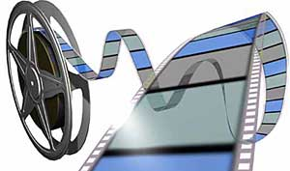
We presented this message at Bee Creek Park in College Station, TX.
If you would like to watch the video of the service, click here:
http://campaignkerusso.org/2012/11/free-powerpoint-sermon-joseph-god-has-the-plan/
We would love to know more about the people who download our lessons & sermons. We invite you to email us & let us know where & how you use them.
info@ckbrazos.org

Slide 4
Jesus was a good boy growing up.
How is this like Joseph?

Slide 5
The boy Jesus loved God.
How is this like Joseph?

Slide 6
Jesus is favored by His Heavenly Father.
How is this like Joseph?

Slide 7
Jesus came to His own people (the Jews) and they hated Him.
How is this like Joseph?

Slide 8
God had plans to make Jesus the ruler of everyone – the King of Kings.
How is this like Joseph?

Slide 9
The temple leaders were Jealous of God’s plan for Jesus. They hated it when He talked about it.
How is this like Joseph?

Slide 10
Jesus was sent to Earth to by the Heavnly Father because He was concerned about us.
How is this like Joseph?

Slide 11
The jealous temple leaders made a plot to kill Him.
How is this like Joseph?

Slide 12
They stripped off Jesus’ special coat.
How is this like Joseph?

Slide 13
Jesus has a coat in Heaven that is all red – as if it were dipped in blood.
How is this like Joseph?

Slide 14
They thought they could stop God’s plan for Jesus by killing Him –but they could not stop God.
How is this like Joseph?

Slide 15
God the Father raised Jesus from the prison of death.
How is this like Joseph?

Slide 16
God the Father made Jesus the ruler of everyone – just as He promised.
How is this like Joseph?

Slide 17
Everyone in the world would bow down to him.

Slide 19
Pharaoh put Joseph in charge of managing the famine and feeding the world.
Jesus supplies food for the soul.
“And Jesus said unto them, I am the bread of life: he that cometh to me shall never hunger ; and he that believeth on me shall never thirst.” John 6:35

Slide 20
Eventually, even Joseph’s brothers had to come from their home, very far away, to ask this Egyptian leader for some food.
They didn’t even recognize that it was their own little brother whom they had betrayed so many years ago.

Slide 21
People also don’t see Jesus for who He really is.
This is called “spiritual blindness.”
“The devil… blinded the minds of those who do not believe. They cannot see the light of the Good News… about… Christ, who is… God.” 2 Cor. 4:4
It is not possible to see Jesus unless HE opens our eyes. This is a miracle!

Slide 22
Believers can see Him with the eyes of faith. They have spiritual sight.
“Before long, the world will not see me anymore, but you will see me. Because I live, you also will live.”
John 1:19

Slide 23
After Jesus rose from the dead, He walked, talked and had a meal with two of His old friends… but, like Joseph’s brothers, they did not recognize Him.
He had to open their eyes and reveal Himself to them.

Slide 24
Joseph wanted his brothers to know who he was, but first he wanted to know if they were sorry for what they did. So, he tested them.
He had an expensive palace cup hidden in the food sack of the youngest brother.
Would they let this brother get in trouble and save themselves or would they help him?

Slide 25
But the brothers had changed. Joseph’s brother Judah, begged him not to keep Benjamin as a prisoner,
“We cannot leave our youngest brother Benjamin. We had another brother, but he is dead, and if we lose Benjamin our father will die of sorrow. I beg you to take me in his place.”

Slide 26
He felt guilty about the brother they thought they had killed.
(We too must repent of our sins.)
They cared about the pain their father would feel.
(We need to realize how our sins hurt our Father in Heaven.)
They offered to take their brother’s punishment. This is the love of God in their hearts → Just like Jesus who took our punishment on the cross.

Slide 27
When we show our sorrow for our sins, Jesus opens our eyes and reveals Himself to us.

Slide 28
When Joseph saw that his brothers were sorry for what they had done, he started to cry, and he revealed himself to them.
He was not only a leader of the world, but he was the very brother they had sinned against!
He loved them, and he forgave them.
Just like Jesus forgives us!
"I am your brother Joseph, the one you sold into Egypt!”

Slide 29
What is the Sinner‘s Prayer?
This is a prayer we can pray when we are ready to admit we are sinners and need Christ’s forgiveness.
It must be prayed with faith in our hearts and a readiness to have a life-changing encounter with Jesus Christ.

Slide 31
John Wesley’s Testimony
“…the preacher was describing the change which God works in the heart through faith in Christ and I felt my heart strangely warmed.”
Disciple’s Testimony
“They said to each other, ‘Did not our hearts burn within us while he talked to us on the road, while he opened to us the Scriptures?’”

Slide 32
A Prayer of Faith → Pray this rayer if :
If you never have before
You have in the past, but you think it would mean more today.
You have been walking afar off and you want to come back.
You want to set an example & show others how it is done.
You just like to give your heart to Jesus again & again.
Faith

Slide 33
We Declare Our Faith Publicly Because Jesus Declared His LOVE Publicly
“If you stand before others and are willing to say you believe in me, then I will tell my Father in heaven that you belong to me.” Mat 10:32

Slide 34
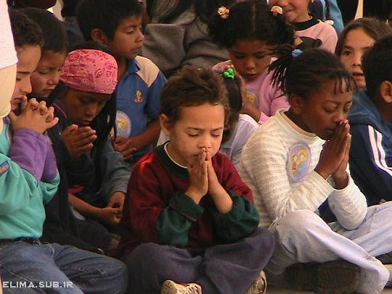
Dear Jesus,
I know I am a sinner & need your forgiveness.
I believe you died for my sins.
I now turn from sin.
Come into my heart I pray.
Please wash away my sin.
Do you want to meet Jesus as your savior right now?
Do you believe He died to save you from your sins & that He rose from the dead?
Do you believe that He is waiting to save you right now?

Slide 35
“But some people did accept him. They believed in him, and he gave them the right to become children of God.” John 1:12

Slide 37
“If you openly say, ‘Jesus is Lord’ and believe in your heart that God raised him from death, you will be saved.”
Rom. 10:9
What did you learn today?
What have you been thinking about God lately?
What do you want to tell the world about Jesus?

Slide 38
“Draw near to God, and He will draw near to you…
…Cleanse your hands, you sinners, and make your hearts pure, you who are half-hearted towards God.” James 4:8 WNT

Slide 39
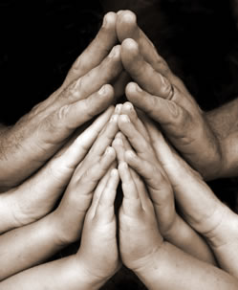
Close in Prayer

