Slide 1
Joseph and the Stone that the Builders Rejected

Slide 2
We presented this message at Bee Creek Park in College Station, TX.
If you would like to watch the video of the service, click here:
http://campaignkerusso.org/2012/11/free-powerpoint-sermon-joseph-god-has-the-plan/
We would love to know more about the people who download our lessons & sermons. We invite you to email us & let us know where & how you use them.
info@ckbrazos.org

Slide 4
“Jacob’s sons became jealous of Joseph and sold him to be a slave in Egypt. But God was with him and saved him from all his troubles. The king of Egypt liked Joseph and respected him because of the wisdom God gave him. The king… put him in charge of all the people…

Slide 5
Then all the land… became so dry that nothing would grow, and the people suffered very much. Jacob’s sons… could not find anything to eat. But when Jacob heard there was grain in Egypt, he sent his sons there… Joseph told his brothers who he was…” Acts7:9-13

Slide 6
Joseph’s brothers had to come from their home, very far away, to ask this Egyptian leader for some food.
They didn’t even recognize that it was their own little brother whom they had betrayed so many years ago.

Slide 7
When Joseph saw that his brothers were sorry for what they had done, he started to cry, and he revealed himself to them.
He was not only a leader of the world, but he was the very brother they had sinned against!
He loved them, and he forgave them.
Just like Jesus forgives us!
"I am your brother Joseph, the one you sold into Egypt!”

Slide 8
Now, a word about cornerstones:
This the most important stone.
Without it, the building will fall apart.

Slide 9
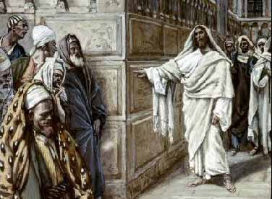
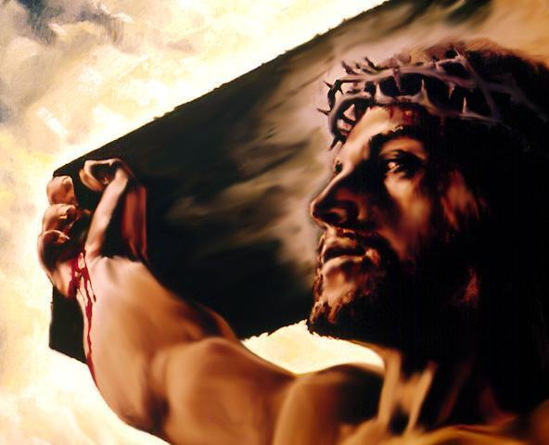
The Stone that the Builders Rejected...

Slide 10
…Has become the Cornerstone!
Without Him, we will fall apart.

Slide 11
Both were Rejected: Joseph couldn’t fight it…
…and Jesus wouldn’t.
z

Slide 12
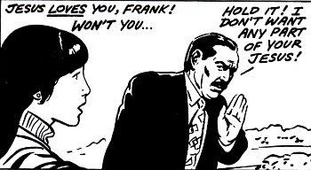
If we want to reject Jesus, He allows it. He doesn't fight us.

Slide 13
Joseph’s brothers soon found out how important their little brother was to them!
The stone the builders rejected became the cornerstone. He saved their lives!

Slide 14
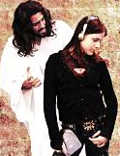
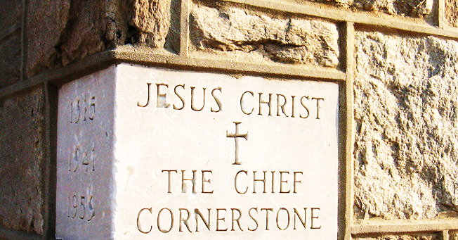
If we reject Jesus, He will let us, but we are rejecting the only one who can save us!
The Cornerstone

Slide 15
Watch this Related Video: “The Stone You Rejected” Here: http://www.youtube.com/watch?v=LuWAoXart2o

Slide 16
Watch this Related Song: “Jesus is the Cornerstone” Here: http://www.youtube.com/watch?v=d88K3YDlD9I

Slide 17
What is the Sinner‘s Prayer?
This is a prayer we can pray when we are ready to admit we are sinners and need Christ’s forgiveness.
It must be prayed with faith in our hearts and a readiness to have a life-changing encounter with Jesus Christ.

Slide 19
John Wesley’s Testimony
“…the preacher was describing the change which God works in the heart through faith in Christ and I felt my heart strangely warmed.”
Disciple’s Testimony
“They said to each other, ‘Did not our hearts burn within us while he talked to us on the road, while he opened to us the Scriptures?’”

Slide 20
A Prayer of Faith → Pray this rayer if :
If you never have before
You have in the past, but you think it would mean more today.
You have been walking afar off and you want to come back.
You want to set an example & show others how it is done.
You just like to give your heart to Jesus again & again.
Faith

Slide 21
We Declare Our Faith Publicly Because Jesus Declared His LOVE Publicly
“If you stand before others and are willing to say you believe in me, then I will tell my Father in heaven that you belong to me.” Mat 10:32

Slide 22
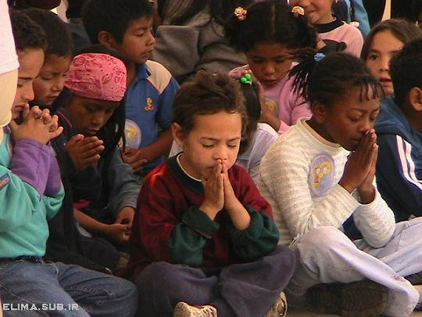
Dear Jesus,
I know I am a sinner & need your forgiveness.
I believe you died for my sins.
I now turn from sin.
Come into my heart I pray.
Please wash away my sin.
Do you want to meet Jesus as your savior right now?
Do you believe He died to save you from your sins & that He rose from the dead?
Do you believe that He is waiting to save you right now?

Slide 23
“But some people did accept him. They believed in him, and he gave them the right to become children of God.” John 1:12

Slide 25
“If you openly say, ‘Jesus is Lord’ and believe in your heart that God raised him from death, you will be saved.”
Rom. 10:9
What did you learn today?
What have you been thinking about God lately?
What do you want to tell the world about Jesus?

Slide 26
“Draw near to God, and He will draw near to you…
…Cleanse your hands, you sinners, and make your hearts pure, you who are half-hearted towards God.” James 4:8 WNT

Slide 27
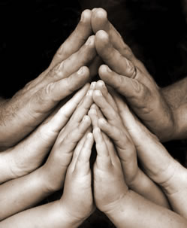
Close in Prayer

