Slide 1
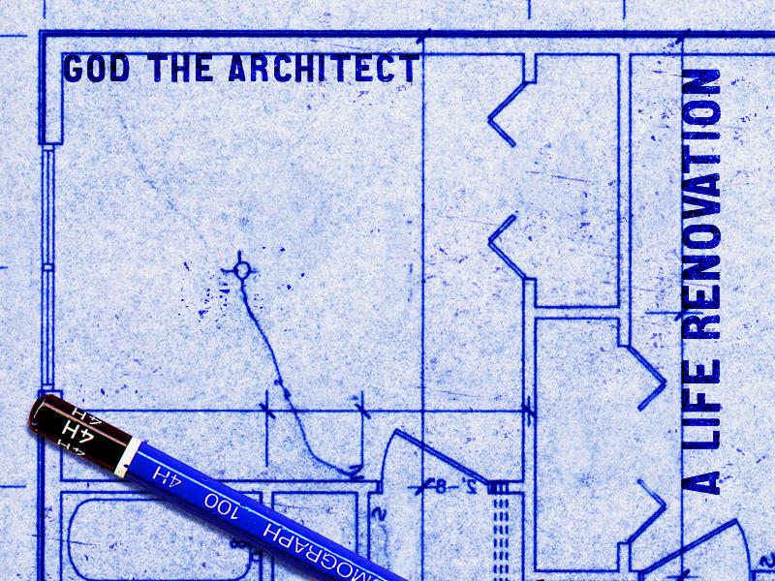
God the Great Planner
Joseph –
God, the Master Planner

Slide 2
We presented this message at Bee Creek Park in College Station, TX.
If you would like to watch the video of the service, click here:
http://campaignkerusso.org/2012/11/free-powerpoint-sermon-joseph-god-has-the-plan/
We would love to know more about the people who download our lessons & sermons. We invite you to email us & let us know where & how you use them.
info@ckbrazos.org

Slide 3
Watch this Related Song: “God Has a Plan For Me” Here: https://youtu.be/xweEX_gs1z4

Slide 5
In many ways, Joseph is a picture of Jesus! Both men were rejected by their own brethren:
z
Joseph could not fight
them and Jesus would not!

Slide 6
Joseph’s brothers soon found out how important their little brother was to them!
The stone the builders rejected became the cornerstone. He saved their lives!

Slide 7
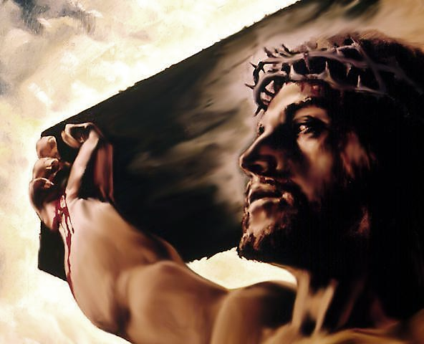

Slide 8
…Has become the Cornerstone!
Without Him, we will fall apart.

Slide 9
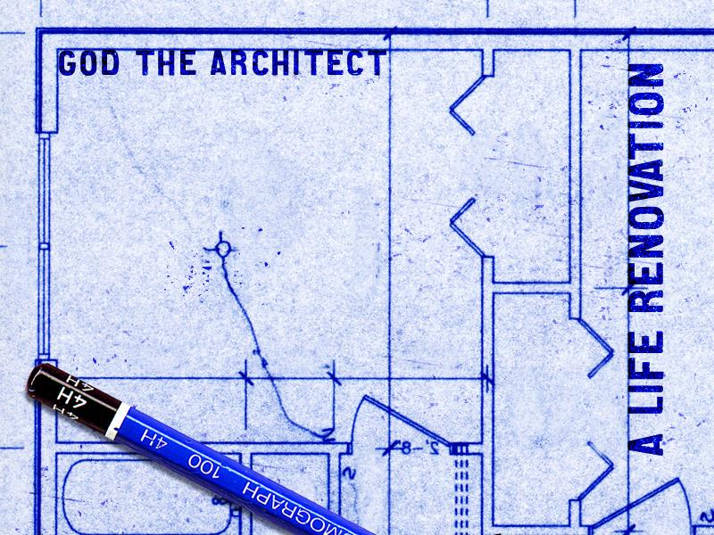
God the Great Planner
God, the Master Planner
1) God’s Plans Are Stronger
2) God’s Plans Are Wiser
3) God’s Plans Are Kinder than We Deserve

Slide 10
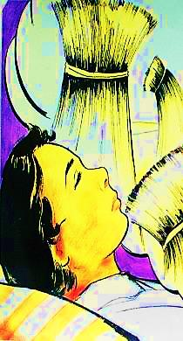
God’s Plans Are Stronger Joseph had no Idea what His Life would be.
Hated & betrayed by his brothers
Thrown into a pit & sold into slavery
Falsely accused and put in prison
Lifted from prison
Made a world leader
Savior of his whole family

Slide 11
“Look here, you people who say, ‘Today or tomorrow we are going to a certain town and will stay there a year. We will do business there and make a profit.’ How do you know what will happen tomorrow? For your life is like the morning fog -- it's here a little while, then it's gone.” James 4:13 NLT

Slide 12
“What you ought to say is, ‘If the Lord wants us to, we will live and do this or that.’ Otherwise, you will be boasting about your own plans, and all such boasting is evil…”
James 4:13-16 NLT

Slide 13
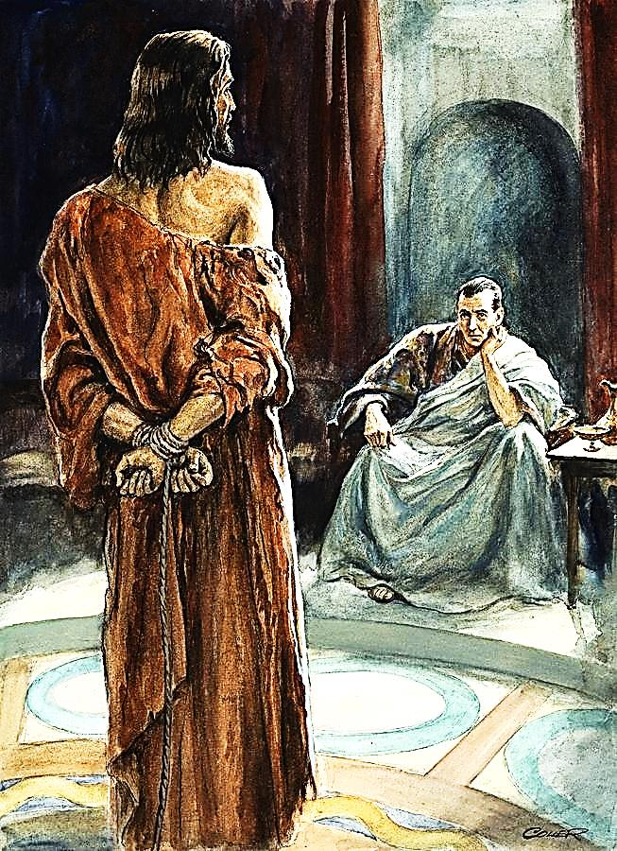
Pilate thought he had power over his own life and others.
“Why won’t you answer my question?” Pilate asked. “Don’t you know that I have the power to let you go free or to nail you to a cross?”
Jesus replied, “If God had not given you the power, you couldn’t do anything at all to me.”
John 19:10, 11

Slide 14
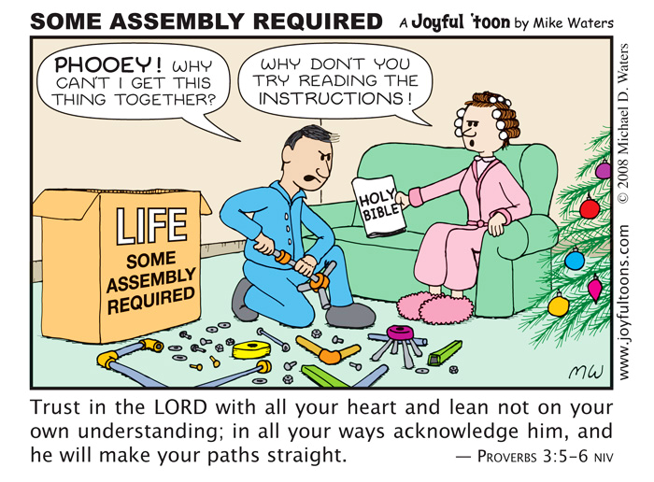

Slide 15
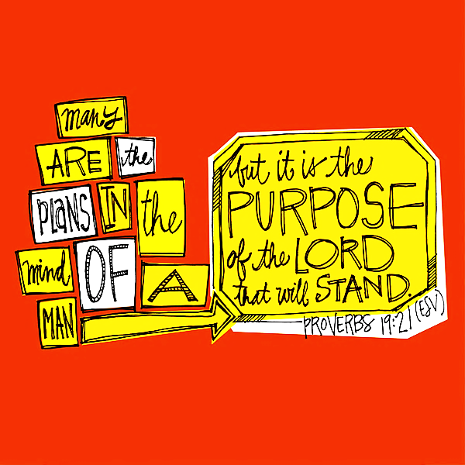

Slide 16
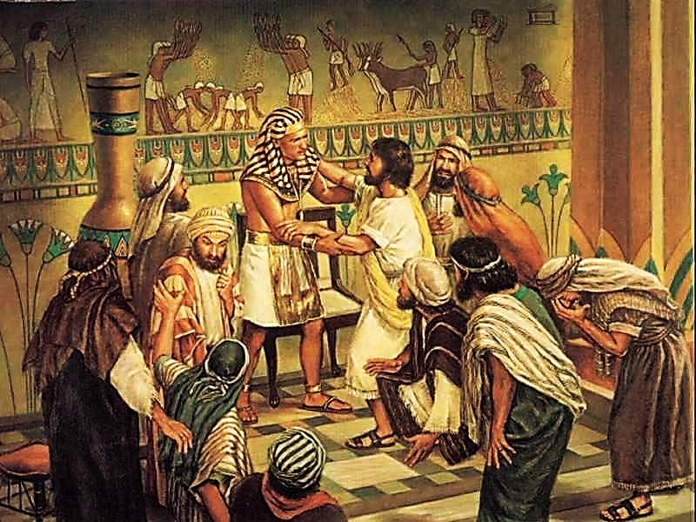
God’s Plans Are Wiser God’s plans for Joseph saved his whole family in a time of widespread famine.

Slide 17
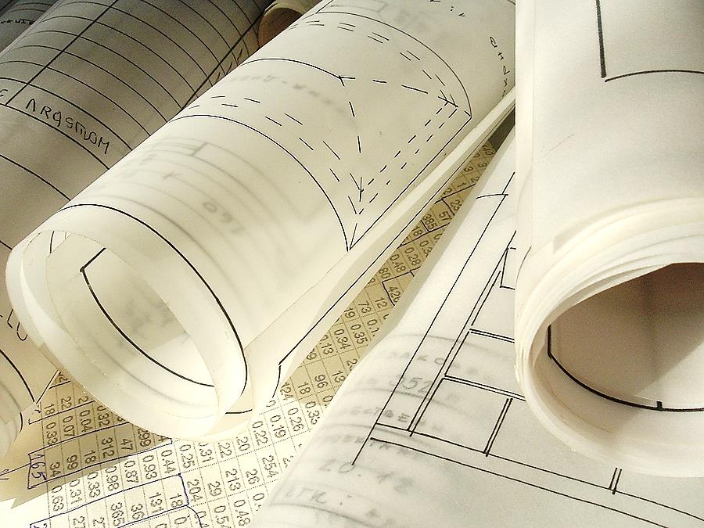
“The Lord says: ‘My thoughts and my ways are not like yours.’” Isaiah 55:8

Slide 18
“Trust the Lord with all your heart, and don't depend on your own understanding… Don't depend on your own wisdom.” Proverbs 3:5-6

Slide 19
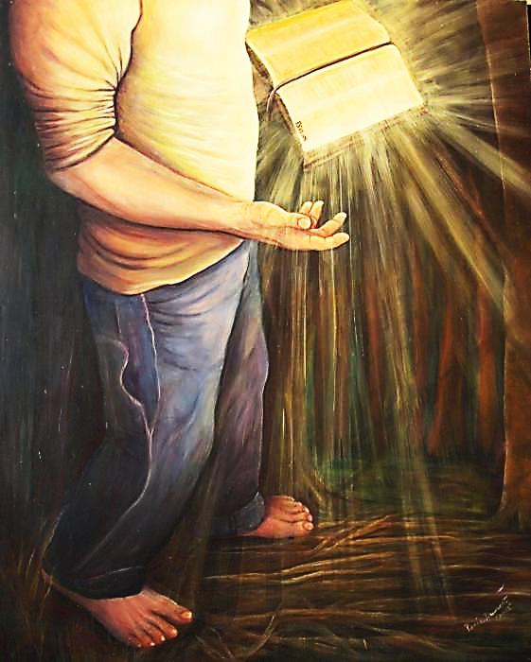
“The Lord directs the steps of the godly. He delights in every detail of their lives.” Psalm 37:23

Slide 20
Joseph’s brothers tried to kill him, but he saved them, reunited his family and brought them into the king’s House.
God’s Plans are Kinder
than We Deserve

Slide 21
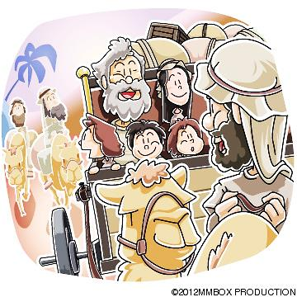
“It is true that you planned to do something bad to me. But really, God was planning good things.
God’s plan was to use me to save the lives of many people. And that is what happened.”
Genesis 50:20

Slide 22
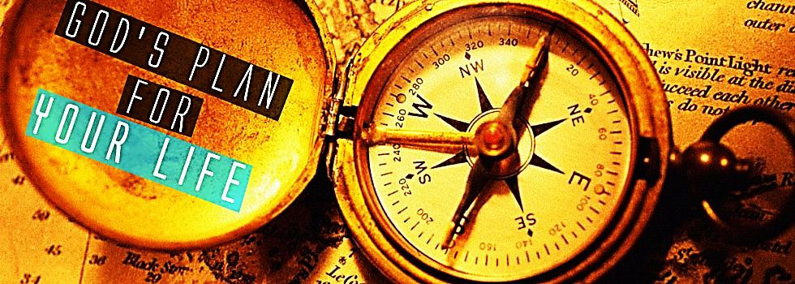
“We know that God makes all things work together for the good of those who love Him and are chosen to be a part of His plan.”

Slide 24
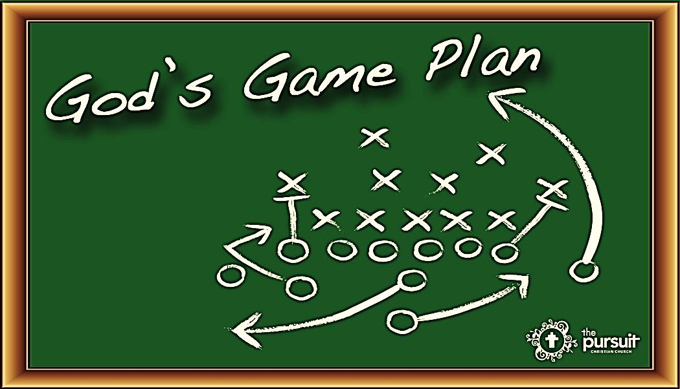
“I say this because I know the plans that I have for you.” This message is from the Lord. “I have good plans for you. I don’t plan to hurt you. I plan to give you hope and a good future.” Jeremiah 29:11

Slide 25
Watch this Related Video: “Joseph – It Was God’s Plan” Here: http://youtu.be/5HmKJf06bKE

Slide 26
Watch this Related Song: “When God Has Another Plan” Here: http://youtu.be/Rg2a5-XtqHE

Slide 27
What is the Sinner‘s Prayer?
This is a prayer we can pray when we are ready to admit we are sinners and need Christ’s forgiveness.
It must be prayed with faith in our hearts and a readiness to have a life-changing encounter with Jesus Christ.

Slide 29
John Wesley’s Testimony
“…the preacher was describing the change which God works in the heart through faith in Christ and I felt my heart strangely warmed.”
Disciple’s Testimony
“They said to each other, ‘Did not our hearts burn within us while he talked to us on the road, while he opened to us the Scriptures?’”

Slide 30
A Prayer of Faith → Pray this rayer if :
If you never have before
You have in the past, but you think it would mean more today.
You have been walking afar off and you want to come back.
You want to set an example & show others how it is done.
You just like to give your heart to Jesus again & again.
Faith

Slide 31
We Declare Our Faith Publicly Because Jesus Declared His LOVE Publicly
“If you stand before others and are willing to say you believe in me, then I will tell my Father in heaven that you belong to me.” Mat 10:32

Slide 32
Dear Jesus,
I know I am a sinner & need your forgiveness.
I believe you died for my sins.
I now turn from sin.
Come into my heart I pray.
Please wash away my sin.
Do you want to meet Jesus as your savior right now?
Do you believe He died to save you from your sins & that He rose from the dead?
Do you believe that He is waiting to save you right now?

Slide 33
“But some people did accept him. They believed in him, and he gave them the right to become children of God.” John 1:12

Slide 35
“If you openly say, ‘Jesus is Lord’ and believe in your heart that God raised him from death, you will be saved.”
Rom. 10:9
What did you learn today?
What have you been thinking about God lately?
What do you want to tell the world about Jesus?

Slide 36
“Draw near to God, and He will draw near to you…
…Cleanse your hands, you sinners, and make your hearts pure, you who are half-hearted towards God.” James 4:8 WNT

Slide 37
Close in Prayer

