Slide 1
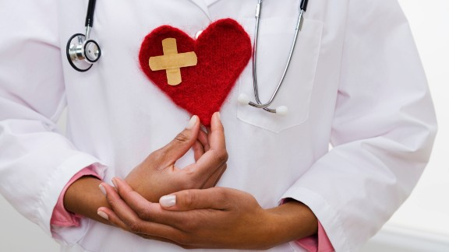
Jesus Does Heart Transplants
The Transformation of Zacchaeus

Slide 2
Jesus Does Heart Transplants:
The Transformation of Zacchaeus

Slide 3
If you would like to watch the video of the service, click here:
http://campaignkerusso.org/2012/11/free-powerpoint-sermon-joseph-god-has-the-plan/
We would love to know more about the people who download our lessons & sermons. We invite you to email us & let us know where & how you use them.
info@ckbrazos.org

Slide 4
Watch Related Video: “Zacchaeus” Here:
http://www.youtube.com/watch?v=UxjXRLdMF80

Slide 5
Finding Our Best Form
The world says: “We should [conform] man to be like others.” (heard a lot in youth)
The Devil said: “I will [deform] man by sin.” (heard a lot in adulthood)
Education says: “Let us [inform] man with knowledge.” (heard a lot from “experts”)
Society says: “We will [reform] man through re-training.” (send to institutions)
BUT, Christ says: “I will [transform]
man by love.” (Jesus)

Slide 6
The bible is not a book you read, it’s an encounter with Jesus!
“The Scriptures were not given for our information, but for our transformation.” Moody
“Therefore, if anyone is in Christ, he is a new creation. The old has passed away; behold, the new has come.”
2 Cor. 5:17

Slide 7
Zacchaeus: A Small Man with a Small, Hard Heart to Match
“Jesus was going through the city of Jericho. A man was there named Zacchaeus, who was a very important tax collector, and he was wealthy.”
Luke 19:1,2

Slide 8
Zacchaeus Wants to See Jesus
“He wanted to see who Jesus was, but he was not able because he was too short to see above the crowd.
He ran ahead to a place where Jesus would come, and he climbed a sycamore tree so he could see him.”
Luke 19:3,4

Slide 9
Jesus Wants to Stay with Zacchaeus
“When Jesus came to that place, he looked up and said to him, "Zacchaeus, hurry and come down! I must stay at your house today.“
Zacchaeus came down quickly and welcomed him gladly.” Luke 19:6,7

Slide 10
Change Will Come with a Sense of Urgency!
He heard Jesus was passing by → He heard the Testimony of Others → He Ran to See Jesus.
“Zacchaeus, make haste, and come down; for today I must abide at your house.
And he made haste, and came down, and received him joyfully.”
He Was So Ready
to Be Saved!!!

Slide 11
It Feels Urgent to Both God & the Sinner
Jesus Knew His Name.
Jesus was anxious
to be the Guest of this Sinner.
Jesus Asked to be Invited.
Zacchaeus Invited Jesus into the House.

Slide 12
People didn’t understand what Jesus saw in such a bad sinner.
“All the people saw this and began to complain, ‘Jesus is staying with a sinner!’” Luke 19:7

Slide 13
… and give you a heart of flesh. Ezk. 36:26
And I will remove the heart of stone

Slide 14
Zacchaeus Becomes a Different Man
“But Zacchaeus stood and said to the Lord, "I will give half of my possessions to the poor. And if I have cheated anyone, I will pay back four times more."
Jesus said to him, "Salvation has come to this house today…
The Son of Man came to find lost people and save them.”
Luke 19:8-10

Slide 15
Jesus Changes are Amazing!
"I will give half of my possessions to the poor. And if I have cheated anyone, I will pay back four times more."
The presence of Jesus Broke his Sin Bondage.
Now He is Free to Love & Free to Give.

Slide 16
A Jesus Heart Change is Fearless
(“Zacchaeus Stood & said unto the Lord; Behold…”)
Free from the opinions of others
Free from the shame of his past
Free to testify of his change

Slide 17
Jesus confirms his change – “This day is salvation come to this house.”

Slide 18
Watch Related Video: “Bibletoons Zacchaeus” Here:
http://www.youtube.com/watch?v=EU4mHfKtLBU

Slide 19
Sing Related Song: “Change My Heart Oh God ” Here:
http://www.youtube.com/watch?v=CEtsHWFE6-w

Slide 20
What is the Sinner‘s Prayer?
This is a prayer we can pray when we are ready to admit we are sinners and need Christ’s forgiveness.
It must be prayed with faith in our hearts and a readiness to have a life-changing encounter with Jesus Christ.

Slide 22
John Wesley’s Testimony
“…the preacher was describing the change which God works in the heart through faith in Christ and I felt my heart strangely warmed.”
Disciple’s Testimony
“They said to each other, ‘Did not our hearts burn within us while he talked to us on the road, while he opened to us the Scriptures?’”

Slide 23
A Prayer of Faith → Pray this rayer if :
If you never have before
You have in the past, but you think it would mean more today.
You have been walking afar off and you want to come back.
You want to set an example & show others how it is done.
You just like to give your heart to Jesus again & again.
Faith

Slide 24
We Declare Our Faith Publicly Because Jesus Declared His LOVE Publicly
“If you stand before others and are willing to say you believe in me, then I will tell my Father in heaven that you belong to me.” Mat 10:32

Slide 25
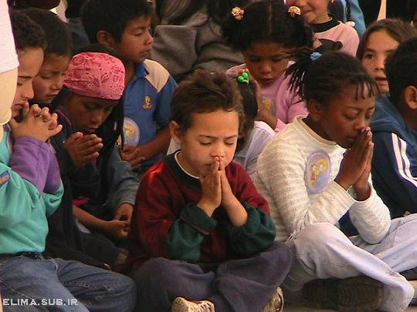
Dear Jesus,
I know I am a sinner & need your forgiveness.
I believe you died for my sins.
I now turn from sin.
Come into my heart I pray.
Please wash away my sin.
Do you want to meet Jesus as your savior right now?
Do you believe He died to save you from your sins & that He rose from the dead?
Do you believe that He is waiting to save you right now?

Slide 26
“But some people did accept him. They believed in him, and he gave them the right to become children of God.” John 1:12

Slide 28
“If you openly say, ‘Jesus is Lord’ and believe in your heart that God raised him from death, you will be saved.”
Rom. 10:9
What did you learn today?
What have you been thinking about God lately?
What do you want to tell the world about Jesus?

Slide 29
“Draw near to God, and He will draw near to you…
…Cleanse your hands, you sinners, and make your hearts pure, you who are half-hearted towards God.” James 4:8 WNT

Slide 30
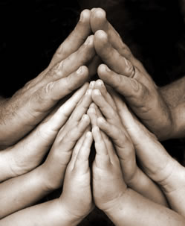
Close in Prayer

