Slide 2
Previously, my wife Therese preached a sermon called, “Don’t be a Nimrod”
Today, our sermon is entitled, “Don’t be an Esau.”
[Tell Esau story]
The book of Hebrews has something very interesting to say about Esau.

Slide 3
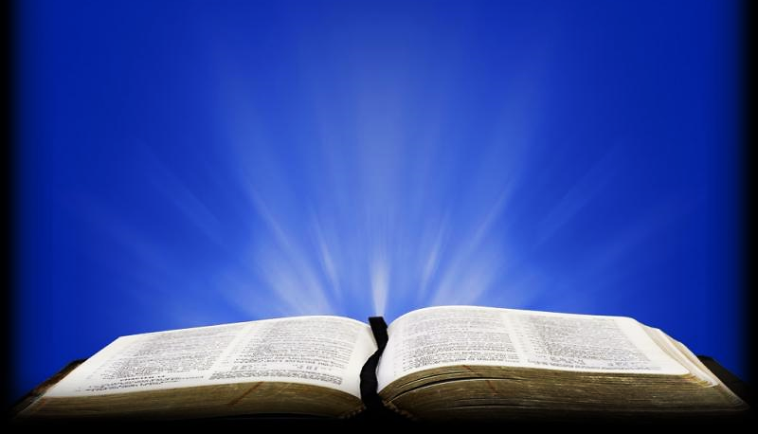
Hebrews 12:17 KJV
“For ye know how that afterward, when he would have inherited the blessing, he was rejected: for he found no place of repentance, though he sought it carefully with tears.”

Slide 4
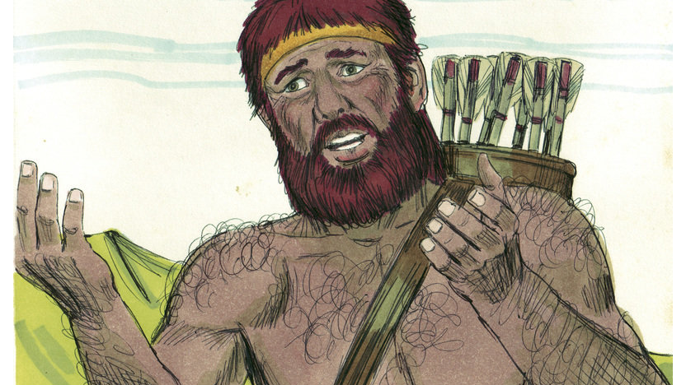

Slide 5
After reading this verse, I wondered: why Esau’s tears didn’t bring him true repentance.
I then wondered: what is true repentance, and what was Esau crying about?
But before we get into all that, let’s look at some of the crazy things your kids might cry about.

Slide 6
This kid tried to paint himself green and turn himself into the Hulk… didn’t work. He cried about it.
Maybe we do that sometimes: we try to paint ourselves as more important than we really are, and then cry when it doesn’t happen.

Slide 7
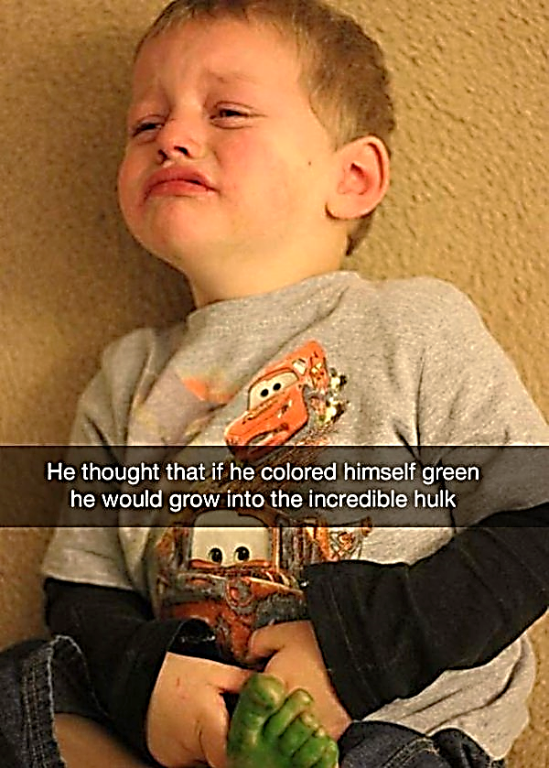

Slide 8
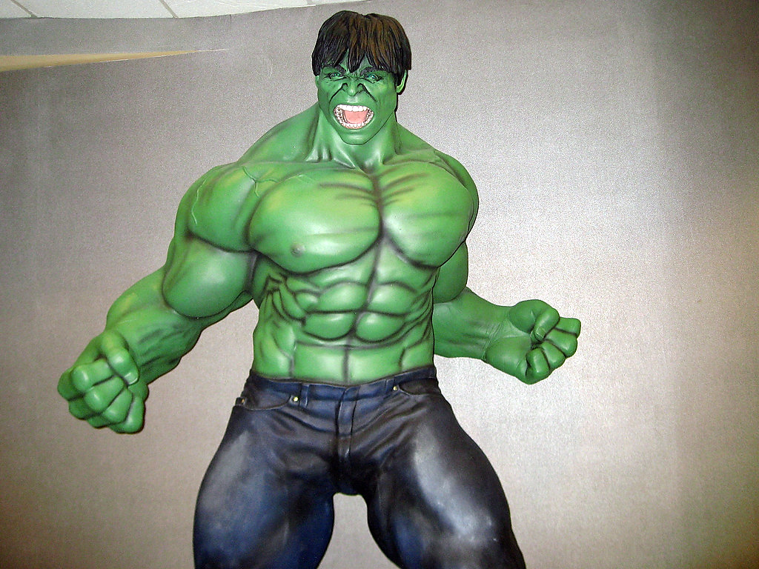
Didn’t Work!

Slide 9
This kid couldn’t get his hands around all the crayons he wanted. He cried about it.
He wanted more than he could hold.
Even after we grow up, don’t we sometimes have a fit if we don’t get everything we want, and maybe cry about it?

Slide 10
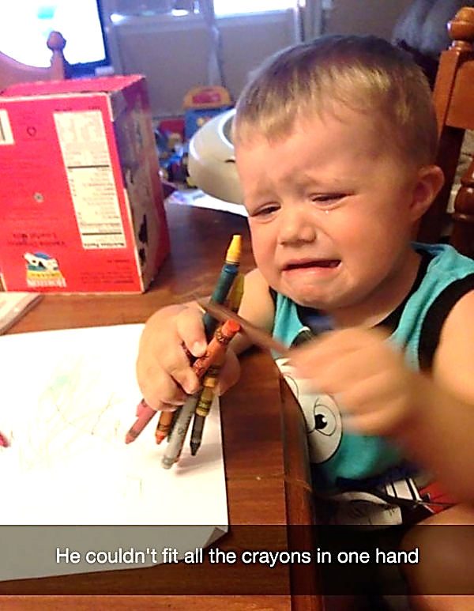

Slide 11
This kid wanted to continue playing in the trash. She cried about it.

Slide 12
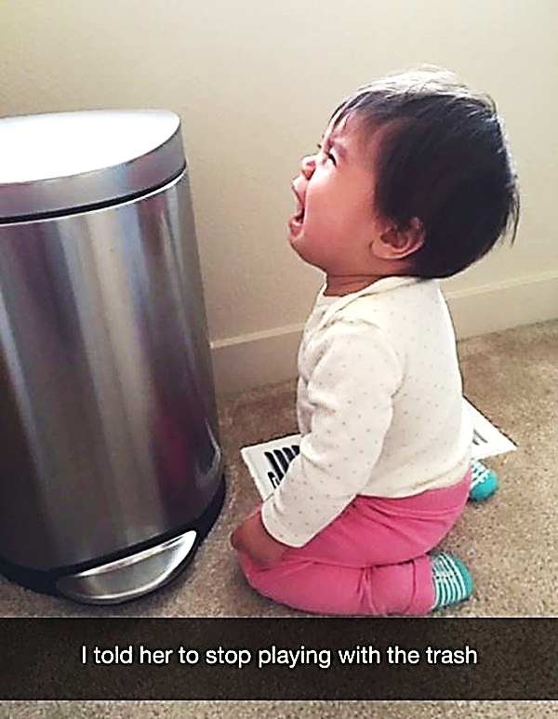

Slide 13
And this kid just didn’t want to come out of the toilet. And it made her cry.
And isn’t this how people are?
Just like these little kids, we might cry, when we’re told by anyone, including our loving Heavenly Father, that we need to get out of the toilet, and walk away from the trash.
And isn’t that what repentance REALLY is?
It’s growth, it’s change, it’s moving on.

Slide 14
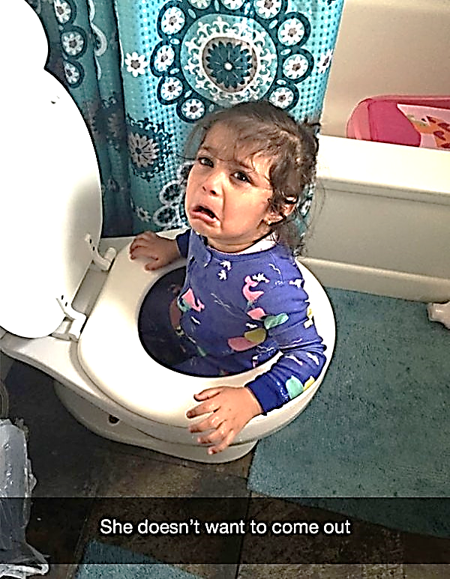

Slide 15
Tears can be a good thing in the Kingdom of God.
When you or I feel sorry about our sins, it might make us cry.
But not all tears lead to real repentance: to growth, to change, to moving on.
With Esau: there was no growth, no change, no moving on. What’s that all about, Lord?
Guess what?…. The Lord gave me seven questions to find the answers to.

Slide 16
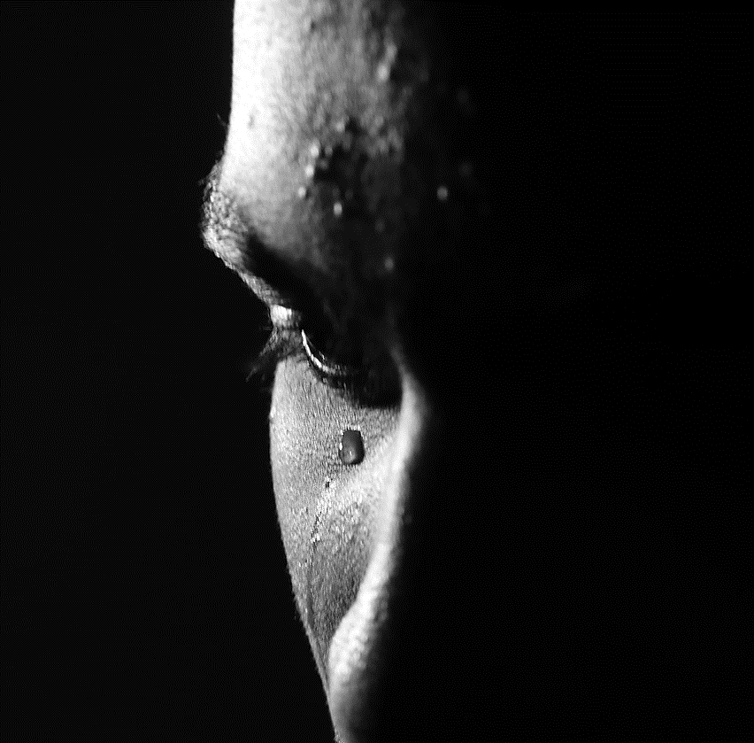
#1 Are the tears of a Christian always Godly?

Slide 17
#2 Can there be tears without repentance?

Slide 18
#3 Can there be repentance without tears?

Slide 19
#4 When we seek a place of repentance, do we always find it?

Slide 20
#5 Can I live the Christian life without repentance?

Slide 21
#6 What is the result of my living an unrepentant Christian life… and will I care?

Slide 22
#7 What does all this mean for you, me and for the church in general?

Slide 23
So, let’s find the answers together… in the Encyclopedia… NO!!... IN THE… BIBLE!

Slide 24
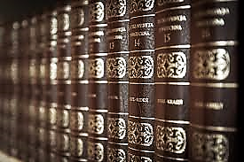

Slide 26
Let’s take a look at question #1.

Slide 27
#1 Are the tears of a Christian always Godly?

Slide 28
Psalms tells what the Lord listens for, in our cries, and what He looks for, in our tears.

Slide 29
Psalm 34:15
“The eyes of the LORD are toward the righteous and his ears toward their cry.”

Slide 30
He listens closely to our cries, but He knows the difference between God-centered and self-centered tears.
If we could send our tears to be analyzed in God’s chemical laboratory : You know: test tubes and beakers and bubbling stuff? What would our tears be made of?

Slide 31
Well, for me… probably a mix of 5-parts Godly, 5-parts selfish – and that’s on a good day!

Slide 32
5 Parts Godly – 5 Parts Selfish

Slide 33
Let’s admit it, we cry, we are sorry: for different reasons.
So let’s see how God looks at sorrow:

Slide 34
II Cor 7:10 (NLT)
“For the kind of sorrow God wants us to experience leads us away from sin and results in salvation. There’s no regret for that kind of sorrow. But worldly sorrow, which lacks repentance, results in spiritual death.”

Slide 35
This verse describes two kinds of sorrow:
The first brings us closer to God… the other makes us feel dead inside, distant and disconnected from God.

Slide 36
Our sorrow:
Are we drawn closer to God… or farther away

Slide 37
Tell Story of Job, filled with sorrow

Slide 38
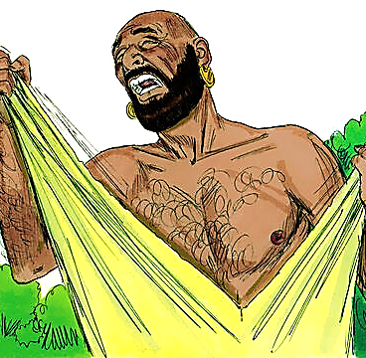
Job
HIS LOSSES
HIS ACCUSERS
HIS INNER STRUGGLE

Slide 39
Job 16:7,8,16,17 (ICB)
“God, you have surely taken away my strength. You have destroyed my whole family. You have made me thin and weak. And people feel that this shows I have done wrong…

Slide 40
Job 16:7,8,16,17 (ICB)
“My face is red from crying. I have dark circles around my eyes. And yet my hands have never done anything cruel. And my prayer is pure.”

Slide 41
Job continued to struggle through the emotions of self-pity, anger, hopelessness and claims of innocence-as he argued with his accusers.
Self-pity: Job didn’t deserve all the losses in his life
Anger: Job felt God had turned against him
Hopelessness: Job felt he should never have been born
Claims of Innocence: Job was not the sinner his friends assumed he was

Slide 43
You know, tears can easily come from just feeling sorry for ourselves.
“Boo-hoo, the Lord doesn’t love me: because he doesn’t accept me on my terms.”
That was me, during a time of rebellion and depression that I went through. But God requires us to accept Him on His terms.

Slide 44
“Boo-hoo, the Lord doesn’t love me because he doesn’t accept me on my terms.”

Slide 45
I’m so grateful for the patience of the Lord through my own sins and failures as a Christian.
The only way I know, to really feel God’s grace: is through real repentance…
Not the “Boo-Hoo, I’m so sad.. I’m gonna go eat some dirt” attitude.

Slide 46
“Boo-Hoo, I’m so sad. I’m gonna go eat some dirt.”

Slide 47
OK, back to Job: Was Job a good person? Yes, by human standards. Even God said so, way back in chapter 1 of Job.
Did Job lose his blessings because he stopped being good? His accusers thought so. And Job cried tears of anguish and self-pity because He felt abandoned by his friends and by God.
Both Job and his accusers assumed that Job’s blessings were a result of Job’s goodness. Job was blessed, not because of his goodness. Our blessings come because of God’s goodness, not our own.

Slide 48
In his community, Job was, by all accounts, a very blessed man.
Land, cattle, houses, family and health
But… he was not righteous in his own right.
Like any of us, he was not perfect.
We might slip into thinking, like Job, “You know, I’m blessed, because of my goodness.” but… those blessings might disappear for a time.. And where are we then?

Slide 49
We find ourselves crying “foul” because of this wrong thinking.
When we suffer loss, we complain and protest to God, or to our accusers, based on this wrong thinking. We will not move on until we forget about our own goodness, and lean only, on the goodness of God.

Slide 50
The Apostle Paul had the same struggle:

Slide 51
I Cor. 4:3-4 (NLT)
“As for me, it matters very little how I might be evaluated by you or by any human authority. I don’t even trust my own judgment on this point. My conscience is clear, but that doesn’t prove I’m right. It is the Lord himself who will examine me and decide.”

Slide 52
Rising above the temptation to defend myself, is one of my goals as a believer, but it is not one I have mastered, yet.
It helps to put things in perspective, when I read this verse:

Slide 54
In Him, In Him, in Him, In Him…I must keep repeating this to myself.
It’s not all about us, it’s all about HIM

Slide 55
So back to our first question:

Slide 56
Are the tears of a Christian always Godly? Answer: No, there is worldly sorrow and Godly sorrow. God knows the difference.

Slide 57
THIS BRINGS US TO OUR SECOND QUESTION:

Slide 58
#2 Can there be tears without repentance?

Slide 59
[TELL STORY OF PETER WHEN HE DENIED KNOWING JESUS]
. Be warned..
. Satan will try to sift you like wheat
. I’m ready to do anything for you, says Peter
. Today, before the rooster crows, you will deny me three times. And then it happened.

Slide 60
Mat. 26:75 (ICB)
“Then he remembered what Jesus had told him: “Before the rooster crows, you will say three times that you don’t know me.” Then Peter went outside and cried painfully.”

Slide 61
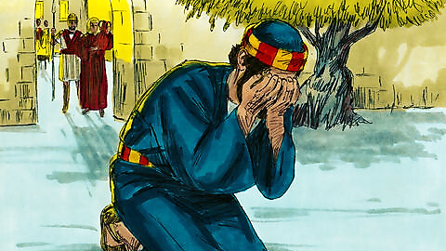

Slide 62
Peter felt shamefully guilty, and cried bitterly.
But tears, by themselves, will lead us nowhere. Tears alone, are no guarantee of repentance and growth.

Slide 63
The Israelites of the Old Testament times quite often cried bitterly at God’s altar.
They were very loud and expressive in the show of their religion.
But, once they got back home: their day-to-day behavior, revealed the real condition of their hearts. In church they weren’t being real, and God did not look forward to their services, their worship or even their tears.

Slide 65
Mat 26:75
Mal 2:13-14a (ERV) You can cry and cover the Lord’s altar with tears, but the Lord will not accept your gifts. He will not be pleased with the things you bring to him. You ask, “Why are our gifts not accepted?..”

Slide 66
What about Peter? Peter’s tears and his declarations of love and loyalty were not enough, in and of themselves.
Jesus asked Him three times, “Peter, do you love me?” And Peter repeated three times, “Lord, you know I love you.” But the conversation didn’t end there. After each, “Lord, you know I love you,” Jesus responded, “Then feed my sheep”

Slide 67
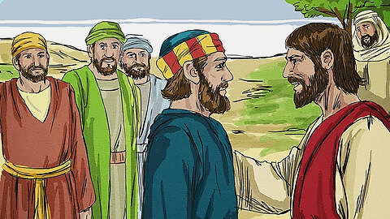

Slide 68
The lesson here, reveals a somewhat embarrasing truth: We can cry and proclaim our love for Jesus on our knees, but what he is looking for, is what we do when we get back on our feet.

Slide 69
How Genuine is Our Sorrow for Sin?
Temporary
Crying Fits
Life Changing, Heartfelt Sorrow for Sin

Slide 70
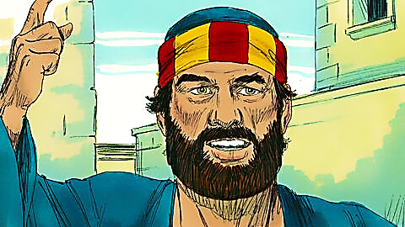
Peter cried, and then he changed his life.
This is what true repentance looks like.

Slide 71
So, in answer, to our second question:

Slide 72
Can there be tears without repentance? Answer: Yes, there can be tears, without true repentance.

Slide 73
OUR THIRD QUESTION ASKS THIS :

Slide 74
#3 Can there be repentance without tears?

Slide 75
Billy Graham, in one of his daily devotions, shares this:
“There is a certain amount of sorrow involved in repentance that we don’t see much of today. That word means moaning and even groaning. I don’t mean that we have to have, a great emotional experience, but I do believe that we need some tears of repentance. We need to be sorry for our sins, and to say, “Oh, God, I have sinned against You, and I’m sorry….”

Slide 76
Billy Graham goes on to say,
“…I am not an emotional person. I don’t know why, but I don’t cry easily. But of the few times I have cried in my life, some of them have been over sin that I committed many years ago.
The night I came to Christ, I didn’t have any tears. But later I went home and I looked out my window at the North Carolina sky and I cried over my sins. I said, “Oh, God, forgive me.” And the most wonderful peace swept over my soul. From that moment on, I’ve known that my sins were forgiven.” [Do you have that peace?]

Slide 77
Two examples in scripture:
Zech Chapter 12 tells the
story of Israel’s final victory over all its enemies as Jerusalem is finally redeemed, and then, soon after, looking at their Messiah and King, they realize that He is the very One whom they had pierced, the Crucified Christ. And the entire nation of Israel goes into mourning and deep repentance upon that awful realization.

Slide 78
Zech. 12:10 (TLB)
“Then I will pour out the spirit of grace and prayer on all the people of Jerusalem. They will look on him they pierced, and mourn for him as for an only son, and grieve bitterly for him as for an oldest child who died.”

Slide 79
Gospel of John chapter 20
Doubting Thomas overcomes his doubts:

Slide 80
John 20:25-28 (TLB)
When they kept telling him, “We have seen the Lord,” he replied, “I won’t believe it unless I see the nail wounds in his hands—and put my fingers into them—and place my hand into his side…”

Slide 81
John 20:25-28 (TLB)
“…Eight days later the disciples were together again, and this time Thomas was with them. The doors were locked; but suddenly, as before, Jesus was standing among them and greeting them.

Slide 82
John 20:25-28 (TLB)
“…Then he said to Thomas, “Put your finger into my hands. Put your hand into my side. Don’t be faithless any longer. Believe!”
“My Lord and my God!” Thomas said.”

Slide 83
Thomas had his doubts. You could be a secret “Doubting Thomas” even as a Christian, waiting for some miraculous event to flash before you and erase all your doubts. I declare to you, from my own life , and that of countless believers who love the Lord, that the day you touch and are touched, by the nail-scarred hands and wound in the side of our living savior, on that day your heart will be full, and you will proclaim, “My Lord and my God.”

Slide 84
Put your hand in the hand of the man
Who stilled the water
Put your hand in the hand of the man
Who calmed the sea
Take a look at yourself
And you can look at others differently
Put your hand in the hand of the man
From Galilee

Slide 85
Salvation comes with joy and a wonderful new life.
And it may take some time, but eventually, the tears will come. When we get to touch and be touched by the One whom we have pierced, the tears will come. When we get to know what our sins have cost Him, the tears will come.

Slide 86
A portion of the scripture found in John 12:21, can be found in a church somewhere, taped to the pulpit, just above where the pastor lays his sermon notes and serves as a reminder to himself each time he preaches to his congregation. It reads, “Sir, we want to see Jesus.”
When we see Jesus, when we see our Savior, when we see His cross, when we see His sacrifice, when we see Jesus, the tears will come.

Slide 87
Can there be repentance without tears? Answer: It’s complicated

Slide 88
FOURTH QUESTION:
When we seek a place of repentance, do we always find it?

Slide 89
#4 When we seek a place of repentance, do we always find it?

Slide 90
Back to Esau one more time…

Slide 91
Hebrews 12:17 KJV
“For ye know how that afterward, when he would have inherited the blessing, he was rejected: for he found no place of repentance, though he sought it carefully with tears.”

Slide 92
Again, and again, scripture teaches that we shall find God, “when we seek Him with our whole heart.”
We must conclude that Esau was not wholeheartedly seeking his place of repentance.

Slide 93
“When we seek Him with our whole heart.”

Slide 94
We’re all familiar with the condition of half-heartedness:
Every once in a while, I’ll hear a sermon that makes me squirm in my seat, because it’s hitting the mark.
The word of God, is revealing some half-hearted part of me, that I’d like to ignore.

Slide 95
It takes some bare-knuckle honesty and courage to stop side-stepping whatever God wants me to own up to.
I need to just to stand there and take it, but that’s so hard to do.
David in Psalm 139 summed up this feeling in the 3 verses: [you can recite them out loud with me if you like]

Slide 96
Psalm 139: 1, 7, 24
Verse 1: “You have searched me, LORD, and you know me..”
Verse 7: “Where can I go from your Spirit? Where can I flee from your presence..?”
Verse 24: “See if there is any offensive way in me and lead me in the way everlasting.”

Slide 97
A very long poem entitled, “The Hound of Heaven” speaks of the ever-persistent nature of God, striving to bring us to a place of honesty and humility.
I have felt at times that the Lord was like a bloodhound, hunting me down.
Try as I could, to run, hide, disguise myself as an “OK” Christian, His Spirit kept chasing after me → the heavenly hound from whom there is no escape.

Slide 98
I, for one, am glad when I finally run out of steam, and He catches up with me.
I may be miserable for a while, but the running is over and only then can the healing begin.

Slide 99
“I, for one, am glad when I finally run out of steam, and He catches up with me.”

Slide 100
Question #4 was: When we seek a place of repentance, do we always find it?
The answer is: Only if we seek it with our whole heart.

Slide 101
Do we always find the repentance? If we seek it with our whole heart.

Slide 102
QUESTION NUMBER 5
Can I live the Christian life without repentance, or rather: any more repenting?
My knee-jerk answer to this: “I wouldn’t bet on it.”
Two verses come to mind:

Slide 103
5# Can I live the Christian life without repentance?

Slide 104
Gal. 6:7 (ICB)
“Do not deceive yourselves; no one makes a fool of God. You will reap exactly what you plant.”

Slide 105
Rom. 6:15-16 “Well then, since God’s grace has set us free from the law, does that mean we can go on sinning? Of course not! Don’t you realize that you become the slave of whatever you choose to obey?...

Slide 106
Rom. 6:15-16
…”You can be a slave to sin, which leads to death, or you can choose to obey God, which leads to righteous living.”

Slide 107
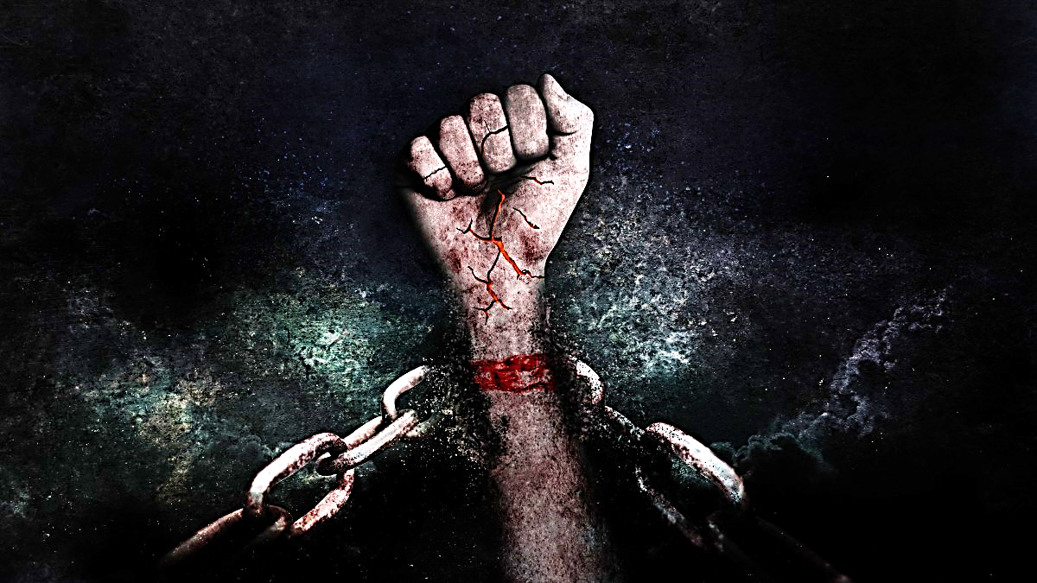
Being a slave to sin leads to death.

Slide 108
Choosing to obey God, leads to righteous living.

Slide 109
So, I’m back to my original knee-jerk response: “I wouldn’t bet on it” [Warning:]
If you are fantasizing, committing sin as a Christian, you are already in place of dangerous deception and need to take an immediate step back toward the Lord.
Find a trusted fellow Christian to confess to and pray with → don’t go it alone and please don’t put off this warning.

Slide 111
Everybody: remember this little trick:
The words: Secret, Sin, Stupid and Suicide… all begin with the letter “S”.
Make up any sentence with those words in it, and it will always come out the same!
So, in answer to our question: Can I live the Christian life without repentance?
The answer is: Secret sin is stupid suicide!

Slide 112
Can I live the Christian life without repentance? Answer: Sin will surely enslave you.

Slide 113
THIS LEADS IN TO QUESTION 6:
What is the result of my living an unrepentant Christian life… and: will I care?

Slide 114
#6 What is the result of my living an unrepentant Christian life… and will I care?

Slide 115
A little history lesson:
The nation of Israel had been living in a backslidden condition.
They were far from God in their spiritual lives. Ezekiel was God’s prophet at this time.
So, God does something we might think is horrible.
He allows Ezekiel’s wife to die, but commands Ezekiel to act like nothing has happened, to just go on with his life, without missing a beat.

Slide 116
God tells Prophet Ezekiel to do a very hard thing.

Slide 117
The people are dumfounded, by Ezekiel’s seeming unfeeling behavior toward someone he was supposed to have loved.
He doesn’t even talk about it with anyone!
They cannot understand how he can be this way. And this goes on for some time.
Finally, God lets Ezekiel tell the people what God thinks of Israel’s hard-hearted attitude toward the One they should have loved.

Slide 118
Ez. 24:22-23 (NLT)
“Then you will do as Ezekiel has done. You will not mourn… Your heads will remain covered, and your sandals will not be taken off. You will not mourn or weep, but you will waste away because of your sins. “

Slide 119
Just as Ezekiel “seemed” to have no care for the loss of his beloved wife…
Just as he “seemed” to go about as if nothing had happened, as if nobody had died…
…acting as if he never loved her anyway…
This is how the Israelites were acting about their dying relationship with God…
As if nothing had happened… as if they never loved Him anyway!!!

Slide 120
Now, back to our question:
“What is the result of our living an unrepentant Christian life… and: will we care?” Answer: No, we won’t, we will “waste away because of our sins.”
And if the scripture holds true, like the children of Israel, “We won’t much care.”
Esau didn’t much care. Oh, he was upset for a while about the birthright he lost… up until the next bowl of stew filled his belly.

Slide 122
What is the result of my living an unrepentant Christian life… and will I care? Answer: I will waste away and begin feeling nothing for Jesus.

Slide 123
WHICH BRINGS US TO CONCLUDING QUESTION:
What does all this mean for you, me and the church in general?

Slide 124
#7 What does all this mean for you, me and for the church in general?

Slide 125
Let’s get back to our leading man: Esau!
From his story, we learned a lot about tears and repentance.
But what is the root of Esau’s problem? What was missing in his life?
To understand this, I want share something personal.

Slide 126
The other day I was talking with my wife, Therese, and she shared a story from her childhood.
As a child, Therese loved to dance. When she was about eight or nine years old, she asked her father if she could enroll in dance classes.
He responded by saying she could attend classes if she were able to stand up on her toes, one leg at a time.
She easily stood on the toes of her left leg, but when she tried to do the same with her right leg she simply couldn’t!

Slide 128
The effects of having had polio when Therese was 3 years old, left her with a severely weakened calf muscle in her right leg.
Her father showed Therese in a seemingly cruel manner, that dance classes might not be a possibility.
She felt crushed and, for an eight-year-old, it was a painful disappointment.

Slide 129
Recalling that time in her life, my wife acknowledged that perhaps, just perhaps, God had allowed her get polio, to save her from going in a direction that might have led her away from His calling on her life and even her salvation.
She looks back on the whole situation, with, what I call: an eternal viewpoint.

Slide 130
An Eternal Viewpoint

Slide 131
God wants each of us to have: an eternal viewpoint.
The root of Esau’s problem was that he didn’t. All he could see was that bowl of stew, which would satisfy him, for the time being.
But he forsook his inheritance, which was supposed to be his, by rights: his birthright.
Afterward he couldn’t find a place of repentance because he didn’t have an eternal viewpoint. All he could do was cry in his soup.

Slide 133
As sons and daughters of God we have an inheritance that we must not neglect.
Our lives may be filled with all sorts of stuff that satisfies us: for the time being.
Remember, they’re just bowls of stew.
Having an eternal viewpoint doesn’t mean we never make mistakes, but it helps us recognize that bowl of stew, which is just a metaphor, for anything that gets in the way of our walk with the Lord.

Slide 134
It could be physical hunger, like Esau.
It could be a hunger for attention, celebrity, acceptance, to be attractive, strong, envied.
It could be a weakness for anger, resentment, vengeance.
It could be an appetite for power, money, or the material things money can buy.
Let’s view all these things, for what they really are → measly bowls of earthly stew.
Don’t be an Esau: Have an eternal Viewpoint.

Slide 135
What does all this mean for you, me and for the church in general? Answer: All that the world offers is not worth pursuing or even caring about. We need an eternal viewpoint!

Slide 136
An Eternal Viewpoint

