Slide 1
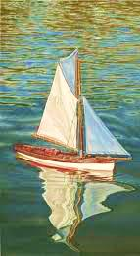
The Story of the Boy’s Boat

Slide 2
The Boy’s Boat
A young boy lovingly built a little sailboat. When he finished, he took it to a stream behind his house and put it in the water. The little boat sailed perfectly! But the wind blew hard, and his boat was taken away and he could not find it. After he searched for a long time, he sadly returned home.

Slide 3
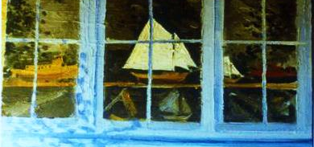
One day, he was walking downtown and saw his own boat in a store window. Having found out from the store-owner how much the boat would cost, he returned home and got all his money.

Slide 4
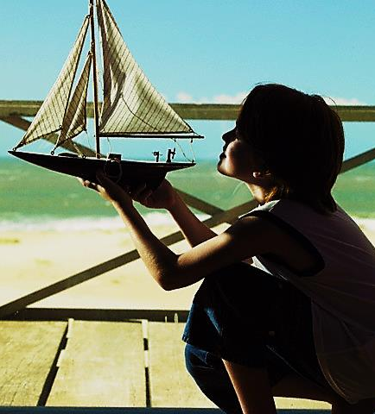
After paying for the boat, he was walking home and said to the little boat, “You are twice mine.
I made you and I bought you.”

Slide 5
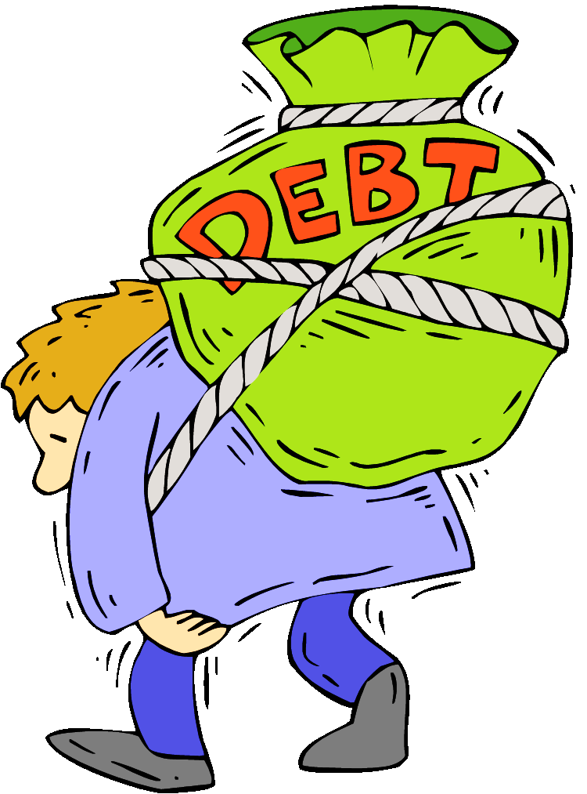
Jesus made us, but we got lost when we sinned!
“The person who sins will die.”Ezk 18:20
Death is the debt every sinner owes.
We need someone to
buy us back.
We need someone both willing and able to pay that price.

Slide 6
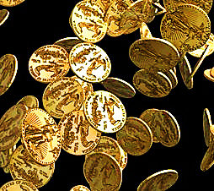
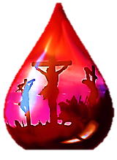
"…you were not bought with things that can pass away, like silver or gold…. Instead, you were bought by the priceless blood of Christ. He is a perfect lamb. He doesn’t have any flaws at all.” Pet. 1:18-19

Slide 7
Blood Must be Shed…
…either the blood of the person who sinned or the blood of an innocent substitute.

Slide 9
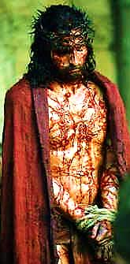
Jesus Laid Down His Life
“No one takes my life from me. I give my life of my own free will.”
John 10:18

Slide 10
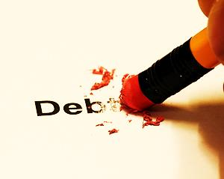

Slide 11
We Are

Slide 12
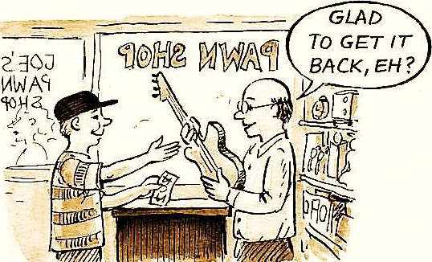
After we got lost, Jesus, who had made us, chose to also buy us with His own blood. All He wants is to get us back!

Slide 13
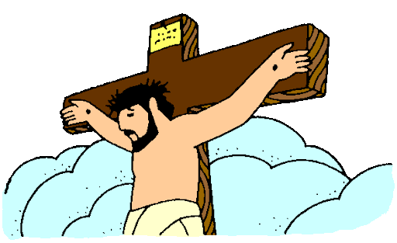
Talk about when Jesus made us.
Talk about when Jesus bought us with His blood.

