Slide 1
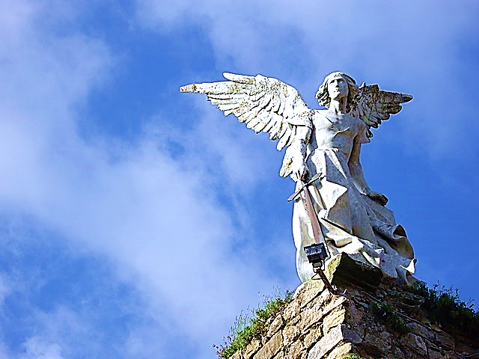
On the
Side
of
THE
ANGELS
Part 1
Worldly
War Games

Slide 3
On the Side of the Angels Part 1 of 5 Worldly War Games

Slide 4
On the
Side
of
THE
ANGELS
Part 1
Worldly
War Games
Black
Our Party
Us
Athletes
White
Their Party
Them
Nerds
Born Here
Rich
College
C.E.O.
Moved Here
Poor
Trades
Janitor

Slide 5
People naturally tend to divide into groups and then take sides.
Here, in our cover picture we see some typical grouping and side-taking patterns.

Slide 6
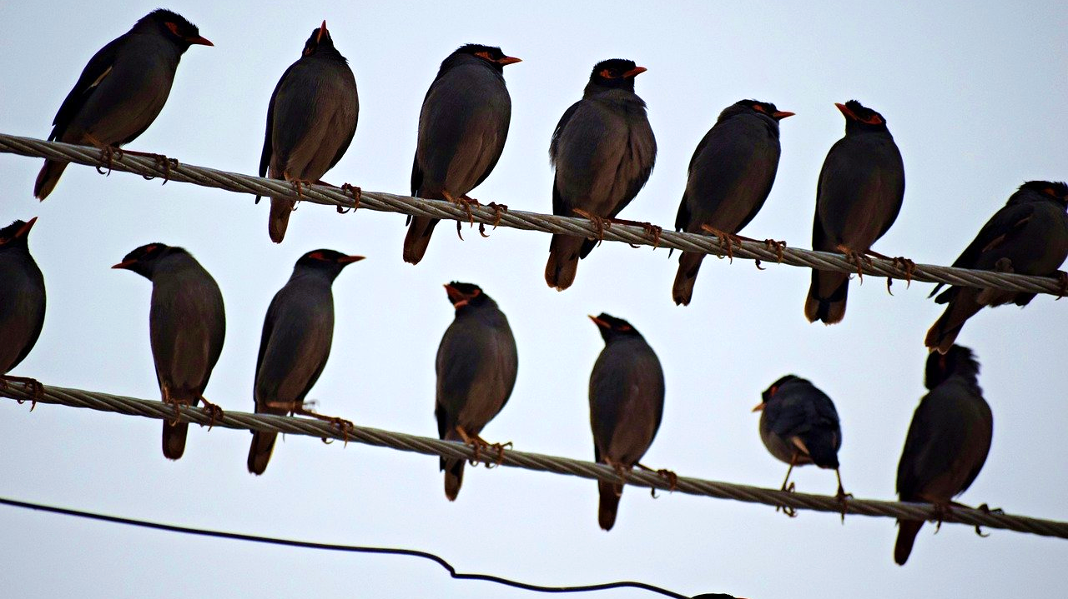
Birds of a feather, flock together.

Slide 7
Another saying goes like this, “I’m on the side of the Angels.” –And that’s the title of this series of teachings.
Grouping is entrenched in human behavior.
As another saying puts it, “Birds of a feather flock together.”

Slide 8
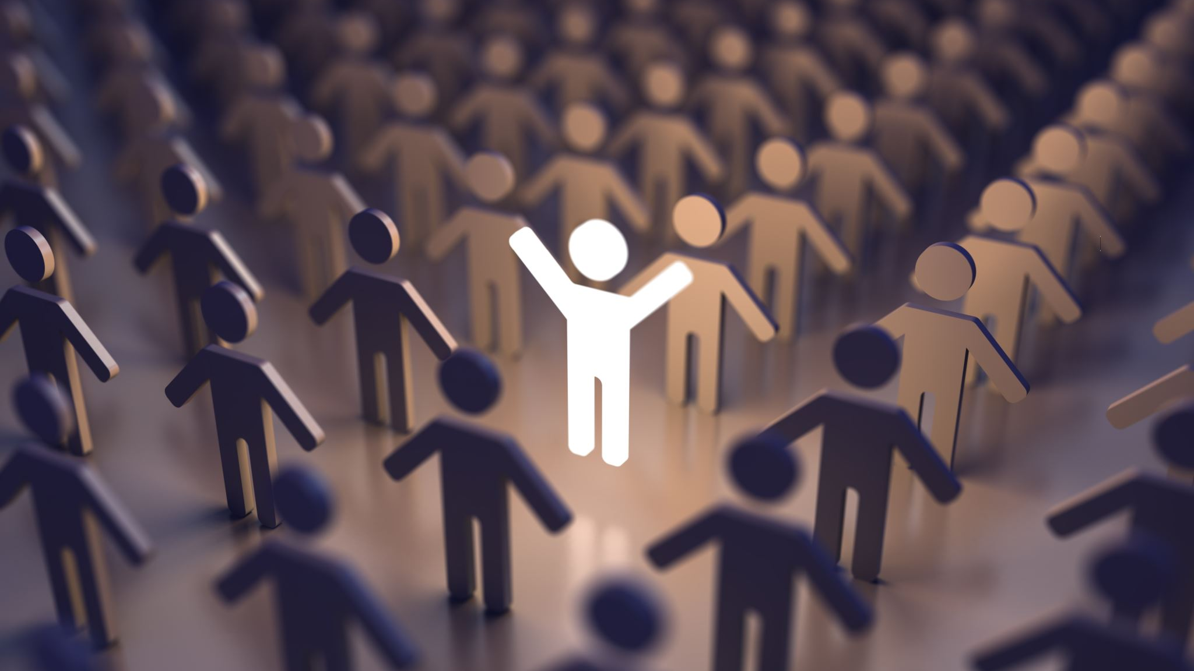
Human Grouping and Side Taking

Slide 9
In this series, we are going to look at some strengths and (mostly) the pitfalls inherent in human grouping and side-taking.

Slide 10
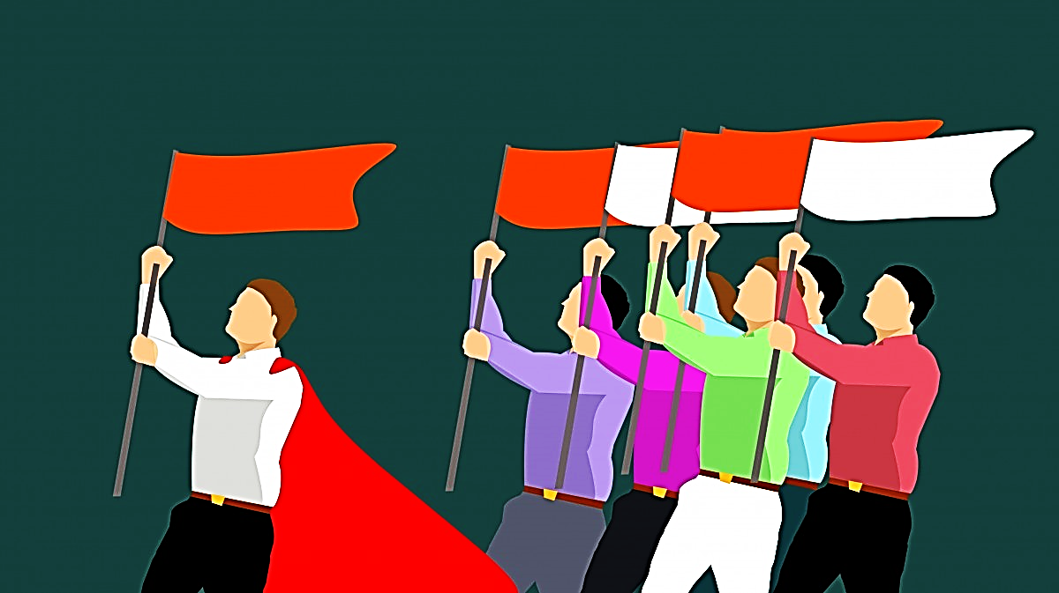

Slide 11
We form alliances, then, to further encourage the process of group bonding, we create symbolic representations of our chosen affiliations.
These may take the form of the group’s flags, emblems, uniforms, colors, slogans, songs, signs, even gestures, etc.

Slide 12
Regarding the power of grouping, scripture says this:

Slide 13
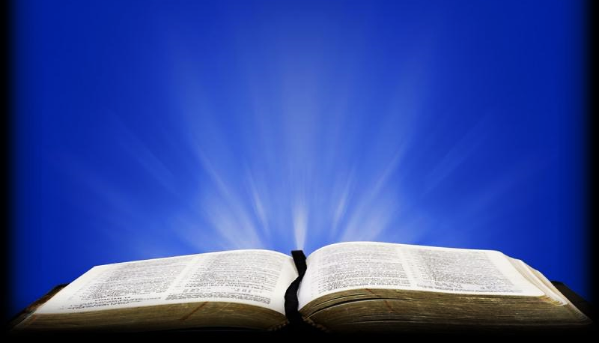
Proverbs 11:21 KJV
“Though hand join in hand, the wicked shall not be unpunished: but the seed of the righteous shall be delivered.”

Slide 14
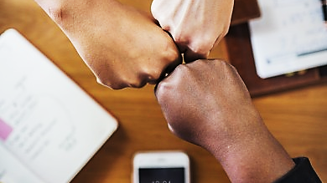

Slide 15
This is saying that when the wicked join forces and form groups, they do become stronger.—Still, they cannot defeat God.
Naturally, this grouping power can be used for good:
It can strengthen productivity by adding extra manpower.
It can strengthen productivity by adding diversity of gifts.
It can strengthen resistance to temptation.
And the stronger can assist the weaker.

Slide 16
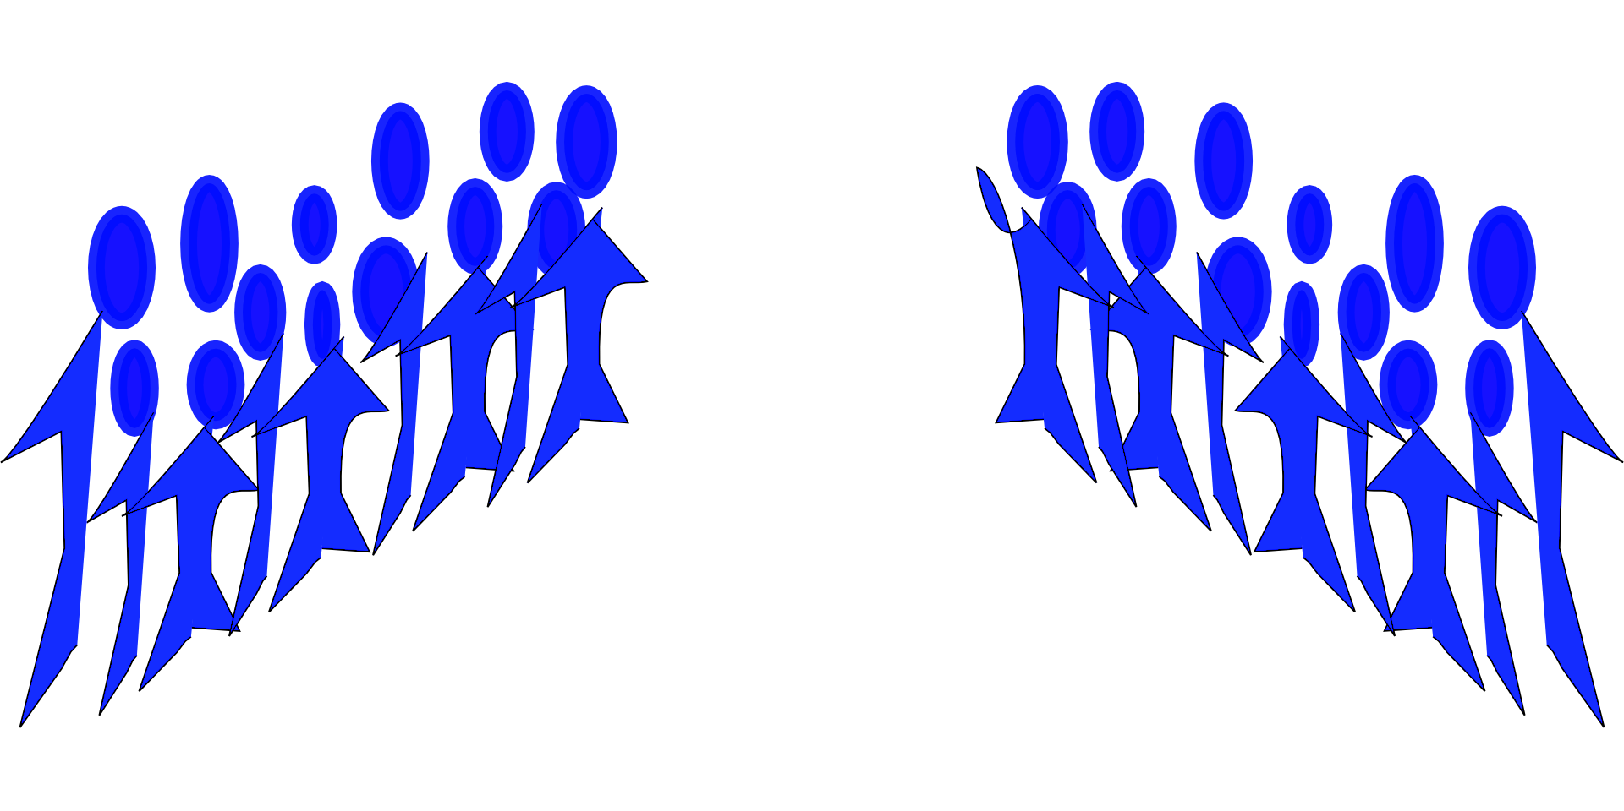
Although grouping can be a good thing, it has many dangers. We will examine Five Biblical Dangers
& Pitfalls.
Worldly War Games
Emboldening Rebellion
Groupthink
Caustic Kings (Their Motive & Methods)
Dangerous Duplicity

Slide 17
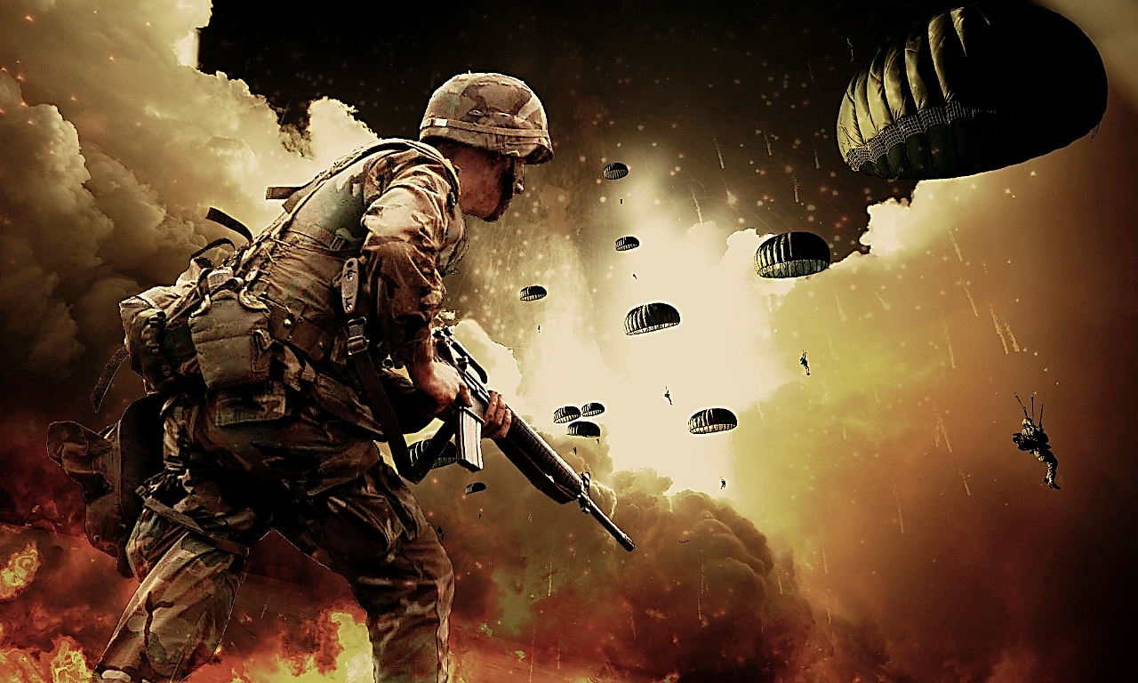
Worldly War Games

Slide 18
Today we are going to look at “Worldly War Games.”
So, biblically, what exactly is “worldliness?”
It is embracing the world’s values rather than Heaven’s.

Slide 19
Embracing the world’s values Rather than Heaven’s values

Slide 20
The bible divides worldliness into these three categories:

Slide 21
1 John 2:16
“For all that is in the world—
[1] the desires of the flesh and
[2] the desires of the eyes and
[3] the pride of life—
is not from the Father but is from the world.”

Slide 22
Today we are looking at “The Pride of Life” and its favorite expression—competition (or rivalry).
Christ’s own disciples were filled with the pride of life.
It was all they knew… the only way they knew how to be.
After all, they were of the world.

Slide 23
Mark 9:33-35 (GNT)
“They came to Capernaum, and after going indoors Jesus asked his disciples, “What were you arguing about on the road?” But they would not answer him, because on the road they had been arguing among themselves about who was the greatest…

Slide 24
Mark 9:33-35 (GNT) cont.
“…Jesus sat down, called the twelve disciples, and said to them, “Whoever wants to be first must place himself last of all and be the servant of all.”

Slide 25
And even at the Last Supper:
Luke 22:24 (GW)
“Then a quarrel broke out among the disciples. They argued about who should be considered the greatest.”

Slide 27
Quite often the people of the world will form groups for the purpose of rivalry.
The world is infatuated with taking sides, it is the very structure of human society.
The world forms sides and then pits those sides against one another.
Each with the ultimate aim of being the best.
The idealistic concept of, “just good healthy sportsmanship” is largely a myth.

Slide 28
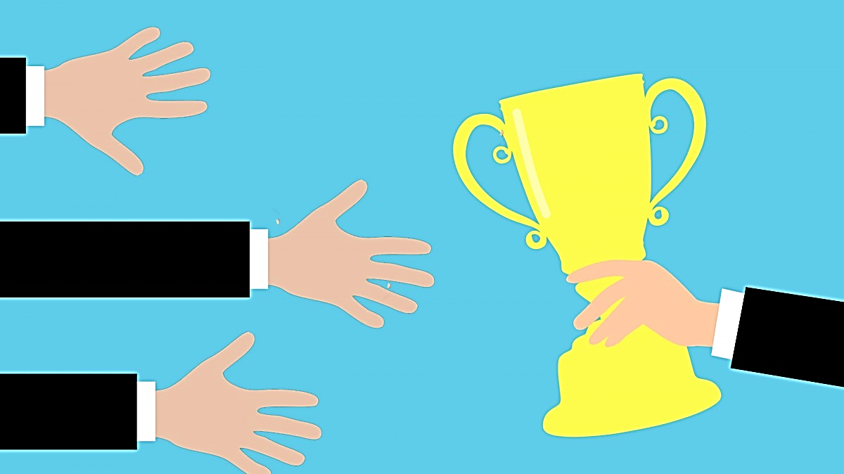
Me
The
Best
Me
Me

Slide 29
This is the world’s way! It is what the world values.
The world values competition and the pride of dominance.
As individuals, we all tend to fall into this “Pride of Life” trap.

Slide 30
Who’s the winner now?

Slide 31
The world is structured as a giant score board that everyone is watching.
Which of us is the winner now?
We often compete on an individual level, but we greatly amplify that spirit when we apply it to our preferred groups.
More people / more pride / more fun!

Slide 32
39

Slide 33
For example, after the “2020” Olympic games in Japan, a U.S. news announcer exclaimed, “We’re #1.”
Yes, USA had won the most gold medals.
It was USA 39 gold medals to China’s 38.

Slide 34
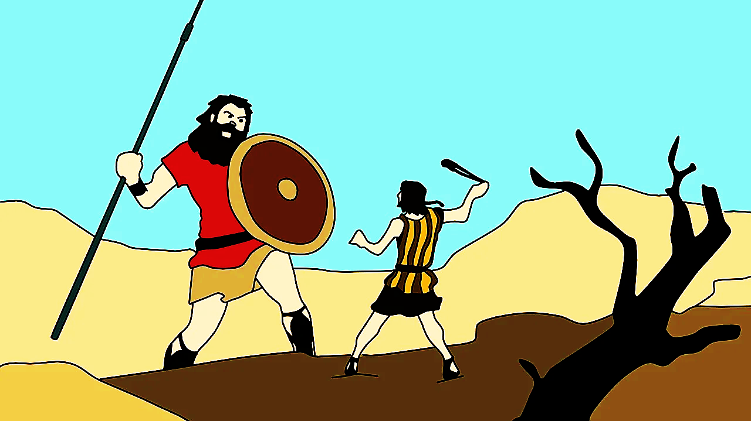

Slide 35
Remember, the Philistines chose their
Champion, Goliath and God saw to it that
David would be the one to represent Israel…
…Because God knew that David was just a young, inexperienced boy who could never defeat Goliath in his own strength.
He was the most unlikely champion.
But he was a boy who knew, even in his limited experience, that the battle is the Lord’s.

Slide 36
We Are
The
Best

Slide 37
The world always asks, “Who is the greatest among us?” It is their way!
Living in Christ, our lives are changing and, most of all, our values are changing.
It is time to get off this merry-go-round of worldly rivalry.

Slide 38
Satan was on this pride-ride when he pitted himself in competition against God Himself.
He then introduced this ride to Adam & Eve.
Ever since, the whole world has been going round and round—all trying to be winners.
My team, school, family, country, church, etc.

Slide 39
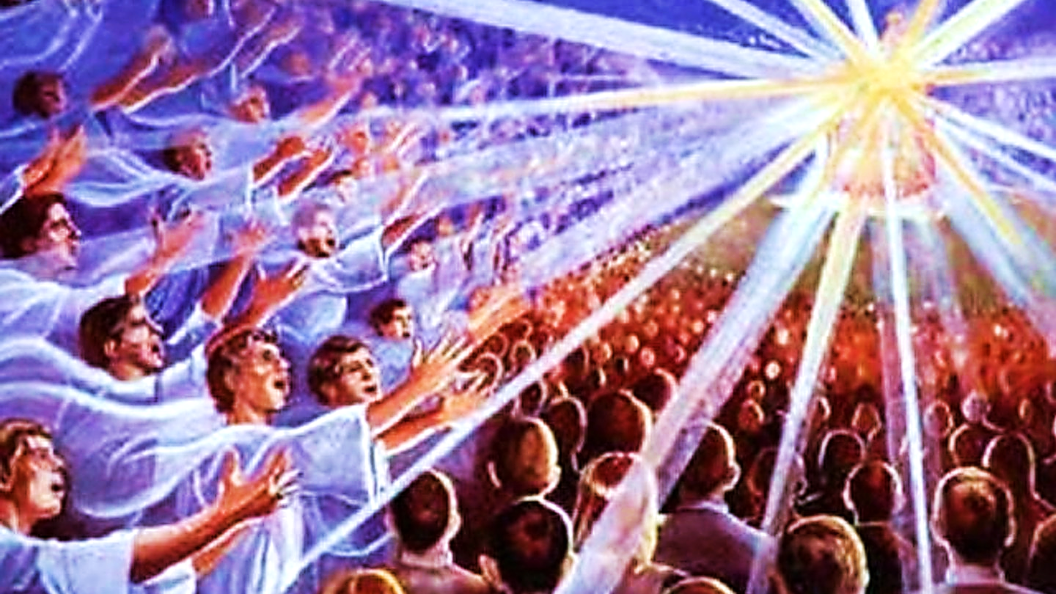

Slide 40
Now, let’s talk about the angels. Angels do two things; they obediently deliver messages for King Jesus and…
When they are in court (in Heaven), they bow and praise the King in loud fervent worship.

Slide 41
Speak God’s Word Worship God Study His Word Intercede for the Lost

Slide 42
We are called to these same two duties (to speak God’s Word and to worship HIM, plus two more…
Bible study (because we have limited knowledge of God) and…
Intercession for the lost (because the church has also been given priestly duties).

Slide 43
An exception to the normal angelic understanding of their humble station is the actions and desires of an angel named Lucifer.
He went far beyond the calling for which he was created.
He became interested in the idea of hierarchy and rank.
He began to see God as his rival, and he wanted to be the greatest of all.
This verse shows us his thought process.

Slide 44
Isiah 14:12-15 (BBE)
“How great is your fall from heaven, O shining one, son of the morning! How are you cut down… For you said in your heart, I will go up to heaven, I will make my seat higher than the stars of God… I will be like the Most High. But you will come down to the underworld…”

Slide 45
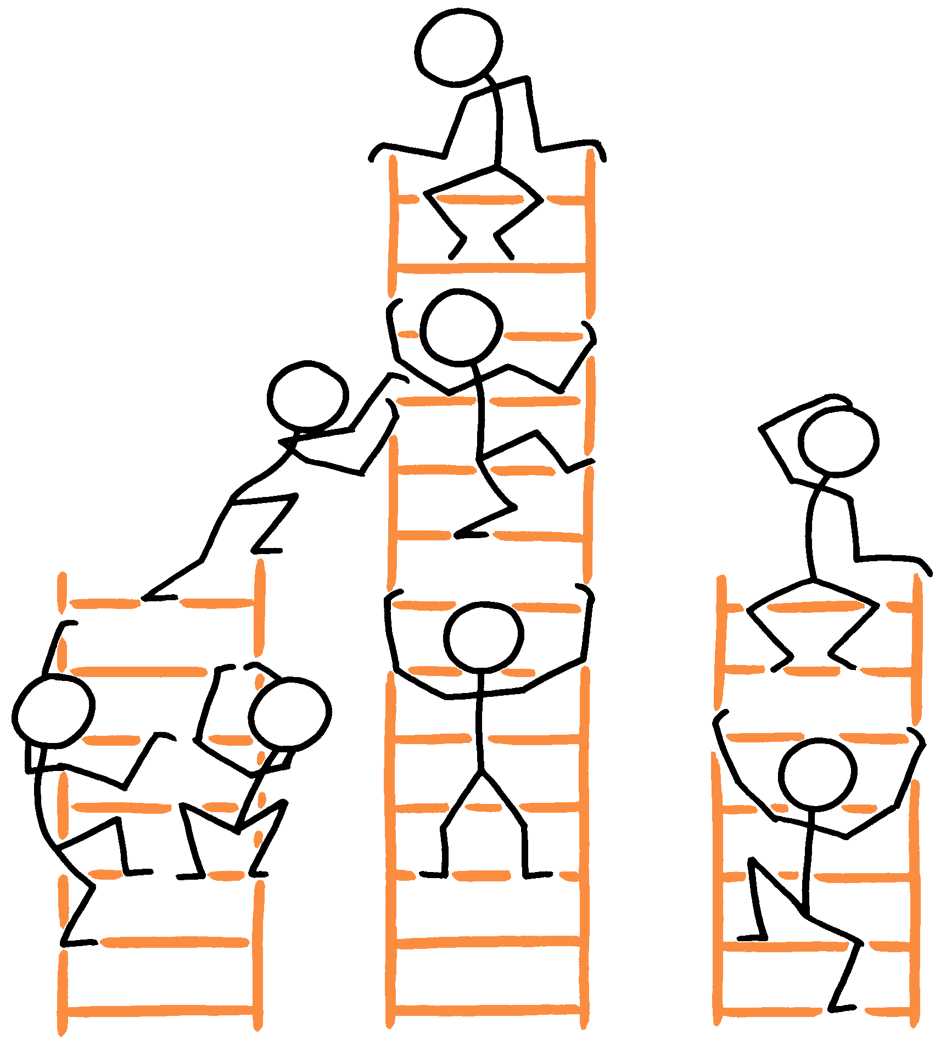
Worldliness Looks Like This→
Watch it buddy.
Hey, occupied!
This one has more potential.
What now?
On my way!
My rung!
Hey!
Hope I
make
it.

Slide 46
When we start thinking about hierarchy or rank…
Who is higher than us, as well as who is beneath us… we are thinking like the Devil.
Whom do we look up to or look down at?
When we begin to see others as our rivals…
When we want to be the greatest one or even part of the greatest organized group…
We have truly begun thinking like the Devil.
It is the Pride of Life… it is the way of the devil and the world.

Slide 47
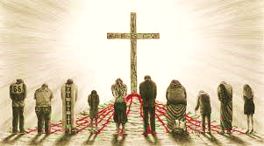
The Kingdom of Heaven Looks Like This→

Slide 48
But Heaven is different—only Jesus is important.
Every other creation, like angels, are happy just to serve as His messengers and have the opportunity to worship Him forever.
That’s nothing like the hierarchy of the world.
It’s not a ladder of importance where men are measured by their position.

Slide 49
Rather, in heaven, all God’s creatures have the same lowly position…At the feet of Jesus.
Equally loved, equally forgiven.
Jesus is great and the rest of us are small!!

Slide 50
Ephesians 1:20-22 (AMP)
“…He raised Him from the dead and seated Him… far above all rule and authority and power and dominion, whether angelic or human, and far above every name that is named…

Slide 51
Ephesians 1:20-22 (AMP) cont.
“…above every title… And He put all things, in every realm, in subjection under Christ’s feet and appointed Him as supreme and authoritative head over all things...”

Slide 52
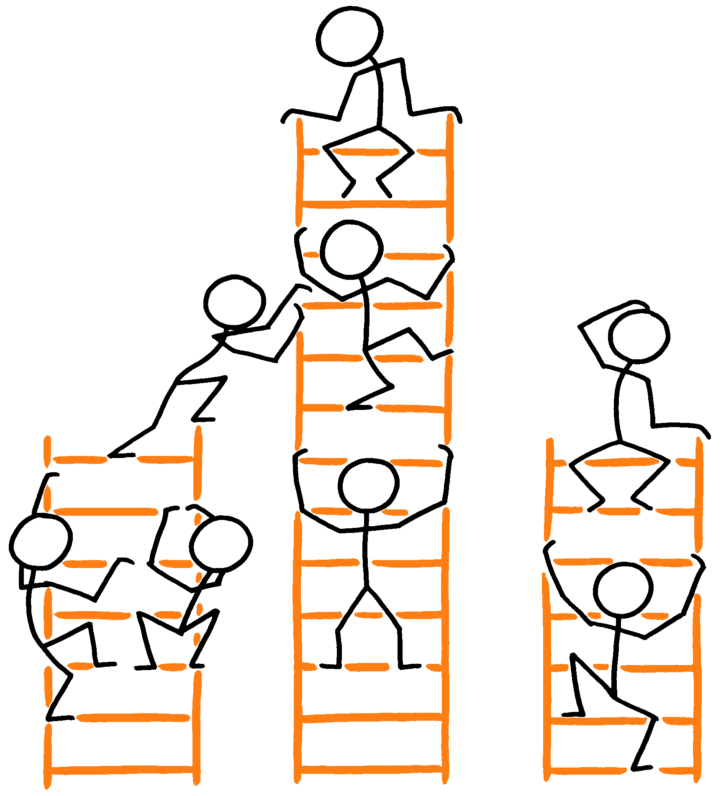
As we grow in Christ, we realize that this world is not our world anymore. Pride and rivalries become less and less important to us. It is all a bunch of foolish worldliness and the world can have it— Give me Jesus!!

Slide 53
Philippians 3:20(AMP)
“But we are different, because our citizenship is in heaven. And from there we eagerly await the coming of the Savior, the Lord Jesus Christ.”

Slide 54
The Jews came out of Egypt, and now they were living in Canaan, but God warns them not to imitate the cultures and attitudes of the nations around them.
It’s time to live like the angels in the Kingdom of God with a new way of thinking.

Slide 55
Don’t imitate the world

Slide 56
Obedience replaces seeking prominence

Slide 57
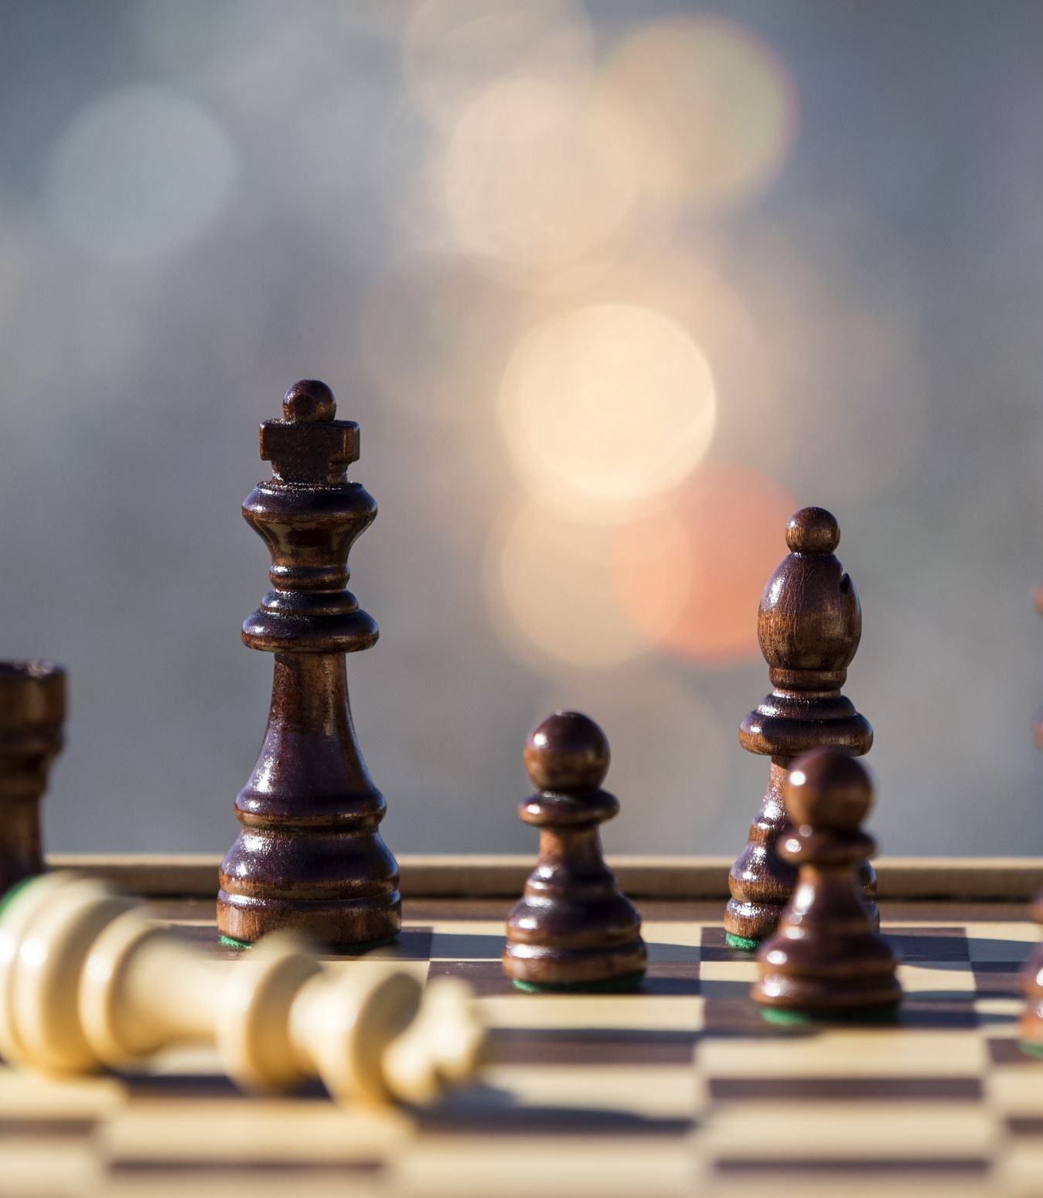
WORSHIP REPLACES RIVALRY

Slide 58
Obedience replaces seeking prominence.
Worship replaces rivalry.

Slide 59
Leviticus 18:3 (ESV)
“You shall not do as they do in the land of Egypt, where you lived, and you shall not do as they do in the land of Canaan, to which I am bringing you. You shall not walk in their statutes.”

Slide 60
1 John 2:15-16 (MEV)
“Do not love the world or the things in the world. If anyone loves the world, the love of the Father is not in him. For all that is in the world—the lust of the flesh, the lust of the eyes, and the pride of life—is not of the Father, but is of the world.

Slide 62
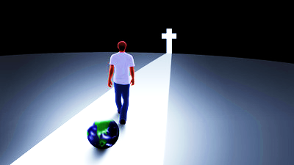
Christ Art

Slide 63
Just walk away.
The world divides itself into rival groups… but we are not of the world.
We have nothing to prove, we have only to serve the Lord.

Slide 64
Next Time: On the Side of the Angels Part 2 of 5 Emboldening Rebellion & Groupthink

