Slide 1
When Jesus Was a Lamb

Slide 2
Welcome All

Slide 3
Let’s Begin with Prayer

Slide 4
Note: After you download the slideshow, you may also need to download some videos from YouTube & add them into this PowerPoint. This tool can help you: Free YouTube Download
We present these messages in outdoor venues using the SonShineTent. Watch the video of our service that goes with this message, click here: http://campaignkerusso.org/?p=6056
We would love to know more about the people who download our lessons & sermons. We invite you to email us & let us know where & how you use them.
info@campaignkerusso.org

Slide 5
When Jesus Was a Lamb

Slide 6
Song: Jesus Lamb God
Video Goes Here Title: Jesus Lamb God Download Here:
https://www.youtube.com/watch?v=Zx7KB-DermI

Slide 7
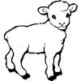
Jesus was Pictured as a Lamb in the O.T.
The Bible has two main sections:
The first tells us what happened before Jesus was born.
The second tells us what happened after Jesus was born.
BUT, Jesus WAS in the first section… pictured as a lamb…
NT
OT

Slide 8
Jesus was Pictured as a Lamb in the O.T.
Sometimes, people wear costumes.
It is hard to see who they really are under the costume.
Jesus was in the Old Testament a great deal.
He was often pictured as a little lamb.

Slide 9
Everyone living then knew that a lamb was the only accepted sacrifice for sin.
Isaac wondered how they could make a sacrifice without a lamb.
Abraham answered:
“My son, God will provide HIMSELF a lamb for a burnt offering”
Gen. 22:8
Abraham was seeing into the future.

Slide 10
For the real sacrifice -- God had His own Son (not Abraham’s) in Mind!

Slide 11
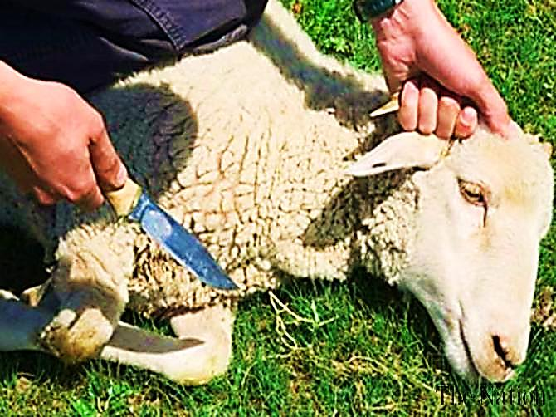
“He was beaten down and made to suffer, but he didn’t open his mouth. He was led away like a sheep to be killed. Lambs are silent while their wool is being cut off. In the same way, he didn’t open his mouth.” Isa. 53:7

Slide 12
People wondered who this Lamb would be and how He would take away the sin of the world.
John the Baptist pointed right at Jesus and said “Behold the Lamb of God.”

Slide 13
Video: John the Baptist
Video Goes Here Title: John the Baptist
Download Here:
https://www.youtube.com/watch?v=vzpu5Ql1THk

Slide 14
How is Jesus the Lamb of God?
We need to look at the story of the Passover to see why lambs are so important to God.
We will look at a night that all the Hebrew people were saved because of a lamb.

Slide 15
Passover
On this day the death angel would take all the first-born sons of the Egyptians.
God said, each family that sacrifices a lamb and puts its blood on their doorposts will be saved.
He promised that the death angel would just pass over their house.
But, the lamb had to be special…

Slide 16
Video: Passover Lamb
Video Goes Here Title: Passover Lamb
Download Here:
https://www.youtube.com/watch?v=QZuiH6dYHv4

Slide 18
The Lamb must be Perfect
“You were bought with the precious blood of Christ’s death. He was a pure and perfect sacrificial Lamb.” 1 Pet. 1:19

Slide 19
A lamb for a family - Jesus was the Lamb for God’s lost family – the whole world!

Slide 20
It must be Slain & Burned with Fire
Fire speaks of the judgment of God.
Our sins were judged on the cross.
If we believe, we will never face another judgment.

Slide 21
Jesus Laid Down His Life Willingly
“He was beaten down and made to suffer, but he didn’t open his mouth. He was led away like a sheep to be killed. Lambs are silent while their wool is being cut off. In the same way, he didn’t open his mouth.” Isa. 53:7

Slide 22
The Blood Must be Applied by Faith
“The blood will be a sign for you on the houses where you are; and when I see the blood, I will pass over you.”
Ex.12: 13

Slide 23
The Blood must be Applied by Faith
“ …That’s why his blood is much more powerful and makes our consciences clear...” Heb. 9:14

Slide 24
You Must Eat the Whole Lamb
“Whoever eats My flesh and drinks My blood has life that lasts forever…” John 6:54
Jesus wants us to consume Him.
No picky eaters.
Jesus requires 100% commitment – no half way Christians.

Slide 25
Song: Lamb of God
Video Goes Here Title: Lamb of God
Download Here:
https://www.youtube.com/watch?v=pW7UgzFG4v4

Slide 26
Is Jesus
Speaking to You?
“They said to each other, ‘Did not our hearts burn within us while he talked to us on the road, while he opened to us the Scriptures?’”
John Wesley Said:
“…the preacher was describing the change which God works in the heart through faith in Christ and I felt my heart strangely warmed.”
Jesus makes His presence Known by a small voice!

Slide 28
What is the Sinner‘s Prayer?
This is a prayer we can pray when we are ready to admit we are sinners and need Christ’s forgiveness.
It must be prayed with faith in our hearts and a readiness to have a life-changing encounter with Jesus Christ.

Slide 29
A prayer of faith → Pray this prayer if :
If you never have before
You have in the past, but you think it would mean more today
You have been walking afar off and you want to come back
You want to set an example & show others how it is done
You just like to give your heart to Jesus again & again
Faith

Slide 30
We Declare Our Faith Publicly Because Jesus Declared His LOVE Publicly
“If you stand before others and are willing to say you believe in me, then I will tell my Father in heaven that you belong to me.” Mat 10:32

Slide 31
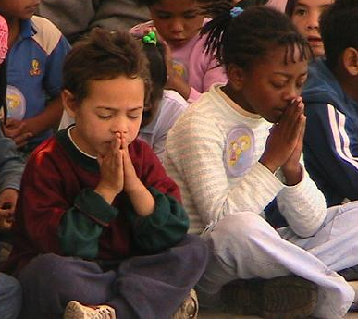
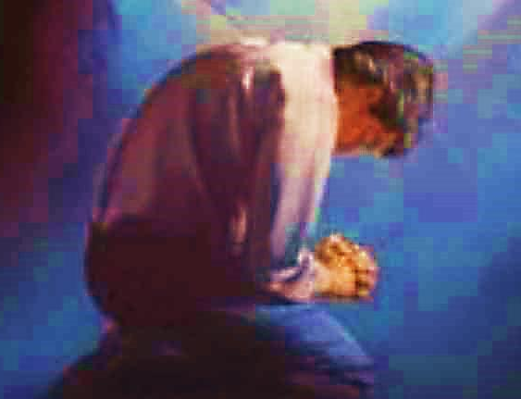
Three Important Questions
Do you want to know Jesus as your Savior right now?
Do you believe He died to save you from your sins & that He rose from the dead?
Do you believe that He is here, waiting to save you right now?

Slide 32
The Prayer of a Sinner Turning to Jesus
Dear Jesus, I know that I have sinned against You and that my sins separate me from You.
I am truly sorry.
Right now, I turn away from my sinful past .
Please forgive me, and help me to keep from sin.
I believe You died for my sins.
I Believe You rose from the dead, you are alive, and you hear this prayer from my heart.
I invite You Jesus to be both my Savior and the Lord of my life.
I want You to rule my life from now on.

Slide 33
“But some people did accept him. They believed in him, and he gave them the right to become children of God.”
John 1:12

Slide 35
“If you openly say, ‘Jesus is Lord’ and believe in your heart that God raised him from death, you will be saved.”
Rom. 10:9
What did you learn today?
What about The Lamb of God?
What have you been thinking about God lately?
What do you want to tell others about Jesus?

Slide 36
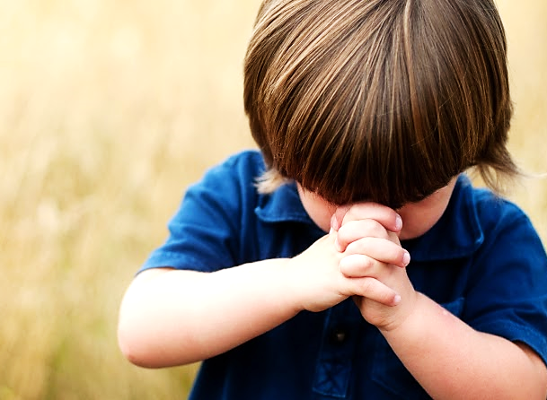
Let’s Close in Prayer

Slide 37
Note: After you download the slideshow, you may also need to download some videos from YouTube & add them into this PowerPoint. This tool can help you: Free YouTube Download
We present these messages in outdoor venues using the SonShineTent. Watch the video of our service that goes with this message, click here: http://campaignkerusso.org/?p=6056
We would love to know more about the people who download our lessons & sermons. We invite you to email us & let us know where & how you use them.
info@campaignkerusso.org

