Slide 1
The Bells of Christmas

Slide 2
If you would like to watch the video of the service, click here:
https://campaignkerusso.org/?p=19642
We would love to know more about the people who download our lessons & sermons. We invite you to email us & let us know where & how you use them.
info@ckbrazos.org

Slide 3
The Bells of Christmas

Slide 4
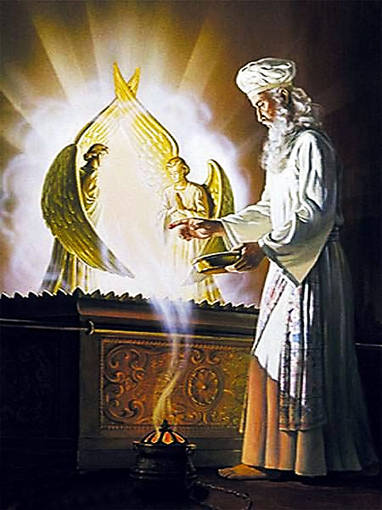
In Israel, the High Priest went into a room (behind a veil) called the Holy of Holies where he offered the blood of the lamb as a sacrifice for the sins of the people.

Slide 5
This reminds us of Jesus, our High Priest, who would enter the original Holy of Holies (in Heaven) and offer His own blood as a sacrifice for our sin.

Slide 6
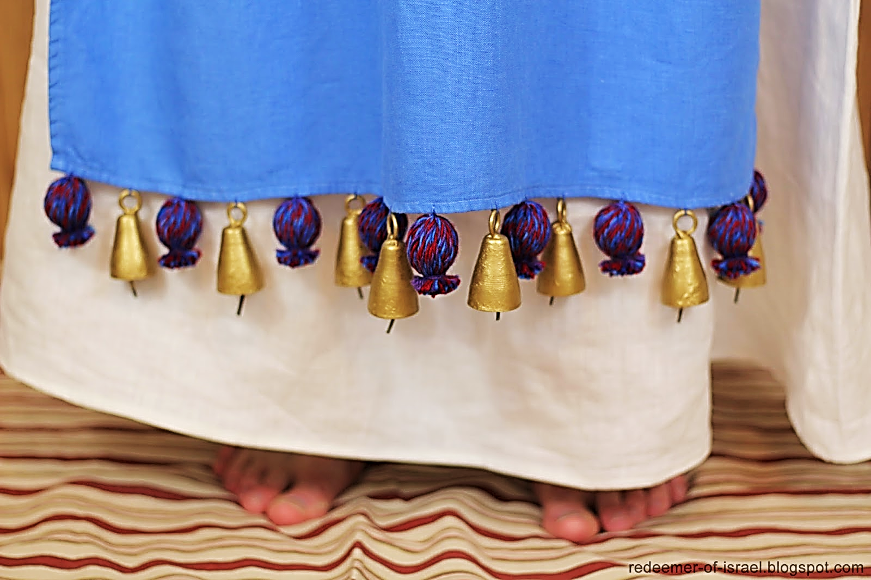
Bells on the High Priest’s Robe

Slide 7
The bible bells are worn by the High Priest around the hem of his robe.
They made the ‘sounds’ of the High Priest as he moved about in the Holy of Holies.

Slide 8
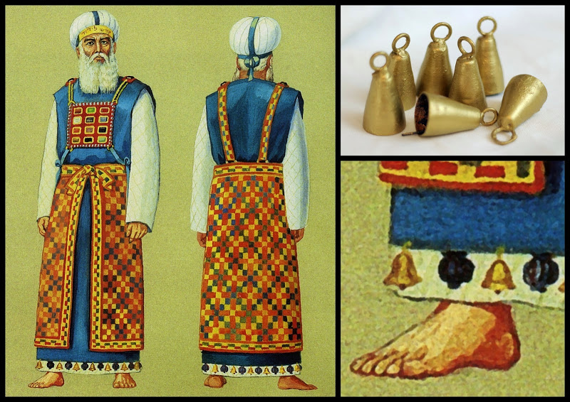
The hem of the Priest’s garment was very special… from it hung bells of gold.

Slide 9
These bells made the sounds of the priest and were evidence of his movements.

Slide 10
The ringing of the bells around the priest’s hem told you that the priest was alive and well.
The ringing of the bells told you that the priest was still working on your behalf.

Slide 11
Ex. 28:34, 35 (NIRV)
“Sew a gold bell between every two pomegranates all around the hem of the robe. Aaron must wear the robe when he serves as priest…

Slide 12
Ex. 28:34, 35 (NIRV)
…The bells will jingle when he enters the Holy Room while he is serving the Lord. And they will jingle when he goes out…”

Slide 13
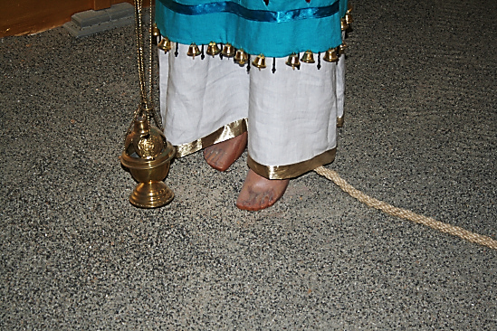
If the High Priest ever made an imperfect sacrifice, he would be struck dead.
Tradition says they tied a rope to his leg so they could…
…retrieve his dead body without entering the Holy of Holies themselves.

Slide 14
We are like the bells hanging on the hem of our High Priest’s (JESUS) garment.

Slide 15
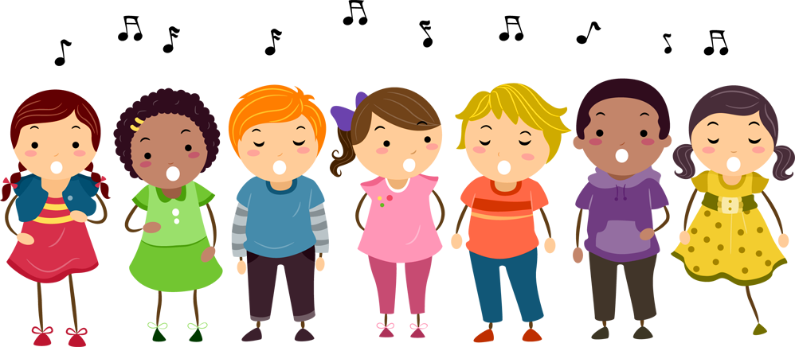
The bells ring (as witnesses) for God.
The bells surround the hem of His robe.
Remember the woman who touched His hem and was healed.
As bells on His hem, our message heals the sin-sick soul.

Slide 16
Today, the hem bells are His Church. Jesus is in Heaven, and we are around His hem, representing Him down here on Earth.
We are the audible evidence of Him for a world who can’t see or hear Him.
We are the sounds of God.

Slide 17
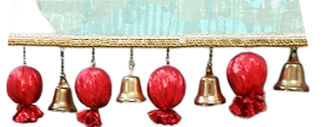
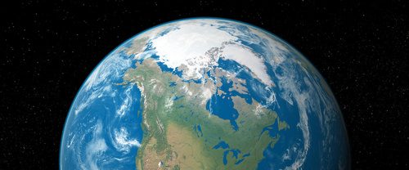
“We, however, are citizens of heaven, and we eagerly wait for our Savior, the Lord Jesus Christ, to come from heaven.”
Phil. 3:20 (GNT)

Slide 18
We are the body of Jesus (on earth) who is our Head (in Heaven).
We are like bells hanging from His hem.
We are near enough to Earth for the world to hear His message ringing out from us.
We are the sounds of God for Earth’s sake.

Slide 19
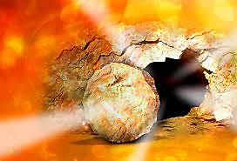
We are the hem bells that tell the world that our High Priest, Jesus has made a perfect sacrifice, that it has been accepted by the Father, and that He is still alive and well!

Slide 20
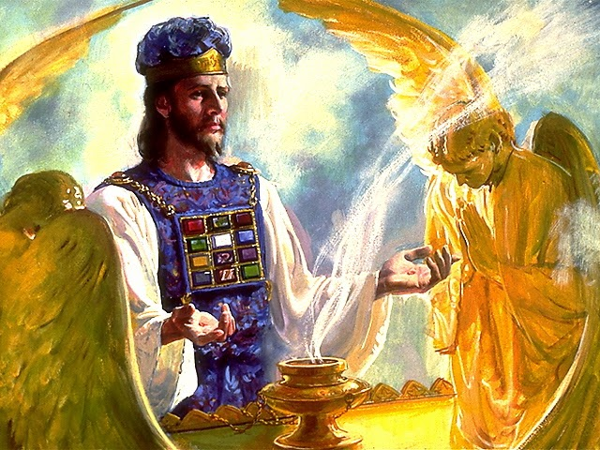
We are the hem bells that tell the world that our High Priest (JESUS) is still busy on our behalf.
Let every move our Priest (JESUS) makes be announced & sung about by (US) His bells on Earth.

Slide 21
We are the hem bells that sing of “Peace on Earth, Good Will toward Men” through the sacrifice of Jesus.
We Are the Bells of Christmas Day!

Slide 22
If we fail to ring, the world may think our High Priest (JESUS) is dead.
If we fail to ring, humanity will not know that JESUS is ever busy—ever working to save men’s souls.
We must never stop ringing out the good news of the gospel.

Slide 23
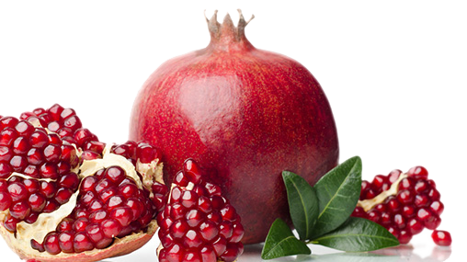
Each joyful bell was to be flanked by fruitful, seed-filled pomegranates on each side.

Slide 24
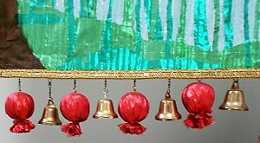
The hem bells are both joyful & fruitful:
Fruitful / Joyful / Fruitful /Joyful / Fruitful etc.
“Shout for joy to the Lord, everyone on earth. Burst into joyful songs and make music.”
Ps. 98:4 (GW)
“The fruit of those who are right with God is a tree of life, and he who wins souls is wise.”
Pv. 11:30 (TLB)

Slide 25
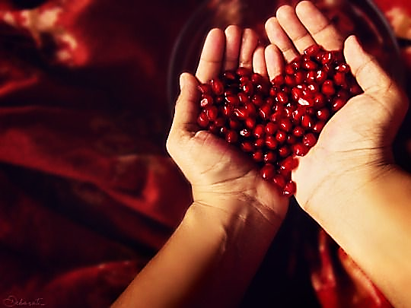
In the abundance of fruit, we have the most joy!
Ring the bells, sing the songs.

Slide 26
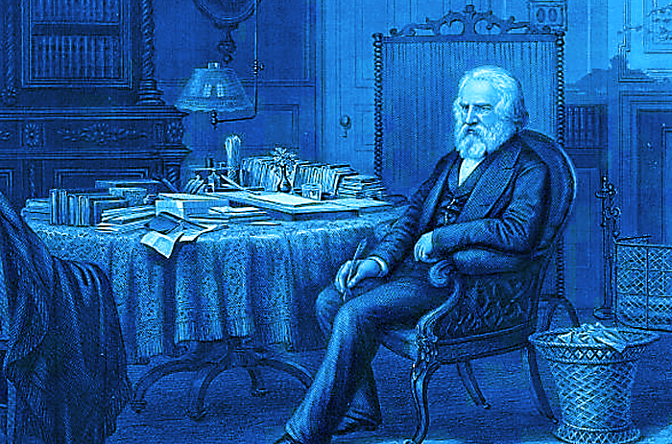
Poet Henry Wadsworth Longfellow sustained serious burns attempting to put out a fire on the dress of his beloved wife, Frances .
Sadly, she died.
He had been grieving her for two years when he began caring for his dear boy who had come home after being badly injured in the Civil war.

Slide 27
In the distance he heard the cheerful tolling of Christmas bells and he struggled inwardly.
But ultimately, his pain gave birth to newfound faith as he penned this poem:

Slide 28
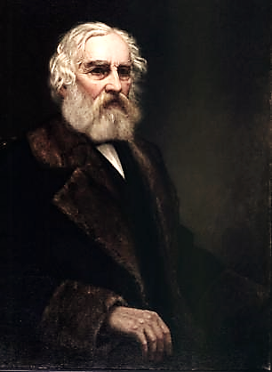
“I heard the bells on Christmas Day
Their old, familiar carols play,
and wild and sweet
The words repeat
Of peace on earth, good-will to men!”

Slide 29
“And in despair I bowed my head;
‘There is no peace on earth,’ I said;
‘For hate is strong,
And mocks the song
Of peace on earth, good-will to men!’"

Slide 30
“Then pealed the bells more loud and deep:
‘God is not dead, nor doth He sleep;
The Wrong shall fail,
The Right prevail,
With peace on earth, good-will to men.’"

Slide 31
Like the Israelites, Longfellow heard the message of the Christmas bells:
1) Jesus (the Priest) is not dead.
2) He is still working on our behalf.
3) Believers will have fruitfulness & joy.

Slide 32
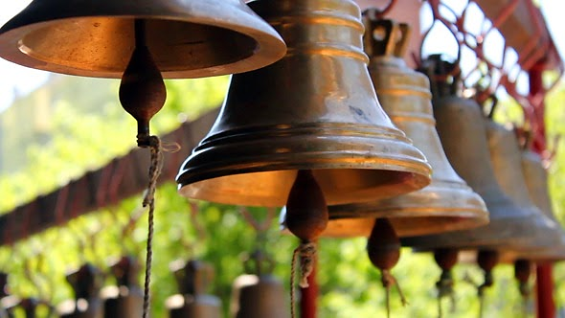
Let us remember, we are the Church, and we are God’s “church bells.”
Our true citizenship is in Heaven, but we ring out the good news of the gospel here on Earth… we tell the world about what our High Priest, Jesus is doing for mankind..

Slide 33
Ring church bells, ring! We hang from the hem of His garment and tell the world:
- Jesus is alive and well.
- He is still working on our behalf.
- His children are joyous and fruitful.

Slide 34
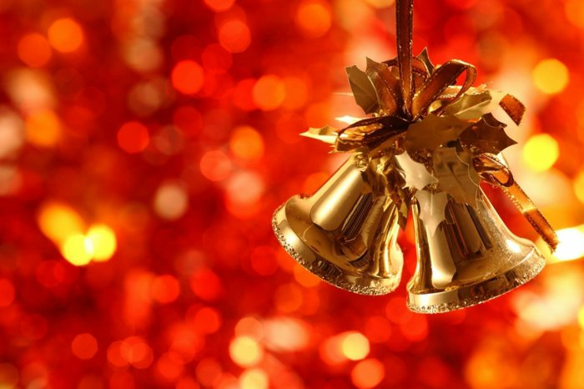
“Peace on Earth
Good Will to Men”

Slide 35
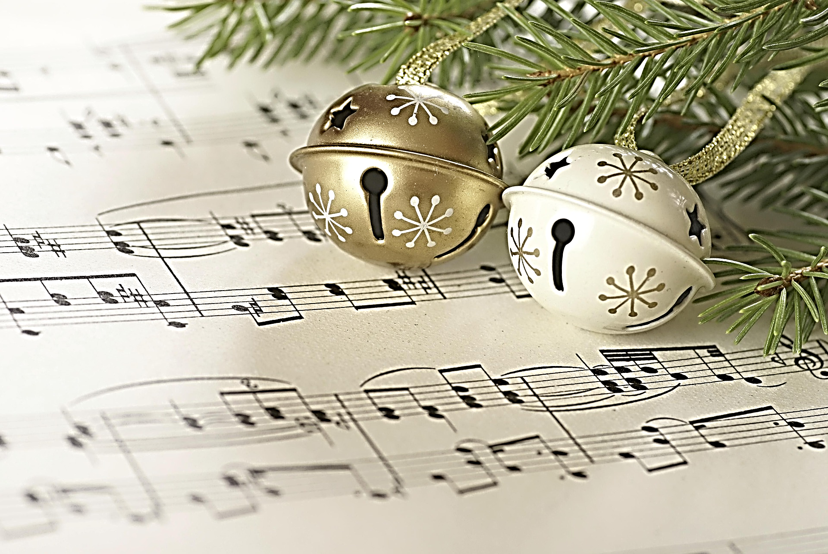
The following songs go well with this message.

Slide 36
Next Slide - Song: Easter Song (2md Chapter of Acts) View Here: https://www.youtube.com/watch?v=-6S3dp6elpw

Slide 37
Next Slide - Song: I Heard the Bells (Burl Ives) View Here: https://www.youtube.com/watch?v=2nk77EOgapg

Slide 38
Next Slide - Song: I Heard the Bells (Casting Crowns) View Here: https://www.youtube.com/watch?v=M5vgyj_aQkw

Slide 39
Next Slide - Song: Ring Those Bells View Here: https://www.youtube.com/watch?v=d39dQhQP38A

Slide 40
What is the Sinner‘s Prayer?
This is a prayer we can pray when we are ready to admit we are sinners and need Christ’s forgiveness.
It must be prayed with faith in our hearts and a readiness to have a life-changing encounter with Jesus Christ.

Slide 42
John Wesley’s Testimony
“…the preacher was describing the change which God works in the heart through faith in Christ and I felt my heart strangely warmed.”
Disciple’s Testimony
“They said to each other, ‘Did not our hearts burn within us while he talked to us on the road, while he opened to us the Scriptures?’”

Slide 43
A Prayer of Faith → Pray this rayer if :
If you never have before
You have in the past, but you think it would mean more today.
You have been walking afar off and you want to come back.
You want to set an example & show others how it is done.
You just like to give your heart to Jesus again & again.
Faith

Slide 44
We Declare Our Faith Publicly Because Jesus Declared His LOVE Publicly
“If you stand before others and are willing to say you believe in me, then I will tell my Father in heaven that you belong to me.” Mat 10:32

Slide 45
Dear Jesus,
I know I am a sinner & need your forgiveness.
I believe you died for my sins.
I now turn from sin.
Come into my heart I pray.
Please wash away my sin.
Do you want to meet Jesus as your savior right now?
Do you believe He died to save you from your sins & that He rose from the dead?
Do you believe that He is waiting to save you right now?

Slide 46
“But some people did accept him. They believed in him, and he gave them the right to become children of God.” John 1:12

Slide 48
“If you openly say, ‘Jesus is Lord’ and believe in your heart that God raised him from death, you will be saved.”
Rom. 10:9
What did you learn today?
What have you been thinking about God lately?
What do you want to tell the world about Jesus?

Slide 49
“Draw near to God, and He will draw near to you…
…Cleanse your hands, you sinners, and make your hearts pure, you who are half-hearted towards God.” James 4:8 WNT

Slide 50
Close in Prayer

