Slide 1
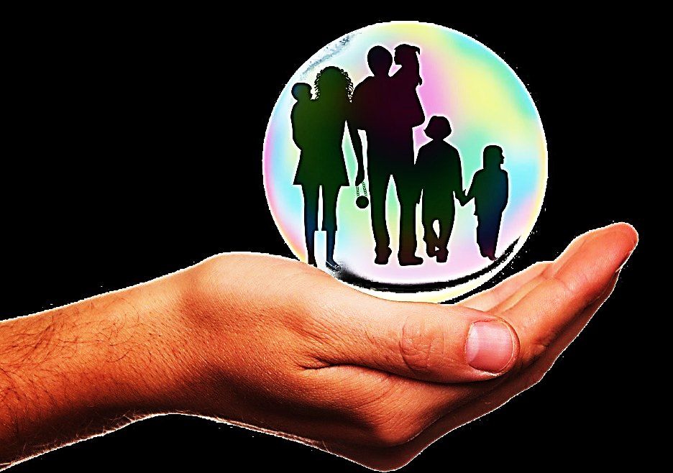
Kept by His Power
2 Thessalonians 2:13-3:16
Key Verse: “The Lord is faithful, and he will strengthen you and protect you from the evil one.” 2
Thess. 3:3 (NIV)

Slide 2
Kept by His Power
(2 Thessalonians 2:13-3:16)
Key Verse: “The Lord is faithful, and he will strengthen you and protect you from the evil one.” 2 Thess. 3:3 (NIV)
Paul was concerned about these new believers.
As young Christians they were especially vulnerable to Satan’s attacks and schemes i.e., persecution and deception.
A little background will show us why he was so concerned. (see: Acts 17:1-15)
Paul was only in Thessalonica for three Saturdays (or two weeks) before an angry mob drove him out.

Slide 3
Kept by His Power
(2 Thessalonians 2:13-3:16)
That same mob followed him to the next town over and drove him out of town again.
The Bereans (in that town) were more studious than the Thessalonians.
Paul went on to Athens while his companions, Silas and Timothy remained behind to check on the Thessalonians.
Paul sent for Silas and Timothy to come to him and report on the Thessalonians’ spiritual welfare.

Slide 4
Kept by His Power
(2 Thessalonians 2:13-3:16)
Paul was worried.
Those Thessalonian mobsters were a bunch of vicious brutes, and his little babies in Christ weren’t as studious as the Bereans.
He was only there to teach them for three Sabbaths. Can they handle the persecution?
Will they be susceptible to all the false teaching floating around?

Slide 5
Kept by His Power
(2 Thessalonians 2:13-3:16)
But, to Paul’s delight, his babies were still doing well.
“But now Timothy has just returned, bringing us good news about your faith and love. He reports that you always remember our visit with joy and that you want to see us as much as we want to see you. So, we have been greatly encouraged in the midst of our troubles and suffering, dear brothers and sisters, because you have remained strong in your faith. It gives us new life to know that you are standing firm in the Lord.” 1 Thess. 3:6-8 (NLT)

Slide 6
Kept by His Power
(2 Thessalonians 2:13-3:16)
This brings us back to our key verse:
“The Lord is faithful, and he will strengthen you and protect you from the evil one.” 2 Thess. 3:3 (NIV)
God both strengthens believers in persecution and protects them from the lies of the evil one.
The truth here is that we are kept by the same power through which we were saved!
GOD’s power!

Slide 7
Kept by His Power
(2 Thessalonians 2:13-3:16)
Paul understood how completely of God (not him) both their salvation and growth was.
“My brothers, the Lord loves you. We should thank God for you always.” _{2 Thess. 2:13 (WE)}
Do we continually thank God for the salvation and growth of our fellow believers… our spouses, our children?
We may love them, but we can’t save them, keep them saved, grow or perfect them.

Slide 8
Kept by His Power
(2 Thessalonians 2:13-3:16)
“…Here is why…” _{2 Thess. 2:13 (WE)}
Paul is about to tell us four reasons why we can rest secure in Christ’s work in us and in our loved ones. Each reason demonstrates that we are His handiwork… not our own.
Firstly: He chose us before the world was made.
“…From the beginning God chose you to be saved.” _{2 Thess. 2:13 (WE)}

Slide 9
Kept by His Power
(2 Thessalonians 2:13-3:16)
We can take no credit for our own salvation.
“You did not choose Me. I chose you, and I orchestrated all of this so that you would be sent out and bear great and perpetual fruit…” John 15:16 (VOICE)
At the same time, the bible says everyone is freely invited to partake in God’s salvation.
“For whosoever shall call upon the name of the Lord shall be saved.” Rom.10:13 (KJV)

Slide 10
Kept by His Power
(2 Thessalonians 2:13-3:16)
“But if any man love God, the same is known of him.” 1 Cor. 8:3
God, in His infinite wisdom, knows our hearts and shapes our path according to His foreknowledge of our future choices and our yieldedness to Him.
“Because whom He did foreknow, He also did
fore-appoint, [to be] conformed to the image of
His Son…” Rom. 8:29 (YLT)
God knows us better than anyone and He uses everything He knows about us to lovingly transform us into the image of His Son.

Slide 11
Kept by His Power
(2 Thessalonians 2:13-3:16)
Secondly: Not only did God choose us, the Holy Spirit does all the work in us.
“…You were saved because the Spirit made you holy…” 2 Thess. 2:13 (WE)
Thirdly: We choose to place our faith in His Word, but God helped us to do even that.
“…through the sanctifying work of the Spirit and through belief in the truth…” 2 Thess. 2:14 (NIV)
“For by grace are ye saved through faith; and that not of yourselves: it is the gift of God.” Eph. 2:8 (KJV)

Slide 12
Kept by His Power
(2 Thessalonians 2:13-3:16)
Fourthly: God started the process by sending a witness (Paul) so that they could hear the Gospel & believe.
“God used the Good News that we preached to call you to be saved. He called you so that you can share in the glory of our Lord Jesus Christ.”
2 Thess. 2:14 (ICB)
“How then shall they call on him in whom they have not believed? and how shall they believe in him of whom they have not heard? and how shall they hear without a preacher?” Rom. 10:14 (KJV)

Slide 13
Kept by His Power
(2 Thessalonians 2:13-3:16)
“God is the one who began
this good work in you, and I am
certain that he won't stop before it is complete on the day that Christ Jesus returns.” Phil. 1:6 (CEV)
God is not taking us from good-ish humans to super good humans. He is fixing broken, sin infested humans and making us holy and usable for His work and His glory.
“And he is able to keep you from slipping and falling away, and to bring you, sinless and perfect, into his glorious presence with mighty shouts of everlasting joy.” Jude 1:24 (TLB)

Slide 14
Kept by His Power
(2 Thessalonians 2:13-3:16)
Now we have a THEREFORE verse. This is where God is saying, “I said all of that just to say this…”
“Therefore, brothers, stand fast and keep the instructions which you have been taught, either by word or by our letter.” 2 Thess. 2:15 (RGT)
Therefore, since:
God chose you before creation
God sent you a witness to preach the Gospel to you…

Slide 15
Kept by His Power
(2 Thessalonians 2:13-3:16)
…and since:
God gave you the faith to believe
& God saved, cleansed and strengthened you by His Spirit…
Considering all that, despite the persecution and lies, YOU HANG IN THERE… hold fast to your faith and to God’s Word!!
Now Paul, knowing they needed both encouragement and hope for their future (without his being there to help them), prays for them….

Slide 16
Kept by His Power
(2 Thessalonians 2:13-3:16)
“ “May our Lord Jesus Christ
himself and God our Father, who
loved us and by his grace gave us
eternal encouragement and good hope, encourage your hearts and strengthen you in every good deed and word.” 2 Thess. 2:16, 17 (NIV)
Now, Paul takes a little turn… He asks them to pray for His ministry of evangelism…
We must also remember to pray to the “Lord of the Harvest” for those doing evangelistic ministry today.

Slide 17
Kept by His Power
(2 Thessalonians 2:13-3:16)
“Now I want to talk about some
other matters. Brothers and
sisters, pray for us. Pray that the
Lord’s message will spread quickly. Pray that others will honor it just as you did. And pray that we will be saved from sinful and evil people. Not everyone is a believer.” 2 Thess. 3:1,2 (NIRV)
“Now, enough about me…
back to you my precious young converts…”
He prays for them again…

Slide 18
Kept by His Power
(2 Thessalonians 2:13-3:16)
“And the Lord guide your hearts to the love of God, and the waiting for of Christ.”
2 Thess. 3:5 (GNV)
These were young Christians with hearts full of love and excitement for the return of Christ. These are often the strengths of young Christians.
But there were also weaknesses in the young Thessalonian church… weaknesses that could hinder their continued growth in Christ…

Slide 19
Kept by His Power
(2 Thessalonians 2:13-3:16)
“While we were with you, we
gave you the order: “Whoever
doesn’t want to work shouldn’t be
allowed to eat. We hear that some of you are not
living disciplined lives. You’re not working, so you go around interfering in other people’s lives. We order and encourage such people by the Lord Jesus Christ to pay attention to their own work so they can support themselves.” 2 Thess. 3:10-12 (GW)
Remember: “By the sweat of your brow you will eat your food until you return to the ground…”
Gen. 3:19 (NIV)

Slide 20
Kept by His Power
(2 Thessalonians 2:13-3:16)
Some Thessalonian believers
had become, lazy, complaining
busy bodies who were all up in
everybody’s business. These were “believer babies” (not baby believers).
Baby Christians, like any babies, need to be fed, carried, coddled & cleansed (they make messes). Parents are happy to do it for a season, but babies should be walking & starting to feed themselves by one year old (or so). Carrying & coddling should end.
An adult provides his/her own food and also feeds others, carries his/her own load and also that of others, cleans up his/her own and other’s messes – all with love and grace.

Slide 21
Kept by His Power
(2 Thessalonians 2:13-3:16)
“In the name of the Lord Jesus
Christ, we command you,
brothers and sisters, to keep
away from every believer who is idle and disruptive and does not live according to the teaching you received from us.” 2 Thess. 3:6 (NIV)
“And if any man obey not our word by this epistle, note that man, and have no company with him, that he may be ashamed. Yet count him not as an enemy but admonish him as a brother.” 2 Thess. 3:14,15 (KJV)
For their fellowship, Paul counsels them not hang out with believer babies, but rather, to seek out those who challenge their Christian walk and to imitate them.

Slide 22
Kept by His Power
(2 Thessalonians 2:13-3:16)
Paul gives himself as an example of the kind of believer they should pattern themselves after.
“You know what you must do to imitate us. We lived a disciplined life among you. We didn’t eat anyone’s food without paying for it. Instead, we worked hard and struggled night and day in order not to be a burden to any of you. It’s not as though we didn’t have a right to receive support. Rather, we wanted to set an example for you to follow.” 2 Thess. 3:7-9 (GW)

Slide 23
Kept by His Power
(2 Thessalonians 2:13-3:16)
The ‘we must work to eat’
principle applies to more than
physical work and duties. Remember, the Thessalonian believers had also been lazy about bible study.
“The Berean Jews were of more noble character than those in Thessalonica, for they received the message with great eagerness and examined the Scriptures every day to see if what Paul said was true.” Acts 17:11 (NIV)
The Berean’s listened to Paul preach, but they also studied on their own.

Slide 24
Kept by His Power
(2 Thessalonians 2:13-3:16)
We cannot be students of
God’s word by merely listening
to teachers and preachers. That is acting like babies who are hand fed by caretakers. That’s good for, maybe a year, then you need to start feeding yourself and walking on your own. And after that, start feeding and carrying others.
“Every Scripture is God-breathed and profitable for instruction, for conviction, for correction, and for training in righteousness, so that the man of God may be complete, having been fully equipped toward every good work.” 2 Tim. 3:16,17 (BLB)

Slide 25
Kept by His Power
(2 Thessalonians 2:13-3:16)
Bible study is the worthy work
that helps grow baby believers into self-feeding, mature believers.
“Get [skillful and godly] wisdom! Acquire understanding [actively seek spiritual discernment, mature comprehension, and logical interpretation]! Do not forget nor turn away from the words of my mouth. Do not turn away from her (Wisdom) and she will guard and protect you. Love her, and she will watch over you.” Prov. 4:5,6 (AMP)
Yes, God would keep the Thessalonians, but not on auto-function. We must be yielded to the two powerful tools God uses to keep us, His Spirit and His Word.

Slide 26
Kept by His Power
(2 Thessalonians 2:13-3:16)
We must learn to compare scripture with itself, not with our own human wisdom.
“Which things also we speak, not in the learned words of human wisdom; but in the doctrine of the Spirit, comparing spiritual things with spiritual.” 1
Cor. 2:13 (DRA)
We should be able to cite several bible verses to support what we feel is right and say we believe. Otherwise, we may only be parroting what the world has taught us.

Slide 27
Kept by His Power
(2 Thessalonians 2:13-3:16)
Scripture can only be
understood if we have a strong
foundation in both old and new
testament. We can then compare scripture with scripture and wonder (in awe) at how it all fits
together perfectly.
“He said, “Then you see how every student well-trained in God’s kingdom is like the owner of a general store who can put his hands on anything you need, old or new, exactly when you need it.”
Mat. 13:52 (MSG)

Slide 28
Kept by His Power
(2 Thessalonians 2:13-3:16)
Without a strong foundation in
God’s Word, we are not getting
everything out of scripture that we could be. In a sense… if we will not do the work of diligent study, we won’t even be able to eat the food. Like babies, we will be as if we have no spiritual teeth for proper chewing.
Until we are rooted and grounded in God’s Word, all we can get from God’s Word is baby formula rather than a juicy steak.
“So, I had to treat you like babies and feed you milk. You could not take solid food, and you still cannot.”
1 Cor. 3:2 (CEV)

Slide 29
Kept by His Power
(2 Thessalonians 2:13-3:16)
“We have many things to tell
you about this. But it is hard to
explain because you have stopped
trying to understand. You have had enough time that by now you should be teachers. But you need someone to teach you again the first lessons of God’s teaching. You still need the teaching that is like milk. You are not ready for solid food. Anyone who lives on milk is still a baby and is not able to understand much about living right.” Heb. 5:11-13 (ERV)
Remember: “By the sweat of your brow you will eat your food [comprehend the word]…” Gen. 3:19 (NIV)

Slide 30
Kept by His Power
(2 Thessalonians 2:13-3:16)
Now, Paul gives an exhortation
to those who are giving all
diligence to their spiritual duties.
“But ye, brethren, be not weary in well doing.”
2 Thess. 3:13 (KJV)
Paul is speaking to those who may feel they are surrounded by spiritual babies who must be coddled and clean up after. They should rather pray for them & carry on with God’s grace & love.
Paul now takes the pen in his own hand to write his closing prayer. (Usually, he dictated his letters because it is believed he had eye problems.)

Slide 31
Kept by His Power
(2 Thessalonians 2:13-3:16)
“May the Lord of peace give you His peace at all times. The Lord be with you all. I, Paul, write this last part with my own hand. It is the way I finish all my letters. May all of you have loving-favor from our Lord Jesus Christ.” 2 Thess. 3:16-18

Slide 32
Kept by His Power
(2 Thessalonians 2:13-3:16)
He Who Began a Good Work In You
https://www.youtube.com/watch?v=04wDsq9gr0k

