Slide 1
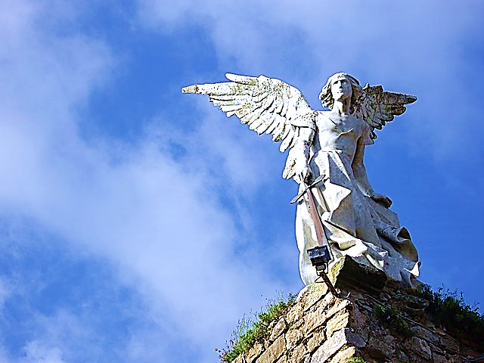
On the
Side
of
THE
ANGELS
Part 4 Caustic Kings (Their Methods)
Black
Our Party
Us
Athletes
White
Their Party
Them
Nerds
Born Here
Rich
College
C.E.O.
Moved Here
Poor
Trades
Janitor

Slide 3
On the Side of the Angels Part 4 of 5 Caustic Kings (Their Methods)

Slide 4
On the
Side
of
THE
ANGELS
Part 4 Caustic Kings (Their Methods)
Black
Our Party
Us
Athletes
White
Their Party
Them
Nerds
Born Here
Rich
College
C.E.O.
Moved Here
Poor
Trades
Janitor

Slide 5
We have been looking at the tendency of humans to form groups and take sides.
Race, politics, natural abilities, territorial interests, classism, education levels, ageism, dress tastes, taste in music, etc., etc., etc.,
There is an old saying that goes like this, “I’m on the side of the Angels.”
And this is the title of this series.
This is message #4 of 5 in the series.

Slide 6
Although grouping can be a good thing, it has many dangers. We will examine Five Biblical Dangers
& Pitfalls.
Worldly War Games
Emboldening Rebellion
Groupthink
Caustic Kings (Their Motive & Methods)
Dangerous Duplicity

Slide 7
We have looked at the motives of Caustic Kings, now let’s look at their methods.
We will look at four basic methods of false Christian leaders

Slide 8
Four Methods of False Christian Leaders
False Beauty & Righteousness
Flattery (beginning with themselves)
Twisting Scripture to Please Men
Shortsighted Scriptural Understanding

Slide 9
False Beauty & Righteousness

Slide 10
Most self-serving leaders are very pleasant.
They are charismatic, engaging and seemingly attentive to their followers.
They seem to have wonderful plans for the future of their ministry and for all those who will stick with them.

Slide 12
2 Corinthians 11:13-14 (NLV)
“Those men are false missionaries. They lie about their work. But they make themselves look like true missionaries of Christ. It is no surprise! The devil makes himself look like an angel of light.”

Slide 13
“The devil makes himself look like an angel
of light.”

Slide 14
The problem with deception is that it wouldn’t work if it wasn’t attractive.
No one chooses to swallow an ugly, bitter pill.
Deception is usually a mixture of attractive truth, sprinkled with even more attractive lies.
It is evil disguised as goodness.
Often, it claims to be fresh new revelation from God.

Slide 15
Flattery
“You’re important here.”

Slide 16
These leaders use common methods to win and hold the loyalty of their followers.
Firstly, they use flattery and hand out titles and advancements.
Often, attempting to keep followers on their side, Caustic Kings will offer them important positions in the organization.

Slide 17
Romans 16:18 (CEB)
“People like that aren’t serving the Lord. They are serving their own feelings. They deceive the hearts of innocent people with smooth talk and flattery.”

Slide 18
The first person they flatter is themselves.
They constantly deflect all criticism and reaffirm themselves.

Slide 19
Jeremiah 14:14 (NLV)
“Then the Lord said to me, “Those men are speaking lies in My name. I have not sent them, or told them, or spoken to them. They are telling you a false dream of a false future that means nothing. They are speaking the lies of their own hearts.”

Slide 20
“God is doing great things in my ministry.”

Slide 21
Jude 16 (CEV)
“These people grumble and complain and live by their own selfish desires. They brag about themselves and flatter others to get what they want.”

Slide 23
In the world, a common method Caustic Kings use is: Twisting Words to serve their personal interests.
It may be in interpreting legal documents, contracts, the constitution, media coverage, alleged quotations, etc.
Most egregiously, men also twist the God’s Word to serve their own kingdoms.

Slide 24
Twisting Scripture to Please Men

Slide 25
People are susceptible to this very enticing form of deceit.
They love to think they have discovered a new, better, higher truth or experience.
People get bored with the age-old, simple, tried & true, plain “daily bread” Gospel of Jesus Christ crucified and resurrected.
But please remember, “New waves” are often just huge swells of polluted water.

Slide 26
“God talked to me in a dream last night and He told me to tell you…”

Slide 27
False teaching often comes in two forms.
The first is; adding to scripture… new revelation, new ways, new manifestations, new approaches to reaching God, etc.
The second is; taking away from scripture.
Usually this comes in the form of cutting out the scriptural challenges to discipleship and concentrating of the services we would like God to preform for us!!!

Slide 28
Revelation 22:18-19 (WE)
“…If anyone adds anything to this book, God will add to him the troubles that are written in this book. If anyone takes away any of the words of God's message, God will take away from him his share of the tree which gives life and the holy city…”

Slide 29
This is the essence of the modern “motivational speaker.”
They concentrate on raising the listener’s self-worth and personal confidence. Motivational speakers tell us that we should be living an amazing life.
Let’s look some typical motivational speaker babble…

Slide 30
"The future belongs to those who believe in the beauty of their dreams.”
"Go confidently in the direction of your dreams! Live the life you've imagined."
"Shoot for the moon. Even if you miss, you'll land among the stars."
"Live, laugh, love."
“High five yourself in the mirror.”
“You… do you!”

Slide 31
Colossians 2:4 (AMP)
“I say this in order that no one may mislead and delude you by plausible and persuasive and attractive arguments and beguiling speech.”

Slide 32
Colossians 2:4 (WE)
“Do not let anyone fool you by his wise words. They are not true. They are what men say. They are the teachings of this world and not what Christ says.”

Slide 33
Let’s look at one verse in the very expressive Passion Translation.

Slide 34
Colossians 2:8 (TPT)
“Beware that no one distracts you or intimidates you in their attempt to lead you away from Christ’s fullness by pretending to be full of wisdom when they’re filled with endless arguments of human logic…

Slide 35
Colossians 2:8 (TPT)
“…For they operate with humanistic and clouded judgments based on the mindset of this world system, and not the anointed truths of the Anointed One.”

Slide 36
Like Clouds With No Rain
Mere Words Without the Power to Give Life

Slide 37
Jude 12-13 (TPT)
“These false teachers are like dangerous hidden reefs at your love feasts, lying in wait to shipwreck the immature. They feast among you without reverence, having no shepherd but themselves. They are clouds with no rain, swept along by the winds…”

Slide 38
Colossians 2:4 (AMP)
“I say this in order that no one may mislead and delude you by plausible and persuasive and attractive arguments and beguiling speech.”

Slide 39
Scripture and the Christian calling is not about High-Fiving ourselves.
It’s not about reaching deep within and finding our inner strength.
Scripture tells us that we should be laying down our lives for the glory of God.

Slide 40
Matthew 16:24 (ESV)
“Then Jesus told his disciples, “If anyone would come after me, let him deny himself and take up his cross and follow me.”

Slide 41
False Christian leaders tend to stress human happy feelings and neglect the biblical truths about suffering as an integral part of the Christian experience.
The sense is that God exists to grant our wishes rather than God using us for His purposes.
False wisdom not only comes from delusional cult leaders, & pseudo-Christian teachers…

Slide 42
It also appeals to the people-pleaser abiding in the heart of each of us.
Even Christian leaders are tempted to preach what they think people want to hear.
They soften the truths that tend to drive people down the block to another church.
Paul made every effort to teach the whole Word of God.

Slide 43
2 Corinthians 4:2 (NLT)
“We reject all shameful deeds and underhanded methods. We don’t try to trick anyone or distort the word of God. We tell the truth before God, and all who are honest know this.”

Slide 44
nnn
Shortsighted Scriptural Understanding

Slide 45
This teacher sees the bible as a black and white book with black and white interpretations.
Much the same as a law book or a phone book.
It doesn’t resonate with his heart, only his head—nothing moves him to grateful tears.
It doesn’t make him want to jump to his feet and worship…
Or fall on his face and repent.
His is but a scholarly, academic approach.

Slide 46
There are many debates
regarding the Christmas star:
The Comet Theory
The Planet Uranus Theory
The Conjunction between
Saturn & Jupiter Theory
;

Slide 47
But the bible is not a book for academia, & such an approach has always ended in error.
The error is not necessarily in what the teacher is saying, but in what he is not saying and not seeing and not feeling about it.
If our approach to the Word is nitpicking at this word and that word… i.e., was the Christmas “star” a real “star,” –missing the greater picture, “Unto us a Son is given!!!” –we are not benefiting from God’s Word the way He wants for us.

Slide 48
“Unto us a Son is given!!!”

Slide 49
1 Timothy 6:4-5 (ERV)
“They are proud of what they know, but they understand nothing. They are sick with a love for arguing and fighting about words. And that brings jealousy, quarrels, insults, and evil mistrust. They are always making trouble, because they are people whose thinking has been confused. They have lost their understanding of the truth…”

Slide 50
This was the case with the Pharisees, who, by the way, knew the Word better than anyone.
But knowing the words in the Word and understanding the significance of the Word are two different things.
God’s Word is meant to move us and change our hearts, not just be learned and analyzed.

Slide 51
Matthew 23:23-24 (WE)
“…You give God a tenth part of small garden plants. But you have not done those bigger matters of the law. You have not judged in the right way. You have not been kind. You have not believed God. You should be doing these things and the other things too. You blind leaders! You take a fly out of your cup, but you drink down a big animal like a camel!”

Slide 52
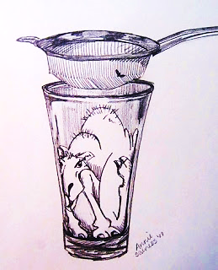
“You take a fly out of your cup, but you drink down a big animal like a camel!”

Slide 53
To these blind leaders, meticulous tithing, God’s love, and faith in God are all the same.
But to God, tithing was never the true point of serving Him—not when done without the relationship He longs to have with us.
Likewise, attending church, tithing, bible reading, good works, saying prayers etc. are all meaningless without the Holy Spirit imparting life to it all.

Slide 54
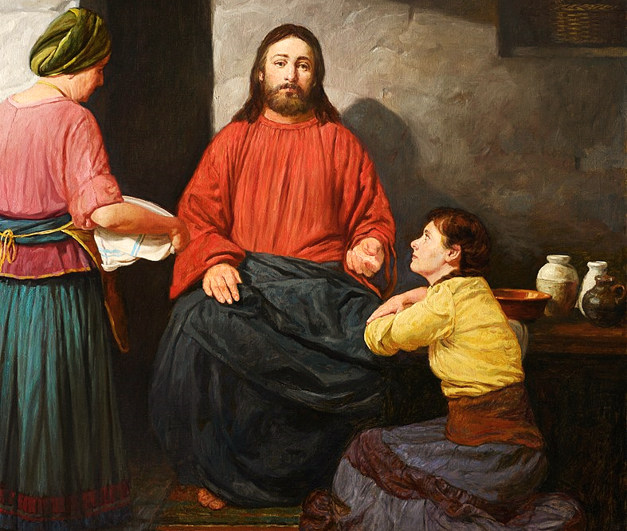

Slide 55
Remember, Martha washed the dishes while Mary sat at Jesus feet as her heart was washed.
Those who have the letter of the law— that is the dead Word which is written on the page…
But lack a living relationship with Jesus…
And lack the Holy Spirit’s anointing, will get entangled in words and deeds, but miss the essence, the heart and life changing power of the gospel.

Slide 56
They will argue about text, compare themselves to other ministers, and engage in “good” works, but…
Their hearts will lack devotion, love, worship…
And they will fail to magnify Jesus and focus on Him as the central theme of all scripture.
They will preach from their heads and not their hearts.

Slide 57
They will seek human approval rather than God’s
Their hearers will not be spiritually moved.
Nothing will change!!!

Slide 58
Thessalonians 1:5 (TPT)
“For our gospel came to you not merely in the form of words but in mighty power infused with the Holy Spirit and deep conviction.”

Slide 59
2 Timothy 3:5 (CEV)
“…and will act as if they serve God but will not have his power…”

Slide 60
Ministry without the power of the Holy Ghost (be it loud, soft, with or without organ, pulpit, laying on of hands, neon lights, worship teams, old or new songs), will end in a powerless service.
The people will not be moved or changed, and the preacher himself will not be moved or changed—but he will still want to hear those “Amens!”
If the Holy Spirit anoints, the listeners will be moved to change, repent, worship, or (mentally) throw rotten tomatoes-something.

Slide 61
2 Corinthians 3:5-6 (CEB)
“…No, our qualification is from God. He has qualified us as ministers of a new covenant, not based on what is written but on the Spirit, because what is written kills, but the Spirit gives life.”

Slide 62
So, you may be thinking, “If I ever run into one of these guys, I’ll be sure to avoid them.”
The truth is, you can’t avoid it, they are everywhere!!
Even in bible days, they were everywhere.
It is only getting worse.
This is the problem with Kings, few can resist the pitfalls.
Pray earnestly for the Holy Spirit’s discernment, and watch you own heart.

Slide 63
Many, many, more & more
false ministers of the Lord’s gospel keep coming & coming.

Slide 64
Matthew 24:11 (ESV)
“…“And many false prophets will arise and lead many astray.”
2 Timothy 4:3 (ESV)
“For the time will come when people will not put up with sound doctrine. Instead, to suit their own desires, they will gather around them a great number of teachers to say what their itching ears want to hear.”

Slide 65
Sadly, many will happily climb on board.

Slide 66
Four Methods of False Christian Leaders
False Beauty & Righteousness
Flattery (beginning with themselves)
Twisting Scripture to Please Men
Shortsighted Scriptural Understanding
In Review

Slide 67
Next Time:
On the Side of the Angels Part 5
Dangerous Duplicity
(Slaves to One Master)

