Slide 3
On the Side of the Angels Part 2 of 5 Emboldening Rebellion & Groupthink

Slide 4
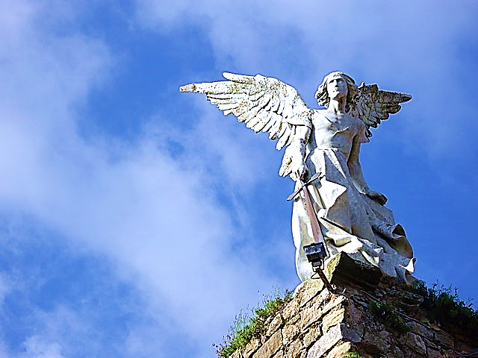
On the
Side
of
THE
ANGELS
Part 2
Emboldening Rebellion & Groupthink
Black
Our Party
Us
Athletes
White
Their Party
Them
Nerds
Born Here
Rich
College
C.E.O.
Moved Here
Poor
Trades
Janitor

Slide 5
People tend to divide into groups and take sides.
Here, in our cover picture we see some typical grouping and side-taking patterns.
We group around politics, race, abilities, territory, class, education, age, taste in dress, taste in music, etc.

Slide 6
Although grouping can be a good thing, it has many dangers. We will examine Five Biblical Dangers
& Pitfalls.
Worldly War Games
Emboldening Rebellion
Groupthink
Caustic Kings (Their Motive & Methods)
Dangerous Duplicity

Slide 7
A saying goes like this, “I’m on the side of the angels”
This is the title of this series.
We are looking at five pitfalls of worldly grouping and taking sides.

Slide 8
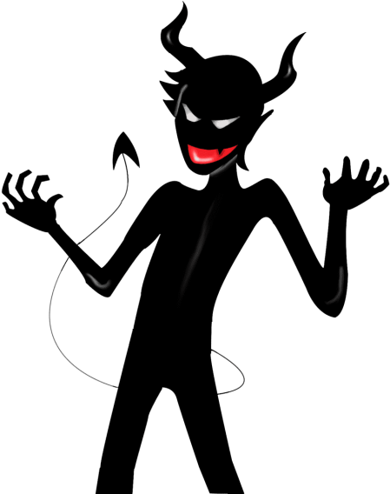
“Ye shall be as gods.”
Today’s
Ugliness
One lie in the
Garden
Grows & Grows & Grows →

Slide 9
We’ve examined the worldwide epidemic of “Worldly War Games” born from the Pride of Life.
We discovered that the essence of it, the first seed-thought came from Satan.
He planted this idea in the hearts of Adam and Eve in the garden and it grew from there.

Slide 10
Today we are going to look at “Emboldening Rebellion” and “Groupthink.”
Regarding the power of grouping, scripture says this:

Slide 12
Proverbs 11:21 KJV
“Though hand join in hand, the wicked shall not be unpunished: but the seed of the righteous shall be delivered.”

Slide 13
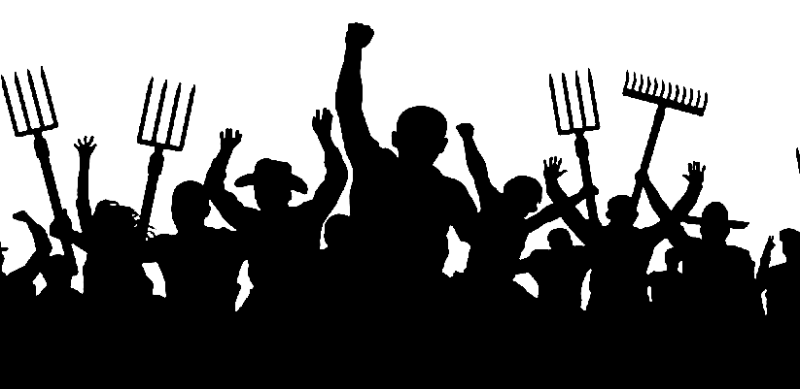
Emboldening Rebellion

Slide 14
This scripture was originally about “Emboldening Rebellion.”
It acknowledges the multiplied power of the rebellious when they join forces.
It is saying that, even when the wicked join forces and form groups, they cannot defeat God.

Slide 15
Scripture warns believers about joining-up with rebellious people in a rebellious world.
Believers might still have some attraction to the world and its frustrations.
We may even feel that unbelievers can still be our allies—our close friends.

Slide 16
We cannot “FRIEND” worldliness.
Their issues are not our issues.
They need our prayers more than our “LIKES.”

Slide 17
We have no fellowship (in the sense of deep, true, shared values) with the world.
They are our mission field, beloved of the Lord.
We must love them and be willing to die trying to bring them the Lord’s salvation, but we must never trust their fellowship to meet our needs.
They are not here for us; we are here for them.

Slide 18
Rebellion is the deadliest contagion of all time !!
When people start coughing it up, it’s best to “mask” our ears & “social distance.”

Slide 19
The problem is that they are in a state of rebellion against God and rebellion is very contagious to humankind.
Fellowship with the world will feed any rebellion still residing in each of us.

Slide 20
They are our mission field.
They need our love, prayers and God’s Word.
We don’t join forces with their anger.

Slide 21
2 Corinthians 6:13-15 (VOICE)
“Don’t develop partnerships with those who are not followers of Jesus’ teachings. For what real connection can exist between righteousness and rebellion? How can light participate in darkness?”

Slide 22
Joining forces strengthens resistance to authority—it emboldens our rebellion.
We use the group to protect our choices.
We might say, “This is how WE—that is, our group—does it… always have.”

Slide 23
“This is how we do it.”
“Always have
—always will.”
“We change for no one.”

Slide 24
We may even call it “team spirit” but it’s just another form of “peer pressure.”
For example, college fraternities may be hesitant to change their hazing methods (citing years of tradition).

Slide 25
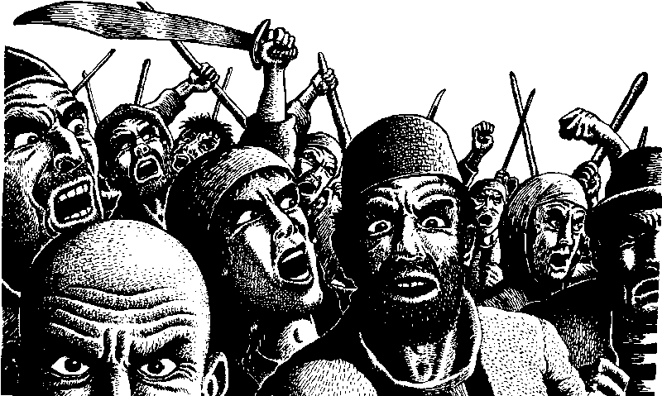

Slide 26
This joining of forces is the dynamic that has historically ignited the passions of lynch mobs.
It has emboldened the followers of evil dictators, rioters, initiation hazers, etc.

Slide 27
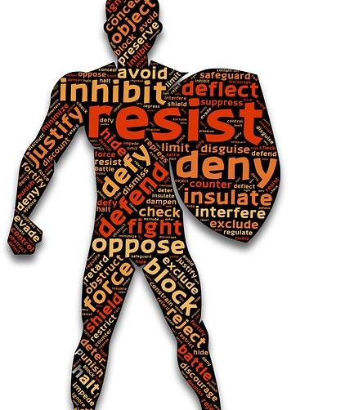
Grouping gives people the boldness to defy authority.

Slide 28
Group dynamics generates the boldness to do what we, as individuals would never dare do on their own.

Slide 29
2 Peter 2:10-11 (Phillips)
“His judgment is chiefly reserved for those who have indulged all the foulness of their lower natures and have nothing but contempt for authority. These men are arrogant and presumptuous—they think nothing of scoffing at the glories of the unseen world...”

Slide 30
Scripture tells what will happen to those who incite rebellion amongst God’s people.

Slide 31
Deuteronomy 13:4-6 (NIV)
“It is the Lord your God you must follow, and him you must revere… That prophet or dreamer must be put to death for inciting rebellion against the Lord your God…”

Slide 32
Let us be very careful about involving ourselves with those who constantly challenge authority.
Let us also be careful about associating with those who would incite people to defy God’s authority in our lives.
Here is an incident when just such a false prophet (named Shemaiah) had incited rebellion.

Slide 33
Jeremiah 29:32 (NLT)
“I will punish him and his family. None of his descendants will see the good things I will do for my people, for he has incited you to rebel against me. I, the LORD, have spoken!”

Slide 34
This brings us to our third danger of grouping and taking sides…
Group Identity can lead to Groupthink.

Slide 35
Groupthink

Slide 36
Groupthink… That is, mental and moral lethargy (or laziness).

Slide 37
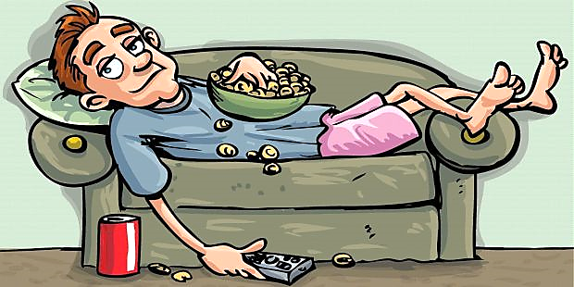
Mental & Moral Laziness
“Truth, what is truth?”

Slide 38
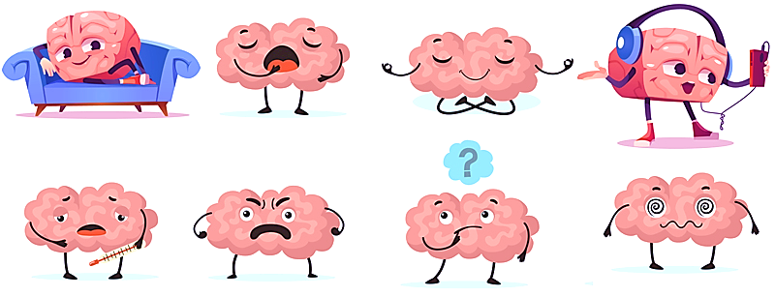
What? I’m supposed to learn God’s Word and apply it to my life? You’re kidding?
Your brain on nothing much.

Slide 39
Before we looks at Groupthink, let’s look at what I’m going to call “Fringe-think.”
These are teachings that challenge conventional thought, thus making the speaker stand out as special, drawing attention to himself.

Slide 40
“It’s new, it’s different. I have seen it and now I share it with you.”

Slide 41
These folks are susceptible to teachers who say, “I will show you a new thing.”
They draw in those who are attracted to teachings that are different, unconventional, often with the promise of being a “new” or “better way.”
They really want to be group leaders and are seeking to gather a group of supporters.

Slide 42
“God has shown me hidden truth no one has ever seen before.”
(i.e., a (i.e., a fringe thing) fringe thing)
WOW!

Slide 44
So, in the end, Fringe-think is, in truth, seeking to become Groupthink one day.
So, what is groupthink?
People are also drawn to affiliate themselves with groups because it helps define and announce who they are.

Slide 46
Eager to find an identity, they simply hang who they are on who their group claims to be → problem solved.
They avoid the work of seeking truth & cover their identity with the group’s identity.
The group’s reputation becomes theirs and they may even adjust their beliefs
and convictions to match the group.

Slide 47
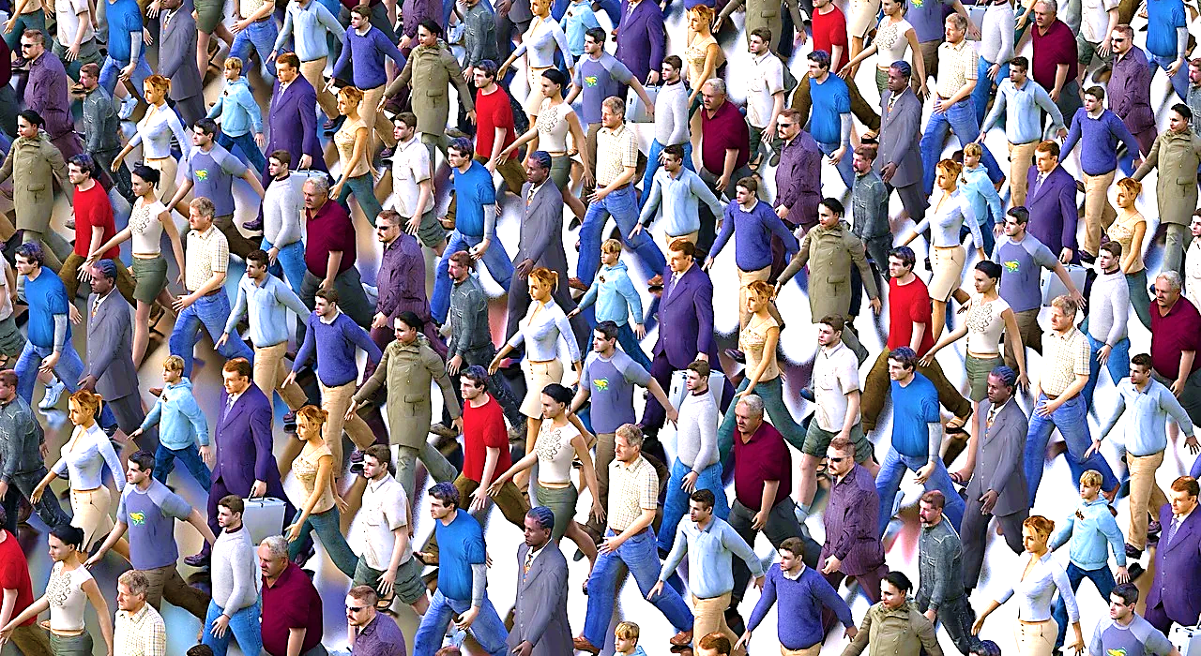
Groupthink

Slide 48
They embrace the group bias & hate what the group hates.
Eventually, they echo the group’s slogans & clichés and assimilate its positions.
Groupthink makes groups vulnerable to corruption.
They hold on to people through peer-pressure—preaching “group loyalty.”

Slide 49
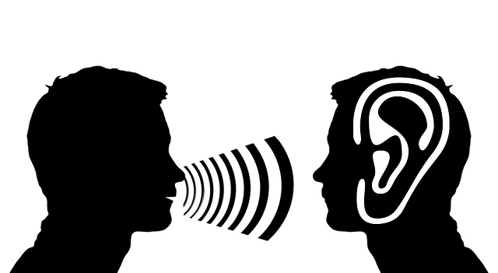
“Tell me what I think.”

Slide 50
We must be lovers of God’s Word alone.
We must never blindly join a group or a take a side—this is lazy both mentally and morally.
Groupthink is really saying, “Okay Group, just tell me what I think.”

Slide 51
Sometimes we don’t even know if we think someone is in the right or in the wrong until we find out which side they represent.
We ask, “What does my group think?”

Slide 52
Groupthink:
The tendency for people to agree with bad decisions to avoid feeling outcast.

Slide 53
Groupthink studies show that, when groups are formed to solve problems, the strongest personalities tend to be the group’s least wise & the wisest are not heard when they speak.
The group usually goes with the desires of the strong but wrong.

Slide 54
Strong but Wrong

Slide 55
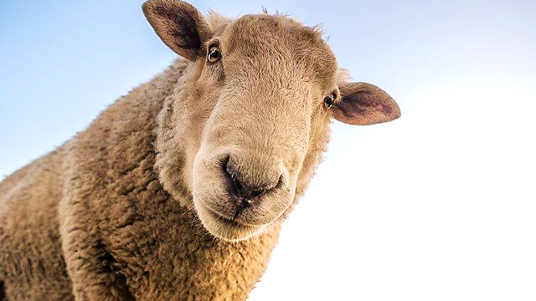
“The simple believe everything.”

Slide 56
Proverbs 14:15 (ESV )
“The simple believes everything, but the prudent gives thought to his steps.”
Proverbs 22:3 (ESV)
“The prudent sees danger and hides himself, but the simple go on and suffer for it.”

Slide 57
2 Timothy 2:15-16 (Phillips)
“But steer clear of these unchristian babblings, which in practice lead further and further away from Christian living. False teachings are as dangerous as blood-poisoning to the body and spread like sepsis from a wound…”

Slide 58
In Review: We are discussing part 2 of the 5-part series, “On the Side of the Angels.”
We have covered three of the dangers that arise from grouping and taking sides.
We looked at “Worldly War Games.”
Those who practice grouping and taking sides are susceptible to such worldly attitudes as rivalry, competition, and worldly pride on a group level, i.e., “We are the chosen ones, we are the best, we rule, etc.”

Slide 59
This worldly attitude robs God of His glory!
We also learned that grouping and taking sides can Embolden any Rebellious attitude abiding in a person’s heart.
Humans naturally resent authority, but fear defying the “powers that be” on our own.
However, when we align ourselves with others who embrace the same defiant or lawless attitudes we do, we suddenly feel emboldened. We say, “OK, Let’s go get them.”

Slide 60
Even the most violent forms of crime, bigotry, property damage, and bodily harm can feel justified when performed by a group.
We must seek to be neither pack-minded nor lone rangers. We must be Jesus minded.
We must have only one alliance. We are all for Christ; His Gospel; His cause; His glory!!!
Our energies are not spent trying to defeat others or take down authorities.

Slide 61
We have only one champion, Jesus, and one Truth—the Word of God.
Finally, we learned about Groupthink, the tendency for peer pressure to influence group members to assimilate the group’s dogma.
Best to find a way to attend a great bible school—in person or online—give your time and your whole heart into learning the bible.
Only the Word of God can retrain our minds, freeing us from the worldly thinking within.

Slide 62
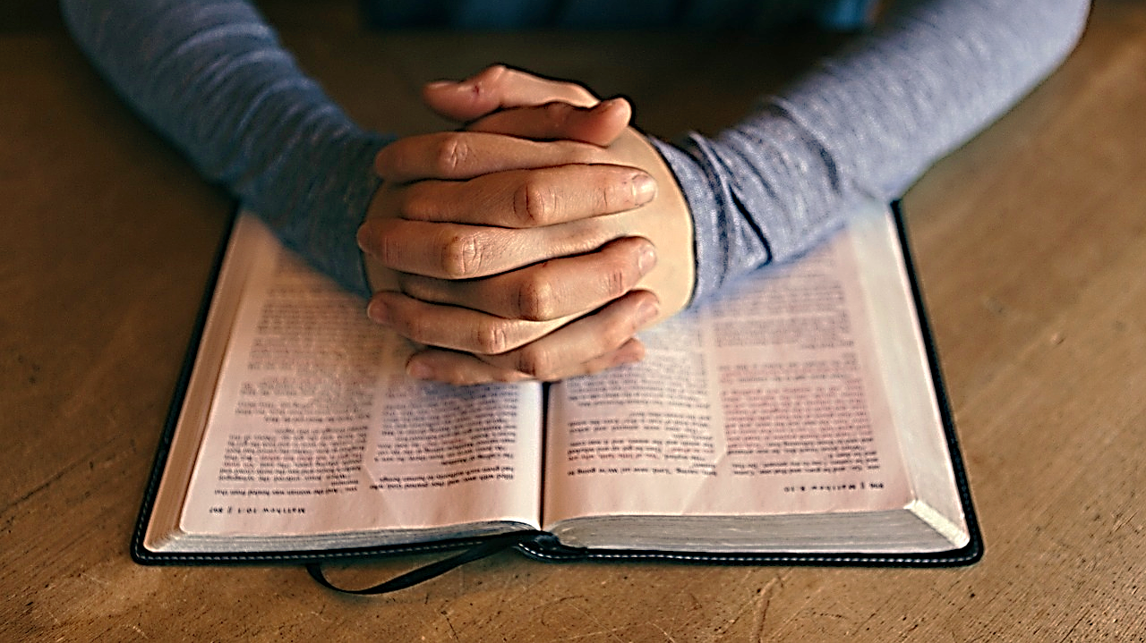

Slide 63
1 John 1:1 (The Message)
“My dear friends, don’t believe everything you hear. Carefully weigh and examine what people tell you. Not everyone who talks about God comes from God. There are a lot of lying preachers loose in the world.”

Slide 64
Mark Twain made an interesting observation.

Slide 65
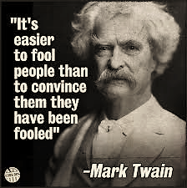

Slide 66
And this quotation gives us the most likely explanation for Mr. Twain’s observation.

Slide 67
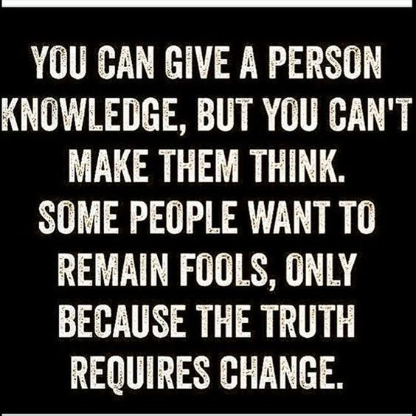

Slide 68
Next time, we will look at our third reason to watch out for grouping and taking sides—Caustic Kings!!

Slide 69
Next Time: On the Side of the Angels Part 3 of 5 Caustic Kings (Their Motive—Hunger)

