Slide 1
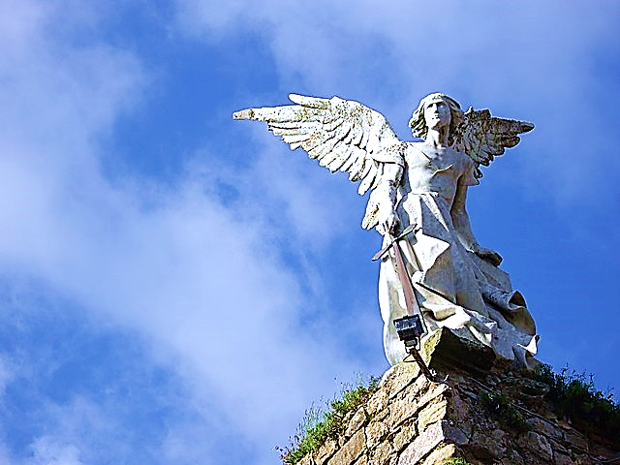
On the
Side
of
THE
ANGELS
Part 5
Dangerous Duplicity
(Slaves to One Master)
Black
Our Party
Us
Athletes
White
Their Party
Them
Nerds
Born Here
Rich
College
C.E.O.
Moved Here
Poor
Trades
Janitor

Slide 3
On the Side of the Angels Part 5
Dangerous Duplicity
(Slaves to One Master)

Slide 4
People naturally tend to divide into groups and then take sides.
Here, in our cover picture we see some typical grouping and side-taking patterns.
We group around politics, race, abilities, territory, class, education, age, taste in dress, taste in music, etc.
An old saying goes like this, “I’m on the side of the Angels.”

Slide 5
On the
Side
of
THE
ANGELS
Part 5
Dangerous Duplicity
(Slaves to One Master)
Black
Our Party
Us
Athletes
White
Their Party
Them
Nerds
Born Here
Rich
College
C.E.O.
Moved Here
Poor
Trades
Janitor

Slide 6
Although grouping can be a good thing, it has many dangers. We will examine Five Biblical Dangers
& Pitfalls.
Worldly War Games
Emboldening Rebellion
Groupthink
Caustic Kings (Their Motive & Methods)
Dangerous Duplicity

Slide 7
When Joshua was fighting the Canaanites, Jesus came to him as “The Angel of the Lord” (Jesus, not yet in the flesh, often took this form in the Old Testament).
Joshua asked Him which side He was on.
Wouldn’t we all like to think God is on our chosen side of any issue?
Don’t we just want to bolster our side with Heaven’s stamp of approval?

Slide 8
Joshua 5:13 (CEB)
“When Joshua was near Jericho, he looked up. He caught sight of a man standing in front of him with his sword drawn. Joshua went up and said to him, “Are you on our side or that of our enemies?...

Slide 10
But Jesus (the Angel of the Lord), answers him, “I am not on anybody’s side.
I am the commander of the Lord’s army.”
For the Lord…
There are only two choices.
One can be on the Lord’s side or not on the Lord’s side.

Slide 11
Joshua 5:13 (CEB) cont.
…He said, “Neither! I’m the commander of the Lord’s heavenly force. Now I have arrived!” Then Joshua fell flat on his face and worshipped. Joshua said to him, “What is my master saying to his servant?...

Slide 13
So, Joshua fell on his face and worshipped Him (this is one reason we know that this was no ordinary angel-angels never let men worship them).

Slide 14
Revelation 22:8-9 (GW) cont.
“I, John, heard and saw these things. When I had heard and seen them, I bowed to worship at the feet of the angel who had been showing me these things. He told me, “Don’t do that! I am your coworker. I work with other Christians, the prophets, and those who follow the words in this book. Worship God!”

Slide 15
Angels spend their time & energy worshipping Jesus & relaying His message.
For an angel, worshipping Jesus & relaying His message is his very existence.
Angels actually see us as co-workers in this occupation—We have the same job as them.
“The side of the Angels” is all about worshipping Jesus & relaying His message.
Listen to what the Angel of the Lord tells Joshua that he should be doing…

Slide 16
Joshua 5:14 (CEB) cont.
“…The commander of the Lord’s heavenly force said to Joshua, “Take your sandals off your feet because the place where you are standing is holy.” So Joshua did this.”

Slide 17
Like Moses before him, Joshua took off his shoes and recognized the Holy One in whose presence He stood.
The Lord was on His own side—always was, always will be.
On this occasion, Israel would win the battle, but at another time, Israel would be in disobedience and taken into captivity.
God is on the side of holiness, not on any group’s side.

Slide 19
When it comes to politics, there are always sides. This will never change.
These are groups that have banded together to take advantage of the strength in numbers principle.
But God is not on the side of any nation or political group.
Nations and political groups have come and gone for centuries… always will.
God is in the business of saving souls!!!

Slide 21
Whose side is God on? Neither! —It’s time to just bow down and worship Him!

Slide 22
One day, the Pharisees came to Jesus and tried to lure Him into a political debate.
They wanted Him to choose a political side, but He was much too busy trying to save men’s eternal souls than to let Himself get distracted with human-centered debates.

Slide 23
Mark 12:14-17 (TPT)
“…So, tell us then, what you think. Is it proper for us to pay taxes to Caesar or not?” Jesus saw through their hypocrisy and said to them, “Why are you testing me? Show me one of the Roman coins.” They brought him a silver coin used to pay the tax. “Now, tell me,”…

Slide 25
Mark 12:14-17 (TPT) cont.
…Jesus said, “whose head is on this coin and whose inscription is stamped on it?” “Caesar’s,” they replied. Jesus said, “Precisely. The coin bears the image of the emperor Caesar, so you should pay the emperor his portion…

Slide 27
Mark 12:14-17 (TPT) cont.
…But because you bear the image of God, you must give to God all that belongs to him.” And they were utterly stunned by Jesus’ words.”

Slide 29
Genesis 1:26 (ESV)
Then God said, “Let us make man in our
image, after our
likeness.

Slide 30
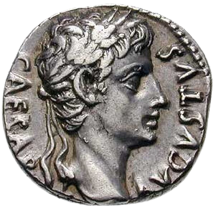
If this image is on your soul, then throw yourself into human interests.
If this image is on your soul, then throw yourself
Into seeking Him.

Slide 31
So, Jesus, which side are you on? What group are you pledged to…?
Israel or the Canaanites—Israel or the Romans?
There will always be political issues that will divide the public into groups voicing their heated sides.
Like Joshua or the Pharisees, we might be tempted to say this side or that side is God’s side—Listen to what the old movie cowboy, John Wayne once said:

Slide 33
God has already told us His side—He cares about the salvation of souls & that for the glorification of Jesus.
He’s asked us to preach to the lost, make intercession for them, worship Him, love His Word & earnestly seeking Him!
Let’s not get distracted by picking sides.
We are made in the image of God, let us wholly, 100% give Him what is truly His—our heart, mind & strength.

Slide 35
All our love, time, devotion & obedience to the great commission belongs to Him.
We have two sides to choose from… to serve Jesus with all our hearts or not.
Believers have only one true identity.
We are “In Christ”—He alone is our identity and the only thing that matters to God.

Slide 36
We may have had other associations & loyalties.
We may be proud to call ourselves a “this” or a “that” or a “former this” or “that.”
We may sing their signature songs, wear their colors, repeat their slogans, and tattoo their image on our skin, but…
All other labels and identifiers must fall by the wayside in light of who we truly are—
Now, we can just call ourselves “His.”

Slide 37
Matthew 6:24 (AMP)
“No one can serve two masters; for either he will hate the one and love the other, or he will be devoted to the one and despise the other. You cannot serve God and mammon [money, possessions, fame, status, or whatever is valued more than the Lord]”

Slide 39
This is exactly what happened to the rich young ruler.
He felt that he wanted to follow Jesus…
But when Jesus challenged him to sell everything he owned, and then follow Him. he couldn’t do it because he had invested so much of his life just getting and being rich.
So, with a heavy heart, he clung to the way of life he knew so well, loved and preferred.
He let Jesus go on without him.

Slide 40
Choosing Jesus is a daily exercise.

Slide 41
We may think there is a world of choices set before us.
The fact is, in God’s mind, there is not a host of sides and choices we can make:
There is only “God’s side,” and “Not God’s Side.”
All other choices God sees as His rivals for your love, trust and devotion.

Slide 42
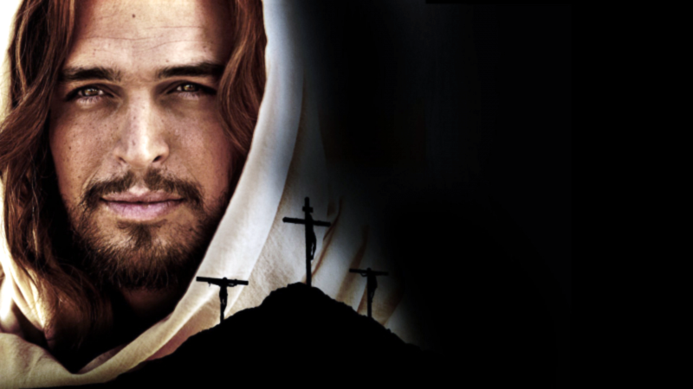
God’s Side
Not God’s Side

Slide 43
Exodus 20:5 (TLB)
“…I, the Lord your God, am very possessive. I will not share your affection with any other god!...”
Exodus 20:5 (GW)
“Never worship them or serve them, because I, the LORD your God, am a God who does not tolerate rivals…”
Exodus 20:5 (CMT)
“Don’t bow down and worship idols. I am the LORD your God, and I demand all your love…”

Slide 44
In our pride, we believe we can throw ourselves into attractive worldly pursuits and be devoted to Christ at the same time.
In this, we must be very careful, the bible teaches that we can easily become the servant of our pursuits and choices.
It happens without our knowing it.
Yet, as we throw our money, energy, time & thought-life into some beloved distraction, invisible chains start forming on our wrists.

Slide 45
Romans 6:16 (ERV)
“Surely you know that you become the slaves of whatever you give yourselves to. Anything or anyone you follow will be your master. You can follow sin, or you can obey God. Following sin brings spiritual death, but obeying God makes you right with him.”

Slide 48
As we learned, we become the servants of whatever we pursue with our heart.
So, just as we can become a slave to sin, simply by pursuing its pleasures.
If we pursue Christ, and spend our energy, time & thought-life focused on Christ—our beloved master, invisible chains will start forming on our wrists.
They are chains of love that will bind us to our beloved and compel us to do His will.

Slide 49
Romans 6:22 (GW)
“Now you have been freed from sin and have become God’s slaves. This results in a holy life and, finally, in everlasting life.”

Slide 50
Lord, I give you my whole heart.

Slide 51
While Moses was up on the mountaintop hearing from God, the Israelites offered up all their gold and riches to build a false God—a golden calf.
They were happily and willingly impoverished by this new master.
All interests that rival the Lord, enslave and impoverish their devotees.
They worshiped the calf until Moses came back and saw what they were up to.

Slide 52
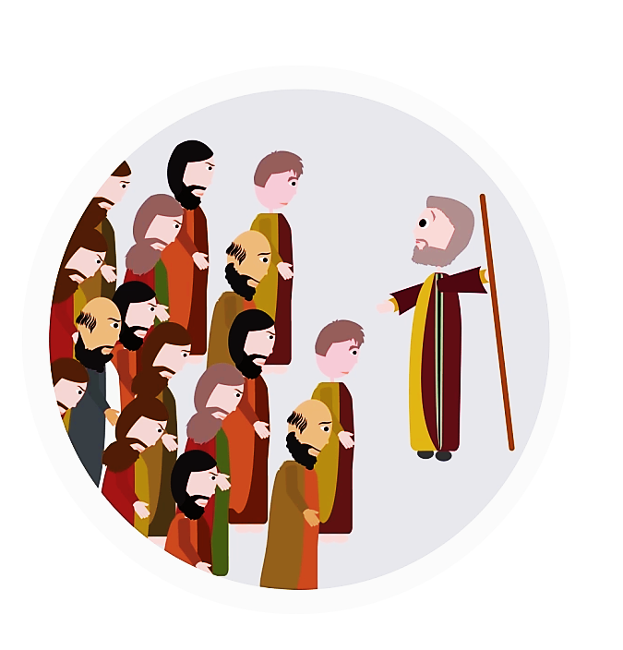
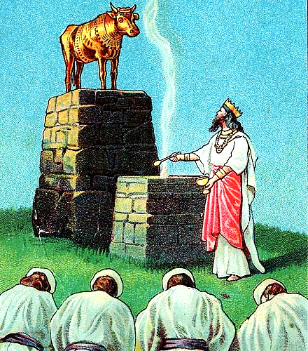

Slide 53
Exodus 32:26-29 (KJV)
“Then Moses stood in the gate of the camp, and said, Who is on the Lord's side? let him come unto me. And all the sons of Levi gathered themselves together unto him. And he said unto them, Thus saith the Lord God of Israel…

Slide 54
What happened next is the reason why the tribe of Levi was chosen to be the perpetual warrior/priests of Israel.
They chose the Lord’s side when their friends and family chose the golden calf.
And when God told them to slay their friends and family which had worshipped the calf, they did… it was a hard choice. God used them to execute His judgement.
Today, in this dispensation, God doesn’t put judgement in our hands, but He does ask us to make the same kind of hard choices.

Slide 55
Exodus 32:26-29 (KJV) cont.
“…Put every man his sword by his side and go in and out from gate to gate throughout the camp, and slay every man his brother, and every man his companion, and every man his neighbour. And the children of Levi did according to the word of Moses…”

Slide 56
Sometimes the Lord’s side is a lonely side.
You can no longer get your kicks from competing for dominance in your arena.
You can no longer be emboldened in your rebellion against the ruling authorities.
You can no longer just let some group tell you what you think.
You can no longer give a chosen leader your heart.
You no longer merely flock with others.

Slide 57
Nothing comes before Jesus…
No competitive teams, recreational activities, jobs, businesses, alma-maters, country, or political parties -- not even church bodies, denominations, civil rights or humanitarian causes.
Not even family.

Slide 58
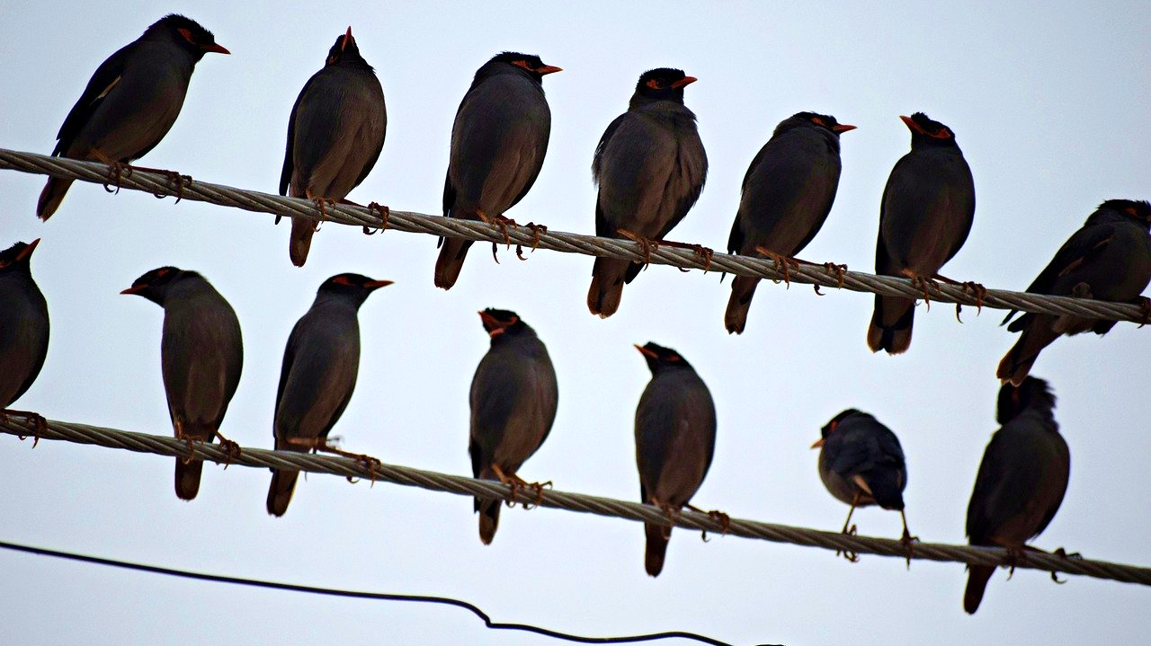
Birds of a feather, flock together.

Slide 59
What happens when God calls.

Slide 60
Luke 14:26-27 (ICB)
“If anyone comes to me but loves his father, mother, wife, children, brothers, or sisters more than he loves me, then he cannot be my follower. A person must love me more than he loves himself! If anyone is not willing to die on a cross when he follows me, then he cannot be my follower.”

Slide 61
We may align ourselves with groups that help people, and that is good, but it is not an end in itself. It helps only on a temporary basis.
The preaching of the gospel & intercessory prayer will save souls for eternity…
Not just improve their way of life for a season.
We must be very wary of the potentially all-consuming power of affiliations and allegiances.

Slide 62
They can easily replace our allegiance to Christ himself.
We must hold very loosely to earthy things and be ready let it all go if God calls on us to do something else for Him.
This doesn’t mean we should break ties every time we disagree with someone or that we should fail to meet a real need.
But we must never set Jesus aside to follow another passion or allegiance.

Slide 63
Colossians 3:23-24 (GW)
“Whatever you do, do it wholeheartedly as though you were working for your real master and not merely for humans. You know that your real master will give you an inheritance as your reward. It is Christ, your real master, whom you are serving.”

Slide 64
Remember, we cannot serve two masters.
Or else, only one will be the main entree (in this meal called our life) and the other will be merely a side dish.
We mustn’t turn Jesus into a Sunday Morning side-dish.
Yes, it feels great to align ourselves with a team, to follow a champion, a leader, to defeat all the competitors, to shout the victory together, just to know –

Slide 65
–we belong to something bigger than ourselves, something worth defending (perhaps, even defending with our lives).
But if we must put our vast potential for loyalty into play (and we must) let us apply it to advancing and defending the Gospel…
At times, we will stand alone… often we will be hated… perhaps even unto the death…
But we must always on the Side of the Angels.

Slide 66
John 15:18-19 (GW)
“If the world hates you, realize that it hated me before it hated you. If you had anything in common with the world, the world would love you as one of its own. But you don’t have anything in common with the world. I chose you from the world, and that’s why the world hates you.”

Slide 67
Listen to what John overheard when he visited Heaven in a vision:

Slide 68
Revelation 5:11-12 (HCS)
“Then I looked and heard the voice of many angels around the throne… Their number was countless thousands, plus thousands of thousands. They said with a loud voice: The Lamb who was slaughtered is worthy to receive power and riches and wisdom and strength and honor and glory and blessing!”

Slide 69
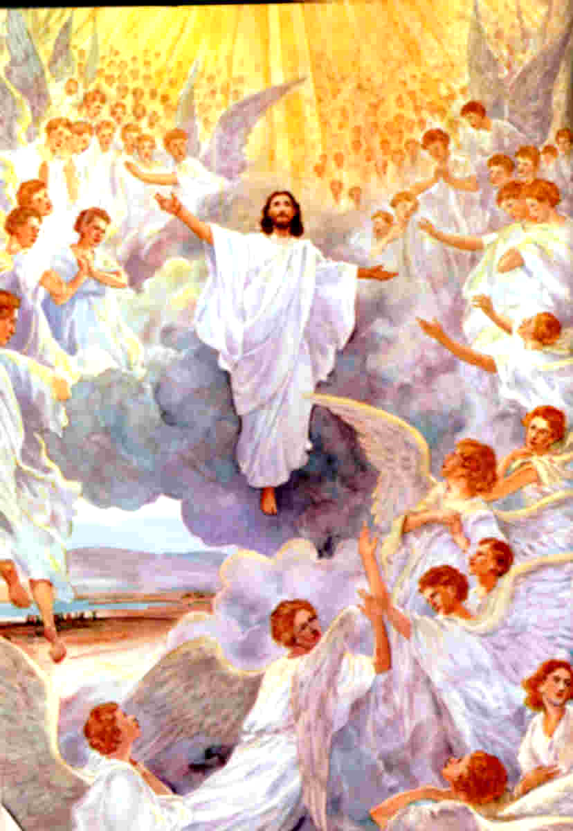
Holy
Worthy
Worthy
Holy
Holy
Worthy
Holy
Worthy
Holy

Slide 70
Finally, King David is a perfect example of a man who was on the side of the angels.
This man had the very heart of angels, a heart of worship and of service.
I suspect the angels might have even joined in with him (in Heaven) as he prayed this prayer.

Slide 71
1 Chronicles 29:11 (NLT)
“Yours, O LORD, is the greatness, the power, the glory, the victory, and the majesty. Everything in the heavens and on earth is yours, O LORD, and this is your kingdom.”

Slide 72
Can we say with David. “O LORD, this is your kingdom.”
And now we will see that David even went far beyond the side of the angels.
He realized that he was unworthy to even be allowed to offer praise to the Most High.
Yet, he must… he must praise the Lord.
He had gone beyond the “side of the angels”
He was now on the side of the REDEEMED.

Slide 73
1 Chronicles 29:14 (NLT)
“But who am I, and who are my people, that we could give anything to you? Everything we have has come from you, and we give you only what you first gave us!”

Slide 74
Today, can we detach ourselves from our various groups and sides and fill our hearts with praise and adoration for the One who died for us and has risen to His throne in Heaven?
Can we stand on the side of the angels (and with David) to offer him a level of praise truly worthy of Who He is?

