Slide 1
On the Side of the Angels Part 3 of 5 Caustic Kings
(Their Motive—Hunger)

Slide 2
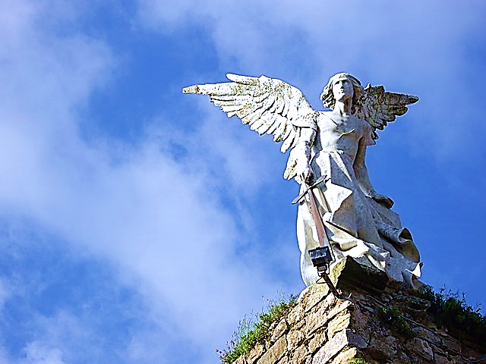
On the
Side
of
THE
ANGELS
Part 3
Caustic Kings
(Their Motive--Hunger)
Black
Our Party
Us
Athletes
White
Their Party
Them
Nerds
Born Here
Rich
College
C.E.O.
Moved Here
Poor
Trades
Janitor

Slide 3
We have been looking at the tendency of humans to form groups and take sides.
There is an old saying that goes like this, “I’m on the side of the Angels.”
And this is the title of this series.
This is #3 of 5 in the series.

Slide 4
Although grouping can be a good thing, it has many dangers. We will examine Five Biblical Dangers
& Pitfalls.
Worldly War Games
Emboldening Rebellion
Groupthink
Caustic Kings (Their Motive & Methods)
Dangerous Duplicity

Slide 5
Our fourth danger from grouping and taking sides is Caustic Kings (their motive—hunger).

Slide 6
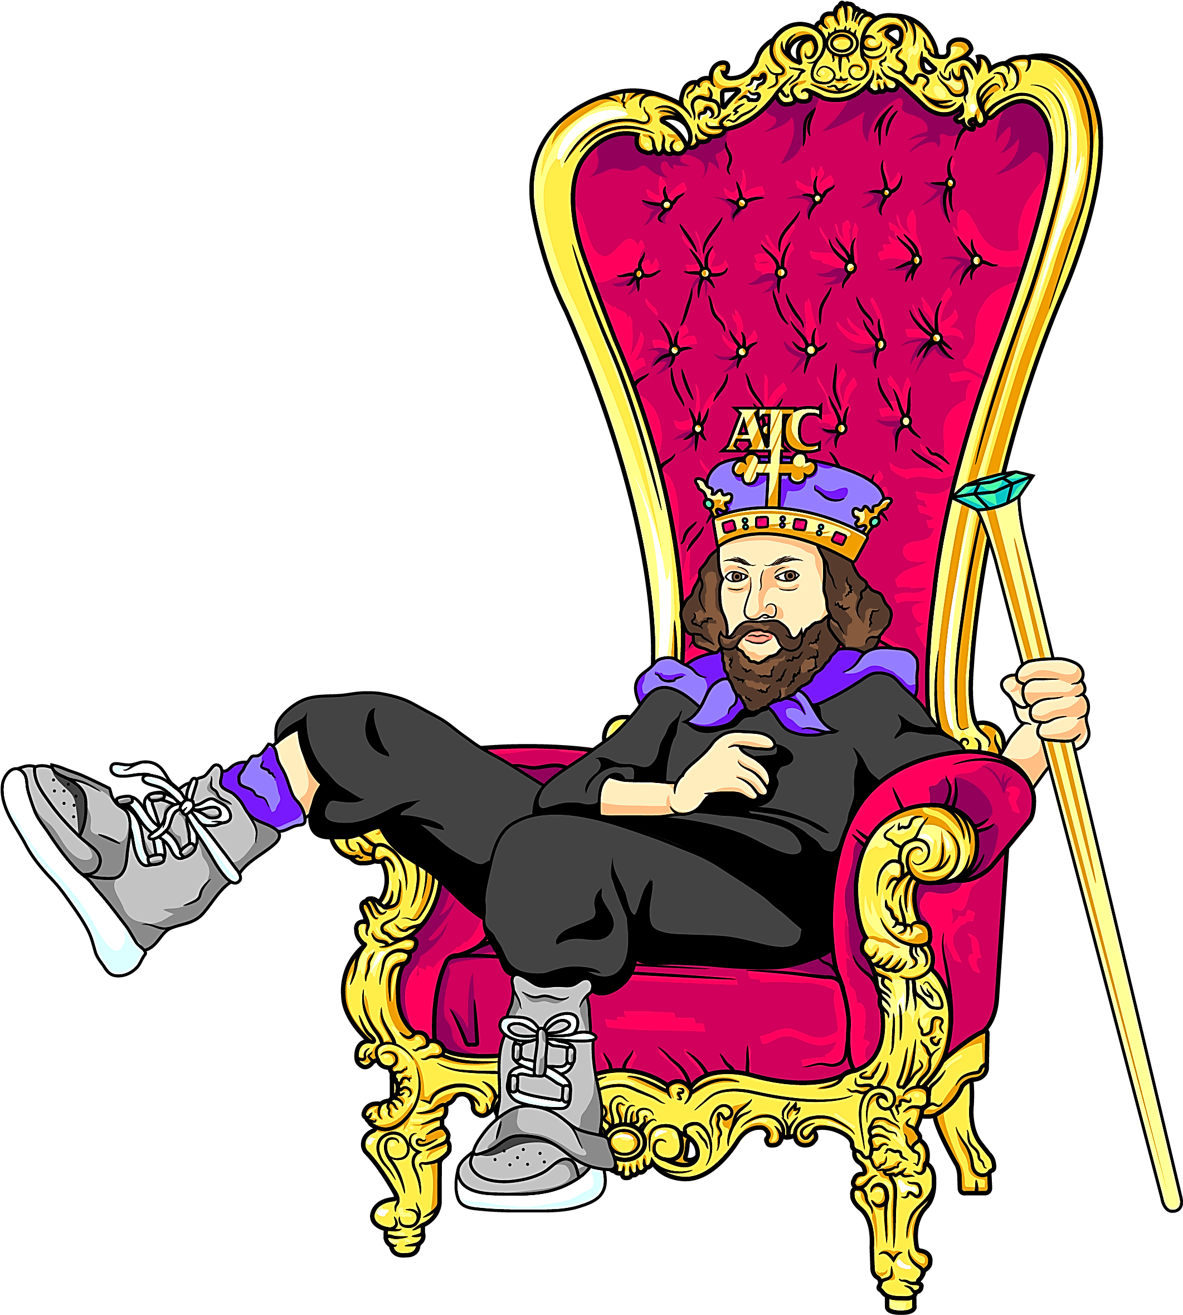
Caustic Kings
Their Motive—Hunger

Slide 8
When people form sides, each side gets a leader, a captain, king, general, president, etc.
The thing about sides is they always have kings, head guys, top-bananas, or in today’s vernacular, “viral influencers.”
People want it, they crave it, they insist on it.
Yes, they do change their kings quite often, but they always follow someone.

Slide 9
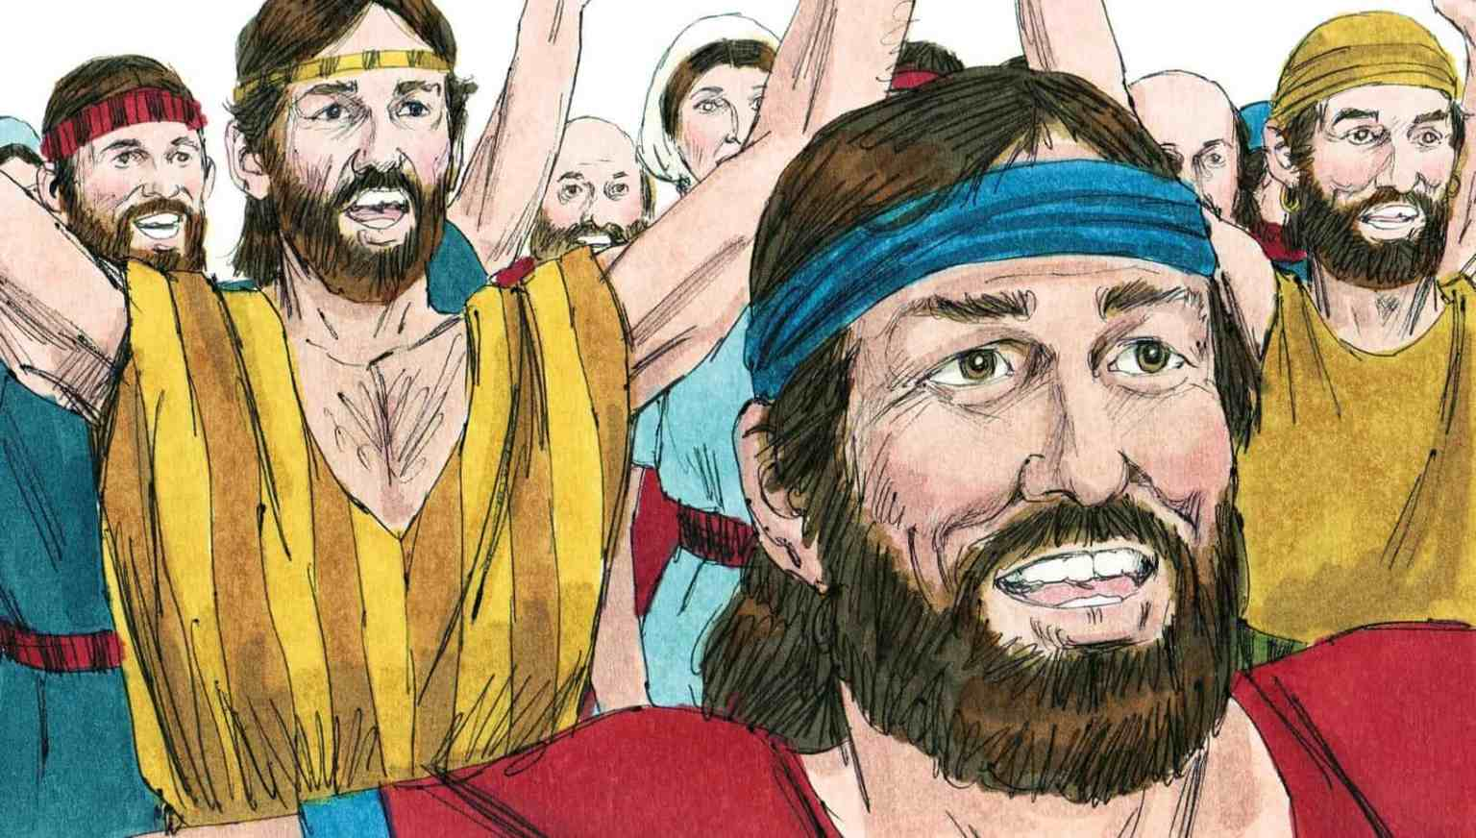

Slide 10
The people of Israel came to Samuel and basically told Samuel to tell God that they wanted to be ruled by a king just like the other nations around them.
Up to this point God had spoken to them through prophets, but they were tired of being led by God and tired of His prophets.
They were tired of being different than the world around them.
Do we look around and think we might just want a NORMAL family life with not too much “God Stuff”?

Slide 11
So, Samuel told God their demands and God said to go ahead and let them have their king but warn them that a king is going to use them and consume their resources.
But they wanted to be “normal”—to be like the nations around them.
They said they didn’t care; they seemed to want the respect and all the pomp and ceremony associated with being a nation with a royal court and a king on the throne.

Slide 12
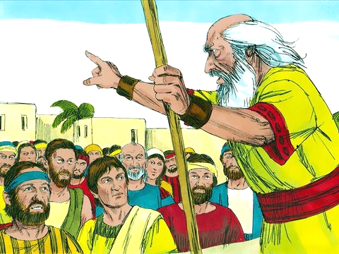

Slide 13
! Samuel 8:10-20 (CEV)
“Samuel told the people who were asking for a king what the Lord had said: If you have a king, this is how he will treat you. He will force your sons to join his army… Still others will have to farm the king’s land and harvest his crops or make weapons and parts for his chariots…

Slide 14
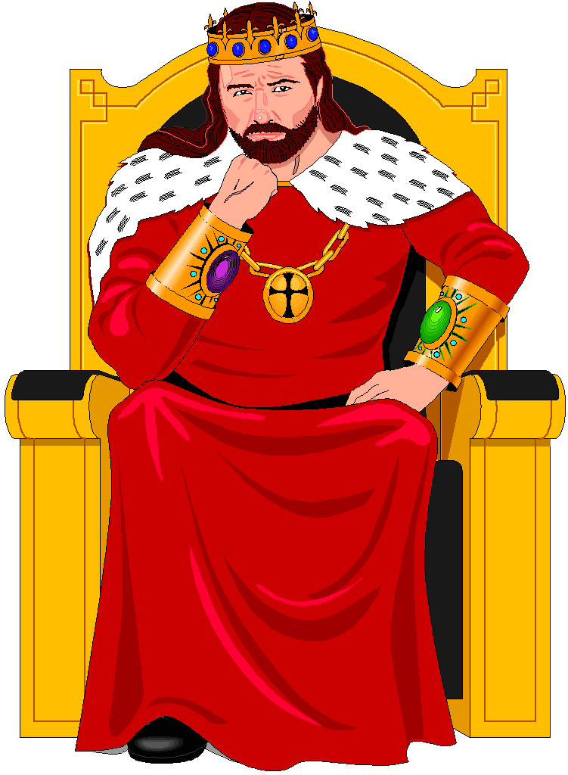

Slide 15
! Samuel 8:10-20 (CEV) cont.
…Your daughters will have to make perfume or do his cooking and baking.
The king will take your best fields, as well as your vineyards, and olive orchards and give them to his own officials. He will also take a tenth of your grain and grapes and give it to his officers and officials…

Slide 16
! Samuel 8:10-20 (CEV) cont.
…The king will take your slaves and your best young men and your donkeys and make them do his work… You will become the king’s slaves, and you will finally cry out for the Lord to save you from the king you wanted. But the Lord won’t answer your prayers…

Slide 17
! Samuel 8:10-20 (CEV) cont.
…The people would not listen to Samuel. “No!” they said. “We want to be like other nations. We want a king to rule us and lead us in battle.”

Slide 18
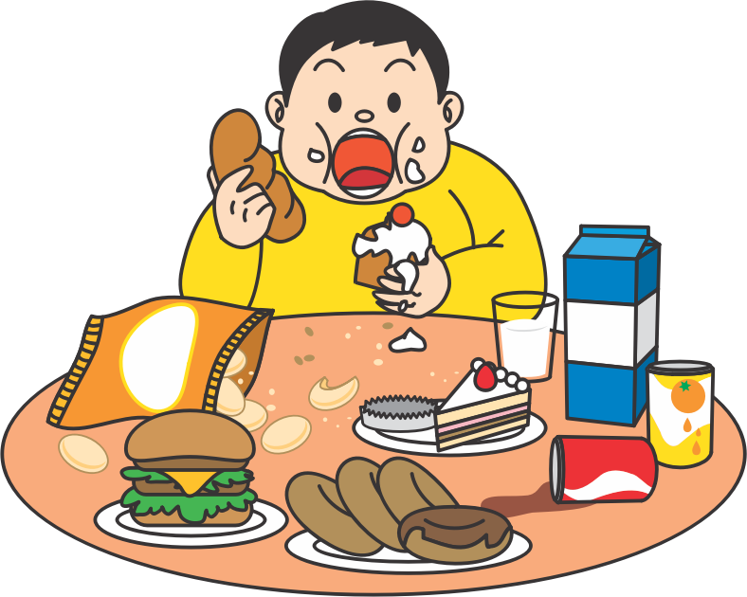
Caustic Kings are Hungry

Slide 19
People love to support the candidate whom they have chosen to lead their group.
Sadly, this creates the perfect opportunity for a leader to manipulate the group.
He is their leader, but they are his resource—food for his consumption, his very self-worth.
He needs them more than they need him.
He eats them for breakfast.
This is human nature—the rule, not the exception. No man is a good king but Jesus.

Slide 20
Eventually, each of us will use people to serve ourselves.
We may even justify it by telling ourselves, “We are actually doing them a favor or “We’re doing it for God.”
Leaders (be they Christian or secular) are all susceptible to this temptation.

Slide 21
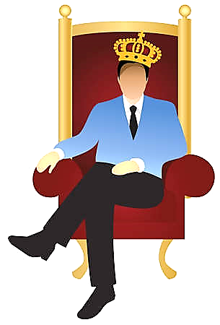

Slide 22
At best, we will resist this temptation and when the Lord shows us this self-serving attitude in our hearts, we must find a place of repentance before Him.
At worst, a leader can become hungrier & hungrier for power, authority, the respect of his peers, community status, praise, admiration, abiding legacy, material gain, etc.

Slide 24
When this happens, the people this leader claims to be serving, are really what he is consuming to feed his insatiable hunger.
The sheep are abused, neglected and have become the king’s food for his pleasure and his ego.

Slide 25
As long as you are validating them and feeding their bottomless egos, they will love you.
But watch out if you cross them… then it’s war!!

Slide 26
Micah 3:5 (GW)
“This is what the Lord says about the prophets who mislead my people: When they have something to eat, they say, “All is well!” But they declare a holy war against those who don’t feed them.”

Slide 28
You are either thumbs up or thumbs down with them depending on how well you are feeding their physical and egotistical needs.

Slide 29
2 Peter 2:3 (NIRV)
“These teachers are never satisfied. They want to get something out of you. So, they make up stories to take advantage of you…”

Slide 31
Jude 12-13 (TPT)
“…there are many who walk along the Christian road who are really enemies of the cross of Christ. Their future is eternal loss, for their god is their appetite: they are proud of what they should be ashamed of; and all they think about is this life here on earth.”

Slide 32
Matthew 7:15 (NIRV)
“Watch out for false prophets. They come to you pretending to be sheep. But on the inside, they are hungry wolves.”
Jude 12 (ESV)
“…shepherds feeding themselves…”
Hosea 4:8-11 (ESV)
“They feed on the sin of my people…”

Slide 33
This verse takes a little explaining.
The priests of Israel would receive the people’s sin offerings (usually an unblemished sheep) and they would sacrifice the animal as a substitute for the sins the people had committed.
This would cover their sins for a season.
People would do this to be right with God.

Slide 34
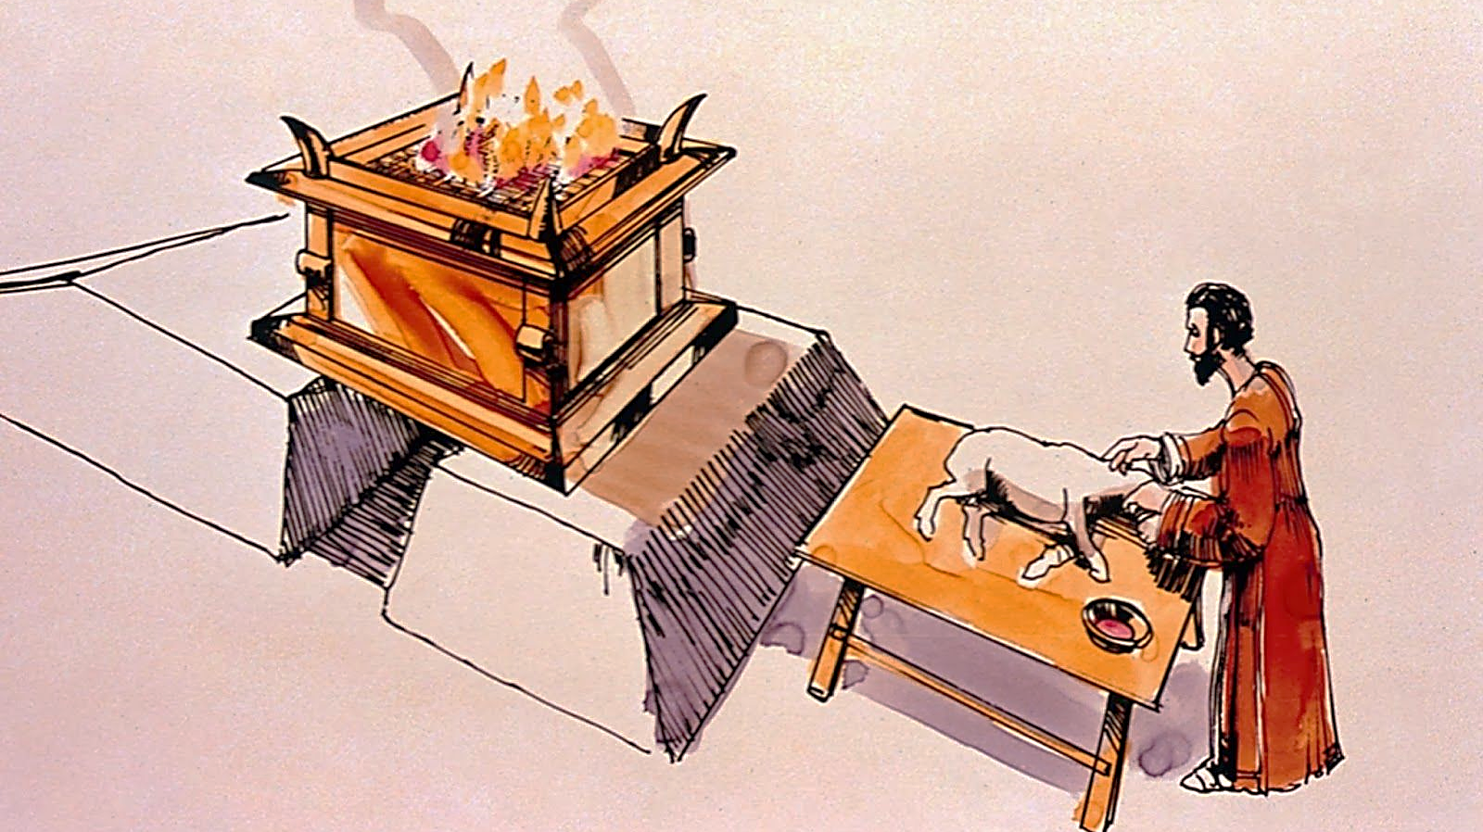

Slide 35
Then, after the sin offering was burnt in the fire, the priests were given the meat to eat.
Therefore, the priests were fed with the sin offerings of the people.
The more sin offerings, the more meat for the priests.
So , the more people sin, the more sin offerings and the more the priests had to eat.
They literally feed on the sheep.

Slide 36
Hosea 4:8-11 (NLT) (GNT) (TLB)
“…people bring their sin offerings, the priests get fed. So, the priests are glad when the people sin!
You grow rich from the sins of my people, and so you want them to sin...
The priests rejoice in the sins of the people; they lap it up and lick their lips for more!”

Slide 37
Christian leaders get followers from those who need Jesus—who need to follow Jesus.
They come to the house of the Lord to follow Jesus but end up following the leader’s ministry more than Christ himself.
In essence, this false leader (this so-called “Holy Man”) is robbing God of followers.
He begins to think in terms of his church, his ministry and his followers.

Slide 39
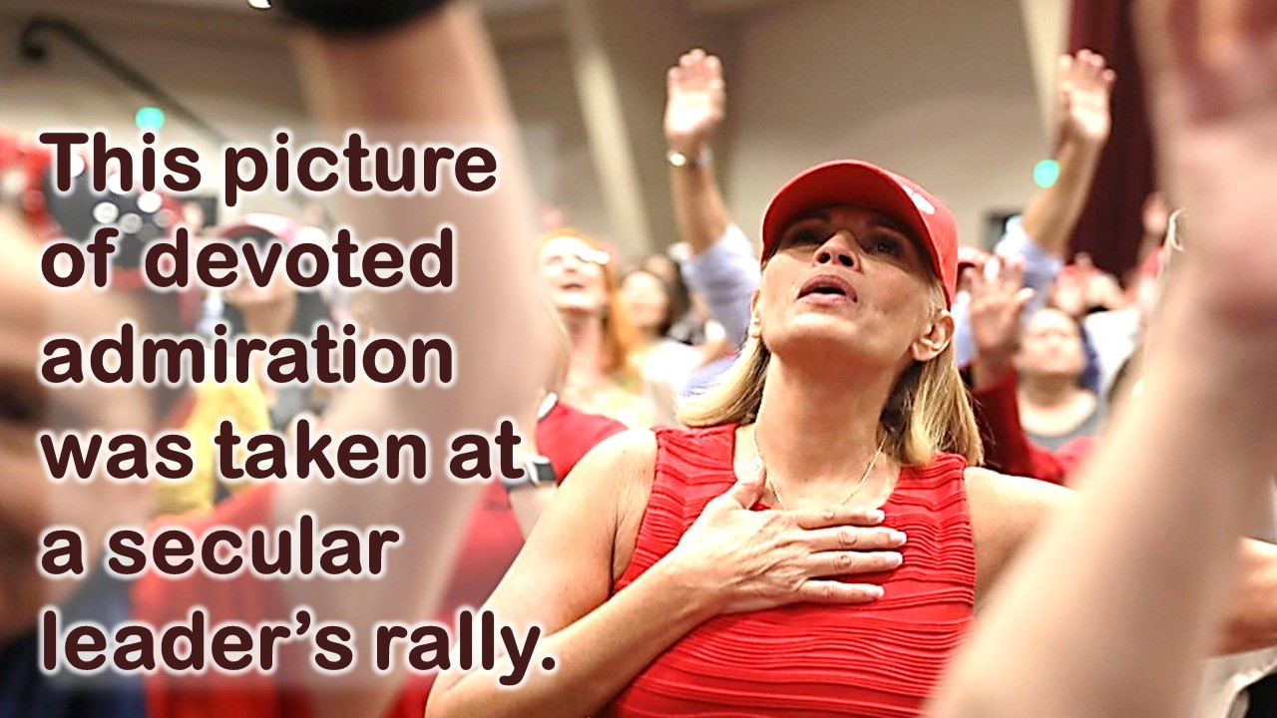

Slide 40
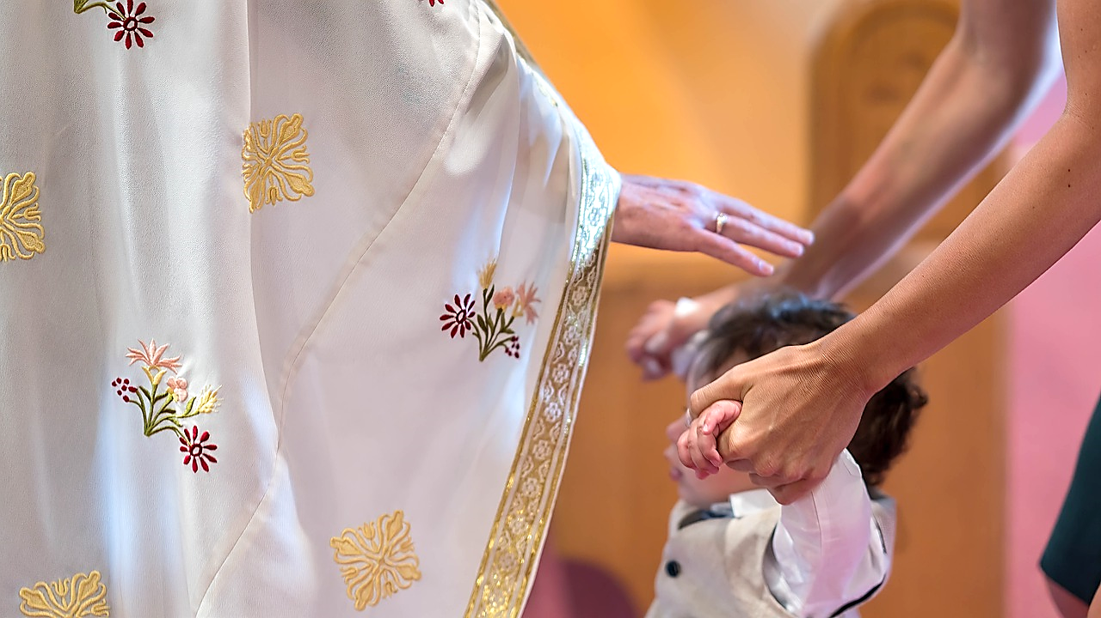

Slide 41
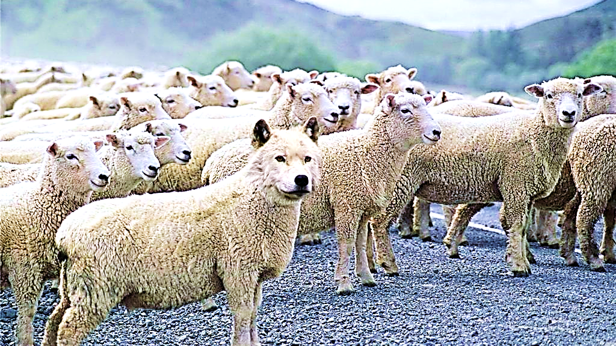
Feeding Themselves
with the Sheep

Slide 42
True Christian workers, who are willing to serve the sheep far more than they serve themselves, are few and far between.
Paul found only one such man he could send to the saints at Philippi.

Slide 43
Philippians 2:19-21 (ISV)
“Now I hope in the Lord Jesus to send Timothy to you soon… I do not have anyone else like him who takes a genuine interest in your welfare.
For all the others look after their own interests, not after those of Jesus the Messiah.”

Slide 44
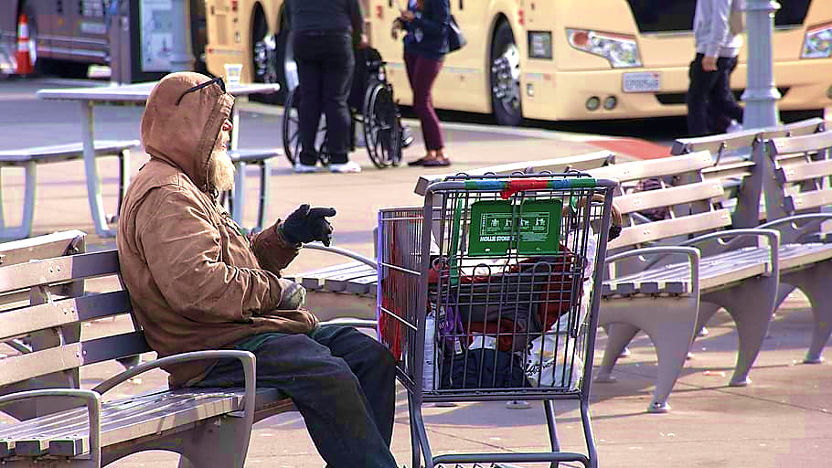

Slide 45
How do we feel about the fringes of society who attend our services…
The mentally ill, the drinkers, drug-users, un-marrieds living together, etc.??
We know that Christ loves them all.

Slide 47
Or do we prefer to see happy, whole families, securely employed, middle-class, well-educated sitting in our pews?
Perhaps they have a nice car—even faithfully tithe.
They are always ready with a handshake and a little praise for the sermon.

Slide 48
Most Christian leaders would like to think they are not seeking personal validation from their flock, but this tendency is basic to human nature.
We must be very self-aware of what and whom we are using for personal validation
Is it our possessions, our spouses, children’s accomplishments, job titles, ministry size, number of souls saved, education level?

Slide 49
Are you feeding off the validation brought by seeming ministry successes (attendance, water baptisms, etc.)???… you might be a Caustic King!!!
Who are the most important people in our services—the famous ministers seated on our platforms, the rich givers, the highly placed politicians, celebrities?

Slide 51
Or is it the poor, the weak, the slightly strange, “fringe” persons like Mary Magdalene, the woman at the well, Matthew, the tax collector, etc., etc., etc.
We went to bible school with a couple who had graduated from Princeton and Harvard.
They went on to live in a bus and start “The Homeless Church” in San Francisco.
We feel privileged to have known them.

Slide 52
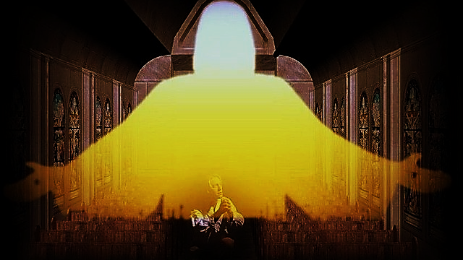

Slide 53
But none of the former (neither the rich nor the poor) are the most important persons in our services.
The most important person in our services is the Lord Jesus Christ Himself.
There is no King but Him—He is a Kind King and not a Caustic King.
He should be treated like our most royal visitor.

Slide 55
Every member (including the pastor) must fall down in awe and worship before Him.
We should all (especially the pastors) seek constant cleansing for our sinful attitudes.

Slide 56
In the Psalms, God shows us exactly what He is looking for in a Christian leader.
He tells how He chose a man to lead His people.
It was a young man who was caring for the mother sheep and their babies.
God was impressed with his combination of love, tenderness and at the same time, great skill.
This man, thought God, is perfect to lead my flock, (Israel, My sheep) unselfishly, with integrity, and skill. –This man would become King David.

Slide 57
Psalm 78:71-72 (GW)
“He brought him from tending the ewes that had lambs so that David could be the shepherd… of Israel, the people who belonged to the Lord. With unselfish devotion David became their shepherd. With skill he guided them.”

Slide 58
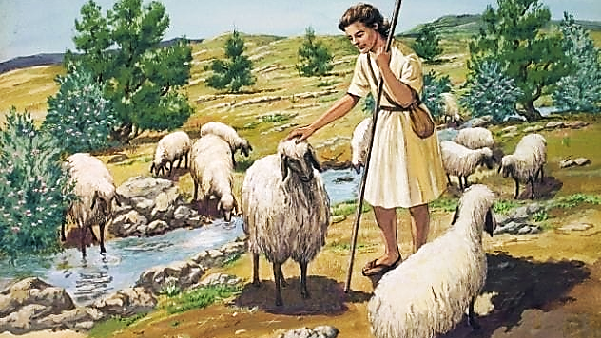

Slide 59
As we form our groups and choose or leaders, let us take great care that we appoint men and women like David.
Leaders who will care more for each lamb in the flock than they do for themselves.
Leaders who have taken the time and made the effort to handle God’s Word as skillfully as David handled his shepherding duties.
A man of integrity… A David!

Slide 60
Next Time:
On the Side of the Angels Part 4 of 5 Caustic Kings (Their Methods)

