Slide 1
A Strange Land

Slide 3
A Strange Land

Slide 4
In Exodus 2:22, Moses, after escaping from Egypt (in fear for his life) finds a wife named Zipporah in the foreign land of Midian.
She gives birth to a son and Moses names him “Gershon” (which means “a stranger.”)
Moses looks over the foreign country he’s living in and says, “I am a stranger in a strange land.”

Slide 5
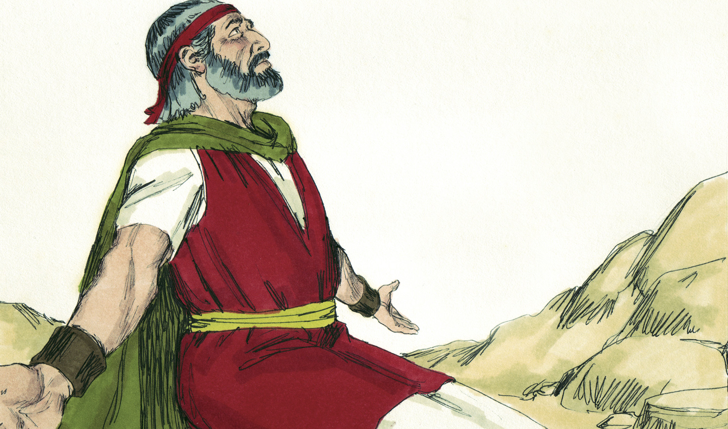
“I am a stranger in a strange land.”

Slide 6
Most of us don’t actually live in a foreign country, but maybe (as Christians) we sometimes get the feeling Moses had: of being a “stranger in a strange land.” I know I do.
Of course, as born-again Christians, we see the unsaved world around us, as strange and foreign. That’s always been true.
But I’m talking about closer to home.

Slide 7
I think when Moses called Midian a strange land, he wasn’t talking about the climate or countryside.
He was talking about the ways, traditions and practices of the people.
I want to take a hard look at the ways, traditions and practices of my own people, the body of Christ and ask myself:

Slide 8
Church Today—
a Strange Land?

Slide 9
Do I feel uncomfortable in today’s Christian climate?
Do your Christian surroundings make you feel like a stranger in a strange land?
Maybe we’re both feeling that way.
I want to know two things:
How we got here—and
How we can get back.
Genesis might tell us how we got here:

Slide 10
Gen 3:1-6 (CSB)
“Now the serpent was the most cunning of all the wild animals that the Lord God had made. He said to the woman, “Did God really say, ‘You can’t eat from any tree in the garden’?”

Slide 11
Gen 3:1-6 (CSB)
“The woman said to the serpent, “We may eat the fruit from the trees in the garden. But about the fruit of the tree in the middle of the garden, God said, ‘You must not eat it or touch it, or you will die.’”

Slide 12
Gen 3:1-6 (CSB)
“No! You will certainly not die,” the serpent said to the woman. “In fact, God knows that when you eat it your eyes will be opened and you will be like God, knowing good and evil.”

Slide 13
Two things which the Devil said to Eve, really stand out to me:
1. First, He said, “Did God really say…”
2. Then, He said, “God knows when you eat it, your eyes will be opened”
Let’s start with number 1:
“Did God really say?”
This is no innocent, harmless question.
Get that out of your mind forever!
It might be the most evil question of all time!

Slide 14
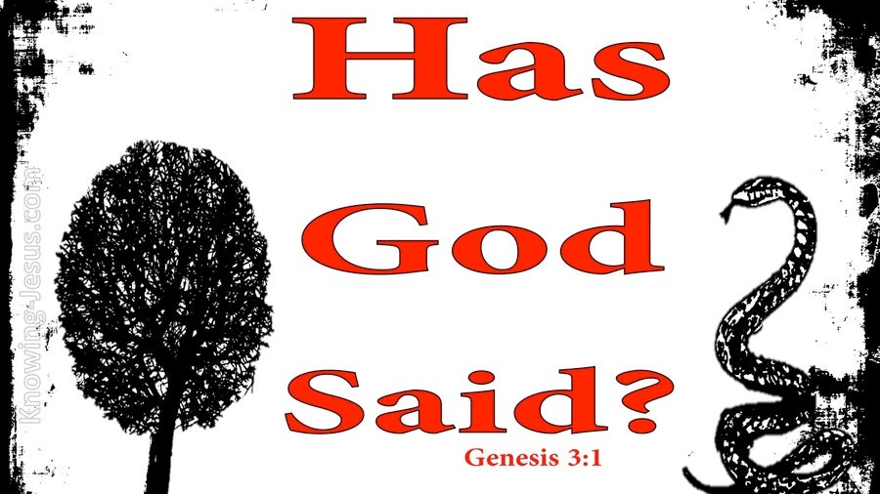
Did
God really Lsay?…

Slide 15
“Did God really say?”
The Devil has been whispering this into Christians’ ears down through history.
It’s not something we actually hear.
It comes to us in the form of doubt.
With Eve, the Devil started, by getting her to doubt the advice of her old teacher, God, and choose the advice of a new teacher, the Devil.

Slide 16
All the Devil had to whisper was
“Did God really say?” to get her to take the wrong road.
And that road led to separating that first family from God.

Slide 17
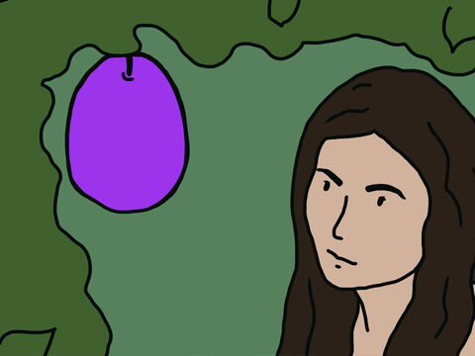
Did God really say?...

Slide 18
(pick up a mask)
Even before the crisis of the Covid 19 Pandemic, another crisis began developing, within the body of Christ—within the church.
It’s similar to a crisis the apostle Paul saw, at the church of Corinth in his day:

Slide 19
I Cor. 3:4
“When one of you says, “I am a follower of Paul,” and another says, “I follow Apollos,” aren’t you acting just like people of the world?”

Slide 21
Paul heard about people taking sides over which preacher was better.
He saw it as: dangerous worldly behavior.
Can’t you just imagine Satan whispering doubt and mistrust into those believer’s ears?
“Don’t you think Paul’s a better preacher?”
“Doesn’t Apollos make things more clear?”
Paul also wrote about it in I Cor. 1:11-12 and included another preacher people sided with.

Slide 22
I Cor. 1:11-12
“…Some members of Chloe’s household have told me about your quarrels, my dear brothers and sisters. Some of you are saying, “I am a follower of Paul.” Others are saying, “I follow Apollos,” or “I follow Peter,” or “I follow only Christ.”

Slide 23
Some of the believers just said, “I follow only Christ.”
Now: what’s wrong with that?
If there was ever a perfect person to follow, wasn’t Jesus their best choice?
In fact- what’s wrong with any of those other people Paul mentioned?
Weren’t they all strong Christian leaders? Paul-Apollos-Peter-Jesus
Yes, they were!

Slide 24
I Follow Only

Slide 25
Maybe Paul’s way of preaching was a little different than Peter’s.
Maybe Apollos told better stories.
Maybe Jesus was especially good with kids!
Paul understood about different cultures.
He even adapted himself to his different surroundings.
In I Cor 9:20-22 he wrote:

Slide 26
I Cor. 9:20-22
"While working with the Jews, I live like a Jew in order to win them; In the same way, when working with Gentiles I live like a Gentile...so I become all things to all people, that I may save some of them by whatever means are possible"

Slide 27
God knows we’re not all the same.
So, what was the problem at Corinth:
Why was Paul so concerned?
Every one of those leaders was preaching the same Gospel message. It wasn’t the leaders!
People had gone too far, and things got mean!
And the church became seriously divided.
In the world, it’s called, “partisan politics.”
And Paul saw it as a danger to the church.

Slide 29
Gal. 5:15 (GW)
“…If you criticize and attack each other, be careful that you don’t destroy each other.”

Slide 30
The problem was not with those leaders.
The problem started when people sided one against each other.
Perhaps the Devil just infected the first person with the lie:
“Isn’t your preacher better than the others?” And it spread like a pandemic.
And it turned into fighting, quarrelling and divisions in the church.

Slide 31
Paul
Apollos

Slide 32
This unchristian attitude can start with a whisper in our ear, but soon we find ourselves at odds with people who used to be our friends.
Even when the Holy Spirit lets us know that our attitudes are carnal…
And even though He would help us make things right…
We can be deceived by Satan’ lies.
And once we start down the wrong path, pride makes it very hard to turn around!

Slide 33
Just a Whisper

Slide 34
You know when my wife and I are headed someplace in our car, we often have “friendly differences” on how to get there.
I have to confess, she is right most of the time, on which road to take.
But… once I’ve taken my road, I won’t turn back—until I start getting low on gas and…
I’m forced to admit I’m on the wrong road and she was right all along!
And all the while my wife’s been telling me: Turn around!

Slide 36
Nobody likes to admit they’re wrong.
It’s pride that keeps us heading in the wrong direction when we need to turn around!
The Devil knows this about us and if he can whisper something in our ear that sounds good, off we go merrily down the road!
Especially if there’s other people who can join us. In another Kerusso Couch Sermon you may have heard, Therese called it “group think”

Slide 38
And that’s what happened in Corinth.
And that whole fight was most likely, over nothing more than the different preaching styles of Godly Christian leaders.
Satan whispered a mistrust of Godly leaders into Christian ears at Corinth and it weakened and divided their church, just as the Devil whispered mistrust into Eve’s ear.

Slide 39
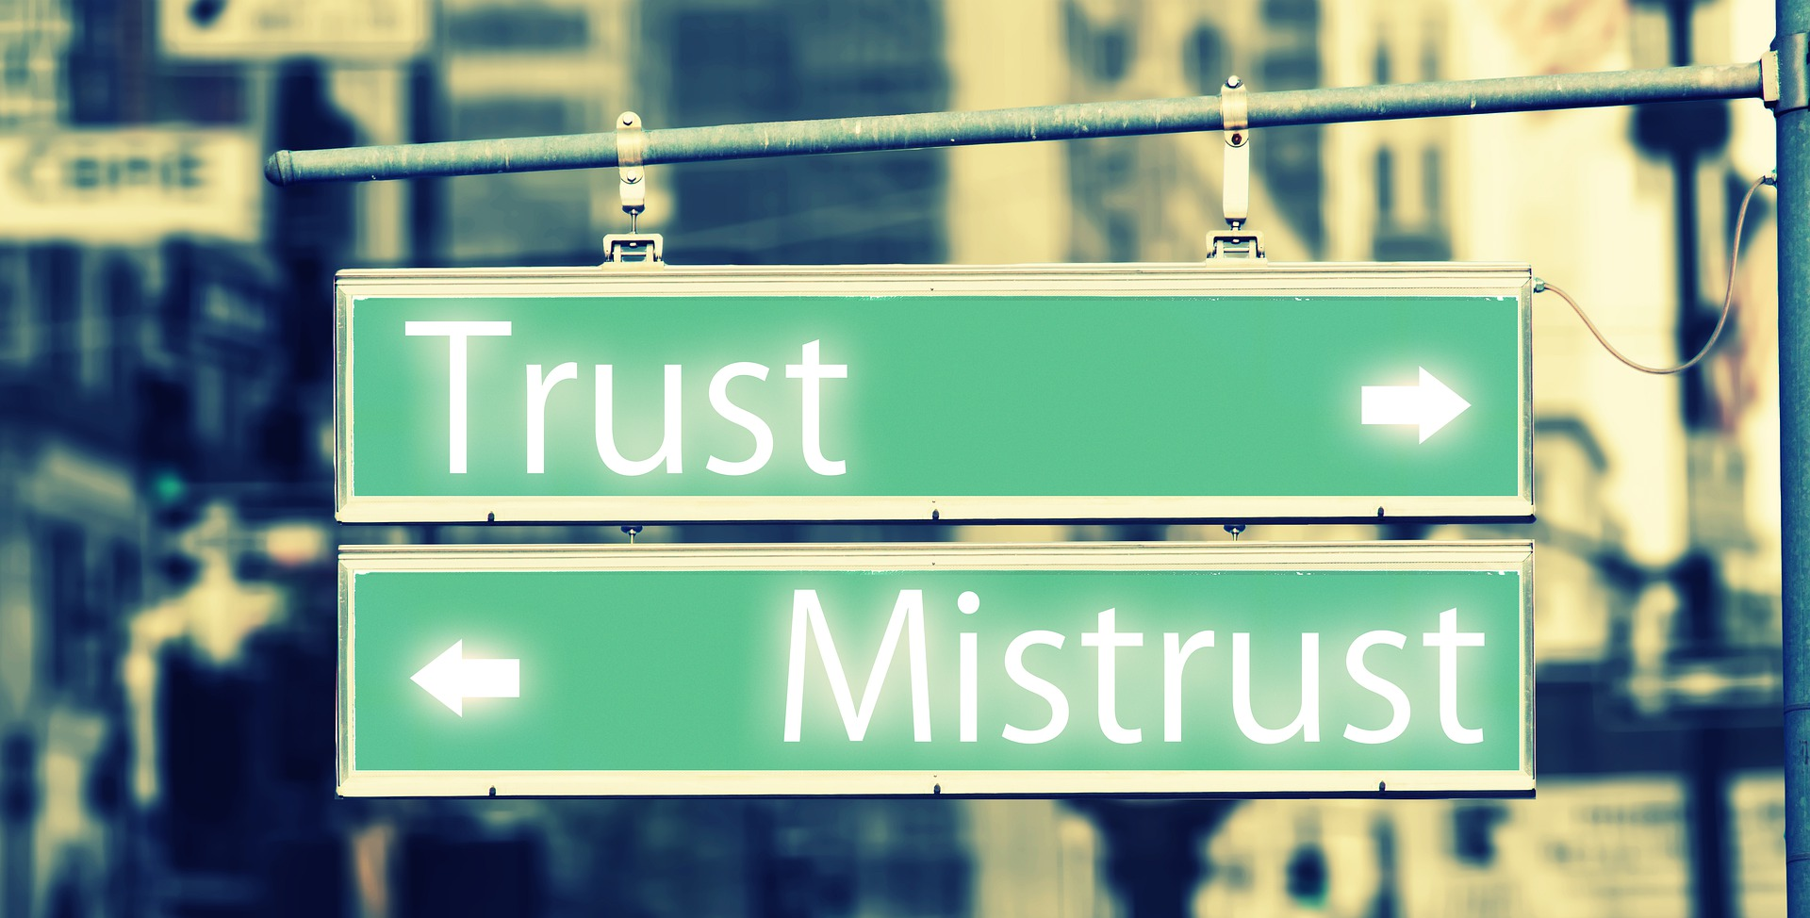

Slide 40
Now, back in Genesis Satan told Eve a second thing :
2. “God knows when you eat it, your eyes will be opened”
So, the Devil has planted doubt in Eve’s ear concerning God’s advice.
Next thing, he tells her God is holding back good things from her and she should take her liberty and eat whatever she wants.

Slide 41
Her personal right to eat the fruit of her choice had become more important to her than Godly counsel.
Satan has now preached to Eve, two false gospels:
1. The gospel of mistrusting authorities
2. The gospel of guarding your personal rights
Paul prophecies an attack upon the last day church, just like it happened to Eve:

Slide 42
1. The gospel of mistrusting
authorities.
2. The gospel of guarding
your personal rights.

Slide 43
I Tim. 4:1 (TLB)
“… in the last times some in the church will turn away from Christ and become eager followers of teachers with devil-inspired ideas.”

Slide 45
This prophecy is coming to pass today, and we must see it for what it is and turn around.
The defiant, rebellious spirit of the unsaved world around us has infected the body of Christ, just as Paul warned it would happen.
It is more dangerous than at Corinth because
Christians in these last times have begun siding with unsaved leaders, preaching false gospels, that have led us away from God.
We need to see it in ourselves and turn around!

Slide 46
We can be traveling down the road of our Christian calling and still take a wrong turn.
Let’s rely on God’s Word and the Holy Spirit.
Then we can know when we’ve been whispered to by the Devil and turn around.
This is the “crisis of our faith” we are facing in today’s church.

Slide 47
There is an old Christian Hymn, “Faith of Our Fathers” which says,
“Faith of our fathers, holy faith! We will be true to thee till death.”
And what is the “Faith of our fathers?”

Slide 49
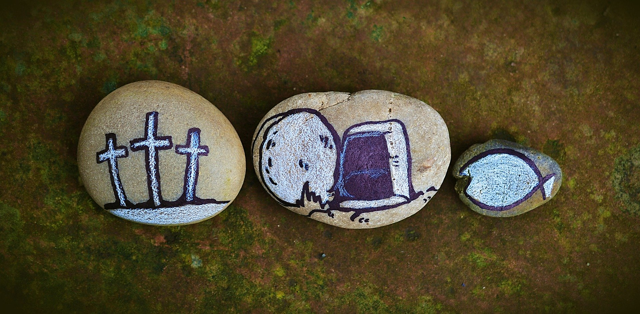
Cross + Resurrection + Salvation
Faith of Our Fathers

Slide 50
Are we staying true to the faith of our fathers?
Or has our faith become misguided?
Are we on a dangerous detour?
Are we, without realizing it, being led down the wrong road?
Then we need to turn around!
Paul reminds all believers to keep on track:

Slide 51
In I Cor 1:23 (TLB)
“…we preach about Christ dying to save them”

Slide 52
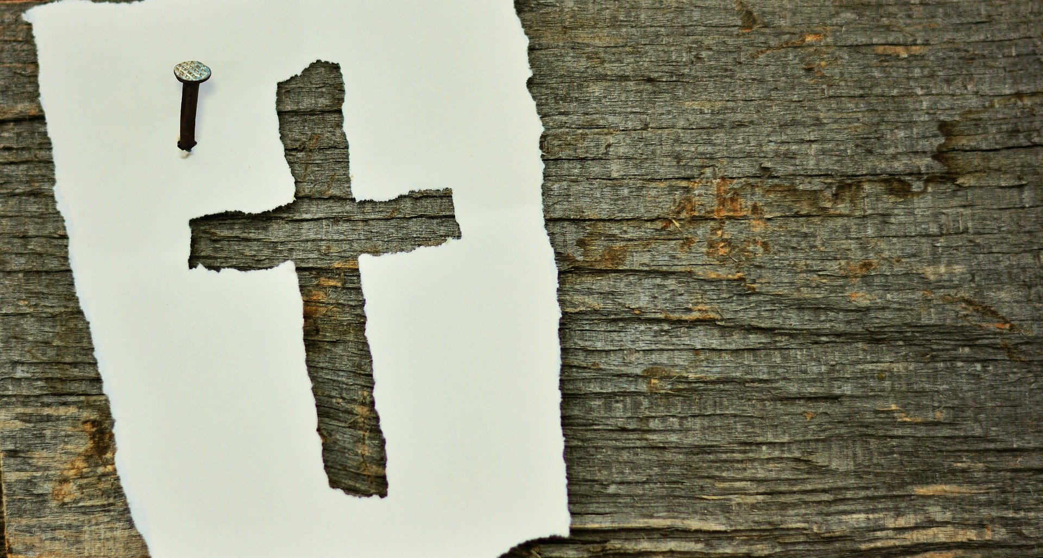
A Simple Gospel

Slide 53
That’s it! That’s the sum-total of our job and calling as Christians:
Remember, listening to the wrong teacher isn’t anything new.
Eve listened to the wrong teacher way back in the garden of Eden.

Slide 54
Two things happened to her:
1. She was seduced into listening to an ungodly leader.
2. He whispered in her ear that she was missing out on some good things and needed to exercise her individual rights.

Slide 55
Rights
Rights

Slide 56
We place a great emphasis today on our “individual rights.”
We don’t want be restricted by the powers that be.
Eve decided to exercise her rights, but for her, it didn’t end well.
Our “individual rights” are guaranteed by our constitution, at least here in America.
But they are not a “gospel” to be believed in.
And The Gospel of Christ never guarantees our rights and often asks us to give them up.

Slide 57
Twice in scripture, Peter fights for individual rights:
First In Mat. 16 after Jesus explains that he must go to the Cross, Peter rebukes Him, saying that his master had a right to live and should not be crucified:

Slide 58
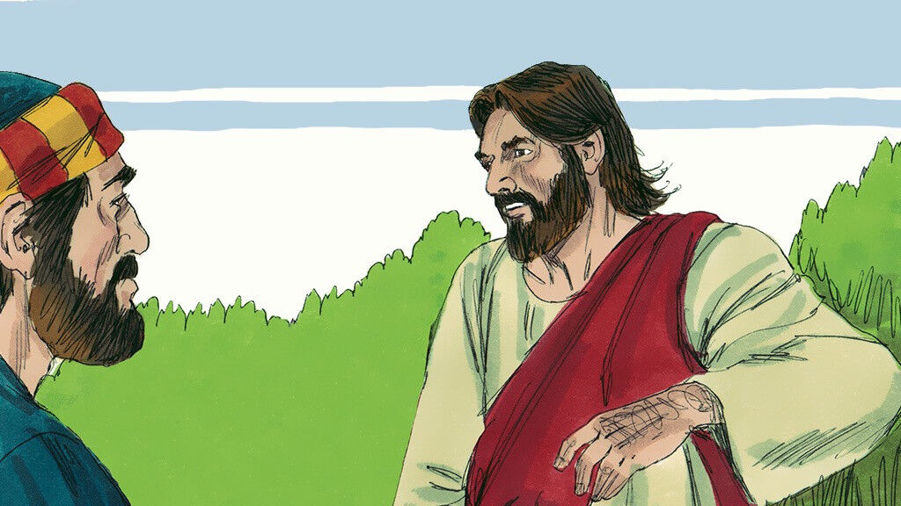

Slide 59
Mat 16:21-22 (NIV)
From that time on Jesus began to explain to his disciples that he must go to Jerusalem and suffer many things at the hands of the elders, the chief priests and the teachers of the law…

Slide 60
Mat 16:21-22 (NIV)
…and that he must be killed and on the third day be raised to life. Peter took him aside and began to rebuke him. “Never, Lord!” he said. “This shall never happen to you!”

Slide 61
(NEW TESTAMENT FOR EVERYONE FOR THE YOUNGER CROWD)
Mat 16:22 (NTE)
…Peter took him and began to tell him off. ‘That’s the last thing God would want, Master!’ he said. ‘That’s never, ever going to happen to you!’

Slide 62
Then, in Mat 26 he attacks a guard with his sword: he physically assaults and injures someone to protect his master’s rightful place as Messiah.

Slide 63
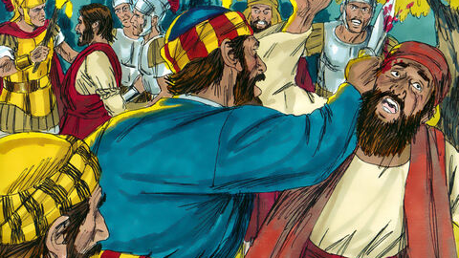

Slide 64
Mat 26:50-51 (NIV)
Jesus replied, “Do what you came for, friend.” Then the men stepped forward, seized Jesus and arrested him. With that, one of Jesus’ companions reached for his sword… and struck the servant of the high priest, cutting off his ear.

Slide 65
Guess who that unnamed servant was? It was Peter! (It says so in John 18:10)
And who could blame Peter for fighting for those rights?
Wouldn’t we do the same thing?
But each time Jesus corrects Peter’s behavior.
First, when Peter rebukes Him, Jesus says…

Slide 66
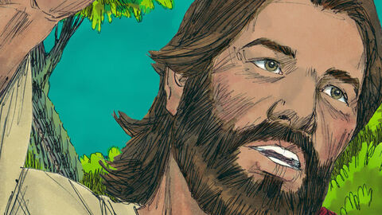

Slide 67
Mat 16:23 (NIV)
“You do not have in mind the concerns of God, but merely human concerns"

Slide 68
(NEW TESTAMENT FOR EVERYONE FOR THE YOUNGER CROWD) Mat 16:23 (NTE) “Jesus turned on Peter. ‘Get behind me, satan!’ he said. ‘You’re trying to trip me up! You’re not looking at things like God does! You’re looking at things like a mere mortal!’”

Slide 69
Secondly, when Peter pulls out his sword to protect his leader, Jesus say this:

Slide 70
Mat. 26:53-54
“Don’t you realize that I could ask my Father for thousands of angels to protect us, and he would send them instantly? But if I did, how would the Scriptures be fulfilled that describe what must happen now?”

Slide 71
Jesus knew, that listening to Peter’s so-called gospel of “individual rights” would overturn God’s mission for Christ to go to the Cross and die for our sins.
And our mission must be as Paul directed: to simply preach about Christ dying to save mankind.
Like Peter, the false “gospel” of our rights and concerns, is, at best, selfish, and at worst: the same lie the Devil whispered into Eve’s ear.

Slide 72
Hey, I Have Rights Here!!

Slide 73
I hope you now see the condition of our church and how we got here.
How can we, now, get back on track as faithful followers of the one true Gospel?

Slide 74
Lets ask ourselves:
“What do we love talking about, sharing, and studying?”
If it’s different than what we used to love talking about, sharing, and studying, then we need to turn around!
God pleads with the people of his day through the prophet Jeremiah
From the very first sentence I feel in my heart that is a Word from the Lord for us today!

Slide 75
Jer. 6:16-17 (TLB)
Yet the Lord pleads with you still: Ask where the good road is, the godly paths you used to walk in, in the days of long ago. Travel there, and you will find rest for your souls. But you reply, “No, that is not the road we want!”

Slide 76
Jer. 6:16-17 (TLB)
…I set watchmen over you who warned you: “Listen for the sound of the trumpet! It will let you know when trouble comes.” But you said, “No! We won’t pay any attention!”

Slide 77
Finally, in Revelation chapter 2 Jesus pleads with the church at Ephesus, asking them to
turn around

Slide 78
Rev. 2:2-5 (TLB)
“I know how many good things you are doing. I have watched your hard work and your patience… You have patiently suffered for me without quitting. Yet there is one thing wrong; you don’t love me as at first!...

Slide 79
Rev. 2:2-5 (TLB) cont.
…Think about those times of your first love (how different now!) and turn back to me again and work as you did before; or else I will come and remove your candlestick from its place among the churches.”

Slide 80
Back in 1960 the US Navy adopted the initials K-I-S-S, as the best and most efficient way to run all their machinery and systems. It stood for “Keep It Simple, Stupid.”

Slide 81
K.
I.
S.
S.
THE KISS PRINCIPLE

Slide 82
KEEP
IT
SIMPLE,
STUPID
THE KISS PRINCIPLE

Slide 83
Dear brothers and sisters in Christ, let’s not be seduced from the simple gospel by the distractions and temptations the Devil would have us follow.
Remember that old children’s song, “This little light of mine?”
It’s a simple song about a simple gospel.
Let’s keep it simple.

Slide 84
The Simple
Gospel

