Slide 2
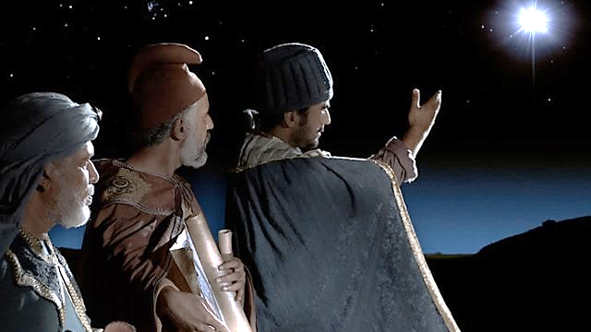
Stars Shine
At Night

Slide 3
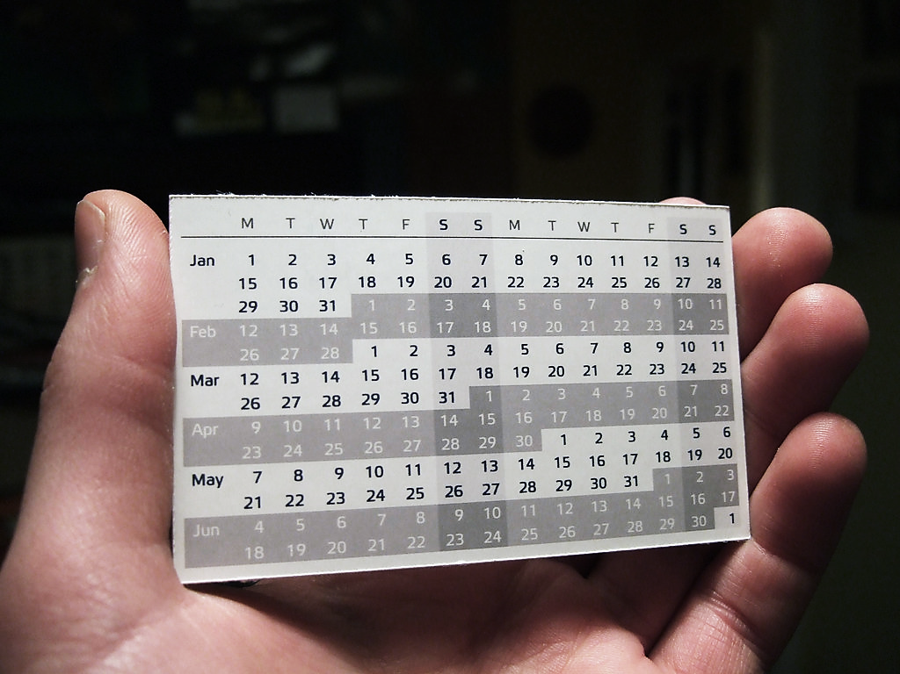
God’s Timetable Pt. 6

Slide 4
Today we will look at God’s Timetable pt. 6 entitled, “Stars Shine at Night.”
In review, we learned that that there were prophecies about a coming King that would be like a lion, would defeat His enemies, and rule the world.
At the cross, Jesus did defeat His enemies→ both death and Satan.
Then, just as a lion always returns to his den, Jesus returned to His Heavenly dwelling.

Slide 5
When the lion returns to his den, he lays down for a long rest because his work is finished.
So too, Jesus declared from the cross “It is Finished.” The enemy is defeated!!
Jesus has done the work He came to do, He won the war against His enemy and returned to His Heavenly rest.
We also learned that the Magi were from the very nations that were threatened by these prophecies.

Slide 6
Last time we looked at the special, prophetic star.
When this star appeared, it would be a blessing to the wise and a warning to the rebellious.

Slide 7
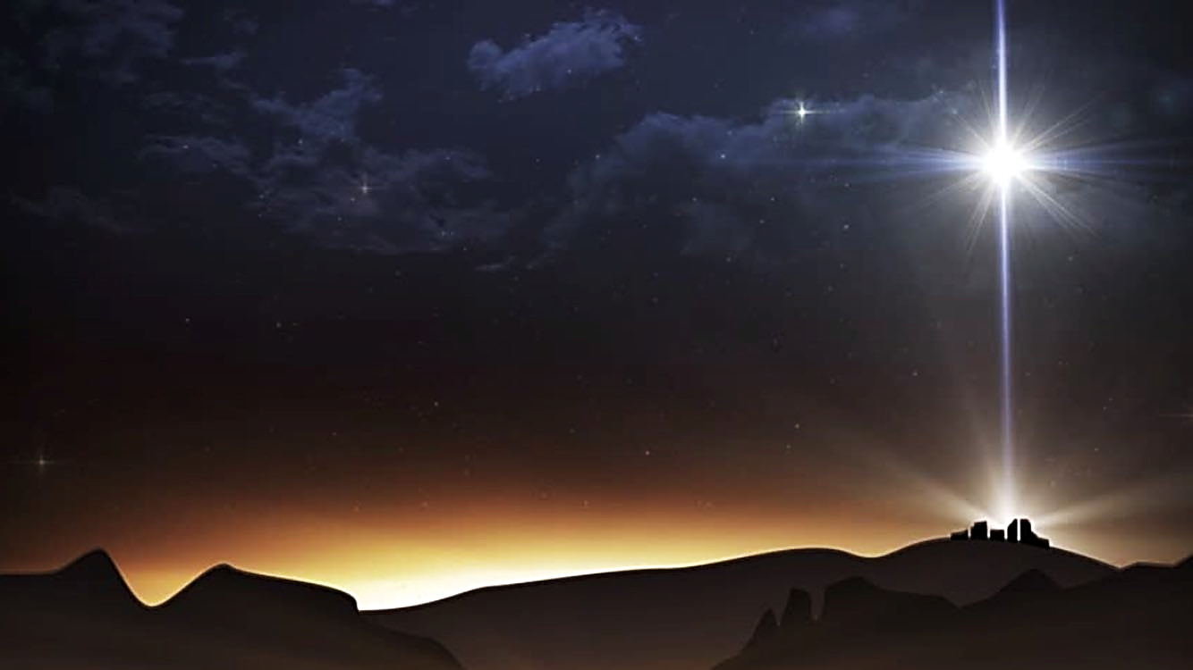

Slide 8
This coming king would be like a Lion who would come from the tribe of Judah.
And He would be worshipped by His brothers (this is speaking of the Israelites and is yet to be fulfilled).
He would also stand on the necks of all His enemies (He did this when He defeated Satan at the cross).

Slide 9
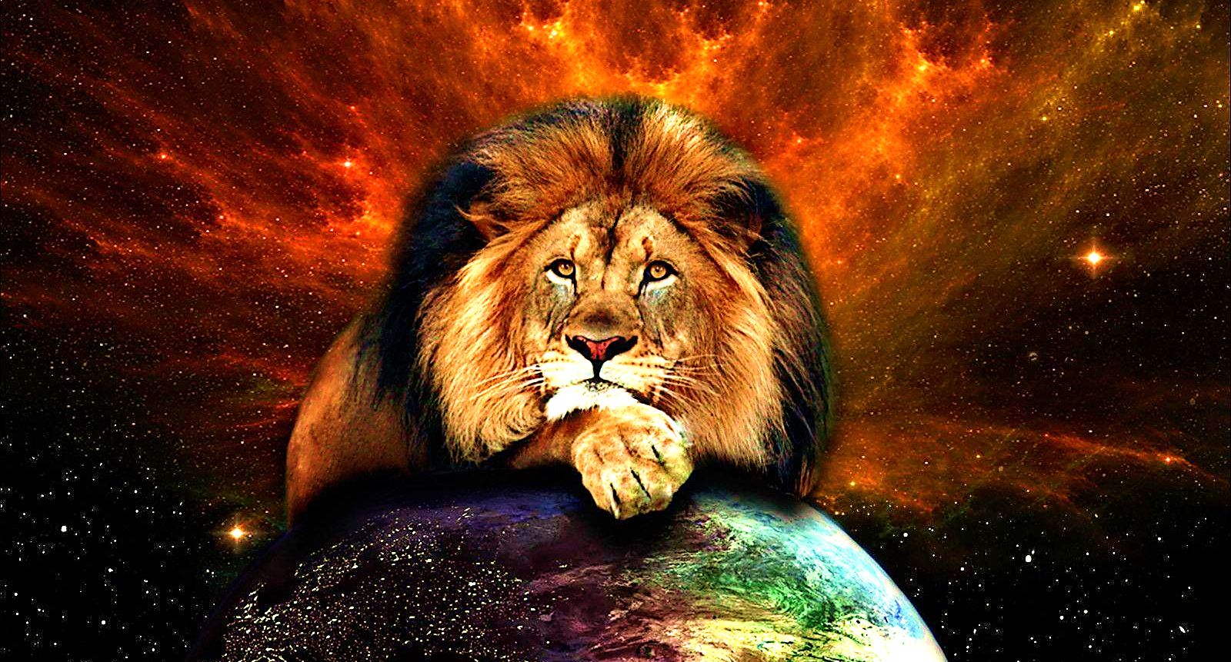

Slide 10
This prophecy (uttered by Jacob and continued by Balaam) was about a coming King, who would be greatly feared by the enemies of Israel.
It also told of a special star that would announce the coming of this “Lion of Judah.”

Slide 11
Imagine how the Magi, these highly respected men of the King’s court,
…these practitioners of the occult,
…these historic enemies of God’s chosen people…
…must have felt as they counted the years, months & days till the coming of…
…this destroyer of the Lord’s enemies!

Slide 12
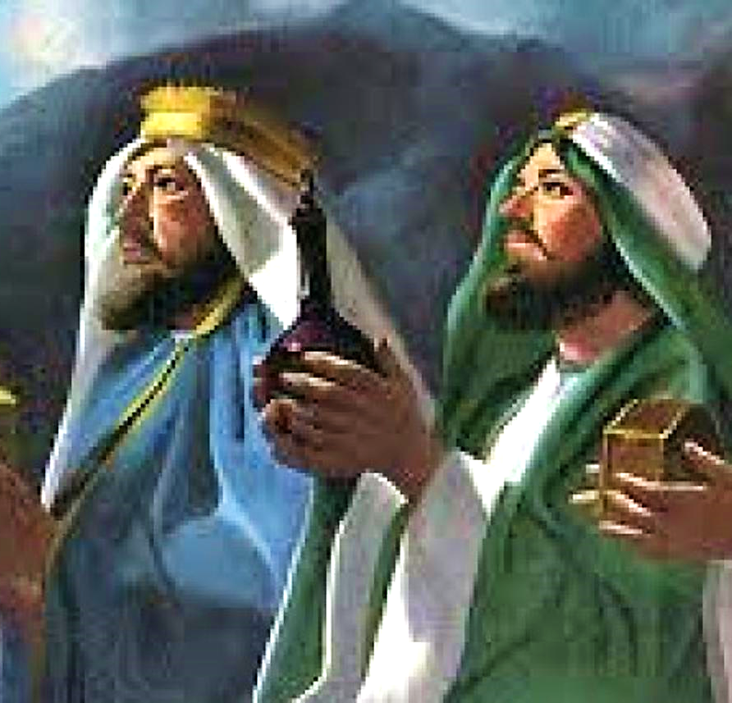
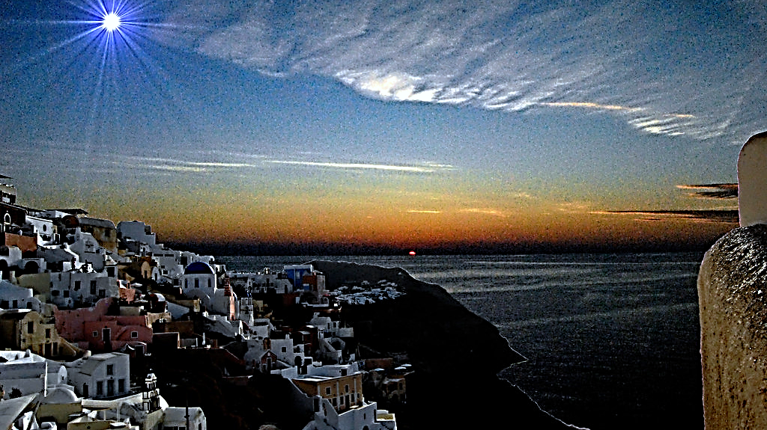

Slide 13
Remember that Daniel was put in charge of the wise men of his time, and he surely would have taught them about the Lion of Judah and the Scepter and the Star.

Slide 14
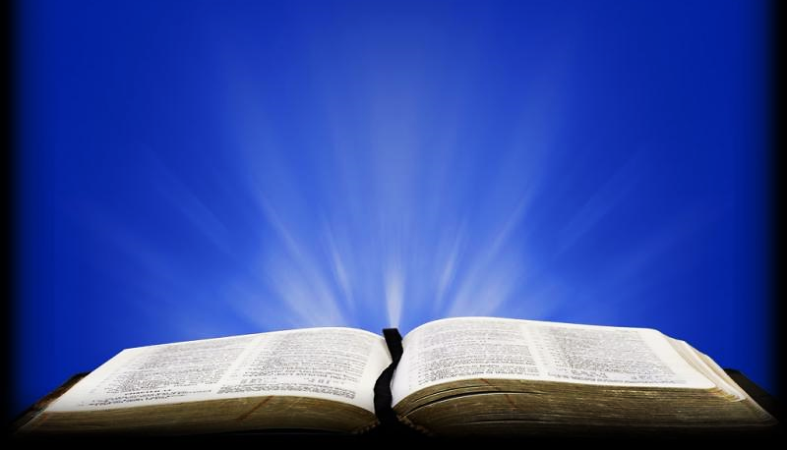
Dan. 2:47-49 (ICB)
“…Then the king gave Daniel an important position in his kingdom… Nebuchadnezzar made him ruler over the whole area of Babylon. And he put Daniel in charge of all the wise men of Babylon.

Slide 15
Dan. 2:47-49 ICB (cont.)
…Daniel asked the king to make Shadrach, Meshach and Abednego important leaders over the area of Babylon. And the king did as Daniel asked. Daniel himself became one of the important people who stayed at the royal court.’

Slide 16
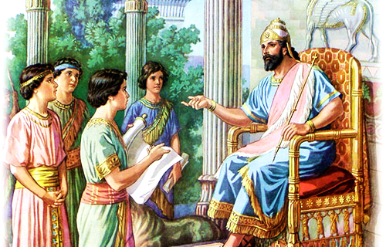

Slide 17
Despite Daniel’s influence, most “magi” practiced divination of every sort including astrology, false prophecy and other occultic practices.
The word “magi” comes from the Persian false religion called “Zoroastrianism.”
The modern word is “magician.”
The same word is used to describe Barjesus, a Jewish Sorcerer in Acts:

Slide 18
Acts 13:6–12 ERV
“…(Paul and Barnabas) met a Jewish man named Barjesus who did magic. He was a false prophet. He always stayed close to Sergius Paulus, who was the governor and a very smart man. He invited Barnabas and Saul (Paul) to come visit him, because he wanted to hear the message of God…

Slide 19
Acts 13:6–12 ERV (cont.)
…But the magician… spoke against them, trying to stop the governor from believing in Jesus. But (Paul), filled with the Holy Spirit, looked hard at (Barjesus) and said, “You son of the devil, full of lies and all kinds of evil tricks!”

Slide 20
This same word for “magi” is used to describe another man by the name of Simon.
He was an early, but very questionable Christian convert.
He wanted to be seen as a spiritual giant & brought this into his “Christianity.”
Let’s see what happened…

Slide 21
Acts 8:9–20 ERV
“…Simon had been doing magic and amazing all the people of Samaria. He bragged and called himself a great man. All the people—the least important and the most important—believed what he said…

Slide 22
Acts 8:9–20 ERV (cont.)
…Simon amazed the people with his magic for so long that the people became his followers. But Philip told the people the Good News about God’s kingdom and the power of Jesus Christ. Men and women believed Philip and were baptized…

Slide 23
Acts 8:9–20 ERV (cont.)
…Simon himself also believed, and after he was baptized, he stayed close to Philip. When he saw the miraculous signs and powerful things Philip did, he was amazed…
Simon saw that the Spirit was given to people when the apostles laid their hands on them.

Slide 24
Acts 8:9–20 ERV (cont.)
…So, he offered the apostles money. He said, “Give me this power so that when I lay my hands on someone, they will receive the Holy Spirit.” Peter said to Simon, “You and your money should both be destroyed because you thought you could buy God’s gift with money.

Slide 25
And so, we see, not only were Magi from Israel’s enemy nations, condemned in prophecy…
…they were also guilty of practicing the evil profession we have now come to call “Eastern Religion.”
Although, from Daniel’s influence, they most likely had some knowledge of the Messianic prophecies.
The practice of most Magi at Christ’s time was a mixed bag of evil tricks.

Slide 26
Now, when it arrived, this prophesied, awesome & fearful star would signal “Time’s Up”
…and the enemies from the East knew it, they were expecting it, and they feared it.
These were dark and evil times, just as we live in today.

Slide 27
The time has come.
The King of Kings has Arrived!

Slide 28
But the coming of this King, it is only fearful to the foolish. To the wise it is hope.
Why did God choose to use a star and not something like a solar explosion?
Likely, Jesus chose a star to announce His arrival because, like Him, a star is a light that shines in the night—shines in darkness.
And, just as the star led the wise men to His house, Jesus is a light that leads men straight to Himself.

Slide 29
Bethlehem Star:
A light in the dark
It points the way to Jesus

Slide 30
John 6:12 ESV
“Again, Jesus spoke to them, saying, “I am the light of the world. Whoever follows me will not walk in darkness but will have the light of life.

Slide 31
Question #1:
What is it like to walk in darkness and what is it like to walk in the light?

Slide 32
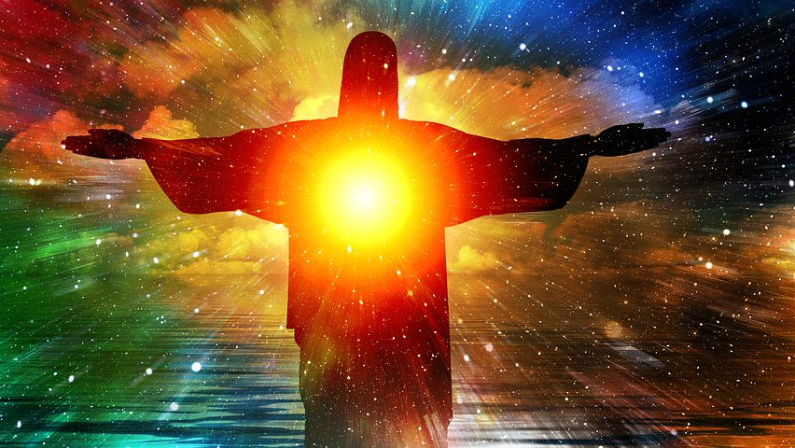

Slide 33
John 1:5 CEV
“The light keeps shining in the dark, and darkness has never put it out.”

Slide 34
Question #2:
When you turn on a light in a dark room, who is the winner the light or the darkness? How does this remind us of Jesus and Satan?

Slide 35
Jesus’ natural, eternal, Heavenly state is light itself!
We see this in the Heavenly visions biblical men have experienced.
And, for a moment here in His earthly ministry, He returned to His eternal state as a being of light at the “Mount of Transfiguration: and it was witnessed by His disciples.

Slide 36
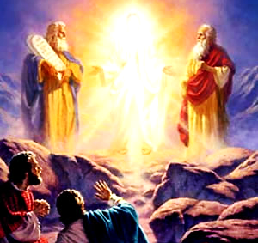
The Mount of Transfiguration

Slide 37
1 John 1:5 ESV
“This is the message we have heard from him and proclaim to you, that God is light, and in him is no darkness at all.”

Slide 38
Question #3:
It is rare for a room to have no shadows or dark corners at all.
Where can they be found in dwellings, in human hearts, in our modern false gods?
How is God different?

Slide 39
There is one dwelling that has no dark corners… Jesus’ Heavenly home.
That is because He is the light there and darkness must flee when He is present.
Here Jesus is compared to a “lamp” that shines with the Glory (or Light of God).
He is a human vessel (He still has His human body), but His divine light nature shines from Him as it did on the Mount of Transfiguration.

Slide 40
Revelation 21:23 ESV
“And the city has no need of sun or moon to shine on it, for the glory of God gives it light, and its lamp is the Lamb.”

Slide 41
Jesus is the
Light of Heaven

Slide 42
Since Jesus is light itself, and He is also the Word of God, His light emanates from His Word.
With His Word He opens our blind eyes and repels any darkness lurking in our hearts.

Slide 44
Psalm 119:130
“The unfolding of your words gives light; it imparts understanding to the simple.”

Slide 45
Question #4:
Have you ever experienced the Word of God seeming to shine from the pages to your heart and mind… explain!?

Slide 46
When Jesus returned to Heaven, He left us in charge of taking His Word to the World.
Jesus was represented by one star shining over His birthplace, shining in the dark sky…leading men to Himself.
Now, in the book of Revelation, the Church is represented as seven stars in Jesus’ right hand.

Slide 47
Rev. 1:16 ISV
“In his right hand he held seven stars, and out of his mouth came a sharp, two-edged sword. His face was like the sun when it shines with full force.”

Slide 48
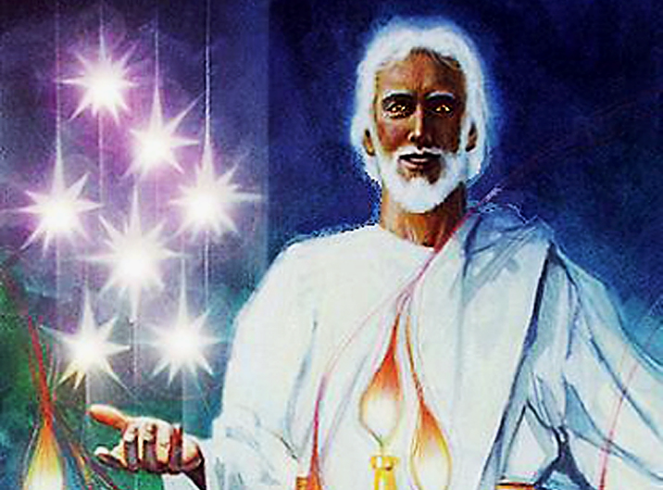

Slide 49
He has passed His shining as a STAR mission on to us.
1) We are LIGHTs shining in a dark land and time.
2) We are called to lead the lost to the place where Jesus dwells.
We serve as stars in His right hand continuing His mission as light to the world and leading wise men to Christ’s door.

Slide 50
Let’s look at God’s original purpose for stars…
He made light on the first day, but…
He didn’t make sun moon or stars till the fourth day.
This tells us that he doesn’t need heavenly bodies to produce light, yet He chose to use these bodies to both contain and emanate it.
Heavenly bodies shine with light that came from God.

Slide 51
Genesis 1:15, 16 ICB
“They will be in the sky to give light to the earth.” And it happened. So, God made the two large lights. He made the brighter light to rule the day. He made the smaller light to rule the night. He also made the stars.”

Slide 52
So, we see that the purpose of Heavenly bodies is to give light to the earth.
These luminaries are not necessary in God’s Heaven because, there, God is light.
We learned that God’s light can never be put out by darkness.
Satan will never be stronger than God.
But one bad thing could happen… the bodies (and that is us) could fail to shine.

Slide 53
Philippians 2:15 (AMP)
“So that you may prove yourselves to be blameless and guileless, innocent and uncontaminated, children of God without blemish in the midst of a morally crooked and spiritually perverted generation…

Slide 54
Philippians 2:15 (AMP) (cont.)
…among whom you are seen as bright lights [beacons shining out clearly] in the world of darkness.”

Slide 55
This verse is saying that if our lives remain blameless and morally pure and uncontaminated by the world , we will shine as a bright light in a dark world.
And as stars, willing to shine, we, like the Bethlehem star itself, can lead the lost right to Christ’s door.

Slide 56
Acts 13:47 NCV
“This is what the Lord told us to do, saying: ‘I have made you a light for the nations; you will show people all over the world the way to be saved.”

Slide 57
Question #5:
What does this verse tell us about the purpose of our lives and how can each of us fulfill this mission?

Slide 58
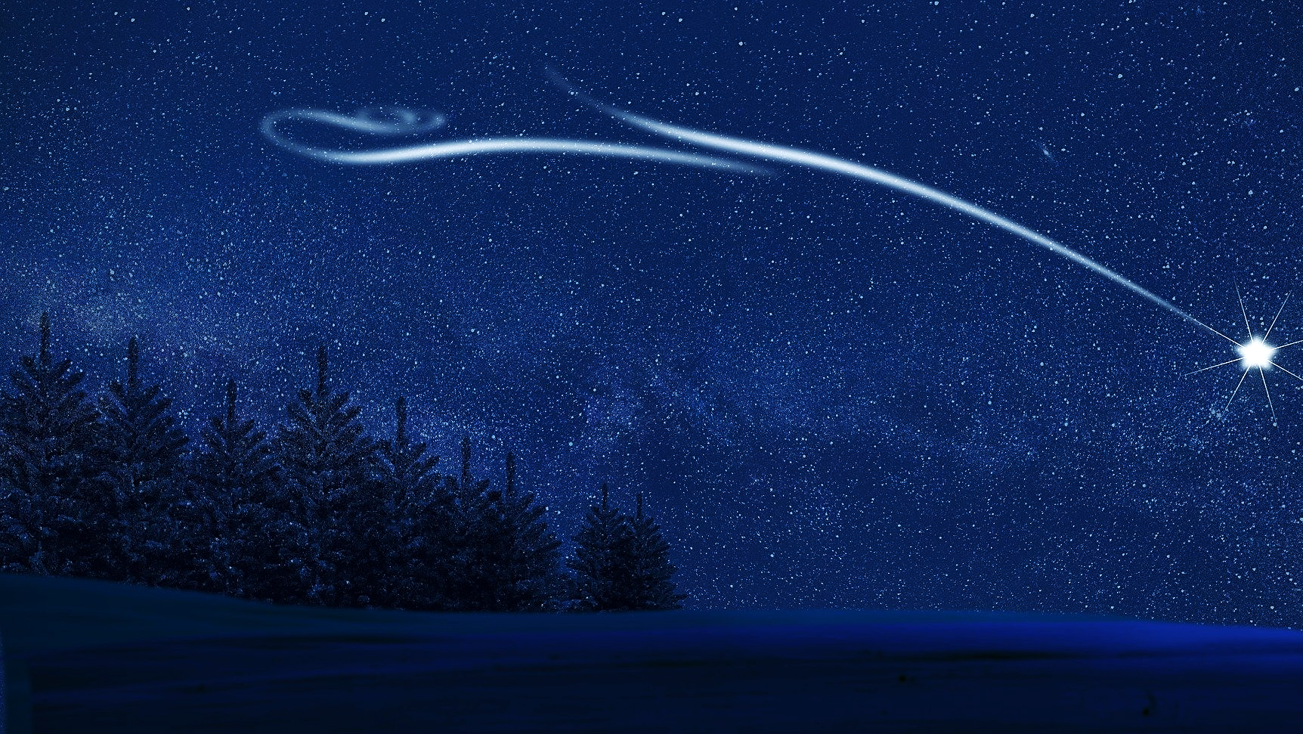
A star is basically
a heavenly object
that is set on fire.
Are we on fire for God?

Slide 59
Well, we didn’t get around to the Scepter or the imposter this time… so, stay tuned.
Coming soon, we will talk about some people who knew that the light had come… they knew the promised King had been born.
They knew that He was the Christ and they said “No-Way… we love our sin.”
This is the sad way many people respond to the light of Christ.

Slide 60
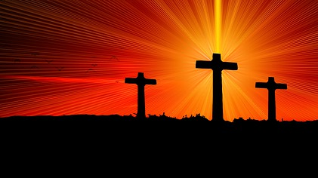
No
Way!
John 3:19 ESV
“And this is the judgment: the light has come into the world, and people loved the darkness rather than the light because their works were evil.”

