Slide 2
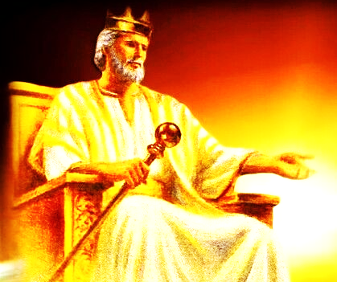
Lord of All
God’s Timetable pt. 7

Slide 3
We learned that that there were prophecies about a coming King that would defeat Israel’s enemies and rule the world.
And that the birth of this King would be announced by a great star in the night.

Slide 4
Also, we saw that, just as that star would be a light in darkness that would lead men to Jesus…
Jesus himself is THE LIGHT in darkness leading men to Himself…
Let’s read, in scripture, a glorious promise God makes to Israel:

Slide 5
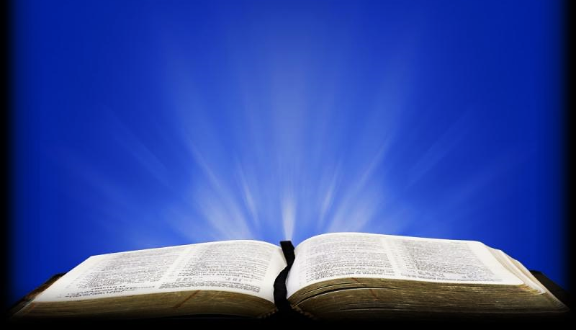
Isiah 60:1-3GW
“Arise, shine, for your light has come, and the glory of the Lord is dawning upon you. Look, darkness covers the earth, and deep darkness covers the peoples, but the Lord will dawn upon you, and his glory will be seen over you. Nations will walk to your light, and kings to the brightness of your dawn.

Slide 6
Jesus Himself is THE STAR in this prophecy… “a star shall rise up” = Jesus!
That big, glowing, celestial body in the night sky was a representation of Jesus.
Also, according to the book of Revelation, we too are stars, held in the right hand of Jesus, and we have His same mission (to lead men to Him)!!

Slide 7
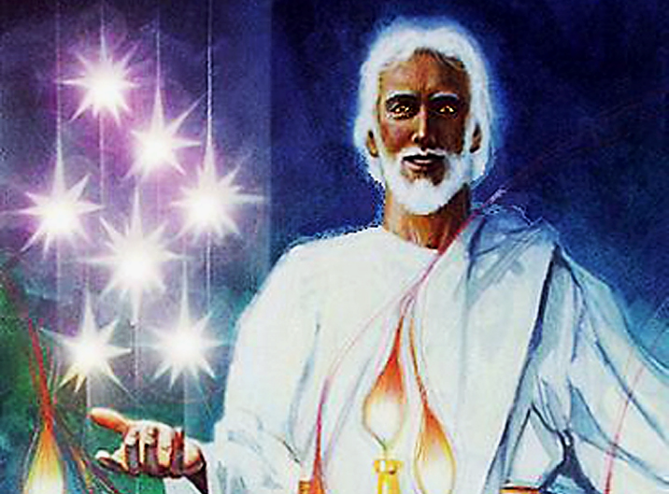

Slide 8
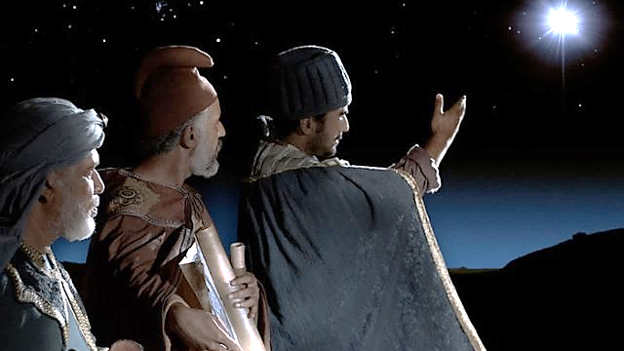
Bethlehem Star:
A light in the dark
It points the way to Jesus

Slide 9
We also learned that the Magi were, most likely, from the very nations threatened by the ancient prophecies.
Not only that, but they were also practitioners of evil religious practices which were condemned by God.

Slide 10
Imagine how the Magi must have felt as they waited for this fearsome, conquering King to be born!
Let’s look at this prophecy again…
Notice that it mentions a star and a scepter.
It also condemns the nations of Moab & Edom.

Slide 11
Num 24:8, 9 (GW)
“The God who brought them out of Egypt has the strength of a wild bull. He will devour nations that are his enemies, crush their bones,
and pierce them with arrows…
Those who bless you will be blessed! Those who curse you will be cursed!”

Slide 12
Num 24:17-23 (GW)
“‘I see someone who is not here now. I look at someone who is not nearby. A star will come from Jacob. A scepter will rise from Israel. He will crush the heads of the Moabites… Edom will be conquered…

Slide 13
Num 24:17-23 (GW) cont.
... So, Israel will become wealthy. He will rule from Jacob and destroy whoever is left in their cities.’ …Who will live when God decides to do this?’”

Slide 14
As fearful as this prophecy about a coming King is… it is only fearful to the foolish.
To the wise it is hope.
The prophetic “Star” would announce His birth & the “Scepter” speaks of His power & authority.
Just as Jesus is the STAR of the prophecy, He is also the SCEPTER of God (represented by a physical scepter).

Slide 15
A scepter is a stick held by a king or a person who is in a place of authority.
Its meaning was described at the coronation of William the Conqueror.
It was decreed: “…by the scepter, uprisings in the kingdom are controlled, and the rod gathers and confines those men who stray."

Slide 16
It is a symbol of great power.
It has been so embraced by people in authority, it even became a fashion statement for a while.
As a stick in a ruler’s hands, the scepter (this mere stick) has taken many forms through the years.

Slide 17
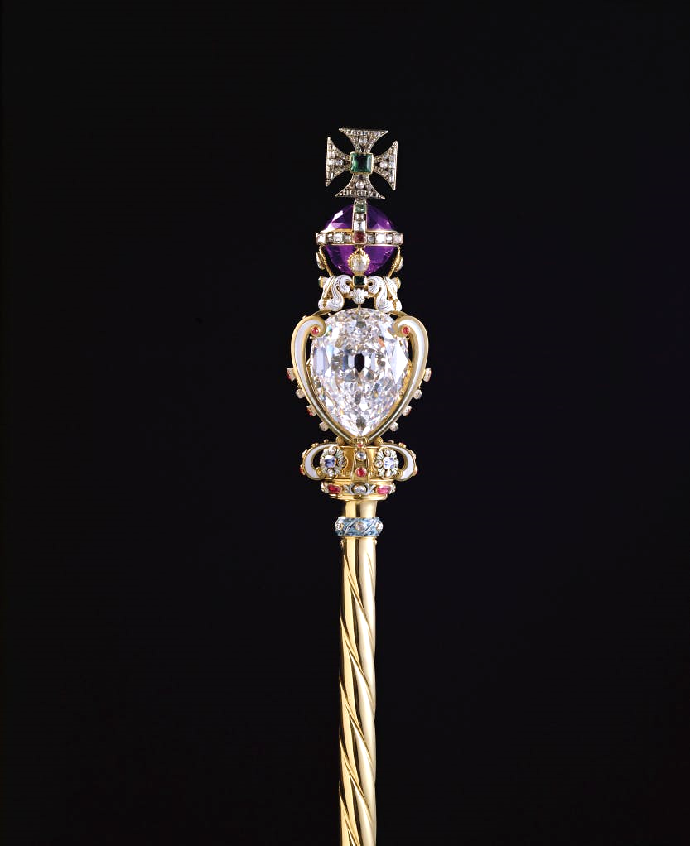
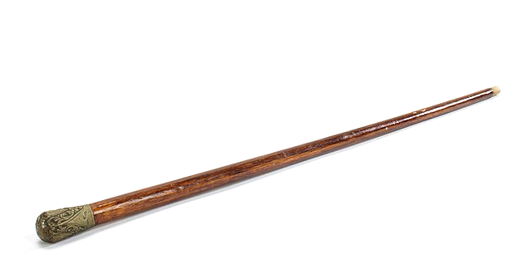

Slide 18
It was believed that the ancient false gods carried them.

Slide 19
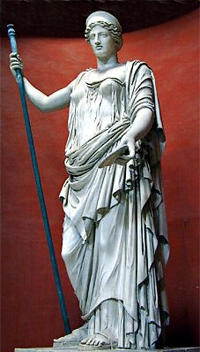
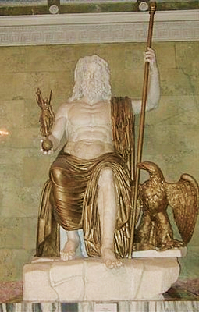
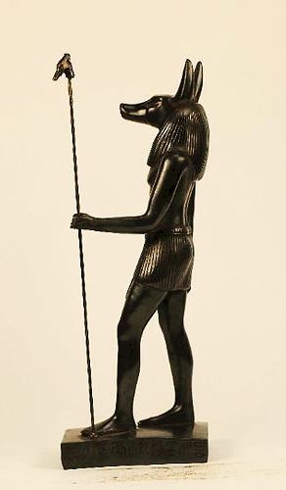

Slide 20
The Romans, Egyptians and other leaders of ancient civilizations also used them as a symbol of authority.

Slide 21
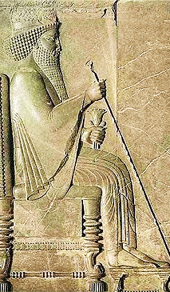
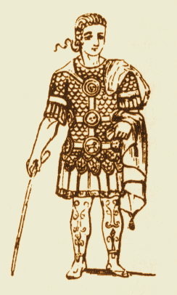
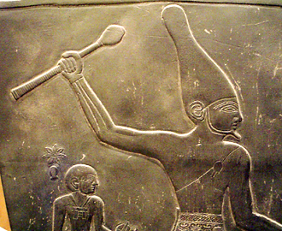
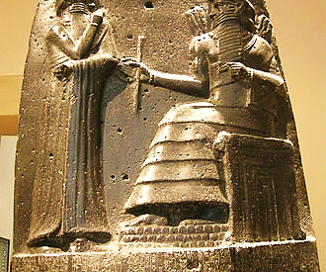

Slide 22
The Scottish, British and German military used a variation of this ancient authority rod.
It came to be known as a “Swagger Stick”
Maybe, because when men think they have power (as they did when they held this stick), they tend to “swagger.”

Slide 23
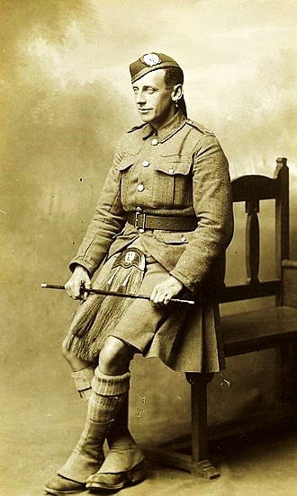
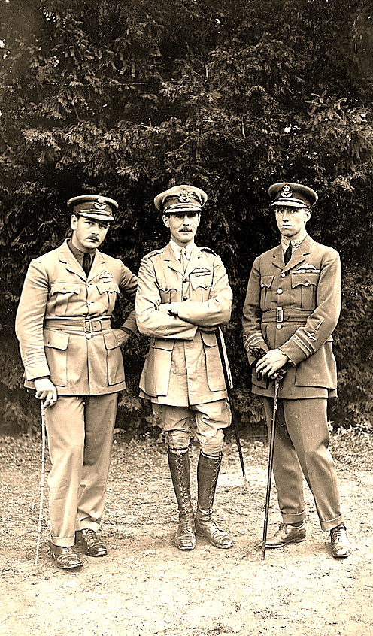

Slide 24
Even in the U.S. military (as far back as George Washington) sported “swagger sticks.”

Slide 25
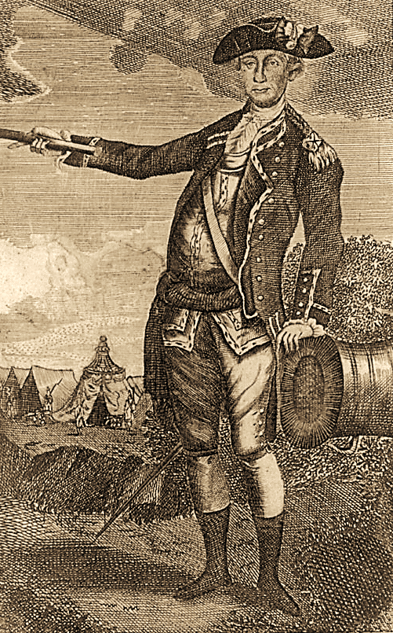

Slide 26
Swagger sticks became so popular they even moved from military applications to the culture at large.
They became a man’s fashion statement.
Oh, how very dapper a man looks with a swagger stick under his arm (or so they thought).

Slide 27
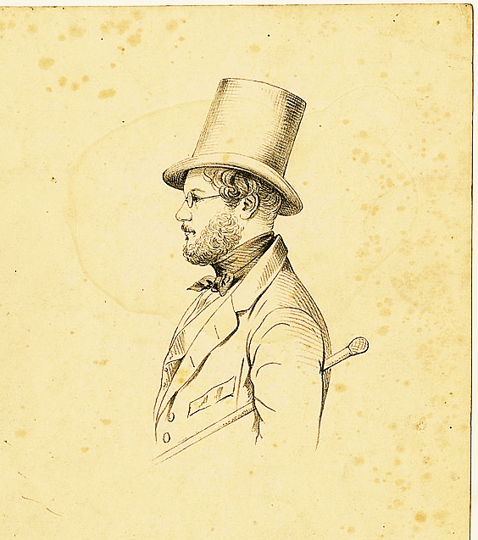
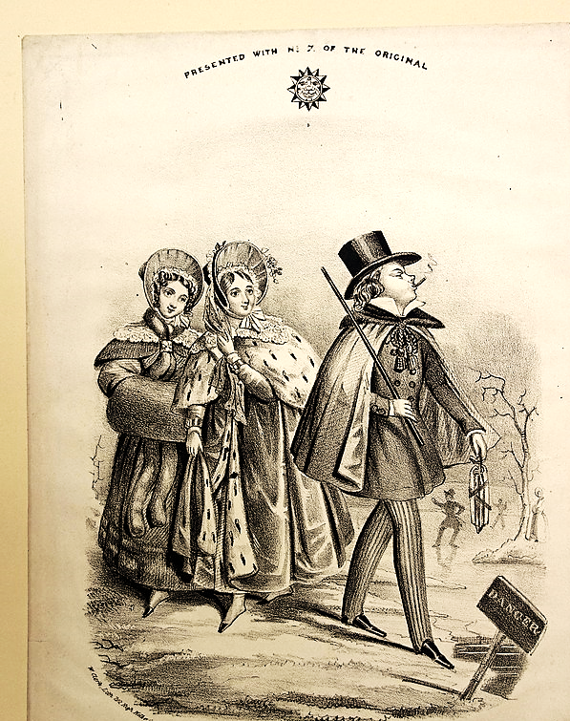
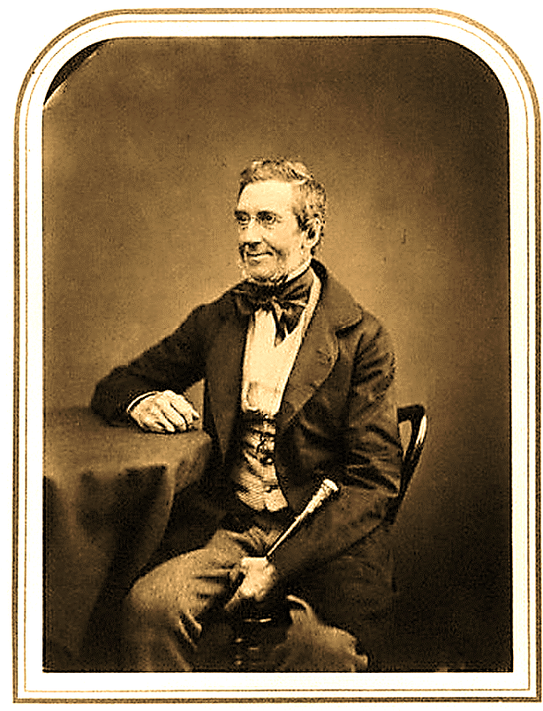

Slide 28
Even today, the symbols of British royalty are represented by a scepter and an orb.
The scepter represents authority, and the orb represents the world.
In other words, the monarch has authority over the whole world.

Slide 29
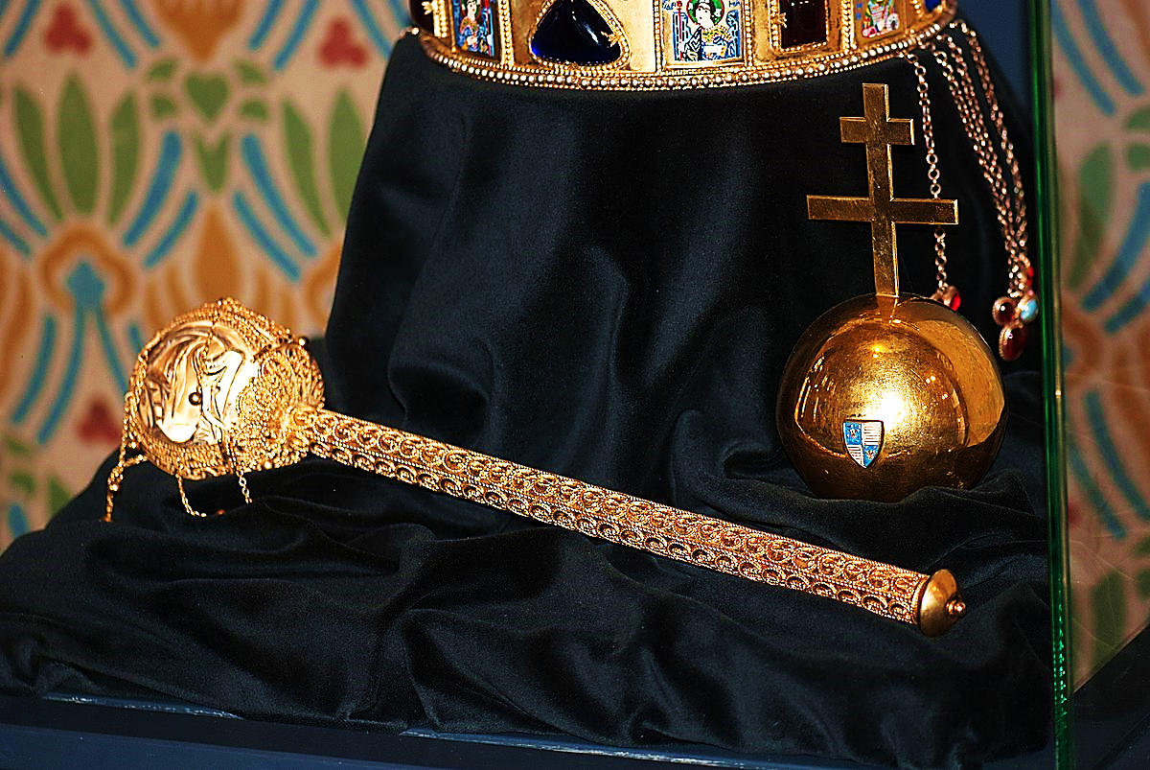
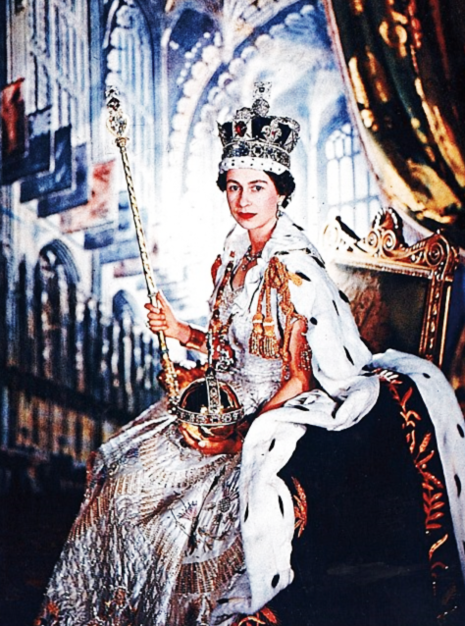

Slide 30
Throughout history, it has been a fearful thing to walk into a king's court and risk displeasing him.
This is why Esther told her uncle that she was afraid to go before the king and plead for his mercy on her people (the Jews).

Slide 31
Esther 4:11 (TLB)
“All the world knows that anyone, whether man or woman, who goes into the king’s inner court without his summons is doomed to die unless the king holds out his gold scepter; and the king has not called for me to come to him in more than a month.”

Slide 32
Esther 4:16 (GW)
“…I will go to the king, even if it is against a royal decree. If I die, I die.”

Slide 33
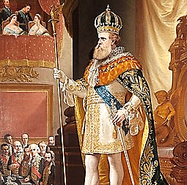

Slide 34
Question #1 :
How did Esther’s concern for her people impact her fear for her own life?

Slide 35
But she does go in before him, and God gives her favor, and the king does hold out his scepter to her.
Whew… it could have gone either way.

Slide 36
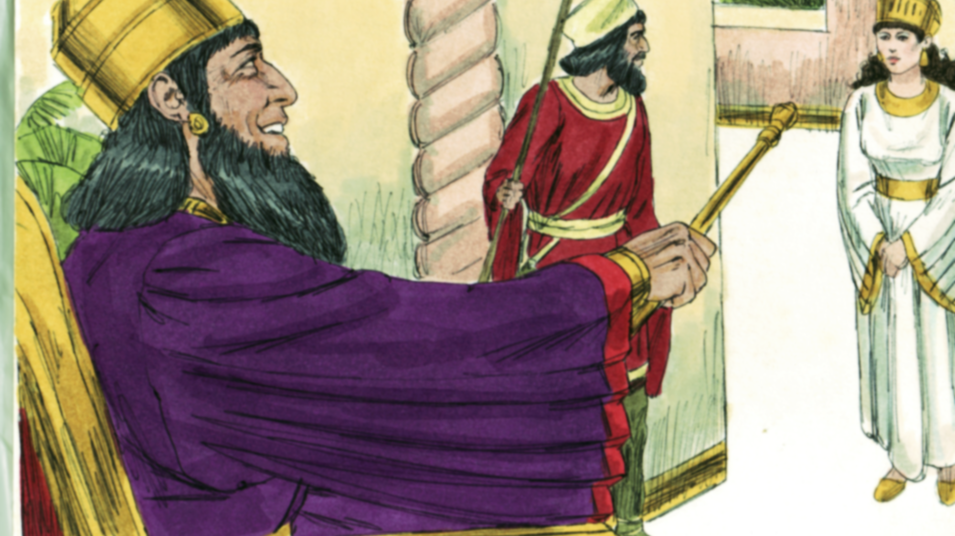

Slide 37
When one goes into a king’s court, the king is seen seated with a scepter in his hand.
Wise visitors would bow and pay great amounts of tribute in the form of money (or goods), as if to say, I submit to your authority, you are greater than I am.
Basically, they are paying the greater king not to kill them [right then and there] and to show mercy on the nations they represent.

Slide 38
Prophecy tells us that Jesus is Lord of ALL!!!
Not only is He the only one worthy to hold a scepter, He, Himself, is the Scepter of God.
Seated at the right hand of The Father, the Father executes judgement by Him.
Prophecy warns that the Father will crush the all enemies of Jesus and bring them to His feet.

Slide 39
Psalm 110:1-3 (CSB)
“This is the declaration of the Lord to my Lord: ‘Sit at my right hand until I make your enemies your footstool.’ The Lord will extend your mighty scepter from Zion. Rule over your surrounding enemies.”

Slide 41
Dan. 2:44 (HB)
“In the days of those kings, the God of heaven will set up a kingdom that will never be destroyed… It will crush all these kingdoms and bring them to an end, but will itself endure forever.”

Slide 42
This is what the Lord thinks of all the ungodly rulers and scepter wielding kings of the world.

Slide 43
Isaiah 14:5 (KJB)
“The LORD hath broken the staff of the wicked, and the sceptre of the rulers.”

Slide 44
The best thing any ruler of any kingdom can do is worship the one & only true king of the universe!!!
Ask yourself this question, “What are we, any of us, in comparison to who Jesus is?”
Do we really want to challenge His authority?

Slide 45
Psalm 68:32-35 (ERV)
“Kings on earth, sing to God! Sing songs of praise to our Lord! Sing to him who rides his chariot through the ancient skies. Listen to his powerful voice! Tell everyone how powerful he is! …His power fills the skies. God, you are awesome in your Temple!...”

Slide 46
Question #2:
What should all the kings in the world be doing and why?

Slide 47
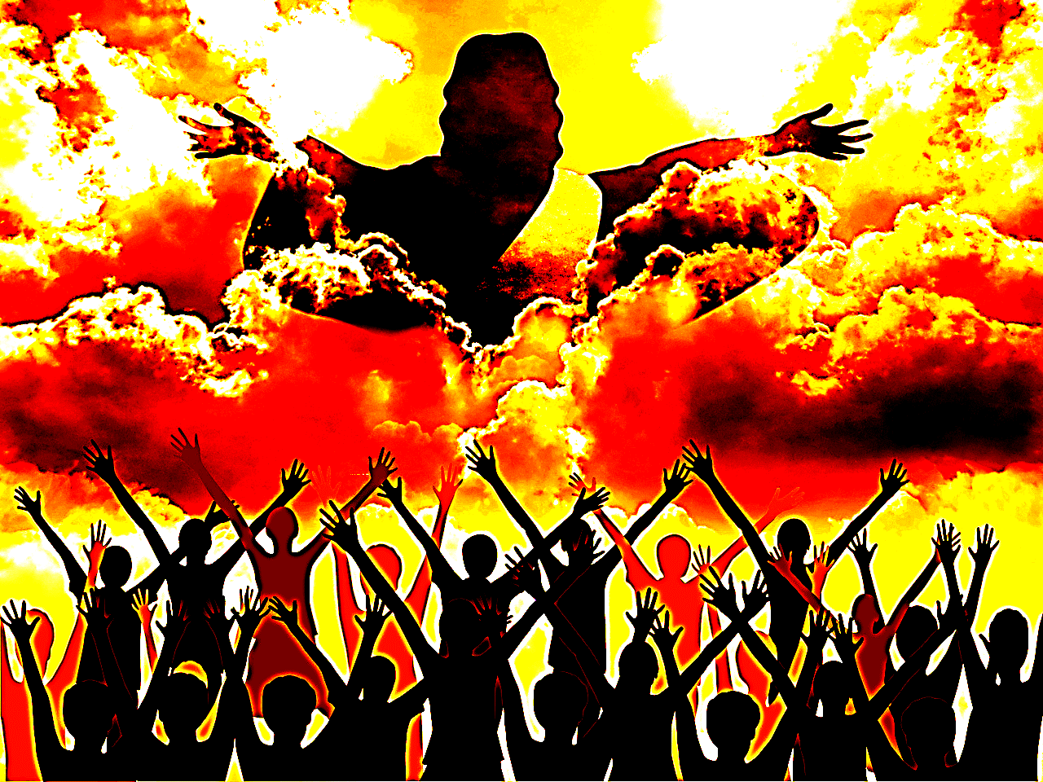

Slide 48
Prophecy also tells us that the kings of the earth would pay tribute to the coming King—the King of the Kings—the Messiah!
The Maji’s gifts were just the beginning of the fulfillment of these prophesies.

Slide 49
Isaiah 60:5, 6 GW
“…The wealth of the nations will come to you. Many camels will cover your land young camels from Midian and Ephah. Everyone from Sheba will come. They will bring gold and incense. They will sing the praises of the Lord.”

Slide 50
It is widely believed that the Maji were from the same area of the world which was once part of the Assyrian-Babylonian & Persian empire.
Remember, it was the Assyrians who first took the Nation of Israel into captivity.
This would make the Maji particularly concerned about this coming King.
You see, God was very angry with Assyria in particular.

Slide 51
Micah 5:1-6 (AMPC)
“They [Assyria] shall smite the ruler of Israel with a rod (a scepter) on the cheek. But you, Bethlehem Ephratah, you are little to be among the clans of Judah; [yet] out of you shall One come forth (for Me) Who is to be Ruler in Israel, Whose goings forth have been from of old…

Slide 52
Micah 5:1-6 (AMPC)
…from ancient days (eternity). Therefore, shall He give them up until the time that she who travails has brought forth… And this [One] shall be our peace… Thus, shall He [the Messiah] deliver us from the Assyrian… when he comes into our land and when he treads on our borders.”

Slide 53
These verses are saying that Assyria did hurt Israel, but it was like the Assyrian king only hit Israel on the cheek with his scepter stick.
It reminds us of God’s promise regarding Satan, that though, like a snake, Satan might bite the Messiah’s heel, Messiah will crush Satan’s head.
God waits for the right time to punish evil, but He never forgets or neglects it.

Slide 54
Genesis 3:15 (ERV)
“I will make you and the woman enemies to each other. Your children and her children will be enemies. You will bite her child’s foot, but he will crush your head.”

Slide 55
Question #3:
When and how did Satan bite Jesus’ heel, and when and how did Jesus’ crush Satan’s head?

Slide 56
Her child will be called Jesus, and you will damage Him a little, but He will… in His Time… destroy you altogether at the cross.
Because time has passed, we may think God has let evil men go unpunished.
Speaking to a group of particularly arrogant Jewish leaders, Jesus quoted this verse from the Psalms…

Slide 57
Psalm 82:6-8 (ESV)
I said, “You are gods, sons of the Most High, all of you; nevertheless, like men you shall die, and fall like any prince.”

Slide 58
Jesus quoted this verse to men in high authority (which is another use for the word “gods” in scripture).
They were so sure they were as God.
We might also remember that God originally did create Adam in His image.
But now, what has happened? They are not gods, they will die (with their swagger sticks and scepters in hand), like every so-called important man before them.

Slide 59
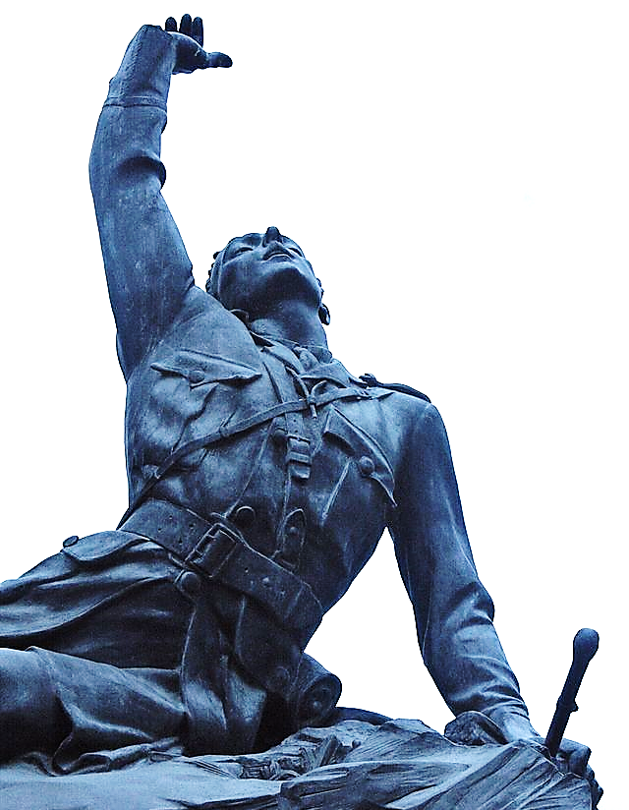
Statue depicting a dying soldier with his swagger stick in hand…
Death comes to us all (swagger stick or not).

Slide 60
The Jews were made to pay either tribute or taxes to each and every one of the many nations that have conquered them throughout history.
But a new day was coming where, instead of the wealth of Israel flowing out to their conquerors, tribute would be flowing from those nations and to their coming King.
Kings will bring gifts & tribute to the Messiah in hopes of gaining His favor.

Slide 61
Isa. 14:2-7 (NHEB)
“…They will take as captives those whose captives they were; and they shall rule over their oppressors. It will happen in the day that the LORD will give you rest from your sorrow, from your trouble, and from the hard service in which you were made to serve…

Slide 62
Isa.14:2 (NHEB) (cont.)
“…that you will take up this parable against the king of Babylon, and say, ‘How the oppressor has ceased. How the attacker has ceased. The LORD has broken the staff of the wicked, the scepter of the rulers…

Slide 63
CRACK

Slide 64
Mat. 29:27 (MNT)
“And they twisted a thorny crown for him, and put it on his head, and placed a reed in his right hand. Then they knelt before him, in mockery, crying, "Hail, King of the Jews!"

Slide 65
Down through the ages, the Lordship of Jesus has been nothing but a joke.

Slide 66
Question #4:
Why do you think Jesus lets people treat Him this way?

Slide 67
But, that mockery, though meant for evil, represented a profound truth!
The thorny crown, was essentially His true crown, and that feeble reed, was His true scepter.
For a mere, golden crown would have been as hollow and as worthless as the crowns that all the other rulers wear.
And a diamond crusted rod would be as harsh and unfeeling as the scepters the other rulers carry.

Slide 68
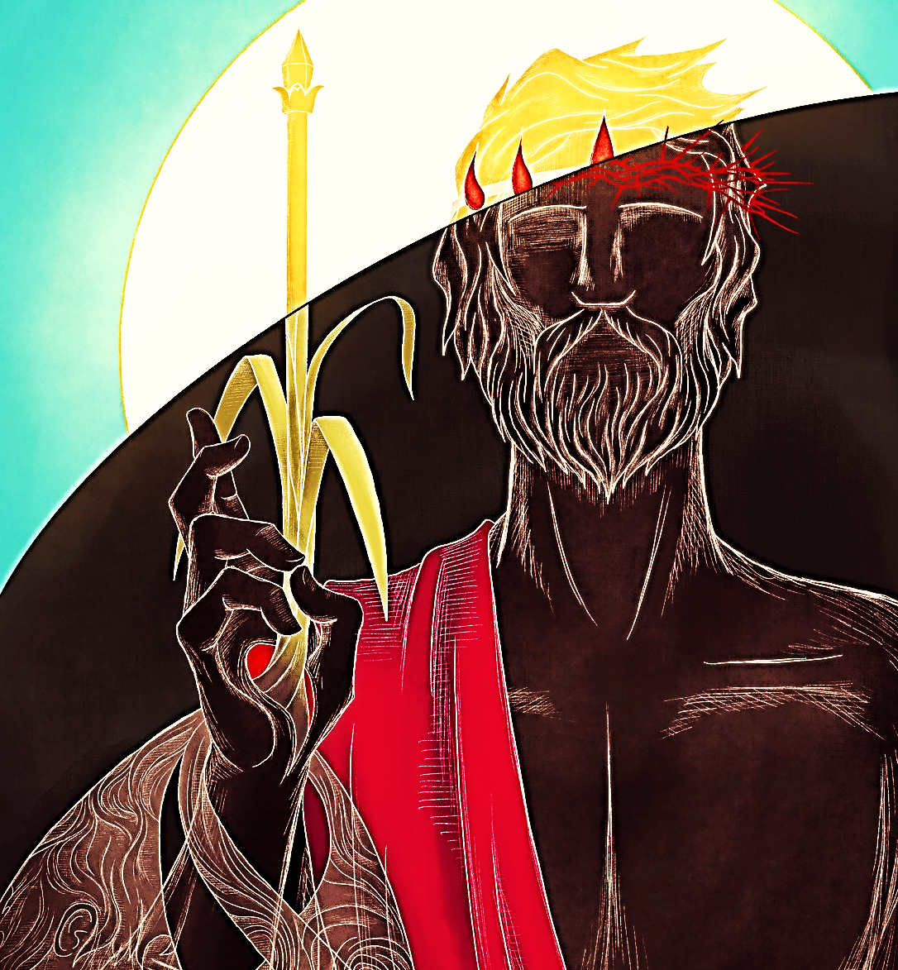

Slide 69
That cruel crown was the crown of a true King willing to bear it (along with all its shame and suffering, even unto death) all for the sake of the people He governed, and for their sake alone.
It was that crown, that crown of thorns and that wimpy reed in His right hand, that proved him worthy (later) of a symbolic golden crown and sturdy staff.

Slide 70
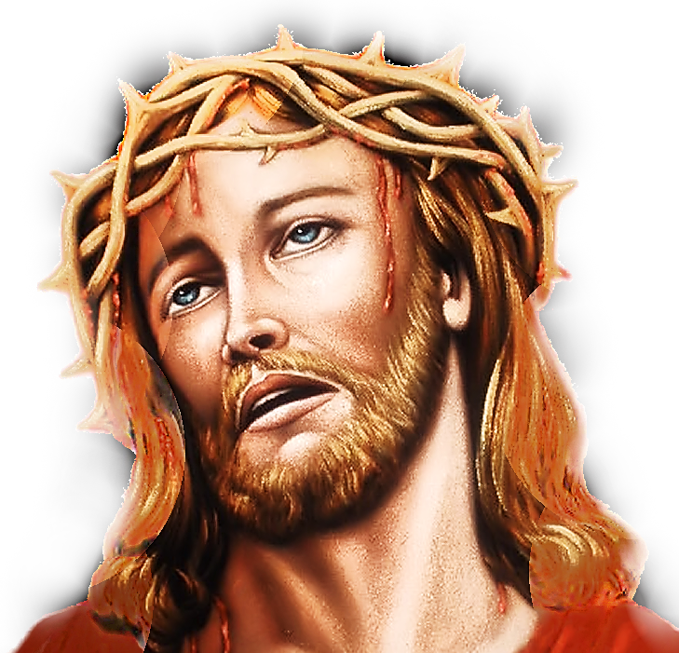
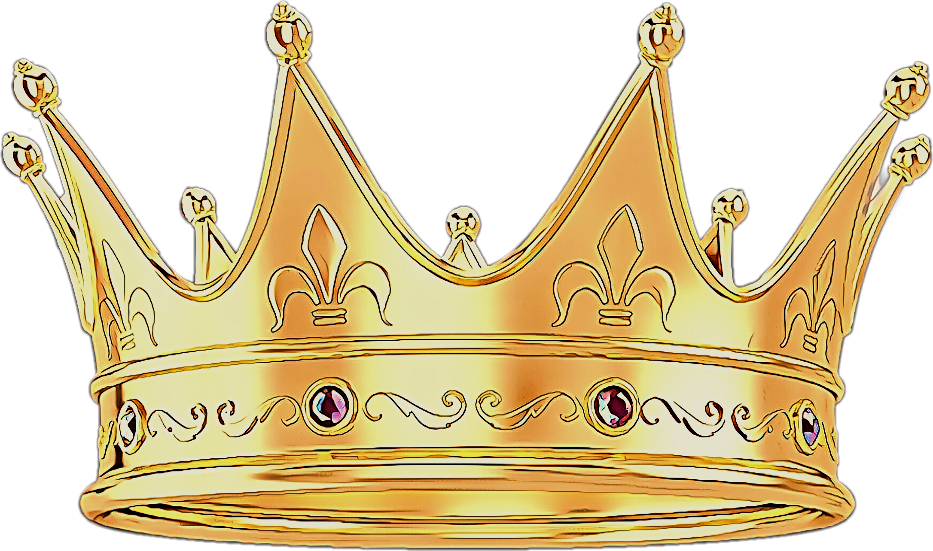

Slide 71
Isa. 49:7 (WEB)
“Thus, saith the LORD, the Redeemer of Israel, and his Holy One, to him whom man despiseth, to him whom the nation abhorreth, to a servant of rulers, kings shall see and arise, princes also shall worship, because of the LORD that is faithful, and the Holy One of Israel, and he shall choose thee.”

Slide 72
Jesus would be a King like the world has never known.
A king which the world is incapable of producing because all rulers are at heart selfish, carnal, power-lovers with a little authority in their hands.
Only Jesus is a truly good man, and a wise, just and righteous ruler.
A ruler, who would bring peace.

Slide 73
Isa. 9:6 (YLT)
“For a Child hath been born to us, A Son hath been given to us, And the princely power is on his shoulder, And He doth call his name Wonderful, Counsellor, Mighty God, Father of Eternity, Prince of Peace.”

Slide 74
Jesus would be a different kind of King with a different kind of scepter.
His would be a shepherd's loving staff.

Slide 76
Psalm 45:6 (NASB)
“Your throne, O God, is forever and ever; A scepter of uprightness is the scepter of Your kingdom.”

Slide 77
Psalm 23:4 (KJV)
Yea, though I walk through the valley of the shadow of death, I will fear no evil: for thou art with me; thy rod and thy staff they comfort me.”
John 10:11 (NIV)
“I am the good shepherd. The good shepherd lays down his life for the sheep.”

Slide 78
Jer. 23:5 (NET)
"I, the Lord, promise that a new time will certainly come when I will raise up for them a righteous branch, a descendant of David. He will rule over them with wisdom and understanding and will do what is just and right in the land.”

Slide 79
Micah 5:4 (NET)
“HE will assume his post and shepherd the people by the Lord's strength, by the sovereign authority of the Lord his God. They will live securely, for at that time he will be honored even in the distant regions of the earth.”

Slide 80
These Maji were from countries that were enemies of God’s people.
But they understood enough about prophetic scripture to know that this coming King from Judah wasn’t someone to fight against.
This group of Maji seemed determined to find out all they could about where and when this Messiah would be born.

Slide 81
They studied scripture more carefully than the current Jewish leadership.
They diligently watched the sky for that promised star.
They had packed up a great treasure ready to give as tribute to the new King.
They had prepared to make a long journey just to worship The Great One.
They had decided to seek Him with all their hearts, worship him, and surrender everything to Him.

Slide 82
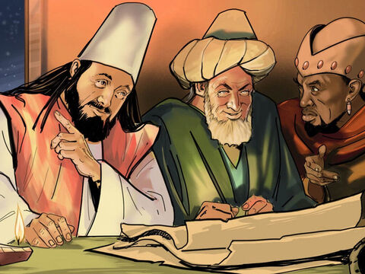

Slide 83
Proverbs 2:2-5 (AMPC)
“…apply your heart to understanding [seeking it conscientiously and striving for it eagerly]; Yes, if you cry out for insight, And lift up your voice for understanding; If you seek skillful and godly wisdom as you would silver…

Slide 84
Proverbs 2:2-5 (AMPC) cont.
“…And search for her as you would hidden treasures; Then you will understand the [reverent] fear of the Lord [that is, worshiping Him and regarding Him as truly awesome] And discover the knowledge of God.”

Slide 85
In searching so diligently for the Promised One, they found great fulfillment and joy in their journey.
Ironically, it is those who fear the Lord for His great awesomeness that find great joy and seek be closer and closer to Him.
While those who defy the Lord and fail to fear or seek Him, yes…
Those who would rather scoff Him, find only sorrow.

Slide 86
Proverbs 1:7 (AMP)
“Knowledge begins with fear and respect for the Lord, but stubborn fools hate wisdom and refuse to learn.”

Slide 87
Proverbs 1:29, 30
“Because they hated knowledge and did not choose the fear of the Lord [that is, obeying Him with reverence and awe-filled respect], They would not accept my counsel, And they spurned all my rebuke.”

Slide 88
This group of wise men had studied scripture, watched the sky and sought diligently for truth.
They applied themselves to seek the Lord’s anointed, no matter what the cost.
They determined to bow before Him, and worship Him, and surrender to Him everything body, soul and mind..
And this pursuit of wisdom brought them great joy.

Slide 89
Matthew 2:10 (KJV) Isaiah 12:6 (TLB)
“When they saw the star, they rejoiced with exceeding great joy.”
Isaiah 12:6 (TLB)
“Let all the people of Jerusalem shout his praise with joy. For great and mighty is the Holy One of Israel, who lives among you.”

Slide 90
Question #5:
What do you think their rejoicing looked like? Re-enact it.

Slide 91
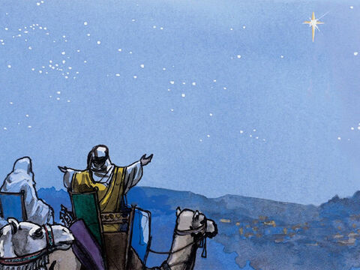

Slide 92
So, they loaded up their caravan with riches and gifts to offer to this great king and headed on out to pay this GREAT ONE due homage.

Slide 94
And this would be just the beginning of the kings of the world bringing gifts and paying homage to the King of Kings and Lord of All.
By the end of God’s plan, all kings will bow before Jesus.
Three types of gifts are mentioned here. They were worth fortunes.
They also represent three major things about Jesus’ nature and His mission.

Slide 95
Gold: Reminds us that Jesus is a King.
Frankincense: Was used by the High Priest to offer prayers in the Holy Place.
This reminds us that Jesus is our High Priest who “lives to continually make intercession for us.”
Finally, there was Myrrh. This was used for embalming the dead.
It reminds us that Jesus died for our sins.

Slide 97
And how might we offer these same gifts to our Savior and King? We might give Him our worldly goods (our gold).
We might become High Priests and spend time in fervent intercession (burning ‘spiritual’ Frankincense) for the lost.
And for Myrrh, we could offer our own lives as “living sacrifices.” Giving our lives to the preaching of the gospel.

Slide 98
We call Him savior, We call Him advisor, we call Him friend, we call Him physician, we call Him co-pilot, and counselor,
We love Him as comforter, provider, strengthener and our way-maker…
But will we acknowledge Him as Lord and King, as ruler of our lives?
Are we compelled to bow, worship, serve His ends, promote His name & obey Him?

Slide 99
Too often, our gentle benefactor is all the Jesus many believers want.

Slide 100
Do we respond to Him fully for who He really is?
He is The Christ, The Messiah. The King of the Universe, The Lord of ALL, The Lord of you and me!! …our BOSS!
When He says, “Who will go for me”, do we quickly say, “send me Lord?”

Slide 101
I Call You Lord

Slide 102
Nations often rebel against their monarchs.
We hate the idea of any king over us.
We cherish our personal freedoms.
We don’t like to be told what to do.

Slide 103
Sadly, this attitude even effects our relationship with the King of the Universe.
Our personal freedoms, are, in fact, more important to us than our relationship with God…
Especially if it means we must give up any of our precious freedoms for His higher cause.
Yes, to humans, there is no issue more important than our right to do what we want to do.

Slide 104
Although, no human should dominate other humans… Jesus is God Eternal.
Nevertheless, in our rebellion, we try to re-write the commands of God, ignore, or pick & choose to suit our own preferences.
We are unwilling to submit ourselves to any monarch, even if that King is Jesus!
Jesus asks us right now, “Who do you say I AM?”
If He is the Christ, we must be His obedient servants without reservation.

Slide 105
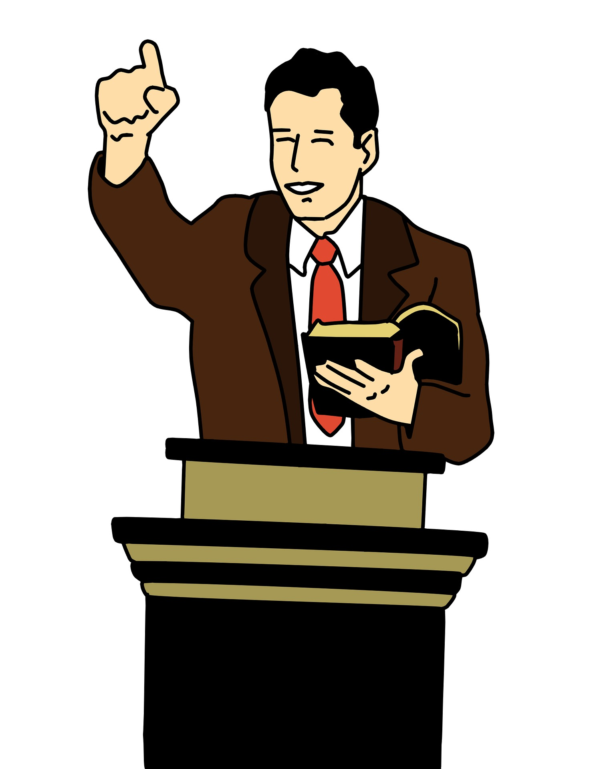
MAYBE

Slide 106
John 1:5 (CEV)
“The light keeps shining in the dark, and darkness has never put it out.”

Slide 107
Question # :
When you turn on a light in a dark room, who is the winner the light or the darkness? How does this remind us of Jesus and Satan?

Slide 108
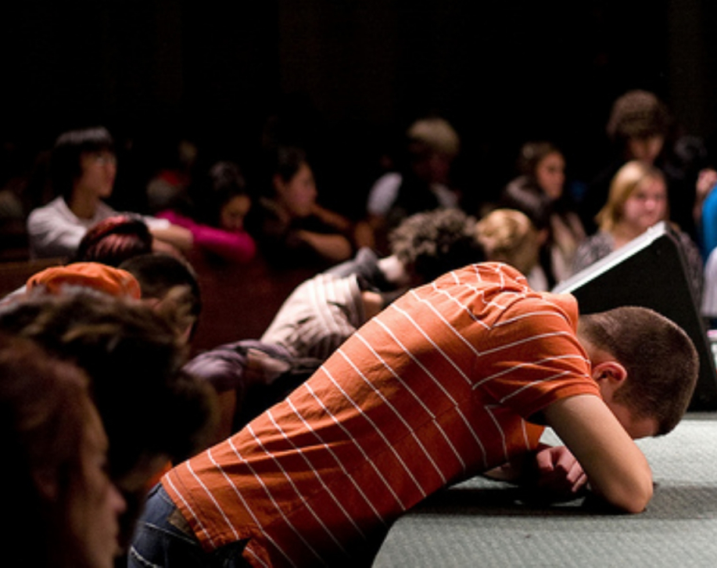
Next:
Wise Men Still Bow Before Him
God’s Timetable pt. 8

