Slide 2
Today’s lesson is called – “Why you just have to love the whole bible.”

Slide 3
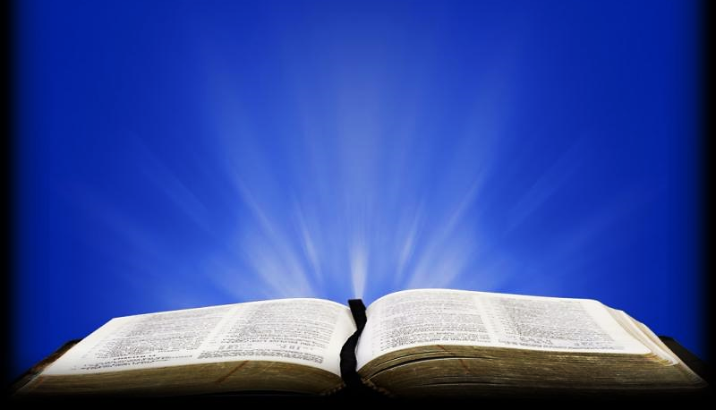
1Co 13:12 KJV
“For now, we see through a glass, darkly; but then face to face: now I know in part; but then shall I know even as also I am known.”

Slide 4
1Co 13:12 NLT
“Now we see things imperfectly, like puzzling reflections in a mirror, but then we will see everything with perfect clarity. All that I know now is partial and incomplete, but then I will know everything completely, just as God now knows me completely.”

Slide 5
Question #1
If Holy Spirit takes away our spiritual blind-folds, enabling us the Lord Jesus in His Word, why then, do we need to continue studying the bible over and over again?

Slide 6
Interesting - “Darkly” in the Greek is…
I'·neg-mä (Pronounce – eye’-nig-ma)
From which we get the English word, “enigma”
Remember the famous Oliver Stone’s movie “JFK” a character (played by Joe Pesci) who quotes Winston Churchill:
“It’s a mystery wrapped in a riddle inside an enigma!”

Slide 7
So, the revelation of Jesus Christ – all that He is - all that He has done for us is...
“A mystery wrapped in a riddle inside an enigma!”
The Holy Spirit shows us these truths one layer at a time… opening each layer to our understanding.

Slide 8
The book of Genesis is the book of beginnings (“Genesis” means “beginning”)
Genesis contains the beginning of every major truth in this unfolding book.
For example: Light begins on day one.
Then Jesus is revealed as the light of the world.
Then His light shines in His church.
Finally, He is the light of the Heavenly city.

Slide 9
In Genesis we see the creation of Heavens & Earth.
Then, in Revelation, Heaven & Earth are burned.
Finally, A new Heaven & Earth are created.
In Genesis we are introduced to the FIRST man—named Adam.
Later Jesus is called the LAST man.

Slide 10
In Genesis, we see the beginning of sin.
Then, Jesus becomes a sacrifice for sin.
And finally, we are told of a coming judgement day for the sin of unbeliever.
In Genesis, after the fall, we see the beginnings of God’s plan to save mankind.
Finally, the plan concludes with a great reconciliation of all born-again believers with Jesus, their beloved Creator & Savior.

Slide 11
The bible is one continuous love story.
Chapters 1-11 explain man’s fallen condition through their rebellion against God.
The whole rest of the bible tells the story of God’s plan and efforts to fully restore His relationship with His beloved creation after they had rejected Him.
Genesis is the beginning of that story.

Slide 12
This plan starts with the story of six important men and their families:
Adam, Noah, Abraham, Isaac, Jacob and Joseph.
The bible is one long story about a single extended family – the family of Jesus.
Genesis tells us of the very beginnings of the line through which the Savior would be born.
This family of Abraham will become His Nation.
In this is nation, the tribe of Judah was formed.
This tribe is where Jesus’ parents are from.

Slide 13
Luke 24:25-27 TLB
“Then Jesus said to them, “You are such foolish, foolish people! You find it so hard to believe all that the prophets wrote in the Scriptures! Wasn’t it clearly predicted by the prophets that the Messiah would have to suffer all these things before entering his time of glory?...

Slide 14
Luke 24:25-27 TLB
...Then Jesus quoted them passage after passage from the writings of the prophets, beginning with the book of Genesis and going right on through the Scriptures, explaining what the passages meant and what they said about himself..”

Slide 15
Question #2
Why did Jesus call them foolish… what did He expect them to already know (and why)?

Slide 16
John 5:39, 40 MSG
“You have your heads in your Bibles constantly because you think you’ll find eternal life there. But you miss the forest for the trees. These Scriptures are all about me! And here I am, standing right before you, and you aren’t willing to receive from me the life you say you want.”

Slide 17
Question #3
Which parts of the Old Testament are about Jesus (and why)?

Slide 18
Since Jesus wasn’t born yet, these little sneak peeks of Jesus in the Old Testament are told with stories that are actually shadows of Jesus.
Outside our kitchen window we saw this fun shadow of our pear tree on the ground.
We thought it looked like a crown of thorns on the ground.

Slide 19
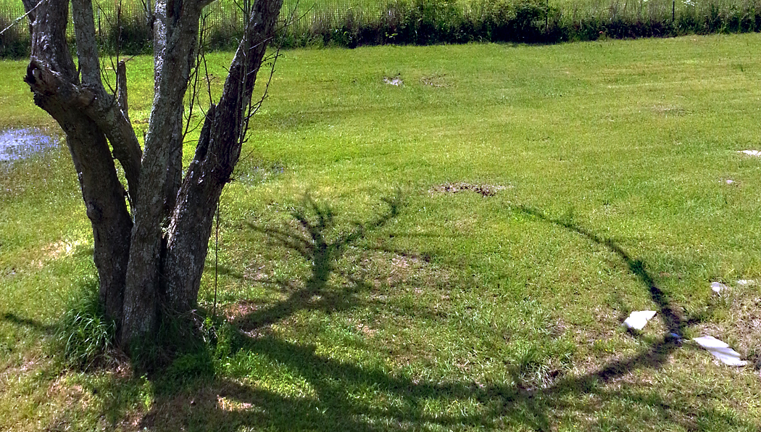

Slide 20
It reminded us of the shadows of Jesus in the Old Testament.
They are not actually Him; they are shadows of Him.
Let’s look at what the bible says about all the reflections of Jesus in the Old Testament:

Slide 21
Col. 2:17 GW
“These are a shadow of the things to come, but the body that casts the shadow belongs to Christ.”

Slide 22
Heb. 10:1 NCV
“The law [Old Testament sacrifices] is only an unclear picture of the good things coming in the future; it is not the real thing...”

Slide 23
Question #4
The Old Testament is full of shadows of Jesus but, how powerful is a shadow of Jesus compared to the man Jesus Himself?

Slide 24
Let’s look at some events that were mere shadows in the Old Testament before they were realities through Christ Jesus.
The following are just a few shadows of Jesus hidden in the Old testament:

Slide 25
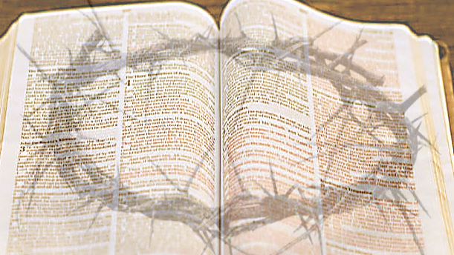
His Crown of Thorns

Slide 26
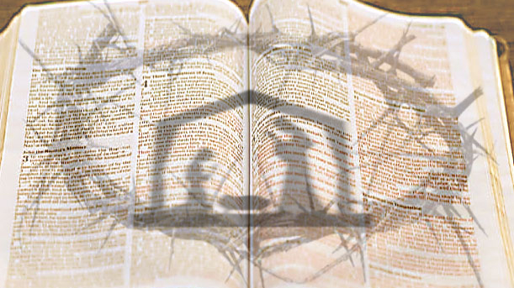
His Birth

Slide 27
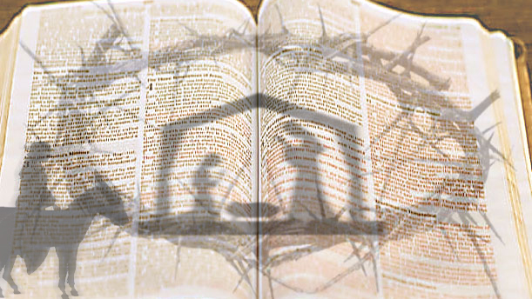
His Ride into Jerusalem on a Donkey

Slide 28
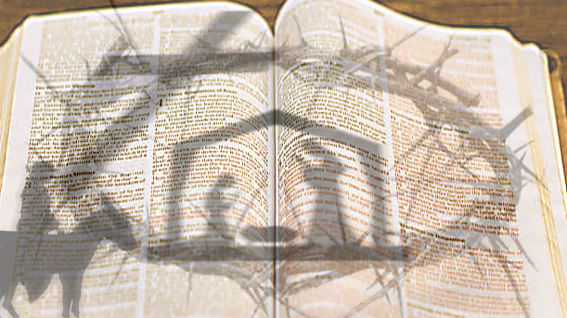
His Death on the Cross

Slide 29
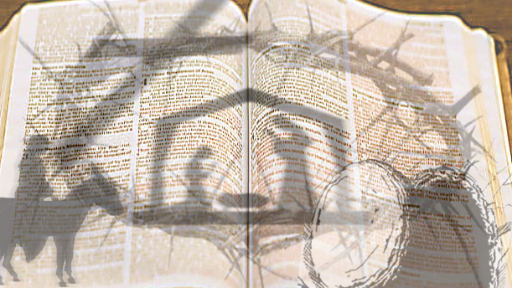
His Resurrection

Slide 30
Heb. 10:1 Rom. 15:4 NlV
“The law [Old Testament sacrifices] is only an unclear picture of the good things coming in the future; it is not the real thing...”

Slide 31
Question #5
Why was the Old Testament written and how does it help us?

Slide 32
Our plan is to work our way through the bible (theme by theme) with the goal of highlighting Jesus Christ and His work on the cross in every book of the bible.
Next Time:

