Slide 1
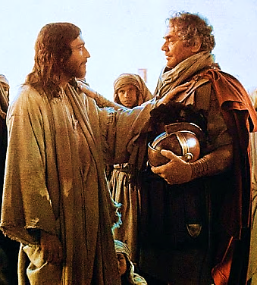
Roman Centurion:
A Soldier Understands God’s Authority

Slide 2
If you would like to watch the video of the service, click here:
https://campaignkerusso.org/?p=9128
We would love to know more about the people who download our lessons & sermons. We invite you to email us & let us know where & how you use them.
info@ckusa.org

Slide 3
Today we will study two words:
Authority
&
Faith
What does authority do?
What does faith do?

Slide 4
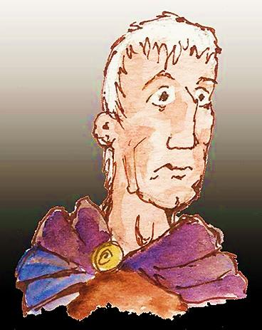
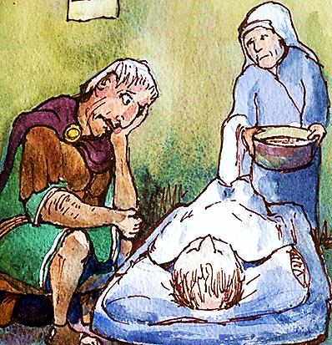
In Capernaum, there lived a centurion -- a Roman army officer who commanded about one hundred men.
The centurion had a servant who was very ill. He was paralyzed and in great pain.

Slide 5
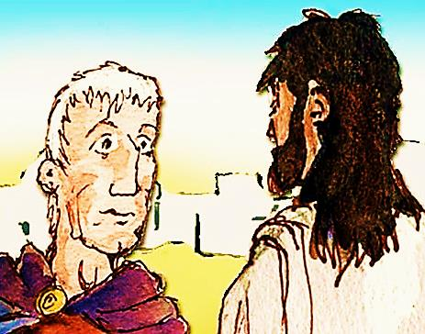
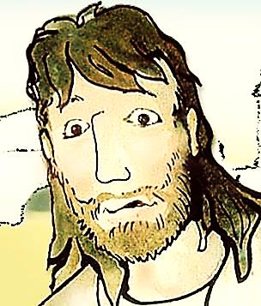
When Jesus entered Capernaum, the centurion went up to him and said, "Lord, my servant is at home in such pain that he can't even move."
“I will go and heal him,” Jesus replied.

Slide 6
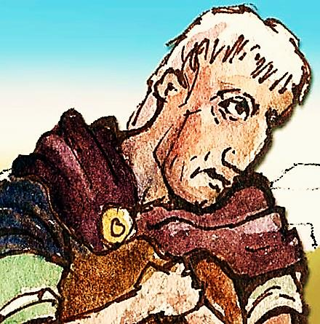
But the officer said, “Lord, I am not worthy for you to enter my house. Just give the order and my servant will be made well.”

Slide 7
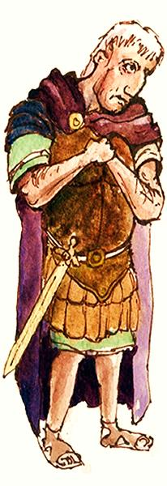
“I have officers who give orders to me, and I have soldiers who take orders from me. I can say to one of them, ‘Go!’ and he will go. I can say to another, ‘Come!’ and he will come. I can say to my servant, ‘Do this!’ and he will do it.”

Slide 8
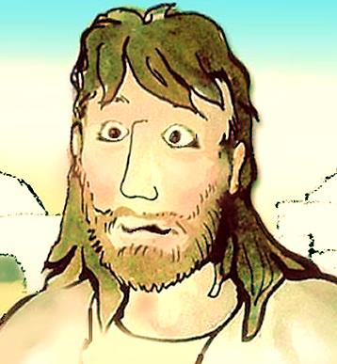
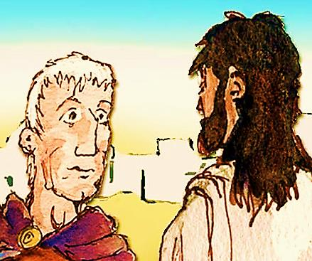
When Jesus heard this, he was astonished. “In all of Israel I have not found anyone with this much faith!”
Then Jesus said to the officer, “You may go home now. Your faith has made it happen!”

Slide 9
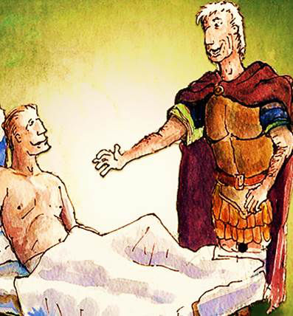
At that very moment, the servant was healed!

Slide 10
Next Slide - Video:
The Centurion and Jesus
View Here:
http://youtu.be/i1Q_koDsCxM

Slide 11
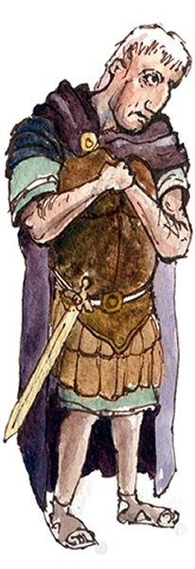
“Just give the order and my servant will be made well.”
He understood God’s authority.
What God speaks… HAPPENS!

Slide 12
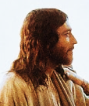
What is Authority?
Over what things does
Jesus have authority?
Sickness (the soldier’s servant)
…and?

Slide 13
Over what things does
Jesus have authority?
Sickness (the soldier’s servant)
Evil

Slide 14
Next Slide - Video:
Healing the Demon Possessed Man
View Here:
http://youtu.be/br1oaXnpVNU

Slide 15
Over what things does
Jesus have authority?
Sickness (the soldier’s servant)
Evil (the demon possessed man)
…and

Slide 16
Over what things does
Jesus have authority?
Sickness (the soldier’s servant)
Evil (the demon possessed man)
Nature

Slide 17
Next Slide - Video:
Calms the Wind & Waves
View Here:
http://youtu.be/FV9iXS5EVQ0

Slide 18
Over what things does
Jesus have authority?
Sickness (the soldier’s servant)
Evil (the demon possessed man)
Nature (the wind & waves)
…and

Slide 19
Over what things does
Jesus have authority?
Sickness (the soldier’s servant)
Evil (the demon possessed man)
Nature (the wind & waves)
Life & Death

Slide 20
Next Slide - Video:
Raising Lazarus from the Dead
View Here:
http://youtu.be/iYpGizQH_Rs

Slide 21
Over what things does
Jesus have authority?
Sickness (the soldier’s servant)
Evil (the demon possessed man)
Nature (the wind & waves)
Life & Death (Lazarus)

Slide 22
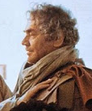
God’s Authority
Plus… Our Faith
…and what if we don’t have very much faith?

Slide 23
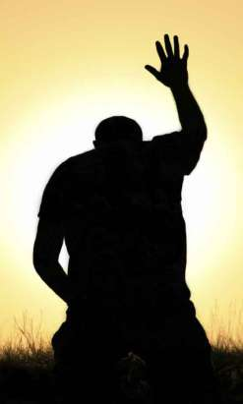
God Has All Authority
Our Faith Grows Daily
The man answered, “Please have pity and help us if you can!”
Jesus replied, “Why do you say ‘if you can’? Anything is possible for someone who has faith!”
Right away the boy’s father shouted, “I do have faith! Please help me to have even more.”
Mark 9:22-24

Slide 24
What is the Sinner‘s Prayer?
This is a prayer we can pray when we are ready to admit we are sinners and need Christ’s forgiveness.
It must be prayed with faith in our hearts and a readiness to have a life-changing encounter with Jesus Christ.

Slide 26
John Wesley’s Testimony
“…the preacher was describing the change which God works in the heart through faith in Christ and I felt my heart strangely warmed.”
Disciple’s Testimony
“They said to each other, ‘Did not our hearts burn within us while he talked to us on the road, while he opened to us the Scriptures?’”

Slide 27
A Prayer of Faith → Pray this rayer if :
If you never have before
You have in the past, but you think it would mean more today.
You have been walking afar off and you want to come back.
You want to set an example & show others how it is done.
You just like to give your heart to Jesus again & again.
Faith

Slide 28
We Declare Our Faith Publicly Because Jesus Declared His LOVE Publicly
“If you stand before others and are willing to say you believe in me, then I will tell my Father in heaven that you belong to me.” Mat 10:32

Slide 29
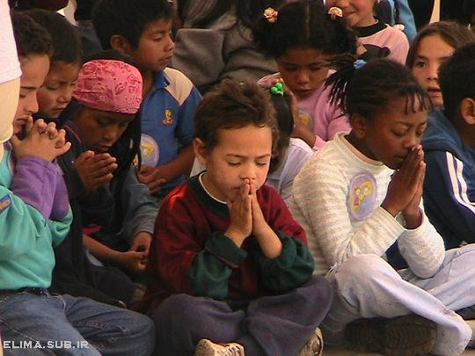
Dear Jesus,
I know I am a sinner & need your forgiveness.
I believe you died for my sins.
I now turn from sin.
Come into my heart I pray.
Please wash away my sin.
Do you want to meet Jesus as your savior right now?
Do you believe He died to save you from your sins & that He rose from the dead?
Do you believe that He is waiting to save you right now?

Slide 30
“But some people did accept him. They believed in him, and he gave them the right to become children of God.” John 1:12

Slide 32
“If you openly say, ‘Jesus is Lord’ and believe in your heart that God raised him from death, you will be saved.”
Rom. 10:9
What did you learn today?
What have you been thinking about God lately?
What do you want to tell the world about Jesus?

Slide 33
“Draw near to God, and He will draw near to you…
…Cleanse your hands, you sinners, and make your hearts pure, you who are half-hearted towards God.” James 4:8 WNT

Slide 34
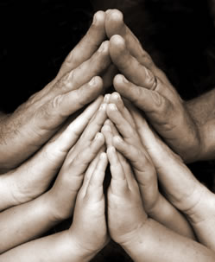
Close in Prayer

