Slide 2
Let’s start with a review of our last lesson.
The bible shows us God’s plan for the salvation for fallen mankind.
It tells of creation, then the fall of man, then the forming of a nation through which a Savior would come.
Then of Jesus’ death and resurrection in order to save mankind and offer them a Heavenly destiny.

Slide 3
Even in the Old Testament, Jesus is the leading character.
He is seen in “shadows,” metaphors, pre-incarnation appearances and prophecies.
Today, our lesson is called –
“Studio #1 – The Drama Begins”

Slide 4
Studio #1 – The Drama Begins

Slide 5
God is inherently creative.
He doesn’t decide to create or try to create, He is The Creator.
It’s His nature.
Before the world began, the heart & mind of God was a creative “studio.”
Here the future was conceived, produced, sealed and put “in the can.”
Now it is playing out.
Earth is the soundstage on which this production is currently playing.

Slide 6
It is the beginning of time itself.
It’s the beginning of a great drama, a drama of truth.
The beginning of God’s Plan for man.
It is the original template of universal truth from which other (man-made, fictional) dramas will be mere echoes.
Here are the principal players.

Slide 7
The Director:
Tells everybody what needs to be done to make his vision come to pass. His will is done!
Let’s call this the role of the Heavenly Father.

Slide 8
The Leading Man:
Our hero.
He understands his role and knows all his lines.
He does the will of the
director.
Let’s call this the role of Jesus.

Slide 9
The Producer: Is a “helper.”
He runs around accomplishing
whatever needs to be
done for the set,
production,
director & actors.
Let’s call this the role of the Holy Spirit.

Slide 10
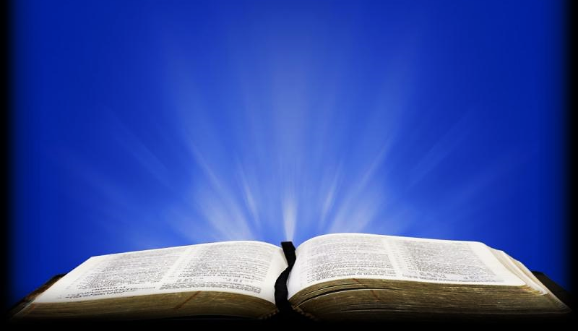
“In the beginning God created the heavens and the earth” Gen. 1:1 KJV

Slide 11
Question #1
Who was already there before the beginning and what did He do?

Slide 12
The main players in our story are:
Jesus (the HERO)
Mankind (the characters in distress)
Satan (the antagonist) or “adversary”
Plus, animals and creation, itself (the set)

Slide 13
Then there’s the audience:
The angels &
Any faithful believers who have already finished their role on Earth and have gone (off stage) to their Heavenly reward (joining the angels in Heaven).

Slide 14
“…These things the angels desire to behold.” 1 Pet. 1:12 RGT

Slide 15
“Since we have such a huge crowd of men of faith watching us from the grandstands, let us strip off anything that slows us down or holds us back, and especially those sins that wrap themselves so tightly around our feet and trip us up...” Heb 12:1 TLB

Slide 16
Question #2
How might knowing that we are being watched by both the angels and the faithful saints in Heaven influence how we walk our Christian walk?

Slide 17
The story of God & man is the true drama of the ages:
What are the dynamics of any good play?
1. The plot is planned well before production begins.
2. The drama begins, then…
3. A problem arises (a bad guy or bad circumstance).

Slide 18
A mission to save those in danger is put into action.
A climactic event saves the day (thanks to the hero).
Peace is restored.
The hero is celebrated.

Slide 19
Let’s take a sneak peek at the first planning meeting…
Now… it’s before time ever started…
The only thing in existence is God…
One God in three persons – The trinity.
The meeting is in process…
Question: “What to create??”
Answer: A friend and a world for that friend to live in.

Slide 20
What if that friend gets himself in trouble?
What if He rejects his God’s authority and goes his own way?
A plan must be made to save him.
Let’s listen in on some of the things that were planned before the world was made.
Let’s look at what all was pre-determined.

Slide 21
This was God’s plan which he had made long ago."
Act 2:23 ICB

Slide 22
“I know Him [Myself] because I come from His [very] presence, and it was He [personally] Who sent Me.” JHN 7:29 ESV AMPC

Slide 23
“I don’t speak on my own. I say only what the Father who sent me has told me to say.” Jhn 12:49 CEV

Slide 24
Question #3
Before the world began, it was determined where Jesus would go and exactly what He would say. How does this remind us of the relationship between the director and the leading man?

Slide 25
"You were bought with the precious blood of the death of Christ, who was like a pure and perfect lamb. Christ was chosen before the world was made…”
1Pe 1:19, 20 ICB

Slide 26
"Jesus was given to you, and you killed him. With the help of evil men you nailed him to a cross. But God knew all this would happen. This was God’s plan which he had made long ago.”
Act 2:23 ICB

Slide 27
Question #4
It was determined what Jesus would have to suffer. Why would Jesus come to Earth knowing what was going to happen to Him there?

Slide 28
“…in the hope of eternal life that God, who cannot lie, promised before time began.” Tit 1:2 HCSB

Slide 29
"even as he chose us in him before the foundation of the world, that we should be holy and blameless before him…"
Eph 1:4 ESV

Slide 30
“For from the very beginning, God decided that those who came to him—(and all along he knew who would)—should become like his Son, so that His Son would be the First, with many brothers.” Rom 8:29 TLB

Slide 31
“Then the king will say to those on his right, ‘Come, you who will receive good things from my Father. Inherit the kingdom that was prepared for you before the world began.” Mat. 25:34 CEB

Slide 32
Question #5
What are some things we read in today’s scriptures that were already planned for believers before the world was made?

Slide 33
So, we see, there was great preparation in the planning room before the action even began.

Slide 34
This was God’s plan which he had made long ago."
Act 2:23 ICB

Slide 35
In this lesson, we have virtually listened at the planning room door and learned some of the things that were already planned before time even began.
We learned that it was decided:

Slide 36
It was decided that Jesus would go on a mission to Earth.
It was decided where Jesus would live, where He would go, and exactly what Words He would say.
It was decided that Jesus would die on a cross as a sacrificial lamb for the sin of mankind.

Slide 37
It was decided that believers would be made holy, blameless Sons of God in the image of Jesus.
It was decided that believers would be given eternal life.
It was decided that believers would inherit many good things including the whole the Kingdom of God.

Slide 38
Gen. 1:1 is simply the curtain call…
The whole plan is about to be rolled out.
From the bible’s first verse to the last we see a great unfolding of God’s own autobiography.
It’s God’s story of the relationship between Himself & mankind → the love of His life.
The beloved creation for whom He would give His life in order to save.
Well, that’s it for now -- until next time…

Slide 39
Next Lesson:

