Slide 2
Today’s lesson is called: “Time FOR Change”
Not Time TO change, but TIME FOR change.

Slide 3
The next major truth we are going to examine is TIME itself.
Last time we studied what happened before time began.
The third word in the bible, “beginning” speaks of the first tick of the very first (imaginably) clock.
Tick, tick, tick…time began.
So, we see that God Himself invented (created) time.
What does time mean to God and what does He do with it?

Slide 4
God created it, so TIME is a GOOD thing.
Often, we have a love/hate relationship with time – we either feel it is going by too slowly, or too quickly.
God, however, is neither impatient with, nor is He stressed by time.
He created time and it serves Him well.
See the YouTube Song: “In His Time” – on the Maranatha! Music channel.
Also see, “He Who Began a Good Work” – Sung by Steve Green on the “Thedogdog99” channel.

Slide 5
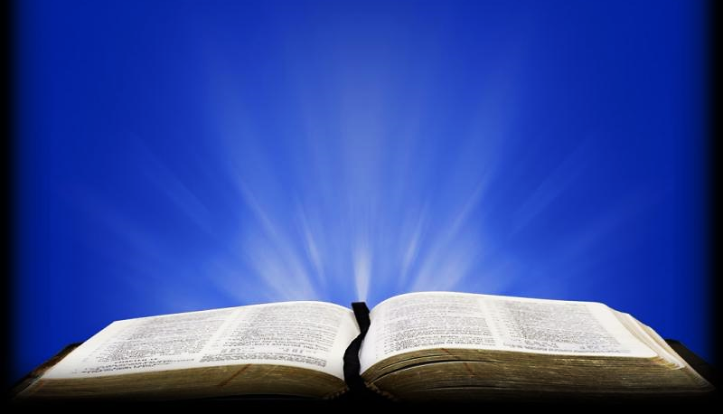
2 Pet. 3:8 CSB
"Dear friends, don't overlook this one fact: With the Lord one day is like a thousand years, and a thousand years like one day.”

Slide 6
Psa. 90:4 NLT
"For you [God], a thousand years are as a passing day, as brief as a few night hours."

Slide 7
Question #1:
There is an old saying, “God is never in a hurry, but He’s always on time.” Considering these verses, why do you think God is more comfortable (than we are) with how fast or how slowly time may seem to pass?

Slide 8
We know God can do anything He likes, and He could do it instantaneously.
Yet, He seems to value the use of time and process.
He often takes His time to bring about His changes.
Like an artist who values workmanship, each step is important on the way to reaching His end goal.

Slide 9
For example, for a potter…
…the clay must be unearthed,
then filtered of gravel & impurities…
then cured, folded & molded…
left to dry…
base-painted…
top-coated,
fired in a kiln, and finally…
sealed…
..before the finished piece can be useful.

Slide 10
A true artist takes time to work toward absolute perfection.
Look at the detail in just one potter’s masterpiece.
God will work on us until we are in the image of Jesus.
Today, we will look at God’s use of “process” and time in CREATION itself.

Slide 11
Gen 1:2 NET
"Now the earth was without shape and empty, and darkness was over the surface of the watery deep, but the Spirit of God was moving over the surface of the water."

Slide 12
ISA 45:18 TPT
“…He created the earth, shaped it, and established it all by himself. He made it fit and orderly and beautiful for its inhabitants…”

Slide 13
Question #2
These verses show that God used a step-by-step process while preparing the earth for mankind. He took six whole days for this process (a very long time for God).
How is God’s use of time and process different from how (most of us) would prefer God worked on our behalf?

Slide 14
And it was
GOOD!

Slide 15
There are at least three reasons why God may choose to use a step-by-step process in His workmanship:
Firstly, like a chef on a cooking show…
He wants to demonstrate each of the steps as they progressively build upon each other in His unfolding plan.
Consider this verse:

Slide 16
Neh. 9:6 NLV
“…You made the heavens,
the heaven of heavens with all their angels.
You have made the earth and all that is on it,
and the seas and all that is in them.
You give life to all of them,
and the angels of heaven bow down to You.”

Slide 17
Here, scripture lists His creation process in steps and, as a result, the angels bow down in admiration of His work.
They admire every step of His process.

Slide 18
Secondly, He wants to allow each step to have plenty of TIME and space to do its work.
After all, He is working with very stubborn subjects –mankind (us).

Slide 19
2 Co 3:18 WE
"…People can see that we have some of the bright and wonderful light that the Lord has. And we are becoming brighter and brighter, more and more like him. It is the Lord, the Spirit, who does this.”

Slide 20
And we are becoming brighter and brighter, more and more like him. It is the Lord, the Spirit, who does this.” 2 Co 3:18 WE

Slide 21
Process Builds Relationship

Slide 22
Thirdly, the Lord wants to include us in the process.
He doesn’t want to just snap His fingers.
He wants us to walk with Him and learn to trust Him through times and experiences we may not understand.
As we do, we develop a relationship with Him.

Slide 23
Phl. 3:12 KJV HCSB
"Not that I have already reached the goal or am already fully mature, but I make every effort to take hold of it because I also have been taken hold of by Christ Jesus.”

Slide 24
A story is told of a boat rowing event.
The oarsmen paired up, two per boat.
A very small man was left, seemingly without a partner…
When a huge man , with a pleasant smile walked up to him and said, “We Row?”
The weaker man agreed, and they formed a partnership.

Slide 25
“We Win!”

Slide 26
As you might imagine, the smaller man could barely pull his oar.
The large man did all the work with ease.
Because of his strength, the pair easily pulled out ahead of the rest and then arrived first to the finish.
With joy in his voice, the strong man turned to his puny partner and exclaimed, “WE WIN!”

Slide 27
Yes, the larger man was entirely responsible for the win…
But it was his great pleasure to share the win with his companion and friend.
Both of these things are true…
The strong man did it (really) and…
They did it together.
This is the relationship the Lord wants to develop with his sons and daughters.

Slide 28
We need to know that He rowed with us every stretch of our Christian race, and that He, alone, brought us to victory.
Yet, at the same time, we should know that He works with us and in us so that He might spend time with us and develop a growing relationship with us.
“We Win!”

Slide 29
In Genesis 1:2-3 we find that the earth is in a condition which reflects of the state of mankind just before Jesus and the Holy Spirit begin to work in our lives.
In this verse, we see a metaphor (or picture) of salvation.

Slide 30
Gen 1:2-5 VOICE
"At first the earth lacked shape and was totally empty, and a dark fog draped over the deep while God’s spirit-wind hovered over the surface of the empty waters. Then there was the voice of God. Let there be light. And light flashed into being...

Slide 31
Gen 1:2-5 VOICE (cont.)
“…God saw that the light was beautiful and good, and He separated the light from the darkness. God named the light “day” and the darkness “night.” Evening gave way to morning.
That was day one.”

Slide 32
Question #3
As you consider those verses about what happened to the Earth on its first day, how might it remind us of what happens to a person the first day they give their heart to Jesus?

Slide 33
“Tohu Wabohu”

Slide 34
Gen. 1:2 says… “At first the earth lacked shape and was totally empty.”
In the Hebrew language it says, the earth was “tohu wabohu”…
Tohu Wabohu means “waste” and “emptiness” in English.

Slide 35
Before we know Jesus, our lives consist of waste and emptiness.
We are covered in darkness.
So, where is God when we are suffering tohu wabohu in our lives?

Slide 36
Job 22:10-14 CJB
"At first the earth lacked shape and was totally empty, and a dark fog draped over the deep while God’s spirit-wind hovered over the surface of the empty waters. Then there was the voice of God. Let there be light. And light flashed into being...”

Slide 37
Does God know, does see our dark and helpless condition?
Yes, He sees, He cares!!!
His loving Holy Spirit hovers over our lives (as it did over chaotic earth) making us ready for the life-giving Word of God.
He hovers, waiting and preparing our hearts.
He never forces Himself on anyone, rather, He hovers and waits for a personal invitation.

Slide 38
The day comes when the Word of God comes to us as it once came to the Earth so long ago, saying, “Let there be light!”
When we hear the voice of God and believe, we also see the light.
His is the voice that spoke life to our soul, plus…
He is the light that shown into our lives.
Both the Voice and the Light are Jesus, back then (at creation) and now (at each soul’s salvation).

Slide 39
Jhn 12:46 NLT
“I have come as a light to shine in this dark world, so that all who put their trust in me will no longer remain in the dark.”

Slide 40
And the Light is beautiful and good!
And He sets us apart into His Light and brings us out of the world’s darkness.
And we begin to see our dark past as our long “Night.”
And now, in Christ, we finally have “Day,” our first DAY.
We are new creations in Christ Jesus!
Let’s picture this process…

Slide 41
“Tohu Wabohu”

Slide 42
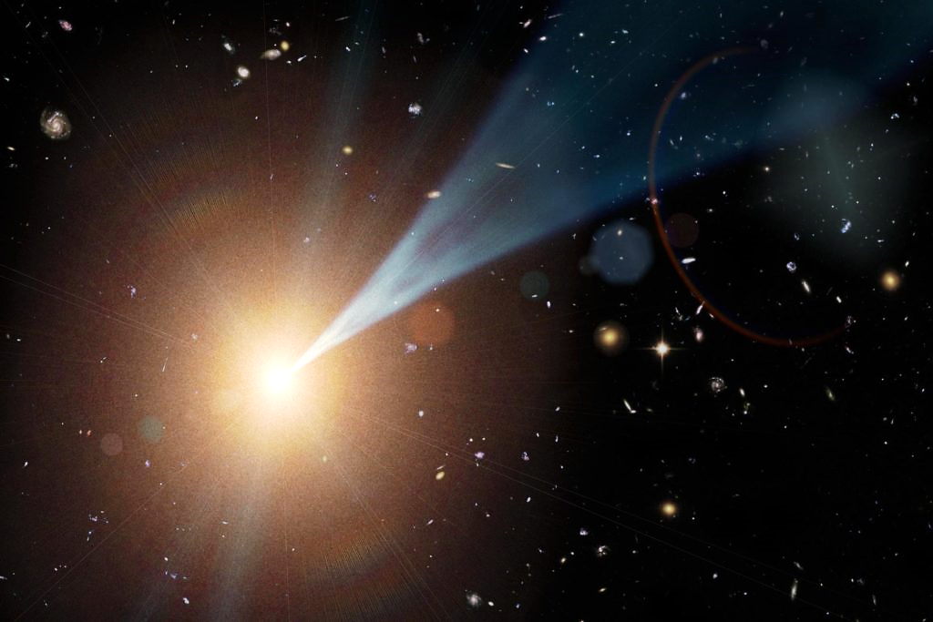
“Let there be LIGHT”

Slide 43
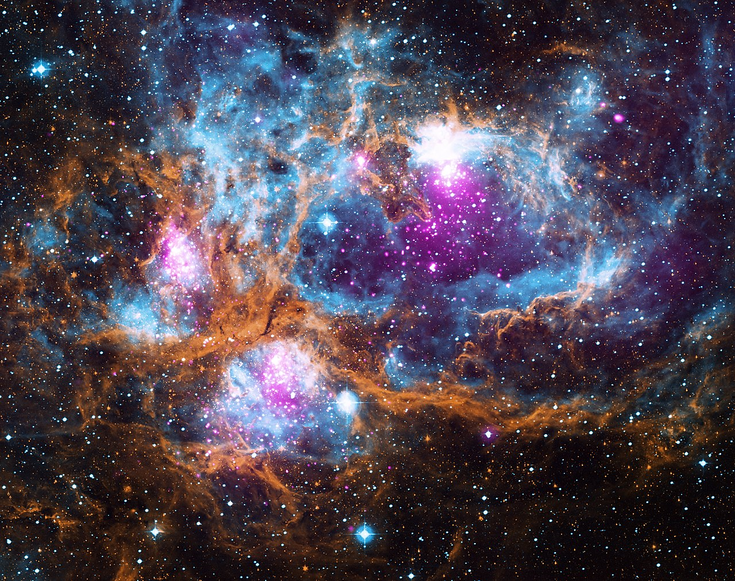
And there was LIGHT

Slide 44
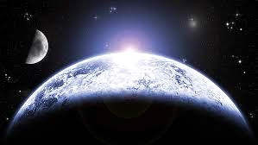
As it is in a Believer’s Life:
The Holy Spirit hovers
The Word of God speaks
The Light of the World shines
Life begins, grows & multiplies
Order, purpose & direction begin

Slide 45
In this verse, God Himself compares the work He did at Creation with the work He does in a new believer’s life:

Slide 46
Isa. 44:24 NLV
“The Lord, Who makes you, bought you and saves you, and the One Who put you together before you were born, says, “I am the Lord, Who made all things. I alone spread out the heavens, and I alone spread out the earth.”

Slide 47
We are His most beloved project—a continued expression of His creativity.
As it was with earth, so it is with us…
A beginning followed by a process then on to a finish.

Slide 48
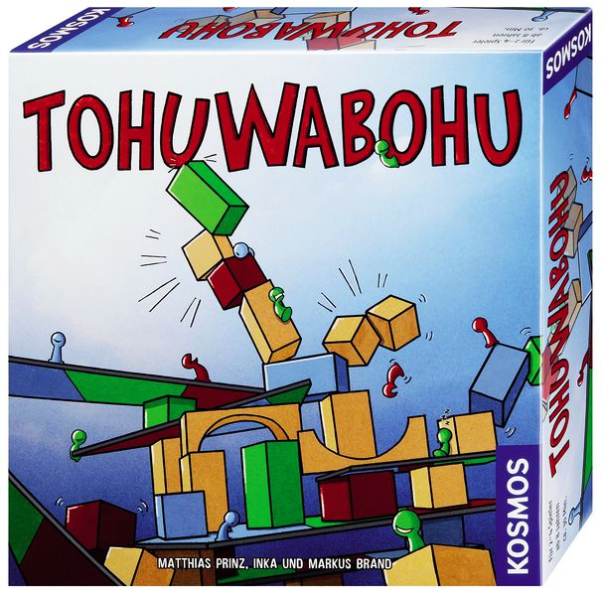
There is actually a board-game called: “TOHUWABOHU.”
It is a game about the creation process.

Slide 49
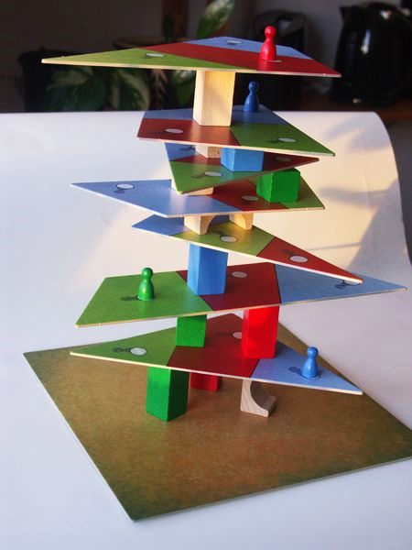
The object is to build things with the parts provided.

Slide 50
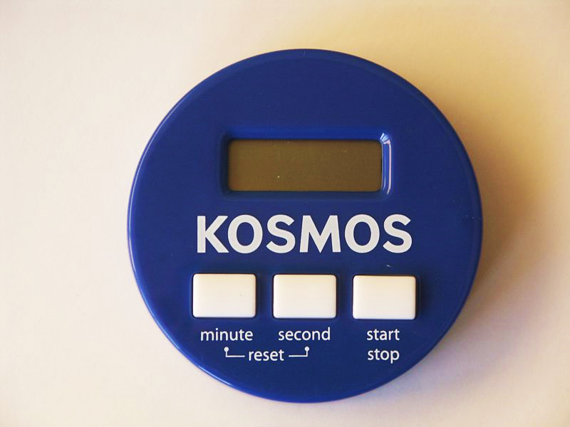
00.15
Picture cards tell you what to build.
The catch is… a timer gives you only 15 seconds to build it.
The fastest builder wins.
This is where God is quite different than the board-game. God does not rush!

Slide 51
Phl. 1:6 TPT
" …the One who began this glorious work in you will faithfully continue the process of maturing you and will put his finishing touches to it until the unveiling of our Lord Jesus Christ!”

Slide 52
Psa 138:8 TPT
"…Since your love for me is constant and endless, I ask you, Lord, to finish every good thing that you’ve begun in me!”

Slide 53
Question #4
Talk about how reassuring it is to know that God always likes to finish what He starts?

Slide 54
Eph 2:10 ESV
"For we are his workmanship, created in Christ Jesus for good works....”

Slide 55
Phl. 2:13 ERV
“Yes, it is God who is working in you. He helps you want to do what pleases him, and he gives you the power to do it.”

Slide 56
Question 5
What is the difference between us trying hard to be perfect and God perfecting us Himself?

Slide 58
Times & Seasons

