Slide 1
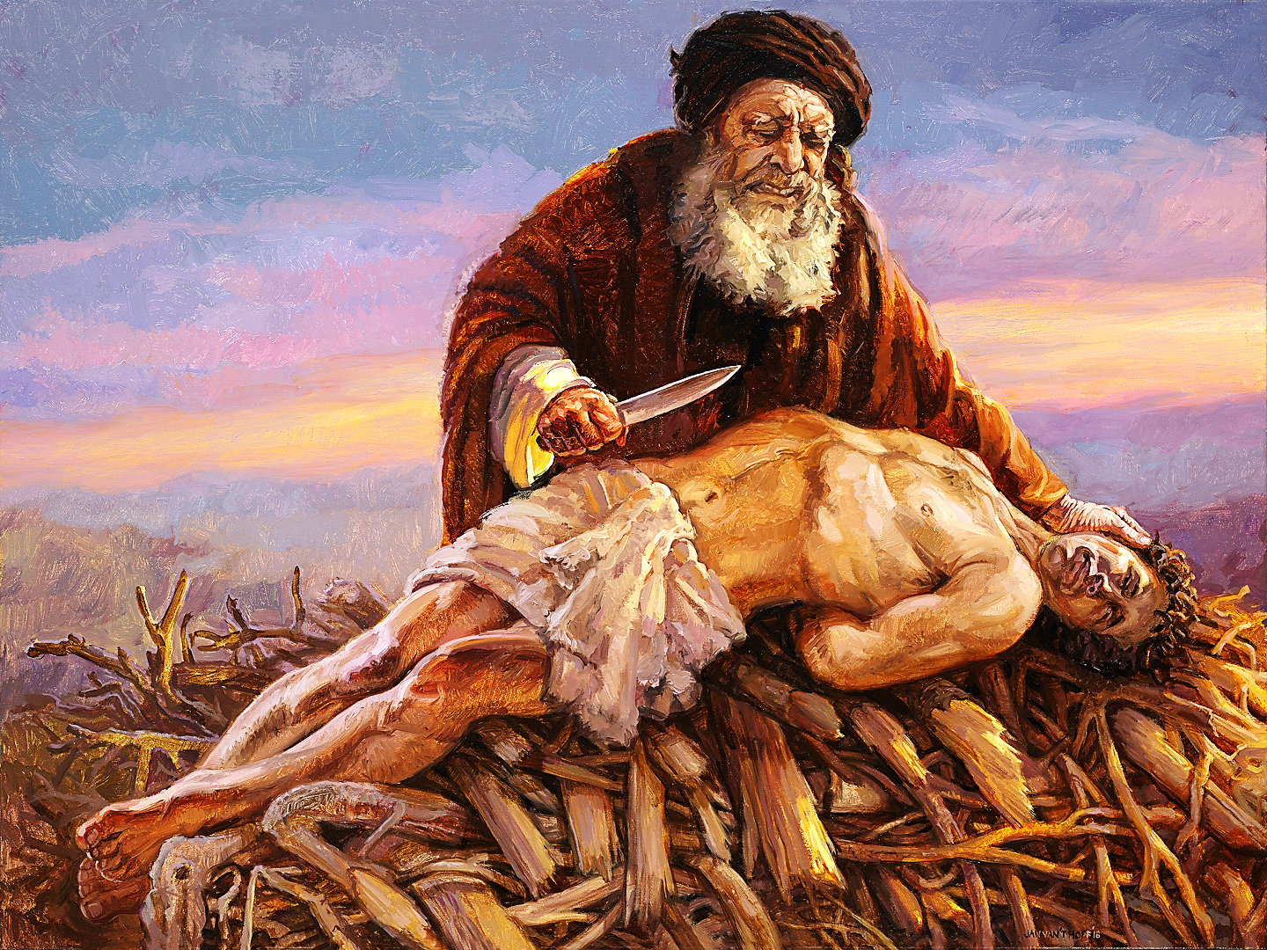
Abraham, Isaac & Jesus

Slide 2
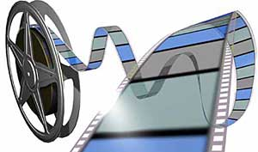
If you would like to watch a video of our service using this PowerPoint, click or (Ctrl click) here:
https://campaignkerusso.org/?p=7743
We would love to know more about the people who download our lessons & sermons. We invite you to email us & let us know where & how you use them.
info@ckusa.org

Slide 3
Abraham, Isaac & Jesus
The life of Isaac has many pictures of Jesus.
After this lesson, be ready to talk about the many ways (even though he lived years before Jesus was even born) Isaac was an amazing picture of Jesus!!

Slide 4
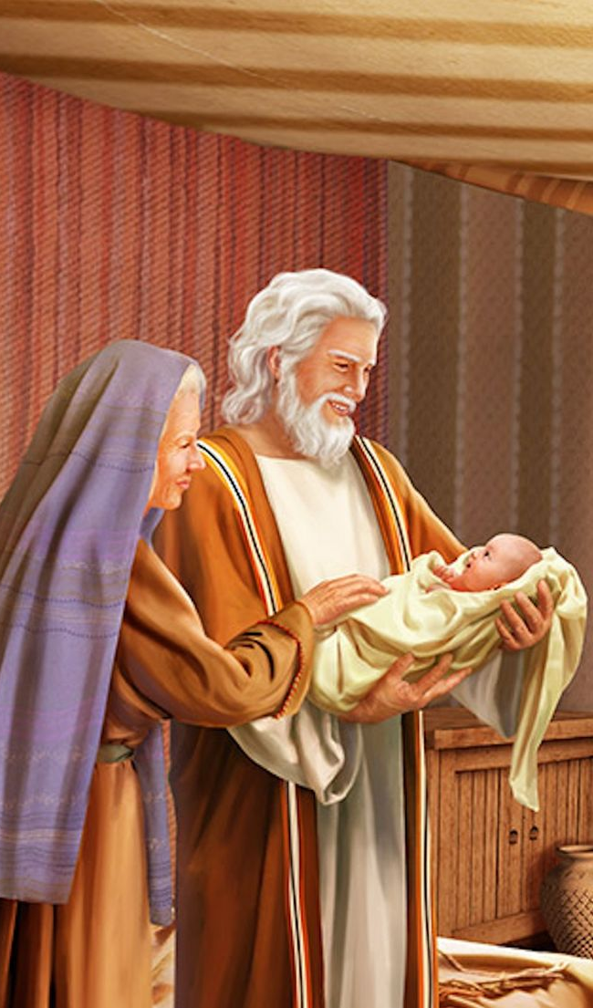
Abraham and Sarah very much wanted a child, but for many years God did not give them one.
One day three angels came to see Abraham and promised him that God would give him and Sarah a son.
Even though they were too old to have a baby, Isaac was born just as God had promised.

Slide 5
Jesus is The Promised Son!
The bible is full of promises that The Son of God would come someday… and He did.

Slide 6
God tested… Abraham and said, “Abraham!” And he said, “Here I am.”
God said, “Take now your son, your only son Isaac, whom you love, and go to Moriah and offer him as a sacrifice upon one of the mountains.

Slide 8
Back then, sacrifices were made for sin.
They would build an altar of stone then, sacrifice a “perfect” lamb.
This sacrifice was actually a picture of God’s Perfect Lamb – Jesus Christ!
God’s Son was coming into the world to sacrifice Himself for our sin.
Jesus is Perfect !!!

Slide 9
God commanded Abraham to offer a sacrifice, but instead of a perfect lamb, God required Abraham’s only son, Isaac.
God said, “Take now your son, your only son Isaac, whom you love so greatly, and go to the land of Moriah, and… offer him for a burnt-offering to Me.”

Slide 10
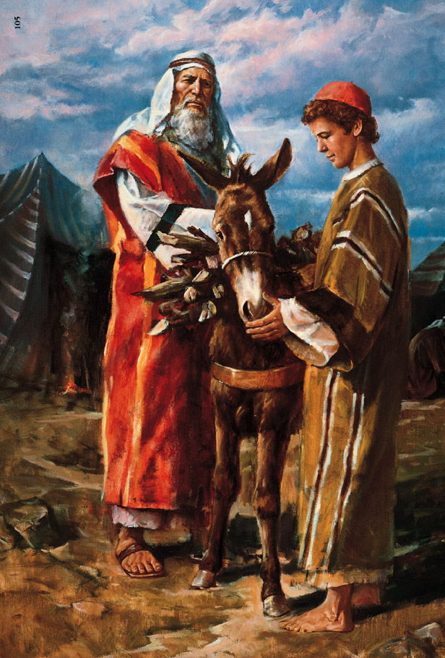
Abraham was very sad, but he trusted God, and obeyed.
He took two men and a donkey to carry the wood for the fire.
He went toward the mountain with Isaac, his son.
On the third day Abraham saw the mountain far away.

Slide 11
As they came near the mountain, Abraham said to the men,
"Stay here with the donkey, while I go up the mountain with Isaac to worship;
And when we have worshipped, WE will come back to you."

Slide 12
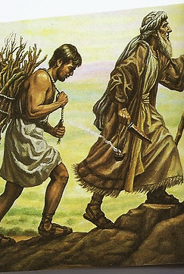
Isaac’s bundle is a picture of Jesus carrying his own cross up Mt. Calvary.

Slide 13
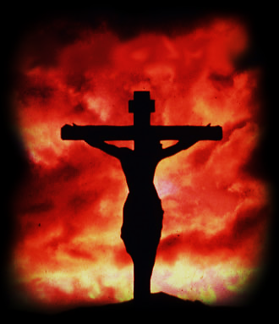
The fire & knife in the hand of Abraham reminds us of God the Father and how He judged our sin upon His only Son on the cross.

Slide 14
Abraham took the wood for the sacrifice and laid it on the shoulders of Isaac his son, and he took the fire… and a knife; and the two of them went on together.
As they were walking, Isaac said, "My father! See, here are the fire and the wood, but where is the lamb for the sacrifice?"
And Abraham said, "My son, God will provide HIMSELF a lamb..."

Slide 15
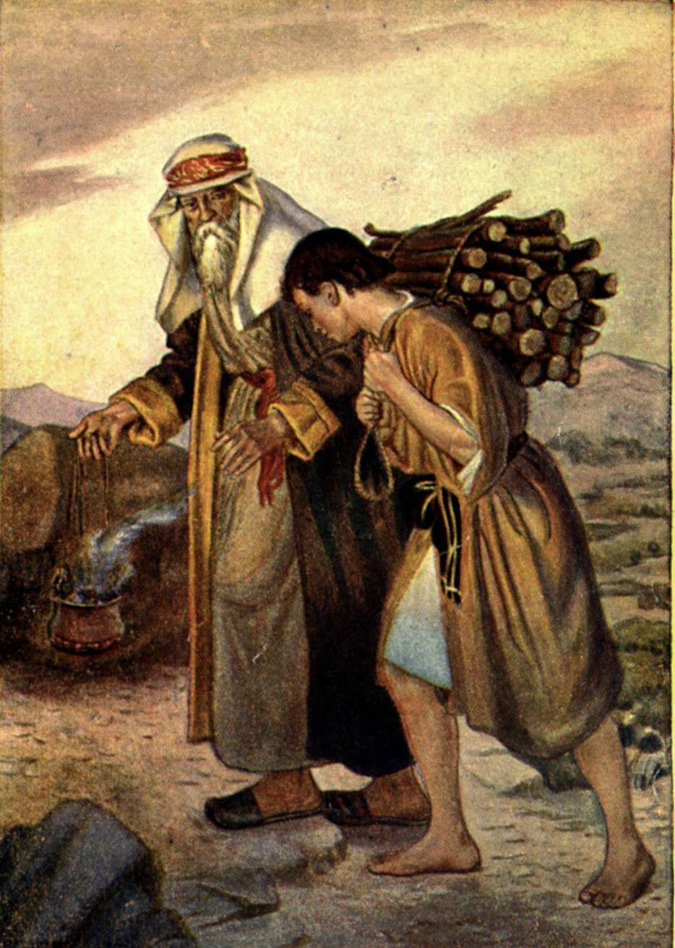

Slide 16
God was using Abraham to show us the future… Jesus is the true Lamb of God.

Slide 17
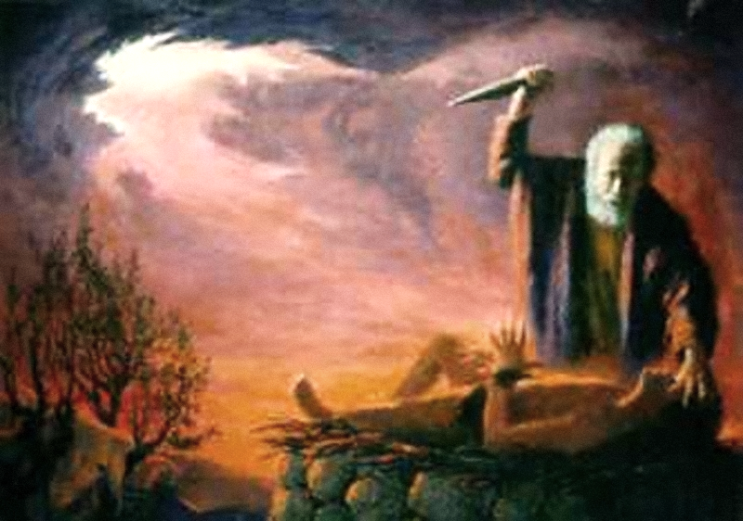
Abraham built an altar and placed the wood on it.
Then he tied the hands and the feet of his only son, Isaac, and laid him on the altar.
Abraham stretched forth his hand and took hold of the knife to slay his son.

Slide 18
Jesus was also bound by His hands and feet.
Like Isaac, Jesus was obeying and trusting His Father.
Jesus was obedient to death.
He willingly laid down His life.

Slide 19
The Angel of the Lord called, “Abraham, Abraham!”
He answered, “Here I am.” The Angel said…
“Do not lay your hand on the boy or do anything to him; for now I know that you obey God.
You have not held back from giving your son, your only son.”

Slide 20
“God shall provide Himself a Lamb.”
A substitute for sin’s judgment
Abraham looked up saw a ram caught in a thicket.
Abraham took the ram and
offered it instead of his son!
He called the place, “The Lord Will Provide” or “Jehovah-Jireh” in Hebrew.
It is said to this day, “On the mount of the Lord it will be provided.”
Jesus (our substitute lamb) also died on a mount.
He provided salvation for the world.
“HIMSELF!”

Slide 21
To Abraham, it was as if his son were raised from the dead.
Like Isaac, Jesus was also miraculously delivered from death.
Isaac is a picture of the Resurrection of Jesus.

Slide 22
Christ died for our sins… He was buried… He was raised on the third day.

Slide 23
Suggested Next Slide - Video:
Amazing story of a man, his love for his only son, a sacrifice and a bridge.
This video is a “must see.”
Click or Ctrl Click Here:
http://www.youtube.com/watch?v=c-O--4o1dvA

Slide 24
“If you declare with your mouth that Jesus is
Lord, and believe in your heart that God raised him from the dead, you
will be saved.”
Rom. 10:9
Name some ways Isaac was like Jesus!
What does this mean for us today?
What do you want to say about Jesus today?

Slide 25
What is the Sinner‘s Prayer?
This is a prayer we can pray when we are ready to admit we are sinners and need Christ’s forgiveness.
It must be prayed with faith in our hearts and a readiness to have a life-changing encounter with Jesus Christ.

Slide 27
John Wesley’s Testimony
“…the preacher was describing the change which God works in the heart through faith in Christ and I felt my heart strangely warmed.”
Disciple’s Testimony
“They said to each other, ‘Did not our hearts burn within us while he talked to us on the road, while he opened to us the Scriptures?’”

Slide 28
A Prayer of Faith → Pray this rayer if :
If you never have before
You have in the past, but you think it would mean more today.
You have been walking afar off and you want to come back.
You want to set an example & show others how it is done.
You just like to give your heart to Jesus again & again.
Faith

Slide 29
We Declare Our Faith Publicly Because Jesus Declared His LOVE Publicly
“If you stand before others and are willing to say you believe in me, then I will tell my Father in heaven that you belong to me.” Mat 10:32

Slide 30
Dear Jesus,
I know I am a sinner & need your forgiveness.
I believe you died for my sins.
I now turn from sin.
Come into my heart I pray.
Please wash away my sin.
Do you want to meet Jesus as your savior right now?
Do you believe He died to save you from your sins & that He rose from the dead?
Do you believe that He is waiting to save you right now?

Slide 31
“But some people did accept him. They believed in him, and he gave them the right to become children of God.” John 1:12

Slide 33
“Draw near to God, and He will draw near to you…
…Cleanse your hands, you sinners, and make your hearts pure, you who are half-hearted towards God.” James 4:8 WNT

Slide 34
Close in Prayer

